Slide 1


InfoFlight
A Flight Management System with Spring Boot and React
Team No:-4
Vivek Kumar Sahu
Niharika Pathak
Hariprasath

Slide 2
Objectives
User Authentication and Authorization
Flight Scheduling and Management
Responsive Design
Maintenance and Support
Data Security and Privacy

Slide 3

Introduction
A flight management system developed with Spring Boot and React JS is a robust software solution designed for efficient airline operations. It combines Spring Boot's powerful backend with React JS's dynamic frontend to deliver a seamless user experience for both administrators and passengers. Key features include secure user authentication, scalable performance, flight scheduling, booking management, and real-time updates. The system ensures data security and compliance. With its responsive design and robust support mechanisms, this system enhances operational efficiency and improves the overall passenger experience

Slide 4
Spring Boot Fundamentals
In a flight management system developed using Spring Boot, the framework plays a pivotal role in streamlining backend development. Utilizing Spring Boot, developers can rapidly create RESTful APIs for functionalities such as flight scheduling, reservation management, and user authentication. Overall it provides a scalable and efficient foundation for the flight management system.

Slide 5

Technical Requirements
Registration
Login
View schedule /Reserve ticket
Searching flight schedule
Uploading Information into the system
You can download our project at
https://github.com/viveksahu06/Infosys_Internship

Slide 6

Types of User
Admin
Creating a flight
Changing time schedule
Creating a new route
Updating airport information
Registering and managing users
View statistics
Registered user
View flight schedule
Book, confirm/cancel reservation
Unregistered User
View flight schedule

Slide 7
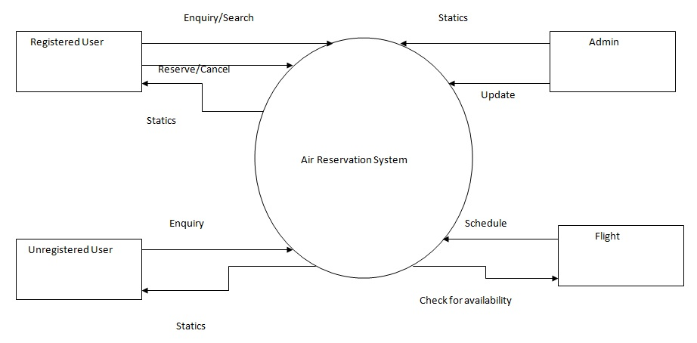
Data Flow Diagram

Slide 8
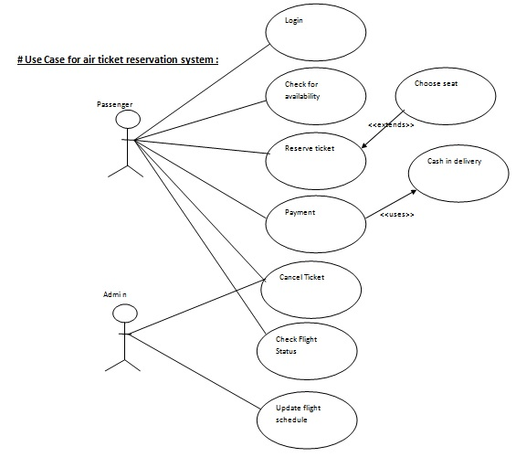
Use Case Diagram

Slide 9
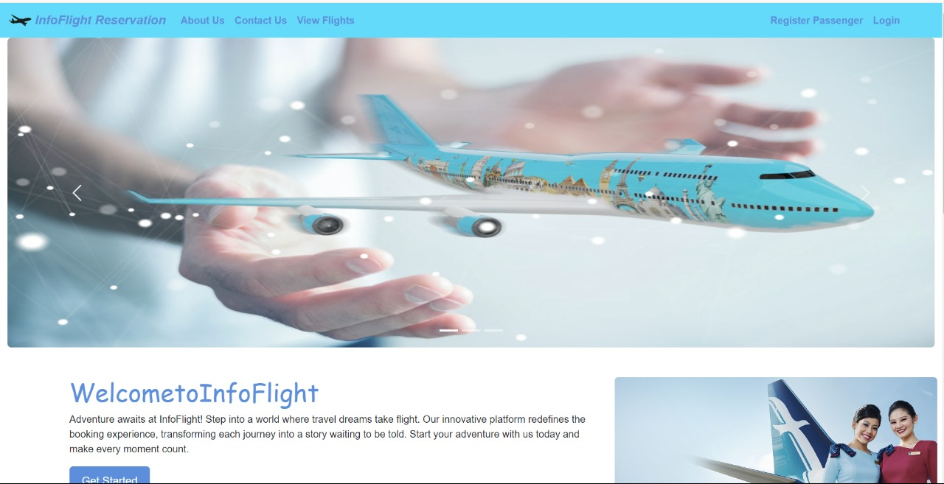
Project Description
Home Page
Home page introduces the site and user can understand that what facility we provide in this system. User can see login, registration, schedule and contact menu in home page.

Slide 10
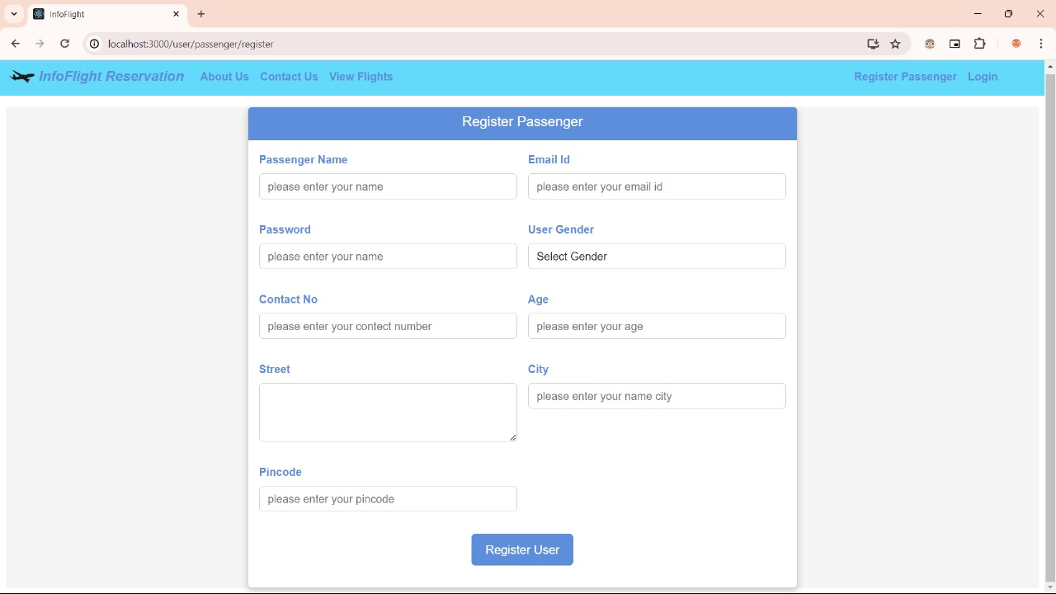
Registration Page

Slide 11
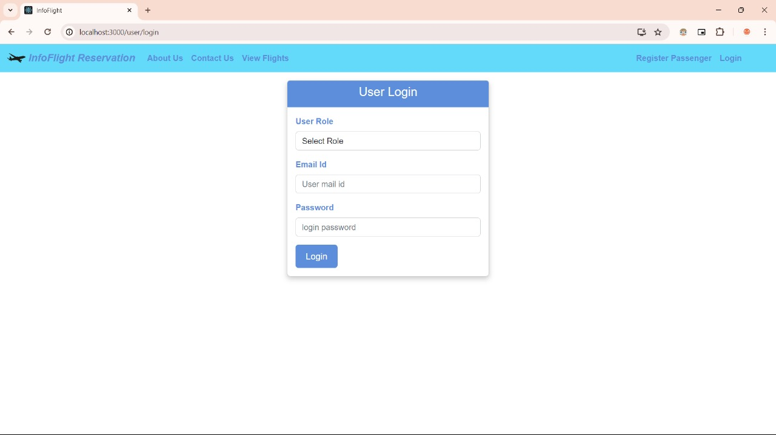
Login Page

Slide 12
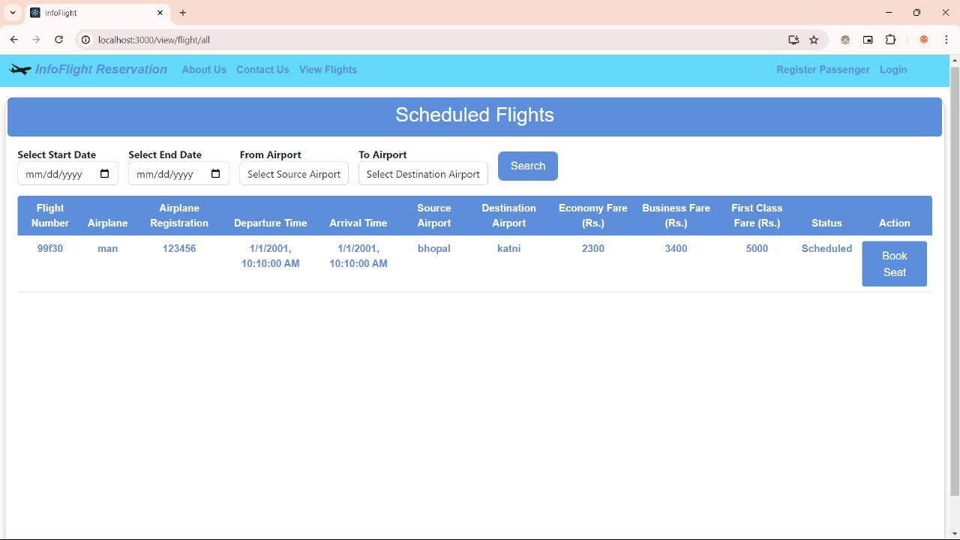
View Flights

Slide 13
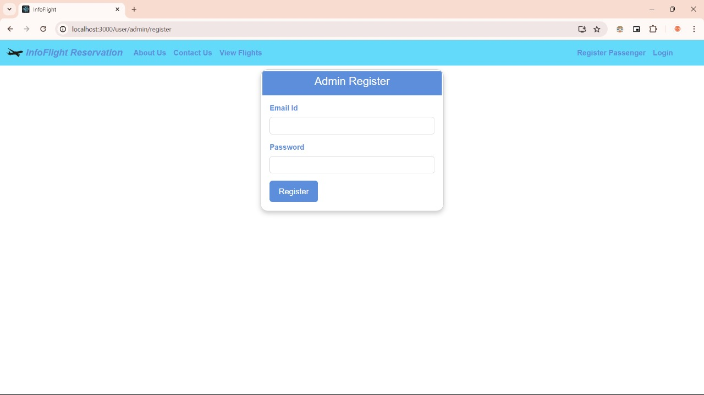
Admin Login When an admin login into the system admin will see this dashboard, admin usually perform these task (edit profile, add flight, add route, add schedule, add airport info, generate report.)

Slide 14
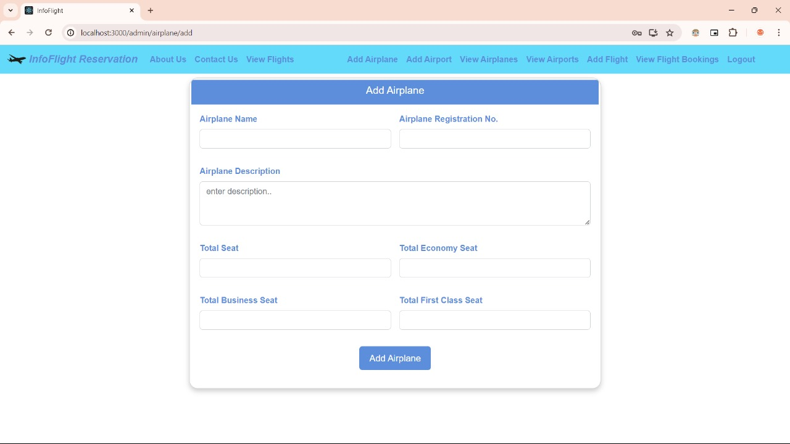
Create Flight Admin can create flight here by giving value(Flight name, Total Seat, City, Status)

Slide 15
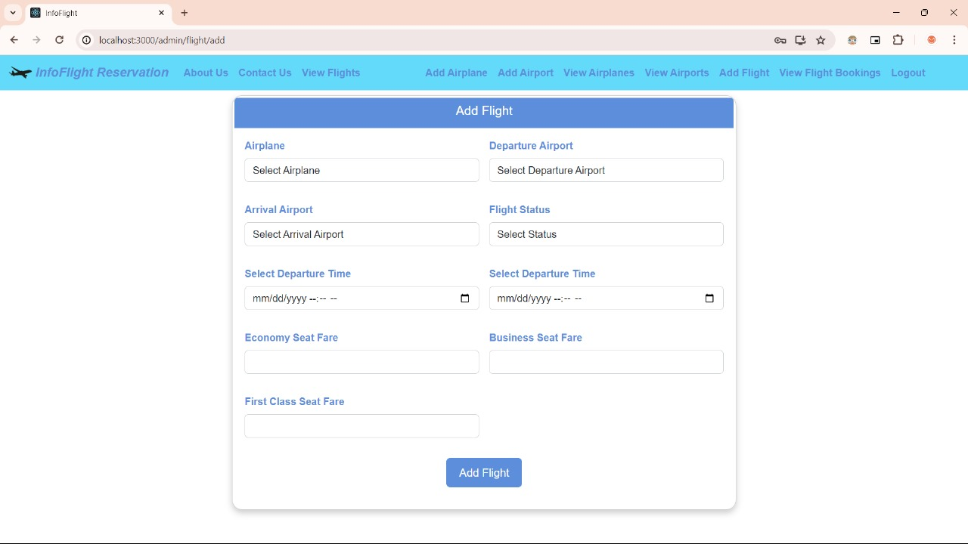
Add Flight

Slide 16
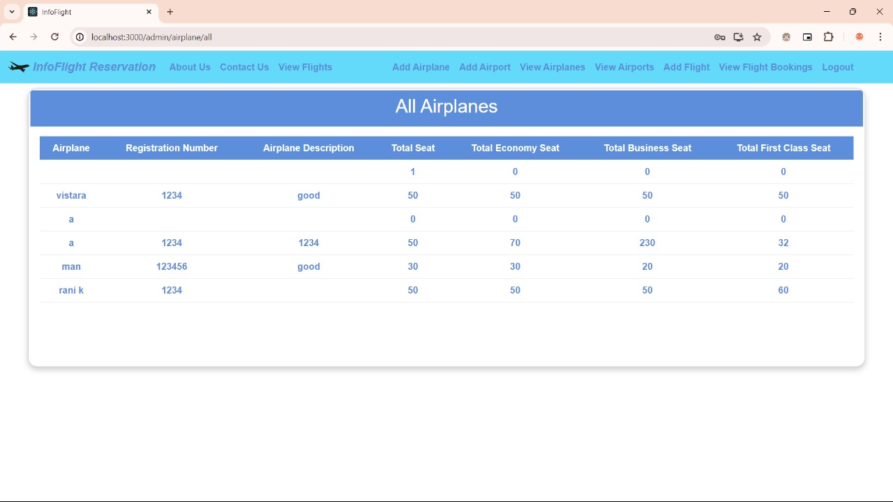
All the airplanes stored by admin

Slide 17
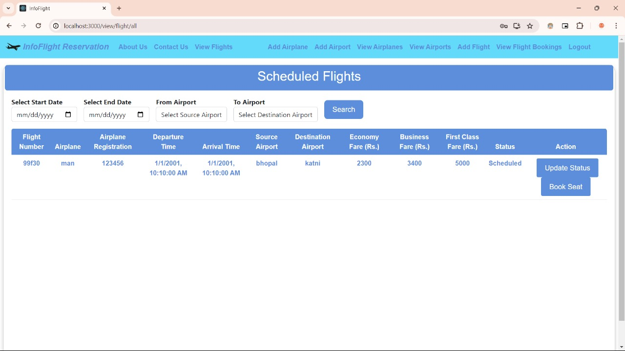
Scheduled Flights

Slide 18
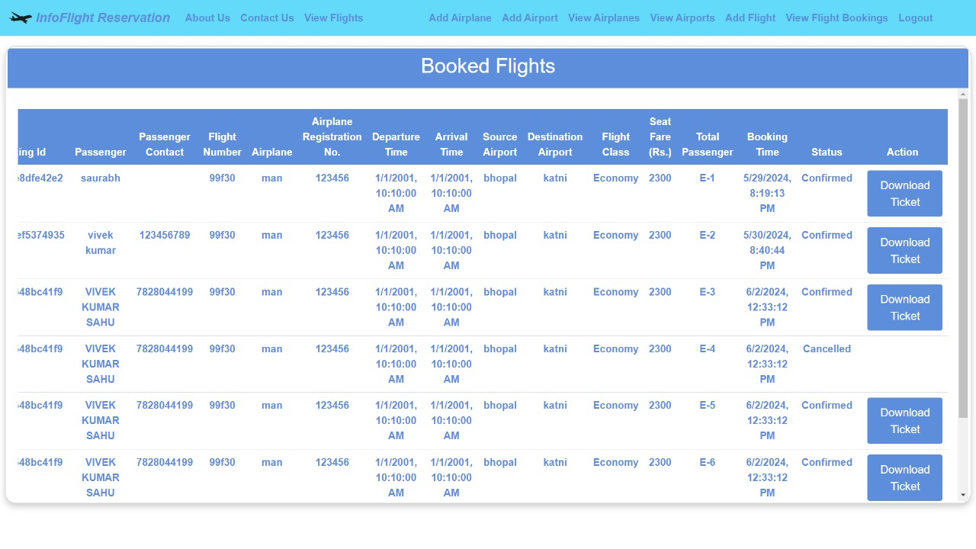
Booked Flights

Slide 19
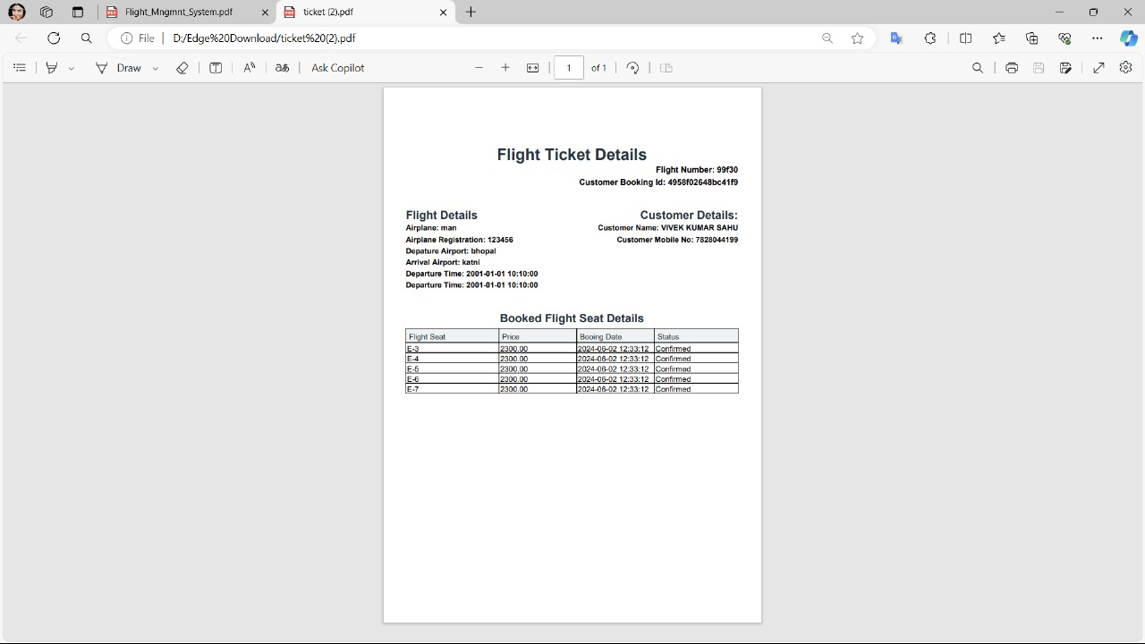
Flight ticket generated

Slide 20
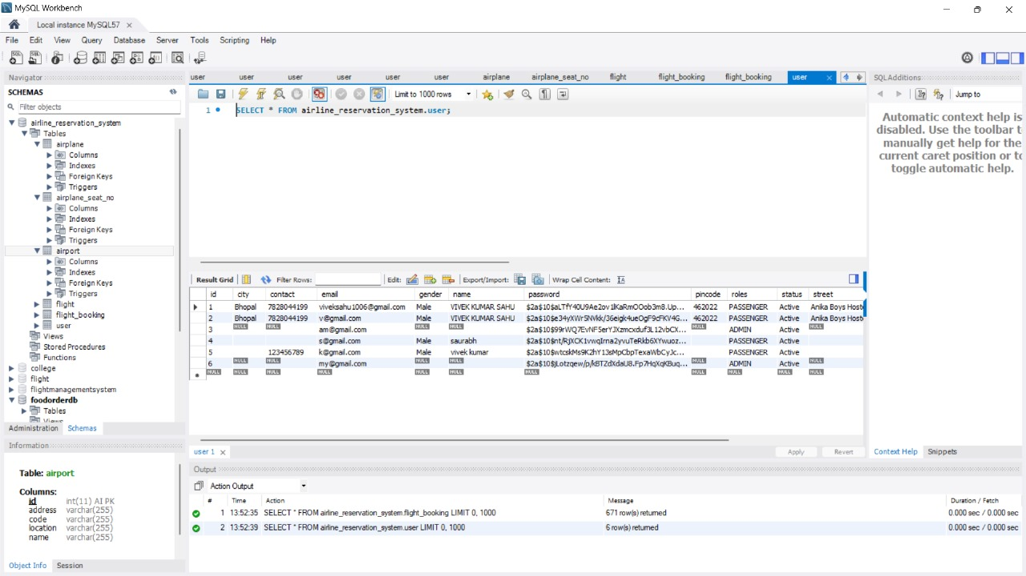
Database Side:

Slide 21
Future Works
Develop mobile app of this system.
Add mobile verification system.
Introduce live chat between admin & user.

Slide 22
Conclusion
In conclusion, the flight management system developed using Spring Boot and React JS provides a scalable, efficient, and secure solution for modern airline operations. It integrates key functionalities such as flight scheduling, booking management, and real-time updates, while ensuring a user-friendly interface and robust backend support.

Slide 23
Thank You

