Slide 1

Team No:-4
Vivek Kumar Sahu
Niharika Pathak
Hariprasath R Deepika Varsha
Shreya Gandhi
Infosys Springboard Internship 4.0

Slide 2

InfoFlight
A Flight Management System with Spring Boot and React

Slide 3


Introduction
Welcome to
with Spring Boot and React. In this presentation will cover the key aspects of integrating these technologies to create a modern and efﬁcient ﬂight management system.

Slide 4



Spring Boot Fundamentals
Understanding the basics of
. Topics include dependency injection, auto-conﬁguration, and building RESTful APIs with Spring Boot. We explored how these concepts apply to our ﬂight management system.

Slide 5


React Essentials
Exploring the essentials of . We covered components, state management, and the virtual DOM. Understanding how to leverage React to create a dynamic and responsive user interface for our ﬂight management system.

Slide 6


Integrating Spring Boot and React
Bringing it all together. We will discuss the best practices for integrating backend with a React frontend. Topics include REST API consumption, state management, and deployment strategies.

Slide 7

Technical Requirements
Frontend: React
Node.js & npm: Install from Node.js
Tools: Visual Studio Code, Chrome/Firefox
Backend: Spring Boot
JDK: Install JDK 11+ from Oracle
Database: MySQL
Install MySQL: Download from MySQL
Tools: MySQL Workbench or other SQL clients
Build & Run
Frontend:
Development: npm start
Production Build: npm run build
Backend:
Run Spring Boot: mvn spring-boot:run

Slide 8

Types of User
Admin
Creating a flight
Changing time schedule
Creating a new route
Updating airport information
Registering and managing users
View statistics
Registered user
View flight schedule
Book, confirm/cancel reservation
Unregistered User
View flight schedule

Slide 9


Testing and Deployment
Ensuring the reliability and scalability of our ﬂight management system. We will delve into testing strategies for both
backend and React frontend. Additionally, we will explore deployment options for our system.
You can download our project at
https://github.com/viveksahu06/Infosys_Internship

Slide 10
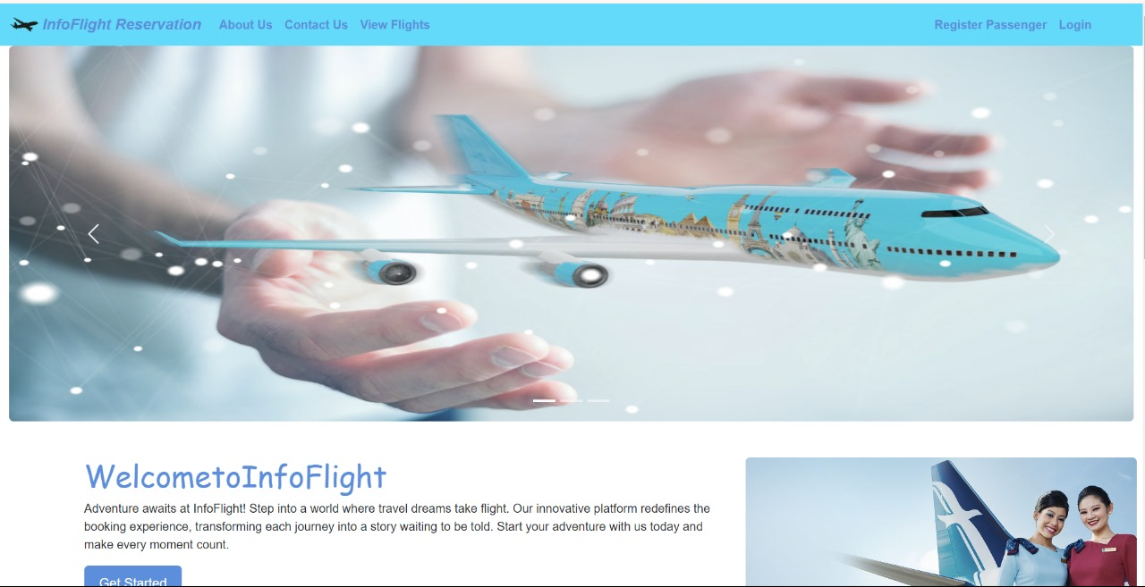
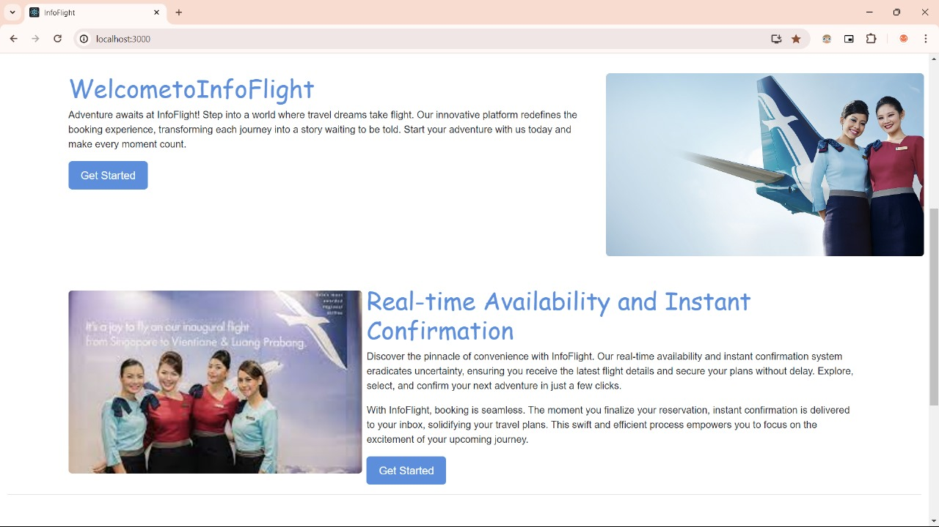
User Side : Landing Page(Frontend using react)

Slide 11
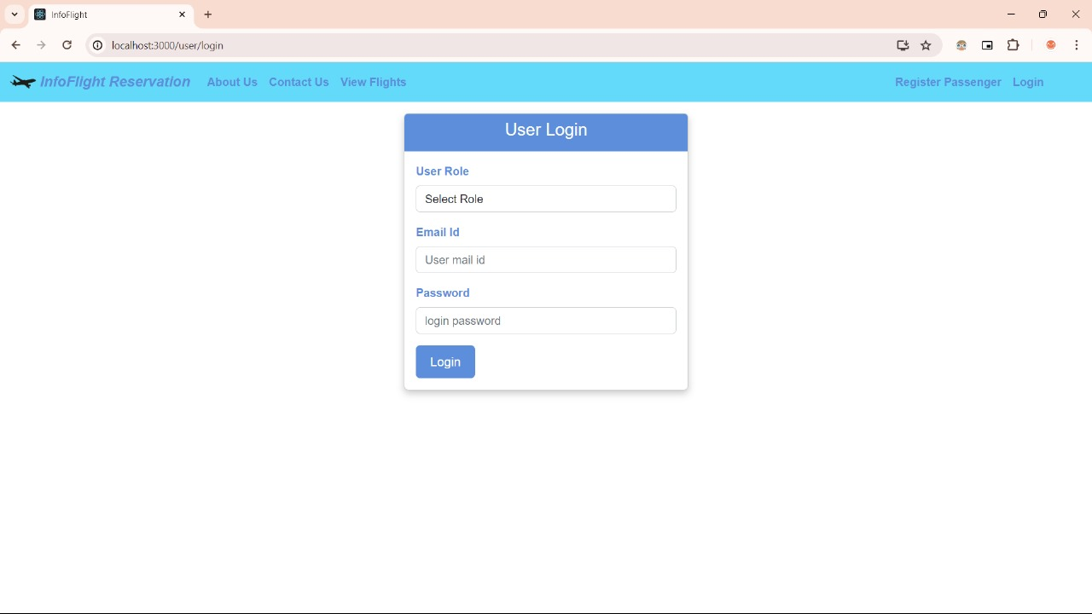
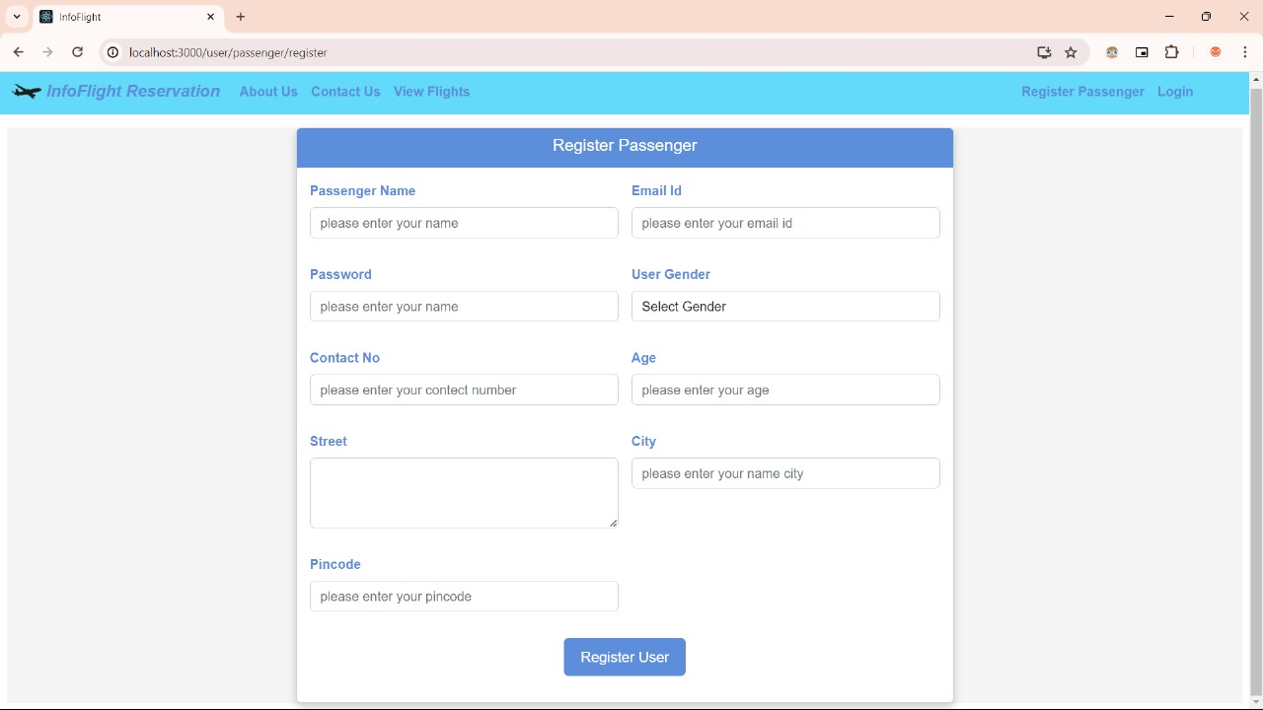
Login
Register Passenger

Slide 12
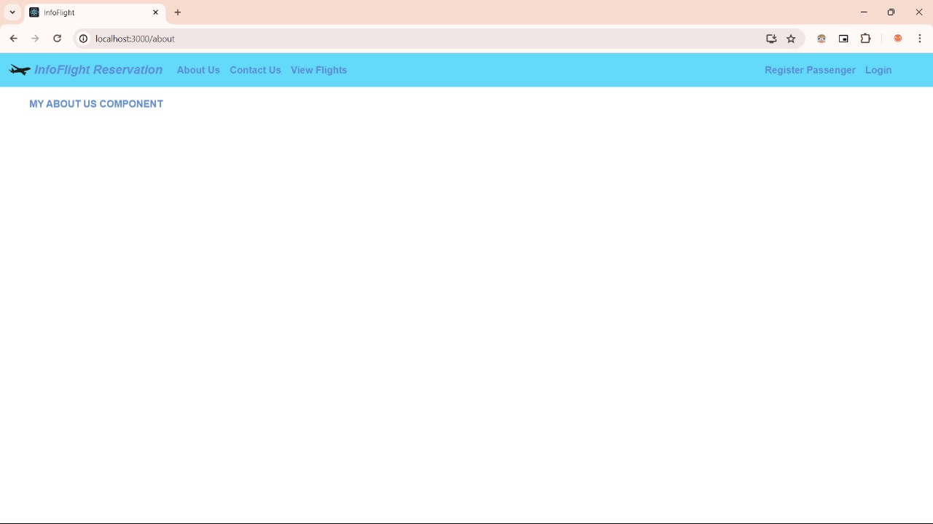
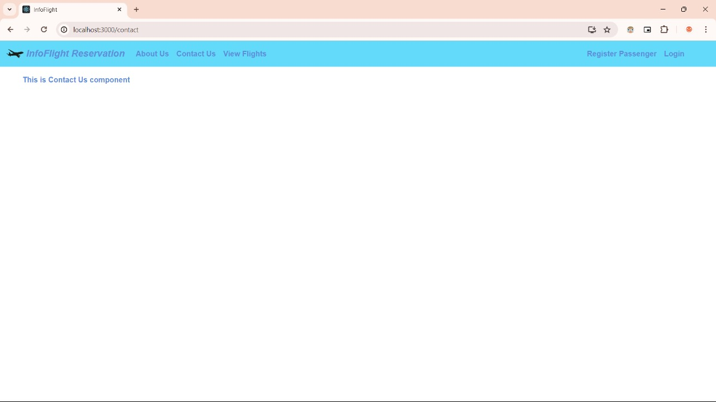
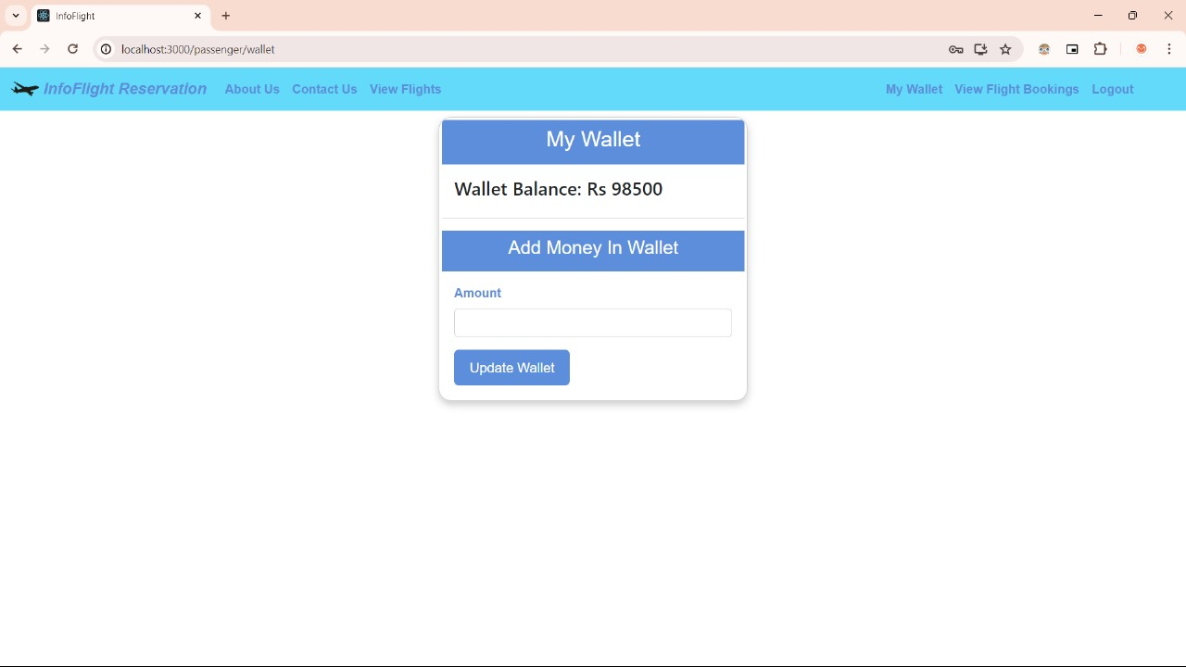
About Us
Contact US
My Wallet

Slide 13
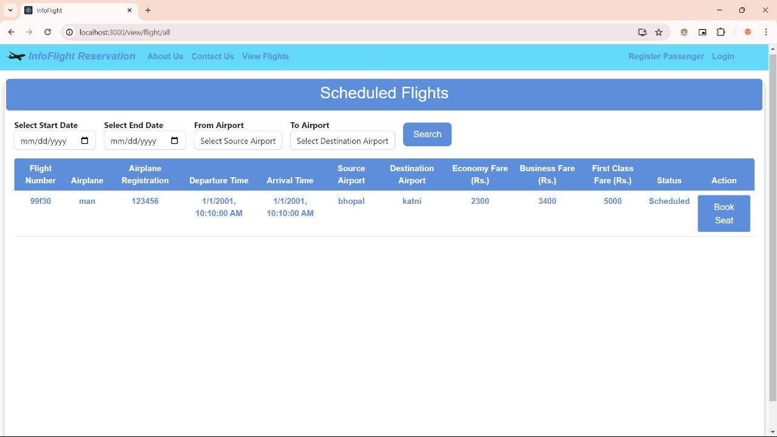
View Flights

Slide 14
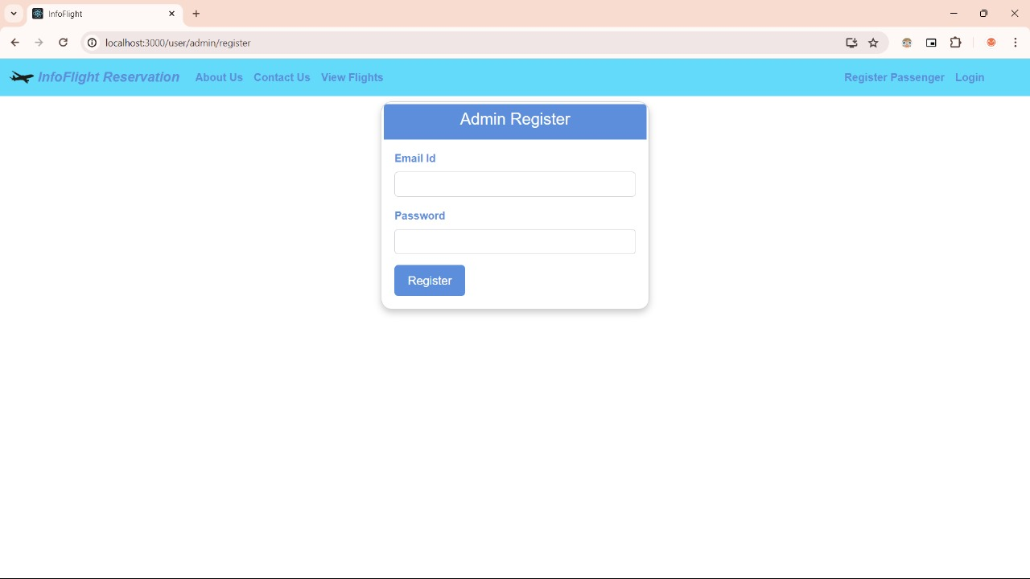
Admin Side: Backend

Slide 15
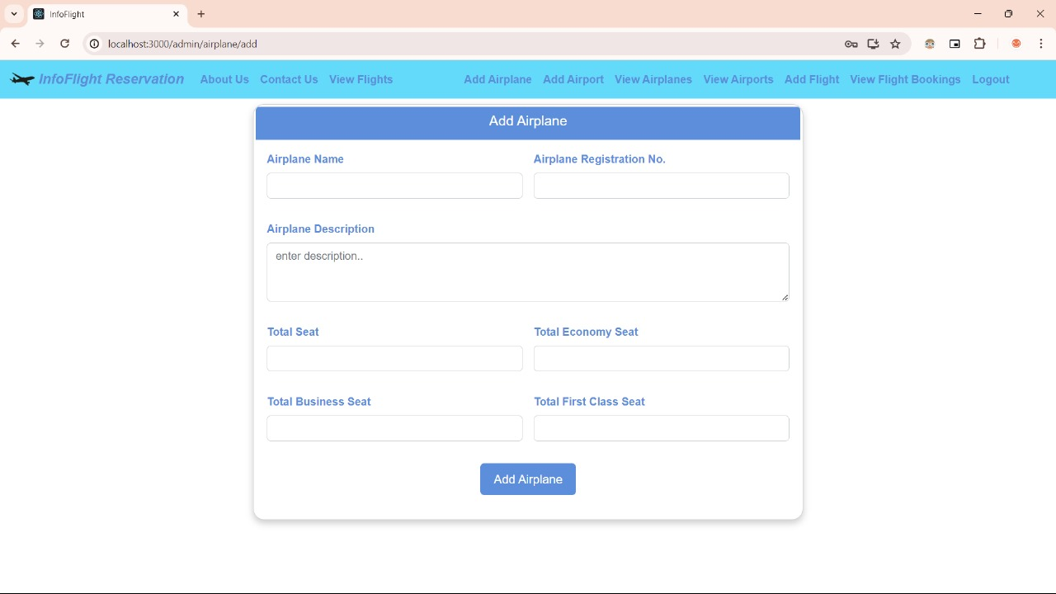
Add Airplanes

Slide 16
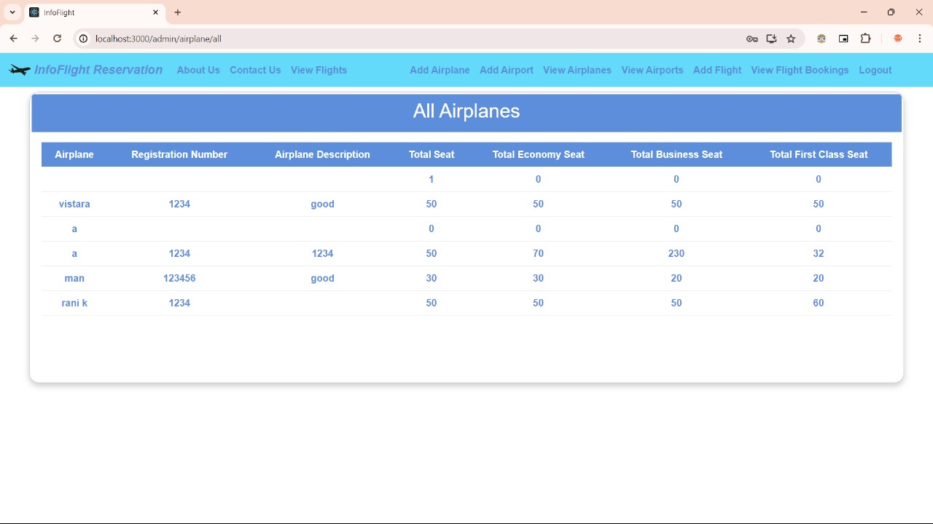
All the airplanes stored by admin

Slide 17
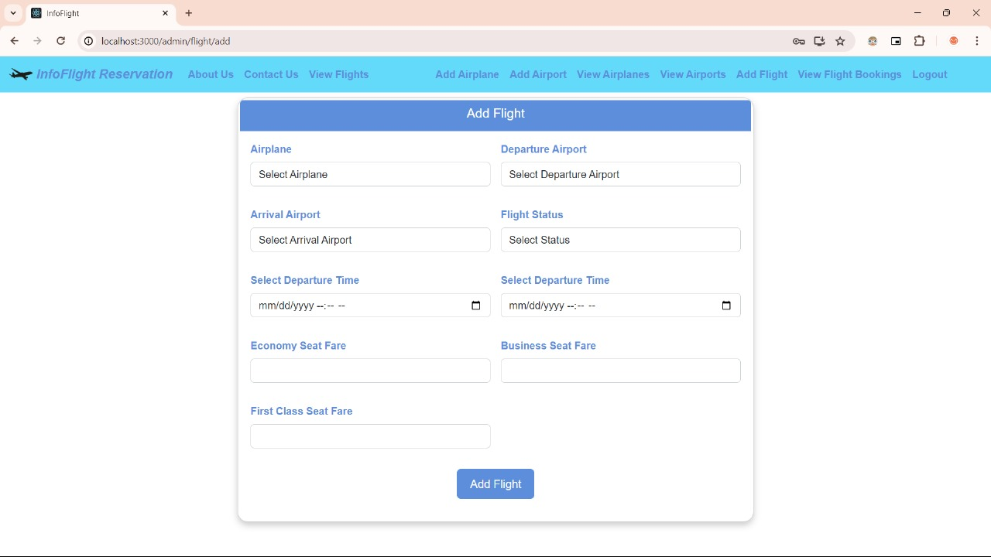
Add Flight

Slide 18
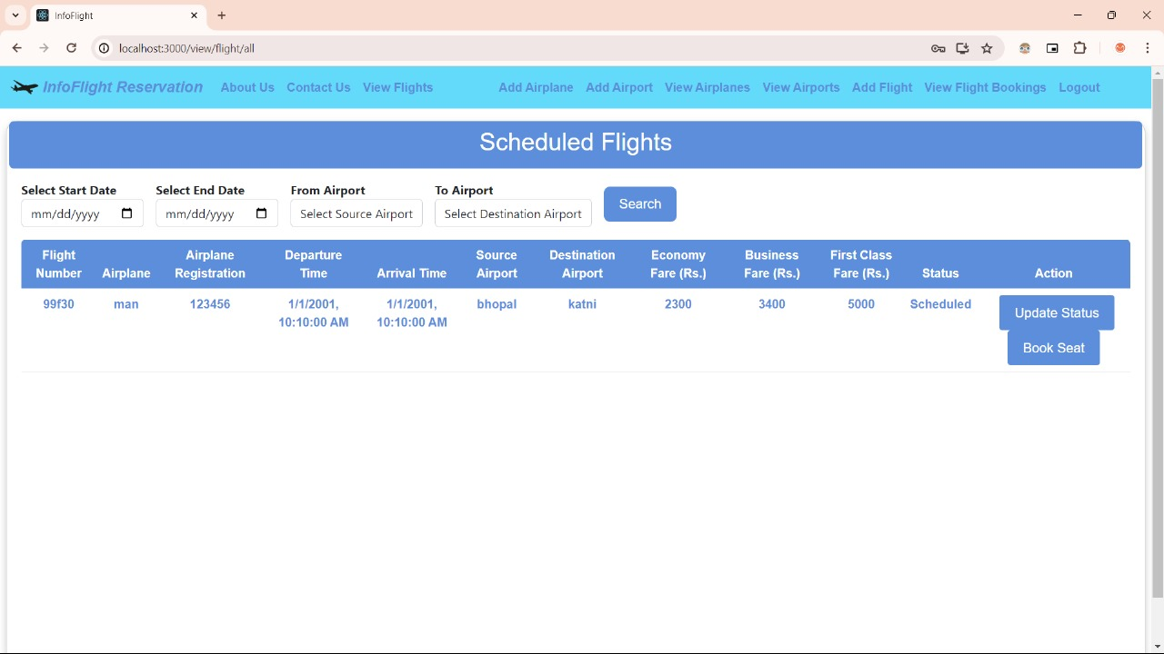
Scheduled Flights

Slide 19
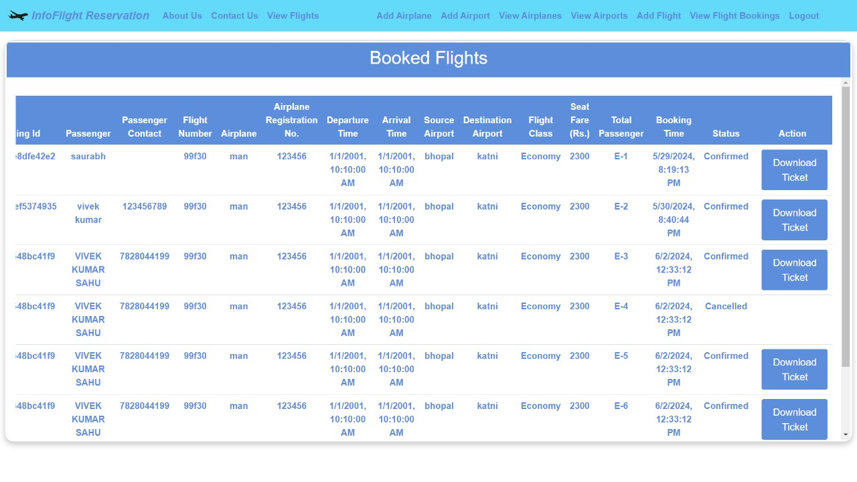
Booked Flights

Slide 20
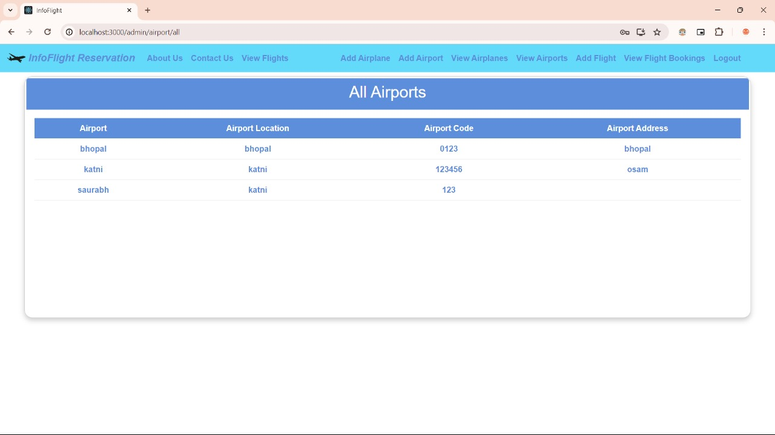
All Airports

Slide 21
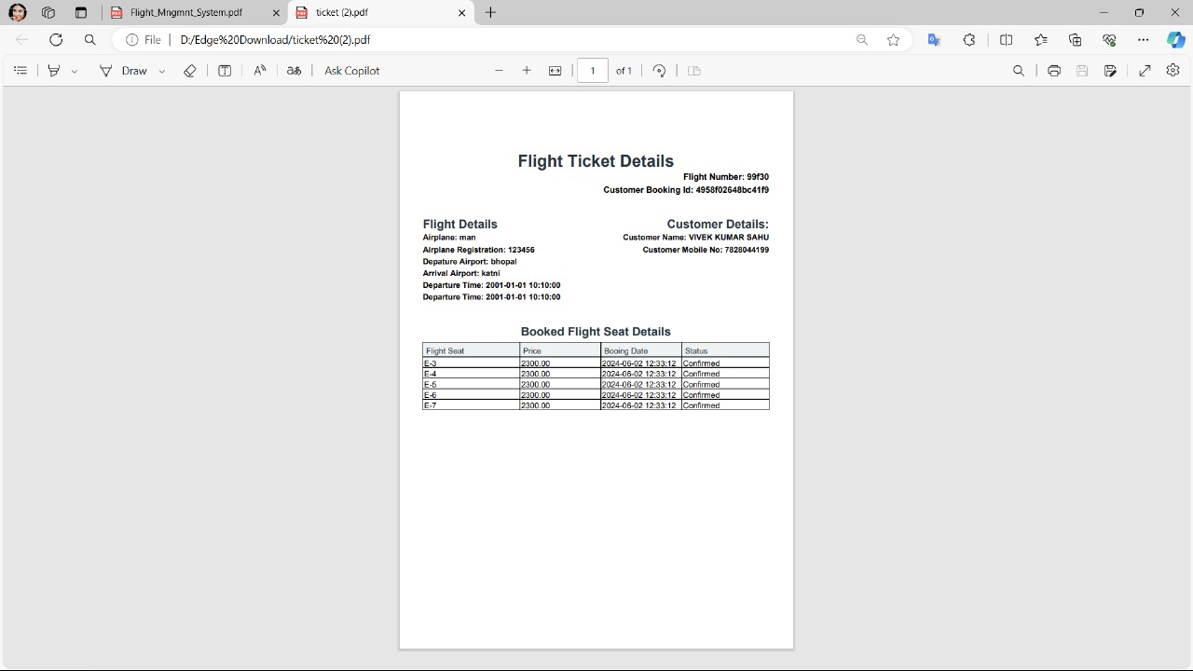
Flight ticket generated :

Slide 22
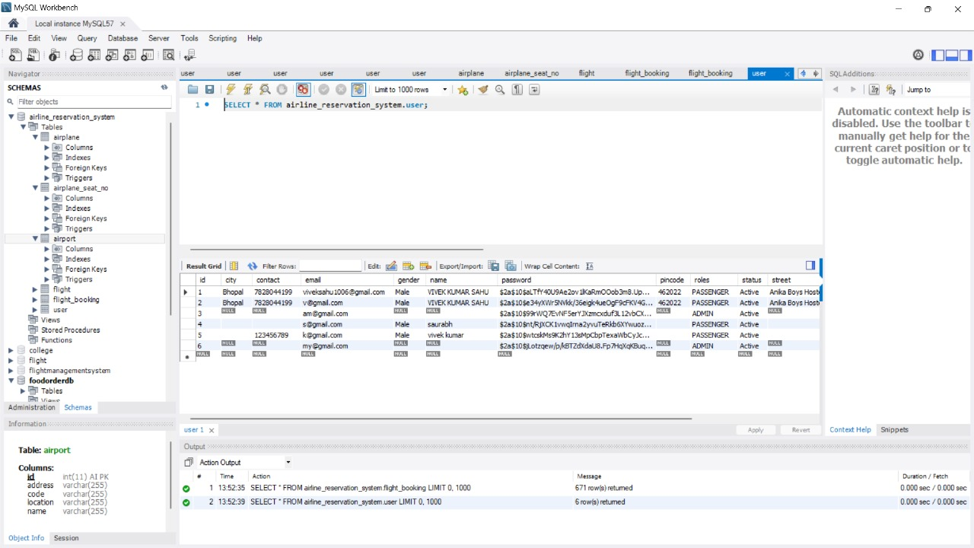
Database Side:

Slide 23

Conclusion
In conclusion, we have explored the key components of building a ﬂight management system with and React. By leveraging the strengths of both technologies, we can create a robust and user-friendly system that meets the demands of the aviation industry.

