Slide 1

Under the Esteemed Guidance of Dr. M. Vasumati Devi Associate Professor
MULTI-TARGET STANCE DETECTION WITH ADVERSARIAL ATTENTION NETWORK
Batch members
G. Greshma (21NN1A0514)
Lakshmi Priya Yadav (21NN1A0501)
K. Meghana (21NN1A0531)
P. Shahina Parveen (21NN1A0550)
D. Hari Priya (20NN1A05D4)

Slide 2
Index
Abstract
Introduction
Literature Survey
Research Gaps Identified
Proposed Work
System Architecture
Algorithm
Dataset Used
Results and Discussion
Conclusion
References

Slide 3
ABSTRACT
Stance detection is a way of identifying whether a text is representing favor, opposition, or neutrality towards a target. Existing stance detection models often struggle with unseen targets and multiple stance categories. the propose of a Multi-Target Adversarial Attention Network (MTAAN) that uses Bidirectional Encoder Representations from Transformers(BERT) that will do adversarial training and attention mechanisms. This model consists of three core modules: the Target Discriminator, Sentiment Discriminator, and Stance Detection Module. Adversarial training enhances robustness by challenging the stance classification process, leading to improved generalization on unseen targets. The proposed model achieves an accuracy of 96%, outperforming existing models such as CNN (83%) and LSTM (77%).

Slide 4
INTRODUCTION
Stance detection is about figuring out if someone supports, opposes, or is neutral about a topic, and it's challenging because people often discuss multiple topics at once.
The multi-target adversarial attention network improves stance detection by using attention techniques and adversarial training, allowing it to identify stances related to several topics simultaneously and adapt to new ones.
Stance and sentiment are not always the same; two statements can express a favorable stance but have different sentiments, making it challenging to distinguish between them.
The proposed method enhances the model's ability to generalize across different contexts and targets, allowing it to perform effectively even on topics it has not encountered during training.

Slide 5
LITERATURE SURVEY
SI.No | Author-Year | Work Description | Advantages | Limitations
[1] | Y. Li, H. He, S. Wang, Francis C. M. Lau, and Y. Song (2023) | The researchers developed a model called Branch Bidirectional Encoder Representations from Transformers (BERT) to perform Conversational Stance Detection (CSD). | Allowing for a better understanding of opinions expressed over multiple posts. | The dataset is limited to six social media platforms in Hong Kong, potentially missing global trends and diverse contexts.
[2] | H. Chai , J. Cui , S. Tang, Ye Ding , X. Liu, B. Fang, and Q. Liao (2025) | The study uses a Multigraph Sparse Interaction Network (MG-SIN) with multitask learning, task-specific and task-related graphs. | Identifies the relationships between the meanings and contexts of different tasks | The model's complexity might require a lot of computing resources and may not be effective with all kinds of social media data.

Slide 6
SI.No | Author-Year | Work Description | Advantages | Limitations
[3] | C. Li, H. Peng, J. Li , L. Sun, L. Lyu, L. Wang , Philip S. Yu , and L. He (2022) | The method improves accuracy by combining stance and rumor detection, requiring fewer labeled examples and providing clearer insights. | The method improves accuracy by merging stance and rumor detection, needing fewer labeled examples and providing clearer insights. | Results may depend on the quality of input data and the specific social media context. Bookmark messageCopy message
[4] | P.J .Khiabani and A. Zubiaga (2024) | The CT-TN model boosts cross-target stance detection by merging text and social network features | Effectively incorporates social features for better predictions. | The model's success may vary with the quality of the input data.
[5] | S.Sengan ,S. Vairavasundaram , Logesh Ravi, A.Q. M. AlHamad, H.A.Alkhazaleh, and M.Alharbi (2024) | This study introduces Fake Find, a hybrid model using CNN and RNN to detect fake news by combining text, visuals, and user stance. | The model enhances rumor detection by combining content from various sources. | The model's effectiveness can be affected by the quality of the input data and the type of social media used.

Slide 7
Research Gaps Identified
Most models analyze one target at a time, missing context dependencies across targets.
Models fail to predict stance for new targets not present in training data.
Traditional models rely on standard supervised learning.
Standard models do not emphasize key text regions for stance detection.

Slide 8
Proposed Work
To improve stance detection, our MTAAN model includes:
BERT-based Feature Extraction:
Uses BERT to understand the context of words in the text, capturing how they relate to each other.
Adversarial Attention Mechanism:
Adds a layer that helps the model focus on important parts of the text while also making it more robust by using target and sentiment discriminators.
Multi-Target Stance Classification:
Allows the model to identify stances towards multiple targets (like different people or issues) all at once.
Optimized Training Process:
Trains the model effectively using Binary Cross-Entropy (BCE) loss and adversarial loss to improve its performance.

Slide 9
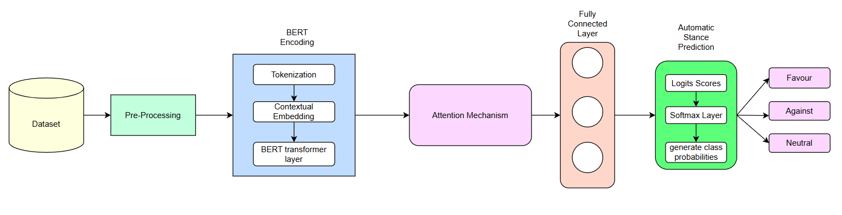


System Architecture

Slide 10
Algorithm
Input: Tweet text and Target
Output: Predicted stance class (Favor, Against, Neutral)
Step 1: Initialize model parameters including BERT encoder weights, attention layer weights W_att, classifier weights W_cls, and biases. Also initialize discriminator modules for target and sentiment learning.
Step 2: Set hyperparameters:
Learning rate η
Number of epochs N
Batch size B
Maximum sequence length L
Loss weights for adversarial modules λ₁ and λ₂

Slide 11
Algorithm
Step 3: Preprocess the input data:
Tokenize the tweet and target using the BERT tokenizer.
Convert them into input IDs and attention masks.
Create dataset objects for training and testing.
Step 4: Define the model architecture:
BERT Encoder: Extract contextual embeddings from input sequences.
Attention Layer: Apply a trainable linear attention mechanism to focus on important words.
Feature Aggregation: Compute the weighted representation using:
A = tanh(W_att × H)
H_weighted = A ⊙ H
(

Slide 12
Algorithm
(Here, ⊙ denotes element-wise multiplication.)
Aggregate the representations using mean pooling:
v = mean(H_weighted)
Step 5: Classification:
Pass the pooled representation through a fully connected layer to obtain class logits:
z = W_cls × v + b_cls
Apply Softmax to get final stance probabilities:
y = softmax(z)
Step 6: Integrate adversarial discriminators:
Target Discriminator: Learns to distinguish target features.

Slide 13
Algorithm
Sentiment Discriminator: Learns to distinguish sentiment features.
These modules challenge the stance detector to learn generalized, task-robust features.
Step 7: Train the model:
Use CrossEntropyLoss for stance classification.
If adversarial learning is enabled, use a joint loss function:
L_total = L_stance − λ₁ × L_target − λ₂ × L_sentiment
Optimize using Adam optimizer and update weights via backpropagation.
Step 8: Evaluate the model using standard metrics:
Accuracy, Precision, Recall, F1-Score
Additional metrics:
- RMSE = √mean((y_true − y_pred)²)

Slide 14
Algorithm
- MAE = mean(|y_true − y_pred|)
- MAPE = mean(|(y_true − y_pred) / y_true|) × 100
- AUC = Area under ROC Curve (for multi-class: One-vs-Rest)
Step 9: Return the predicted stance class with the highest probability (Favor, Against, or Neutral).
Predicted class = argmax(y)
Step 10: Establish a Flask backend to handle prediction requests..
Step 11: Develop a web application using Streamlit to provide a user-friendly interface for stance detection,create input fields for users to enter text and select target topics. Implement a function to send user input to the backend for prediction..

Slide 15
Algorithm
Step 12: Users can input fields for users to enter text and select target topics.
Step 13: The web application processes the user input using the trained MTAAN model and receive stance predictions in real-time.
Step 14: You will get the predicted stance to the user, providing feedback based on the input text and selected target

Slide 16
Dataset Used
Dataset name: Semeval 2016 Dataset.
Source: Available in open datasets (eg: Kaggle)
Preprocessing: Handling missing values, Normalization.
Total Records: 2914
Number of Labels : 6
Link: https://www.saifmohammad.com/WebPages/StanceDataset.htm

Slide 17
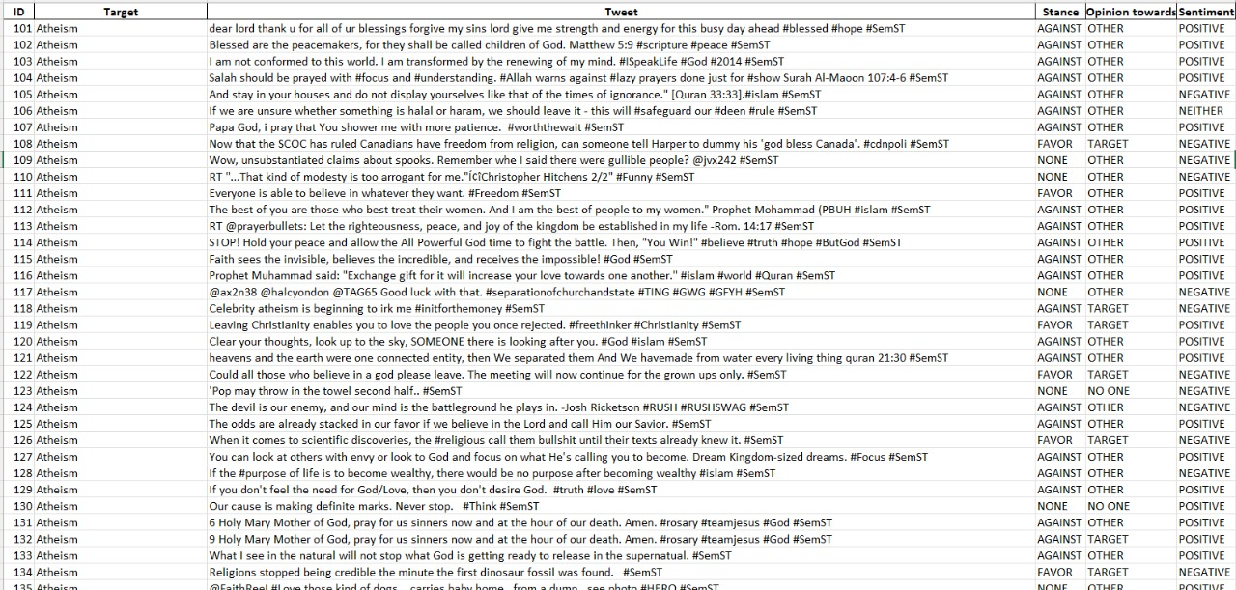

Slide 18
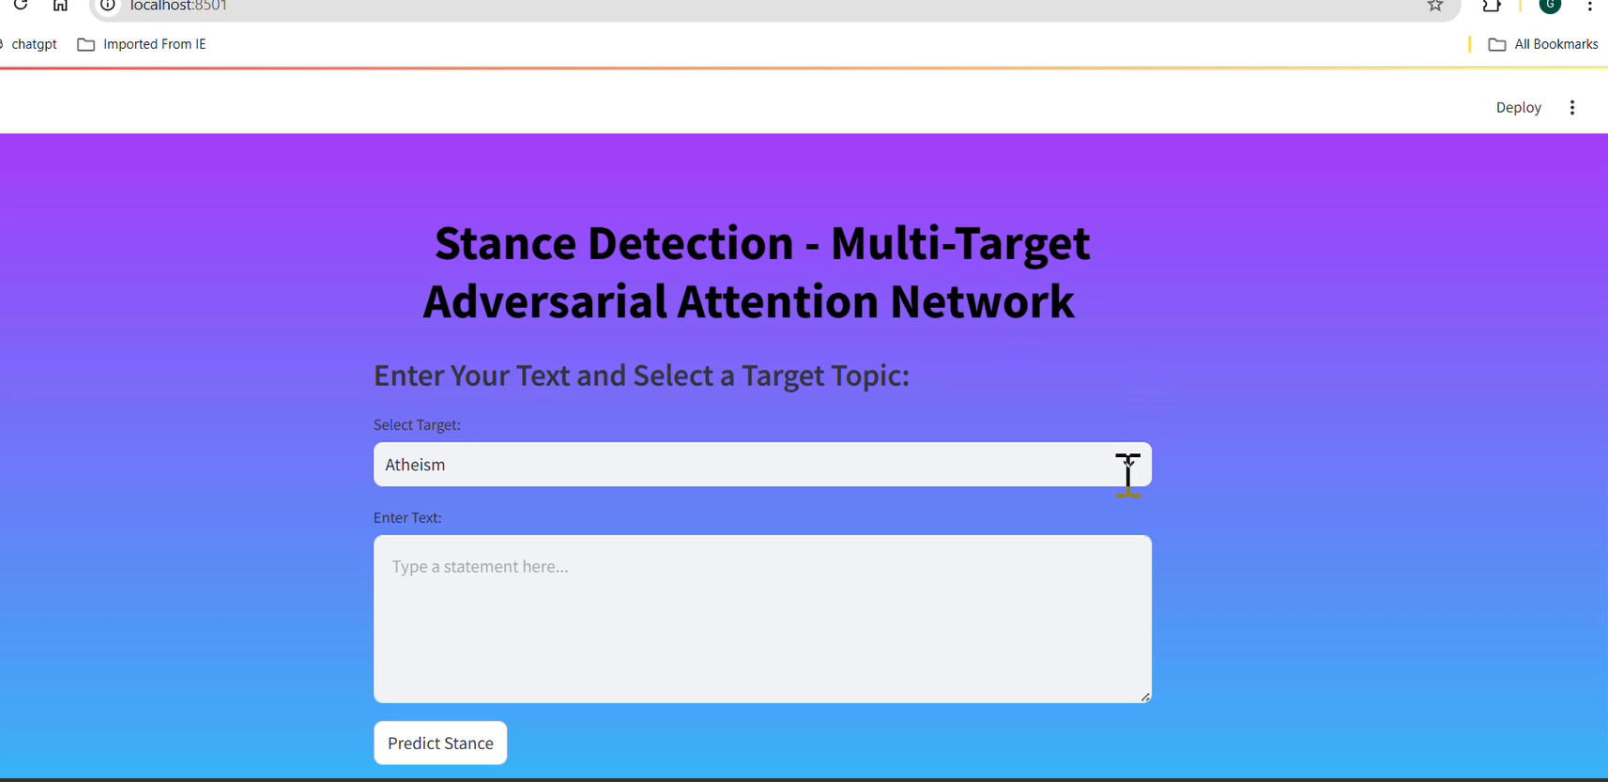
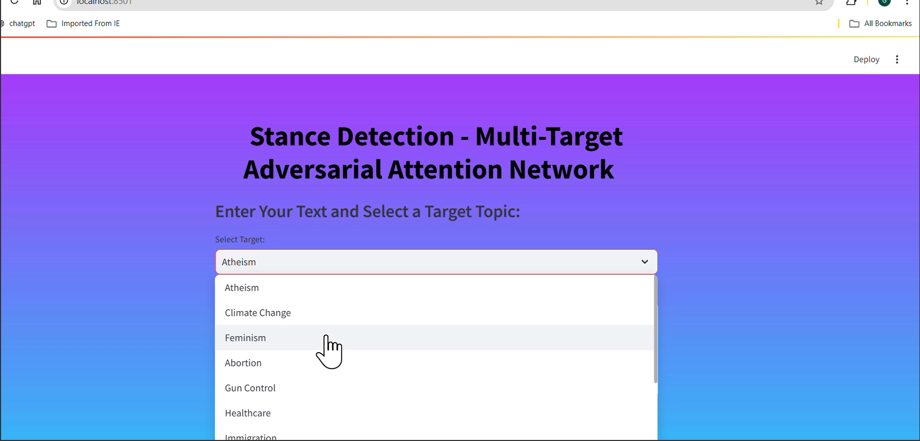
Results and Discussion

Slide 19

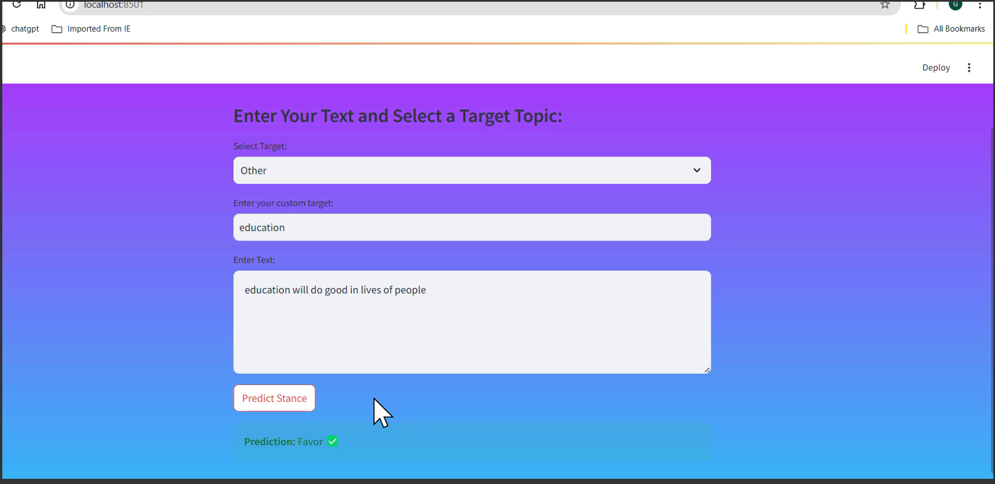
Results and Discussion

Slide 20
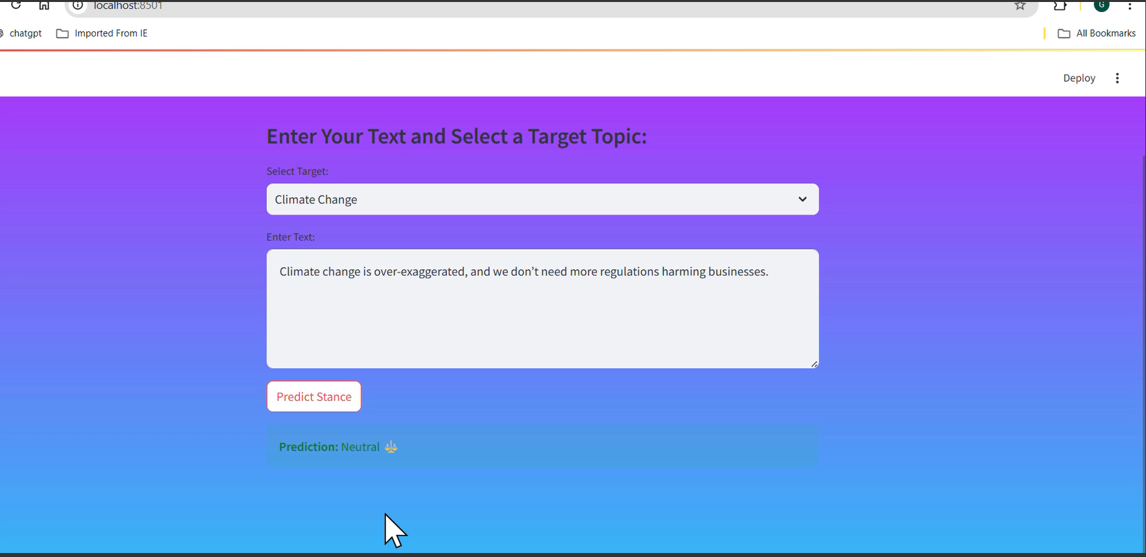
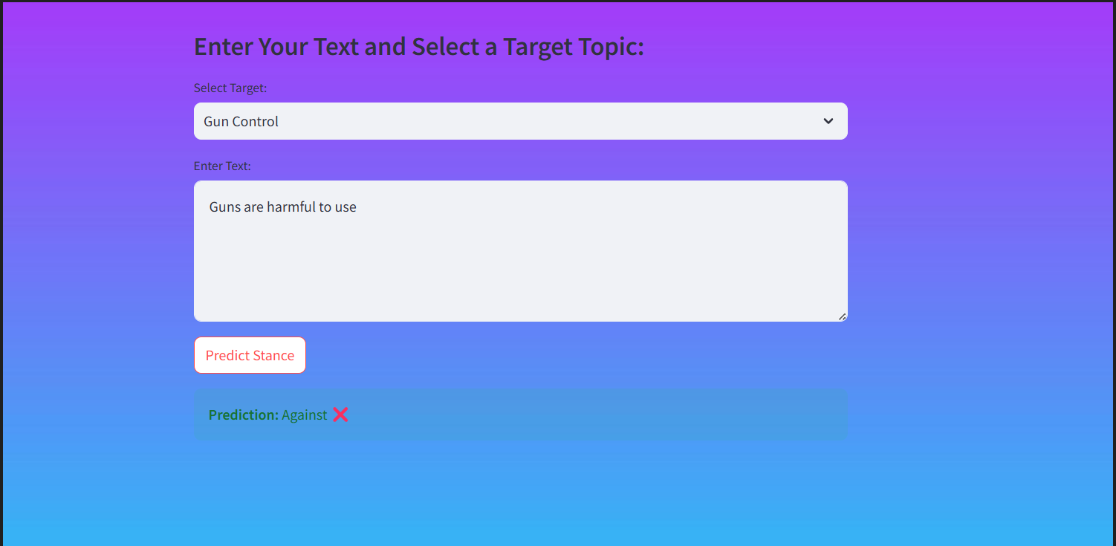
Results and Discussion

Slide 21
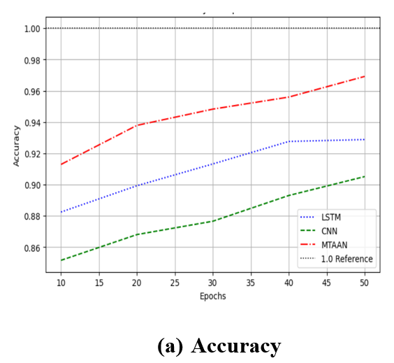

Results and Discussion

Slide 22
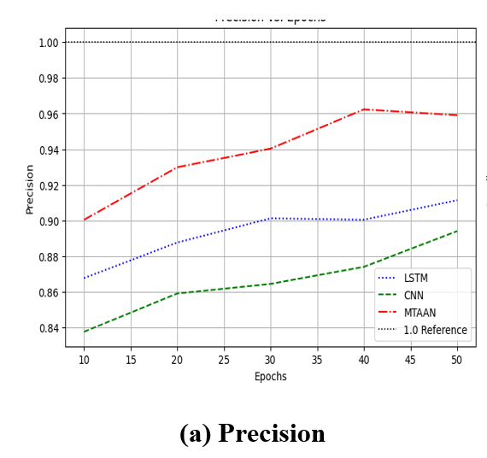
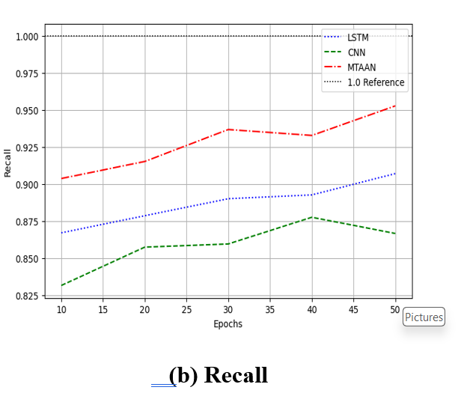


Results and Discussion

Slide 23
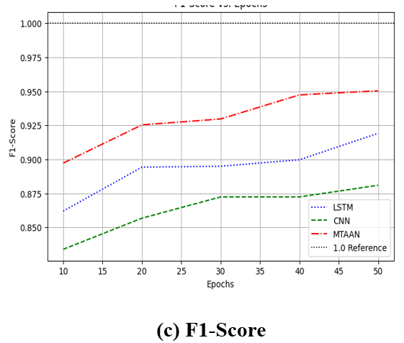
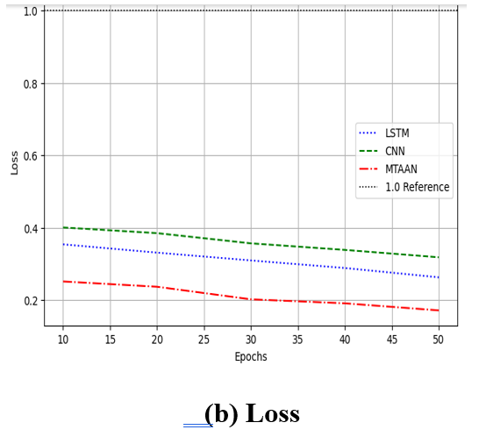


Results and Discussion

Slide 24
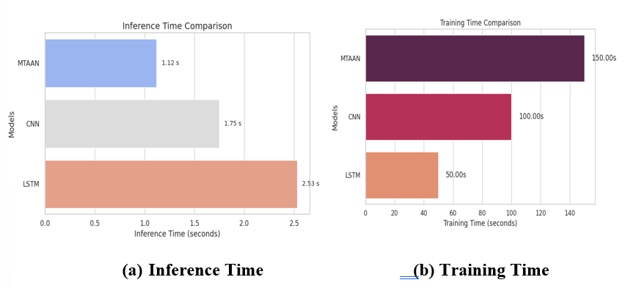
Results and Discussion

Slide 25
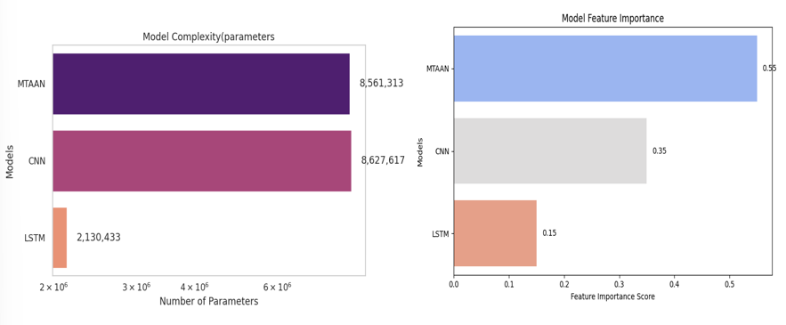
Results and Discussion

Slide 26
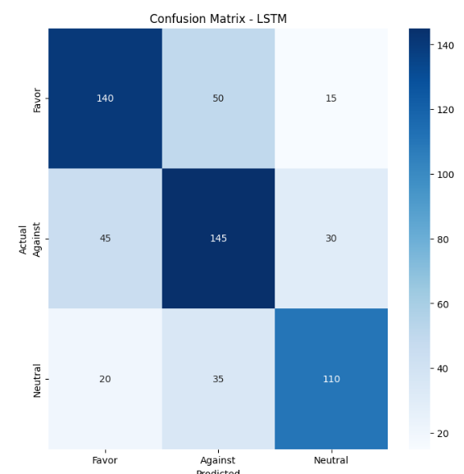
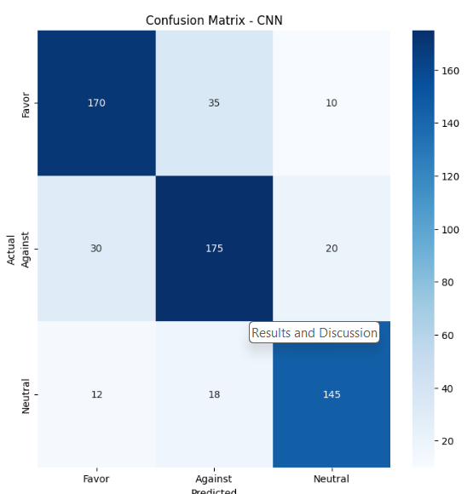
Results and Discussion

Slide 27
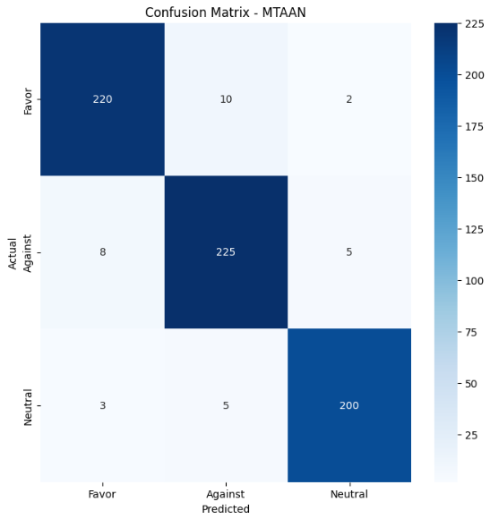
Results and Discussion
The experimental results compare CNN, LSTM, and the proposed MTAAN model using metrics like accuracy, loss, precision, recall, and F1-score. MTAAN consistently outperforms others, achieving higher accuracy, lower loss, and better balance across metrics. Confusion matrices, cross-validation, and performance analysis confirm its superior classification, faster inference, higher feature importance, and robustness despite increased training time and model complexity.

Slide 28
Conclusion
In this project, we focused on developing the Multi-Target Adversarial Attention Network (MTAAN) to automatically identify a speaker's stance on various topics in social media. By using advanced techniques in natural language processing, our system can accurately detect opinions, even when the subjects are not clearly mentioned in the text. The model combines a pre-trained BERT encoder with an adversarial attention mechanism to improve its performance, incorporating three main parts: the Target Discriminator, Sentiment Discriminator, and Stance Detection Module. Through adversarial training, we aimed to enhance stance classification by reducing errors in sentiment and target detection while optimizing stance recognition.

Slide 29
References
Y. Li, H. He, S. Wang, F. C. M. Lau and Y. Song, "Improved Target-Specific Stance Detection on Social, vol. 10, no. 6, pp. 3031-3042, Dec. 2023, doi: 10.1109/TCSS.2023.3320723Media Platforms by Delving Into Conversation Threads," in IEEE Transactions on Computational Social Systems.
H. Chai et al., "MG-SIN: Multigraph Sparse Interaction Network for Multitask Stance Detection," in IEEE Transactions on Neural Networks and Learning Systems, vol. 36, no. 2, pp. 3111-3125, Feb. 2025, doi: 10.1109/TNNLS.2023.3328659.
C. Li et al., "Joint Stance and Rumor Detection in Hierarchical Heterogeneous Graph," in IEEE Transactions on Neural Networks and Learning Systems, vol. 33, no. 6, pp. 2530-2542, June 2022, doi: 10.1109/TNNLS.2021.3114027.
P. J. Khiabani and A. Zubiaga, "Few-Shot Learning for Cross-Target Stance Detection by Aggregating Multimodal Embeddings," in IEEE Transactions on Computational Social Systems, vol. 11, no. 2, pp. 2081-2090, April 2024, doi: 10.1109/TCSS.2023.3264114.
S. Sengan, S. Vairavasundaram, L. Ravi, A. Q. M. AlHamad, H. A. Alkhazaleh and M. Alharbi, "Fake News Detection Using Stance Extracted Multimodal Fusion-Based Hybrid Neural Network," in IEEE Transactions on Computational Social Systems, vol. 11, no. 4, pp. 5146-5157, Aug. 2024, doi: 10.1109/TCSS.2023.3269087.

