Slide 1
21AIE205(PML) PROJECT GROUP-15
SAI SRI DARSINI H(CB.EN.U4AIE21055)
SYKAM SUMANJALI(CB.EN.U4AIE21068)
SUDA HARI PRIYA(CB.EN.U4AIE21067)
KURAGAYALA DEVI PRASAD(CB.EN.U4AIE21026)

Slide 2
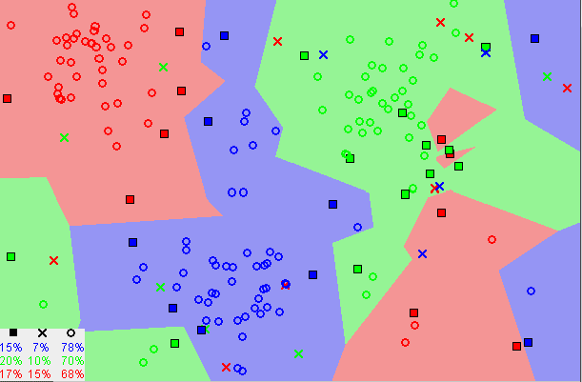
K-Nearest neighbours (KNN)
The k-nearest neighbors (KNN) algorithm is a simple, easy-to-implement supervised machine learning algorithm that can be used to solve both classification and regression problems.
The KNN algorithm assumes that similar things exist in close proximity. In other words, similar things are near to each other.
Image showing how similar data points typically exist close to each other

Slide 3
To classify an unknown record:
Compute Euclidean distance to other training records
Identify k-nearest neighbours
KNN Algorithm:
Load the data
Initialize K to your chosen number of neighbors
For each example in the data
Calculate the distance between the query example and the current example from the data.
Add the distance and the index of the example to an ordered collection
Sort the ordered collection of distances and indices from smallest to largest (in ascending order) by the distances
Pick the first K entries from the sorted collection
Get the labels of the selected K entries
If regression, return the mean of the K
If classification, return the mode of the K labels

Slide 4
Choosing value of k:
If k is too small, sensitive t noise points
If k is too large, neighbourhood may include points from other classes.
Advantages
The algorithm is simple and easy to implement.
There’s no need to build a model, tune several parameters, or make additional assumptions.
The algorithm is versatile. It can be used for classification, regression, and search (as we will see in the next section).
Disadvantages
The algorithm gets significantly slower as the number of examples and/or predictors/independent variables increase.

Slide 5

Naïve bayes algorithm
Naïve Bayes algorithm is a supervised learning algorithm, which is based on Bayes theorem and used for solving classification problems.
It is mainly used in text classification that includes a high-dimensional training dataset.
It is a probabilistic classifier, which means it predicts on the basis of the probability of an object.
Some popular examples of Naïve Bayes Algorithm are spam filtration, Sentimental analysis, and classifying articles.
BAYES THEOREM: This theorem is used to determine the probability of a hypothesis with prior knowledge. It depends on the conditional probability.
Formula-
Where,
P(A|B) is Posterior probability: Probability of hypothesis A on the observed event B.
P(B|A) is Likelihood probability: Probability of the evidence given that the probability of a hypothesis is true.
P(A) is Prior Probability: Probability of hypothesis before observing the evidence.
P(B) is Marginal Probability: Probability of Evidence.

Slide 6

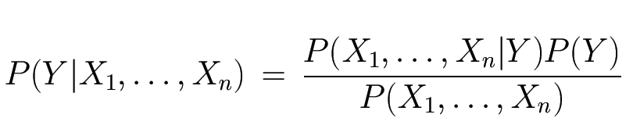
BAYESIAN CLASSIFICATION: Create a classifier model for this we find probability of given set of inputs for all possible values of class variable y and pick up the output with maximum probability.
Mathematically expressed as:
Bayes Classifier:
Prior
Likelihood
Normalization constant
The likelihood of the features is assumed to be Gaussian, hence, conditional probability is given by:

Slide 7
Advantages of Naïve Bayes Classifier:
Naïve Bayes is one of the fast and easy ML algorithms to predict a class of datasets.
It can be used for Binary as well as Multi-class Classifications.
It performs well in Multi-class predictions as compared to the other Algorithms.
It is the most popular choice for text classification problems.
Disadvantages of Naïve Bayes Classifier:
Naive Bayes assumes that all features are independent or unrelated, so it cannot learn the relationship between features.
Applications of Naïve Bayes Classifier:
It is used for Credit Scoring.
It is used in medical data classification.
It can be used in real-time predictions because Naïve Bayes Classifier is an eager learner.
It is used in Text classification such as Spam filtering and Sentiment analysis.

Slide 8
PYTHON IMPLEMENTATION OF THE NAÏVE BAYES ALGORITHM:
We will use the "user_data" dataset, which we have used in our other classification model. Therefore we can easily compare the Naive Bayes model with the other models.
Steps to implement:
Data Pre-processing step
Fitting Naive Bayes to the Training set
Predicting the test result
Test accuracy of the result(Creation of Confusion matrix)
Visualizing the test set result.

