Slide 1

AI IN NATURAL LANGUAGE PROCESSING
21AIE314
Group-8
Sykam Sumanjali – CB.EN.U4AIE21068
Suda Hari Priya – CB.EN.U4AIE21067
Likhitha Shree S – CB.EN.U4AIE21052
Souvik Groain – CB.EN.U4AIE21065

Slide 2
Problem Statement:
SARCASM DETECTION
The project aims to develop deep learning and machine learning models for accurately detecting sarcasm in English and Hindi, addressing challenges in adapting linguistic features and cultural nuances, advancing NLP for multilingual sarcasm detection.

Slide 3
DATASET
FOR ENGLISH
FASTTEXT CRAWL 300D 2M DATASET : This dataset consists of 300-dimensional word embeddings trained using FastText on a vast web corpus containing approximately 2 million words.
SARCASM ON REDDIT: This dataset contains 1.3 million sarcastic comments from the Internet commentary website Reddit.
TWEETS DATASET IN HINDI LANGUAGE : This dataset consists of over 16,000 tweets (including both sarcastic and non-sarcastic) for researchers interested in working on Sarcasm Detection in Hindi.
Number of Sarcastic tweets: 6051
Number of Non-Sarcastic Tweets: 10128

Slide 4
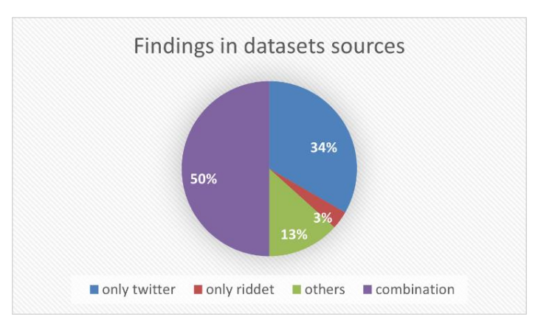
DATASET SOURCES
reddit

Slide 5
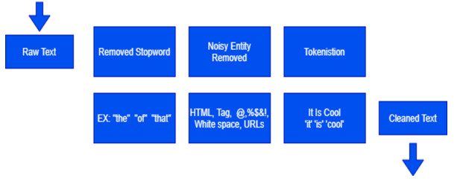
METHODOLOGY
DATA PREPROCESSING :
Notes:
One of the disadvantages of getting a dataset from social networks is the noise that gets on with the dataset. Social network data, for example (tweet), maybe within a style of user's mention (@ & user), simple text, reference, content tag as hashtags (#), and URLs, in this step, preprocessed for the preparation dataset before the feature extraction and classification task

Slide 6
TOKENISATION
Tokenization is the method of cutting sentences or words into shorter pieces named tokens like symbols, words, and phrases that are helpful on their own.
That task was performed by applying the NLP toolkit.
Text to Numeric Conversion: Converting these tokens into numeric values. This can be done in several ways, including:
Integer Encoding: Each unique word is assigned an integer value.
Like, sentence "machine learning is cool" will convert into something like "2315 834 12 4510".

Slide 7
WORD EMBEDDINGS
Words are converted into dense vectors that represent their meanings.
Eg: king : [-0.34, 0.98, -0.04, 0.32]
queen : [0.25, -0.23, -0.10, -0.72]
Here it's just 4 numbers in a 1D vector, but in actual there will be 200-500 numbers in a 1D vector for each word.
These word embeddings captures intrinsic meaning in some way for each words. It kind of stores “meaning” of words or “insights” of the words inside them.
We use word embeddings to transfer the knowledge of words to model so that it can perform better.

Slide 8
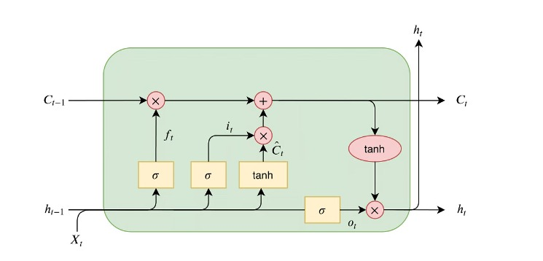
LSTM (LONG SHORT TERM MEMORY)
LSTM is type of RNN (Recurrent Neural Network) which "remembers" text to perform better in the task we are doing.

Slide 9
There are 3 gates in a single LSTM cell.
Forget gate
This gate decides what should be forgetted from the past text. What things are irrelevant to remember
First part from left is forget valve.
Memory Cell
This gate decides how much new memory should influence the old memory.
New memory is generated by a single layer neural network with pentagon shaped activation function(tanh).
Output will be element-wise multiple the new memory cell, and add to the old memory to form the new memory.
Memory cell is in the middle of the above figure.

Slide 10
3.Output gate
This gate generates output of this particular LSTM cell.
It's in the right part of above LSTM cell figure.
It's controlled by new memory & previous output.
This valve controls how much new memory should output to the next LSTM unit.
Input gate:
X_t: Current input vector.
h_(t-1): Output from the previous block (previous hidden state).
C_(t-1): Memory from the previous block (previous cell state).
In one LSTM layer, there will be a chain of this type of LSTM cells.

Slide 11
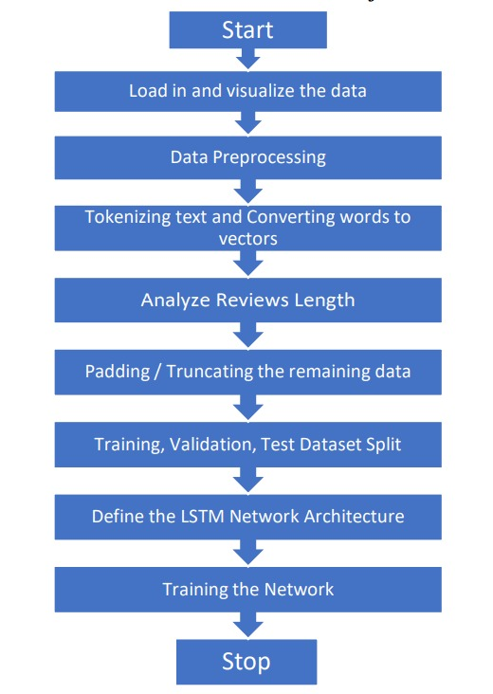
Flow Chart:

Slide 12
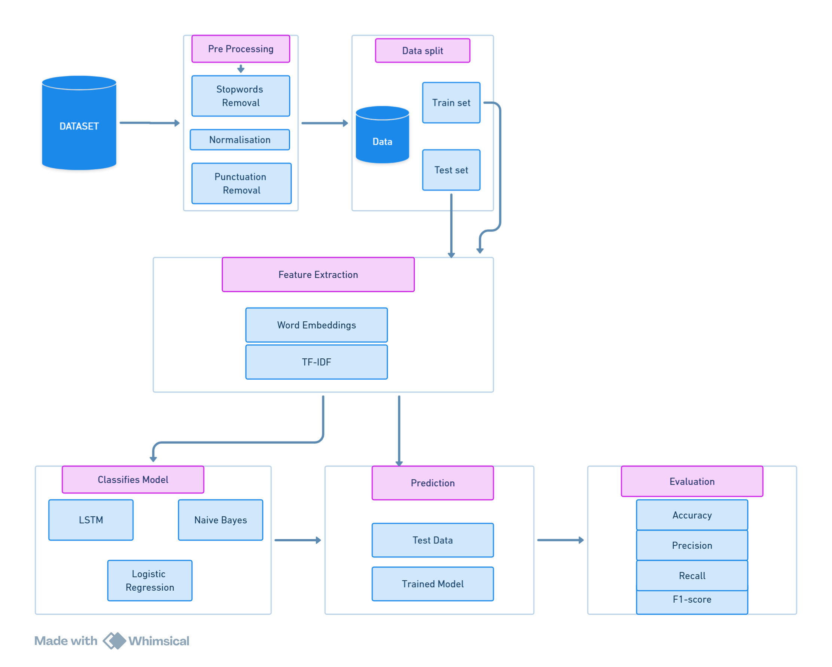
PROPOSED METHODOLOGY BLOCK DIAGRAM

Slide 13
FOR HINDI TWEETS
Data preprocessing involves several steps to clean and prepare the text data for analysis: • Handling Missing Data: Empty entries are removed to ensure data quality.
• Text Cleaning: URLs, mentions, hashtags, and punctuation are removed. Emojis are also stripped out using regular expressions.
• Tokenization: The text is tokenized using NLTK’s word tokenizer.
• Stop Words Removal and Stemming: Common stop words are removed, and words are stemmed to their root forms to reduce noise and dimensionality. A custom text processing function is applied to clean and standardize the tweets.

Slide 14
TF-IDF Vectorization To convert the textual data into numerical format, TF-IDF (Term Frequency-Inverse Document Frequency) vectorization is employed. This technique trans forms the text into a matrix of TF-IDF features, capturing the importance of each term in the document relative to the entire dataset.
Feature Engineering with Doc2Vec We use Gensim’s Doc2Vec model for generating document embeddings. Each tweet is tokenized, and a Tagged Document is created for each entry, associating the text with its label. The Doc2Vec model is trained on these tagged documents to create feature vectors representing the semantic content of each tweet.
Model Training and Evaluation The feature vectors and corresponding labels are split into training and validation sets using a 70-30 split. A RandomForestClassifier is trained on the training set to classify tweets as sarcastic or non-sarcastic. The model’s performance is evaluated using several metrics: Accuracy, ROC score and confusion matrix

Slide 15
RESULTS
The LSTM model trained on the English Reddit dataset achieved a validation accuracy of 72.76%.
LSTM Model Predictions After training the LSTM model, we utilized it to predict the probabilities of sarcasm for given sentences.
Below are examples of sentences along with their predicted probabilities:
“Sun rises from the east” : 0.08
“Oh, because that’s obviously what I meant” : 0.85
“Sure, because that makes total sense” : 0.99

Slide 16

Using ML The table shows performance metrics for sarcasm detection on a Reddit English dataset using two machine learning models: Logistic Regression demonstrates a slightly higher recall of 72.22%, indicating that it is marginally better at correctly identifying sarcastic comments. On the other hand, Naive Bayes achieves a higher precision of 71.49%, which means it is more effective at correctly classifying comments as sarcastic when they are indeed sarcastic.

Slide 17
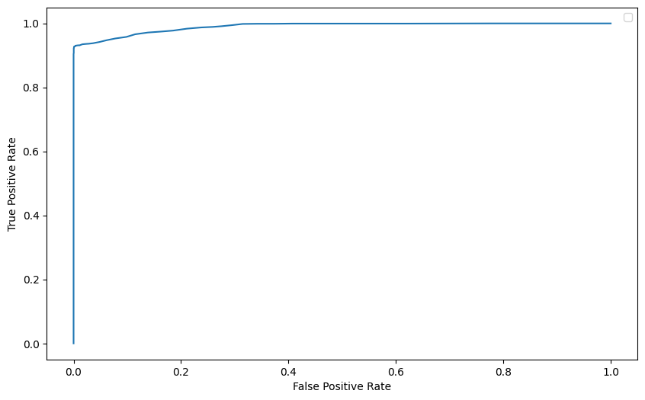
Sarcasm Detection Performance for Hindi tweets
The model achieved a high accuracy score of 97.05%, indicating that it correctly classified a significant portion of the Hindi tweets as sarcastic or non-sarcastic. Additionally, the RoC AUC score of 0.9609 suggests a strong ability of the model to distinguish between sarcastic and non-sarcastic tweets.

Slide 18
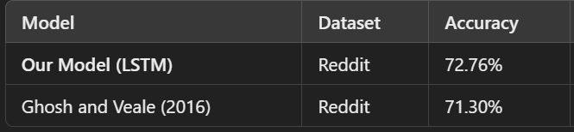
COMPARITIVE ANALYSIS
Our LSTM model shows improved performance compared to the LSTM model by Ghosh and Veale (2016) on the Reddit dataset.
This suggests that our approach to training the LSTM model for sarcasm detection in English text from Reddit is effective and provides better accuracy. https://www.researchgate.net/publication/301636658_Fracking_Sarcasm_using_Neural_Network

Slide 19
CONCLUSION
We explored methods for detecting sarcasm across social media platforms and languages. We employed distinct approaches for English text from Reddit and Hindi text from Twitter. Our findings contribute to the development of robust sarcasm detection systems for diverse online communication.
Challenge: Understanding sarcasm in social media text across languages and platforms.
English (Reddit): We leveraged Long Short-Term Memory (LSTM) networks to capture the sequential information crucial for contextual understanding in sarcasm identification.
Hindi (Twitter): We utilized Doc2Vec embeddings in conjunction with a Random Forest Classifier to capture the semantic meaning of Hindi text and effectively detect sarcasm.
Comparative Analysis: We analyzed the performance of LSTMs on English Reddit data and the Doc2Vec with Random Forest Classifier approach on Hindi Twitter data. This provided insights into the efficacy of different techniques for multilingual social media sarcasm detection.
Contribution: Our findings advance the development of robust sarcasm detection systems, offering valuable implications for NLP research and applications in multilingual and diverse social media contexts.

Slide 20


