Slide 1
Network Application(s)
Open northbound API
Controller Platform
Open southbound API
Data forwarding elements
(e.g., OpenFlow switches)
Network Infrastructure
Notes:
Figure 1

Slide 2
Management plane
Control plane
Data plane
Notes:
Figure 3

Slide 3
Net App 1
Net App 2
Net App n
Abstract network views
Open northbound API
Network Abstractions (e.g., topology abstraction)
Control plane
Global network view
Network OS (SDN controllers)
Open southbound API
Data Plane
Forwarding Devices
Network Infrastructure
Notes:
Figure 2

Slide 4

Conventional Networking
Network applications
Intrusion Detection System
Routing Algorithms
Firewalling
(e.g., Packet Filters)
Load balancer
SDN controller
Software-Defined Networking
Notes:
Figure 4

Slide 5

Management plane
Network Applications
Network Applications
Net App
Net App
Programming languages
Net App
Net App
Routing
Access Control
Load balancer
Net App
Net App
Language-based Virtualization
Control plane
Northbound Interface
Network Operating System and Hypervisors
Debugging, Troubleshooting, Testing and verifications
Network Operating System
Network Hypervisor
Data plane
Southbound Interface
Network infrastructure
(a)
(b)
(c)
Notes:
Figure 5

Slide 6
SDN CONTROLLER
RULE
ACTION
STATS
FLOW TABLE
Net App
Net App
Net App
Net App
Net App
Net App
SDN DEVICE
Packet + counters
Network
Operating
System
FLOW TABBLES
Forward packet to port(s)
Encapsulate and forward to controller
Drop packet
Send to normal processing pipeline
Control Communications
Control Communications
Switch port
MAC
src
MAC dst
Eth type
VLAN ID
IP
src
IP
dst
TCP
psrc
TCP pdst
Notes:
Figure 7

Slide 7
SDN Controller Node
SDN Controller Node
Westbound/
Eastbound APIs
Onix
Onix
ONOS
ONOS
yanc
yanc
0.75
Notes:
Figure 6

Slide 8
Management Applications
Routing Protocols
Load Balancers
Security
ACLs
Network Virtualization
Network Monitoring
Attack Detection
Northbound Interfaces
REST
Programming Languages
East/Westbound
Mechanisms and Protocols
Shortest Path Forwarding
Notification Manager
Security Mechanisms
Controller Platform
Topology Manager
Stats Manager
Device Manager
East/Westbound Abstraction Layer
Southbound Abstraction Layer
Common Interfaces
Southbound Interfaces
ForCES CE-CE
SDNi
OpenFlow
OVSDB
ForCES
POF
Hardware-based Forwarding Devices
Software-based Forwarding Devices
Data Plane Elements
Notes:
Figure 8

Slide 9
4
5
6
Control plane
3
7
Data plane
2
1
Notes:
Figure 9

Slide 10
Business Need
Software Defined Management
Workload Definition, Orchestration, and Optimization
Service Delivery Operational Level Agreement
Software Defined Environments
Software Defined Network
Software Defined Computing
Software Defined Storage
Notes:
Figure 2

Slide 11
Software Defined Management
Workload Definition, Orchestration, and Optimization
Software Defined Environments
SDN
Platform
Software Defined Network Unified Controller
Overlay (DOVE)
OpenFlow
Server
Virtual Switches
Multiplatform (hypervisors)
(e.g. Vmware, KVMS)
Traditional Infrastructure
OpenFlow enabled Infrastructure
Notes:
Figure 2

Slide 12
Section V: Ongoing research efforts and challenges
Switch designs
Controller platforms
Resiliency and Scalability
Performance evaluation
Security and dependability
Organizational barriers, Hybrid SDN, Migration
SDN in carrier transport networks
SDN completes the SDE puzzle
Section IV: Comprehensive survey: Bottom-up approach
Debugging and troubleshooting (Debugging, Testing and Verification, Simulation & Emulation)
Applications
Traffic engineering
Mobility & Wireless
Measurement & Monitoring
Security & Dependability
Data Center Networking
Programming languages
Language-based Virtualization
Northbound API
Network Operating System (SDN Controllers)
Hypervisor-based virtualization
Southbound interfaces
Infrastructure (Overview of available OpenFlow devices, Table II)
Section III: What is SDN? (History of SDN, Terminology, Definitions, Alternative interpretations)
Section II: State of quo in “Computer Networking” and motivations
Section I: Introduction
Notes:
Figure 10

Slide 13
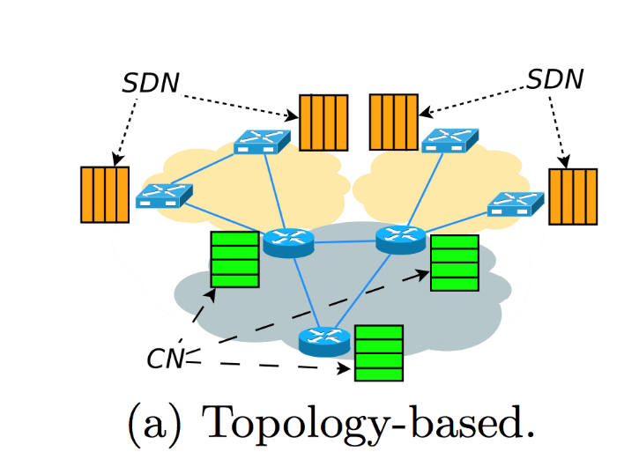
SDN
SDN
CN

Slide 14
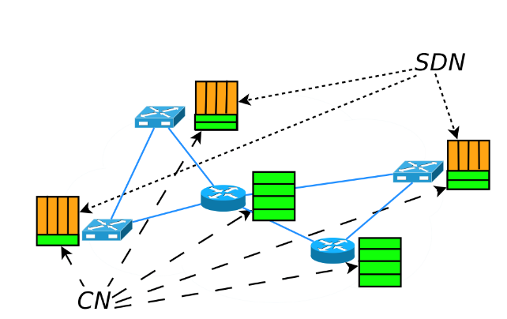
SDN
CN

Slide 15
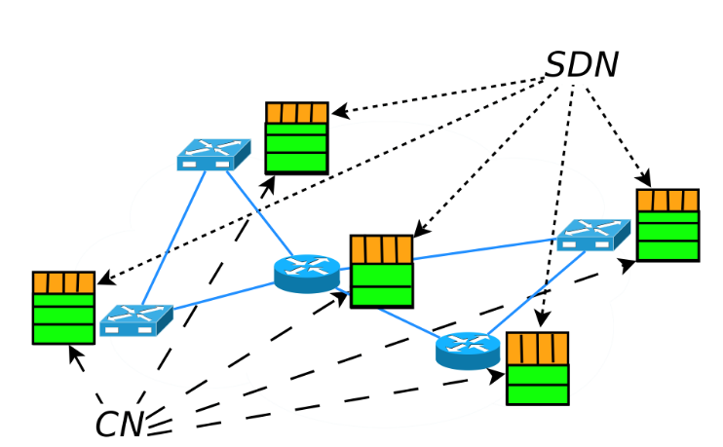
SDN
CN

Slide 16
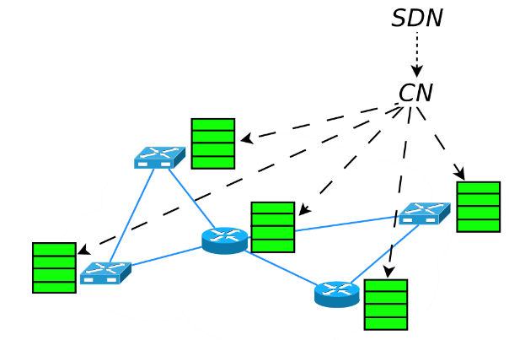
CN
SDN

