Slide 1
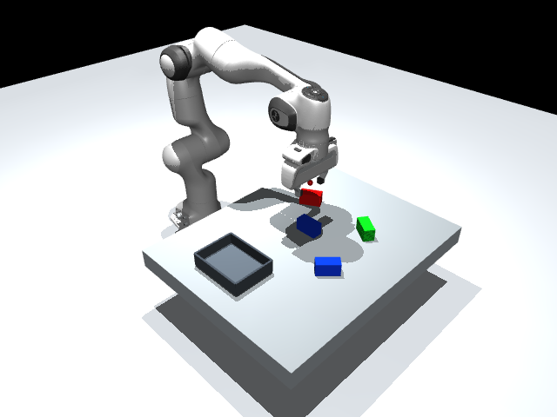
Digital Image Processing in Robotics
From camera pixels
to robot action
How does a robot identify the selected box,
estimate its position and angle, and pick it up?
SETTI APPALANAIDU - 92510118026
MOHITRAJSINH JADEJA - 92510118004
Actual MuJoCo run
MuJoCo Vision-Guided Multi-Object Pick-and-Place
01
Notes:
This project asks how a robot can turn camera pixels into a physical action. In this MuJoCo demonstration, I choose a box color, inspect the image-processing stages, select an instance when two boxes share the color, and then let a Panda arm pick it into a tray. The target position and angle come from the rendered camera image. Simulator object coordinates are used later only to measure errors. The Panda robot model and workshop DLS components are reused with attribution. The camera calibration, vision pipeline, controls, tests and integration are the new project work. The results shown here come from completed simulation runs.
Likely professor questions
Q: Is this a real robot?
A: No. It is a physics simulation with rendered camera images and a contact-based grasp.
Q: Did you create the Panda model?
A: No. The Panda model and workshop utilities are reused under their supplied licenses.
Q: Does the robot already know the target position?
A: The movement target is estimated from the camera image, not read from object coordinates.
Evidence: project/outputs/results.csv, summary.json, coordinate_log.json and actual MuJoCo captures.

Slide 2
From camera pixels to robot action
Image processing
01 Camera
02 Filter
03 Segment
04 Clean mask
Render RGB pixels
Reduce impulse noise
Threshold HSV color
Opening + closing
Perception and robot movement
05 Detect
06 Localize
07 Validate / IK
08 Control
Outline, centre, angle
World position + yaw
Solve reachable poses
Execute physical grasp
The robot moves only after a selected region and its estimated pose pass validation.
MuJoCo Vision-Guided Multi-Object Pick-and-Place
02
Notes:
The pipeline has two connected parts. First, digital image processing prepares the camera image: optional simulated noise, median filtering, HSV color thresholding and morphological cleanup. Next, perception interprets the cleaned pixels as a rectangular object, estimates its centre and long-edge angle, and maps these to world coordinates. A validity and reachability gate must pass before motion begins. Inverse kinematics finds joint values for the desired hand poses, and the position servos execute those joint commands. Planning chooses the approach and transfer sequence. The dashboard pauses between these stages so each result can be explained before the robot moves.
Likely professor questions
Q: Where does DIP end?
A: Filtering and mask operations are DIP; object interpretation and pose estimation are perception. The practical boundary overlaps.
Q: Are segmentation and detection the same?
A: Segmentation labels pixels; detection groups and validates an object region.
Q: Does IK identify the box?
A: No. IK receives a desired hand pose after perception.
Evidence: project/outputs/results.csv, summary.json, coordinate_log.json and actual MuJoCo captures.

Slide 3
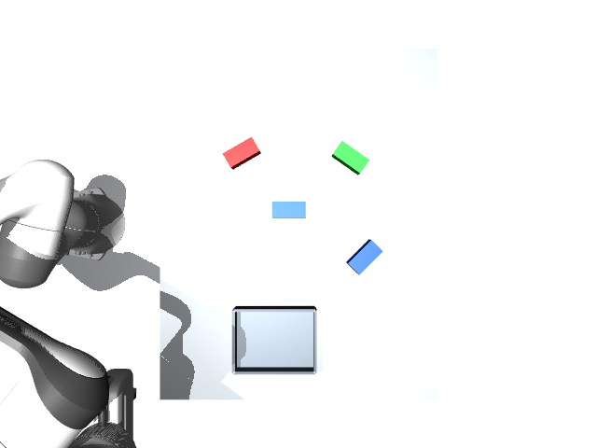
A calibrated scene with selectable targets
Four visible boxes
Two blue instances
Choose color. Click an instance
when multiple regions match.
Fixed overhead RGB camera
640 x 480 pixels | 45° vertical FOV
Conservative workspace
Every requested pose gets an IK check.
MuJoCo Vision-Guided Multi-Object Pick-and-Place
03
Notes:
The scene contains a Panda arm, a flat table, a tray and four elongated boxes: red, green and two blue instances. The fixed overhead camera renders a 640 by 480 RGB frame. The observation pose keeps the boxes visible before capture. One matching color region is selected automatically, while two blue regions require a click in the camera preview. Box setup uses metre and degree controls within a conservative workspace. Each requested placement also needs joint-limited IK and sampled table-clearance checks. The validated area is smaller than the robot's theoretical workspace, and the demonstration does not claim universal collision-free reachability.
Likely professor questions
Q: Why an overhead camera?
A: It makes flat-plane localization clear and reduces perspective complications.
Q: What if two boxes have the same color?
A: The dashboard pauses until the user clicks one detected instance.
Q: Can a box be placed anywhere?
A: No. Bounds, separation, IK and sampled clearance checks must accept the pose.
Evidence: project/outputs/results.csv, summary.json, coordinate_log.json and actual MuJoCo captures.

Slide 4


Median filtering reduces simulated noise
Simulated salt-and-pepper noise: 8%
3 x 3 median filter: noise reduced
Other boxes are scene objects. They are not image noise.
MuJoCo Vision-Guided Multi-Object Pick-and-Place
04
Notes:
MuJoCo's RGB image is usually clean, so the noise shown here is deliberately simulated. A fixed random seed changes selected pixels to black or white, creating salt-and-pepper noise. The displayed example corrupts eight percent of pixels. A three by three median filter sorts each channel's local values and chooses the middle value, so an isolated extreme value usually does not dominate the result. The filter runs before segmentation. It greatly reduced the measured image difference in this example, but can soften small details and does not remove every kind of noise. The other boxes are distractor objects, not image noise.
Likely professor questions
Q: Why use a median rather than a mean?
A: The median is less affected by isolated black or white outliers.
Q: Does it remove all noise?
A: No. It targets impulse noise here and can also change edges.
Q: Are the other boxes noise?
A: No. They are scene objects; color segmentation separates the chosen color.
Evidence: project/outputs/results.csv, summary.json, coordinate_log.json and actual MuJoCo captures.

Slide 5
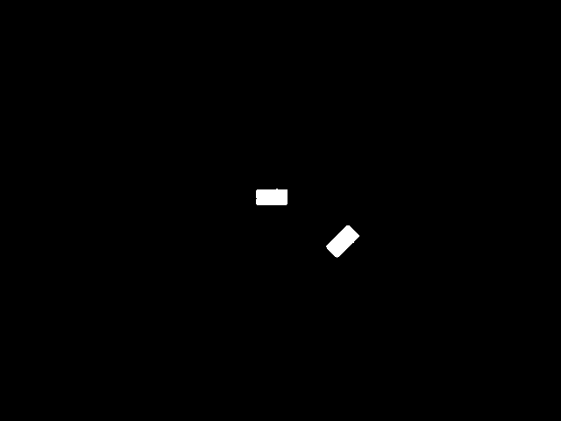

HSV segmentation and mask cleanup
HSV threshold mask
After opening + closing
White = BLUE pixels. Median filtering already removes most specks in this frame.
MuJoCo Vision-Guided Multi-Object Pick-and-Place
05
Notes:
The filtered RGB image is converted to HSV: hue describes color, saturation describes its strength, and value describes brightness. Threshold ranges produce a binary mask. Matching pixels are white and everything else is black. Red uses two hue ranges because hue wraps around the scale. A three by three opening applies erosion followed by dilation to remove small isolated foreground regions. Closing reverses that order to fill small gaps. The median filter already removes most impulse specks in these rendered frames, so the extra change may be small. Morphology improves the mask but does not by itself decide which region is a valid box.
Likely professor questions
Q: Why HSV instead of RGB?
A: Hue is easier to threshold across some brightness changes, although HSV is not illumination-invariant.
Q: What is opening?
A: Erosion followed by dilation with the same small structuring element.
Q: Why are two red ranges needed?
A: Red lies near both ends of OpenCV's hue scale, which runs from zero to 179.
Evidence: project/outputs/results.csv, summary.json, coordinate_log.json and actual MuJoCo captures.

Slide 6
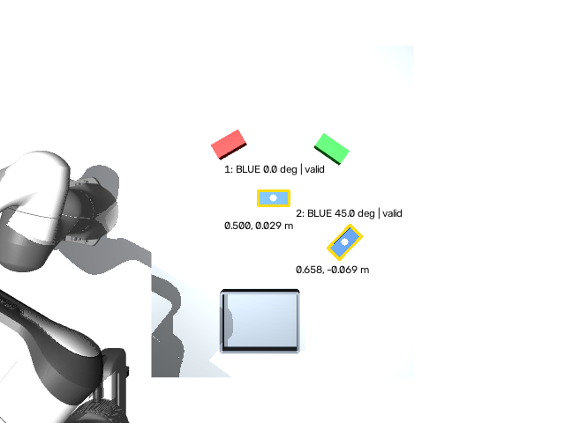
Detect a rectangle and estimate its angle
Contours → rotated rectangles
Reject invalid size, shape and fill.
Choose one matching region.
Long edge gives the image angle.
Calibration converts it to world yaw.
Elongated box: clear orientation
Square box: ambiguous yaw
MuJoCo Vision-Guided Multi-Object Pick-and-Place
06
Notes:
Contours group the white pixels into candidate regions. The program rejects regions with implausible area, side length, aspect ratio or rectangular fill. OpenCV minAreaRect fits a rotated rectangle to each accepted outline. Its centre is the image location, and the longest edge supplies an orientation cue. The fill ratio is a shape-validity measure, not a probability of correctness. An elongated box has a clear long edge; a square would have ambiguous yaw. The image angle is not sent directly to the robot. Both edge endpoints are converted through camera calibration to obtain a world direction, and world yaw is normalized modulo 180 degrees.
Likely professor questions
Q: Can color tell you the angle?
A: No. The rectangular outline gives orientation; color only selects pixels.
Q: Why not use a square?
A: A square lacks a unique long edge and has extra rotational ambiguity.
Q: Is the validity score a confidence probability?
A: No. It is the contour area divided by fitted rectangle area.
Evidence: project/outputs/results.csv, summary.json, coordinate_log.json and actual MuJoCo captures.

Slide 7
Pixels become world position and yaw
Pixel centre
Calibrated ray
Box-top plane
World estimate
(u, v)
Camera pose (C, R)
z = 0.27 m
(x, y, z), yaw
f = H / [2 tan(FOV / 2)]
P = C + t r, with Pz = box-top height
World yaw = atan2(Δy, Δx) of the mapped long edge
Fixed camera • flat table • known 4 cm box height • yaw modulo 180°
MuJoCo Vision-Guided Multi-Object Pick-and-Place
07
Notes:
A pixel is a viewing direction, not a distance in metres. The camera's field of view and image size give the focal length, while its position and rotation define the ray in world coordinates. The program intersects that ray with the known box-top plane at z equal to 0.27 metres. It then subtracts half the box height to report the box centre. Using the tabletop plane would give the wrong geometry. Mapping the longest-edge endpoints gives the world yaw. Calibration matters because any camera or height error changes the target estimate. These results assume a fixed overhead camera, a flat table and uniform box height.
Likely professor questions
Q: Why use the box top rather than the table?
A: The colored pixels lie on the object, whose top is four centimetres above the table.
Q: What if the camera tilts?
A: Use its correct rotation and ray-plane geometry, or depth; do not assume the overhead mapping still holds.
Q: How is error measured?
A: Only after detection, compare the image estimate with independent simulator ground truth.
Evidence: project/outputs/results.csv, summary.json, coordinate_log.json and actual MuJoCo captures.

Slide 8
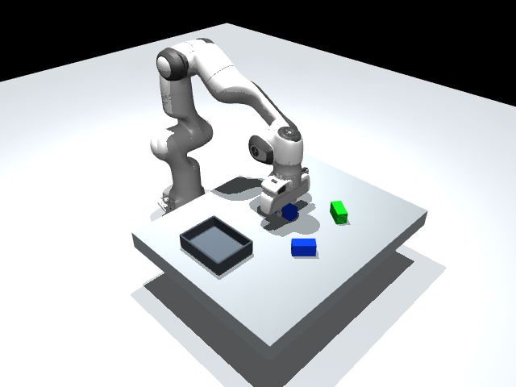
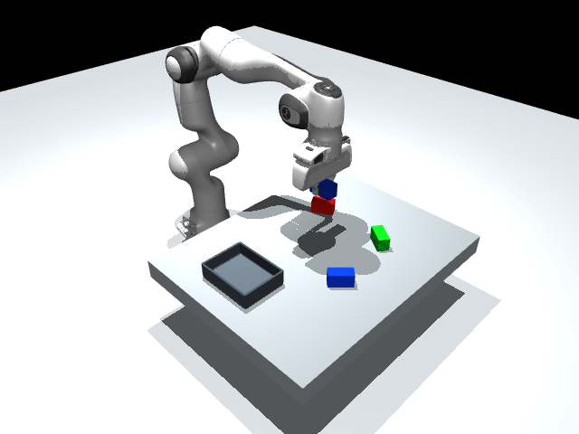
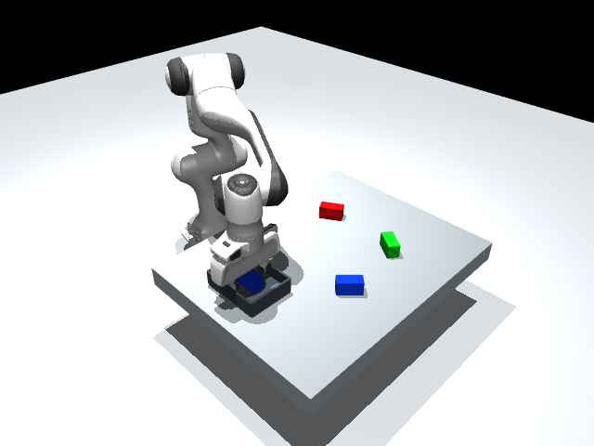
Vision supplies a pose; IK and control move the arm
Grasp
Lift
Release
Vision pose
DLS IK
Joint targets
Position servos
Approach → align → descend → grasp → lift → tray → release → return
Finger contact, friction and gravity. No object weld or teleport.
MuJoCo Vision-Guided Multi-Object Pick-and-Place
08
Notes:
The selected image estimate defines a box centre and yaw. The planner builds hand waypoints above the box, down to grasp height, up for lifting, over the tray and down to release. Damped least-squares IK uses a Jacobian to find bounded joint targets for each pose. All waypoints are checked before starting. The arm's position servos then follow smoothly interpolated joint commands, while the gripper opens and closes through its tendon actuator. The actual box is transported by finger contact, friction and gravity. There is no box teleport or object weld. A final retreat and return clear the camera for the next demonstration.
Likely professor questions
Q: What does damping do in IK?
A: It limits large joint changes near poorly conditioned configurations, at the cost of exact tracking.
Q: What does the controller do?
A: It applies torques so the joints follow position commands through physics.
Q: Is the grasp attached by a constraint?
A: No object attachment is used. The existing finger-coupling constraint only synchronizes the fingers.
Evidence: project/outputs/results.csv, summary.json, coordinate_log.json and actual MuJoCo captures.

Slide 9
The same perception-to-action idea in industry
Real robotics applications
This classroom simulation
Workpiece location and robot guidance
HSV color + rectangular contours
Vision-guided picking and packing
Known top plane + fixed RGB camera
Warehouse item picking
Simulated Panda + two-finger contact
Industrial systems may add depth, learned perception, conveyor tracking and suction tools.
Sources: ABB Vision Systems; ABB Robotic Item Picker. Links in speaker notes.
MuJoCo Vision-Guided Multi-Object Pick-and-Place
09
Notes:
The general idea appears in industrial robot systems: a camera measures the scene, perception identifies useful objects or workpiece locations, and a robot acts on those estimates. ABB documents vision-guided workpiece handling, picking and packing, and warehouse item picking as real examples. These applications should be separated from this classroom implementation. Commercial systems may use three-dimensional sensors, learned perception, suction tools, moving conveyors and more advanced planning. Our project uses simple HSV ranges, a known object plane, rectangular boxes and a simulated two-finger gripper. It demonstrates the reasoning chain clearly, rather than reproducing an industrial product's capabilities.
Likely professor questions
Q: Could this directly run a warehouse?
A: No. Real systems need stronger perception, calibration, planning and hardware validation.
Q: Why not use YOLO?
A: The color-and-shape method solves this controlled teaching task and is easier to explain.
Q: What would improve it next?
A: Depth for variable heights, occlusion handling and fuller collision-aware planning.
Evidence: project/outputs/results.csv, summary.json, coordinate_log.json and actual MuJoCo captures.
https://new.abb.com/products/robotics/application-equipment-and-accessories/vision-systems
https://www.abb.com/global/en/areas/robotics/solutions/functional-modules/item-picking-family/robotic-item-picker

Slide 10
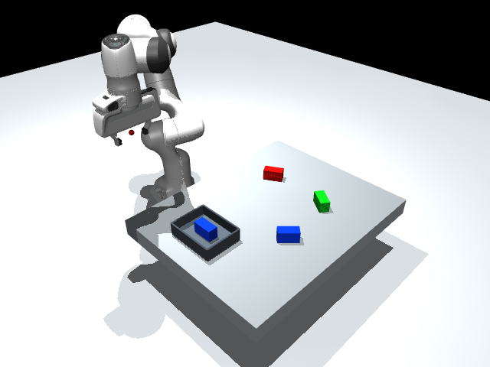
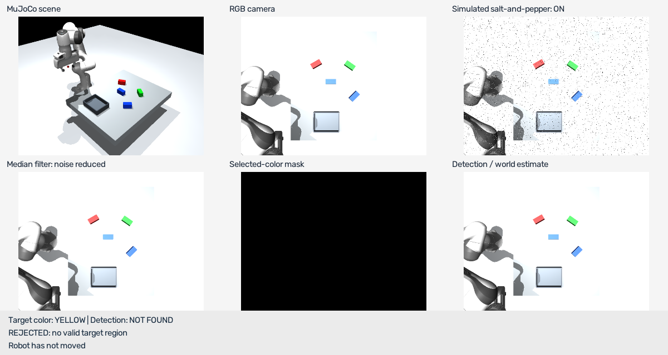
Measured results and practical limits
10 / 10
0.200 cm
0.296°
3 / 3
Physical picks
Mean position error
Mean yaw error
Correct refusals
Missing YELLOW: motion refused
Limits
Fixed height
Controlled lighting
Occlusion
Sampled paths
Completed test set only; no general reliability claim.
MuJoCo Vision-Guided Multi-Object Pick-and-Place
10
Notes:
The completed test set used ten physical pick-and-place runs across blue, red and green targets, several positions and yaw angles, and zero, three and eight percent simulated noise. It also tested the second blue instance. Every selected object lifted, was released inside the tray and left the fingers open. Three negative checks correctly refused a missing target, an outside-workspace target and an unreachable IK pose. Position and angle errors are calculated only after image detection. The initial failed blue-threshold run is preserved, and these reported numbers come from the corrected run. Limits include fixed heights, controlled lighting, occlusion and sampled rather than exhaustive path checking.
Likely professor questions
Q: Does ten out of ten prove perfect reliability?
A: No. It reports only this finite completed test set.
Q: What happened when no target was found?
A: The program displayed rejection and left the robot pose and controls unchanged.
Q: What is the main conclusion?
A: Calibrated image processing can supply usable target estimates for a physical simulated grasp.
Evidence: project/outputs/results.csv, summary.json, coordinate_log.json and actual MuJoCo captures.

Slide 11
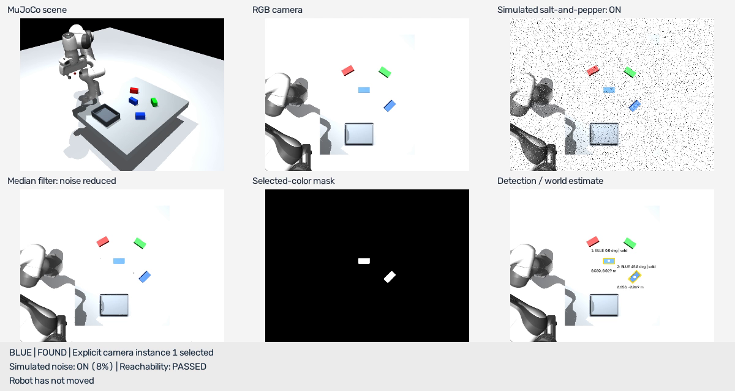
Live Demo: Vision-Guided Pick and Place
Recording of the completed MuJoCo simulation
Click the video to play in PowerPoint
MuJoCo Vision-Guided Multi-Object Pick-and-Place
11
Notes:
Now that we have seen the image-processing pipeline and measured results, let us watch the completed MuJoCo simulation. This embedded video is a recording of the tested run, not a live simulation. Click the video to play. Point to the camera view, simulated noise, filtered image, mask and detection overlay, then follow the physical approach, grasp, lift, transfer and release. If the live MuJoCo window fails or runs too slowly, use this embedded recording and explain the same steps. Advance to the thank-you slide after the recording.
Likely professor questions
Q: Is this video live?
A: No. It records the completed MuJoCo simulation.
Q: Does the recording change the reported results?
A: No. The measured results remain those of the completed test set.
Q: Is the video linked to a separate file?
A: The MP4 is embedded in this PowerPoint.

Slide 12
Thank you
Feel free to ask questions.
MuJoCo Vision-Guided Multi-Object Pick-and-Place
12
Notes:
Thank you. Feel free to ask questions. Keep this slide visible during discussion. Refer back to the pipeline, calibration and measured-results slides when answering technical questions.
Likely professor questions
Q: What is the main result?
A: The robot uses the detected camera estimate to command a physical simulated pick and place.
Q: What are the main limits?
A: Fixed box height, controlled lighting, occlusion and sampled path checks.
Q: Where can we see the measured evidence?
A: Slide 10 retains the completed test-set results.

