Slide 1
CUSTOMER ANALYTICS / PYTHON PROJECT
From Transactions
to Customer Strategy
Who drives value, who needs attention—and what should we do next?
1,000 transactions • 946 customers • 11 Apr–10 Jun 2023
Python • Pandas • RFM scoring • Customer insight
01

Slide 2
01 / THE OPPORTUNITY
The business question is bigger than a segment label
RFM is useful only when it changes where we invest attention, offers and retention effort.
PROTECT
RECOVER
GROW
Which customers create disproportionate value—and how do we keep them?
Which customers may be drifting away, and what is a sensible win-back test?
Where can relevant product recommendations or better timing increase engagement?
Our approach
Use transaction history to score Recency, Frequency and Monetary value; group customers; compare segment value and behaviour; then turn the strongest patterns into testable actions.
Important distinction: these are descriptive signals—not proof that a campaign will cause a lift.
RFM Segmentation & Customer Insight Analysis
02

Slide 3
02 / THE EVIDENCE BASE
What the data can—and cannot—tell us
TRANSACTIONS
CUSTOMERS
OBSERVED REVENUE
COVERAGE
1,000
946
513.7k
61 days
Unique orders
Unique customer IDs
Currency not specified in source data
11 Apr–10 Jun 2023
Available
Not available
• Customer, order, date and transaction amount
• Product label and location
• Observed repeat purchase and spend
• Returns, reviews or satisfaction scores
• Detailed product attributes or basket combinations
• A full year of data for seasonal comparisons
Data checks: 0 missing cells • 0 exact duplicate rows
RFM Segmentation & Customer Insight Analysis
03

Slide 4
03 / THE METHOD
RFM gives each customer three complementary lenses
R
RECENCY
F
FREQUENCY
M
MONETARY
How recently did they buy?
How often did they buy?
How much did they spend?
Lower days = stronger recent activity
More distinct orders = stronger repeat behaviour
Higher observed spend = greater revenue value
Scoring logic
Each metric is ranked into five quantile-based scores; transparent rules then assign one of eight customer segments.
Reference date: 11 Jun 2023 (the day after the final observed transaction). Segment labels depend on the chosen rules and period.
RFM Segmentation & Customer Insight Analysis
04

Slide 5
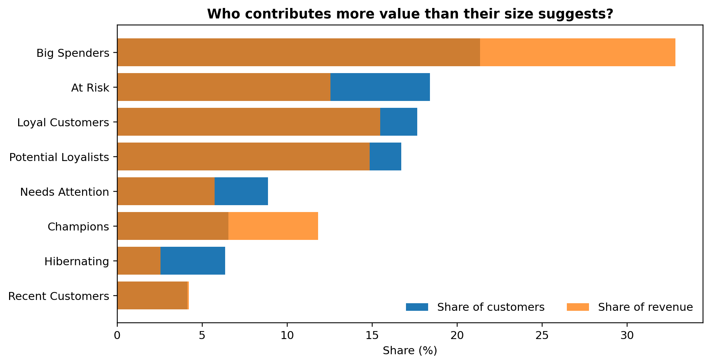
04 / WHAT WE FOUND
The first insight: customer share and revenue share are not the same
Comparing both shares helps identify segments worth protecting—not just the biggest groups.
BIG SPENDERS
32.8% of revenue from 21.4% of customers.
CHAMPIONS
11.8% of revenue; 979 average observed spend per customer.
BUSINESS IMPLICATION
Protect high-value experiences while testing how to grow repeat behaviour.
RFM Segmentation & Customer Insight Analysis
05

Slide 6
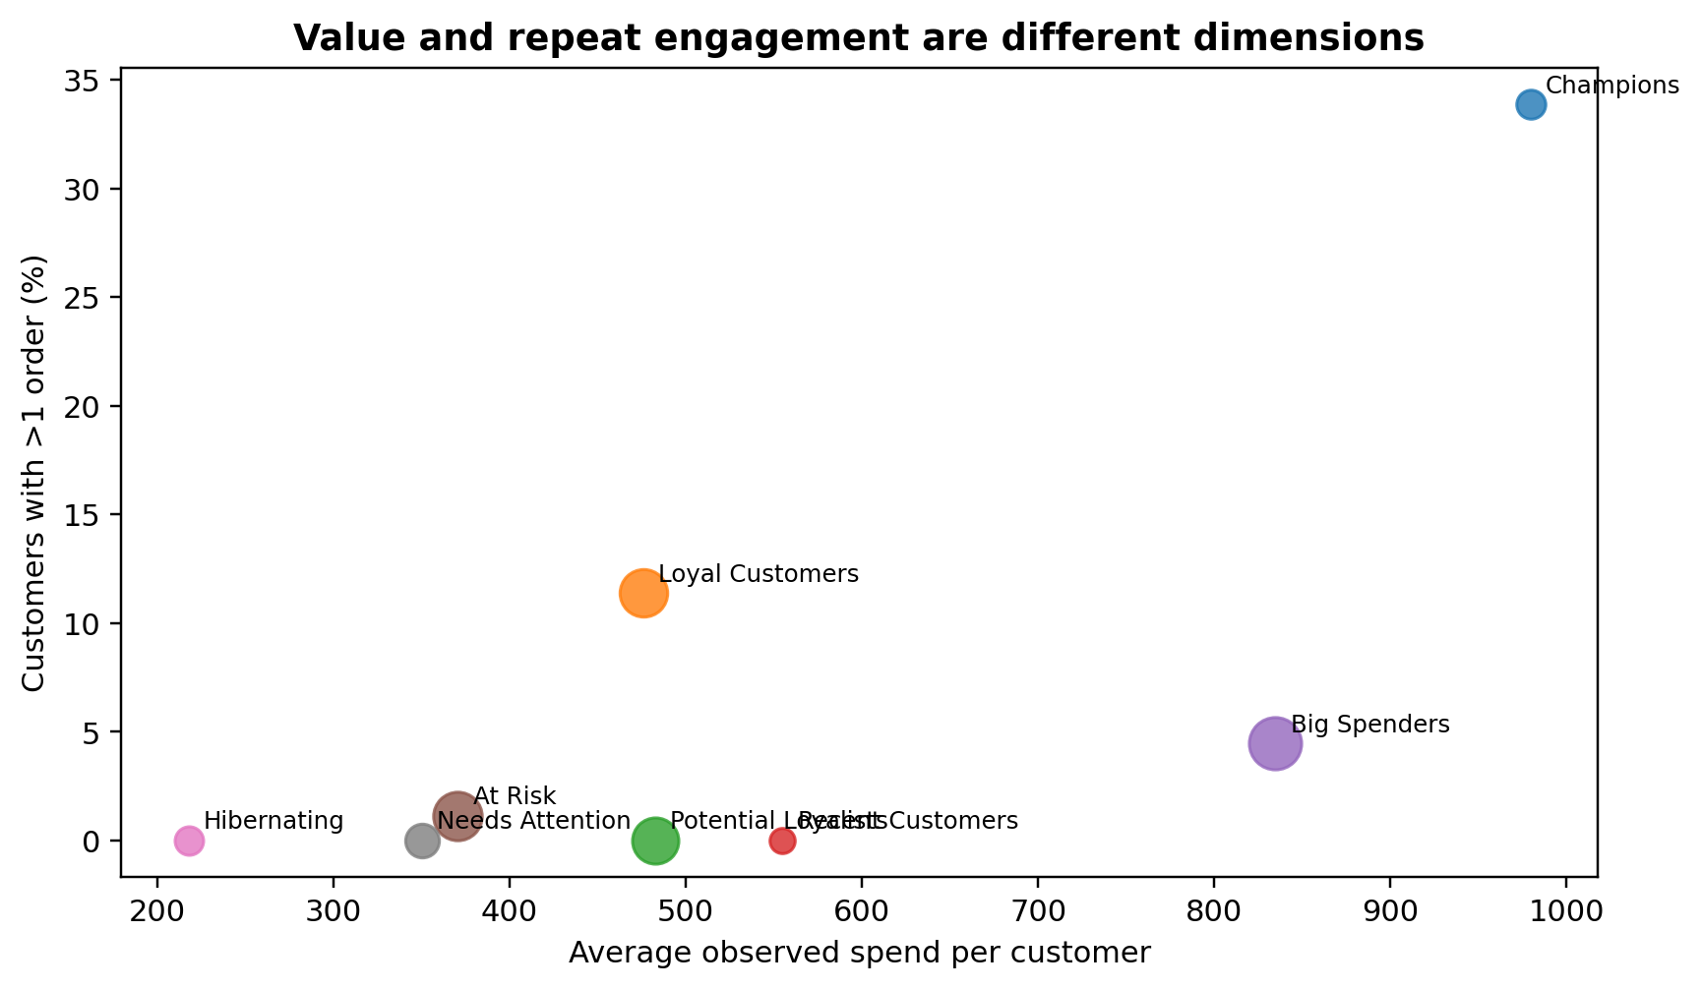
04 / WHAT WE FOUND
The second insight: high spend does not automatically mean loyalty
Repeat purchasing is a useful behavioural proxy, but not a direct measure of satisfaction.
CHAMPIONS
33.9% have placed more than one observed order.
BIG SPENDERS
4.5% repeat-purchase rate in this observed period.
WHAT TO DO
Reward repeat behaviour; separately monitor high-spend customers with low repeat activity.
RFM Segmentation & Customer Insight Analysis
06

Slide 7
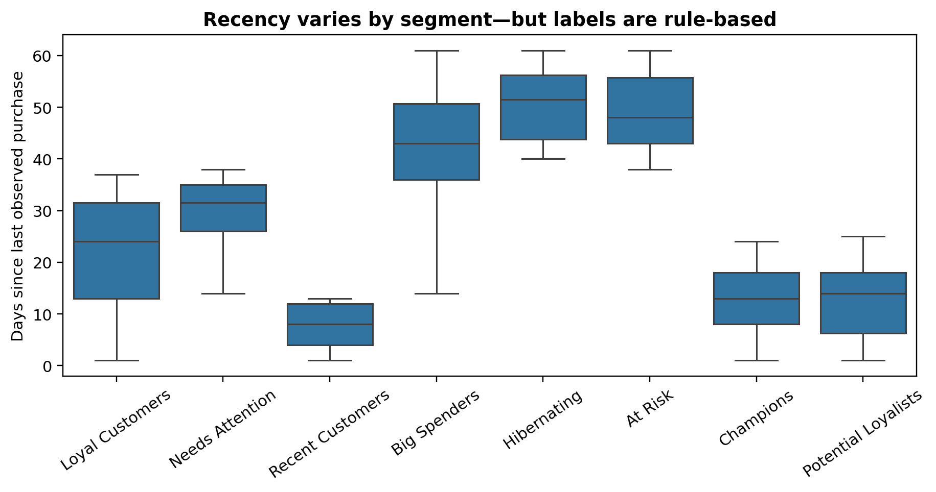
05 / FROM INSIGHT TO ACTION
Where should retention effort go first?
Use recency together with frequency and spend; do not treat a segment label as a guaranteed churn prediction.
AT RISK
174 customers; average observed spend 371.
HIBERNATING
60 customers; average observed spend 218.
RECOMMENDED TEST
Prioritise high-value, less-recent customers; test personalised reminders and controlled incentives.
RFM Segmentation & Customer Insight Analysis
07

Slide 8
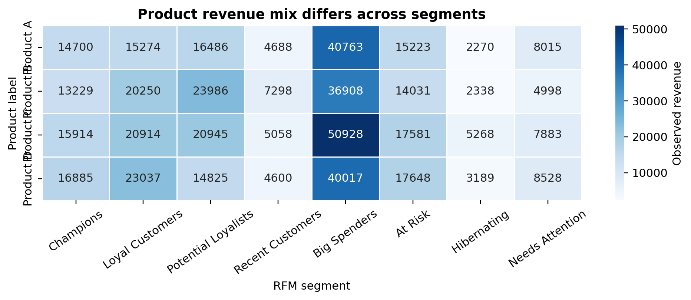
06 / GROWTH OPPORTUNITY
Product patterns can shape recommendations—but cannot prove bundles
The product labels are generic, so findings indicate where to investigate rather than why customers buy.
OBSERVED SIGNAL
Product C leads observed revenue among Big Spenders (50,928).
WHAT WE CAN'T CLAIM
No orders contain multiple distinct product labels; basket association rules cannot be calculated from this file.
NEXT STEP
Test recommendations as hypotheses and measure conversion / incremental revenue.
RFM Segmentation & Customer Insight Analysis
08

Slide 9
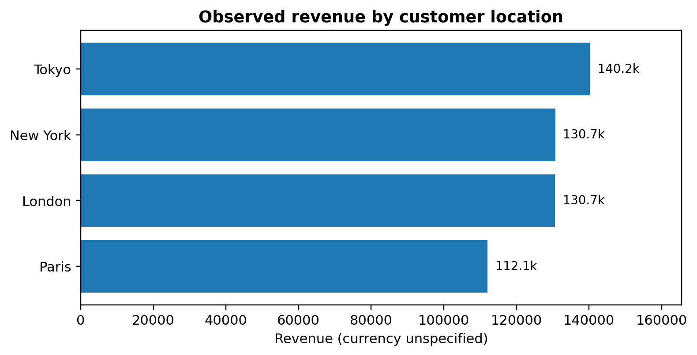
06 / GROWTH OPPORTUNITY
Geography helps prioritise tests—not explain customer behaviour
Compare total revenue with customer count and average revenue; avoid assuming location causes the difference.
How to act on this
• Localise messaging only where the segment/product mix supports it.
• Run a small campaign or holdout test before scaling.
• Compare conversion and revenue per customer—not just total sales.
Customer location is assigned from the most frequently observed transaction location.
RFM Segmentation & Customer Insight Analysis
09

Slide 10
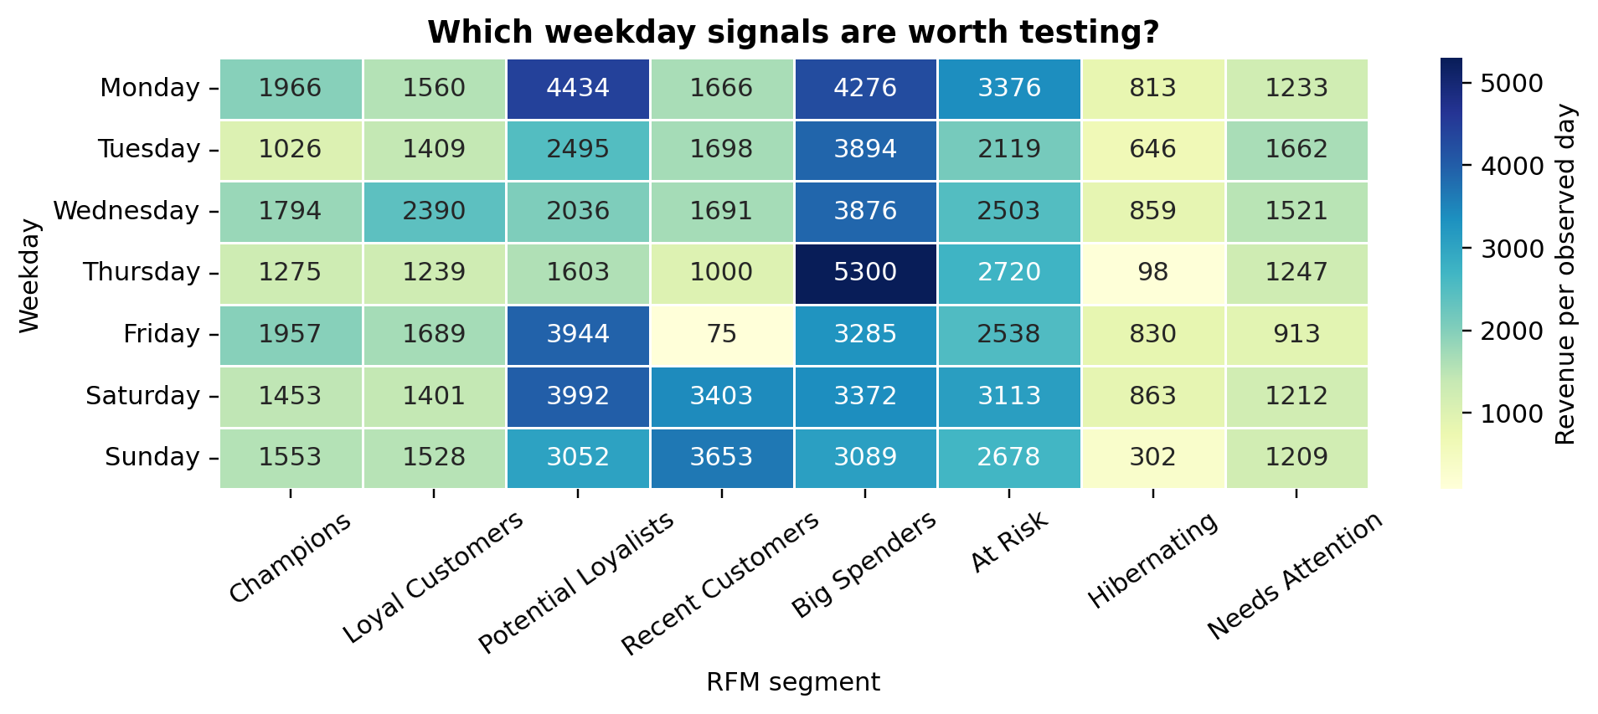
07 / WHEN TO ENGAGE
Timing differences suggest experiments, not a calendar rule
Daily revenue is normalised by observed active dates to reduce distortion from unequal coverage.
Use peaks as test ideas
• Champions: Monday
• Loyal Customers: Wednesday
• Potential Loyalists: Monday
• Big Spenders: Thursday
Short observation window; compare results over a longer period before changing send times or staffing.
RFM Segmentation & Customer Insight Analysis
10

Slide 11
08 / RECOMMENDATIONS
A practical 30-day action plan
Move from descriptive insight to controlled tests with clear success measures.
1
WEEK 1
Prioritise
Rank At Risk / Hibernating customers by historical spend and recency; define eligible cohorts.
2
WEEK 2
Launch tests
Test personalised win-back vs. standard messaging; keep a holdout group.
3
WEEK 3
Grow value
Test segment-specific product recommendations and campaign timing.
4
WEEK 4
Evaluate
Compare repeat purchase, conversion, incremental revenue and cost per reactivated customer.
Success means incremental lift versus a control group—not simply clicks or revenue after a campaign.
RFM Segmentation & Customer Insight Analysis
11

Slide 12
09 / LIMITATIONS & NEXT DATA
The next dataset should close the biggest decision gaps
No returns / feedback
One product label per order
~2 months of history
Satisfaction and dissatisfaction are not directly measurable.
Cannot infer products bought together.
Annual seasonality and long-term churn are not established.
COLLECT
COLLECT
COLLECT
Returns, reason codes, ratings, complaints
Order-line / basket-level product IDs
12+ months of dated transactions
Better data would let us move from descriptive segmentation toward retention measurement, product affinity and customer-experience diagnosis.
RFM Segmentation & Customer Insight Analysis
12

Slide 13
THE TAKEAWAY
Segment to prioritise.
Experiment to learn.
Measure to prove.
RFM provides a useful starting map of customer value and engagement. The next step is to test targeted actions and measure incremental impact.
RFM Segmentation & Customer Insight Analysis
13

