Slide 1

Razor Engine
(ASP .Net Core MVC)

Slide 2
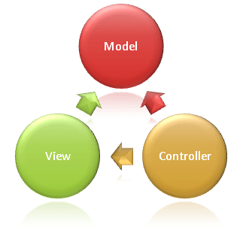
What are View’s Responsibilities?
Views are responsible for presenting content through the user interface. They use the Razor view engine to embed .NET code in HTML markup.
View Engine renders the HTML to the browser
By default ASP.Net MVC supports ASPX and the Razor View Engine
There are many more third-party view engines, like Spark, Nhaml.. Also available.

Slide 3
ASPX View Engine (Web form view engine) -
The namespace used by the ASPX View Engine is System.Web.Mvc.WebFormViewEngine
<ul> <%foreach (var item in Products) { %> <% if (item.IsInStock) { %> <p><%=item.ProductName%> is in stock</p> <% } else { %> <p><%=item.ProductName%> is not in stock</p> <% } %> <%} %> </ul>

Slide 4
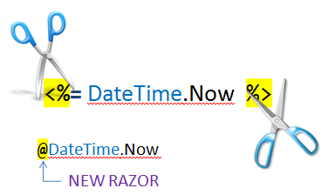
https://www.dotnettricks.com/learn/mvc/difference-between-razor-view-engine-and-aspx-view-engine

Slide 5
Razor View Engine -
The namespace used by the Razor View Engine is System.Web.Razor
<ul> @foreach (var item in Products) { @if(item.IsinStock) { @item.ProductName is in stock } else { @item.ProductName is in stock } } </ul>

Slide 6
What are
Layout,
_ViewStart,
RenderBody,
RenderSection
https://www.tutorialsteacher.com/mvc/layout-view-in-asp.net-mvc

Slide 7
HTML Helpers
https://dzone.com/articles/working-with-built-in-html-helper-classes-in-aspne

Slide 8
Ref :
https://www.c-sharpcorner.com/UploadFile/ff2f08/aspx-view-engine-vs-razor-view-engine/

