Slide 1

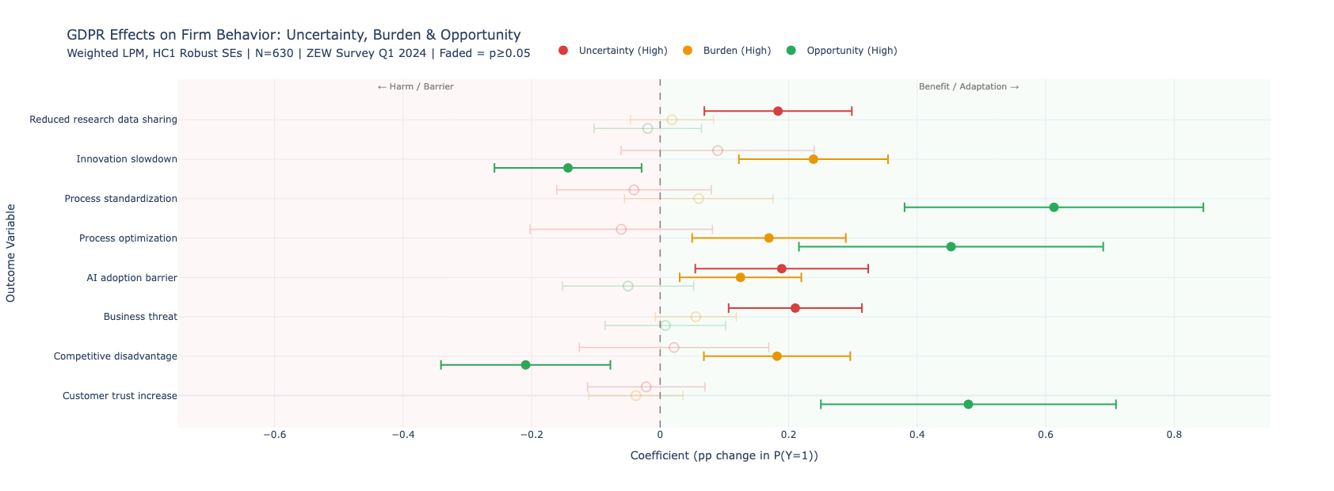
The Economics of Data Privacy: Regulatory Uncertainty and Corporate Responses to the EU GDPR
Hariaksha Gunda*, Dr. Martin Kesternich, Dr. Michael Price
Department of Economics, Finance, and Legal Studies
QUESTION AND SIGNIFICANCE
DATA AND METHODS
LITERATURE AND CONTEXT
How do regulatory uncertainty and compliance burden — arising from the EU General Data Protection Regulation (GDPR) — shape firm behavior, specifically with respect to AI adoption, research data sharing, and perceptions of competitive disadvantage?
Why It Matters:
GDPR (effective May 2018) is the world's most consequential data privacy law, affecting millions of firms across the EU and beyond
Despite 6+ years of enforcement, many firms still report significant uncertainty about how to interpret and apply its provisions
Regulatory ambiguity may generate unintended costs: suppressed innovation, reduced academic-industry data collaboration, and barriers to AI deployment
Understanding which firms bear these costs — and which convert compliance into competitive advantage — has direct implications for EU digital policy and competitiveness
Outcome variables (8 binary outcomes):
AI adoption barrier (a_ki)
Innovation slowdown (a_inno)
Research data sharing reduction (a_forsch)
Process standardization (a_stand)
Process optimization (a_proz)
Business threat perception (a_gefahr)
Competitive disadvantage (a_nachteil)
Customer trust increase (a_vertrau)
Key Regressors: Uncertainty, Compliance burden, Opportunity orientation
Controls: firm size, sector, data usage importance, customer privacy, sensitivity, data sharing behavior
Model: Weighted Linear Probability Model (LPM), HC1 robust SEs
GDPR research largely focuses on legal compliance obligations and enforcement (Baldwin et al., 2011). Economic studies document reduced venture investment post-GDPR (Jia et al., 2021) and declines in web traffic and e-commerce revenue (Goldberg et al., 2022), while others find GDPR increased data input costs by 22% on average, with larger firms less affected (Demirer et al., 2024). Regulatory uncertainty is theorized to produce overcompliance or avoidance behaviors as firms adopt precautionary interpretations under ambiguous rules (Baldwin et al., 2011).
Yet empirical evidence on how uncertainty specifically shapes behavioral firm responses, separate from burden, remains limited.
This study fills that gap using a cross-sectional survey of 637 German firms (ZEW), isolating independent effects of uncertainty, burden, and opportunity orientation across behavioral outcomes.
Data Summary
Sample: | 637 German firms
Source: | ZEW Business Survey, Q1 2024
Sectors: | ICT, Knowledge-intensive services, Manufacturing
Size: | 5 to 1,000+ employees
Weights | Analytic survey weights (WLS)
FINDINGS
THEORETICAL FRAMEWORK
FUTURE RESEARCH
Regulatory Uncertainty
↓
Legal Ambiguity → Avoidance Behavior
↓
Reduced AI Adoption and Data Sharing
This study's cross-sectional design limits causal identification. Three directions would strengthen and extend these findings:
1. Panel Data & Causal Identification Track the same firms over time to establish whether uncertainty precedes behavioral changes. A difference-in-differences design exploiting variation in national supervisory authority enforcement intensity across EU member states could isolate causal effects.
2. Cross-Country Comparison Germany may not be representative of the broader EU. Comparing firm responses across high-enforcement (Germany, France) vs. low-enforcement (Eastern Europe) jurisdictions would test whether regulatory culture moderates the uncertainty-behavior relationship.
3. Disaggregating Uncertainty This study measures uncertainty as a single index. Future work should distinguish between interpretive uncertainty (what does the law require?) and enforcement uncertainty (will we be penalized?) — these likely produce different behavioral responses and require different policy remedies.
Policy Implication: Results suggest that clearer regulatory guidance — not just stricter enforcement — is the most direct lever for reducing GDPR's unintended innovation costs.
Compliance Burden
↓
Cost Pressure → Innovation Constraint
Opportunity Orientation ↓ Strategic Framing à Competitive Gain
REFERENCES
[1] Baldwin, Robert, Martin Cave, and Martin Lodge. Understanding regulation: theory, strategy, and practice. Oxford university press, 2011.
[2] Demirer, M., Hernández, D. J. J., Li, D., & Peng, S. (2024). Data, privacy laws and firm production: Evidence from the GDPR (No. w32146). National Bureau of Economic Research.
[3] Goldberg, Samuel G., Garrett A. Johnson, and Scott K. Shriver. "Regulating privacy online: An economic evaluation of the GDPR." American Economic Journal: Economic Policy 16, no. 1 (2024): 325-358.
[4] Jia, Jian, Ginger Zhe Jin, and Liad Wagman. "The short-run effects of the general data protection regulation on technology venture investment." Marketing Science 40, no. 4 (2021): 661-684.
Uncertainty
Drives legal paralysis
Reduces AI adoption
Reduces data sharing
Burden
Suppresses AI and innovation
Adds perceived competitive disadvantage for EU firms
Opportunity
Converts GDPR into process improvements and customer trust gains

