Slide 1

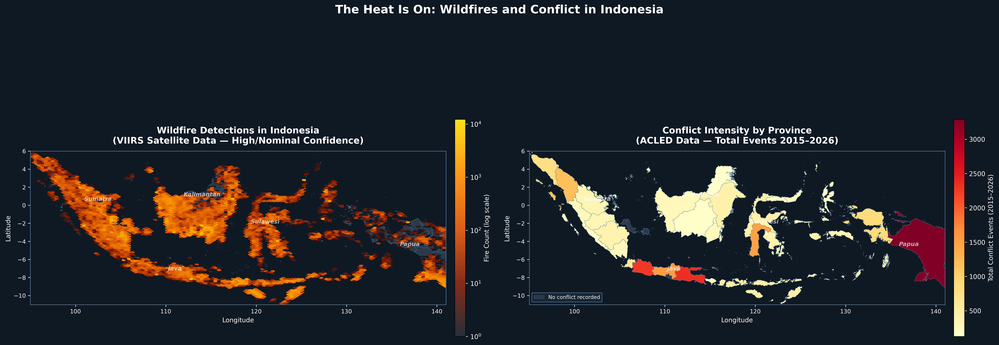
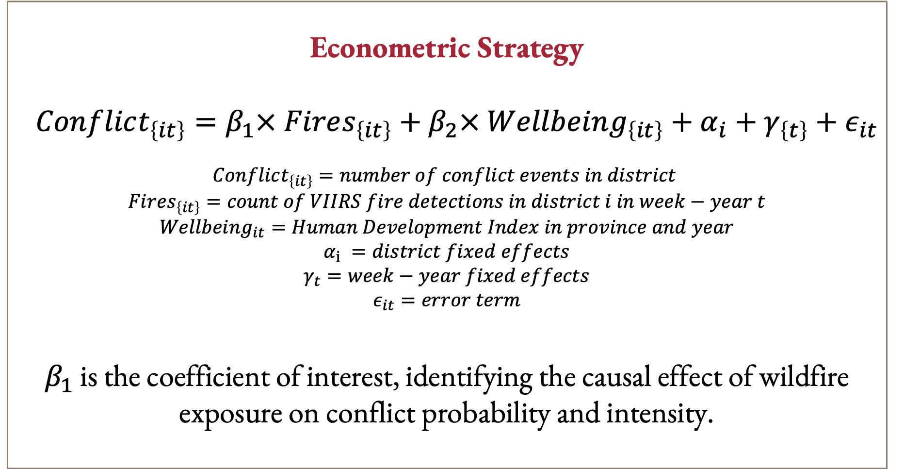
Causal Impacts of Wildfires on Conflict Probability and Intensity in Indonesia:
Hariaksha Gunda*, Dr. Michael Price
Department of Economics, Finance, and Legal Studies
QUESTION AND SIGNIFICANCE
DATA AND METHODS
STUDY AREA
Does wildfire exposure causally increase the probability and intensity of local conflict in Indonesia?
Indonesia's peatlands are among the most fire-prone landscapes on Earth, with large-scale burning events occurring regularly since the 1990s. Fires destroy agricultural livelihoods, displace communities, and degrade natural resources that rural populations depend on for survival. At the same time, Indonesia has a well-documented history of violent conflict tied to land disputes, resource scarcity, and displacement of indigenous communities by corporate agricultural expansion.
Despite this, the causal link between wildfire shocks and conflict remains understudied. Existing research documents co-occurrence of fires and social unrest, but stops short of establishing causality — leaving a critical gap for policymakers designing climate adaptation and conflict-prevention strategies. This study addresses that gap by exploiting spatiotemporal variation in wildfire exposure across Indonesian districts to estimate its effect on conflict probability and intensity, using ACLED conflict data and satellite-derived fire records.
Wildfire Data | Conflict Data
NASA VIIRS MODIS satellite detections | ACLED georeferenced conflict events
Nov 2000 – Feb 2026 | 2015 – 2026
Point-level fire detections → aggregated to district-month | Weekly events → aggregated to district-month
Confidence filter: high/nominal only | Event types: battles, riots, Violence Against Civilians, protests
Start
Econometric Strategy
$$Conflict_{\left\{it\right\}}=β_{1}× Fires_{\left\{it\right\}}+β_{2}× Wellbeing_{\left\{it\right\}}+α_{i}+γ_{\left\{t\right\}}+ε_{it}$$
$$Conflict_{\left\{it\right\}}=number of conflict events in district$$
$$Fires_{\left\{it\right\}}=count of VIIRS fire detections in district i in week−year t$$
$$Wellbeing_{it}=Human Development Index in province and year$$
$$α_{i} =district fixed effects$$
$$γ_{t}=week−year fixed effects$$
$$ε_{it}=error term$$
$β_{1}$ is the coefficient of interest, identifying the causal effect of wildfire exposure on conflict probability and intensity.
Limitations
We assume that fire timing is exogenous or as good as random conditional on fixed effects
However, unobserved shocks and could bias results.
Future work using an instrumental variables approach will mitigate this limitation.
FUTURE STEPS
FINDINGS
Instrumental Variable Approach — Implement wind patterns as an instrument for wildfire exposure, exploiting exogenous variation in fire smoke dispersal to strengthen causal identification
Mechanism identification — Subsequent analysis will disentangle whether conflict is driven primarily by crop loss, displacement, or competition over remaining resources
Heterogeneity by land tenure — Examining conflict responses across formal vs. informal land tenure regions, particularly in palm oil and pulpwood concession areas, will clarify the role of institutional context
Policy evaluation — Future research will exploit Indonesia's Peatland Restoration Agency (BRG) interventions as natural experiments to test whether fire-prevention policies also reduce conflict risk
LITERATURE AND CONTEXT
Climate Shocks and Conflict Burke et al. (2009), Dell et al. (2012), and Hsiang et al. (2013) collectively establish that climatic shocks — including temperature increases and extreme weather events — significantly raise civil conflict incidence, reduce economic output, and destabilize political institutions across diverse global contexts.
Resource Scarcity & Violence Homer-Dixon (1994) argues that environmental scarcity generates conflict through livelihood disruption and group grievance — a framework directly applicable to rural Indonesia, where agricultural dependence is high and customary land rights are frequently contested by corporate concession holders.
Indonesia-Specific Context Fires in Indonesia are driven by El Niño-induced drought, illegal land clearing for palm oil, and drainage of carbon-rich peatlands. Burgess et al. (2012) and Balboni et al. (2025) show that political incentives and weak property rights enforcement make fire risk in the region a deeply institutional phenomenon.
Research Gap While the literature addresses climate-conflict links and Indonesian fire dynamics, no study directly estimates causal effects of wildfire exposure on conflict outcomes at the district level in Indonesia.
REFERENCES
[1] Balboni, C., Burgess, R., & Olken, B. A. (2025). The origins and control of forest fires in the tropics. Review of Economic Studies.
[2] Burgess, R., Hansen, M., Olken, B. A., Potapov, P., & Sieber, S. (2012). The political economy of deforestation in the tropics. The Quarterly Journal of Economics, 127(4), 1707-1754.
[3] Homer-Dixon, T. F. (1994). Environmental scarcities and violent conflict: evidence from cases. International Security, 19(1), 5-40.
[4] Burke, M. B., Miguel, E., Satyanath, S., Dykema, J. A., & Lobell, D. B. (2009). Warming increases the risk of civil war in Africa. Proceedings of the National Academy of Sciences, 106(49), 20670-20674.
[5] Hsiang, S. M., Burke, M., & Miguel, E. (2013). Quantifying the influence of climate on human conflict. Science, 341(6151), 1235367.
[6] Dell, M., Jones, B. F., & Olken, B. A. (2012). Temperature shocks and economic growth: Evidence from the last half century. American Economic Journal: Macroeconomics, 4(3), 66-95.

