Slide 1

Machine Learning in Health Care
- Harichandana Gonuguntla

Slide 2
What is Machine Learning?
1
Definition
2
Importance in Health Care
Machine learning is a type of artificial intelligence that enables computers to learn and improve their performance without being explicitly programmed.
Machine learning can help transform the health care industry by unlocking insights from large amounts of data, identifying patterns, and predicting outcomes.

Slide 3
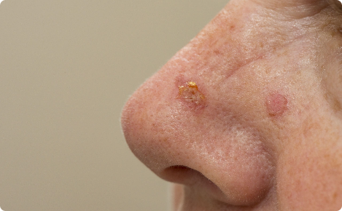

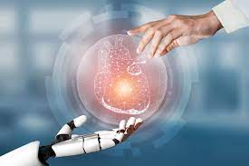

Applications of Machine Learning in Health Care
Medical Imaging
Patient Monitoring
Machine learning can be used to analyze medical images, making it easier for doctors to detect diseases like skin cancer.
Machine learning can help doctors monitor patients remotely, providing more personalized care and improved outcomes.
Disease Outbreaks
Machine learning can help forecast and prevent disease outbreaks, like the flu or COVID-19.

Slide 4

Key Health Care Trends
Key Health Care Trends
Data Explosion
Cloud Computing
Investor Excitement
Consumerization

Slide 5

Benefits and Challenges of Machine Learning in Health Care
1
Benefits
Machine learning can improve diagnosis and treatment, reduce errors, and ultimately save lives.
Challenges
2
Data security and privacy, lack of interoperability, and ethical considerations are just a few of the challenges that need to be addressed.
3
Future Implications
Despite the challenges, the potential benefits of machine learning in health care are enormous. Advances in technology and data collection will continue to drive innovation in this field.

Slide 6

Logistic Regression in Health Care
Basics
In Health Care
Examples
Logistic regression is a statistical method used to predict a binary outcome based on a set of input variables.
Logistic regression can be used to predict the likelihood of a patient developing a particular disease based on demographic, lifestyle, and medical data.
Logistic regression has been used to predict the likelihood of readmission to the hospital after surgery, and to identify patients at risk of developing sepsis.

Slide 7
Interpretation of Model Output:
Features with positive coefficients (e.g., max systolic BP, max temperature, sd mean BP) are associated with an increase in the log-odds of mortality.
Features with negative coefficients (e.g., min diastolic BP, min glucose, min heart rate) are associated with a decrease in the log-odds of mortality.

Slide 8
Accuracy:
Common evaluation metric in machine learning
Used to measure the overall performance of a classification model
Number of correct predictions / Total number of predictions

Slide 9


Conclusion
Recap of Benefits
Future Implications
Machine learning, including logistic regression, has the potential to improve health care outcomes by predicting and preventing diseases, reducing errors, and improving patient care.
Continued research and innovation will lead to even greater possibilities for machine learning in health care.

