Slide 1
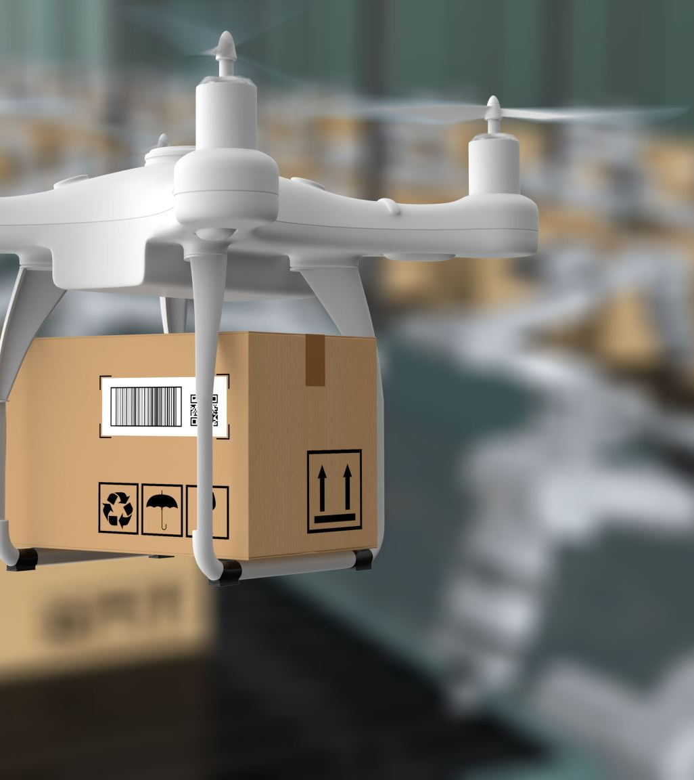
Data Engineering Pipeline for Delivery Prediction Service using AI/ML

Slide 2
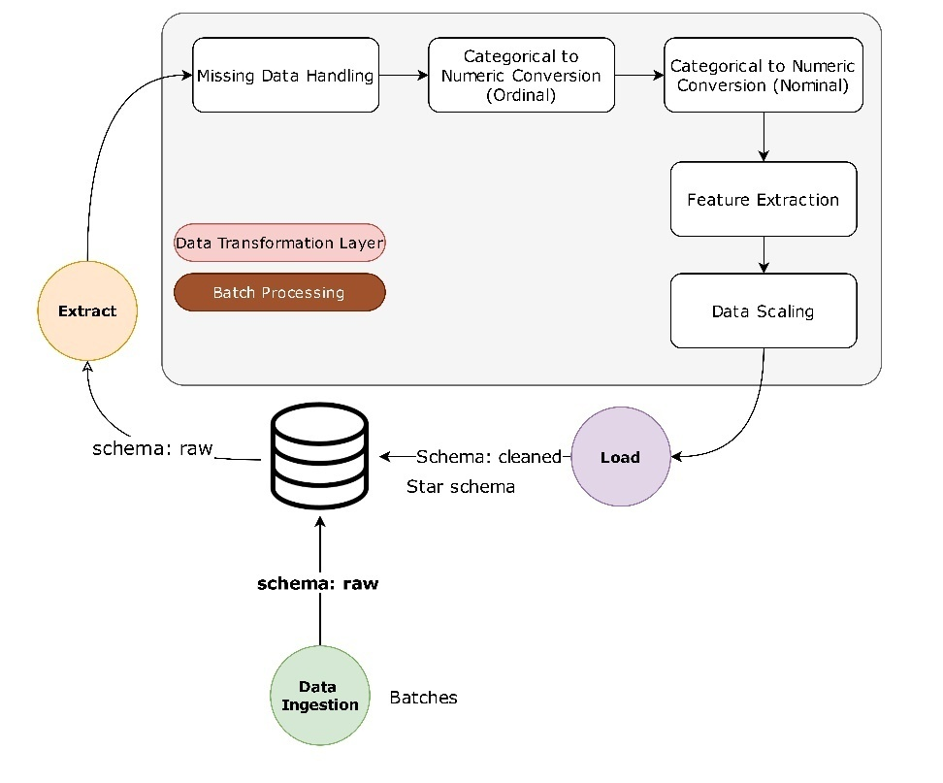
Data Flow Architecture
1. Key Stages of the Data Flow
The pipeline is well structured to manage and deliver the data records safely.
The initial aim is to ensure the data integrity , usability and streamlined query. 2. Architecture Diagram
Input Source: PostgreSQL (Raw Delivery Data)
Transformation: Missing data handling, categorical encoding, feature extraction, Data scaling.
Final Storage: PostgreSQL (Normalized Schema) or Optimized Database Tables
Processing Mode: Scheduled Batch Jobs
Technology Utilized: SQL, Python (Pandas), PostgreSQL
Notes:
This slide introduces the structured data pipeline for managing delivery dataset records.
The goal is to ensure data integrity, usability, and efficient querying.A well-structured pipeline allows for automated ingestion, transformation, and optimized storage.
This ensures that data is ready for analytics, decision-making, and reporting.
Data is extracted from PostgreSQL as raw delivery records.
The transformation stage includes missing data handling, categorical encoding, and anomaly filtering.
The final storage is in a normalized PostgreSQL schema for structured querying.The pipeline follows a batch processing approach, where updates happen periodically.SQL and Python (Pandas) are used for transformations and data validation

Slide 3
Data Flow Architecture
Justification for Processing Approach
Scheduled Batch Jobs: Ideal for structured ingestion at defined intervals..
Rationale: At the initial stage the data set contains the periodic static updates.
Future Enhancements: Processing the data from Transitioning to incremental for better effiency.
Choice of Storage Format
Optimized Database Tables: This allows for quick querying and relational integrity.
PostgreSQL Normalization: This efficiently organizes data for analytics.
Why This Choice? Why This Choice? Unlike flat files (CSV, Parquet), tables offer indexing, joins, and security.
Notes:
This slide explains why batch processing is used instead of real-time ingestion.
Batch Processing is suitable for scheduled ingestion at regular intervals. Since the dataset consists of static periodic updates, real-time ingestion is unnecessary.
Future Enhancements could include incremental data processing, where only new or changed records are processed instead of reloading all data.
The final processed data is stored in optimized database tables.
PostgreSQL's normalization ensures efficient analytics and relational integrity.
Unlike CSV or Parquet, databases provide faster querying, indexing, and security.
Structured storage allows for efficient joins, indexing, and retrieval performance.

Slide 4
Ensuring Data Integrity
1. Common Data Challenges
Missing Data: Checking the missing values in the key fields such as traffic level and Distance.
Duplicate Records: The duplicate records can affect the analytical accuracy.
Extreme Values: The outliers present in the distance metrics will impact the delivery time calculation .
Categorical Discrepancies: Categorical values in fields like vehicle_type and order_type and more
2. Validation & Quality Measures
Missing Fields Imputation: Mean/mode imputation and domain-specific heuristics.
Duplicate Records Elimination: Identification of duplicate records with the help of primary keys.
Outlier Handling: By using statically modeling outliers can identified outliers Automatically
Field Categorization: Normalization of the various fields that store the same type of information in every record.
3. Schema Management & Data Monitoring
Automated schema validation through integrity rules with DB constraints.
Continuous Monitoring for Data Drift: Periodic checks across field distribution.
Alerts-based Validation: Real-time anomaly detection by using SQL trigger.
Notes:
This slide outlines the key data quality challenges encountered in the dataset.
Missing values in key fields (e.g., traffic_level, weather_description) can affect analysis.
Duplicate records introduce redundancy and bias results.Outliers in distance metrics can skew delivery time predictions.Categorical discrepancies in fields like vehicle_type and order_type can affect classification models.Addressing these issues ensures data reliability and consistency.
Strategies for improving data quality.
Filling missing fields: Imputation techniques (mean/mode) ensure completeness.
Removing duplicates: Primary key-based filtering eliminates redundant records.Handling outliers.Categorical standardization: Formatting corrections ensure consistent classification.These measures ensure clean, reliable, and structured data for processing.
Maintaining schema integrity is critical for structured storage.
Automated schema checks prevent breaking changes.
Continuous monitoring for data drift detects shifting trends.SQL triggers create real-time alerts for unexpected anomalies.

Slide 5
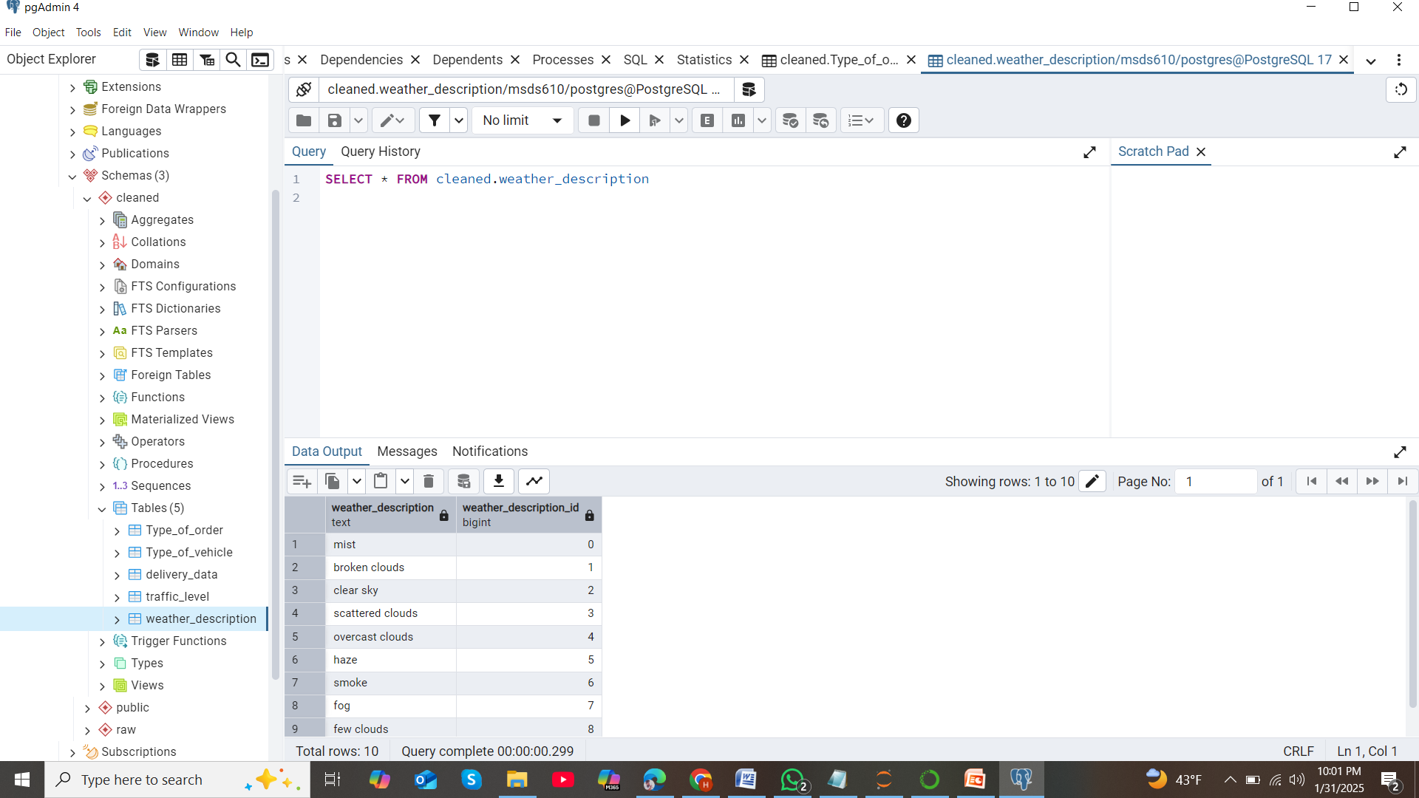
Pipeline Implementation

