Slide 1
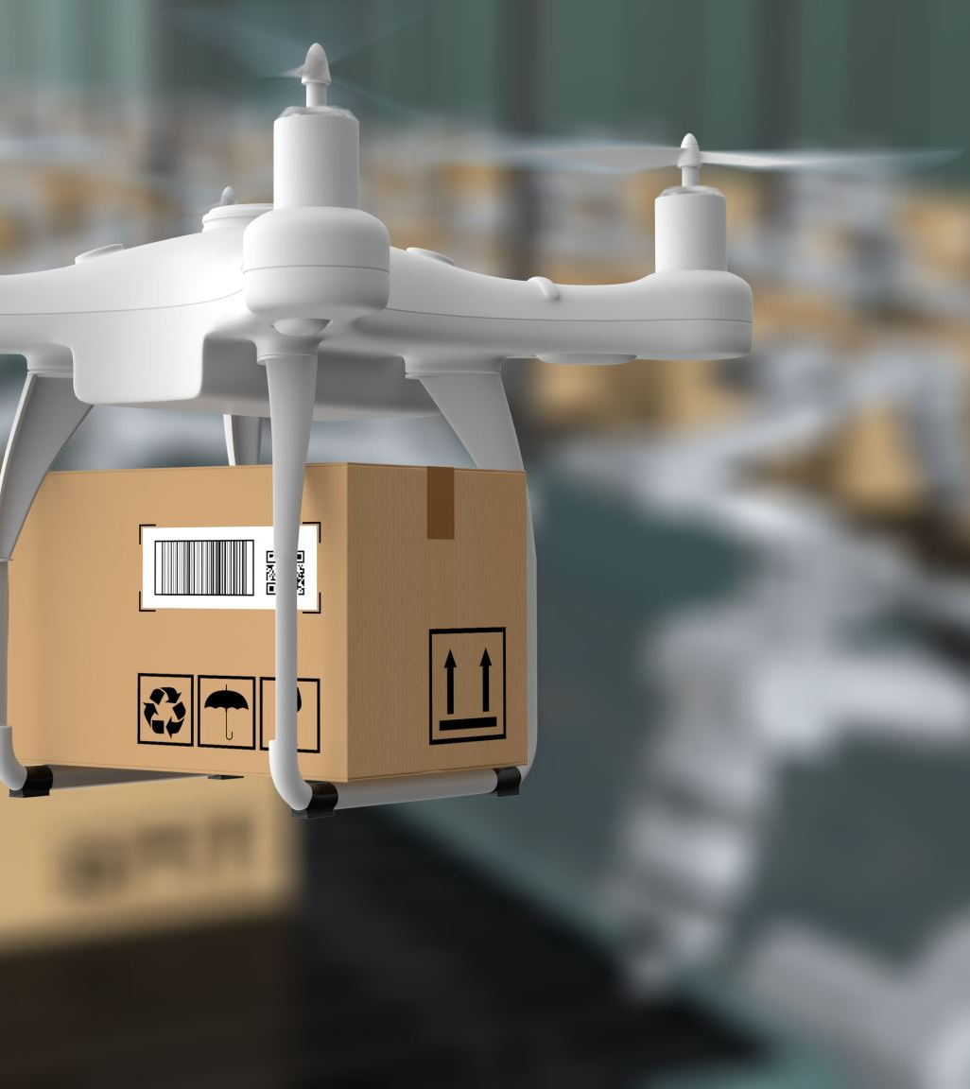
"Food Time Delivery Dataset: Analyzing Factors Influencing Delivery Efficiency"

Slide 2
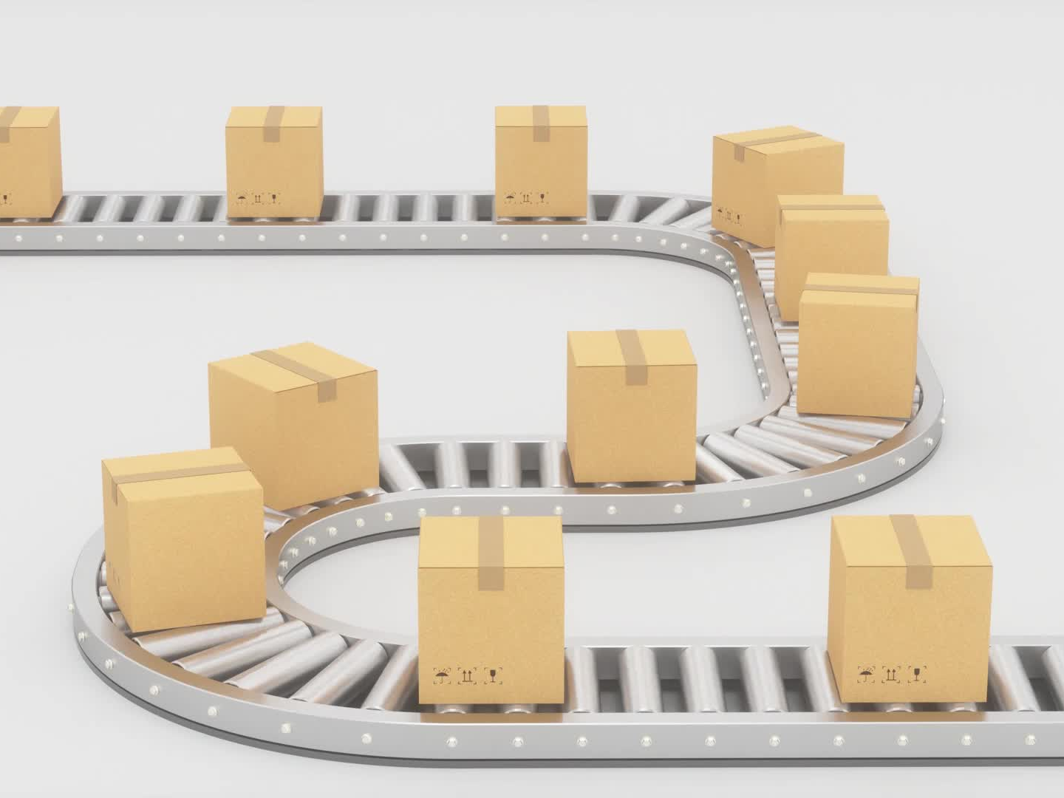
Description of Dataset
The "Food Time Delivery Dataset" describes the factors which are effecting the delivery efficiency which includes all the details such restaurants and delivery locations, delivery agent details , weather conditions, distance and traffic conditions so the data set explore the factors effecting on-time delivery and overall efficiency.
Source:
https://www.kaggle.com/datasets/gautamdeora7/food-delivery-time-a-multi-factor-dataset/data

Slide 3
Overview of Dataset
 | Coloumn Name | Data Type | Classfication | Descriptions
0 | ID | Object | categorial | Unique ID for each record.
1 | Delivery_person_ID | object | Categorical | ID of the delivery person.
2 | Delivery_person_Age | Float64 | Continuous | Age of the delivery person.
3 | Delivery_person_Ratings | Float64 | Continuous | Ratings given to the delivery person.
4 | Restaurant_latitude | Float64 | Continuous | Latitude of the restaurant.
5 | Restaurant_longitude | Float64 | Continuous | Longitude of the restaurant.
6 | Delivery_location_latitude | Float64 | Continuous | Latitude of the Delivery.
7 | Delivery_location_longitude | float64 | Continuous | Longitude of the Delivery
8 | Type of Order | object | categorial | Type of order

Slide 4
9 | Type_of_vehicle | object | Categorical | Type of vehicle used for delivery.
10 | temperature | float64 | Continuous | Temperature at the time of delivery.
11 | humidity | float64 | Continuous | Humidity at the time of delivery.
12 | precipitation | float64 | Continuous | Precipitation level at the time of delivery.
13 | weather_description | object | Categorical | Description of the weather (e.g., Clear, Rainy).
14 | Traffic_Level | object | Categorical | Traffic level during the delivery (e.g., Low, ...
15 | Distance (km) | float64 | Continuous | Distance of the delivery route in kilometers.
16 | TARGET | object | Categorical | Target variable indicating the status or outco...

Slide 5
The data set contains categorical and continuous data
The dataset is having different attributes which contains different details for the food delivery process
It has an unique id along with delivery agent id and his details such as age and ratings for the agent also the latitude and longitude of the delivery agent and restaurants and type of the order and the type of vehicle like 2 or 4 wheeler also it contains the detailed information of temperature weather conditions like humidity additionally it has the traffic details and distance of the delivery

Slide 6

The data set contains 17 column each column represent the different variable in dataset
The dataset having 11 float type data and 7 object type data
memory usage is 1.4+mb
Classification: there are 11 continuous data and 7 categorial data

Slide 7
Well Defined Problem on MLS
Our objective is to develop a machine learning model that can predict on-time or delayed food delivery using critical factors from the dataset that strongly correlate with late delivery, which includes traffic conditions, weather conditions: temperature, humidity, precipitation; delivery agent data: age, ratings, vehicle type, and distance from the restaurant to the drop-off location.
This would thereby enable the understanding of such variables to influence delivery performance, thus optimizing logistic operations to enable customer satisfaction with better time estimates of delivery. The model will enable the companies to optimize resource utilization, adjust the route to be covered considering the traffic and weather conditions, and ensure operations are more efficient.
Our feature selection approach will be informed by both univariate analysis-such as chi-square tests for categorical variables and t-tests for numerical variables-to identify single features significantly associated with delivery delays-and multivariate analysis, including recursive feature elimination, so as to take into account interactions and redundancy among features. This process will help us in the selection of the most important factors that will lead to a more accurate model in predicting on-time or delayed deliveries.

Slide 8

A sketch MLS
Data Collection
collect the related data like delivery and agent details and restaurant details, location, vehicle, distance, traffic and whether details
Data preprocessing
Preprocess the data such as find out and handle the missing values and converting the categorial features into numeric features outlier detections and drop the duplicate values
Model selecting
Type of the problem, classifications such as logical regression and random forecast
Model Training
Split the preprossed data into train and test data
Model Selection
Use trained models to make predictions

Slide 9
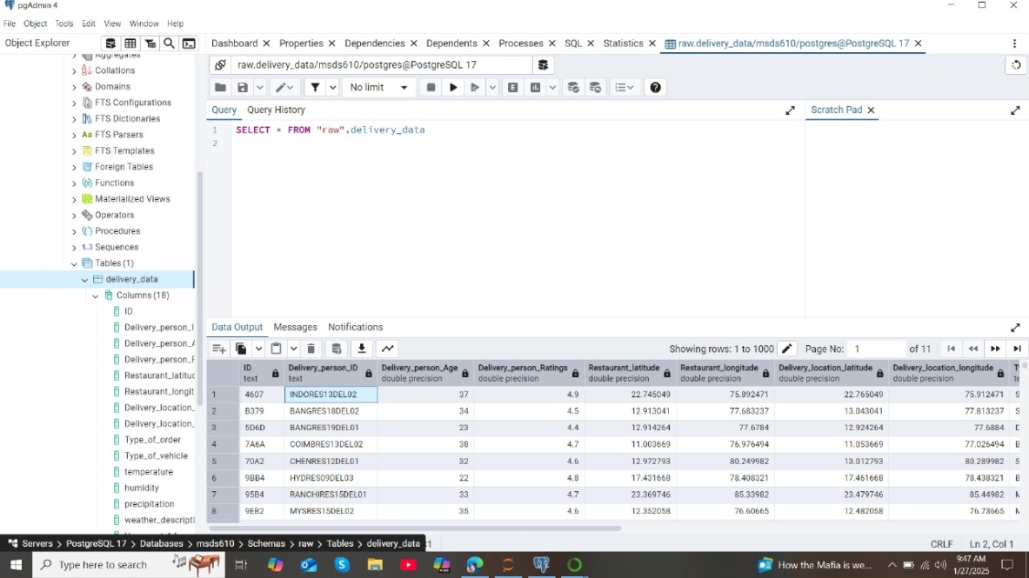
PgAdmin loading

