Slide 1
Library Management System
Harideep Reddy Boothpur (700763263)
Ooha Reddy Bollampalli (700762295 )

Slide 2
What is the purpose of the database ?
The purpose of the database is to organize, store, and manage information related to the library, such as books, members, and loan records, in a structured and efficient manner. It is needed to:
• Facilitate easy retrieval of data (e.g., searching for books or members).
• Maintain an accurate record of loans, returns, and overdue books.
• Streamline operations like book borrowing and member registration.
• Generate reports for decision-making, such as popular books or overdue statistics.

Slide 3
Who are the users and what information and functions do they need ?
Users:
1. Library Staff/Admin
• Information Needed:
• Member details, book inventory, loan details, and overdue records.
• Functions Needed:
• Add/remove books and members.
• Update book availability.
• View and manage loans, returns, and reports.
2. Members
• Information Needed:
• Available books, borrowing history, and loan status.
• Functions Needed:
• Login to their account.
• Search and reserve books.
• View borrowing history and return due dates.

Slide 4
What is the input data is available to the database ?
Books:
• Title, author, genre, publication year, availability, and unique book ID.
• Members:
• Name, email, phone number, membership ID, and password.
• Loans:
• Book ID, member ID, borrow date, return date, and loan status.
Books Table: Information about each book in the library.
• Members Table: Details about library members.
• Loans Table: Records of which member borrowed which book and when.
What kind of information should be stored in the database?

Slide 5
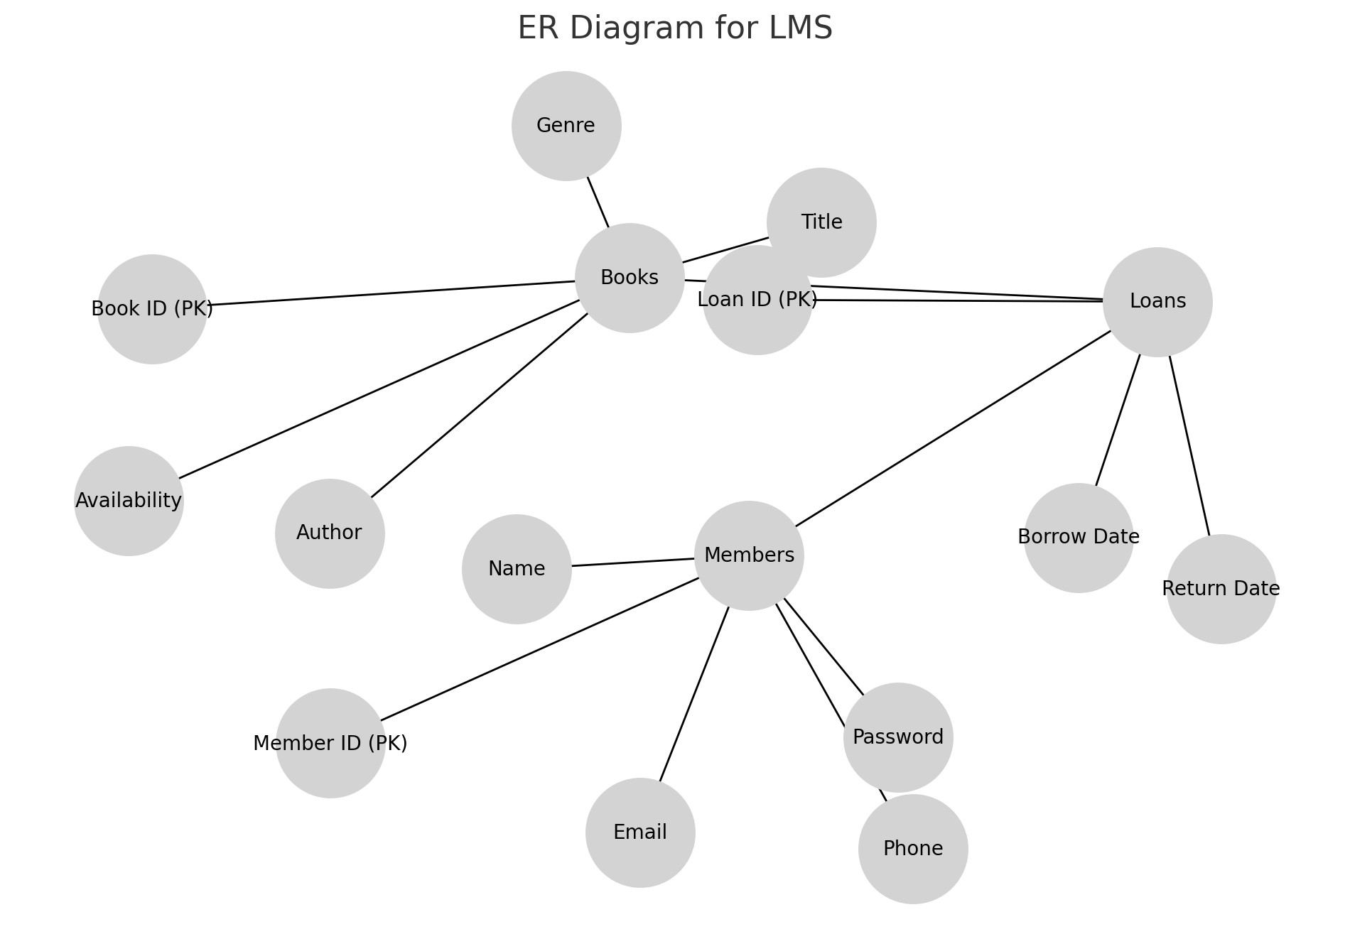
ER diagram

Slide 6
Schema Design
Schema Design
1. Books Table
• Attributes:
• BookID (Primary Key)
• Title (VARCHAR)
• Author (VARCHAR)
• Genre (VARCHAR)
• Availability (BOOLEAN)
• Attributes:
• MemberID (Primary Key)
• Name (VARCHAR)
• Email (VARCHAR, Unique)
• Phone (VARCHAR)
• Password (VARCHAR)
• Purpose: Stores details about members of the library.
3. Loans Table
• Attributes:
• LoanID (Primary Key)
• BookID (Foreign Key referencing Books(BookID))
• MemberID (Foreign Key referencing Members(MemberID))
• BorrowDate (DATE)
• ReturnDate (DATE)
• Purpose: Tracks which member has borrowed which book and for how long.
2. Loans Table
• Attributes:
• LoanID (Primary Key)
• BookID (Foreign Key referencing Books(BookID))
• MemberID (Foreign Key referencing Members(MemberID))
• BorrowDate (DATE)
• ReturnDate (DATE)
• Purpose: Tracks which member has borrowed which book and for how long.
3. Members Table
• Attributes:
• MemberID (Primary Key)
• Name (VARCHAR)
• Email (VARCHAR, Unique)
• Phone (VARCHAR)
• Password (VARCHAR)

Slide 7
Back-End Requirements
1. Database Engine:
For your Library Management System (LMS), I would recommend using MySQL as the database engine. Here’s why:
• MySQL is an open-source relational database management system (RDBMS) that supports ACID (Atomicity, Consistency, Isolation, Durability) properties and is widely used for web applications.
• Scalability and performance: MySQL can handle moderate to large datasets and supports indexing, making it ideal for applications like LMS where you need fast retrieval of books, members, and loans.
• Community support: It has a large community and robust documentation, making it easier to find solutions to problems.
• Ease of integration: MySQL integrates easily with frameworks such as Flask, which you’re using in your LMS application.

Slide 8
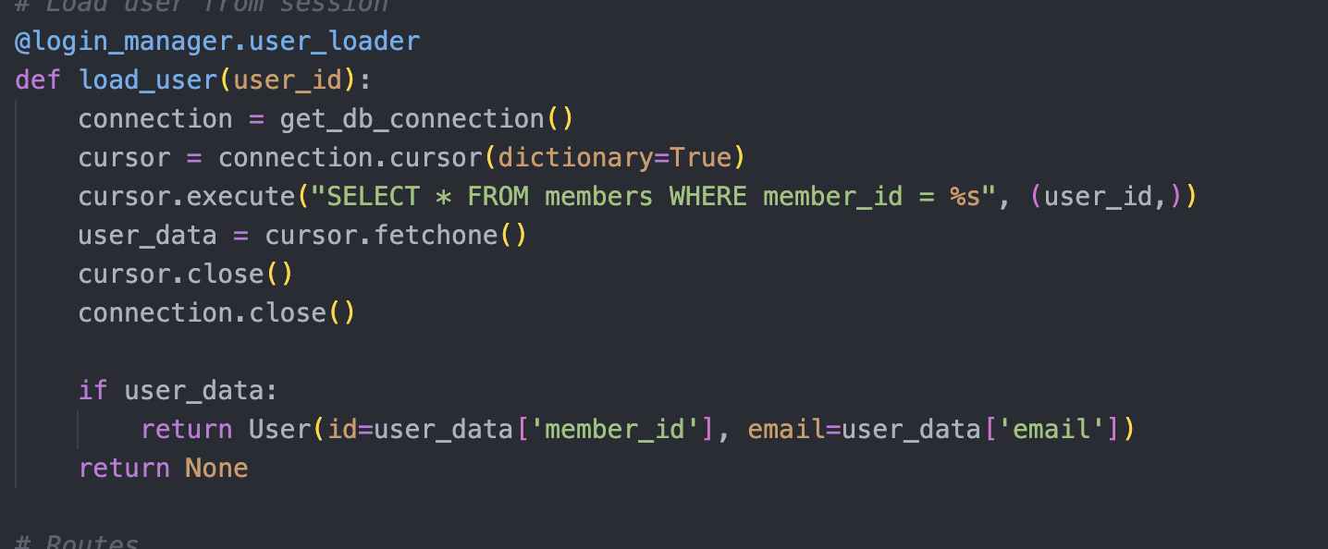
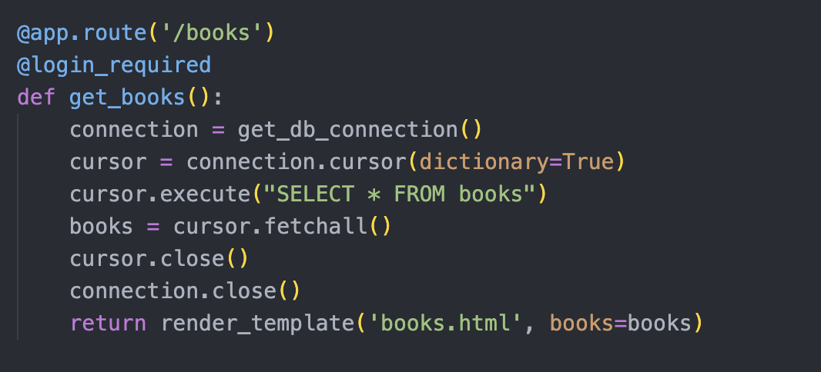
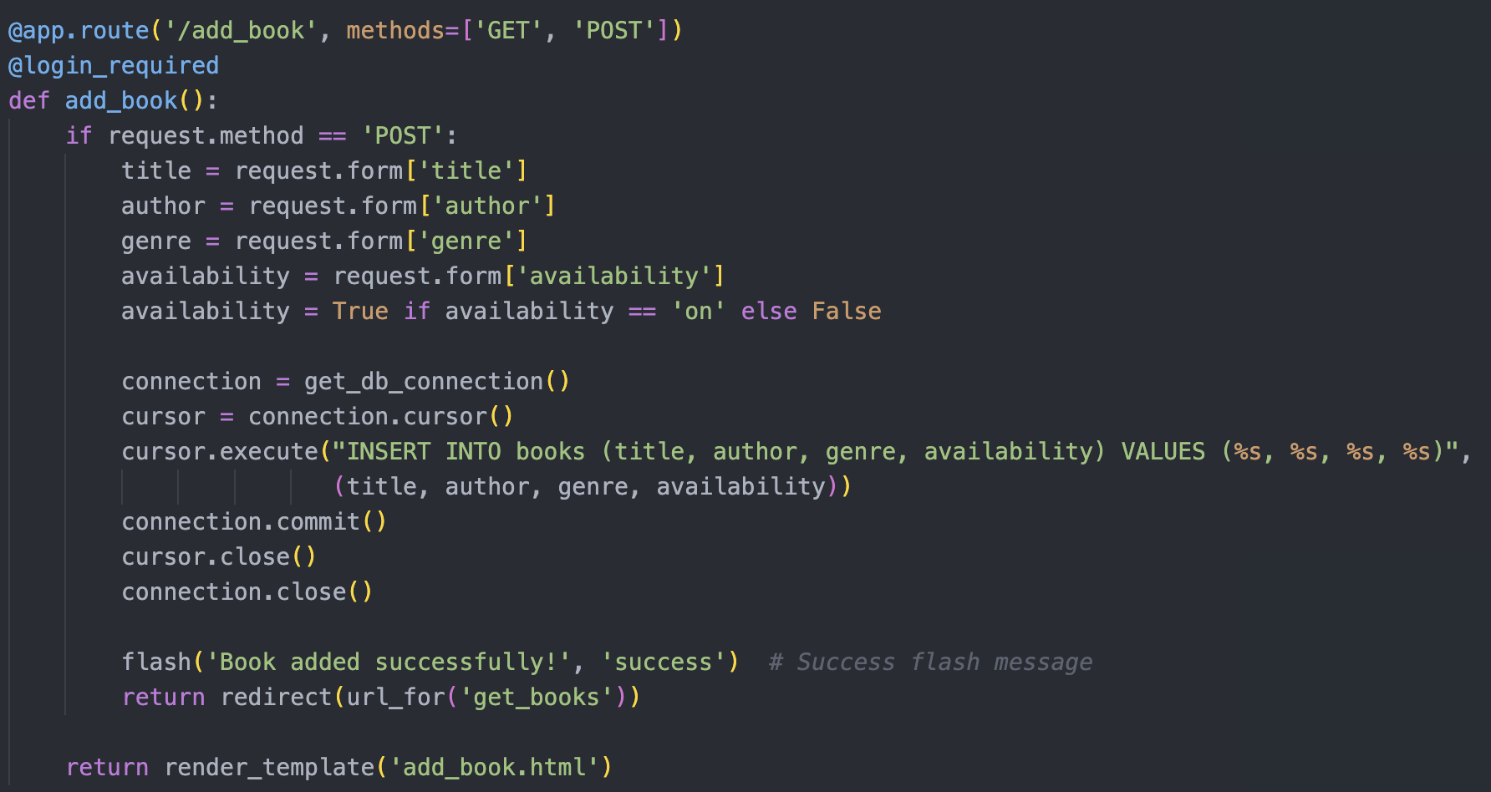
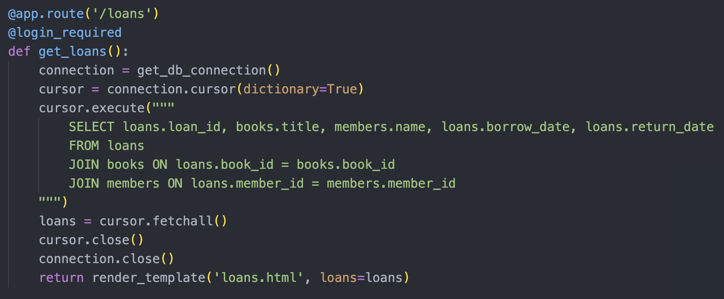
CRUD Operations

Slide 9
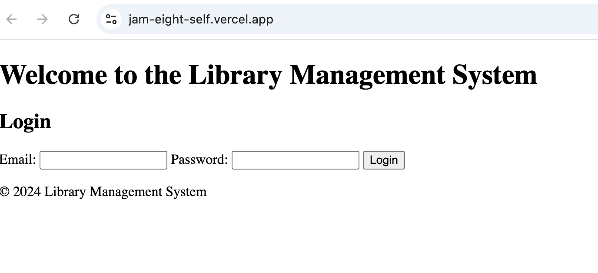
USER INTERFACE
X
Application Link
jam-eight-self.vercel.appjam-eight-self.vercel.app

Slide 10
Thank You

