Slide 1

ELDERLY FALL DETECTION SYSTEM

Slide 2

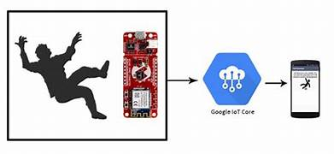
Objective
The objective of an elderly fall detection system using an ESP8266 is to monitor the movements and activities of elderly individuals to detect if they have fallen or fall in distress.
The system uses sensors and algorithms to identify potential falls and triggers alerts to caregivers or emergency services so that prompt assistance can be provided.
This helps in reducing the risks and consequences of falls in the elderly population, ensuring their safety and well-being.

Slide 3
Components
1) Esp 8266
2)Gyrometer and Accelerometer
3) Breadboard
4) Connection jumper pins
5) USB to type A connector
6) Arduino software
7) Blynk iot

Slide 4

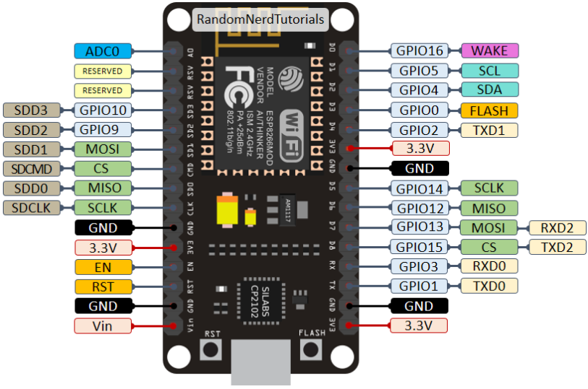
ESP 8266

Slide 5
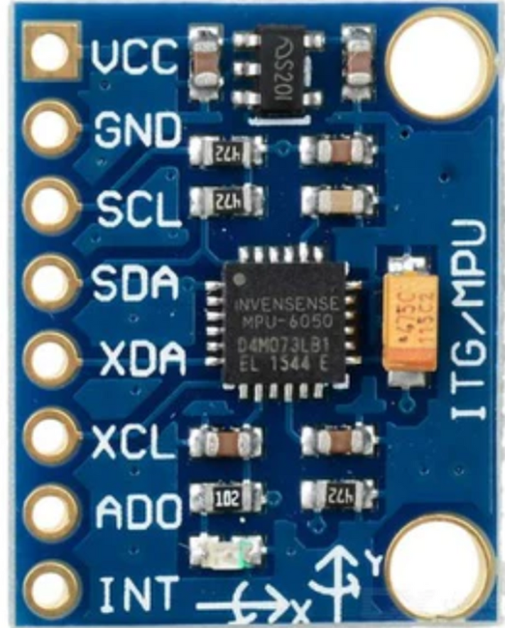
MPU
6050

Slide 6
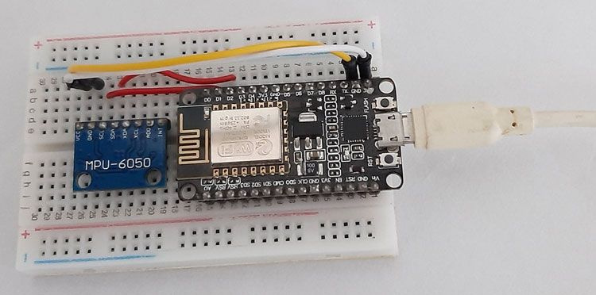
Connections

Slide 7
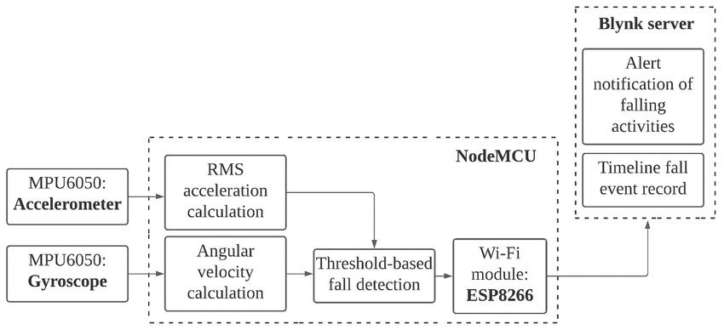
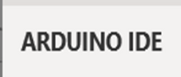
Block Diagram

Slide 8
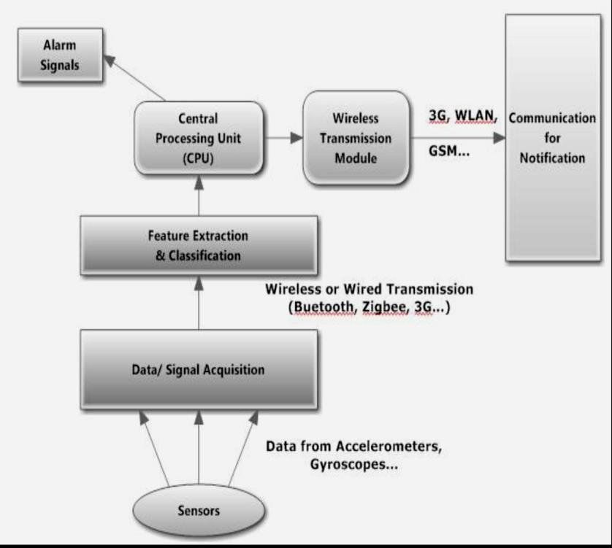
Workflow

Slide 9
Thank You

