Slide 1

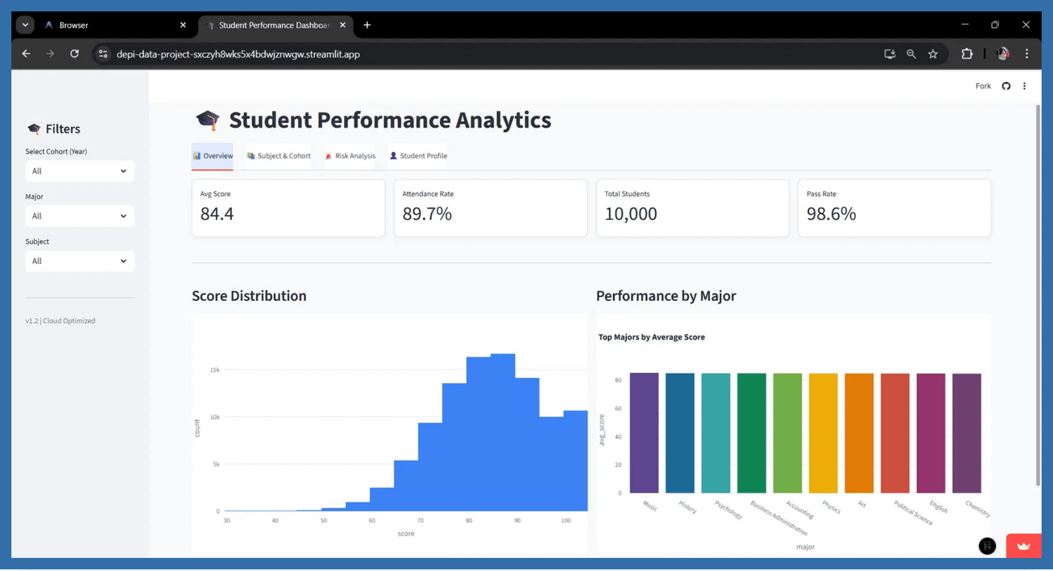
Student Performance Dashboard
Interactive Analytics for Educational Insights
Group 4 (DEPI Data Project)
November 2025
Team Members:
Abdulrahman Mustafa (Team Leader)
Malak Samir
Eman Wassem
Khaled Ehab
Ahmed Mohamed Galal Shoeib

Slide 2



Problem Statement: Bridging the Data-to-Insight Gap
The Challenge
The Solution
Educational institutions collect massive amounts of data.
A centralized, interactive dashboard built on Streamlit.
Teachers and admins struggle to find actionable insights in raw spreadsheets.
Real-time visualization of grades, attendance, and performance trends.
Identifying "at-risk" students happens too late, hindering timely intervention.
UVP: Early warning system
for students needing support, driven by a high-performance data stack.

Slide 3




Core Project Objectives: Setting the Performance Benchmark
1. Scalability
2. Performance
Process and analyze 1 Million+ student records efficiently.
Deliver insights in < 5 seconds using high-speed, in-memory analytics.
3. Usability
4. Accessibility
Create an intuitive interface for non-technical users, primarily teachers and administrators.
Ensure data is accessible via a robust, web-based platform (Streamlit Cloud).

Slide 4




Architecture & Tech Stack: Building for Scale and Speed
Data Workflow Pipeline
Raw Data (CSV)
ETL Pipeline (Pandas)
Parquet Storage
DuckDB (Star Schema)
Streamlit Dashboard
➡️
➡️
➡️
➡️
Core Languages & Databases
Python
– Core logic and scripting
DuckDB
– High-performance in-memory SQL
Frameworks & Tools
Streamlit
– Interactive web application
Plotly
– Dynamic and interactive charts
Pandas
– ETL pipeline processing
DevOps & Deployment
GitHub Actions
– CI/CD for automated deployment
Streamlit Cloud
– Web-based hosting platform

Slide 5




Data Pipeline: From Raw Data to Analytics-Ready Storage
1. Extraction
Combined real IPEDS institutional data with synthetic student records.
Total Volume: 1,000,000 Students
2. Transformation
Cleaned missing values and standardized formats. Modeled into a Star Schema:
Fact Table: Student Performance
Dimensions: Student, University, Course, Date
3. Loading
Saved as optimized Parquet files for efficient storage and querying.
Size Reduction: 90% smaller than CSV

Slide 6
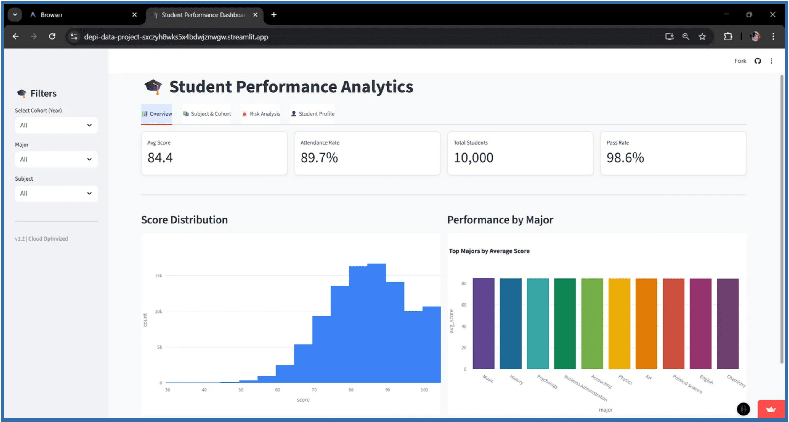



Key Features - Overview Dashboard
KPIs at a Glance
Distribution Analysis
Smart Filtering
Instant view of Average Score (84.4), Attendance Rate (89.7%), and Pass Rate (98.6%).
Histograms showing the spread of grades across the entire student cohort for deeper insights.
Slice data instantly by Year, Major, or Subject to focus on specific student populations.

Slide 7
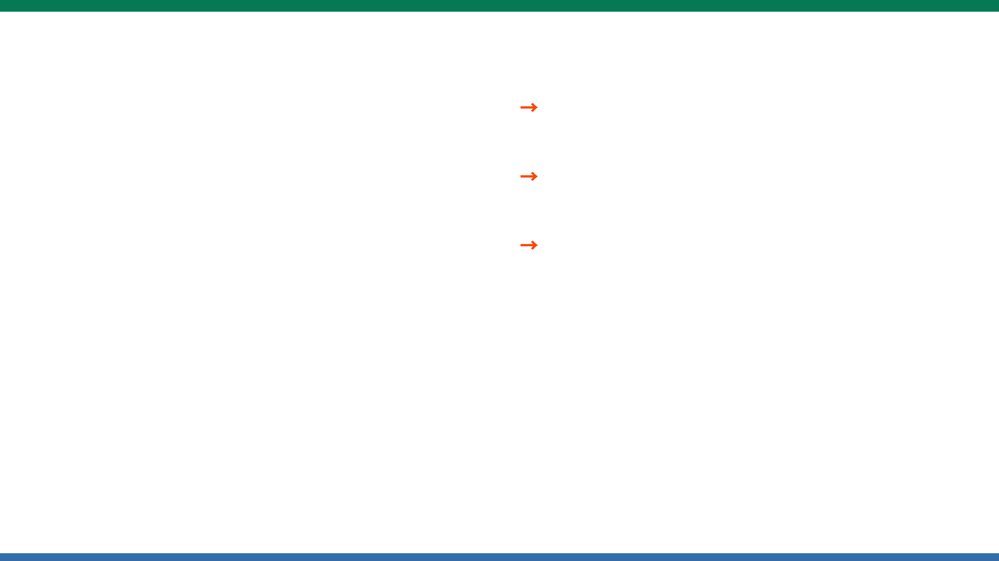
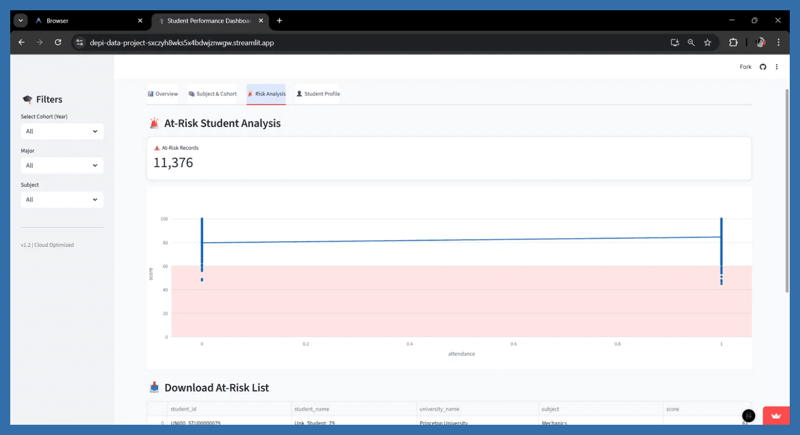

Risk Analysis
Correlation Analysis:
Scatter plot showing the strong link between Attendance and Scores.
At-Risk Identification:
Automatically flags students meeting risk criteria.
Actionable Insights:
Teachers can download the at-risk list as CSV for immediate intervention.
At-Risk Criteria:
• Score < 60
• Attendance < 70%

Slide 8
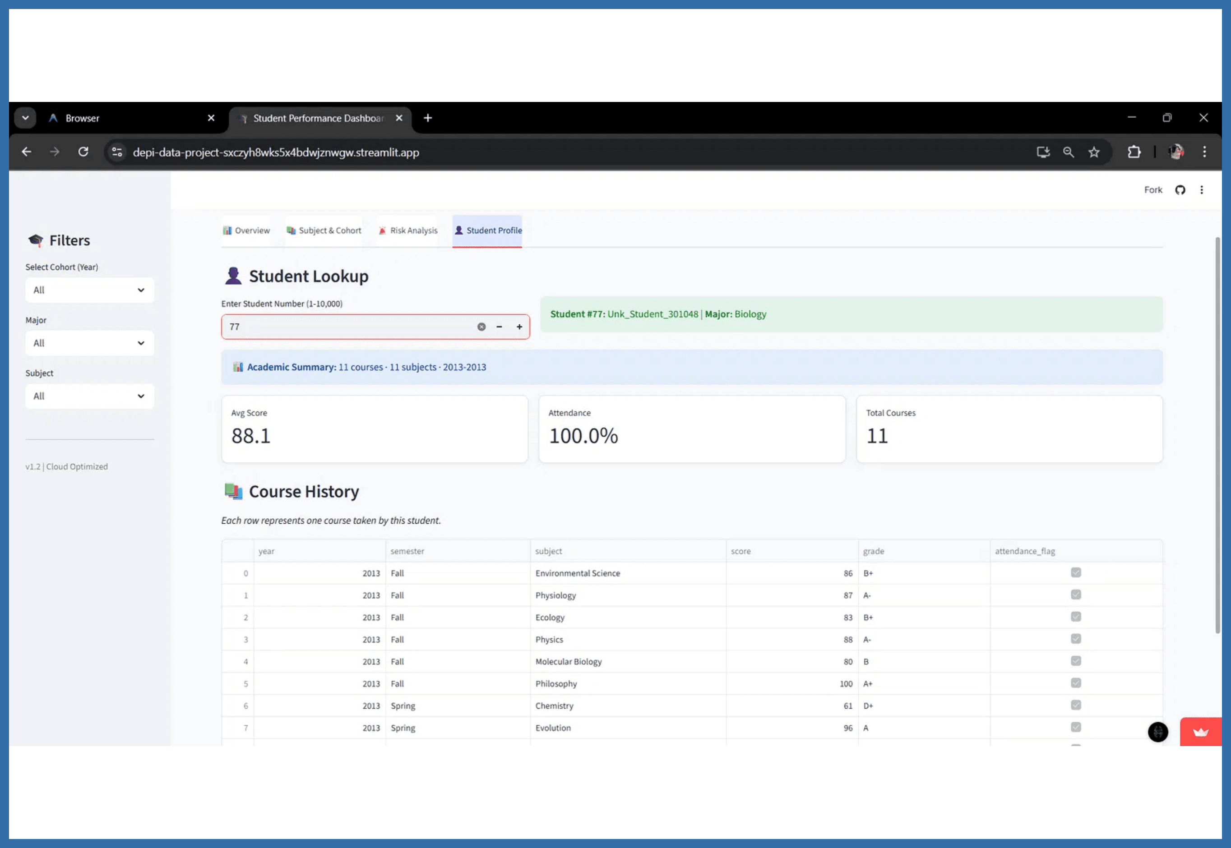



Student Profile: 360° Academic View
Individual Lookup
Search for any student by ID to access their complete academic record instantly.
360° View
See a student's full academic history, grade trends over time, and specific subject performance in one comprehensive dashboard.
Use Case
Parent-teacher conferences or academic advising sessions made efficient and data-driven.

Slide 9
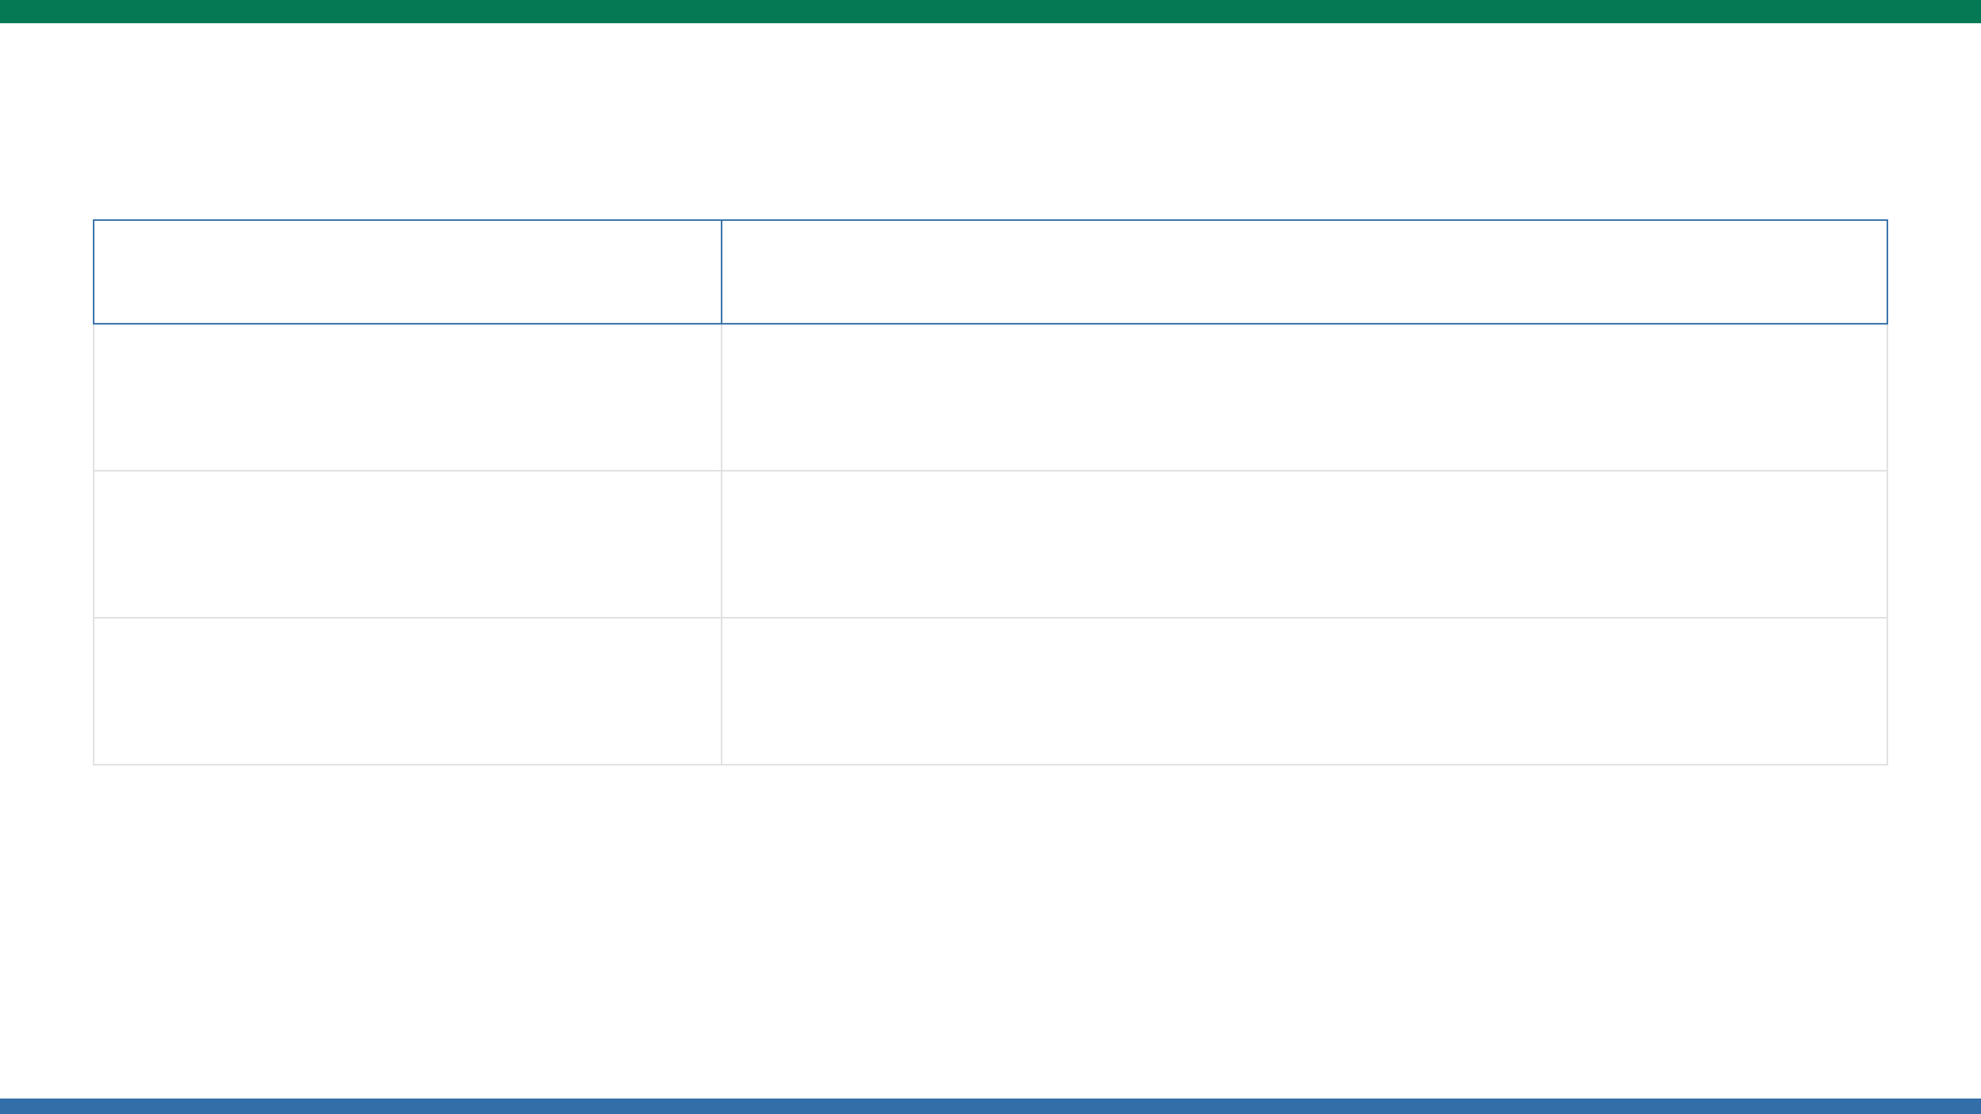





Challenges & Solutions: Engineering Resilience at Scale
Challenge
Solution
Used
for fast, columnar processing and efficient memory management.
Big Data (1M Rows)
DuckDB
and
Parquet
Split large files into parts (`.part1`, `.part2`) and stitched them automatically during the ETL pipeline execution.
GitHub Limits (100MB)
Created a lightweight
specifically optimized for the live demo on Streamlit Cloud.
Cloud Memory Constraints
10K Sample

Slide 10









Next Steps & Project Deliverables
Future Work
Deliverables
Predictive Models
Live Application
Add Machine Learning algorithms to predict future student grades and performance trends.
Fully functional Student Performance Dashboard deployed on Streamlit Cloud.
Real-Time Data
Source Code Repository
Connect to live Learning Management Systems (LMS) for real-time data synchronization.
Complete GitHub repository with all code, configurations, and version control history.
Mobile App
Technical Documentation
Optimize the dashboard layout and functionality for mobile devices and tablets.
Comprehensive README, code comments, and architecture documentation for maintainability.

Slide 11



Thank You!
We're excited to share our Student Performance Dashboard with you.
Live Demo
depi-data-project-sxczyh8wks5x4bdwjznwgw.streamlit.app
Questions & Feedback?

