Slide 1
KONGU ENGINEERING COLLEGE (AUTONOMOUS) PERUNDURAI – 638 060
SUPERMARKET APPLICATION SYSTEM
MICRO PROJECT
JAVA PROGRAMMING (22ITC31)
Submitted by
Haries Ragavendra S (23EIR037)
Harini M (23EIR039)
Harshini Velmuruhan (23EIR040)

Slide 2
ABSTRACT
The growth of technology has transformed the shopping experience. Modern supermarket systems aim to provide efficient solutions to customer management, billing, and stock handling. This project focuses on designing a Supermarket Application System to manage customer records, offer personalized discounts, process payments, and streamline product inventory handling.

Slide 3
PROBLEM STATEMENT
Efficient customer management is a significant challenge for large supermarkets. Traditional systems lack integration and adaptability, leading to inefficiencies in inventory tracking, personalized discounting, and secure payment processing. This project addresses these limitations through a unified and advanced approach.

Slide 4
METHODOLOGY
The project employs:
Customer Record Management for seamless onboarding and personalized discounts.
Shopping List Management with dynamic inventory validation and inclusive pricing.
Secure Payment Processing, including cash and card options with real-time bank balance checks.
Technical Implementation with robust database management and error handling.

Slide 5
IMPLEMENTATION
The application was implemented using Java with key features such as:
In-memory database for fast data retrieval.
Dynamic input handling and validation mechanisms.
Automated billing system with detailed breakdowns.
Secure payment processing with mock bank balance validation.

Slide 6
RESULTS AND DISCUSSION
Key outcomes include:
Improved customer management with dynamic discount retrieval.
Efficient product matching and real-time inventory updates.
Streamlined payment processing with secure validation.
Compared to traditional systems, the proposed solution offers enhanced efficiency, personalization, and error-free transactions.

Slide 7
CONCLUSION
The Supermarket Application System effectively addresses customer and inventory management challenges. It enhances operational efficiency and customer satisfaction through personalized discounts, dynamic inventory tracking, and secure payment processes.
Future enhancements include AI-driven features and cloud-based scalability to further improve the system's capabilities.

Slide 8
SAMPLE CODING
package Supermarket;
import java.util.ArrayList;
import java.util.List;
import java.util.Scanner;
public class SuperMarketApplicationSystem {
int cid;
CustomerDetails[] C = new CustomerDetails[10];
int i = 0;
ArrayList<Product> productList;
Cart cart;
public SuperMarketApplicationSystem() {
productList = new ArrayList<>();
cart = new Cart();
initializeProducts();
}
private void initializeProducts() {
productList.add(new Product("Apple", 0.5, 100));
productList.add(new Product("Banana", 0.3, 150));
….......
…...................
public void addProduct(Product product, int quantity) {
if (product.getStock() >= quantity) {
products.add(product);
product.reduceStock(quantity);
totalAmount += product.getPrice() * quantity;
System.out.println(quantity + " " + product.getName() + "(s) added to the cart.");
} else {
System.out.println("Not enough stock for " + product.getName() + ". Available stock: " + product.getStock());
}
}
public double viewCart() {
System.out.println("Items in your cart:");
for (Product product : products) {
System.out.println("- " + product.getName() + ": $" + product.getPrice());
}
System.out.printf("Total Amount: $%.2f\n", totalAmount);
return totalAmount;
}
}

Slide 9
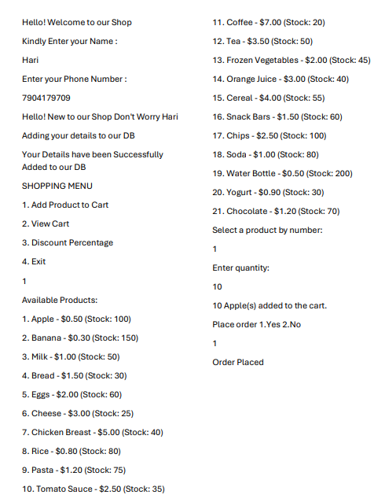
OUTPUT

Slide 10
THANK YOU

