Slide 1

KavinBase
Enterprise AI Document Intelligence Platform
Hybrid RAG · Local LLMs · Multi-Modal Ingestion · Agentic Review Pipeline
Next.js 14 Frontend · FastAPI Backend · PostgreSQL PGVector · Redis · MinIO
-Hariesh R
Notes:
Good morning. This presentation is about KavinBase, our enterprise AI document intelligence platform. The goal is to make large technical PDFs searchable, traceable, and answerable in seconds instead of hours.

Slide 2
THE PROBLEM
THE SOLUTION — KavinBase
1,000+
Instant AI Answers
from any document — in seconds, not hours
Pages per client document package
Engineering & technical documents run into hundreds or thousands of pages per project
Analysts and engineers must manually read, cross-reference and search through dense PDFs
Critical values — revision numbers, tag IDs, design parameters — buried deep inside tables and appendices
A single query may need data from multiple documents, multiple revisions, multiple sections
Hours or days spent per document review cycle; errors from manual extraction are costly
No way to instantly compare specs across revisions or extract answers without opening every file
+ Upload once
Index the entire 1000-page package into PGVector with BAAI/bge-m3 embeddings — one-time operation
+ Ask in plain English
"What is the revision number of document X?" "List all tag numbers in section 4" — answered instantly
+ Hybrid RAG retrieval
Semantic vector search + BM25 keyword + FlashRank reranker ensures the right passage is always found
+ Cite every answer
Every response includes page number + section source — traceable back to the original document
+ Multi-document queries
Cross-reference specs, drawings and datasheets in a single natural-language question
+ Agentic quality gate
Built-in agent pipeline verifies factual accuracy before presenting the answer — no hallucinations
Today, engineering and technical document packages can run into 1,000 pages or more. People spend a lot of time manually reading, comparing revisions, and finding values hidden in tables or appendices. This causes delay and increases the chance of human error
VS
Notes:
Today, engineering and technical document packages can run into 1,000 pages or more. People spend a lot of time manually reading, comparing revisions, and finding values hidden in tables or appendices. This causes delay and increases the chance of human error
KavinBase solves this by letting users upload documents once, index them, and ask questions in plain English. It uses hybrid retrieval, gives page-cited answers, supports multi-document queries, and includes a quality gate so the system is more reliable

Slide 3
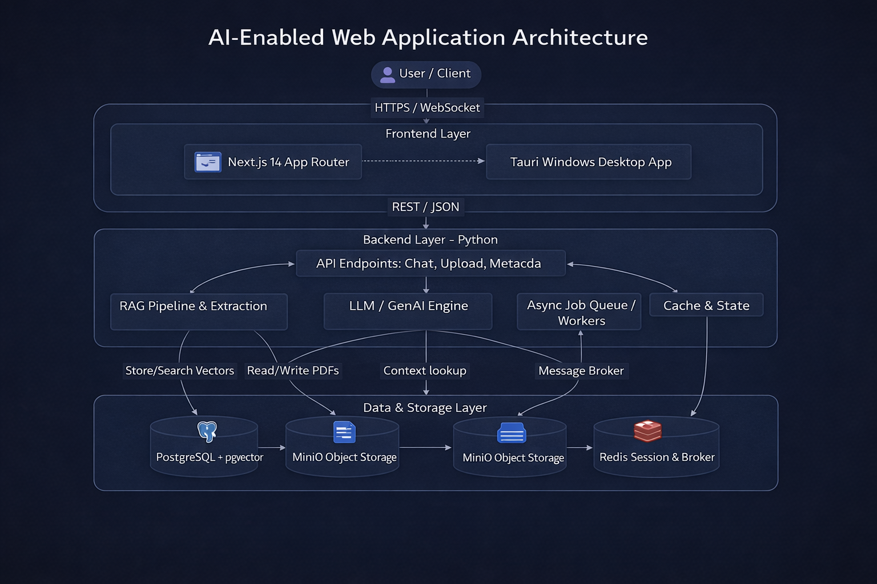
System Architecture Overview
Hybrid Sync/Async Platform with Multi-Layer Persistence
⚡ FastAPI (Python) backend – REST + SSE streaming endpoints
🌐 Next.js 14 (TypeScript/React) frontend – real-time token streaming UI
🔄 Celery workers – asynchronous, CPU-intensive PDF ingestion tasks
🗃️ MinIO – S3-compatible object storage for raw PDFs & binary blobs
🔢 PostgreSQL + PGVector – relational store + 1024-dim vector index (BGE-M3)
⚡ Redis – session cache, streaming state broker, Celery task queue
🔑 JWT-based authentication with scoped role permissions
🏗️ Modular Python backends: rag/, llm/, auth/, memory/, queue/, storage/
Notes:
This slide shows the full stack behind the system: FastAPI backend, Next.js frontend, Celery workers, MinIO for file storage, PostgreSQL with PGVector for vector search, and Redis for sessions and streaming state. The design is split into clear layers so ingestion, retrieval, and generation all work smoothly together.

Slide 4
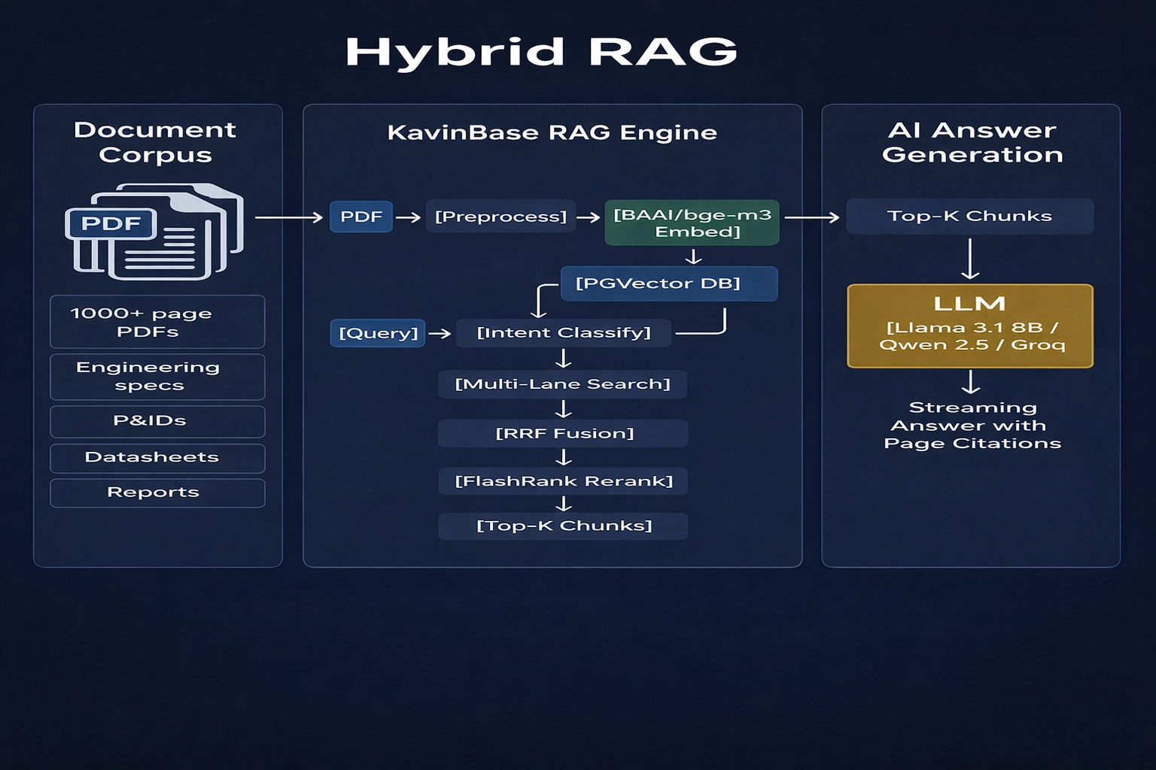
RAG Type: Advanced Hybrid Multi-Lane Retrieval-Augmented Generation
Semantic Vector Search + Keyword BM25 + Cross-Encoder Reranking + Parent Resolution
RAG Architecture: Hybrid Retrieval · Multi-Lane Chunking · Reciprocal Rank Fusion (RRF) · FlashRank Cross-Encoder Reranker
RETRIEVAL MODES (per query intent):
• Fast Mode – vector-only, 14 candidates, no rerank
• Balanced Mode – vector + keyword, 25 candidates, RRF + FlashRank
• High-Fidelity – vector + BM25, 40 candidates, full reranking + parent
MULTI-LANE CHUNK SEARCH:
• Separate lanes for: text, parent-table, image, child-row
• Lane budgets prevent child rows dominating results
• Parent resolution fetches full table when child chunk matches
RECIPROCAL RANK FUSION (RRF k=60):
• Fuses vector similarity ranks + keyword BM25 ranks
• Score: 1/(k + rank_vector) + 1/(k + rank_keyword) + 0.01×kw_score
SCORING MULTIPLIERS (per chunk):
• Element type weight (Title=1.0, NarrativeText=0.9, Table=0.6)
• Extraction source (PyMuPDF=1.0, Docling=0.9, Unstructured=0.8)
• Quality score (0.55 – 1.0 range)
• OCR noise penalty (×0.6 if OCR used)
• Section-query overlap boost (up to +8%)
RERANKER: FlashRank (ms-marco-MiniLM-L-12-v2)
• Cross-encoder re-scores top candidates
• Final score = max(rerank×multiplier, retrieval_score)
VECTOR DB: PostgreSQL PGVector
• Embedding: BAAI/bge-m3 (1024-dim)
• Metadata-filtered similarity_search per collection
Notes:
“The retrieval engine is not just basic vector search. It combines semantic search, BM25 keyword search, RRF fusion, and FlashRank reranking, with parent resolution for tables. That means the system can search across different chunk types and still return the most relevant context.

Slide 5
RAG Type: Advanced Hybrid Multi-Lane Retrieval-Augmented Generation
Semantic Vector Search + Keyword BM25 + Cross-Encoder Reranking + Parent Resolution
RAG Architecture: Hybrid Retrieval · Multi-Lane Chunking · Reciprocal Rank Fusion (RRF) · FlashRank Cross-Encoder Reranker
RETRIEVAL MODES (per query intent):
• Fast Mode – vector-only, 14 candidates, no rerank
• Balanced Mode – vector + keyword, 25 candidates, RRF + FlashRank
• High-Fidelity – vector + BM25, 40 candidates, full reranking + parent
MULTI-LANE CHUNK SEARCH:
• Separate lanes for: text, parent-table, image, child-row
• Lane budgets prevent child rows dominating results
• Parent resolution fetches full table when child chunk matches
RECIPROCAL RANK FUSION (RRF k=60):
• Fuses vector similarity ranks + keyword BM25 ranks
• Score: 1/(k + rank_vector) + 1/(k + rank_keyword) + 0.01×kw_score
SCORING MULTIPLIERS (per chunk):
• Element type weight (Title=1.0, NarrativeText=0.9, Table=0.6)
• Extraction source (PyMuPDF=1.0, Docling=0.9, Unstructured=0.8)
• Quality score (0.55 – 1.0 range)
• OCR noise penalty (×0.6 if OCR used)
• Section-query overlap boost (up to +8%)
RERANKER: FlashRank (ms-marco-MiniLM-L-12-v2)
• Cross-encoder re-scores top candidates
• Final score = max(rerank×multiplier, retrieval_score)
VECTOR DB: PostgreSQL PGVector
• Embedding: BAAI/bge-m3 (1024-dim)
• Metadata-filtered similarity_search per collection
Notes:
“The retrieval engine is not just basic vector search. It combines semantic search, BM25 keyword search, RRF fusion, and FlashRank reranking, with parent resolution for tables. That means the system can search across different chunk types and still return the most relevant context.

Slide 6
LLM Inventory & Model Architecture
Local GGUF / Hugging Face Models · External API (Groq / xAI) · Dedicated Auxiliary Models
Role
Model Name
Backend Type
Provider
Primary Use-case
💬 Lite Chat (rank-1)
Llama 3.1 8B Instruct Q4_K_M
GGUF (llama_cpp)
Primary local chat – GPU preferred
💬 Lite Chat (rank-2)
Qwen 2.5 7B Instruct Q4_K_M
GGUF (llama_cpp)
GGUF fallback chat model
💬 Lite Chat (light)
Qwen 2.5 3B Instruct Q4_K_M
GGUF (llama_cpp)
CPU-first developer setup model
💬 Lite Chat (mini)
Qwen 2.5 1.5B Instruct Q4_K_M
GGUF (llama_cpp)
Ultra-light CPU chat model
🧠 Base Chat (GPU)
Qwen 2.5 7B Instruct (HF)
Hugging Face Transformers
Full HF inference on CUDA
🧠 Base Chat (CPU)
Qwen 2.5 3B Instruct (HF)
Hugging Face Transformers
CPU-safe HF chat model
🤖 Agent Router
Qwen 2.5 0.5B Q4 (GGUF)
GGUF (llama_cpp)
Hidden routing, extraction, gate decisions
📐 Embedding
BAAI/bge-m3 (1024-dim)
Hugging Face Sentence Transformer
Ingestion + retrieval vector embedding
🏷️ Intent Classifier
facebook/bart-large-mnli
Zero-shot NLI pipeline
Query intent classification (MNLI)
📊 Table Detector
microsoft/table-transformer
Hugging Face Vision
Unstructured hi_res table structure
🖼️ Layout Model
unstructuredio/yolox_l0.05
ONNX (YOLOX)
PDF page layout detection (Unstructured)
📝 Reranker
ms-marco-MiniLM-L-12-v2
FlashRank cross-encoder
Post-retrieval chunk reranking
🌐 Net (Groq)
llama-3.1-8b-instant
Groq REST API
External API streaming – rank 1 & 2
🌐 Net (xAI)
grok-beta
xAI Grok REST API
External API streaming – Grok provider
Notes:
“We use different models for different jobs. Smaller Qwen models handle routing, extraction, and gate decisions, while stronger models handle answer generation and review. This keeps the system efficient, accurate, and flexible for both CPU and GPU setups

Slide 7
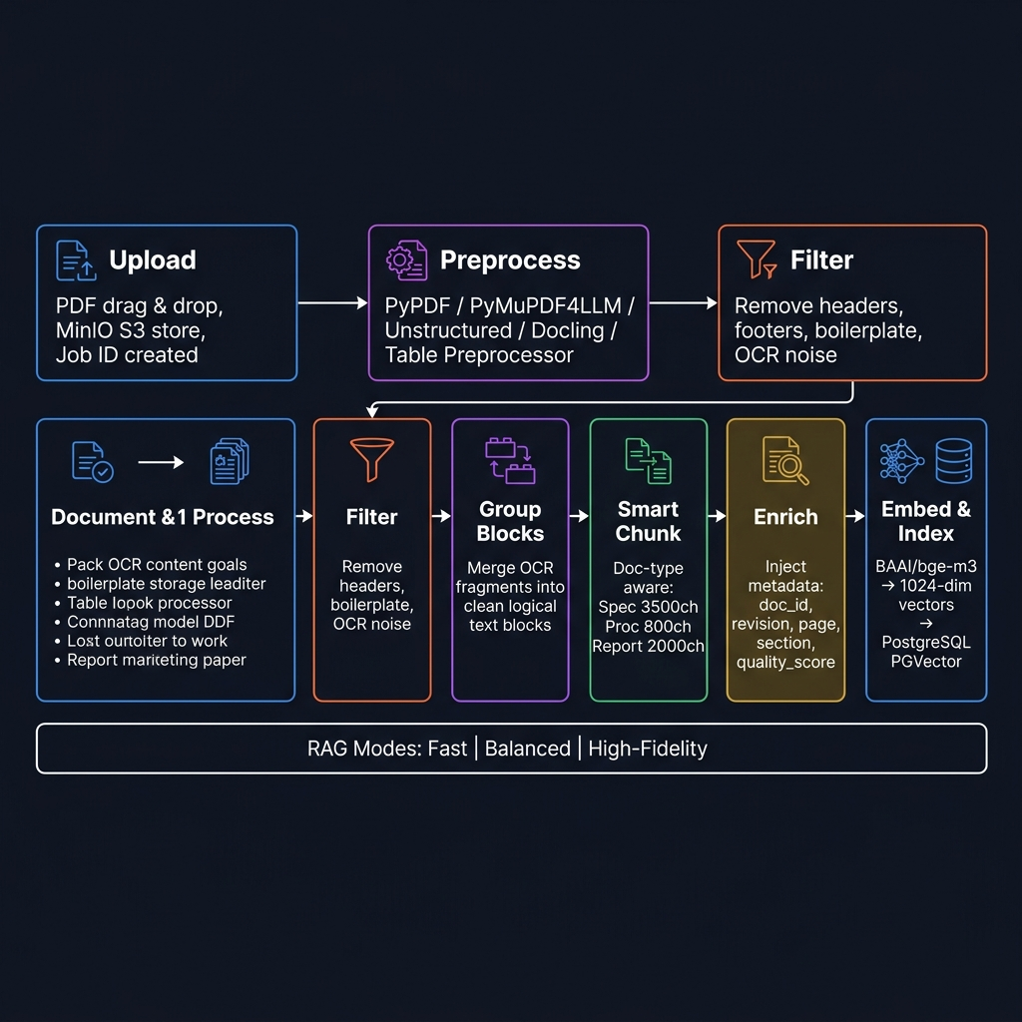
Ingestion Pipeline – Step-by-Step Flowchart
PDF → Preprocess → Filter → Group → Chunk → Enrich → Embed → PGVector
1️⃣ Upload
2️⃣ Preprocess
3️⃣ Filter
4️⃣ Group Blocks
5️⃣ Chunk
6️⃣ Enrich
7️⃣ Embed & Ingest
User drags PDF in Next.js UI. Stored in MinIO (S3). Job ID created in Redis.
stream_pdf_to_elements() Choose: PyPDF / PyMuPDF4LLM / Unstructured / Docling / Table Preprocessor
Remove headers, footers, boilerplate, image noise. Version-tracked FILTER_VERSION.
build_grouped_blocks() Merge OCR fragments into clean logical text blocks.
ContextAwareChunker Doc-type aware config: spec 3500 / proc 800 / report 2000
Metadata injection: doc_id, revision, page, section, quality_score, chunk_type.
BAAI/bge-m3 → 1024-dim vector ingest_to_pgvector() Revision-safe upsert.
→
→
→
→
→
→
RAG Ingest Modes: Fast (pypdf, no tables) · Balanced (hi_res + table structure, no images) · High-Fidelity (hi_res + tables + images extracted)
PRE-PROCESSORS AVAILABLE:
• pypdf_text – lightweight text extraction (PyPDF)
• pymupdf4llm – rich markdown extraction (PyMuPDF)
• unstructured – hi_res layout + OCR (Tesseract/YOLOX)
• docling – academic-grade extraction with table/formula support
• table_preprocessor – specialised Docling-backed table-focused pipeline
DOC-TYPE CHUNKING:
Specification → 3500 / 500
Procedure/SOP → 800 / 100
Report → 2000 / 300
Drawing/P&ID → 1000 / 150
Datasheet → 1500 / 200
Default → 3000 / 400
Notes:
This pipeline explains how a PDF becomes searchable knowledge. First the file is uploaded, then preprocessed, filtered, grouped, chunked, enriched with metadata, embedded using BGE-M3, and finally stored in PGVector. The process is revision-safe, so document updates do not corrupt the index.

Slide 8
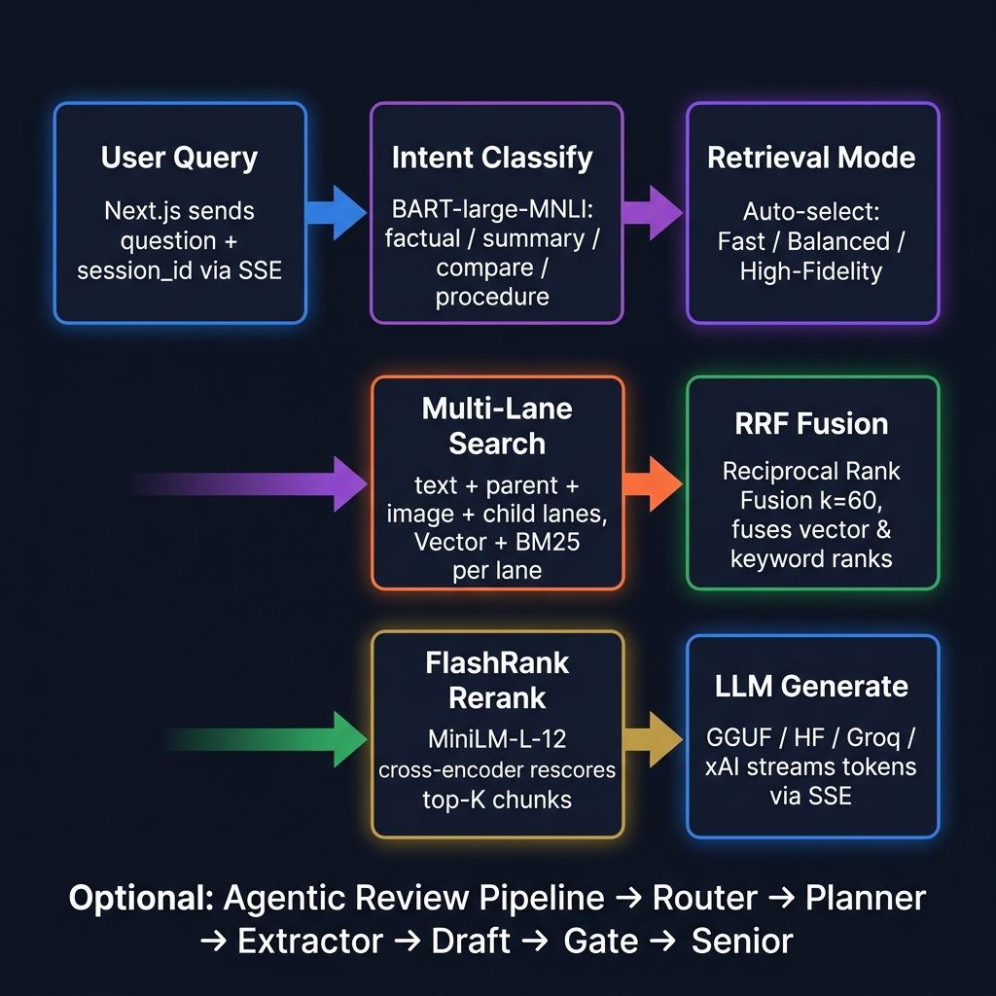
Query Pipeline – Step-by-Step Flowchart
User Question → Intent → Multi-Lane Retrieval → RRF → Rerank → Agentic Review → Stream
1️⃣ User Query
2️⃣ Intent Class.
3️⃣ Retrieval Mode
4️⃣ Multi-Lane Search
5️⃣ RRF Fusion
6️⃣ Rerank
7️⃣ LLM Generate
Next.js sends question + session_id + model_id via SSE stream endpoint.
BART-large-MNLI classifies: summary / factual / compare / procedure / greeting
Auto-selects: Fast / Balanced / High-Fidelity based on intent label.
Per-lane searches: text, parent, image, child. Vector + BM25 keyword per lane.
Reciprocal Rank Fusion fuses vector + keyword ranks (k=60 default).
FlashRank MiniLM-L-12 cross-encoder rescores candidates → top-K.
Prompt built → streamed via GGUF / HF / Groq / xAI. Token-by-token SSE yield.
→
→
→
→
→
→
Optional Agentic Review Pipeline (enable_agent_pipeline=true): Router → Planner → Extractor → Draft → Reviewer → Repair Gate → Senior Escalation (Qwen 3B)
QUERY PROFILE ROUTING:
• metadata – Title+Narrative only, no OCR, text lane only
• table_data – parent+child lane priority, Table element boost
• image_ref – image lane priority, Image element ×1.3 boost
• summary – balanced lanes, broad element set
• explanation – text lane focus, NarrativeText ×1.25
• factual – text+parent lanes, excludes UncategorizedText
SCORING FACTORS:
element_wt × source_wt × quality
× child_pen × ocr_pen × query_mult
× lane_mult × section_mult
QUALITY GATES:
Grounding check < 0.40 → warning
Release gate → blockers list
Eval gate: heuristic pre-LLM
Notes:
When a user asks a question, the system first detects the intent, chooses the right retrieval mode, searches multiple lanes, fuses results, reranks them, and then generates the answer through the model. This makes the answer pipeline smart and adaptive instead of using one fixed search path.

Slide 9
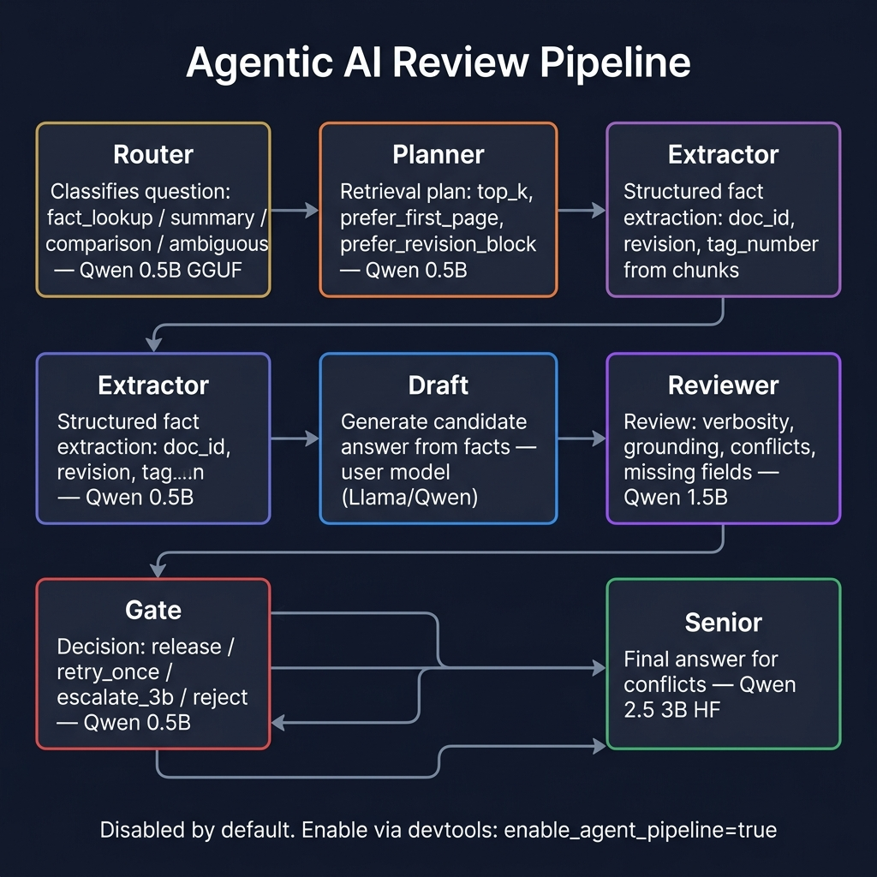
Agentic Review Pipeline – Hierarchical Deliberation Engine
Multi-stage agent chain: Router → Planner → Extractor → Draft → Reviewer → Gate → Senior
Router (0.5B GGUF)
Planner (0.5B GGUF)
Extractor (0.5B GGUF)
Draft (user model)
Reviewer (1.5B GGUF)
Gate (0.5B GGUF)
Senior (Qwen 3B HF)
Classifies question type: fact_lookup / summary / comparison / ambiguous
Determines retrieval plan: top_k, prefer_first_page prefer_title / revision block
Extracts structured facts: document_id, revision, tag_number from chunks
Generates candidate answer from facts + context. Strict-copy or analytical.
Reviews draft: verbosity, grounding, missing fields, conflicts
Decision: release / retry_once escalate_3b / reject
Escalation model for conflicts & ambiguities. Final authoritative answer.
→
→
→
→
→
→
MODEL ASSIGNMENTS: Router/Planner/Extractor/Gate → Qwen 0.5B Q4 | Draft → user model (Llama 8B / Qwen) | Reviewer → Qwen 1.5B Q4 | Senior → Qwen 3B HF
STRICT FACTUAL PATH (eval_gate=true): regex heuristic extraction → validate → release without LLM if high confidence
DISABLED BY DEFAULT — enable via devtools panel: enable_agent_pipeline=true and enable_eval_gate=true
Notes:
This is the quality-control layer. The question goes through router, planner, extractor, draft, reviewer, gate, and senior escalation. The purpose is to reduce hallucinations and ensure the final answer is grounded before it is shown to the user

Slide 10
Frontend Architecture – Next.js 14 (App Router) + TypeScript
Modular React components · SSE streaming · JWT auth · Multi-workspace modes
🏗️ TECH STACK:
• Next.js 14 (App Router) + TypeScript
• Tailwind CSS utility classes
• Lucide React icons
• Tauri (optional desktop build, src-tauri/)
📂 APP ROUTES:
• / – Main workspace (auth-gated)
• /signin – JWT login page
• /welcome – First-run onboarding flow
• /dashboard – Project metrics dashboard
• /pml – PML template editor workspace
• /usage – API usage & model telemetry
🔐 AUTHENTICATION:
• authMe() on mount – redirect to /signin if not logged in
• authLogout() clears session cookie
• First-visit gate → /welcome page
🧩 KEY COMPONENT MODULES:
• components/chat/ – ChatWindow, MessageBubble, ChatInput,
ChatHeader, PreprocessingPreviewPanel, SourceViewerModal,
TableInspectionModal, InlineMetadataPrompt
• components/sidebar/ – Sidebar, ChatList, PdfUpload, Brand
• components/upload/ – PdfUploadButton, UploadProgress,
ChunkingProgress, PdfContextBanner
• components/workspace/ – WorkspaceModeSwitcher,
WorkspaceOverviewDashboard, WorkspaceProjectTree
• components/pml/ – TemplateLibraryPanel
• components/messaging/ – EnterpriseMessagingWorkspace
• components/onboarding/ – GettingStartedModal, ShortcutsModal
🔄 WORKSPACE MODES: ai | pml | team
📡 STREAMING: SSE (Server-Sent Events) token-by-token from backend
🗄️ STATE: localStorage for chats, sidebar, workspace prefs
Notes:
The frontend is built with Next.js 14 and TypeScript, with modular React components and SSE streaming for real-time responses. It also supports authentication, multiple workspace modes, and a structure that can scale as more features are added

Slide 11
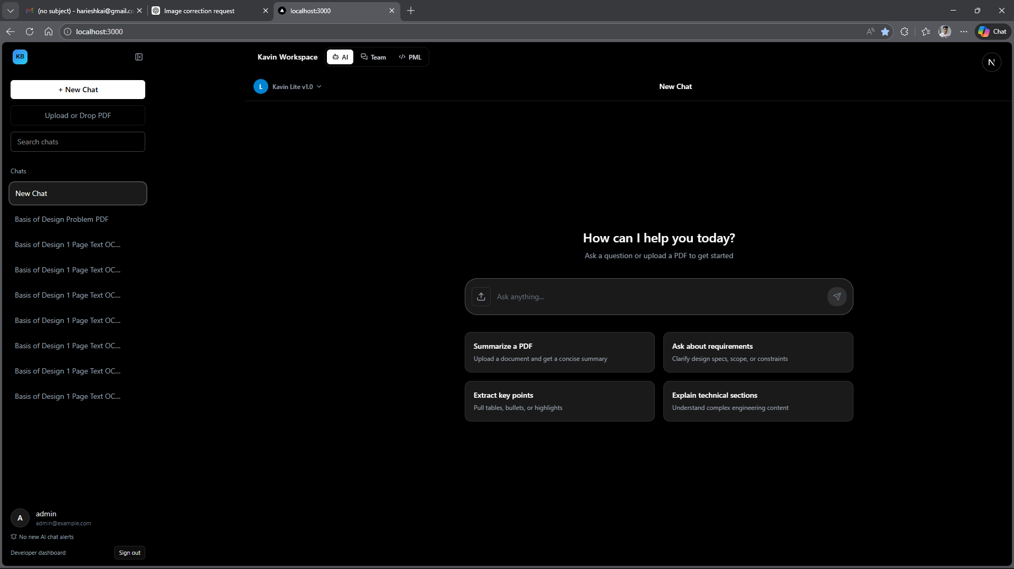
Frontend – Chat Workspace
Real-time AI document Q&A interface with token streaming and citation support
💬 Token-by-token SSE streaming from backend LLM (GGUF / HF / Groq / xAI)
📄 PDF context banner – shows indexed document + revision in chat header
🔍 Source Viewer Modal – opens cited chunk with page/section highlight
📊 Table Inspection Modal – explore structured table data extracted from PDF
🔄 Preprocessing Preview Panel – live ingestion progress (filter, chunk, embed steps)
📝 Inline Metadata Prompt – document_type, revision_code, doc_number confirmation
⏩ Processing Bubble – animated loading state during LLM generation
🧠 Thinking Disclosure – expandable CoT reasoning trace (agent mode)
📌 Model Selector – switch between Lite / Base / Net modes per chat
👍 Feedback Bar – thumbs up/down inline rating per message
[ADD: Chat Workspace Screenshot]
Notes:
This is the main user experience. Users can upload PDFs, view document context, inspect citations, see tables, and get token-by-token answers with source traceability. The design is made for practical document Q&A, not just generic chat

Slide 12
Frontend – Sidebar, Upload & Document Management
PDF ingestion flow, chat history, multi-mode sidebar, Dev Settings panel
📁 SIDEBAR (Sidebar.tsx):
• Collapsible slide-in navigation panel
• Chat list with unread badge counts
• Search/filter chat sessions
• PDF upload trigger (PdfUpload.tsx)
• Model mode indicator (Lite / Base / Net)
• Dev settings panel with live override controls
• User profile + sign-out
📤 PDF UPLOAD FLOW:
• PdfUploadButton → useSmartUpload hook
• Phase 1: metadata extraction (page-1 preview)
• InlineMetadataPrompt: confirm doc_type / revision
• Phase 2: full commit ingestion via Celery worker
• UploadProgress + ChunkingProgress bar (live SSE)
• Cancel support at each phase via job_id / session_id
• Background ingestion status poller (useIngestionStatusPoller)
🗂️ DOCUMENT CONTEXT PANEL:
• PdfContextBanner shows active doc + revision
• Workspace Overview Dashboard (WorkspaceOverviewDashboard.tsx):
– Document table with revision, chunk count, status
– Indexed document list derived from chat sources
• WorkspaceProjectTree – hierarchical project / doc view
⚙️ DEV SETTINGS (devtools/settings API):
• enable_agent_pipeline toggle
• enable_eval_gate toggle
• RAG preprocessor override
• RAG ingest mode override (fast / balanced / high_fidelity)
• enable_fast_document_processing shortcut
• rag_collection_name override
🔔 NOTIFICATIONS & HISTORY SIDE PANELS
Notes:
The sidebar is more than navigation. It manages chats, uploads, model selection, and dev settings. The upload flow includes metadata extraction first, then full ingestion, with progress tracking and cancellation support

Slide 13
Frontend – Dashboard, PML Editor & Team Workspace
Three workspace modes: AI Chat | PML Template Editor | Enterprise Team Messaging
🤖 AI Mode
📝 PML Mode
👥 Team Mode
• Primary document Q&A workspace
• Process Markup Language template editor
• Enterprise messaging workspace
• Sidebar + ChatWindow layout
• TemplateLibraryPanel – saved templates
• Real-time WebSocket team conversations
• Supports multiple parallel chat sessions
• Editor + Output tab layout
• Project threads + assignee management
• Upload → ingest → query inline workflow
• Learn template from example via API
• Team notifications panel
• Citation + source viewer integration
• PML chat backed by base/net model
• AI-assist seed from team context
• Unread badge count aggregation
Notes:
We support three workspace modes: AI chat, PML template editing, and team messaging. This makes the platform useful not only for document Q&A but also for internal collaboration and enterprise workflows.”

Slide 14
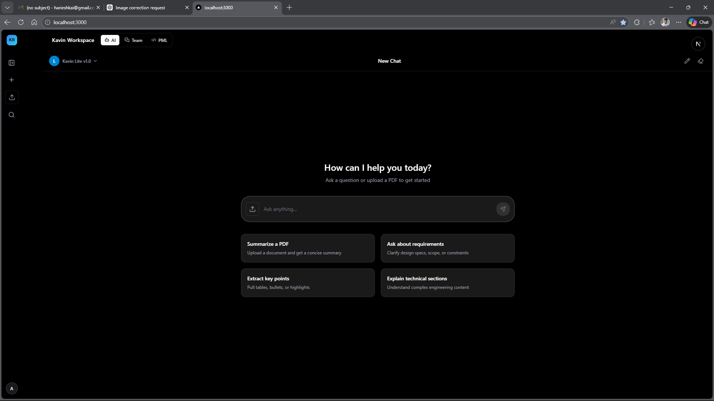
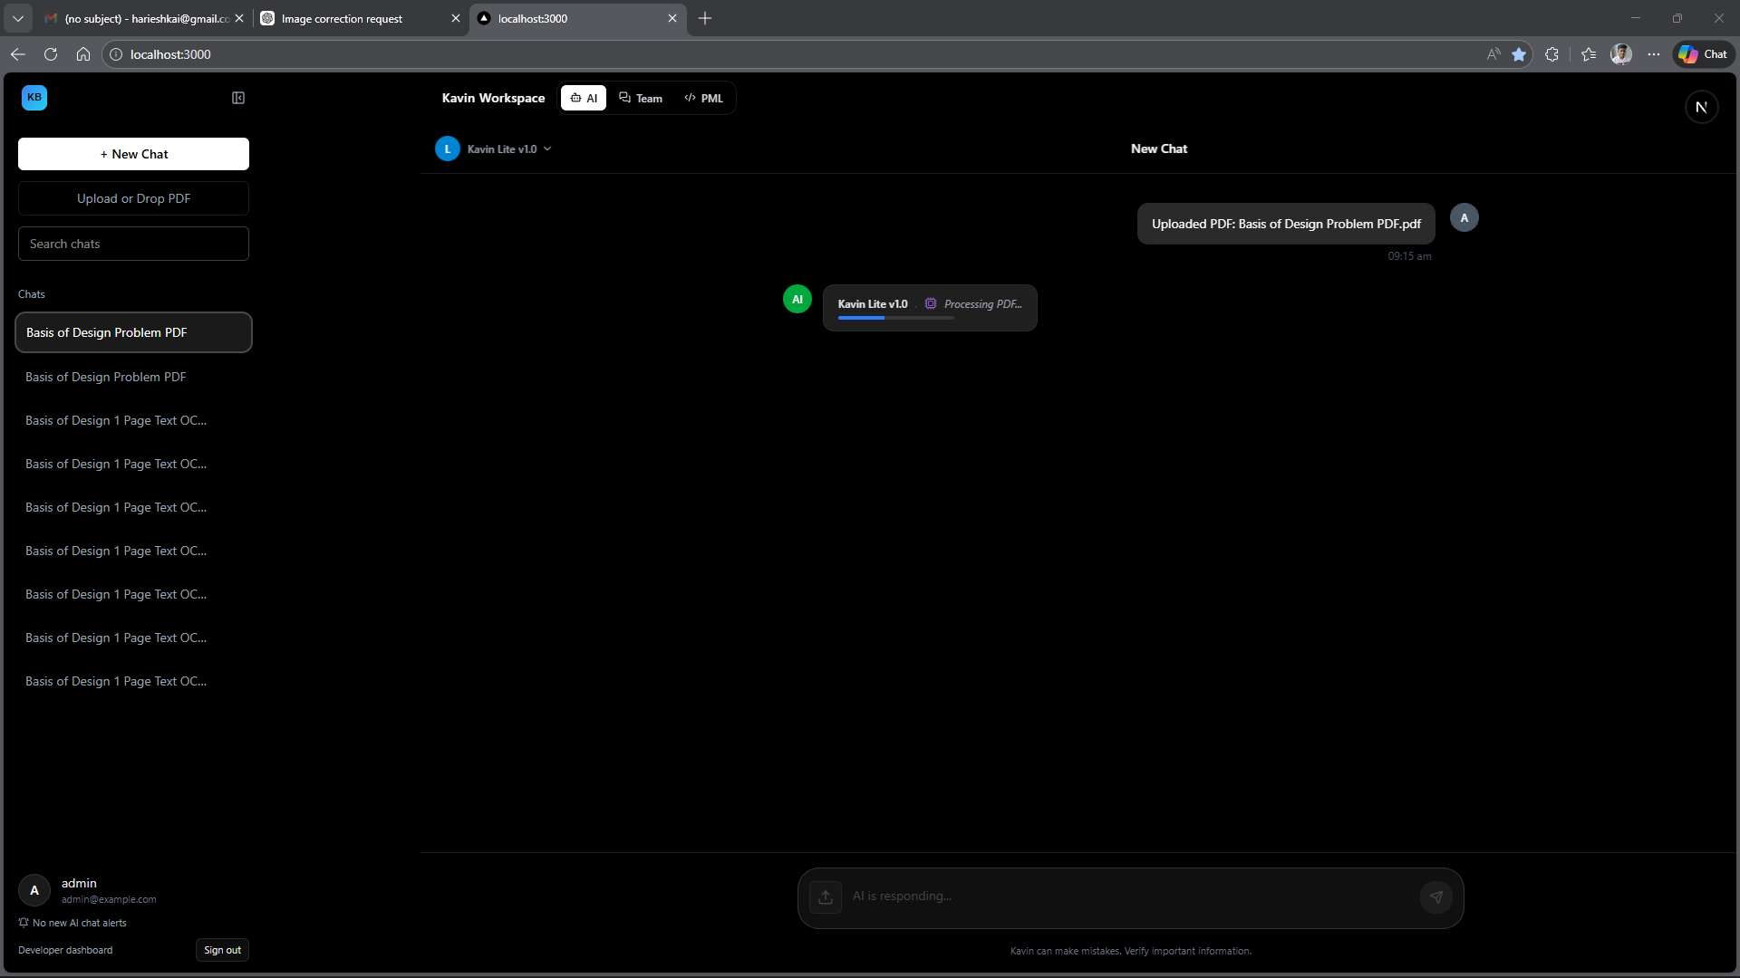
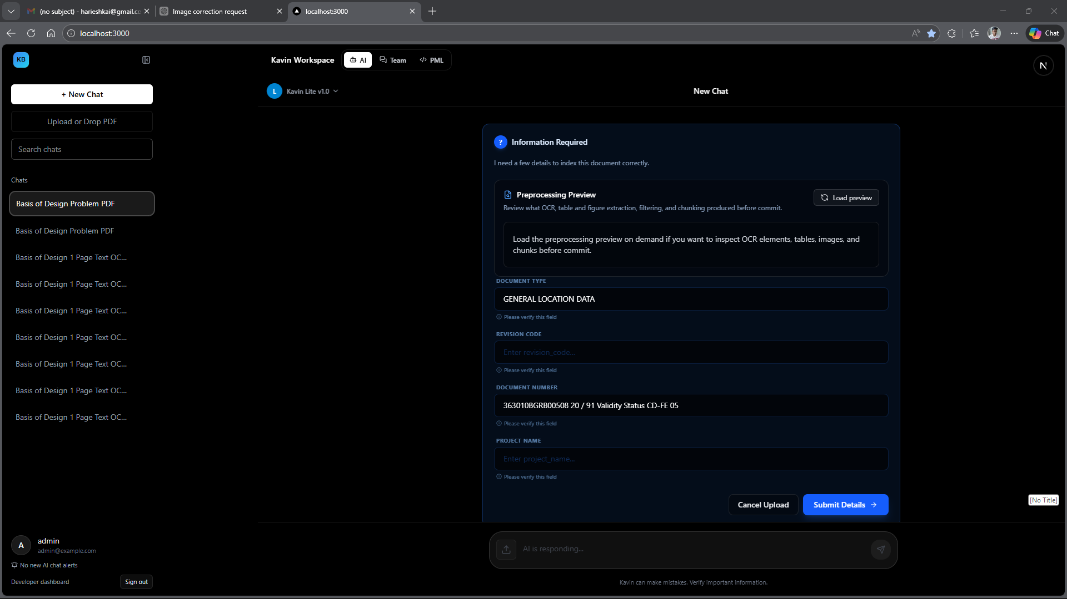
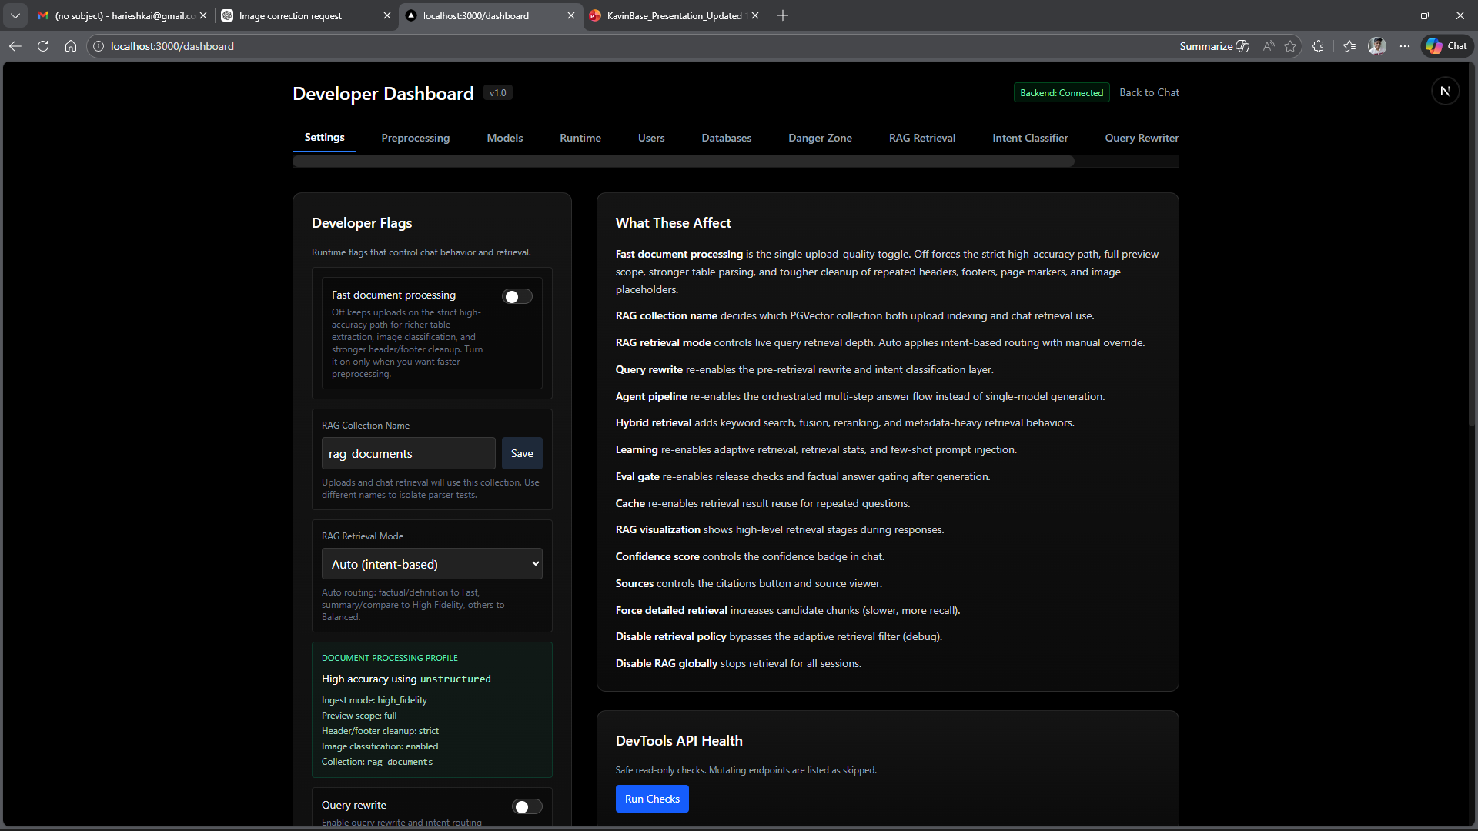
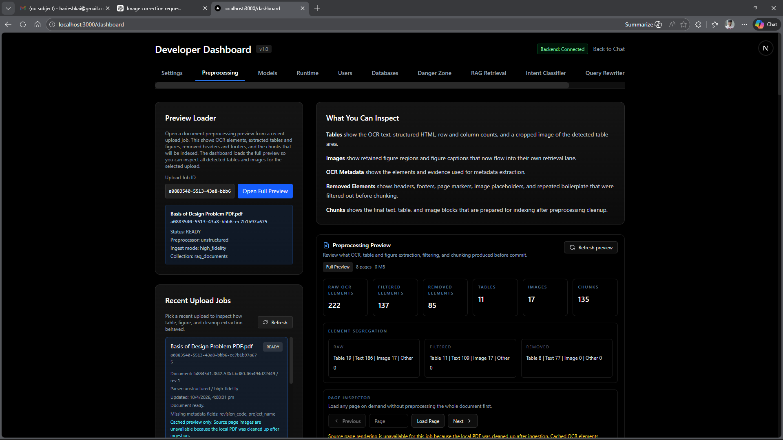
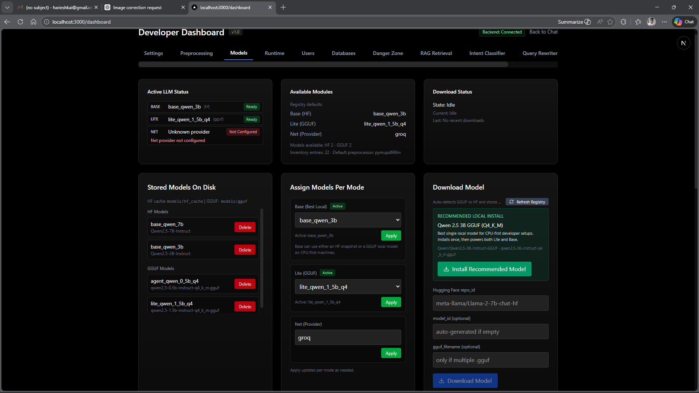
Frontend Screenshots
Add screenshots for each view manually – placeholder frames shown below
[ADD: Chat Window – main Q&A view]
[ADD: PDF Upload flow / Progress bar]
[ADD: Sidebar open with chat list]
[ADD: Source Viewer / Citation Modal]
[ADD: Table Inspection Modal]
[ADD: Preprocessing Preview Panel]
Notes:
“For these slides, say that the actual screenshots will show the real product interface for chat, upload flow, sidebar, source viewer, table inspection, and preprocessing preview. These slides are meant to demonstrate usability, not architecture.”

Slide 15
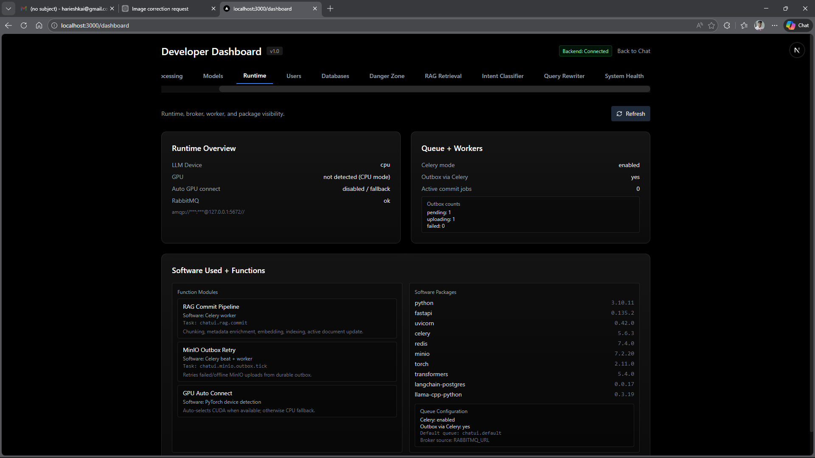
Frontend Screenshots
Add screenshots for each view manually – placeholder frames shown below
[ADD: Chat Window – main Q&A view]
[ADD: PDF Upload flow / Progress bar]
[ADD: Sidebar open with chat list]
[ADD: Source Viewer / Citation Modal]
[ADD: Table Inspection Modal]
[ADD: Preprocessing Preview Panel]

Slide 16
Frontend Screenshots
Add screenshots for each view manually – placeholder frames shown below
[ADD: Chat Window – main Q&A view]
[ADD: PDF Upload flow / Progress bar]
[ADD: Sidebar open with chat list]
[ADD: Source Viewer / Citation Modal]
[ADD: Table Inspection Modal]
[ADD: Preprocessing Preview Panel]

Slide 17
Frontend Screenshots
Add screenshots for each view manually – placeholder frames shown below
[ADD: Chat Window – main Q&A view]
[ADD: PDF Upload flow / Progress bar]
[ADD: Sidebar open with chat list]
[ADD: Source Viewer / Citation Modal]
[ADD: Table Inspection Modal]
[ADD: Preprocessing Preview Panel]

Slide 18
Frontend Screenshots
Add screenshots for each view manually – placeholder frames shown below
[ADD: Chat Window – main Q&A view]
[ADD: PDF Upload flow / Progress bar]
[ADD: Sidebar open with chat list]
[ADD: Source Viewer / Citation Modal]
[ADD: Table Inspection Modal]
[ADD: Preprocessing Preview Panel]

Slide 19
Frontend Screenshots
Add screenshots for each view manually – placeholder frames shown below
[ADD: Chat Window – main Q&A view]
[ADD: PDF Upload flow / Progress bar]
[ADD: Sidebar open with chat list]
[ADD: Source Viewer / Citation Modal]
[ADD: Table Inspection Modal]
[ADD: Preprocessing Preview Panel]

Slide 20
Frontend Screenshots
Add screenshots for each view manually – placeholder frames shown below
[ADD: Chat Window – main Q&A view]
[ADD: PDF Upload flow / Progress bar]
[ADD: Sidebar open with chat list]
[ADD: Source Viewer / Citation Modal]
[ADD: Table Inspection Modal]
[ADD: Preprocessing Preview Panel]

Slide 21
Frontend Screenshots
Add screenshots for each view manually – placeholder frames shown below
[ADD: Chat Window – main Q&A view]
[ADD: PDF Upload flow / Progress bar]
[ADD: Sidebar open with chat list]
[ADD: Source Viewer / Citation Modal]
[ADD: Table Inspection Modal]
[ADD: Preprocessing Preview Panel]

Slide 22
Frontend Screenshots
Add screenshots for each view manually – placeholder frames shown below
[ADD: Chat Window – main Q&A view]
[ADD: PDF Upload flow / Progress bar]
[ADD: Sidebar open with chat list]
[ADD: Source Viewer / Citation Modal]
[ADD: Table Inspection Modal]
[ADD: Preprocessing Preview Panel]

Slide 23
Frontend Screenshots
Add screenshots for each view manually – placeholder frames shown below
[ADD: Chat Window – main Q&A view]
[ADD: PDF Upload flow / Progress bar]
[ADD: Sidebar open with chat list]
[ADD: Source Viewer / Citation Modal]
[ADD: Table Inspection Modal]
[ADD: Preprocessing Preview Panel]

Slide 24
Frontend Screenshots
Add screenshots for each view manually – placeholder frames shown below
[ADD: Chat Window – main Q&A view]
[ADD: PDF Upload flow / Progress bar]
[ADD: Sidebar open with chat list]
[ADD: Source Viewer / Citation Modal]
[ADD: Table Inspection Modal]
[ADD: Preprocessing Preview Panel]

Slide 25
Frontend Screenshots
Add screenshots for each view manually – placeholder frames shown below
[ADD: Chat Window – main Q&A view]
[ADD: PDF Upload flow / Progress bar]
[ADD: Sidebar open with chat list]
[ADD: Source Viewer / Citation Modal]
[ADD: Table Inspection Modal]
[ADD: Preprocessing Preview Panel]

Slide 26
Frontend Screenshots
Add screenshots for each view manually – placeholder frames shown below
[ADD: Chat Window – main Q&A view]
[ADD: PDF Upload flow / Progress bar]
[ADD: Sidebar open with chat list]
[ADD: Source Viewer / Citation Modal]
[ADD: Table Inspection Modal]
[ADD: Preprocessing Preview Panel]

Slide 27
Backend API Exposure & Storage Ecosystem
FastAPI + Pydantic · MinIO + PostgreSQL PGVector + Redis · Celery task queue
🌐 FASTAPI BACKEND:
• Strict Pydantic payload validation
• Swagger UI auto-generated (interactive docs)
• Route groups: Chat, Auth, Upload, RAG, Dev Tools
• SSE (Server-Sent Events) for streaming LLM tokens
• Sidecar process (sidecar_main.py) for auxiliary tasks
📋 API MODULES:
• backend/api/ – route definitions
• backend/main/ – FastAPI app factory
• backend/pml_main.py – PML service entrypoint
• backend/sidecar_main.py – background sidecar
🕐 ASYNC WORKERS:
• Celery + Redis broker for PDF ingestion jobs
• Celerybeat scheduler for periodic tasks
• Job ID tracking with upload_cancellation support
🗄️ STORAGE LAYERS:
MinIO (S3-compatible Object Store):
– Raw PDFs and binary blobs
– Isolated from relational DB
– Local minio-data/ volume
PostgreSQL + PGVector (Vector DB):
– User accounts, projects, session data
– 1024-dimensional BAAI/bge-m3 vector index
– langchain_pg_embedding + langchain_pg_collection tables
– Revision-safe upsert strategy
Redis (Key-Value Store):
– SSE streaming state tracking
– Celery task broker + result backend
– Session abort signals (is_aborted())
– Used-chunk deduplication per session
Notes:
This slide explains the backend services and storage layers. FastAPI handles routes and streaming, Celery handles heavy background jobs, MinIO stores documents, PostgreSQL stores metadata and vectors, and Redis manages session state and task coordination

Slide 28
New Features & Enhancements
Since initial release – advanced pipeline capabilities and quality gates
🚀 AGENTIC REVIEW PIPELINE
7-stage deliberation chain with 3 local models
Strict factual heuristic + LLM reviewer gate
Senior escalation for conflicts & ambiguities
🔍 MULTI-LANE RETRIEVAL
Separate text / parent / image / child lanes
Prevents child-row domination of results
Deterministic parent lookup by doc_id SQL
📊 QUERY PROFILE ROUTING
7 profiles: metadata, table, image, summary,
explanation, factual, general
Per-profile element weights + lane budgets
📝 DOCUMENT-TYPE AWARE CHUNKING
Auto-detect: spec, procedure, report, drawing, datasheet
Tailored chunk_size + overlap per doc type
Content + filename signals (no LLM needed)
🏷️ INLINE METADATA EXTRACTION
Page-1 preview fast path (metadata mode)
LLM-extracted: doc_type, revision, doc_number
Inline confirmation UI before full ingest
⚡ PREPROCESSING REGISTRY
5 preprocessors: pypdf, pymupdf4llm, unstructured,
docling, table_preprocessor
Per-upload override via dev settings
✅ ANSWER QUALITY GATES
enable_eval_gate: grounding score check
Release gate with blocker enumeration
Soft warning appended when score < 0.40
🌐 EXTERNAL LLM NET MODE
Groq: llama-3.1-8b-instant (rate-limited)
xAI: grok-beta
Concurrency guard + rate limit event UI
👥 ENTERPRISE TEAM WORKSPACE
Real-time WebSocket messaging
Project threads + assignee management
Team notification panel + unread counts
Notes:
This section highlights the advanced additions: agentic review, multi-lane retrieval, query profile routing, document-type aware chunking, inline metadata extraction, preprocessing overrides, answer quality gates, and external LLM support. These features make the system stronger and more production-ready.

Slide 29
Technology Stack Summary
Complete technology inventory across all system layers
🖥️ Frontend
⚙️ Backend
🤖 AI / ML
📦 Preprocessing
🗄️ Storage
• Next.js 14 + TypeScript (App Router)
• FastAPI (Python 3.11+)
• llama_cpp (GGUF runtime)
• PyPDF · PyMuPDF4LLM
• PostgreSQL + PGVector
• React hooks / SSE EventSource
• Celery + Redis broker
• Hugging Face Transformers
• Unstructured (hi_res / fast)
• MinIO (S3-compatible)
• Tailwind CSS · Lucide icons
• Pydantic v2 validation
• BAAI/bge-m3 embeddings
• Docling (academic-grade)
• Redis (cache + broker)
• Tauri (optional desktop)
• LangChain / LangChain-Postgres
• FlashRank (MiniLM-L-12)
• Table-Transformer (MSFT)
• Local file system (jobs/)
• JWT cookie auth
• SQLAlchemy (async)
• BART-MNLI zero-shot NLI
• YOLOX layout detection
• HF model cache (snapshots)
Notes:
This slide gives the overall stack in one view. Frontend, backend, AI/ML, preprocessing, and storage are all separated clearly so the system is easier to understand, maintain, and scale

Slide 30
KavinBase
Enterprise AI Document Intelligence – End-to-End
Hybrid RAG · Local LLMs · Agentic Review · Multi-Modal Ingestion
Thank you
Notes:
Thank you. KavinBase is designed to turn large technical document workflows into a fast, reliable, and traceable AI experience

Slide 31
Developer Mode - Overview
Admin-gated REST panel at /devtools | All endpoints require admin JWT | No restart needed for any change
AI Model Management
DBG RAG Debug Tools
Install, download & register LLMs at runtime
3 modes: base (HF) / lite (GGUF) / net (Cloud)
Test model output with a custom prompt
Delete & clean up stale model files from disk
Patch live model registry without restart
POST /devtools/intent - classify query intent
POST /devtools/rewrite - inspect query rewriting
POST /devtools/keywords - keyword extraction view
POST /devtools/retrieve - full retrieval dry-run
Session state inspector per chat session ID
CHART Analytics Dashboard
CTRL System Controls
GET /devtools/mvp/overview (1-168h window)
Ingestion funnel: waiting / processing / ready / error
RAG quality: high / medium / low + cache hit %
User feedback: positive / negative / avg score
Runtime: GPU VRAM, RabbitMQ, Celery workers
Full user lifecycle: create / disable / reset PW
Per-user & per-session RAG override switches
Live DB browser: pgvector, chat DB, Redis, MinIO
Selective reset: RAG / Chat / Redis / MinIO / ALL
Safety gate: env flag + confirmation phrase

Slide 32
LLM Model Management - Three Runtime Modes
Switch between local HF transformers, CPU-friendly GGUF, and cloud API providers without a restart
BASE base Mode - HuggingFace
LITE lite Mode - GGUF / llama.cpp
NET net Mode - Cloud API
Full-precision transformer models
GPU (CUDA) preferred, CPU fallback
Loaded via HF pipeline + tokenizer
Known models:
Qwen/Qwen2.5-3B-Instruct
Qwen/Qwen2.5-7B-Instruct
Install: POST /devtools/models/hf/install
Cache: models/hf/ (HF snapshot dir)
Best for: high-accuracy on GPU servers
4-bit quantised GGUF models
Runs entirely on CPU (no GPU needed)
Loaded via llama-cpp-python bindings
Known models:
Qwen2.5-3B-Instruct-GGUF (Q4)
Qwen2.5-1.5B-Instruct-GGUF (Q4)
Qwen2.5-7B-Instruct-GGUF (Q4)
Meta-Llama-3.1-8B-GGUF
Install: POST /devtools/models/download
Store: models/gguf/
Routes queries to external providers
No local model download required
API key stored in backend secrets
Supported providers:
OpenAI (GPT-4o, GPT-4-turbo)
Google (Gemini Pro / Flash)
Anthropic, Cohere (extensible)
Key check: GET /devtools/models/active
Patch: PATCH /devtools/models/registry
Best for: cloud-first deployments

Slide 33
Model Download & Registry API
Install, register, test and remove models from the live backend via REST | Changes take effect immediately
DL Download Endpoints
AUX Auxiliary & Embedding Models
POST /devtools/models/download
Auto-detects GGUF vs HF snapshot
Handles stale / duplicate entries
POST /devtools/models/hf/install
snapshot_download to HF cache dir
POST /devtools/models/gguf/download
Direct URL stream to models/gguf/
25 GB safety cap, .part temp file
POST /devtools/models/gguf/register
Register pre-existing local .gguf
POST /devtools/models/test
Run a quick generation sample
DELETE /devtools/models/{model_id}
Unregisters + deletes files from disk
PATCH /devtools/models/registry
Patch lite/base/net model IDs live
EMBEDDING MODEL
BAAI/bge-m3 -> 384-dim dense vectors
Powers PGVector semantic search
INTENT CLASSIFICATION
facebook/bart-large-mnli
Zero-shot NLI labeling:
fact_lookup / comparison / procedural
LAYOUT / OCR (Unstructured)
microsoft/table-transformer
unstructuredio/yolo_x_layout
Used in hi_res PDF preprocessing
MODEL INVENTORY
GET /devtools/models
-> full inventory + registry
GET /devtools/models/active
-> per-mode readiness check

Slide 34
RAG Debug & Retrieval Testing Pipeline
Each stage can be tested independently | POST /devtools/intent /rewrite /keywords /retrieve
1. Input
raw question
from developer
2. normalize_text
lowercase strip
unicode clean
3. Intent Classify
bart-large-mnli
fact / compare
4. Query Rewrite
optional LLM
context expand
5. Keyword Extract
BM25 tokens
SQL hybrid
6. PGVector Fetch
dense semantic
retrieval
7. Top N Chunks
ranked results
returned
->
->
->
->
->
->
INT /devtools/intent
RW /devtools/rewrite
KW /devtools/keywords
RTR /devtools/retrieve
Classify any text string
Returns normalized form
and detected intent label
Labels: fact_lookup
comparison, procedural
definition, multi_doc
Show query rewriting
Pass mock chat history
Returns original +
rewritten question
Uses LLM-based
context expansion
Inspect keyword tokens
extracted for SQL search
Used in BM25 hybrid mode
Helps debug why a doc
is or is not retrieved
from the vector store
Full pipeline dry-run
Body: question, doc ID,
revision, collection
Returns top-N chunks,
chunk_ids, rag_mode,
intent + preview[0:3]

Slide 35
MVP Analytics Command Center
GET /devtools/mvp/overview | window_hours param: 1-168 | Real-time operational snapshot for admins
RT Runtime Status
INGEST Ingestion Funnel
RAG RAG Quality
FB User Feedback
GPU device name
VRAM total / free / used
CUDA + torch versions
RabbitMQ:
broker reachability
queue depth per worker
Celery workers:
active worker list
task count per queue
Python / llama-cpp build
Per-window job counts:
WAIT_FOR_METADATA
PROCESSING (active)
READY (success)
ERROR (failed)
TOTAL (all)
Success rate:
ready / (ready+error)
Avg completion seconds
Top 5 error messages
Total Q&A turns
Quality distribution:
HIGH responses
MEDIUM responses
LOW responses
UNKNOWN (unscored)
Cache hit rate (Redis)
Avg latency (ms)
Worst 5 docs by
low-quality rate
Total feedback events
POSITIVE labels:
correct / helpful
thumbs_up
NEGATIVE labels:
incorrect
hallucination
missing_context
Avg feedback score
Top 8 label breakdown

Slide 36
Upload Job Inspector & Preprocessing Preview
GET /devtools/uploads/recent | Last N ingestion jobs with full metadata, artifacts and preview flags
JOB Job Record Fields
PRV Preview & Artifact Flags
job_id Celery task UUID
session_id originating session
status PROCESSING/READY/ERROR
progress 0-100 percentage
progress_label current stage name
error last error if any
company_document_id
revision_number
source_file (original filename)
rag_preprocessor
pypdf / pymupdf / unstructured
rag_ingest_mode
fast / balanced / hi_fi
rag_collection_name
created_at / updated_at
preview_available
True if PDF or artifacts exist
artifact_only_preview
PDF gone, cached JSONs remain:
raw_elements.json
filtered_elements.json
removed_elements.json
filter_report.json
chunks.json
enriched_chunks.json
segregation_summary
element_groups from filter report
text / table / image breakdown
missing_fields
Required metadata not yet provided
(WAIT_FOR_METADATA trigger)

Slide 37
User Management & Resource Provisioning
Admin-only lifecycle | Every user gets isolated PostgreSQL DB + MinIO bucket + Redis namespace
NEW Create User
MGR Manage Users
RES Resources Provisioned
POST /devtools/users
Payload:
email unique address
username login handle
password plain (hashed)
role user | admin
pg_database auto-derived
minio_bucket auto-derived
Auto-provisions:
PostgreSQL: chat_ui_{user}
MinIO: chat-ui-{user}
Redis: user:{user}:
Rollback if provisioning fails
GET /devtools/users
List all registered users
PATCH /devtools/users/disable
Enable or disable login
PATCH /devtools/users/password
Admin reset (no old pwd)
PATCH /devtools/users/role
Promote / demote to admin
DELETE /devtools/users
POST /devtools/users/delete
Both remove user record
PostgreSQL Database
_ensure_postgres_database()
Creates DB if not exists
Runs chat schema init
Name: 3-63 chars, sanitised
MinIO Object Bucket
_ensure_minio_bucket()
Creates bucket if needed
Name: lowercase, 3-63 chars
Redis Namespace
Pattern: user:{username}:
Key isolation per user
set_user_resources()
Persists metadata to auth store

Slide 38
RAG Overrides, Session State & Feature Flags
Per-session and per-user retrieval toggles | GET/PATCH /devtools/settings | No restart required
OVR RAG Override Controls
FLAGS Feature Flags
GET /devtools/rag/overrides
List all active overrides
POST /devtools/rag/disable
Body: {session_id?, username?}
Forces direct LLM - no RAG
POST /devtools/rag/enable
Re-enables RAG for target
Session State Inspector
GET /devtools/session-state/{id}
postgres_message_count
recent_user_messages (last 3)
active_topic (Redis value)
used_chunk_ids_count (Redis set)
GET /devtools/jobs
In-memory active job states
GET /devtools/settings
PATCH /devtools/settings
enable_query_rewrite
Expands with history
enable_hybrid_retrieval
Dense + BM25 search
force_detailed_retrieval
Bypass mode limits
rag_retrieval_mode
auto / semantic
keyword / hybrid
rag_collection_name
Switch PGVector target

Slide 39
Database Visibility Panel
GET /devtools/dbs/{db_id}/tables | GET /devtools/dbs/{db_id}/records?table=&limit=&offset=
PGV rag_db (pgvector)
CHAT chat_db (postgres)
RDS redis (key-value)
S3 minio (object store)
PostgreSQL + pgvector
Tables:
langchain_pg_embedding
langchain_pg_collection
Records browser:
Paginated limit/offset
embedding column
auto-excluded (too large)
Stores semantic vectors
384-dim BGE-M3 embeddings
PostgreSQL chat memory
Tables:
chat_messages
chat_sessions
session_topic_hints
rag_job_runs
rag_audit_log
retrieval_feedback
Stores conversation
history, audit events
and user feedback
Redis key browser
Types shown:
string -> raw value
list -> list[N]
set -> set[N]
zset -> zset[N]
hash -> hash[N]
Namespaces:
rag:* retrieval cache
abort:* stream kill flags
user:* session state
MinIO object browser
Fields shown:
object (full path/key)
size (bytes)
last_modified (ISO)
Default bucket:
chat-ui-documents
Lists ALL objects
recursively, paginated
Returns total count

Slide 40
Runtime Status - System Health Monitoring
GET /devtools/runtime | GET /devtools/models/active | Per-mode readiness check
GPU GPU & Compute
MQ RabbitMQ Broker
Device name (NVIDIA RTX...)
VRAM total / free / used (GB)
CUDA version from torch build
Determines mode selection:
base -> GPU if VRAM fits
lite -> CPU always
Zero VRAM: CPU-only mode
Broker reachability ping
Queue depths:
default general tasks
rag_ingest PDF pipeline
rag_high_mem unstructured
High depth = upload backlog
WRK Celery Workers
MDL Active Model Check
Active worker list
Task count per instance
Queue assignments
Worker types:
default light async
rag_ingest PDF chunking
rag_high_mem hi_res OCR
Zero workers = stalled pipeline
Per mode: base / lite / net
configured_model_id
effective_model_id
type: gguf / hf / net
path: local file/cache
ready: file exists?
loaded: in RAM now?
error: reason if not ready
net: provider + key present?

Slide 41
System Reset Controls - Admin Destructive Operations
Guarded by env flag + confirmation phrase | Each layer can be reset independently or all at once
SAFETY REQUIREMENTS - Both must be true before any reset fires:
1. Env var CHAT_UI_ENABLE_DESTRUCTIVE_DEVTOOLS=1 must be set on the server.
2. Request body must contain: confirm = 'DELETE_EVERYTHING'
/reset/rag
TRUNCATE
pg_embedding
pg_collection
clears all vectors
/reset/chat
TRUNCATE
chat_messages
chat_sessions
topics + docs
/reset/redis
Delete rag:*
and abort:* keys
or full flushdb
wipe_all=True
/reset/minio
Remove ALL objects
in target bucket
minio_bucket
field required
/reset/all
Chains all 4
resets in order
Returns combined
result per target
->
->
->
->

