Slide 1
KavinBase System Overview
End-to-End Artificial Intelligence Document Pipeline
Architecture & Implementation

Slide 2
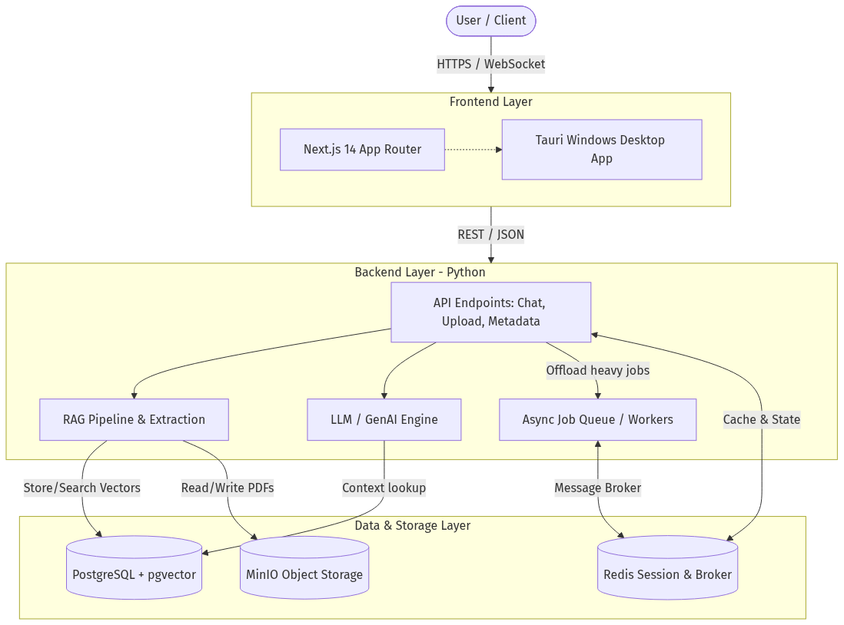
System Architecture
The system acts as a hybrid synchronous-asynchronous platform:
FastAPI backend handles high-speed REST interactions and SSE streaming limits.
Celery offloads CPU-intensive PDF chunking and bounding-box extractions.
Data propagates across multiple purpose-built persistence layers (MinIO, PostgreSQL PGVector, Redis).

Slide 3
Ingestion Pipeline
Documents undergo a rigorous processing workflow:
1. Uploads securely pushed to an S3-compatible MinIO datastore.
2. Heavy lifting is assigned to asynchronous Celery tasks to prevent UI blockage.
3. Unstructured parses complex layouts, while embeddings transform chunks into multi-dimensional vectors for semantic search.

Slide 4
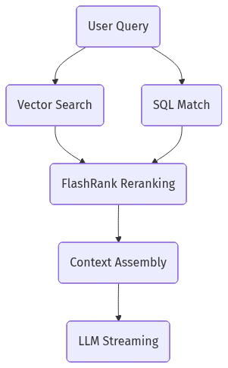
Query Pipeline
Hybrid intelligence retrieval system:
Queries execute concurrently: performing semantic search alongside standard relational keyword hits.
FlashRank takes the overlapping chunk results, applies Cross-Encoding models, and reranks them to ensure optimum context fidelity.
Local LLMs then stream generating responses chunk by chunk over HTTP connections back to the Next.js UI.

Slide 5

AI Intelligence Workflow
A high-level abstraction of the RAG (Retrieval-Augmented Generation) pipeline.
Demonstrates semantic data streaming off vectors and interacting with the neural LLM endpoint.

Slide 6
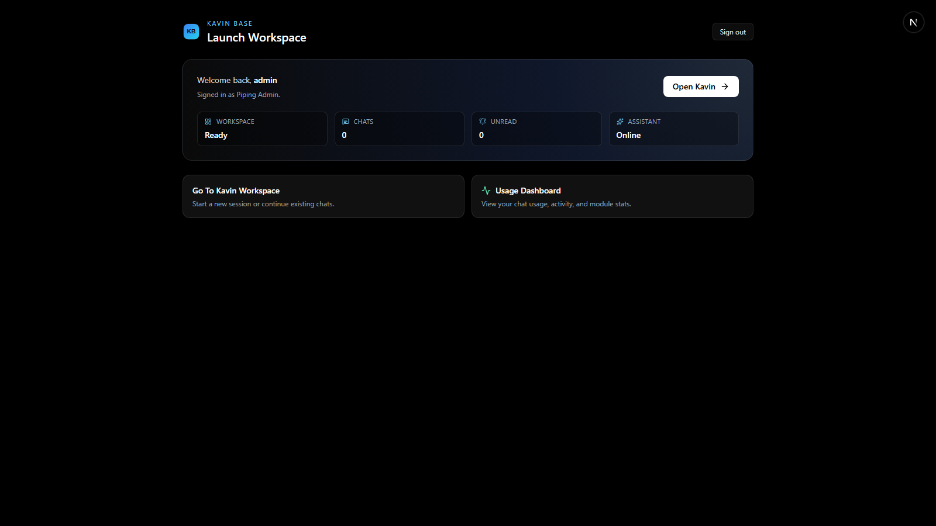
Frontend: Application Dashboard
The Dashboard serves as the main command center.
Pulls real-time project metrics directly from the PostgreSQL instance.
Secure JWT verification protects layout access across routes.

Slide 7

Frontend: Chat Workspace
Real-time intelligence retrieval center.
Maintains continuous SSE (Server-Sent Events) links with the LLM backend for token-by-token rendering.
Embeds technical Markdown, Tables, and citations safely.

Slide 8
Frontend: Projects Hub
Document indexing and status tracking interface.
Monitors active celery worker tasks and asynchronous indexing via simple UI indicators.

Slide 9
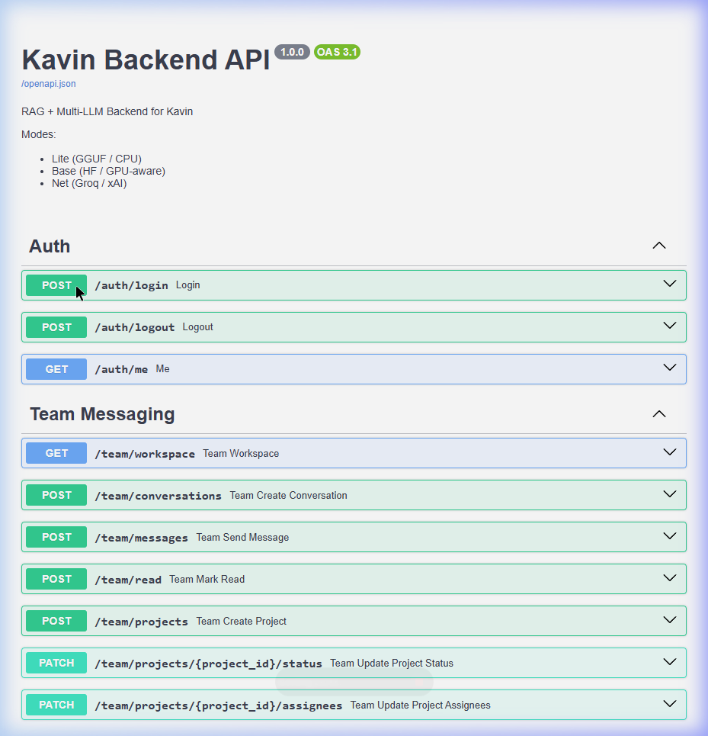
Backend: API Exposure
The FastAPI backend strictly types payloads using Pydantic.
Provides a fully interactive Swagger documentation interface out of the box.
Modular routes separate Chat, Authentication, and Upload workflows seamlessly.

Slide 10
Storage Ecosystem
MinIO (Object Stores): Retains raw PDFs and binary blobs isolated from the database.
PostgreSQL + PGVector (Relational / Vector): Handles user schemas, project models, and the ~384 dimensional vector indexes.
Redis (Key-Value Keyring): Serves as the high-speed Cache layer tracking streaming states and broker messaging.

