Slide 1

KavinBase
Enterprise AI Document Intelligence Platform
Hybrid RAG · Local LLMs · Multi-Modal Ingestion · Agentic Review Pipeline
Next.js 14 Frontend · FastAPI Backend · PostgreSQL PGVector · Redis · MinIO
-Hariesh R
Notes:
Good morning. This presentation is about KavinBase, our enterprise AI document intelligence platform. The goal is to make large technical PDFs searchable, traceable, and answerable in seconds instead of hours.

Slide 2
THE PROBLEM
THE SOLUTION — KavinBase
1,000+
Instant AI Answers
from any document — in seconds, not hours
Pages per client document package
Engineering & technical documents run into hundreds or thousands of pages per project
Analysts and engineers must manually read, cross-reference and search through dense PDFs
Critical values — revision numbers, tag IDs, design parameters — buried deep inside tables and appendices
A single query may need data from multiple documents, multiple revisions, multiple sections
Hours or days spent per document review cycle; errors from manual extraction are costly
No way to instantly compare specs across revisions or extract answers without opening every file
+ Upload once
Index the entire 1000-page package into PGVector with BAAI/bge-m3 embeddings — one-time operation
+ Ask in plain English
"What is the revision number of document X?" "List all tag numbers in section 4" — answered instantly
+ Hybrid RAG retrieval
Semantic vector search + BM25 keyword + FlashRank reranker ensures the right passage is always found
+ Cite every answer
Every response includes page number + section source — traceable back to the original document
+ Multi-document queries
Cross-reference specs, drawings and datasheets in a single natural-language question
+ Agentic quality gate
Built-in agent pipeline verifies factual accuracy before presenting the answer — no hallucinations
Today, engineering and technical document packages can run into 1,000 pages or more. People spend a lot of time manually reading, comparing revisions, and finding values hidden in tables or appendices. This causes delay and increases the chance of human error
VS
Notes:
Today, engineering and technical document packages can run into 1,000 pages or more. People spend a lot of time manually reading, comparing revisions, and finding values hidden in tables or appendices. This causes delay and increases the chance of human error
KavinBase solves this by letting users upload documents once, index them, and ask questions in plain English. It uses hybrid retrieval, gives page-cited answers, supports multi-document queries, and includes a quality gate so the system is more reliable

Slide 3
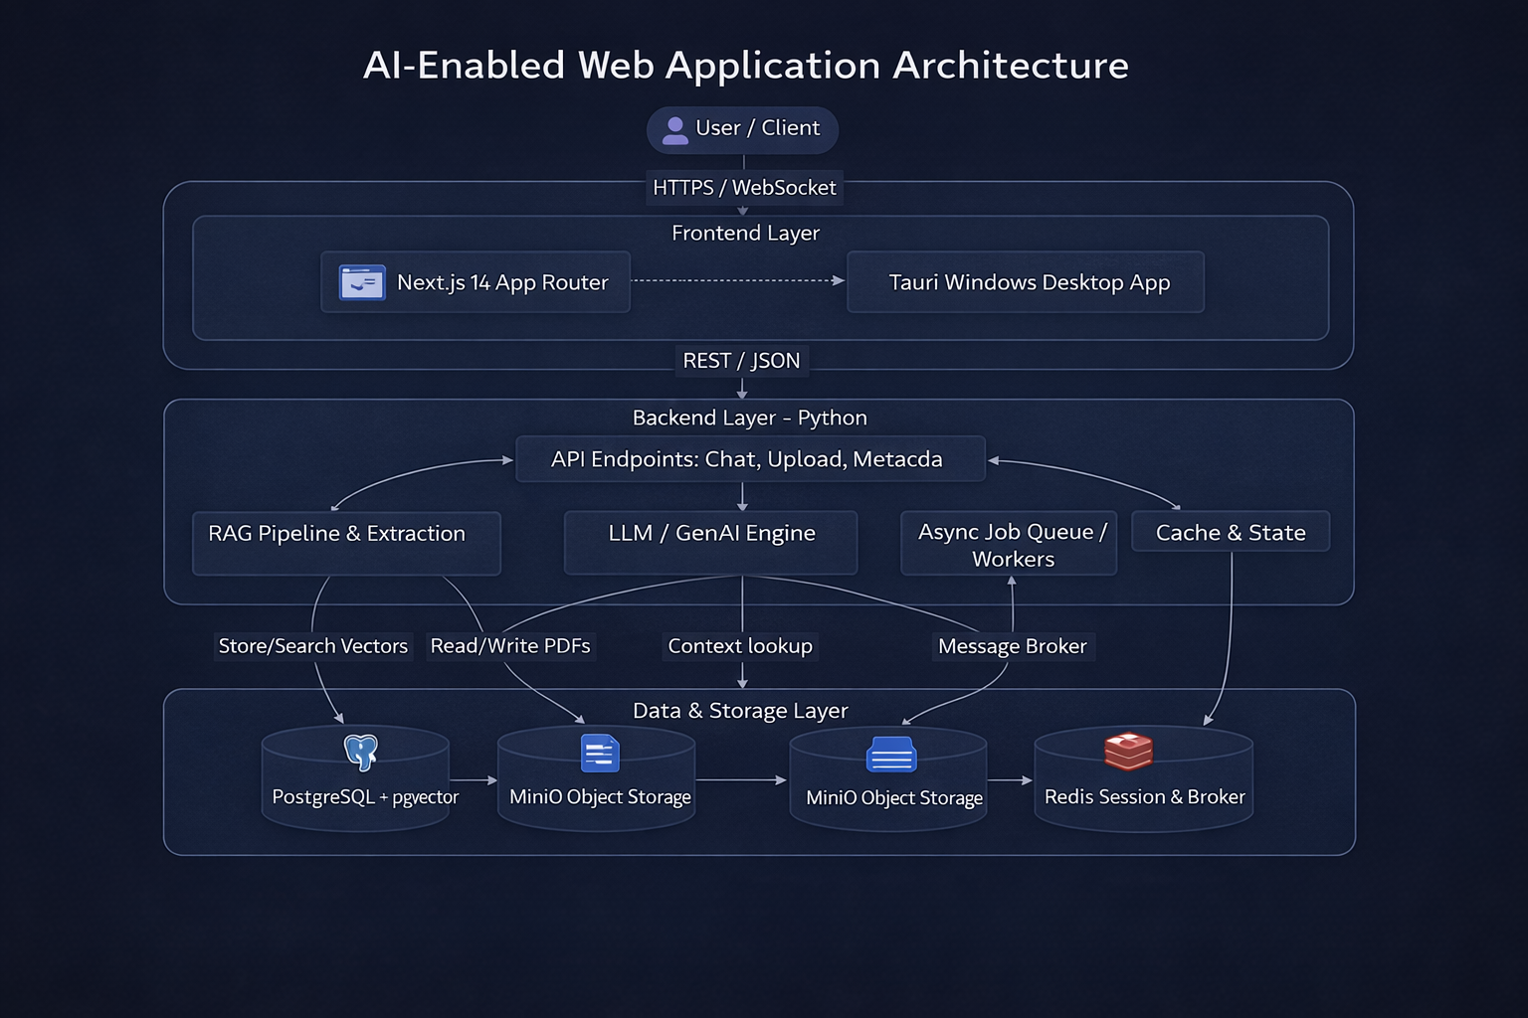
System Architecture Overview
Hybrid Sync/Async Platform with Multi-Layer Persistence
⚡ FastAPI (Python) backend – REST + SSE streaming endpoints
🌐 Next.js 14 (TypeScript/React) frontend – real-time token streaming UI
🔄 Celery workers – asynchronous, CPU-intensive PDF ingestion tasks
🗃️ MinIO – S3-compatible object storage for raw PDFs & binary blobs
🔢 PostgreSQL + PGVector – relational store + 1024-dim vector index (BGE-M3)
⚡ Redis – session cache, streaming state broker, Celery task queue
🔑 JWT-based authentication with scoped role permissions
🏗️ Modular Python backends: rag/, llm/, auth/, memory/, queue/, storage/
Notes:
This slide shows the full stack behind the system: FastAPI backend, Next.js frontend, Celery workers, MinIO for file storage, PostgreSQL with PGVector for vector search, and Redis for sessions and streaming state. The design is split into clear layers so ingestion, retrieval, and generation all work smoothly together.

Slide 4
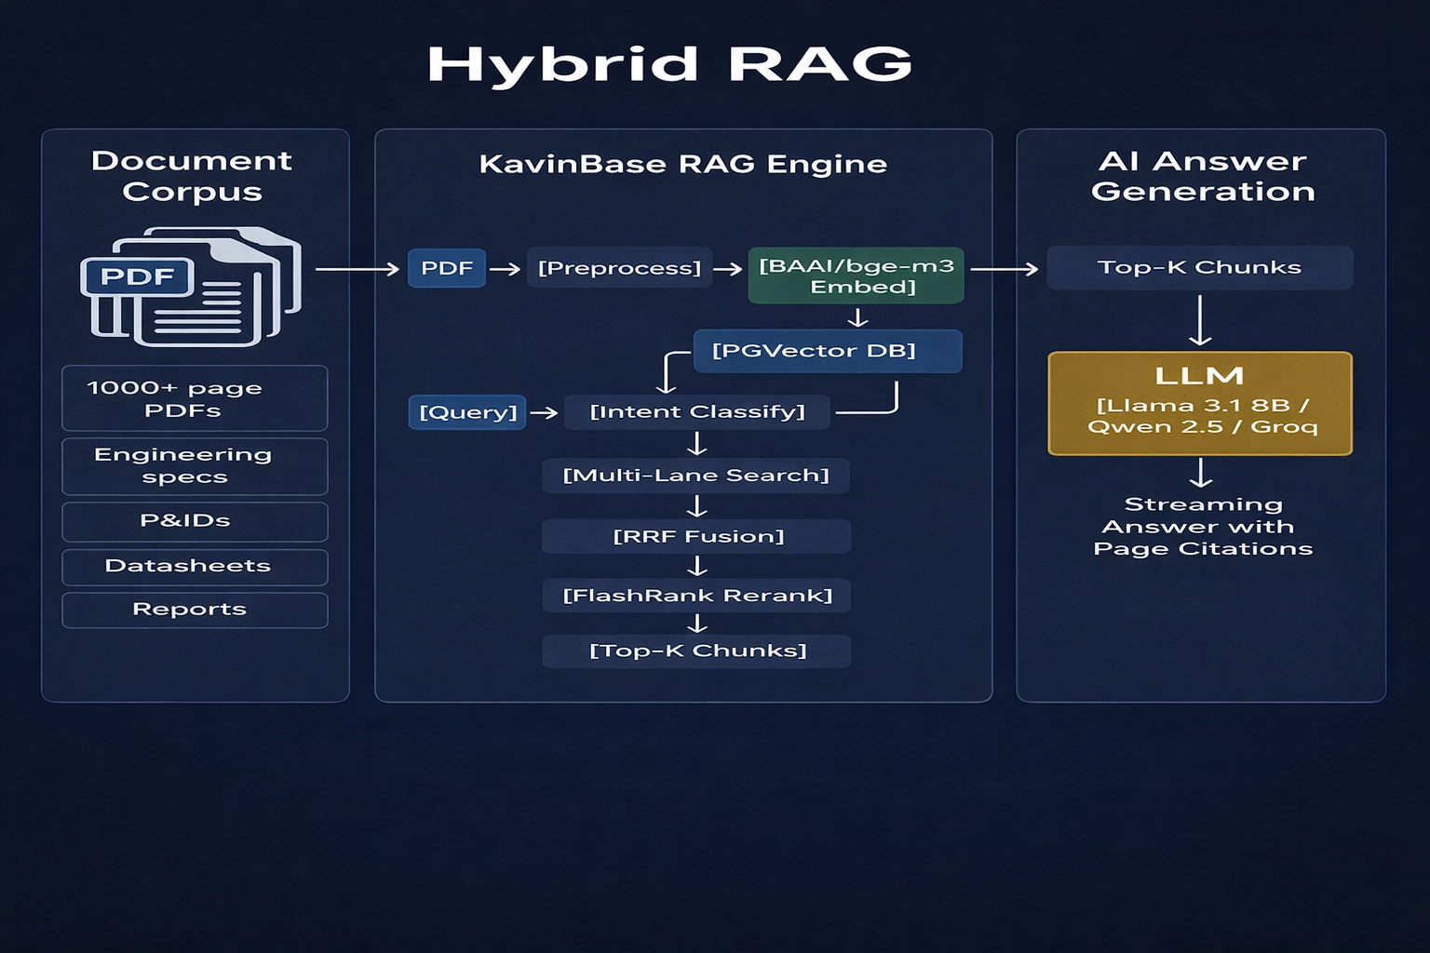
RAG Type: Advanced Hybrid Multi-Lane Retrieval-Augmented Generation
Semantic Vector Search + Keyword BM25 + Cross-Encoder Reranking + Parent Resolution
RAG Architecture: Hybrid Retrieval · Multi-Lane Chunking · Reciprocal Rank Fusion (RRF) · FlashRank Cross-Encoder Reranker
RETRIEVAL MODES (per query intent):
• Fast Mode – vector-only, 14 candidates, no rerank
• Balanced Mode – vector + keyword, 25 candidates, RRF + FlashRank
• High-Fidelity – vector + BM25, 40 candidates, full reranking + parent
MULTI-LANE CHUNK SEARCH:
• Separate lanes for: text, parent-table, image, child-row
• Lane budgets prevent child rows dominating results
• Parent resolution fetches full table when child chunk matches
RECIPROCAL RANK FUSION (RRF k=60):
• Fuses vector similarity ranks + keyword BM25 ranks
• Score: 1/(k + rank_vector) + 1/(k + rank_keyword) + 0.01×kw_score
SCORING MULTIPLIERS (per chunk):
• Element type weight (Title=1.0, NarrativeText=0.9, Table=0.6)
• Extraction source (PyMuPDF=1.0, Docling=0.9, Unstructured=0.8)
• Quality score (0.55 – 1.0 range)
• OCR noise penalty (×0.6 if OCR used)
• Section-query overlap boost (up to +8%)
RERANKER: FlashRank (ms-marco-MiniLM-L-12-v2)
• Cross-encoder re-scores top candidates
• Final score = max(rerank×multiplier, retrieval_score)
VECTOR DB: PostgreSQL PGVector
• Embedding: BAAI/bge-m3 (1024-dim)
• Metadata-filtered similarity_search per collection
Notes:
“The retrieval engine is not just basic vector search. It combines semantic search, BM25 keyword search, RRF fusion, and FlashRank reranking, with parent resolution for tables. That means the system can search across different chunk types and still return the most relevant context.

Slide 5
RAG Type: Advanced Hybrid Multi-Lane Retrieval-Augmented Generation
Semantic Vector Search + Keyword BM25 + Cross-Encoder Reranking + Parent Resolution
RAG Architecture: Hybrid Retrieval · Multi-Lane Chunking · Reciprocal Rank Fusion (RRF) · FlashRank Cross-Encoder Reranker
RETRIEVAL MODES (per query intent):
• Fast Mode – vector-only, 14 candidates, no rerank
• Balanced Mode – vector + keyword, 25 candidates, RRF + FlashRank
• High-Fidelity – vector + BM25, 40 candidates, full reranking + parent
MULTI-LANE CHUNK SEARCH:
• Separate lanes for: text, parent-table, image, child-row
• Lane budgets prevent child rows dominating results
• Parent resolution fetches full table when child chunk matches
RECIPROCAL RANK FUSION (RRF k=60):
• Fuses vector similarity ranks + keyword BM25 ranks
• Score: 1/(k + rank_vector) + 1/(k + rank_keyword) + 0.01×kw_score
SCORING MULTIPLIERS (per chunk):
• Element type weight (Title=1.0, NarrativeText=0.9, Table=0.6)
• Extraction source (PyMuPDF=1.0, Docling=0.9, Unstructured=0.8)
• Quality score (0.55 – 1.0 range)
• OCR noise penalty (×0.6 if OCR used)
• Section-query overlap boost (up to +8%)
RERANKER: FlashRank (ms-marco-MiniLM-L-12-v2)
• Cross-encoder re-scores top candidates
• Final score = max(rerank×multiplier, retrieval_score)
VECTOR DB: PostgreSQL PGVector
• Embedding: BAAI/bge-m3 (1024-dim)
• Metadata-filtered similarity_search per collection
Notes:
“The retrieval engine is not just basic vector search. It combines semantic search, BM25 keyword search, RRF fusion, and FlashRank reranking, with parent resolution for tables. That means the system can search across different chunk types and still return the most relevant context.

Slide 6
LLM Inventory & Model Architecture
Local GGUF / Hugging Face Models · External API (Groq / xAI) · Dedicated Auxiliary Models
Role
Model Name
Backend Type
Provider
Primary Use-case
💬 Lite Chat (rank-1)
Llama 3.1 8B Instruct Q4_K_M
GGUF (llama_cpp)
Primary local chat – GPU preferred
💬 Lite Chat (rank-2)
Qwen 2.5 7B Instruct Q4_K_M
GGUF (llama_cpp)
GGUF fallback chat model
💬 Lite Chat (light)
Qwen 2.5 3B Instruct Q4_K_M
GGUF (llama_cpp)
CPU-first developer setup model
💬 Lite Chat (mini)
Qwen 2.5 1.5B Instruct Q4_K_M
GGUF (llama_cpp)
Ultra-light CPU chat model
🧠 Base Chat (GPU)
Qwen 2.5 7B Instruct (HF)
Hugging Face Transformers
Full HF inference on CUDA
🧠 Base Chat (CPU)
Qwen 2.5 3B Instruct (HF)
Hugging Face Transformers
CPU-safe HF chat model
🤖 Agent Router
Qwen 2.5 0.5B Q4 (GGUF)
GGUF (llama_cpp)
Hidden routing, extraction, gate decisions
📐 Embedding
BAAI/bge-m3 (1024-dim)
Hugging Face Sentence Transformer
Ingestion + retrieval vector embedding
🏷️ Intent Classifier
facebook/bart-large-mnli
Zero-shot NLI pipeline
Query intent classification (MNLI)
📊 Table Detector
microsoft/table-transformer
Hugging Face Vision
Unstructured hi_res table structure
🖼️ Layout Model
unstructuredio/yolox_l0.05
ONNX (YOLOX)
PDF page layout detection (Unstructured)
📝 Reranker
ms-marco-MiniLM-L-12-v2
FlashRank cross-encoder
Post-retrieval chunk reranking
🌐 Net (Groq)
llama-3.1-8b-instant
Groq REST API
External API streaming – rank 1 & 2
🌐 Net (xAI)
grok-beta
xAI Grok REST API
External API streaming – Grok provider
Notes:
“We use different models for different jobs. Smaller Qwen models handle routing, extraction, and gate decisions, while stronger models handle answer generation and review. This keeps the system efficient, accurate, and flexible for both CPU and GPU setups

Slide 7
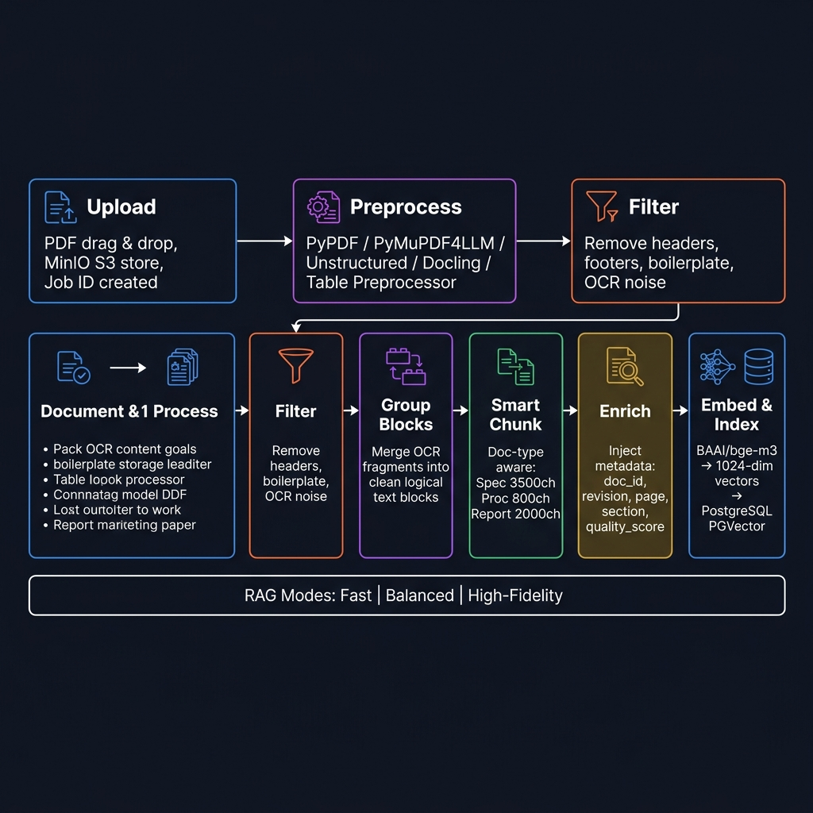
Ingestion Pipeline – Step-by-Step Flowchart
PDF → Preprocess → Filter → Group → Chunk → Enrich → Embed → PGVector
1️⃣ Upload
2️⃣ Preprocess
3️⃣ Filter
4️⃣ Group Blocks
5️⃣ Chunk
6️⃣ Enrich
7️⃣ Embed & Ingest
User drags PDF in Next.js UI. Stored in MinIO (S3). Job ID created in Redis.
stream_pdf_to_elements() Choose: PyPDF / PyMuPDF4LLM / Unstructured / Docling / Table Preprocessor
Remove headers, footers, boilerplate, image noise. Version-tracked FILTER_VERSION.
build_grouped_blocks() Merge OCR fragments into clean logical text blocks.
ContextAwareChunker Doc-type aware config: spec 3500 / proc 800 / report 2000
Metadata injection: doc_id, revision, page, section, quality_score, chunk_type.
BAAI/bge-m3 → 1024-dim vector ingest_to_pgvector() Revision-safe upsert.
→
→
→
→
→
→
RAG Ingest Modes: Fast (pypdf, no tables) · Balanced (hi_res + table structure, no images) · High-Fidelity (hi_res + tables + images extracted)
PRE-PROCESSORS AVAILABLE:
• pypdf_text – lightweight text extraction (PyPDF)
• pymupdf4llm – rich markdown extraction (PyMuPDF)
• unstructured – hi_res layout + OCR (Tesseract/YOLOX)
• docling – academic-grade extraction with table/formula support
• table_preprocessor – specialised Docling-backed table-focused pipeline
DOC-TYPE CHUNKING:
Specification → 3500 / 500
Procedure/SOP → 800 / 100
Report → 2000 / 300
Drawing/P&ID → 1000 / 150
Datasheet → 1500 / 200
Default → 3000 / 400
Notes:
This pipeline explains how a PDF becomes searchable knowledge. First the file is uploaded, then preprocessed, filtered, grouped, chunked, enriched with metadata, embedded using BGE-M3, and finally stored in PGVector. The process is revision-safe, so document updates do not corrupt the index.

Slide 8
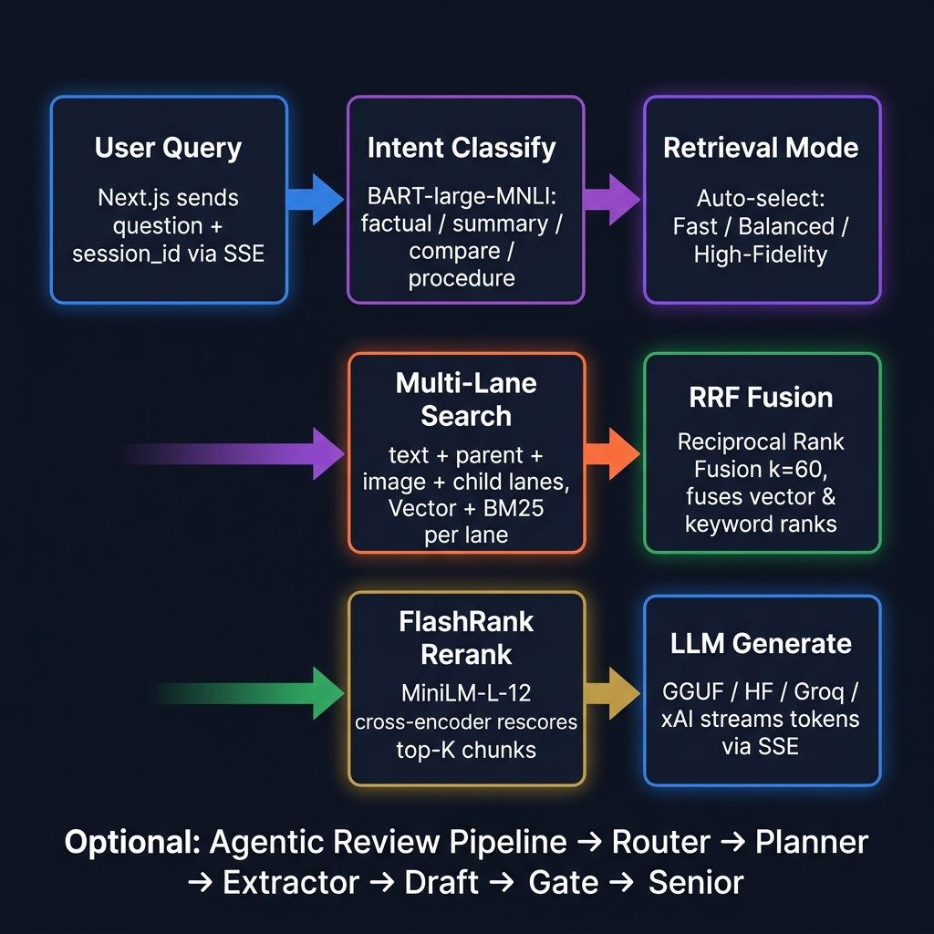
Query Pipeline – Step-by-Step Flowchart
User Question → Intent → Multi-Lane Retrieval → RRF → Rerank → Agentic Review → Stream
1️⃣ User Query
2️⃣ Intent Class.
3️⃣ Retrieval Mode
4️⃣ Multi-Lane Search
5️⃣ RRF Fusion
6️⃣ Rerank
7️⃣ LLM Generate
Next.js sends question + session_id + model_id via SSE stream endpoint.
BART-large-MNLI classifies: summary / factual / compare / procedure / greeting
Auto-selects: Fast / Balanced / High-Fidelity based on intent label.
Per-lane searches: text, parent, image, child. Vector + BM25 keyword per lane.
Reciprocal Rank Fusion fuses vector + keyword ranks (k=60 default).
FlashRank MiniLM-L-12 cross-encoder rescores candidates → top-K.
Prompt built → streamed via GGUF / HF / Groq / xAI. Token-by-token SSE yield.
→
→
→
→
→
→
Optional Agentic Review Pipeline (enable_agent_pipeline=true): Router → Planner → Extractor → Draft → Reviewer → Repair Gate → Senior Escalation (Qwen 3B)
QUERY PROFILE ROUTING:
• metadata – Title+Narrative only, no OCR, text lane only
• table_data – parent+child lane priority, Table element boost
• image_ref – image lane priority, Image element ×1.3 boost
• summary – balanced lanes, broad element set
• explanation – text lane focus, NarrativeText ×1.25
• factual – text+parent lanes, excludes UncategorizedText
SCORING FACTORS:
element_wt × source_wt × quality
× child_pen × ocr_pen × query_mult
× lane_mult × section_mult
QUALITY GATES:
Grounding check < 0.40 → warning
Release gate → blockers list
Eval gate: heuristic pre-LLM
Notes:
When a user asks a question, the system first detects the intent, chooses the right retrieval mode, searches multiple lanes, fuses results, reranks them, and then generates the answer through the model. This makes the answer pipeline smart and adaptive instead of using one fixed search path.

Slide 9
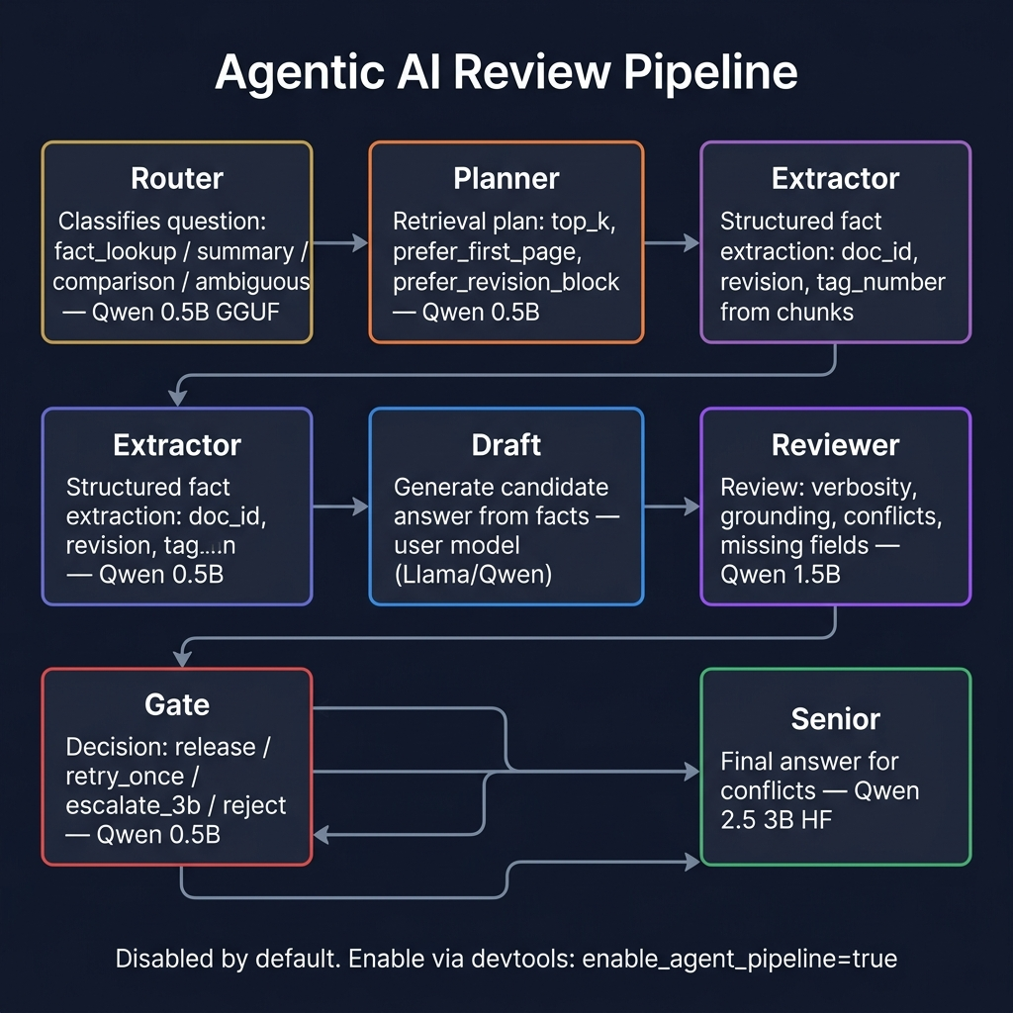
Agentic Review Pipeline – Hierarchical Deliberation Engine
Multi-stage agent chain: Router → Planner → Extractor → Draft → Reviewer → Gate → Senior
Router (0.5B GGUF)
Planner (0.5B GGUF)
Extractor (0.5B GGUF)
Draft (user model)
Reviewer (1.5B GGUF)
Gate (0.5B GGUF)
Senior (Qwen 3B HF)
Classifies question type: fact_lookup / summary / comparison / ambiguous
Determines retrieval plan: top_k, prefer_first_page prefer_title / revision block
Extracts structured facts: document_id, revision, tag_number from chunks
Generates candidate answer from facts + context. Strict-copy or analytical.
Reviews draft: verbosity, grounding, missing fields, conflicts
Decision: release / retry_once escalate_3b / reject
Escalation model for conflicts & ambiguities. Final authoritative answer.
→
→
→
→
→
→
MODEL ASSIGNMENTS: Router/Planner/Extractor/Gate → Qwen 0.5B Q4 | Draft → user model (Llama 8B / Qwen) | Reviewer → Qwen 1.5B Q4 | Senior → Qwen 3B HF
STRICT FACTUAL PATH (eval_gate=true): regex heuristic extraction → validate → release without LLM if high confidence
DISABLED BY DEFAULT — enable via devtools panel: enable_agent_pipeline=true and enable_eval_gate=true
Notes:
This is the quality-control layer. The question goes through router, planner, extractor, draft, reviewer, gate, and senior escalation. The purpose is to reduce hallucinations and ensure the final answer is grounded before it is shown to the user

Slide 10
Frontend Architecture – Next.js 14 (App Router) + TypeScript
Modular React components · SSE streaming · JWT auth · Multi-workspace modes
🏗️ TECH STACK:
• Next.js 14 (App Router) + TypeScript
• Tailwind CSS utility classes
• Lucide React icons
• Tauri (optional desktop build, src-tauri/)
📂 APP ROUTES:
• / – Main workspace (auth-gated)
• /signin – JWT login page
• /welcome – First-run onboarding flow
• /dashboard – Project metrics dashboard
• /pml – PML template editor workspace
• /usage – API usage & model telemetry
🔐 AUTHENTICATION:
• authMe() on mount – redirect to /signin if not logged in
• authLogout() clears session cookie
• First-visit gate → /welcome page
🧩 KEY COMPONENT MODULES:
• components/chat/ – ChatWindow, MessageBubble, ChatInput,
ChatHeader, PreprocessingPreviewPanel, SourceViewerModal,
TableInspectionModal, InlineMetadataPrompt
• components/sidebar/ – Sidebar, ChatList, PdfUpload, Brand
• components/upload/ – PdfUploadButton, UploadProgress,
ChunkingProgress, PdfContextBanner
• components/workspace/ – WorkspaceModeSwitcher,
WorkspaceOverviewDashboard, WorkspaceProjectTree
• components/pml/ – TemplateLibraryPanel
• components/messaging/ – EnterpriseMessagingWorkspace
• components/onboarding/ – GettingStartedModal, ShortcutsModal
🔄 WORKSPACE MODES: ai | pml | team
📡 STREAMING: SSE (Server-Sent Events) token-by-token from backend
🗄️ STATE: localStorage for chats, sidebar, workspace prefs
Notes:
The frontend is built with Next.js 14 and TypeScript, with modular React components and SSE streaming for real-time responses. It also supports authentication, multiple workspace modes, and a structure that can scale as more features are added

Slide 11
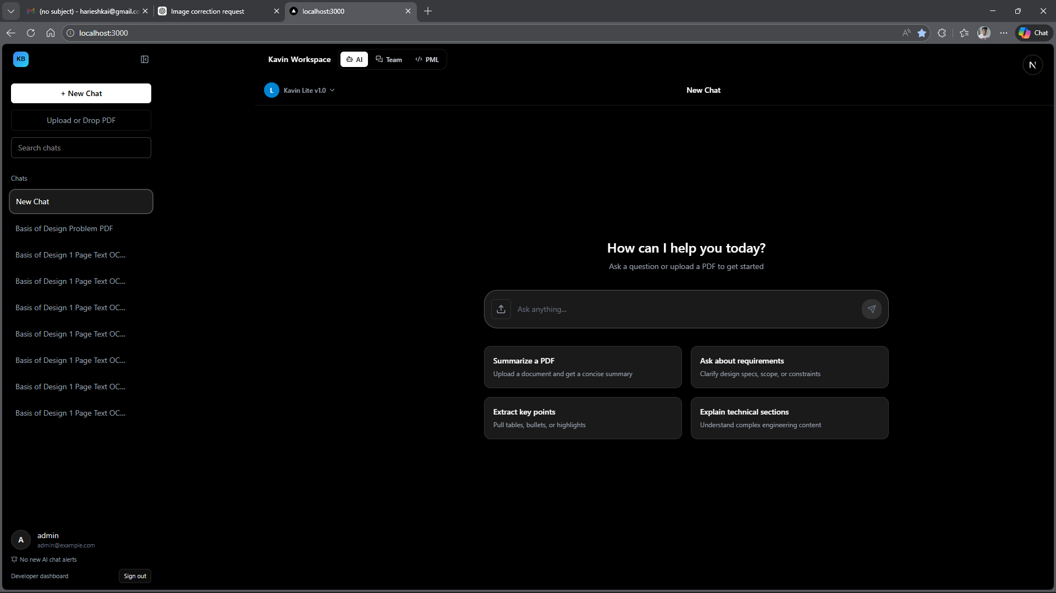
Frontend – Chat Workspace
Real-time AI document Q&A interface with token streaming and citation support
💬 Token-by-token SSE streaming from backend LLM (GGUF / HF / Groq / xAI)
📄 PDF context banner – shows indexed document + revision in chat header
🔍 Source Viewer Modal – opens cited chunk with page/section highlight
📊 Table Inspection Modal – explore structured table data extracted from PDF
🔄 Preprocessing Preview Panel – live ingestion progress (filter, chunk, embed steps)
📝 Inline Metadata Prompt – document_type, revision_code, doc_number confirmation
⏩ Processing Bubble – animated loading state during LLM generation
🧠 Thinking Disclosure – expandable CoT reasoning trace (agent mode)
📌 Model Selector – switch between Lite / Base / Net modes per chat
👍 Feedback Bar – thumbs up/down inline rating per message
[ADD: Chat Workspace Screenshot]
Notes:
This is the main user experience. Users can upload PDFs, view document context, inspect citations, see tables, and get token-by-token answers with source traceability. The design is made for practical document Q&A, not just generic chat

Slide 12
Frontend – Sidebar, Upload & Document Management
PDF ingestion flow, chat history, multi-mode sidebar, Dev Settings panel
📁 SIDEBAR (Sidebar.tsx):
• Collapsible slide-in navigation panel
• Chat list with unread badge counts
• Search/filter chat sessions
• PDF upload trigger (PdfUpload.tsx)
• Model mode indicator (Lite / Base / Net)
• Dev settings panel with live override controls
• User profile + sign-out
📤 PDF UPLOAD FLOW:
• PdfUploadButton → useSmartUpload hook
• Phase 1: metadata extraction (page-1 preview)
• InlineMetadataPrompt: confirm doc_type / revision
• Phase 2: full commit ingestion via Celery worker
• UploadProgress + ChunkingProgress bar (live SSE)
• Cancel support at each phase via job_id / session_id
• Background ingestion status poller (useIngestionStatusPoller)
🗂️ DOCUMENT CONTEXT PANEL:
• PdfContextBanner shows active doc + revision
• Workspace Overview Dashboard (WorkspaceOverviewDashboard.tsx):
– Document table with revision, chunk count, status
– Indexed document list derived from chat sources
• WorkspaceProjectTree – hierarchical project / doc view
⚙️ DEV SETTINGS (devtools/settings API):
• enable_agent_pipeline toggle
• enable_eval_gate toggle
• RAG preprocessor override
• RAG ingest mode override (fast / balanced / high_fidelity)
• enable_fast_document_processing shortcut
• rag_collection_name override
🔔 NOTIFICATIONS & HISTORY SIDE PANELS
Notes:
The sidebar is more than navigation. It manages chats, uploads, model selection, and dev settings. The upload flow includes metadata extraction first, then full ingestion, with progress tracking and cancellation support

Slide 13
Frontend – Dashboard, PML Editor & Team Workspace
Three workspace modes: AI Chat | PML Template Editor | Enterprise Team Messaging
🤖 AI Mode
📝 PML Mode
👥 Team Mode
• Primary document Q&A workspace
• Process Markup Language template editor
• Enterprise messaging workspace
• Sidebar + ChatWindow layout
• TemplateLibraryPanel – saved templates
• Real-time WebSocket team conversations
• Supports multiple parallel chat sessions
• Editor + Output tab layout
• Project threads + assignee management
• Upload → ingest → query inline workflow
• Learn template from example via API
• Team notifications panel
• Citation + source viewer integration
• PML chat backed by base/net model
• AI-assist seed from team context
• Unread badge count aggregation
Notes:
We support three workspace modes: AI chat, PML template editing, and team messaging. This makes the platform useful not only for document Q&A but also for internal collaboration and enterprise workflows.”

Slide 14
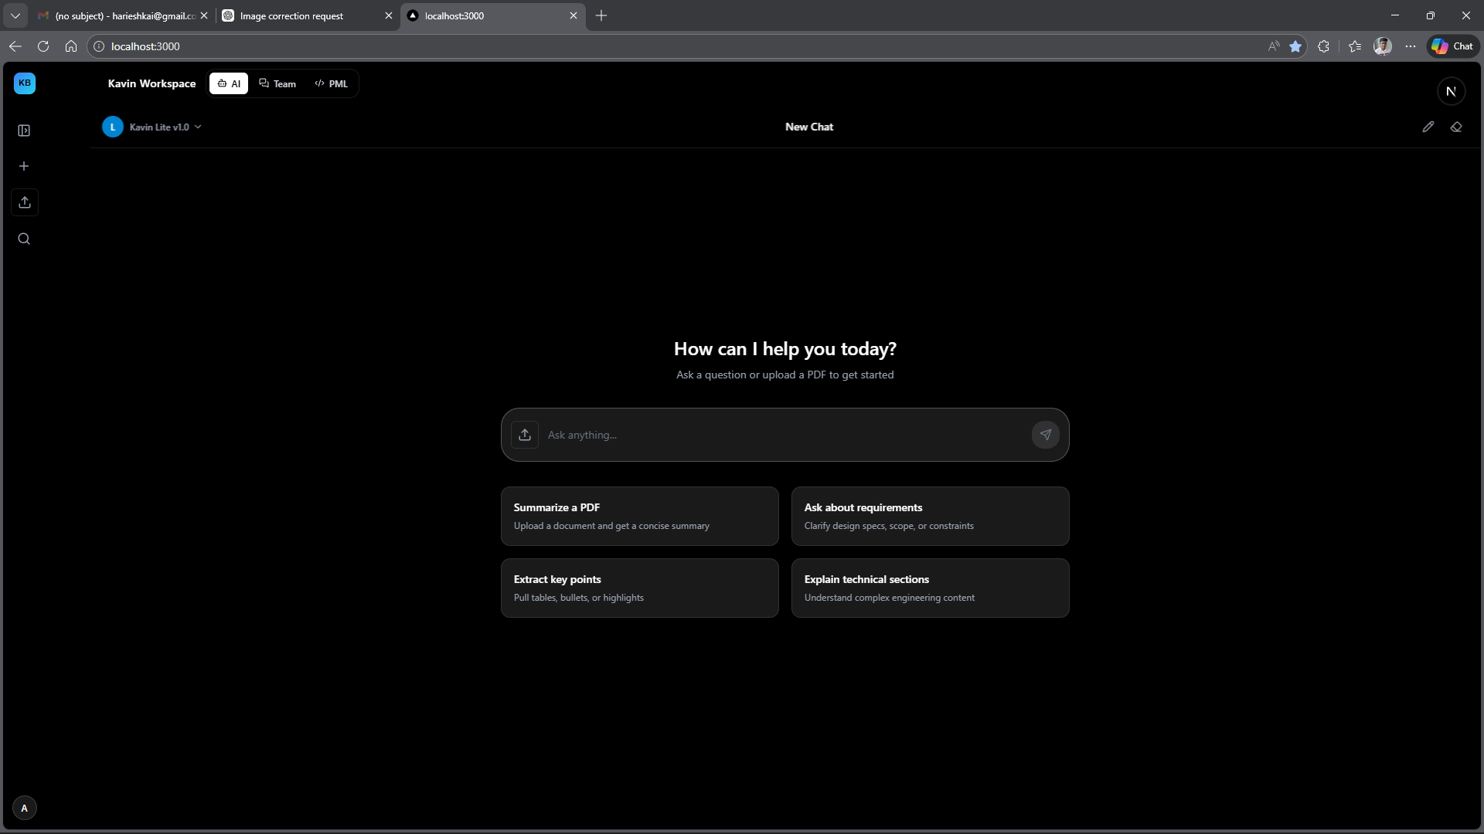
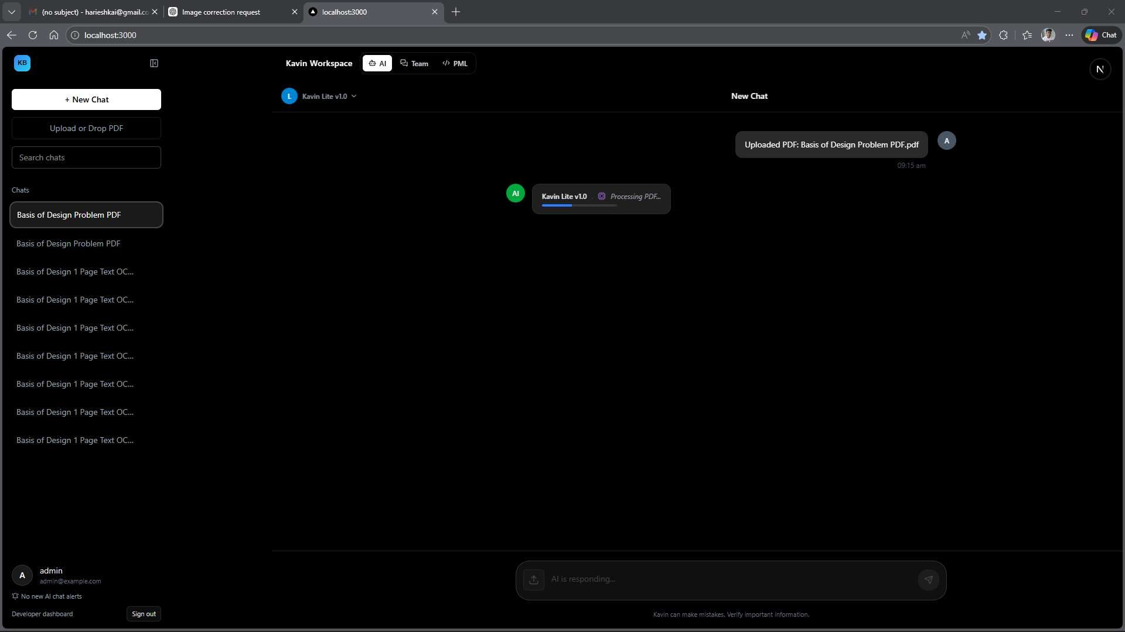
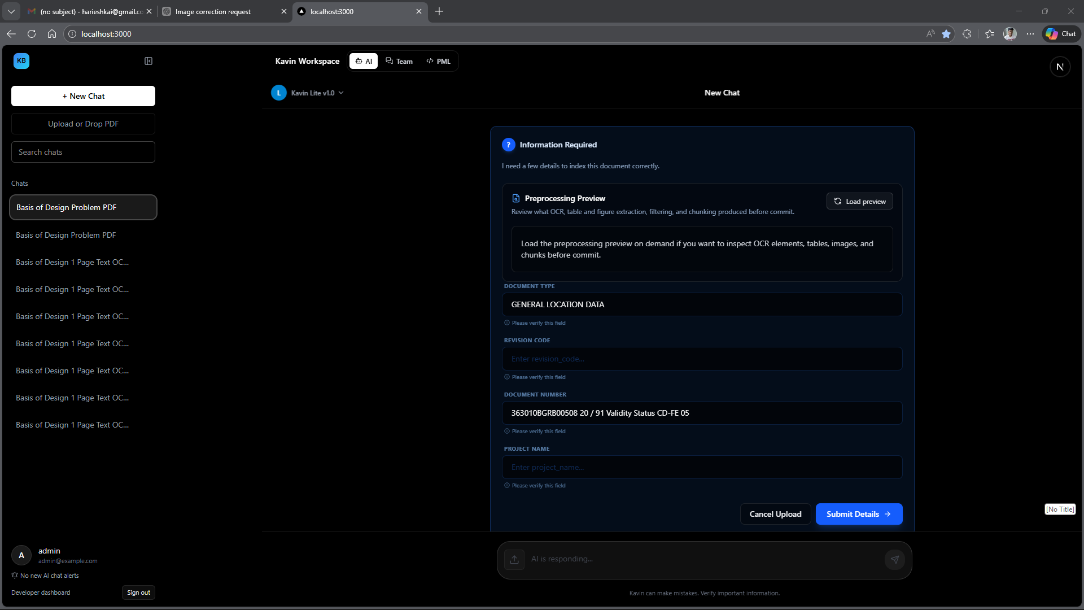
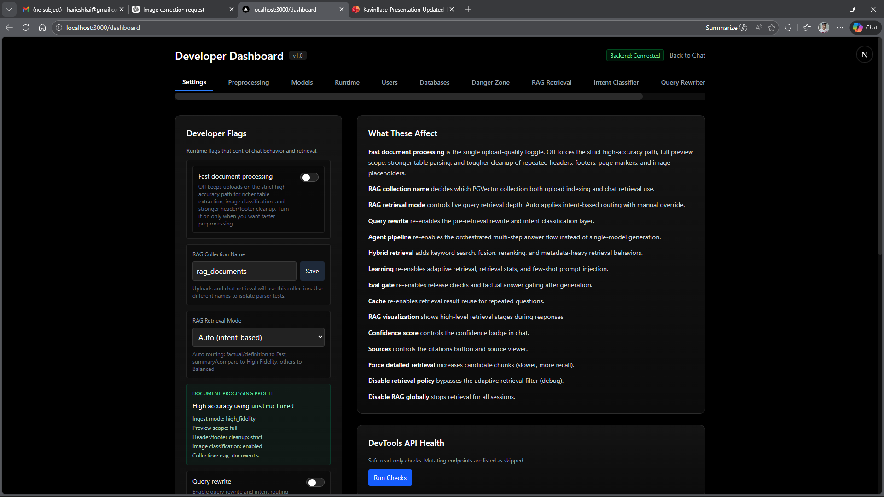
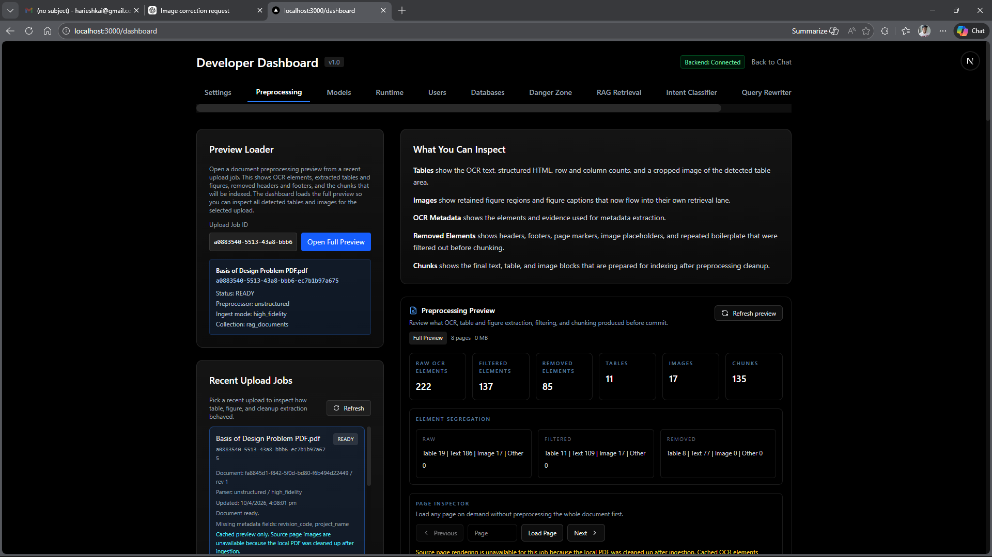
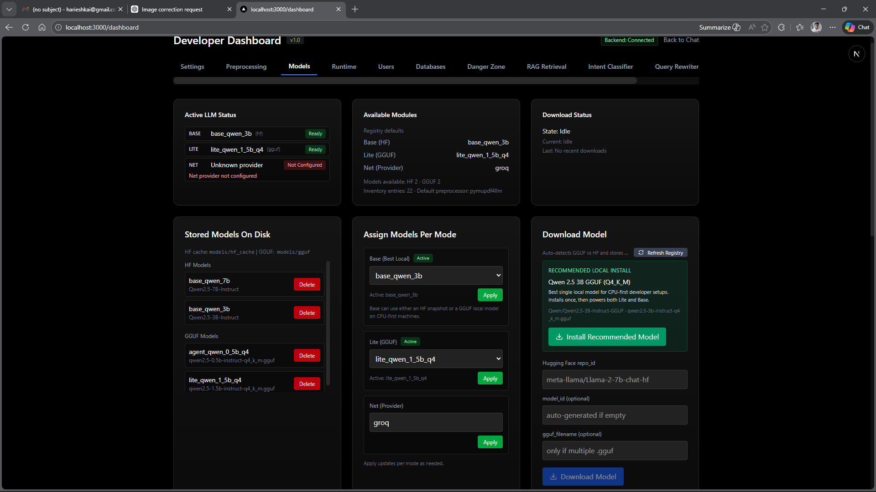
Frontend Screenshots
Add screenshots for each view manually – placeholder frames shown below
[ADD: Chat Window – main Q&A view]
[ADD: PDF Upload flow / Progress bar]
[ADD: Sidebar open with chat list]
[ADD: Source Viewer / Citation Modal]
[ADD: Table Inspection Modal]
[ADD: Preprocessing Preview Panel]
Notes:
“For these slides, say that the actual screenshots will show the real product interface for chat, upload flow, sidebar, source viewer, table inspection, and preprocessing preview. These slides are meant to demonstrate usability, not architecture.”

Slide 15
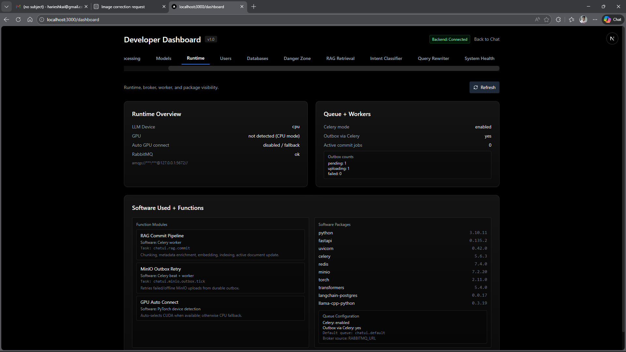
Frontend Screenshots
Add screenshots for each view manually – placeholder frames shown below
[ADD: Chat Window – main Q&A view]
[ADD: PDF Upload flow / Progress bar]
[ADD: Sidebar open with chat list]
[ADD: Source Viewer / Citation Modal]
[ADD: Table Inspection Modal]
[ADD: Preprocessing Preview Panel]

Slide 16
Frontend Screenshots
Add screenshots for each view manually – placeholder frames shown below
[ADD: Chat Window – main Q&A view]
[ADD: PDF Upload flow / Progress bar]
[ADD: Sidebar open with chat list]
[ADD: Source Viewer / Citation Modal]
[ADD: Table Inspection Modal]
[ADD: Preprocessing Preview Panel]

Slide 17
Frontend Screenshots
Add screenshots for each view manually – placeholder frames shown below
[ADD: Chat Window – main Q&A view]
[ADD: PDF Upload flow / Progress bar]
[ADD: Sidebar open with chat list]
[ADD: Source Viewer / Citation Modal]
[ADD: Table Inspection Modal]
[ADD: Preprocessing Preview Panel]

Slide 18
Frontend Screenshots
Add screenshots for each view manually – placeholder frames shown below
[ADD: Chat Window – main Q&A view]
[ADD: PDF Upload flow / Progress bar]
[ADD: Sidebar open with chat list]
[ADD: Source Viewer / Citation Modal]
[ADD: Table Inspection Modal]
[ADD: Preprocessing Preview Panel]

Slide 19
Frontend Screenshots
Add screenshots for each view manually – placeholder frames shown below
[ADD: Chat Window – main Q&A view]
[ADD: PDF Upload flow / Progress bar]
[ADD: Sidebar open with chat list]
[ADD: Source Viewer / Citation Modal]
[ADD: Table Inspection Modal]
[ADD: Preprocessing Preview Panel]

Slide 20
Frontend Screenshots
Add screenshots for each view manually – placeholder frames shown below
[ADD: Chat Window – main Q&A view]
[ADD: PDF Upload flow / Progress bar]
[ADD: Sidebar open with chat list]
[ADD: Source Viewer / Citation Modal]
[ADD: Table Inspection Modal]
[ADD: Preprocessing Preview Panel]

Slide 21
Frontend Screenshots
Add screenshots for each view manually – placeholder frames shown below
[ADD: Chat Window – main Q&A view]
[ADD: PDF Upload flow / Progress bar]
[ADD: Sidebar open with chat list]
[ADD: Source Viewer / Citation Modal]
[ADD: Table Inspection Modal]
[ADD: Preprocessing Preview Panel]

Slide 22
Frontend Screenshots
Add screenshots for each view manually – placeholder frames shown below
[ADD: Chat Window – main Q&A view]
[ADD: PDF Upload flow / Progress bar]
[ADD: Sidebar open with chat list]
[ADD: Source Viewer / Citation Modal]
[ADD: Table Inspection Modal]
[ADD: Preprocessing Preview Panel]

Slide 23
Frontend Screenshots
Add screenshots for each view manually – placeholder frames shown below
[ADD: Chat Window – main Q&A view]
[ADD: PDF Upload flow / Progress bar]
[ADD: Sidebar open with chat list]
[ADD: Source Viewer / Citation Modal]
[ADD: Table Inspection Modal]
[ADD: Preprocessing Preview Panel]

Slide 24
Frontend Screenshots
Add screenshots for each view manually – placeholder frames shown below
[ADD: Chat Window – main Q&A view]
[ADD: PDF Upload flow / Progress bar]
[ADD: Sidebar open with chat list]
[ADD: Source Viewer / Citation Modal]
[ADD: Table Inspection Modal]
[ADD: Preprocessing Preview Panel]

Slide 25
Frontend Screenshots
Add screenshots for each view manually – placeholder frames shown below
[ADD: Chat Window – main Q&A view]
[ADD: PDF Upload flow / Progress bar]
[ADD: Sidebar open with chat list]
[ADD: Source Viewer / Citation Modal]
[ADD: Table Inspection Modal]
[ADD: Preprocessing Preview Panel]

Slide 26
Frontend Screenshots
Add screenshots for each view manually – placeholder frames shown below
[ADD: Chat Window – main Q&A view]
[ADD: PDF Upload flow / Progress bar]
[ADD: Sidebar open with chat list]
[ADD: Source Viewer / Citation Modal]
[ADD: Table Inspection Modal]
[ADD: Preprocessing Preview Panel]

Slide 27
Backend API Exposure & Storage Ecosystem
FastAPI + Pydantic · MinIO + PostgreSQL PGVector + Redis · Celery task queue
🌐 FASTAPI BACKEND:
• Strict Pydantic payload validation
• Swagger UI auto-generated (interactive docs)
• Route groups: Chat, Auth, Upload, RAG, Dev Tools
• SSE (Server-Sent Events) for streaming LLM tokens
• Sidecar process (sidecar_main.py) for auxiliary tasks
📋 API MODULES:
• backend/api/ – route definitions
• backend/main/ – FastAPI app factory
• backend/pml_main.py – PML service entrypoint
• backend/sidecar_main.py – background sidecar
🕐 ASYNC WORKERS:
• Celery + Redis broker for PDF ingestion jobs
• Celerybeat scheduler for periodic tasks
• Job ID tracking with upload_cancellation support
🗄️ STORAGE LAYERS:
MinIO (S3-compatible Object Store):
– Raw PDFs and binary blobs
– Isolated from relational DB
– Local minio-data/ volume
PostgreSQL + PGVector (Vector DB):
– User accounts, projects, session data
– 1024-dimensional BAAI/bge-m3 vector index
– langchain_pg_embedding + langchain_pg_collection tables
– Revision-safe upsert strategy
Redis (Key-Value Store):
– SSE streaming state tracking
– Celery task broker + result backend
– Session abort signals (is_aborted())
– Used-chunk deduplication per session
Notes:
This slide explains the backend services and storage layers. FastAPI handles routes and streaming, Celery handles heavy background jobs, MinIO stores documents, PostgreSQL stores metadata and vectors, and Redis manages session state and task coordination

Slide 28
New Features & Enhancements
Since initial release – advanced pipeline capabilities and quality gates
🚀 AGENTIC REVIEW PIPELINE
7-stage deliberation chain with 3 local models
Strict factual heuristic + LLM reviewer gate
Senior escalation for conflicts & ambiguities
🔍 MULTI-LANE RETRIEVAL
Separate text / parent / image / child lanes
Prevents child-row domination of results
Deterministic parent lookup by doc_id SQL
📊 QUERY PROFILE ROUTING
7 profiles: metadata, table, image, summary,
explanation, factual, general
Per-profile element weights + lane budgets
📝 DOCUMENT-TYPE AWARE CHUNKING
Auto-detect: spec, procedure, report, drawing, datasheet
Tailored chunk_size + overlap per doc type
Content + filename signals (no LLM needed)
🏷️ INLINE METADATA EXTRACTION
Page-1 preview fast path (metadata mode)
LLM-extracted: doc_type, revision, doc_number
Inline confirmation UI before full ingest
⚡ PREPROCESSING REGISTRY
5 preprocessors: pypdf, pymupdf4llm, unstructured,
docling, table_preprocessor
Per-upload override via dev settings
✅ ANSWER QUALITY GATES
enable_eval_gate: grounding score check
Release gate with blocker enumeration
Soft warning appended when score < 0.40
🌐 EXTERNAL LLM NET MODE
Groq: llama-3.1-8b-instant (rate-limited)
xAI: grok-beta
Concurrency guard + rate limit event UI
👥 ENTERPRISE TEAM WORKSPACE
Real-time WebSocket messaging
Project threads + assignee management
Team notification panel + unread counts
Notes:
This section highlights the advanced additions: agentic review, multi-lane retrieval, query profile routing, document-type aware chunking, inline metadata extraction, preprocessing overrides, answer quality gates, and external LLM support. These features make the system stronger and more production-ready.

Slide 29
Technology Stack Summary
Complete technology inventory across all system layers
🖥️ Frontend
⚙️ Backend
🤖 AI / ML
📦 Preprocessing
🗄️ Storage
• Next.js 14 + TypeScript (App Router)
• FastAPI (Python 3.11+)
• llama_cpp (GGUF runtime)
• PyPDF · PyMuPDF4LLM
• PostgreSQL + PGVector
• React hooks / SSE EventSource
• Celery + Redis broker
• Hugging Face Transformers
• Unstructured (hi_res / fast)
• MinIO (S3-compatible)
• Tailwind CSS · Lucide icons
• Pydantic v2 validation
• BAAI/bge-m3 embeddings
• Docling (academic-grade)
• Redis (cache + broker)
• Tauri (optional desktop)
• LangChain / LangChain-Postgres
• FlashRank (MiniLM-L-12)
• Table-Transformer (MSFT)
• Local file system (jobs/)
• JWT cookie auth
• SQLAlchemy (async)
• BART-MNLI zero-shot NLI
• YOLOX layout detection
• HF model cache (snapshots)
Notes:
This slide gives the overall stack in one view. Frontend, backend, AI/ML, preprocessing, and storage are all separated clearly so the system is easier to understand, maintain, and scale

Slide 30
KavinBase
Enterprise AI Document Intelligence – End-to-End
Hybrid RAG · Local LLMs · Agentic Review · Multi-Modal Ingestion
Thank you
Notes:
Thank you. KavinBase is designed to turn large technical document workflows into a fast, reliable, and traceable AI experience

Slide 31
Developer Mode — Overview
Kavin AI ships a built-in /devtools admin panel for deep system introspection.
● All endpoints are admin-gated (JWT role check via require_admin).
● Feature flags can be toggled live without restarting the server.
● Covers: Model mgmt · RAG debug · User admin · DB browser · Reset controls.
● Destructive operations (reset) require an env flag + confirmation phrase.
● Router prefix: /devtools | Tags: Developer Tools

Slide 32
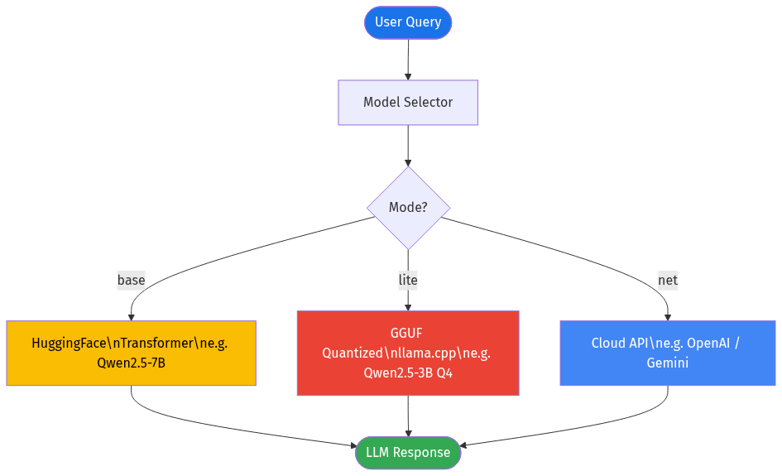
LLM Model Management — Three Modes
base → HuggingFace Transformers (GPU / CPU). e.g. Qwen2.5-7B-Instruct
lite → GGUF Quantized via llama.cpp (CPU-friendly). e.g. Qwen2.5-3B Q4
net → Cloud API provider (OpenAI, Gemini). Key stored in secrets store.
Admin can download, register, test and delete models at runtime via REST.

Slide 33
Model Download & Registry API
DOWNLOAD ENDPOINTS
● POST /devtools/models/download
Auto-detects GGUF vs HF snapshot
● POST /devtools/models/gguf/download
Direct URL → models/gguf/ dir
● POST /devtools/models/hf/install
snapshot_download to HF cache
REGISTER / TEST
● POST /devtools/models/gguf/register
Register local .gguf path
● POST /devtools/models/test
Run a quick generation sample
KNOWN SUPPORTED MODELS
● Qwen/Qwen2.5-3B-Instruct-GGUF
● Qwen/Qwen2.5-1.5B-Instruct-GGUF
● Qwen/Qwen2.5-7B-Instruct-GGUF
● AI-Engine/Llama-3.1-8B-GGUF
● Qwen/Qwen2.5-3B-Instruct (HF)
● Qwen/Qwen2.5-7B-Instruct (HF)
AUX / EMBEDDING MODELS
● BAAI/bge-m3 → embedding
● facebook/bart-large-mnli → intent
● microsoft/table-transformer
● unstructuredio/yolo_x_layout

Slide 34
RAG Debug & Retrieval Testing
POST /devtools/intent → Classify query intent (fact_lookup, comparison, …)
POST /devtools/rewrite → Show how a question is rewritten with history.
POST /devtools/keywords → Inspect keywords extracted for SQL hybrid search.
POST /devtools/retrieve → Full RAG retrieval dry-run, returns top N chunks.

Slide 35
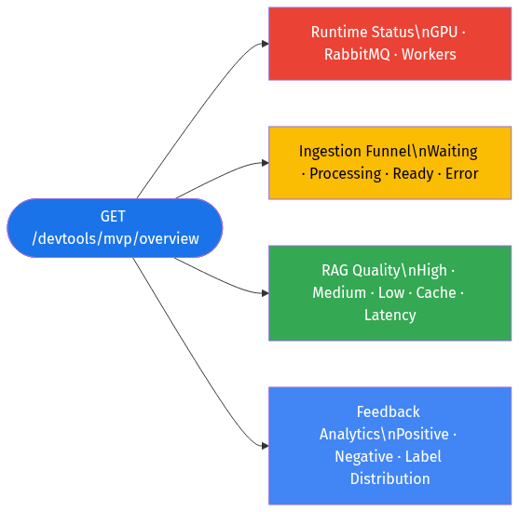
MVP Analytics Command Center
GET /devtools/mvp/overview (window_hours: 1–168h)
● Ingestion Funnel: waiting → processing → ready | error + success rate.
● RAG Quality: high / medium / low distribution + avg latency + cache hit %.
● Feedback: positive / negative counts, avg score, label distribution.
● Runtime: GPU VRAM, RabbitMQ broker health, Celery worker queues.

Slide 36
Upload Job Inspector & Preprocessing Preview
GET /devtools/uploads/recent → Last N ingestion jobs with full metadata.
● Fields: job_id, status, progress %, progress_label, error message.
● Company document ID, revision, source file, RAG preprocessor used.
● preview_available flag — links to extracted element JSON artifacts.
● Segregation summary: raw_elements, filtered_elements, removed, chunks.
● artifact_only_preview flag when PDF is gone but cached artifacts exist.

Slide 37
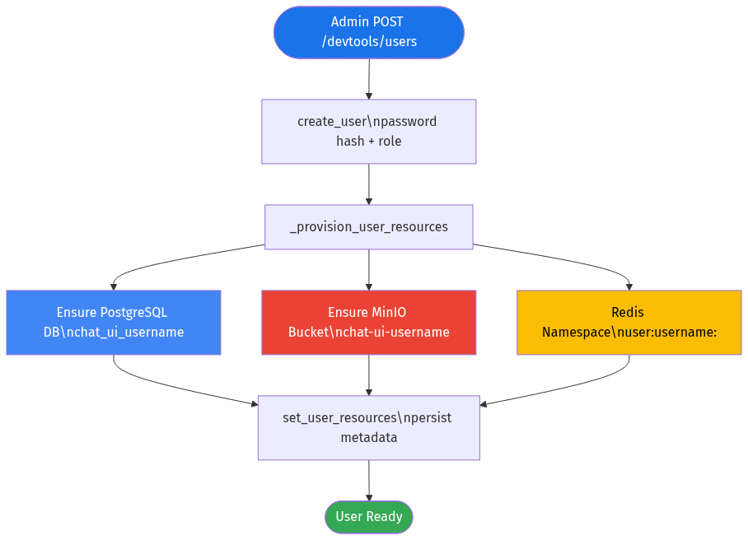
User Management & Resource Provisioning
POST /devtools/users → Create user + auto-provision all storage resources.
PATCH /devtools/users/disable → Enable or disable a user account.
PATCH /devtools/users/password → Admin password reset (no old pwd needed).
PATCH /devtools/users/role → Promote / demote user to admin.
DELETE /devtools/users → Remove user record from auth store.

Slide 38
RAG Overrides & Session State Inspector
RAG OVERRIDE CONTROLS
● GET /devtools/rag/overrides
List all active session/user overrides
● POST /devtools/rag/disable
Disable RAG for session or user
● POST /devtools/rag/enable
Re-enable RAG for session or user
Use case: Force direct LLM answers
without document context retrieval,
per user or per chat session.
SESSION STATE INSPECTOR
● GET /devtools/session-state/{id}
postgres_message_count
recent_user_messages (last 3)
active_topic (Redis)
used_chunk_ids_count (Redis)
FEATURE FLAGS (settings)
● GET/PATCH /devtools/settings
enable_query_rewrite
enable_hybrid_retrieval
force_detailed_retrieval
rag_retrieval_mode

Slide 39
Database Visibility Panel
GET /devtools/dbs → List all registered data sources.
GET /devtools/dbs/{db_id}/tables → Tables/keys/objects per source.
GET /devtools/dbs/{db_id}/records → Paginated row/key/object browser.
● rag_db (PostgreSQL + pgvector) — langchain_pg_embedding, collections.
● chat_db (PostgreSQL) — chat_messages, sessions, topics.
● redis (Key-Value) — token browser, type + value preview.
● minio (Object Store) — bucket object list with size & date.
Embedding vectors are automatically excluded from responses (too large).

Slide 40
Runtime Status — System Health
GET /devtools/runtime → Full runtime snapshot for ops monitoring.
● GPU: device name, total/free/used VRAM, CUDA version.
● RabbitMQ: broker reachability, queue depths per worker type.
● Workers: active Celery workers, task counts, queue assignments.
● Software: Python version, torch version, llama-cpp version.
GET /devtools/models/active → Per-mode model readiness check.
Reports: type (gguf/hf/net), path, loaded-into-memory flag, errors.

Slide 41
System Reset Controls (Admin-Gated)
All reset endpoints require: env CHAT_UI_ENABLE_DESTRUCTIVE_DEVTOOLS=1
Plus confirmation phrase in body: confirm = 'DELETE_EVERYTHING'
─────────────────────────────────────────────────────
POST /devtools/reset/rag → TRUNCATE langchain_pg_embedding + collections.
POST /devtools/reset/chat → TRUNCATE chat_messages, sessions, topics.
POST /devtools/reset/redis → Delete rag:* and abort:* keys (or full flush).
POST /devtools/reset/minio → Remove all objects in the target bucket.
POST /devtools/reset/all → Chains all four resets in sequence.

