Slide 1

KavinBase
Enterprise AI Document Intelligence Platform
Hybrid RAG · Local LLMs · Multi-Modal Ingestion · Agentic Review Pipeline
Next.js 14 Frontend · FastAPI Backend · PostgreSQL PGVector · Redis · MinIO
-Hariesh R
Notes:
Good morning sir. Today I am presenting KavinBase, an enterprise AI document intelligence platform.
The goal of this system is to convert large technical documents into structured, searchable knowledge and generate accurate answers using AI.
It combines Hybrid RAG, local LLMs, and an agentic validation pipeline to ensure both accuracy and reliability

Slide 2
THE PROBLEM
THE SOLUTION — KavinBase
1,000+
Instant AI Answers
from any document — in seconds, not hours
Pages per client document package
Engineering & technical documents run into hundreds or thousands of pages per project
Analysts and engineers must manually read, cross-reference and search through dense PDFs
Critical values — revision numbers, tag IDs, design parameters — buried deep inside tables and appendices
A single query may need data from multiple documents, multiple revisions, multiple sections
Hours or days spent per document review cycle; errors from manual extraction are costly
No way to instantly compare specs across revisions or extract answers without opening every file
+ Upload once
Index the entire 1000-page package into PGVector with BAAI/bge-m3 embeddings — one-time operation
+ Ask in plain English
"What is the revision number of document X?" "List all tag numbers in section 4" — answered instantly
+ Hybrid RAG retrieval
Semantic vector search + BM25 keyword + FlashRank reranker ensures the right passage is always found
+ Cite every answer
Every response includes page number + section source — traceable back to the original document
+ Multi-document queries
Cross-reference specs, drawings and datasheets in a single natural-language question
+ Agentic quality gate
Built-in agent pipeline verifies factual accuracy before presenting the answer — no hallucinations
VS
Notes:
So basically, in real-world projects, engineering documents are very large… sometimes more than 1000 pages.
And if someone wants to find a small piece of information, like a revision number or a tag ID, they have to manually go through multiple pages and even multiple documents.
This takes a lot of time… and also there is a high chance of missing something or making mistakes.
So what KavinBase does is — instead of manually searching, the user can just upload the document once… and then ask questions in simple English.
Behind the scenes, the system uses Hybrid RAG to find the correct information, and LLMs to generate a proper answer.
And importantly, every answer comes with a citation, so the user can verify where the information came from.
So overall, it reduces manual effort and gives faster, more reliable results.

Slide 3
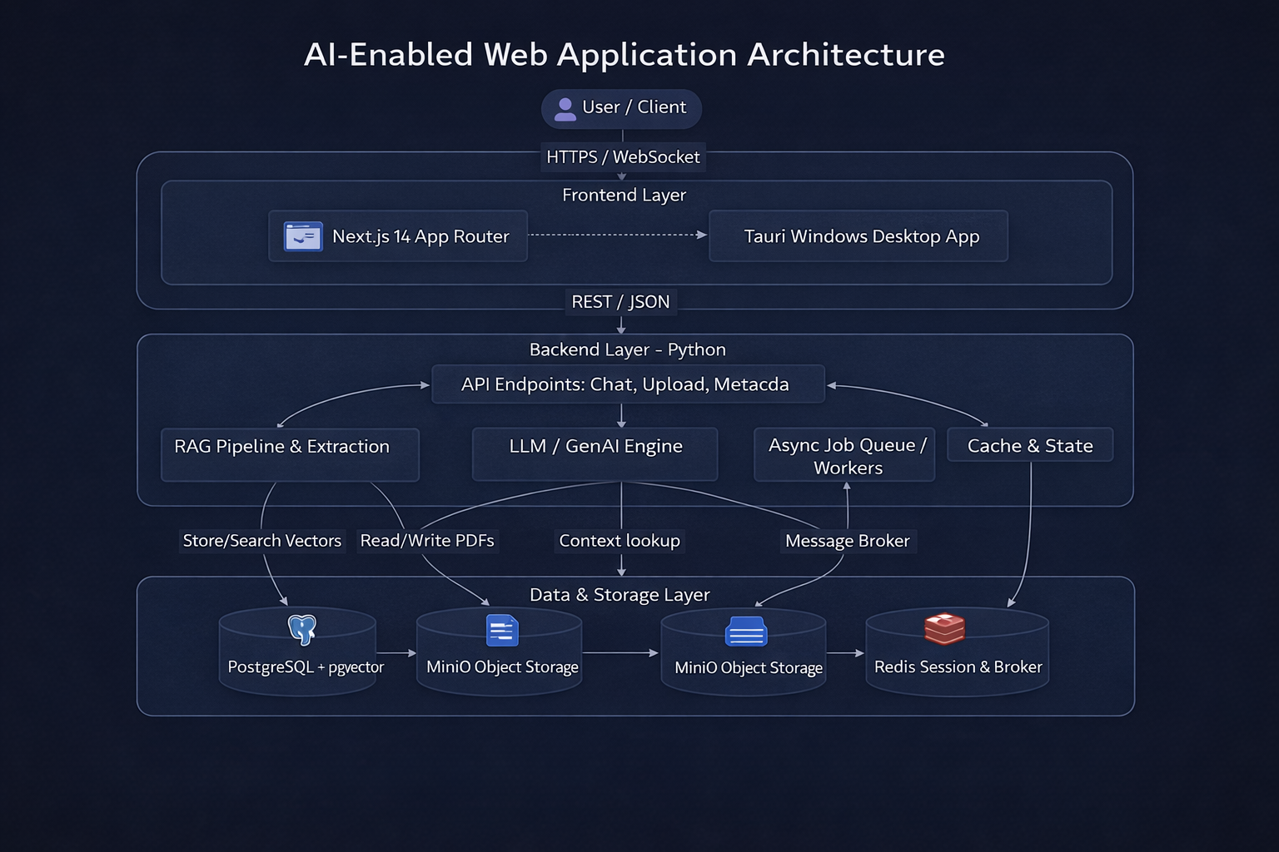
System Architecture Overview
Hybrid Sync/Async Platform with Multi-Layer Persistence
FastAPI (Python) backend – REST + SSE streaming endpoints
Next.js 14 (TypeScript/React) frontend – real-time token streaming UI
Celery workers – asynchronous, CPU-intensive PDF ingestion tasks
MinIO – S3-compatible object storage for raw PDFs & binary blob
PostgreSQL + PGVector – relational store + 1024-dim vector index (BGE-M3)
Redis – session cache, streaming state broker, Celery task queue
JWT-based authentication with scoped role permissions
Modular Python backends: rag/, llm/, auth/, memory/, queue/, storage/
Notes:
o this slide shows the overall architecture of the system.
I designed it in a modular way so that each component handles a specific responsibility.
The frontend is built using Next.js, which handles the user interface and real-time interaction.
The backend uses FastAPI, which manages all the API requests and communication between components.
For processing large documents, I use Celery workers, so heavy tasks like PDF ingestion run asynchronously without blocking the system.
For storage, MinIO is used to store raw PDF files, and PostgreSQL with PGVector is used to store embeddings and metadata for retrieval.
Redis is used for caching, session management, and also as a message broker for task queues.
So overall, this architecture allows the system to scale, handle large workloads, and process multiple requests efficiently.
This separation of components makes the system scalable and suitable for real-world deployment.

Slide 4
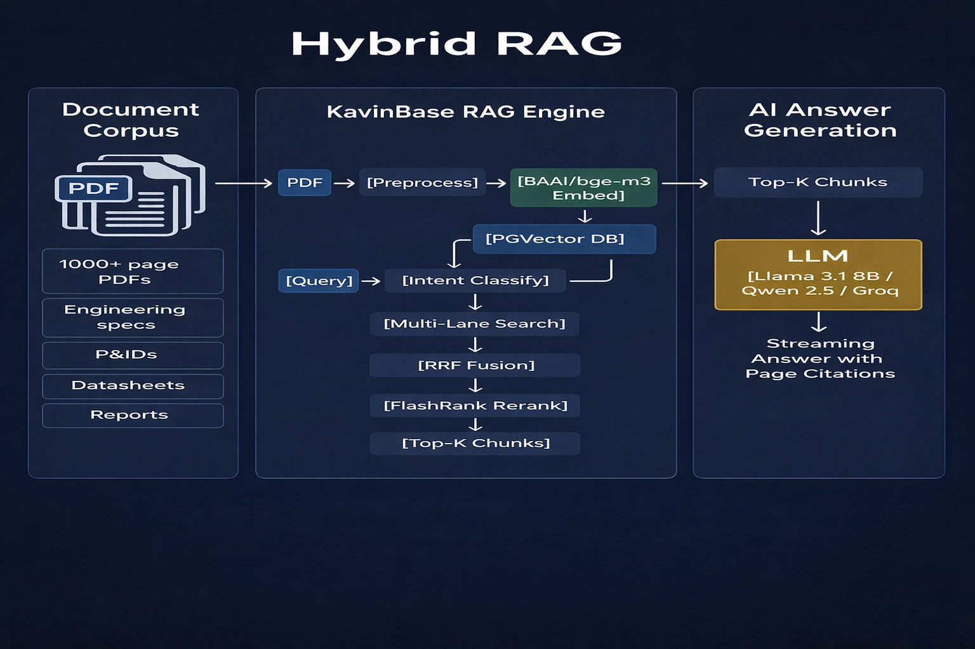
RAG Type: Advanced Hybrid Multi-Lane Retrieval-Augmented Generation
Semantic Vector Search + Keyword BM25 + Cross-Encoder Reranking + Parent Resolution
RAG Architecture: Hybrid Retrieval · Multi-Lane Chunking · Reciprocal Rank Fusion (RRF) · FlashRank Cross-Encoder Reranker
RETRIEVAL MODES (per query intent):
• Fast Mode – vector-only, 14 candidates, no rerank
• Balanced Mode – vector + keyword, 25 candidates, RRF + FlashRank
• High-Fidelity – vector + BM25, 40 candidates, full reranking + parent
MULTI-LANE CHUNK SEARCH:
• Separate lanes for: text, parent-table, image, child-row
• Lane budgets prevent child rows dominating results
• Parent resolution fetches full table when child chunk matches
RECIPROCAL RANK FUSION (RRF k=60):
• Fuses vector similarity ranks + keyword BM25 ranks
• Score: 1/(k + rank_vector) + 1/(k + rank_keyword) + 0.01×kw_score
SCORING MULTIPLIERS (per chunk):
• Element type weight (Title=1.0, NarrativeText=0.9, Table=0.6)
• Extraction source (PyMuPDF=1.0, Docling=0.9, Unstructured=0.8)
• Quality score (0.55 – 1.0 range)
• OCR noise penalty (×0.6 if OCR used)
• Section-query overlap boost (up to +8%)
RERANKER: FlashRank (ms-marco-MiniLM-L-12-v2)
• Cross-encoder re-scores top candidates
• Final score = max(rerank×multiplier, retrieval_score)
VECTOR DB: PostgreSQL PGVector
• Embedding: BAAI/bge-m3 (1024-dim)
• Metadata-filtered similarity_search per collection
Notes:
So this is the core retrieval system used in KavinBase.
Normally, a basic RAG system uses only vector search, which works based on similarity of meaning.
But in technical documents, exact values like tag numbers, revision IDs, or codes are very important… and vector search alone can miss those.
So here I use Hybrid RAG, which combines both semantic vector search and keyword-based BM25 search.
This way, the system understands both the meaning of the query and also matches exact keywords when needed.
On top of that, I use a reranking model, FlashRank, which re-evaluates the retrieved results and selects the most relevant ones.
So overall, this approach improves accuracy and ensures the correct information is retrieved from complex technical documents.
This is important because technical queries require both semantic understanding and exact matching.
This is important because technical queries require both semantic understanding and exact matching.

Slide 5
RAG Type: Advanced Hybrid Multi-Lane Retrieval-Augmented Generation
Semantic Vector Search + Keyword BM25 + Cross-Encoder Reranking + Parent Resolution
RAG Architecture: Hybrid Retrieval · Multi-Lane Chunking · Reciprocal Rank Fusion (RRF) · FlashRank Cross-Encoder Reranker
RETRIEVAL MODES (per query intent):
• Fast Mode – vector-only, 14 candidates, no rerank
• Balanced Mode – vector + keyword, 25 candidates, RRF + FlashRank
• High-Fidelity – vector + BM25, 40 candidates, full reranking + parent
MULTI-LANE CHUNK SEARCH:
• Separate lanes for: text, parent-table, image, child-row
• Lane budgets prevent child rows dominating results
• Parent resolution fetches full table when child chunk matches
RECIPROCAL RANK FUSION (RRF k=60):
• Fuses vector similarity ranks + keyword BM25 ranks
• Score: 1/(k + rank_vector) + 1/(k + rank_keyword) + 0.01×kw_score
SCORING MULTIPLIERS (per chunk):
• Element type weight (Title=1.0, NarrativeText=0.9, Table=0.6)
• Extraction source (PyMuPDF=1.0, Docling=0.9, Unstructured=0.8)
• Quality score (0.55 – 1.0 range)
• OCR noise penalty (×0.6 if OCR used)
• Section-query overlap boost (up to +8%)
RERANKER: FlashRank (ms-marco-MiniLM-L-12-v2)
• Cross-encoder re-scores top candidates
• Final score = max(rerank×multiplier, retrieval_score)
VECTOR DB: PostgreSQL PGVector
• Embedding: BAAI/bge-m3 (1024-dim)
• Metadata-filtered similarity_search per collection
Notes:
So here I go a step deeper into how retrieval works internally.
In technical documents, data is not just plain text… it can be tables, images, or structured rows.
So instead of searching everything in the same way, I use something called multi-lane retrieval.
That means different types of content like text, tables, and images are searched separately in their own lanes.
After retrieving results from each lane, I combine them using a method called Reciprocal Rank Fusion, or RRF.
RRF basically merges results from different retrieval methods and balances their importance, instead of relying on just one.
Then I apply a reranker, FlashRank, which re-evaluates the top results and selects the most relevant chunks.
So this full pipeline ensures that even complex structured data like tables is retrieved accurately.
This prevents important structured data from being missed during retrieval.

Slide 6
LLM Inventory & Model Architecture
Local GGUF / Hugging Face Models · External API (Groq / xAI) · Dedicated Auxiliary Models
Role
Model Name
Backend Type
Provider
Primary Use-case
Lite Chat (rank-1)
Llama 3.1 8B Instruct Q4_K_M
GGUF (llama_cpp)
Primary local chat – GPU preferred
Lite Chat (rank-2)
Qwen 2.5 7B Instruct Q4_K_M
GGUF (llama_cpp)
GGUF fallback chat model
Lite Chat (light)
Qwen 2.5 3B Instruct Q4_K_M
GGUF (llama_cpp)
CPU-first developer setup model
Lite Chat (mini)
Qwen 2.5 1.5B Instruct Q4_K_M
GGUF (llama_cpp)
Ultra-light CPU chat model
Base Chat (GPU)
Qwen 2.5 7B Instruct (HF)
Hugging Face Transformers
Full HF inference on CUDA
Base Chat (CPU)
Qwen 2.5 3B Instruct (HF)
Hugging Face Transformers
CPU-safe HF chat model
Agent Router
Qwen 2.5 0.5B Q4 (GGUF)
GGUF (llama_cpp)
Hidden routing, extraction, gate decisions
Embedding
BAAI/bge-m3 (1024-dim)
Hugging Face Sentence Transformer
Ingestion + retrieval vector embedding
Intent Classifier
facebook/bart-large-mnli
Zero-shot NLI pipeline
Query intent classification (MNLI)
Table Detector
microsoft/table-transformer
Hugging Face Vision
Unstructured hi_res table structure
Layout Model
unstructuredio/yolox_l0.05
ONNX (YOLOX)
PDF page layout detection (Unstructured)
Reranker
ms-marco-MiniLM-L-12-v2
FlashRank cross-encoder
Post-retrieval chunk reranking
Net (Groq)
llama-3.1-8b-instant
Groq REST API
External API streaming – rank 1 & 2
Net (xAI)
grok-beta
xAI Grok REST API
External API streaming – Grok provider
Notes:
So in this system, LLM means Large Language Model, which is responsible for understanding the query and generating the final answer.
Instead of using one large model for everything, I use multiple models, each assigned to a specific task.
For example, smaller models like Qwen 0.5B are used for routing, planning, and extracting structured information.
A slightly larger model like Qwen 1.5B is used as a reviewer to check if the generated answer is correct and complete.
For final answer generation, I use stronger models like Llama 3.1 8B or Qwen 7B, which are better at producing high-quality responses.
For embeddings, I use BAAI bge-m3, which converts text into vectors for retrieval.
And for intent classification, I use BART MNLI to understand what type of question the user is asking.
So overall, instead of overloading a single model, I distribute tasks across multiple models to improve efficiency, reduce cost, and maintain accuracy.
This multi-model approach allows the system to balance performance, cost, and scalability effectively.

Slide 7
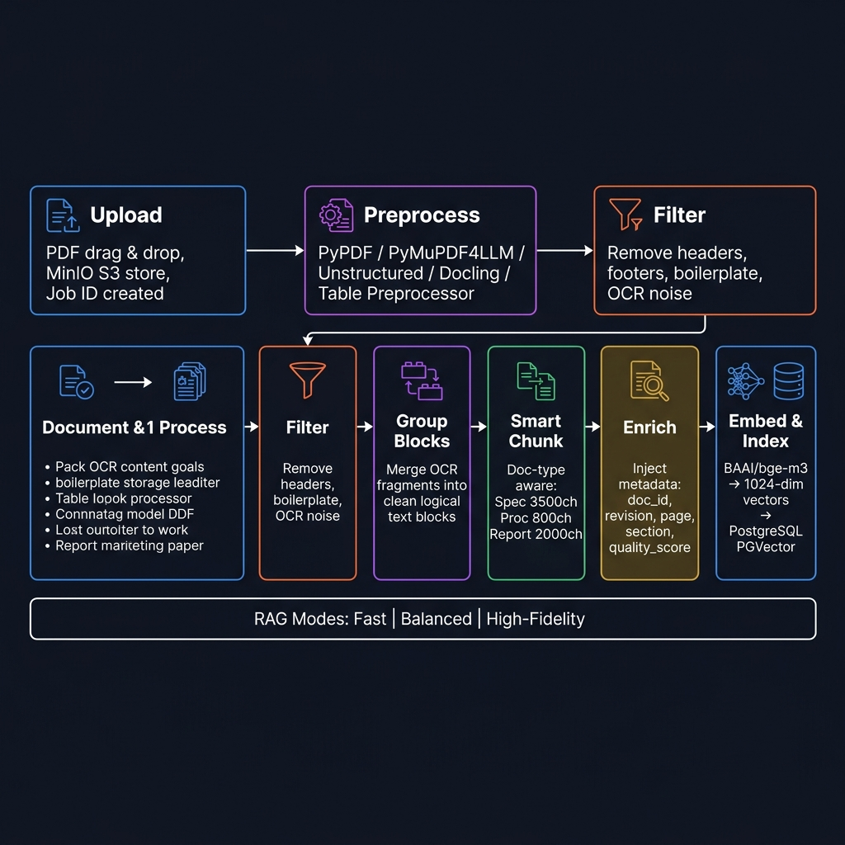
Ingestion Pipeline – Step-by-Step Flowchart
PDF → Preprocess → Filter → Group → Chunk → Enrich → Embed → PGVector
1️⃣ Upload
2️⃣ Preprocess
3️⃣ Filter
4️⃣ Group Blocks
5️⃣ Chunk
6️⃣ Enrich
7️⃣ Embed & Ingest
User drags PDF in Next.js UI. Stored in MinIO (S3). Job ID created in Redis.
stream_pdf_to_elements() Choose: PyPDF / PyMuPDF4LLM / Unstructured / Docling / Table Preprocessor
Remove headers, footers, boilerplate, image noise. Version-tracked FILTER_VERSION.
build_grouped_blocks() Merge OCR fragments into clean logical text blocks.
ContextAwareChunker Doc-type aware config: spec 3500 / proc 800 / report 2000
Metadata injection: doc_id, revision, page, section, quality_score, chunk_type.
BAAI/bge-m3 → 1024-dim vector ingest_to_pgvector() Revision-safe upsert.
→
→
→
→
→
→
RAG Ingest Modes: Fast (pypdf, no tables) · Balanced (hi_res + table structure, no images) · High-Fidelity (hi_res + tables + images extracted)
PRE-PROCESSORS AVAILABLE:
• pypdf_text – lightweight text extraction (PyPDF)
• pymupdf4llm – rich markdown extraction (PyMuPDF)
• unstructured – hi_res layout + OCR (Tesseract/YOLOX)
• docling – academic-grade extraction with table/formula support
• table_preprocessor – specialised Docling-backed table-focused pipeline
DOC-TYPE CHUNKING:
Specification → 3500 / 500
Procedure/SOP → 800 / 100
Report → 2000 / 300
Drawing/P&ID → 1000 / 150
Datasheet → 1500 / 200
Default → 3000 / 400
Notes:
So this slide explains how a PDF is converted into searchable knowledge.
First, the user uploads a document through the frontend, and the file is stored in MinIO.
Then the document goes through preprocessing, where tools like PyMuPDF or Unstructured extract the text and structure.
After that, we filter out unnecessary content like headers, footers, and noise.
Next, the content is grouped into meaningful blocks and then split into chunks based on the document type.
We also enrich each chunk with metadata like document ID, revision, page number, and section.
Then embeddings are generated using the BGE-M3 model, which converts the text into numerical vectors.
Finally, these vectors are stored in PGVector for efficient retrieval.
So this entire pipeline allows even very large documents, like 1000+ pages, to be processed and searched efficiently.
This preprocessing ensures that the data is clean, structured, and optimized before retrieval.

Slide 8
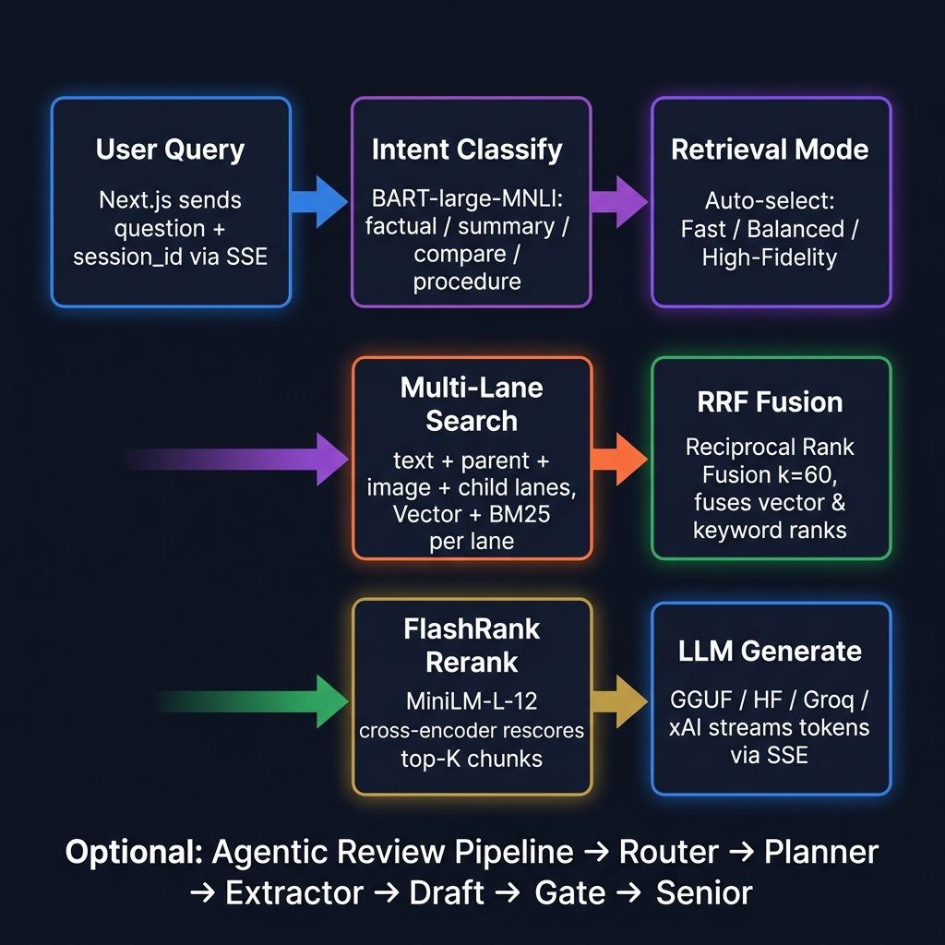
Query Pipeline – Step-by-Step Flowchart
User Question → Intent → Multi-Lane Retrieval → RRF → Rerank → Agentic Review → Stream
1️⃣ User Query
2️⃣ Intent Class.
3️⃣ Retrieval Mode
4️⃣ Multi-Lane Search
5️⃣ RRF Fusion
6️⃣ Rerank
7️⃣ LLM Generate
Next.js sends question + session_id + model_id via SSE stream endpoint.
BART-large-MNLI classifies: summary / factual / compare / procedure / greeting
Auto-selects: Fast / Balanced / High-Fidelity based on intent label.
Per-lane searches: text, parent, image, child. Vector + BM25 keyword per lane.
Reciprocal Rank Fusion fuses vector + keyword ranks (k=60 default).
FlashRank MiniLM-L-12 cross-encoder rescores candidates → top-K.
Prompt built → streamed via GGUF / HF / Groq / xAI. Token-by-token SSE yield.
→
→
→
→
→
→
Optional Agentic Review Pipeline (enable_agent_pipeline=true): Router → Planner → Extractor → Draft → Reviewer → Repair Gate → Senior Escalation (Qwen 3B)
QUERY PROFILE ROUTING:
• metadata – Title+Narrative only, no OCR, text lane only
• table_data – parent+child lane priority, Table element boost
• image_ref – image lane priority, Image element ×1.3 boost
• summary – balanced lanes, broad element set
• explanation – text lane focus, NarrativeText ×1.25
• factual – text+parent lanes, excludes UncategorizedText
SCORING FACTORS:
element_wt × source_wt × quality
× child_pen × ocr_pen × query_mult
× lane_mult × section_mult
QUALITY GATES:
Grounding check < 0.40 → warning
Release gate → blockers list
Eval gate: heuristic pre-LLM
Notes:
So this slide shows how the system processes a user query step by step.
First, the user asks a question through the frontend, which is sent to the backend.
Then the system identifies the intent of the query using a classification model like BART MNLI.
Based on the intent, the system selects the appropriate retrieval mode, such as fast, balanced, or high-fidelity.
Next, it performs multi-lane retrieval, where different types of content like text, tables, and images are searched separately using both vector and keyword search.
The results are then combined using Reciprocal Rank Fusion, and further refined using a reranker like FlashRank.
Finally, the LLM, such as Llama 3.1 or Qwen, generates the answer based on the retrieved context.
The response is then streamed back to the user in real time.
So this pipeline ensures that the system is both accurate and adaptive, instead of using a fixed retrieval approach. This combination of retrieval and LLM generation ensures both relevance and correctness in the final answer.

Slide 9
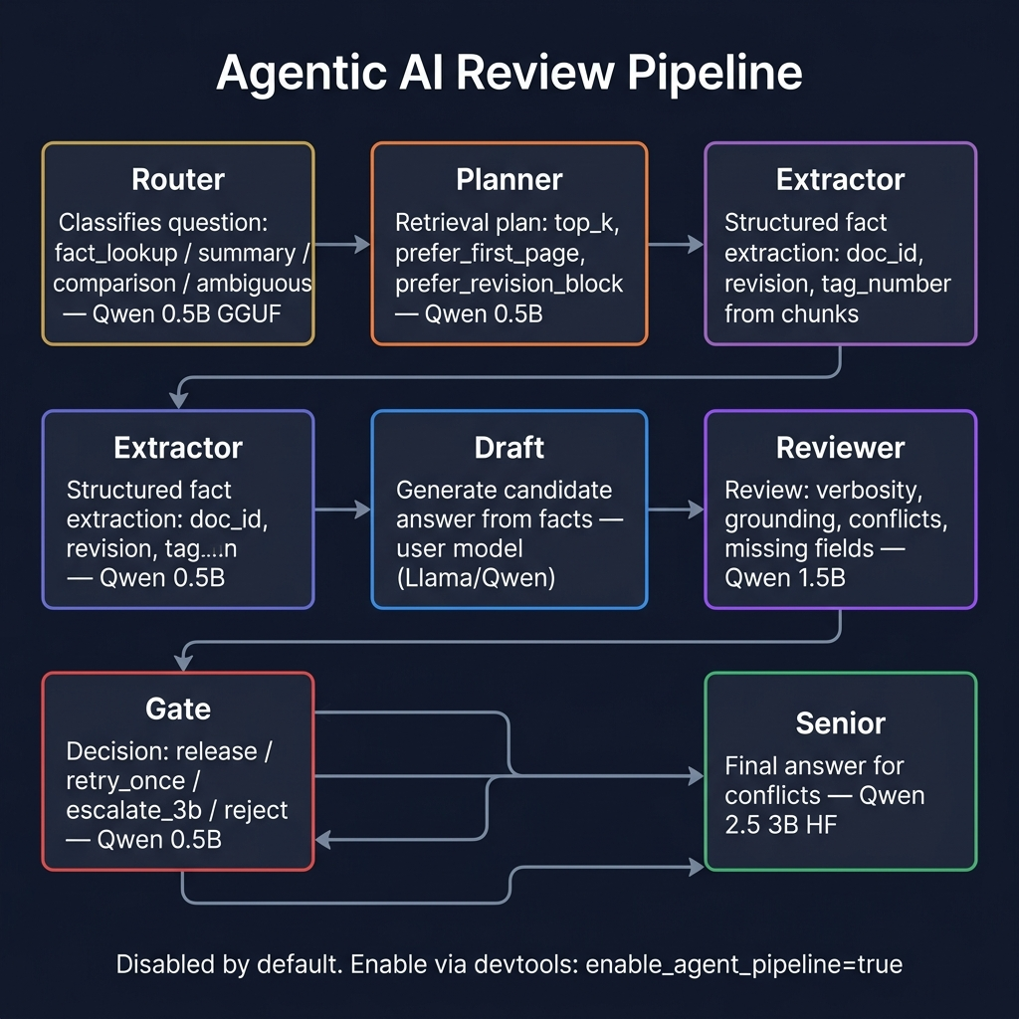
Agentic Review Pipeline – Hierarchical Deliberation Engine
Multi-stage agent chain: Router → Planner → Extractor → Draft → Reviewer → Gate → Senior
Router (0.5B GGUF)
Planner (0.5B GGUF)
Extractor (0.5B GGUF)
Draft (user model)
Reviewer (1.5B GGUF)
Gate (0.5B GGUF)
Senior (Qwen 3B HF)
Classifies question type: fact_lookup / summary / comparison / ambiguous
Determines retrieval plan: top_k, prefer_first_page prefer_title / revision block
Extracts structured facts: document_id, revision, tag_number from chunks
Generates candidate answer from facts + context. Strict-copy or analytical.
Reviews draft: verbosity, grounding, missing fields, conflicts
Decision: release / retry_once escalate_3b / reject
Escalation model for conflicts & ambiguities. Final authoritative answer.
→
→
→
→
→
→
MODEL ASSIGNMENTS: Router/Planner/Extractor/Gate → Qwen 0.5B Q4 | Draft → user model (Llama 8B / Qwen) | Reviewer → Qwen 1.5B Q4 | Senior → Qwen 3B HF
STRICT FACTUAL PATH (eval_gate=true): regex heuristic extraction → validate → release without LLM if high confidence
DISABLED BY DEFAULT — enable via devtools panel: enable_agent_pipeline=true and enable_eval_gate=true
Notes:
So this is the agentic review pipeline, which acts as a quality control layer in the system.
After the initial answer is generated, it doesn’t get directly shown to the user. Instead, it goes through multiple stages.
First, a small LLM like Qwen 0.5B acts as a router and planner to understand the query and decide how to process it.
Then an extractor pulls structured information like document ID, revision, or key values from the retrieved data.
After that, the main LLM, such as Llama 3.1 or Qwen, generates a draft answer.
Then a reviewer model, Qwen 1.5B, checks the answer for correctness, completeness, and grounding.
Based on this, a gate decides whether to release the answer, retry, or escalate.
If needed, a stronger model like Qwen 3B is used for final validation.
So instead of directly trusting a single model, the system uses multiple stages to verify the answer before showing it. This significantly reduces hallucination and improves reliability of the system.

Slide 10
Developer Admin Dashboard
Enterprise-grade control panel for live system management | Admin-gated | No server restart required for any operation
AI AI Model Management
USR User Administration
Switch between three AI model modes at runtime
base — Full HuggingFace transformer (GPU)
lite — GGUF quantised model (CPU only)
net — Cloud API (OpenAI / Gemini)
Download, register and test new models via API
Hot-swap the active model without any downtime
Model readiness checked per mode with error detail
Create users with isolated storage resources
Each user gets a dedicated PostgreSQL database
Personal MinIO bucket for document storage
Scoped Redis namespace for session data
Enable / disable user accounts instantly
Role-based access control (admin / user)
Admin password reset without old credentials
MON System Analytics & Monitoring
DBS Data Visibility & Controls
Live dashboard: GET /devtools/mvp/overview
Configurable time window: 1 to 168 hours
Ingestion funnel: processing / ready / error counts
RAG quality score: high / medium / low distribution
Response latency and semantic cache hit rate
User feedback tracking: positive vs negative ratio
Runtime health: GPU VRAM, queues, worker status
Live browser across all storage layers:
RAG DB — pgvector semantic index
Chat DB — conversation history
Redis — session state & cache keys
MinIO — uploaded document objects
Paginated record inspection (no raw SQL needed)
Selective reset controls with safety confirmation
Per-session & per-user RAG toggle overrides
Notes:
“ So this slide shows the Developer Admin Dashboard, which is used to manage and control the system in real time.
One key feature is AI model management, where we can switch between different model modes like local GGUF models, full Hugging Face models, or external API models without restarting the system.
It also supports user management, where each user gets isolated resources like their own database, storage, and session space, which improves security and scalability.
The dashboard also provides system monitoring features, such as tracking ingestion status, response quality, and system performance like GPU usage and worker activity.
Additionally, we have full visibility into storage layers like PGVector, Redis, and MinIO, allowing inspection and control without writing raw queries.
So overall, this dashboard makes the system easy to manage, monitor, and scale in a real-world environment
This significantly reduces hallucination and improves reliability of the system.

Slide 11
System Quality & Analytics Monitoring
Real-time operational metrics proving system reliability | GET /devtools/mvp/overview | Configurable 1-168 hour window
RT Runtime Health
ING Ingestion Success Rate
RAG RAG Quality Score
FB User Feedback Loop
GPU health check
Device name + VRAM usage
Free vs used memory (GB)
Message broker status
RabbitMQ reachability
Queue depth per worker
Celery worker fleet
Active workers listed
Tasks per queue type
Instant alert if any
component goes offline
Real-time job funnel:
Waiting (pending metadata)
Processing (active tasks)
Ready (successful)
Error (failed)
Success rate =
ready / (ready + error)
Avg processing time
seconds per document
Top 5 error messages
for rapid debugging
Per-response quality labels
scored by eval pipeline:
HIGH — full context hit
MEDIUM — partial context
LOW — poor retrieval
Semantic cache hit rate
(Redis answer caching)
Avg response latency (ms)
Worst 5 documents by
low-quality rate flagged
for re-ingestion review
Users rate every response:
Correct / Helpful
Incorrect / Hallucination
Missing context
Live feedback counters:
Total feedback events
Positive vs Negative
Average feedback score
Label distribution chart
Top 8 labels ranked
Feeds model retraining
and prompt improvement
Notes:
So this slide shows how the system monitors its performance and ensures reliability in real time.
First, we track runtime health, such as GPU usage, worker status, and message queues, to make sure all components are running properly.
Then we monitor ingestion performance, including how many documents are successfully processed and how many fail, along with average processing time.
We also evaluate retrieval quality, where each response is scored as high, medium, or low based on how well it matches the document context.
In addition, the system tracks response latency and cache performance to understand how fast and efficient it is.
We also collect user feedback, like whether the answer was correct or helpful, which can be used to improve the system over time.
So overall, this monitoring layer helps detect issues early, maintain accuracy, and continuously improve system performance. This ensures the system is reliable, measurable, and ready for real-world deployment.

Slide 12
Frontend Architecture – Next.js 14 (App Router) + TypeScript
Modular React components · SSE streaming · JWT auth · Multi-workspace modes
TECH STACK:
• Next.js 14 (App Router) + TypeScript
• Tailwind CSS utility classes
• Lucide React icons
• Tauri (optional desktop build, src-tauri/)
APP ROUTES:
• / – Main workspace (auth-gated)
• /signin – JWT login page
• /welcome – First-run onboarding flow
• /dashboard – Project metrics dashboard
• /pml – PML template editor workspace
• /usage – API usage & model telemetry
AUTHENTICATION:
• authMe() on mount – redirect to /signin if not logged in
• authLogout() clears session cookie
• First-visit gate → /welcome page
KEY COMPONENT MODULES:
• components/chat/ – ChatWindow, MessageBubble, ChatInput,
ChatHeader, PreprocessingPreviewPanel, SourceViewerModal,
TableInspectionModal, InlineMetadataPrompt
• components/sidebar/ – Sidebar, ChatList, PdfUpload, Brand
• components/upload/ – PdfUploadButton, UploadProgress,
ChunkingProgress, PdfContextBanner
• components/workspace/ – WorkspaceModeSwitcher,
WorkspaceOverviewDashboard, WorkspaceProjectTree
• components/pml/ – TemplateLibraryPanel
• components/messaging/ – EnterpriseMessagingWorkspace
• components/onboarding/ – GettingStartedModal, ShortcutsModal
WORKSPACE MODES: ai | pml | team
STREAMING: SSE (Server-Sent Events) token-by-token from backend
STATE: localStorage for chats, sidebar, workspace prefs
Notes:
So this slide shows the frontend architecture of the system.
The frontend is built using Next.js 14 with TypeScript, which helps in building a scalable and structured user interface.
It is designed using modular React components, so each part of the UI like chat, sidebar, and upload flow is separated and easy to maintain.
The system uses Server-Sent Events, or SSE, to stream responses from the backend in real time, so the user can see the answer being generated token by token.
For authentication, JWT-based login is used to securely manage user sessions.
It also supports multiple workspace modes like AI chat, PML editor, and team workspace, making the system more flexible for different use cases.
So overall, the frontend is designed to be interactive, scalable, and responsive for real-time AI applications. This ensures a smooth and real-time user experience while interacting with AI.

Slide 13
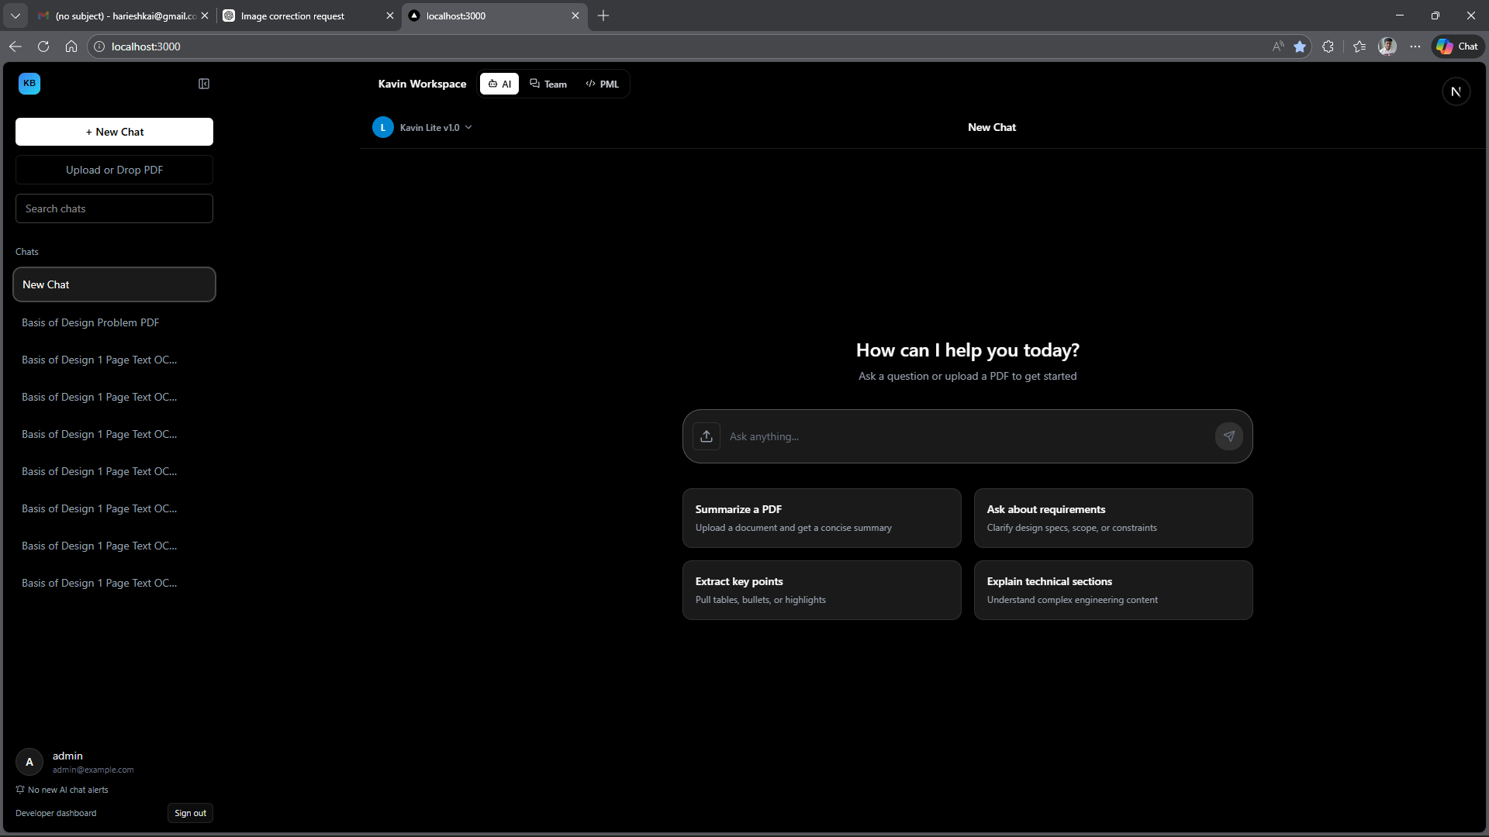
Frontend – Chat Workspace
Real-time AI document Q&A interface with token streaming and citation support
Token-by-token SSE streaming from backend LLM (GGUF / HF / Groq / xAI)
PDF context banner – shows indexed document + revision in chat header
Source Viewer Modal – opens cited chunk with page/section highlight
Table Inspection Modal – explore structured table data extracted from PDF
Preprocessing Preview Panel – live ingestion progress (filter, chunk, embed steps)
Inline Metadata Prompt – document_type, revision_code, doc_number confirmation
Processing Bubble – animated loading state during LLM generation
Thinking Disclosure – expandable CoT reasoning trace (agent mode)
Model Selector – switch between Lite / Base / Net modes per chat
Feedback Bar – thumbs up/down inline rating per message
[ADD: Chat Workspace Screenshot]
Notes:
This is the main user experience. Users can upload PDFs, view document context, inspect citations, see tables, and get token-by-token answers with source traceability. The design is made for practical document Q&A, not just generic chat

Slide 14
Frontend – Sidebar, Upload & Document Management
PDF ingestion flow, chat history, multi-mode sidebar, Dev Settings panel
SIDEBAR (Sidebar.tsx):
• Collapsible slide-in navigation panel
• Chat list with unread badge counts
• Search/filter chat sessions
• PDF upload trigger (PdfUpload.tsx)
• Model mode indicator (Lite / Base / Net)
• Dev settings panel with live override controls
• User profile + sign-out
PDF UPLOAD FLOW:
• PdfUploadButton → useSmartUpload hook
• Phase 1: metadata extraction (page-1 preview)
• InlineMetadataPrompt: confirm doc_type / revision
• Phase 2: full commit ingestion via Celery worker
• UploadProgress + ChunkingProgress bar (live SSE)
• Cancel support at each phase via job_id / session_id
• Background ingestion status poller (useIngestionStatusPoller)
DOCUMENT CONTEXT PANEL:
• PdfContextBanner shows active doc + revision
• Workspace Overview Dashboard (WorkspaceOverviewDashboard.tsx):
– Document table with revision, chunk count, status
– Indexed document list derived from chat sources
• WorkspaceProjectTree – hierarchical project / doc view
DEV SETTINGS (devtools/settings API):
• enable_agent_pipeline toggle
• enable_eval_gate toggle
• RAG preprocessor override
• RAG ingest mode override (fast / balanced / high_fidelity)
• enable_fast_document_processing shortcut
• rag_collection_name override
NOTIFICATIONS & HISTORY SIDE PANELS
Notes:
o this slide shows how document management and system control works from the user side.
The sidebar is used to manage chat sessions, upload documents, and switch between different model modes.
When a user uploads a PDF, the process happens in two stages.
First, metadata is extracted from the first page, such as document type and revision, and the user can confirm it.
Then the full document is processed in the background using Celery workers.
The system also shows real-time progress for uploading and chunking, and allows cancellation if needed.
There is also a document context panel, where users can see the active document, its revision, and indexed details.
Additionally, developer settings are available to control features like enabling the agent pipeline or changing ingestion modes.
So overall, this makes the system flexible, user-friendly, and controllable. This design ensures both ease of use for users and control for developers.

Slide 15
Frontend – Dashboard, PML Editor & Team Workspace
Three workspace modes: AI Chat | PML Template Editor | Enterprise Team Messaging
AI Mode
PML Mode
Team Mode
• Primary document Q&A workspace
• Process Markup Language template editor
• Enterprise messaging workspace
• Sidebar + ChatWindow layout
• TemplateLibraryPanel – saved templates
• Real-time WebSocket team conversations
• Supports multiple parallel chat sessions
• Editor + Output tab layout
• Project threads + assignee management
• Upload → ingest → query inline workflow
• Learn template from example via API
• Team notifications panel
• Citation + source viewer integration
• PML chat backed by base/net model
• AI-assist seed from team context
• Unread badge count aggregation
Notes:
So this slide shows the different workspace modes supported by the system.
The first is AI mode, which is the main document question-answering interface, where users can upload documents and interact with the system.
The second is PML mode, which is used for template-based workflows, where users can create and manage structured templates.
The third is Team mode, which supports collaboration through messaging, project tracking, and shared workflows.
These modes allow the system to go beyond just document Q&A and support broader enterprise use cases.
So overall, the platform is designed to be flexible and adaptable for different types of users and workflows.

Slide 16
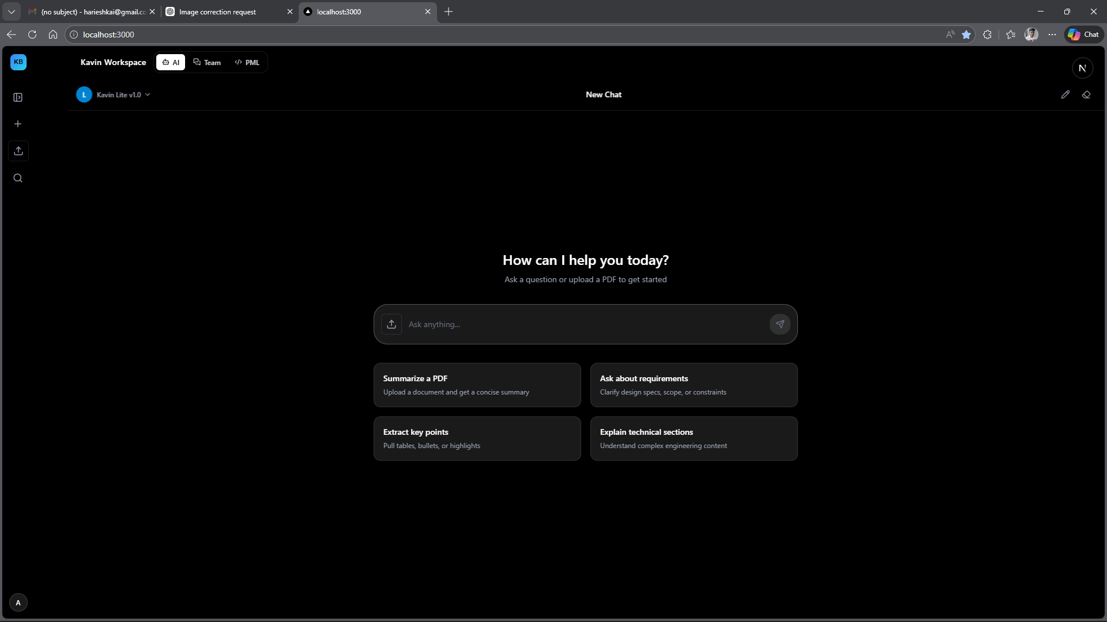
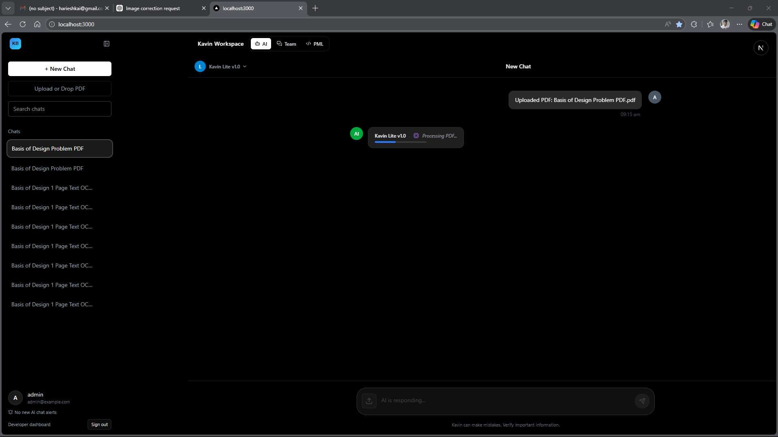
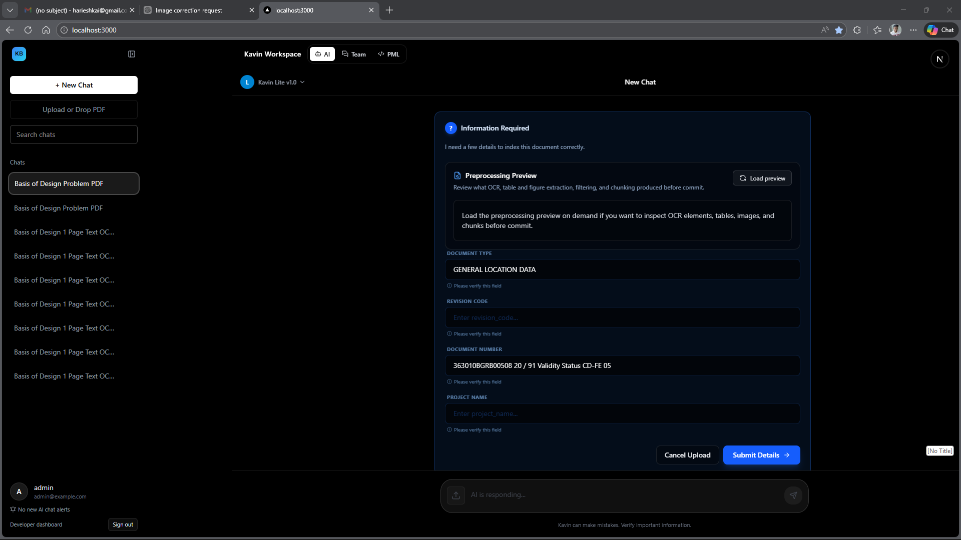
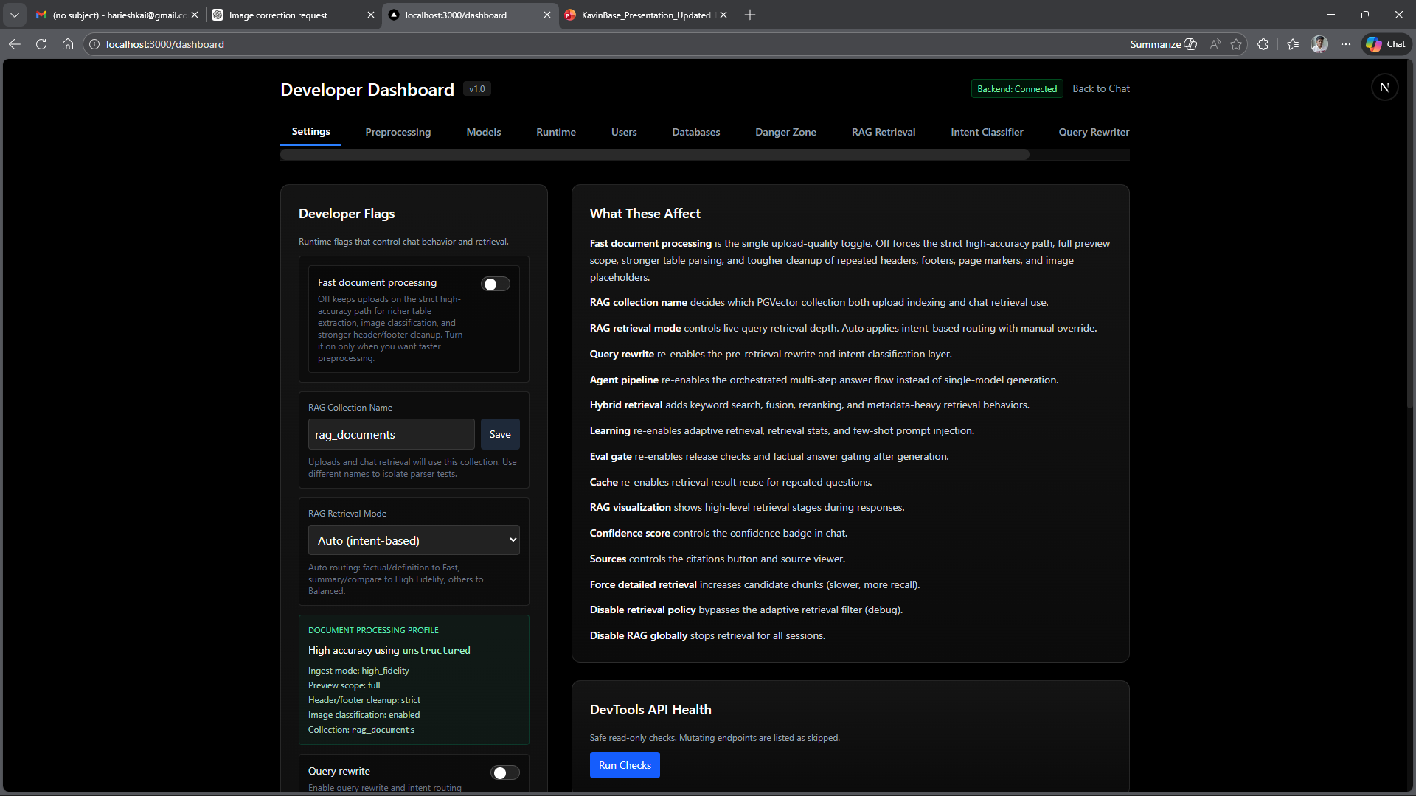
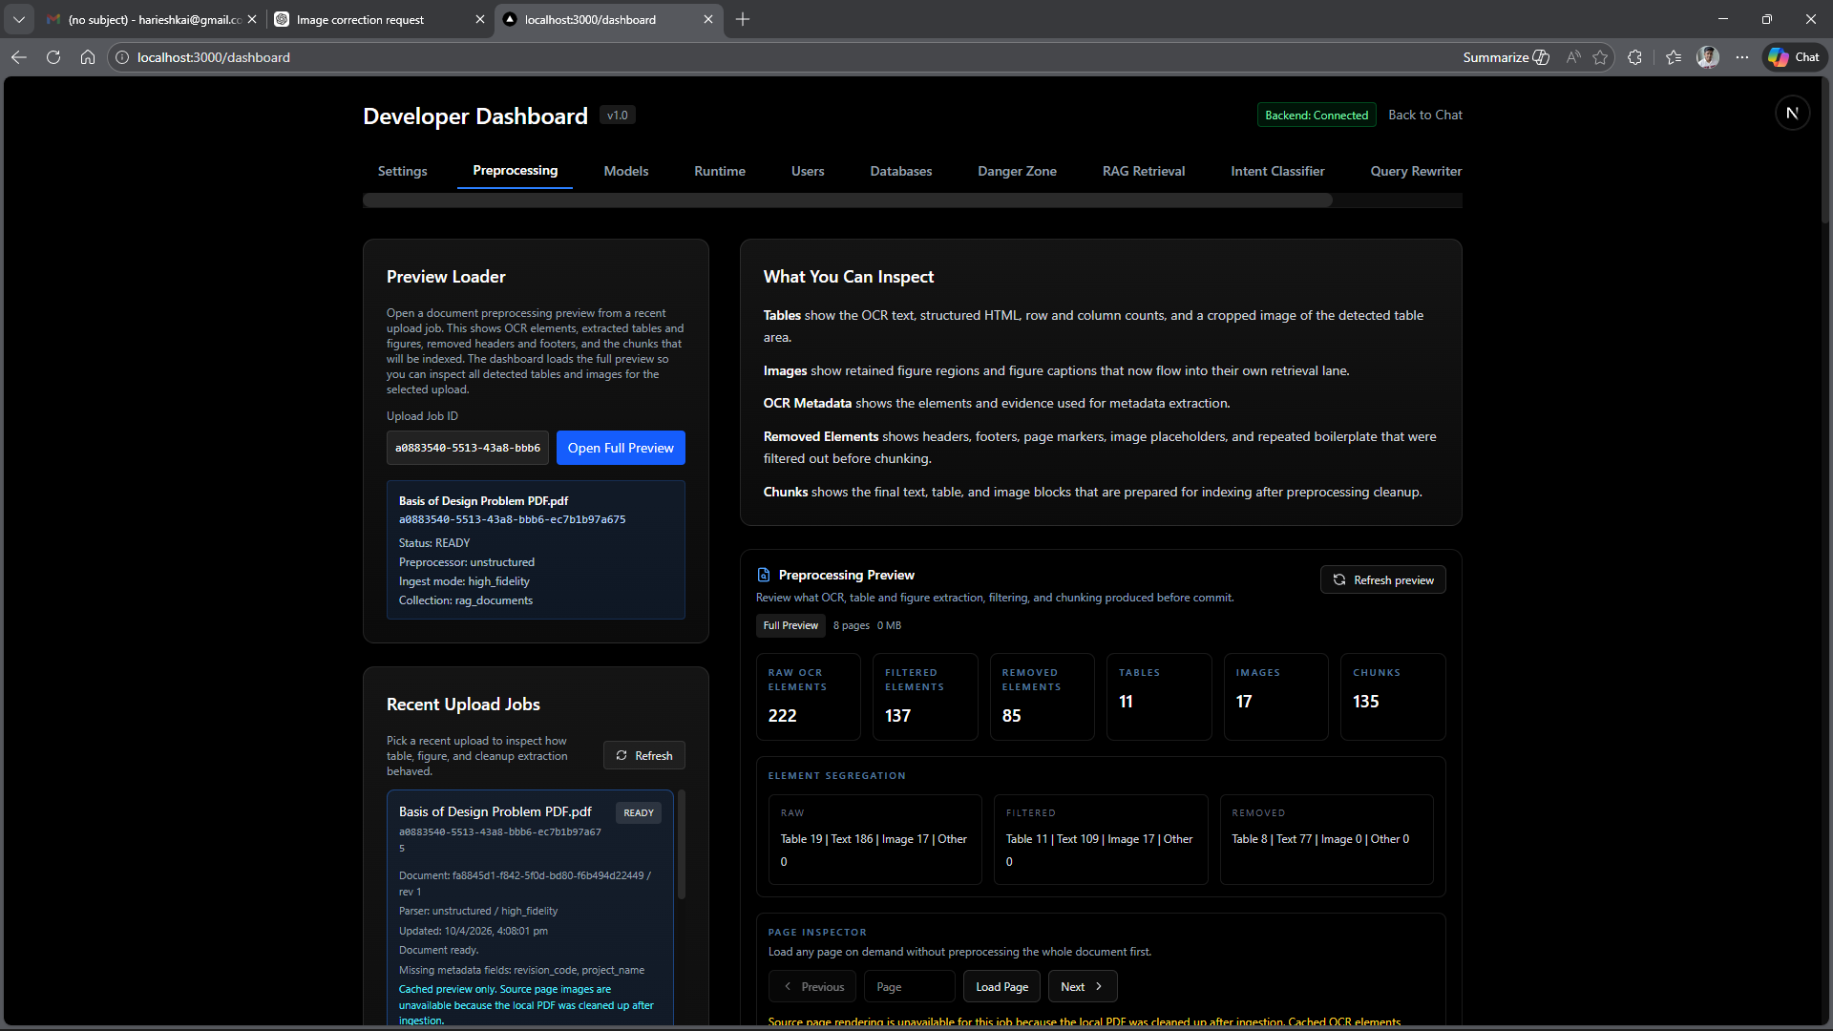
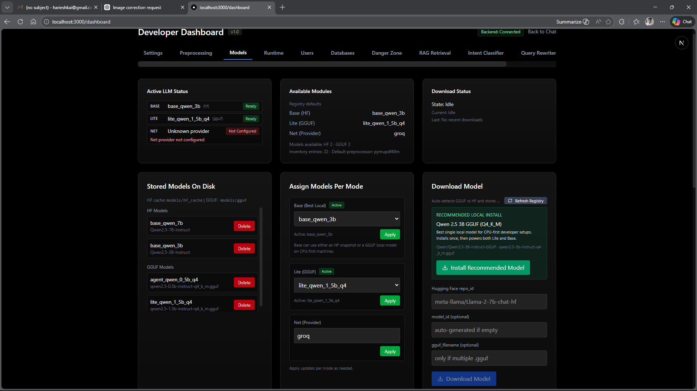
Frontend Screenshots
Add screenshots for each view manually – placeholder frames shown below
[ADD: Chat Window – main Q&A view]
[ADD: PDF Upload flow / Progress bar]
[ADD: Sidebar open with chat list]
[ADD: Source Viewer / Citation Modal]
[ADD: Table Inspection Modal]
[ADD: Preprocessing Preview Panel]
Notes:
“For these slides, say that the actual screenshots will show the real product interface for chat, upload flow, sidebar, source viewer, table inspection, and preprocessing preview. These slides are meant to demonstrate usability, not architecture.”

Slide 17
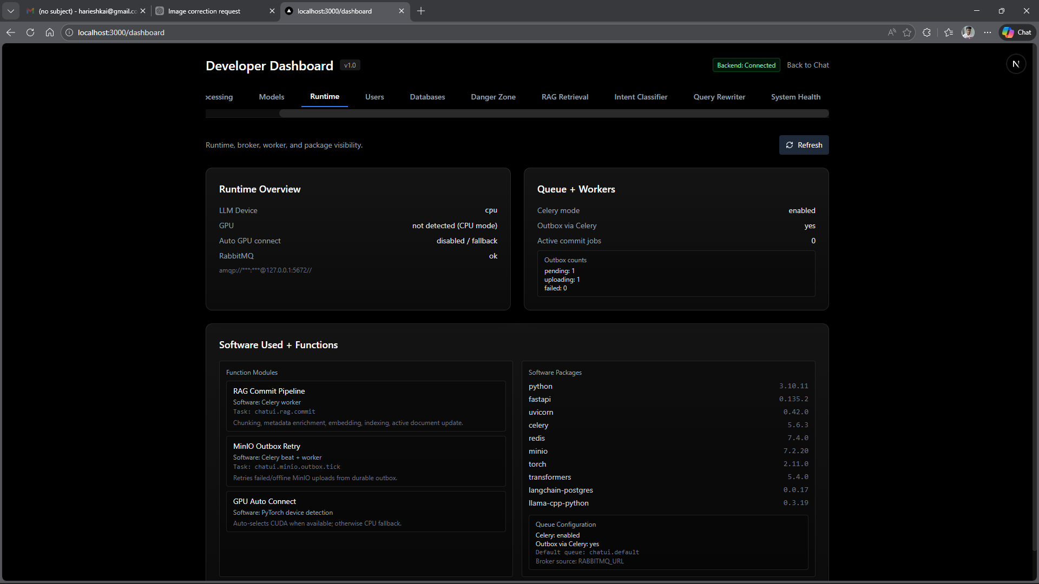
Frontend Screenshots
Add screenshots for each view manually – placeholder frames shown below
[ADD: Chat Window – main Q&A view]
[ADD: PDF Upload flow / Progress bar]
[ADD: Sidebar open with chat list]
[ADD: Source Viewer / Citation Modal]
[ADD: Table Inspection Modal]
[ADD: Preprocessing Preview Panel]

Slide 18
Frontend Screenshots
Add screenshots for each view manually – placeholder frames shown below
[ADD: Chat Window – main Q&A view]
[ADD: PDF Upload flow / Progress bar]
[ADD: Sidebar open with chat list]
[ADD: Source Viewer / Citation Modal]
[ADD: Table Inspection Modal]
[ADD: Preprocessing Preview Panel]

Slide 19
Frontend Screenshots
Add screenshots for each view manually – placeholder frames shown below
[ADD: Chat Window – main Q&A view]
[ADD: PDF Upload flow / Progress bar]
[ADD: Sidebar open with chat list]
[ADD: Source Viewer / Citation Modal]
[ADD: Table Inspection Modal]
[ADD: Preprocessing Preview Panel]

Slide 20
Frontend Screenshots
Add screenshots for each view manually – placeholder frames shown below
[ADD: Chat Window – main Q&A view]
[ADD: PDF Upload flow / Progress bar]
[ADD: Sidebar open with chat list]
[ADD: Source Viewer / Citation Modal]
[ADD: Table Inspection Modal]
[ADD: Preprocessing Preview Panel]

Slide 21
Frontend Screenshots
Add screenshots for each view manually – placeholder frames shown below
[ADD: Chat Window – main Q&A view]
[ADD: PDF Upload flow / Progress bar]
[ADD: Sidebar open with chat list]
[ADD: Source Viewer / Citation Modal]
[ADD: Table Inspection Modal]
[ADD: Preprocessing Preview Panel]

Slide 22
Frontend Screenshots
Add screenshots for each view manually – placeholder frames shown below
[ADD: Chat Window – main Q&A view]
[ADD: PDF Upload flow / Progress bar]
[ADD: Sidebar open with chat list]
[ADD: Source Viewer / Citation Modal]
[ADD: Table Inspection Modal]
[ADD: Preprocessing Preview Panel]

Slide 23
Frontend Screenshots
Add screenshots for each view manually – placeholder frames shown below
[ADD: Chat Window – main Q&A view]
[ADD: PDF Upload flow / Progress bar]
[ADD: Sidebar open with chat list]
[ADD: Source Viewer / Citation Modal]
[ADD: Table Inspection Modal]
[ADD: Preprocessing Preview Panel]

Slide 24
Frontend Screenshots
Add screenshots for each view manually – placeholder frames shown below
[ADD: Chat Window – main Q&A view]
[ADD: PDF Upload flow / Progress bar]
[ADD: Sidebar open with chat list]
[ADD: Source Viewer / Citation Modal]
[ADD: Table Inspection Modal]
[ADD: Preprocessing Preview Panel]

Slide 25
Frontend Screenshots
Add screenshots for each view manually – placeholder frames shown below
[ADD: Chat Window – main Q&A view]
[ADD: PDF Upload flow / Progress bar]
[ADD: Sidebar open with chat list]
[ADD: Source Viewer / Citation Modal]
[ADD: Table Inspection Modal]
[ADD: Preprocessing Preview Panel]

Slide 26
Frontend Screenshots
Add screenshots for each view manually – placeholder frames shown below
[ADD: Chat Window – main Q&A view]
[ADD: PDF Upload flow / Progress bar]
[ADD: Sidebar open with chat list]
[ADD: Source Viewer / Citation Modal]
[ADD: Table Inspection Modal]
[ADD: Preprocessing Preview Panel]

Slide 27
Frontend Screenshots
Add screenshots for each view manually – placeholder frames shown below
[ADD: Chat Window – main Q&A view]
[ADD: PDF Upload flow / Progress bar]
[ADD: Sidebar open with chat list]
[ADD: Source Viewer / Citation Modal]
[ADD: Table Inspection Modal]
[ADD: Preprocessing Preview Panel]

Slide 28
Frontend Screenshots
Add screenshots for each view manually – placeholder frames shown below
[ADD: Chat Window – main Q&A view]
[ADD: PDF Upload flow / Progress bar]
[ADD: Sidebar open with chat list]
[ADD: Source Viewer / Citation Modal]
[ADD: Table Inspection Modal]
[ADD: Preprocessing Preview Panel]

Slide 29
Backend API Exposure & Storage Ecosystem
FastAPI + Pydantic · MinIO + PostgreSQL PGVector + Redis · Celery task queue
FASTAPI BACKEND:
• Strict Pydantic payload validation
• Swagger UI auto-generated (interactive docs)
• Route groups: Chat, Auth, Upload, RAG, Dev Tools
• SSE (Server-Sent Events) for streaming LLM tokens
• Sidecar process (sidecar_main.py) for auxiliary tasks
API MODULES:
• backend/api/ – route definitions
• backend/main/ – FastAPI app factory
• backend/pml_main.py – PML service entrypoint
• backend/sidecar_main.py – background sidecar
ASYNC WORKERS:
• Celery + Redis broker for PDF ingestion jobs
• Celerybeat scheduler for periodic tasks
• Job ID tracking with upload_cancellation support
STORAGE LAYERS:
MinIO (S3-compatible Object Store):
– Raw PDFs and binary blobs
– Isolated from relational DB
– Local minio-data/ volume
PostgreSQL + PGVector (Vector DB):
– User accounts, projects, session data
– 1024-dimensional BAAI/bge-m3 vector index
– langchain_pg_embedding + langchain_pg_collection tables
– Revision-safe upsert strategy
Redis (Key-Value Store):
– SSE streaming state tracking
– Celery task broker + result backend
– Session abort signals (is_aborted())
– Used-chunk deduplication per session
Notes:
So this slide explains the backend architecture and storage layers of the system.
The backend is built using FastAPI, which handles API requests, validation, and real-time streaming of LLM responses using SSE.
For handling heavy tasks like document ingestion, Celery workers are used, which allows asynchronous processing.
For storage, MinIO is used to store raw PDF documents, while PostgreSQL with PGVector is used to store embeddings and metadata for retrieval.
Redis is used as a message broker for Celery, and also for caching and managing session state.
So each storage layer has a specific responsibility, which keeps the system organized and efficient. This separation of storage and processing layers improves scalability, reliability, and maintainability of the system.

Slide 30
New Features & Enhancements
Since initial release – advanced pipeline capabilities and quality gates
AGENTIC REVIEW PIPELINE
7-stage deliberation chain with 3 local models
Strict factual heuristic + LLM reviewer gate
Senior escalation for conflicts & ambiguities
MULTI-LANE RETRIEVAL
Separate text / parent / image / child lanes
Prevents child-row domination of results
Deterministic parent lookup by doc_id SQL
QUERY PROFILE ROUTING
7 profiles: metadata, table, image, summary,
explanation, factual, general
Per-profile element weights + lane budgets
DOCUMENT-TYPE AWARE CHUNKING
Auto-detect: spec, procedure, report, drawing, datasheet
Tailored chunk_size + overlap per doc type
Content + filename signals (no LLM needed)
INLINE METADATA EXTRACTION
Page-1 preview fast path (metadata mode)
LLM-extracted: doc_type, revision, doc_number
Inline confirmation UI before full ingest
PREPROCESSING REGISTRY
5 preprocessors: pypdf, pymupdf4llm, unstructured,
docling, table_preprocessor
Per-upload override via dev settings
ANSWER QUALITY GATES
enable_eval_gate: grounding score check
Release gate with blocker enumeration
Soft warning appended when score < 0.40
EXTERNAL LLM NET MODE
Groq: llama-3.1-8b-instant (rate-limited)
xAI: grok-beta
Concurrency guard + rate limit event UI
ENTERPRISE TEAM WORKSPACE
Real-time WebSocket messaging
Project threads + assignee management
Team notification panel + unread counts
Notes:
So this slide highlights the key features and improvements added to the system.
One of the main features is the agentic review pipeline, which uses multiple LLM stages to verify answers and reduce hallucination.
We also implemented multi-lane retrieval, where different types of content like text, tables, and images are handled separately for better accuracy.
The system uses query profile routing, which adjusts retrieval strategy based on the type of question.
We also support document-type aware chunking, where different document types are processed differently for better results.
Additionally, metadata extraction is done during upload, and users can confirm it before ingestion.
There are also quality gates to evaluate answers before showing them to the user.
And finally, the system supports external LLM APIs like Groq and xAI for flexible deployment.
So overall, these features improve the system’s accuracy, flexibility, and production readiness.

Slide 31
Technology Stack Summary
Complete technology inventory across all system layers
Frontend
Backend
AI / ML
Preprocessing
Storage
• Next.js 14 + TypeScript (App Router)
• FastAPI (Python 3.11+)
• llama_cpp (GGUF runtime)
• PyPDF · PyMuPDF4LLM
• PostgreSQL + PGVector
• React hooks / SSE EventSource
• Celery + Redis broker
• Hugging Face Transformers
• Unstructured (hi_res / fast)
• MinIO (S3-compatible)
• Tailwind CSS · Lucide icons
• Pydantic v2 validation
• BAAI/bge-m3 embeddings
• Docling (academic-grade)
• Redis (cache + broker)
• Tauri (optional desktop)
• LangChain / LangChain-Postgres
• FlashRank (MiniLM-L-12)
• Table-Transformer (MSFT)
• Local file system (jobs/)
• JWT cookie auth
• SQLAlchemy (async)
• BART-MNLI zero-shot NLI
• YOLOX layout detection
• HF model cache (snapshots)
Notes:
o this slide summarizes the complete technology stack used in the system.
On the frontend, we use Next.js with TypeScript for building a scalable and interactive UI.
On the backend, FastAPI is used along with Celery and Redis for asynchronous processing.
For AI and ML, we use LLMs through llama.cpp and Hugging Face, along with BGE-M3 for embeddings, FlashRank for reranking, and BART MNLI for intent classification.
For preprocessing, tools like PyMuPDF, Unstructured, and Docling are used for extracting structured data from PDFs.
And for storage, PostgreSQL with PGVector is used for vector data, MinIO for document storage, and Redis for caching and task management.
So overall, the system uses a combination of modern web technologies and AI models to build a complete end-to-end solution

Slide 32
KavinBase
Enterprise AI Document Intelligence – End-to-End
Hybrid RAG · Local LLMs · Agentic Review · Multi-Modal Ingestion
Thank you
Notes:
Thank you for your time.
KavinBase is designed to transform large technical documents into a fast, accurate, and reliable AI-driven system.

