Slide 1

Blood Bank Connectivity System using Minimum Spanning Tree Algorithms (Prim & Kruskal)
DESIGN AND ANALYSIS OF ALGORITHM LABORATORY – CSE23CL202
DATE : 24 - 11 - 2025
DONE BY
GANESH SRINIVASAN – E0524016
HARIGANESH.V – E0524007
FACULTY INCHARGE:
Examiner 1:Dr.AgastaAdline Examiner 2:Dr.Deepa

Slide 2
TABLE OF CONTENTS
PROBLEM STATEMENT
ALGORITHM
IMPLEMENTATION
SAMPLE INPUT & OUTPUT
CONCLUSION

Slide 3
PROBLEM STATEMENT
In large cities and emergency healthcare networks, multiple blood banks must stay connected to ensure fast, reliable, and cost-effective transportation of blood between centers. However, building a fully connected network requires high operational and transport costs. Hence, there is a need for a system that identifies the most efficient way to interconnect blood banks using minimum cost links.This project builds a cost-efficient network between blood banks using MST algorithms. Each blood bank is a node, and the distance or transport cost becomes the edge.
The system:
Collects user info and blood group
Accepts a weighted adjacency matrix
Computes MST using Prim’s and Kruskal’s algorithms
Compares their cost and execution time
Recommends the better algorithm

Slide 4
ALGORITHM
Prim’s Algorithm
1. Initialize:
key[i] = INF for all nodes; inMST[i] = 0.
key[0] = 0 (start from node 0). parent[i] = -1.
2. Repeat n-1 times:
Find the node u not in MST with the smallest key[u].
Mark u as included: inMST[u] = 1.
For each neighbor v of u (where graph[u][v] != INF):
If !inMST[v] and graph[u][v] < key[v] then:
key[v] = graph[u][v]
parent[v] = u
3. Output:
For i = 1..n-1 print parent[i] - i : graph[i][parent[i]].
Sum those weights → Prim cost.
4. Complexity: O(n²) in your current implementation
Works well for dense graphs and small n.

Slide 5
ALGORITHM
Kruskal’s Algorithm
1. Create edge list:
Iterate i=0..n-1, j=i+1..n-1, if graph[i][j] != INF add edge (i,j,w).
2. Sort edges by weight (qsort used).
3. Initialize union-find:
parent[i] = i, rank[i] = 0.
4. Iterate sorted edges:
For each edge (u,v,w):
If find_set(u) != find_set(v):
print u - v : w
union_set(u,v)
add w to total, increment edge count (taken++)
Stop when taken == n-1.
5. Complexity: O(E log E) dominated by sorting. Works well on sparse graphs (small E relative to n²).

Slide 6
WHY PRIM’S AND KRUSKAL’S ALGORITHM?
You use both Prim’s and Kruskal’s in this project because:
Sometimes Prim’s is faster for dense/complete networks.
Sometimes Kruskal’s is faster for sparse networks.
Running both allows you to compare total cost and execution time.
Your program recommends the best algorithm based on performance.

Slide 7
IMPLEMENTATION
1. Modular Menu-Driven System
The program uses a menu-based structure with options for entering personal details, blood group, graph input, MST computation, and algorithm comparison. Each module is implemented as a separate function.
2. Graph Input Using Adjacency Matrix
The blood bank network is stored in a 10×10 adjacency matrix (graph[MAXN][MAXN]). The code converts 0 to INF to indicate no direct connection, and also ensures the matrix is symmetrical for an undirected graph.
3. Prim’s Algorithm Implementation
Prim's MST is implemented using:
key[] array to track minimum weights
inMST[] to mark visited nodes
parent[] to store the MST structure The algorithm runs n–1 iterations and prints each MST edge.

Slide 8
4. Kruskal’s Algorithm with Union-Find
Kruskal’s MST uses:
An edge list extracted from the matrix
Sorting using qsort()
Cycle detection using Union-Find (find_set() and union_set()) It selects the globally smallest edges while avoiding cycles.
5. Performance Measurement & Final Recommendation
The program measures execution time using clock_gettime(), compares MST cost and time taken for both Prim and Kruskal, and prints a final sentence recommending which algorithm is best for the given user name and blood group.

Slide 9
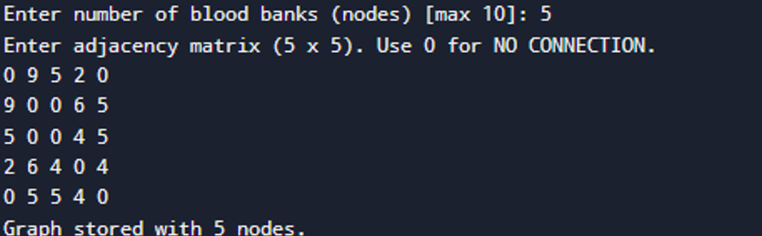
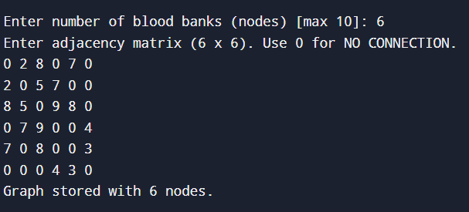
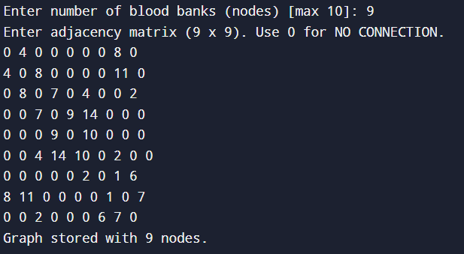
SAMPLE INPUT & OUTPUT
SAMPLE INPUT:
The system successfully received the number of blood banks and stored the entered 5×5 adjacency matrix representing the connections between them.
The system accepted the input for 6 blood banks and successfully stored the corresponding 6×6 adjacency matrix representing their network connections.
The system received 9 blood banks as input and successfully stored the corresponding 9×9 adjacency matrix representing all their connection weights.

Slide 10
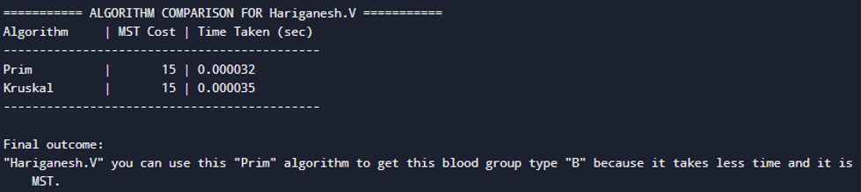
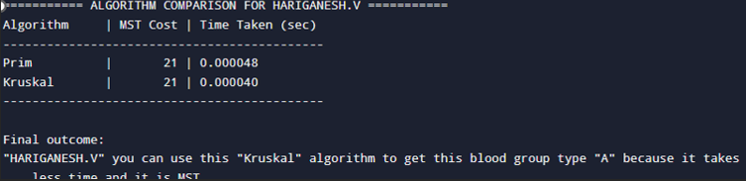
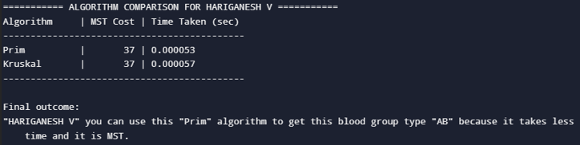
SAMPLE OUTPUT

Slide 11
CONCLUSION
The Blood Bank Connectivity System is designed to find the most cost-efficient routes between multiple blood banks using Minimum Spanning Tree algorithms. In testing, both Prim’s and Kruskal’s algorithms generated optimal networks, but their performance differed based on the type of graph: Prim’s algorithm handled dense networks more effectively, while Kruskal’s performed better on sparse ones. To ensure the best outcome, the system automatically compares the total MST cost and execution time of both methods and recommends the most efficient option. By doing this, the system helps create a faster, more reliable, and cost-optimized transportation network—something essential for timely blood delivery and emergency medical services.

