Slide 1
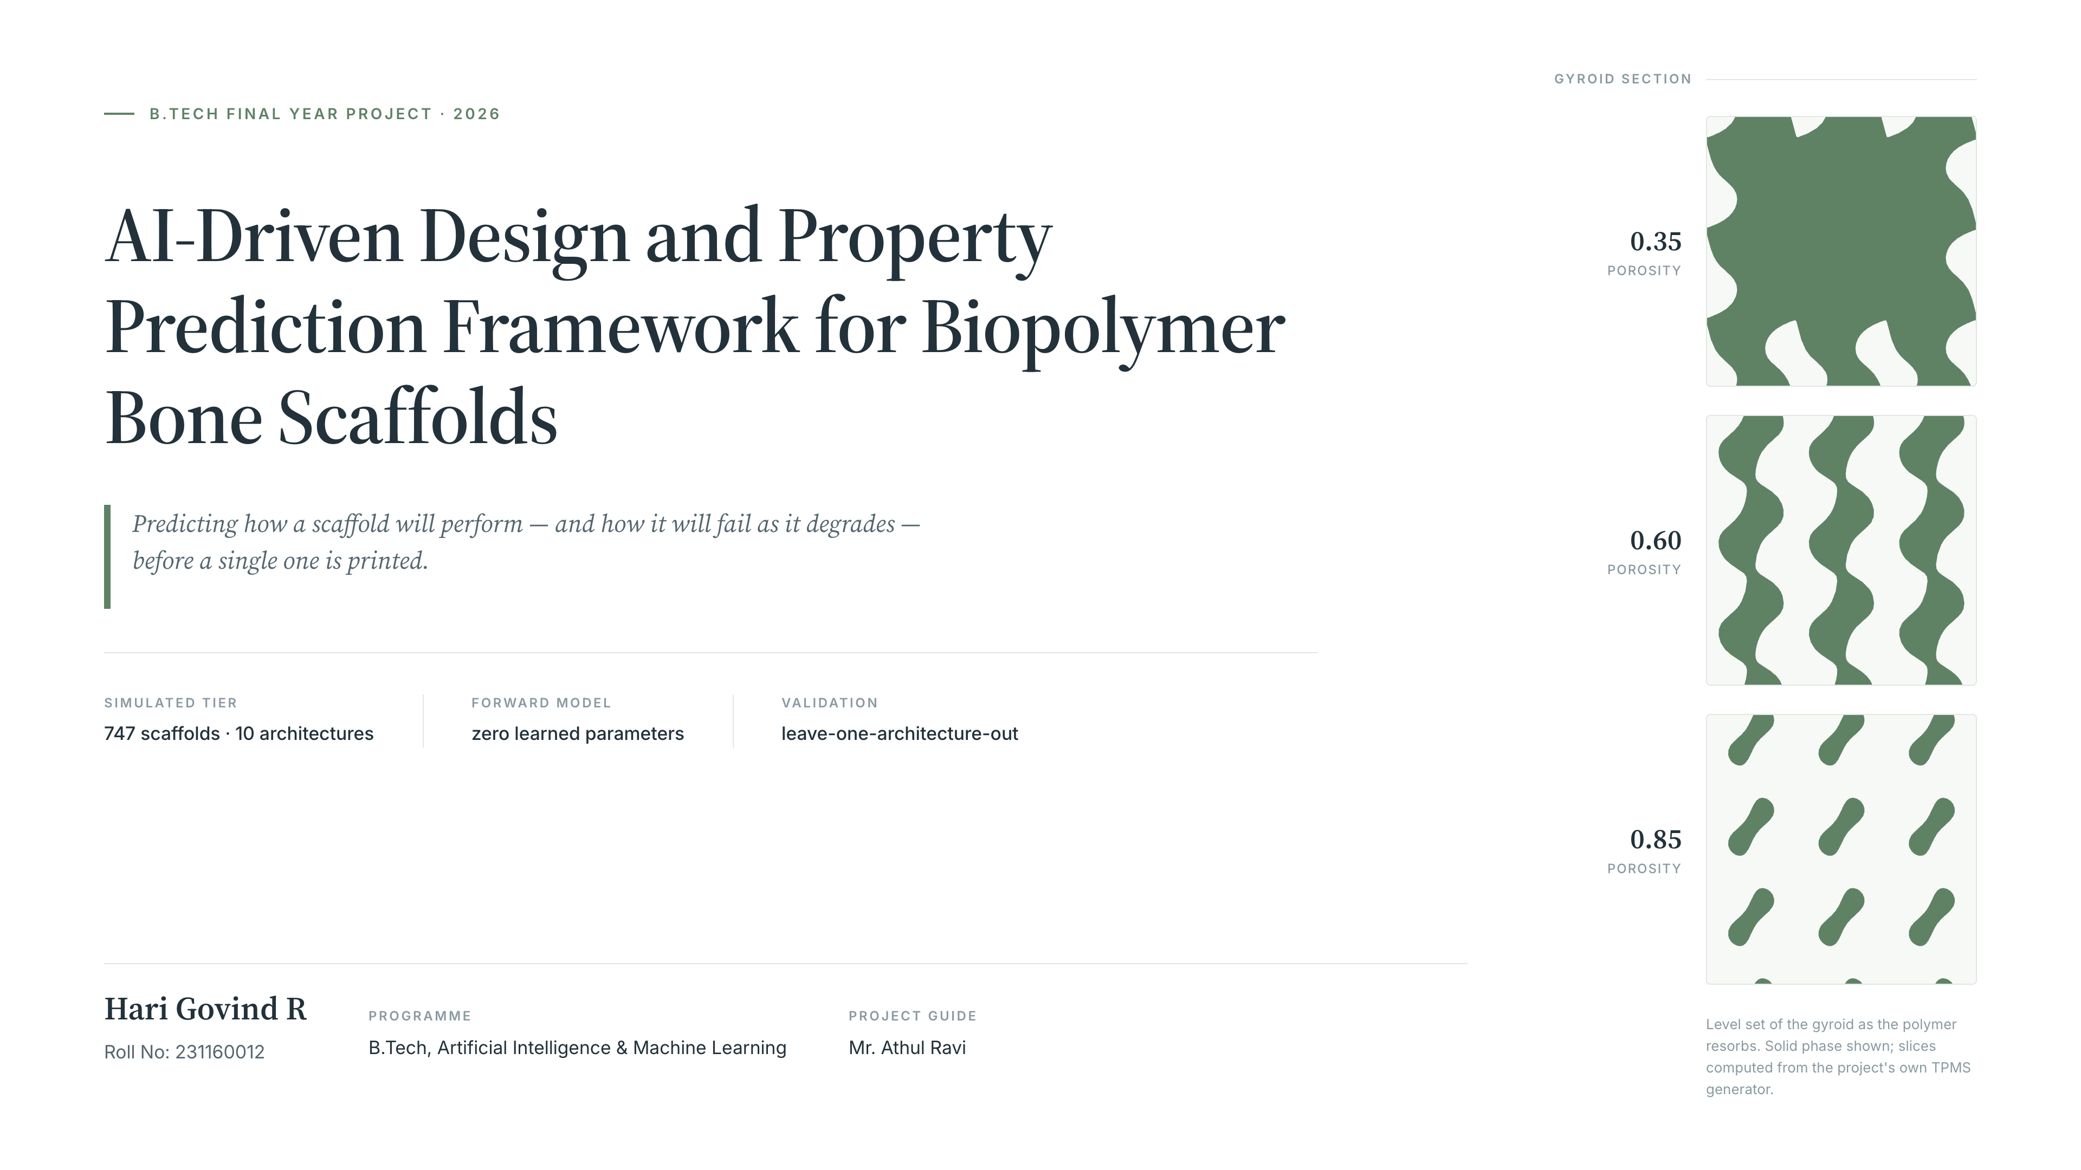
Notes:
Good morning. My project is an AI-driven design and property prediction framework for
biopolymer bone scaffolds. I'm Hari Govind, roll number 231160012, from the Artificial
Intelligence and Machine Learning branch, and this work was carried out under the guidance
of Mr. Athul Ravi.
Let me start with the one-line version. If you want to build a scaffold that holds a bone
defect open while new bone grows into it, today you print one, you test it, you find out it
was too stiff or too weak, and you go around again. That loop takes weeks. What I've built
predicts the mechanical performance of a scaffold — not just on day one, but across the whole
healing window as the polymer degrades — before anything is fabricated.
The three panels on the right are the idea in one image, and they're not decoration. Those
are real cross-sections through a gyroid, computed from the same level-set code that
generates my simulated dataset, at thirty-five, sixty and eighty-five percent porosity. Read
them top to bottom and you're watching a scaffold resorb: the solid phase thins, the pores
open up, and by eighty-five percent that slice has broken into disconnected islands. Every
step of that costs you stiffness. Predicting that trajectory is the problem I set out to
solve.
One thing up front, because it shapes everything that follows. The headline result of this
project is that the physics model wins and the machine learning does not beat it. I'll show
you those numbers honestly rather than dressing them up, because the reason it loses is the
most interesting finding I have.

Slide 2
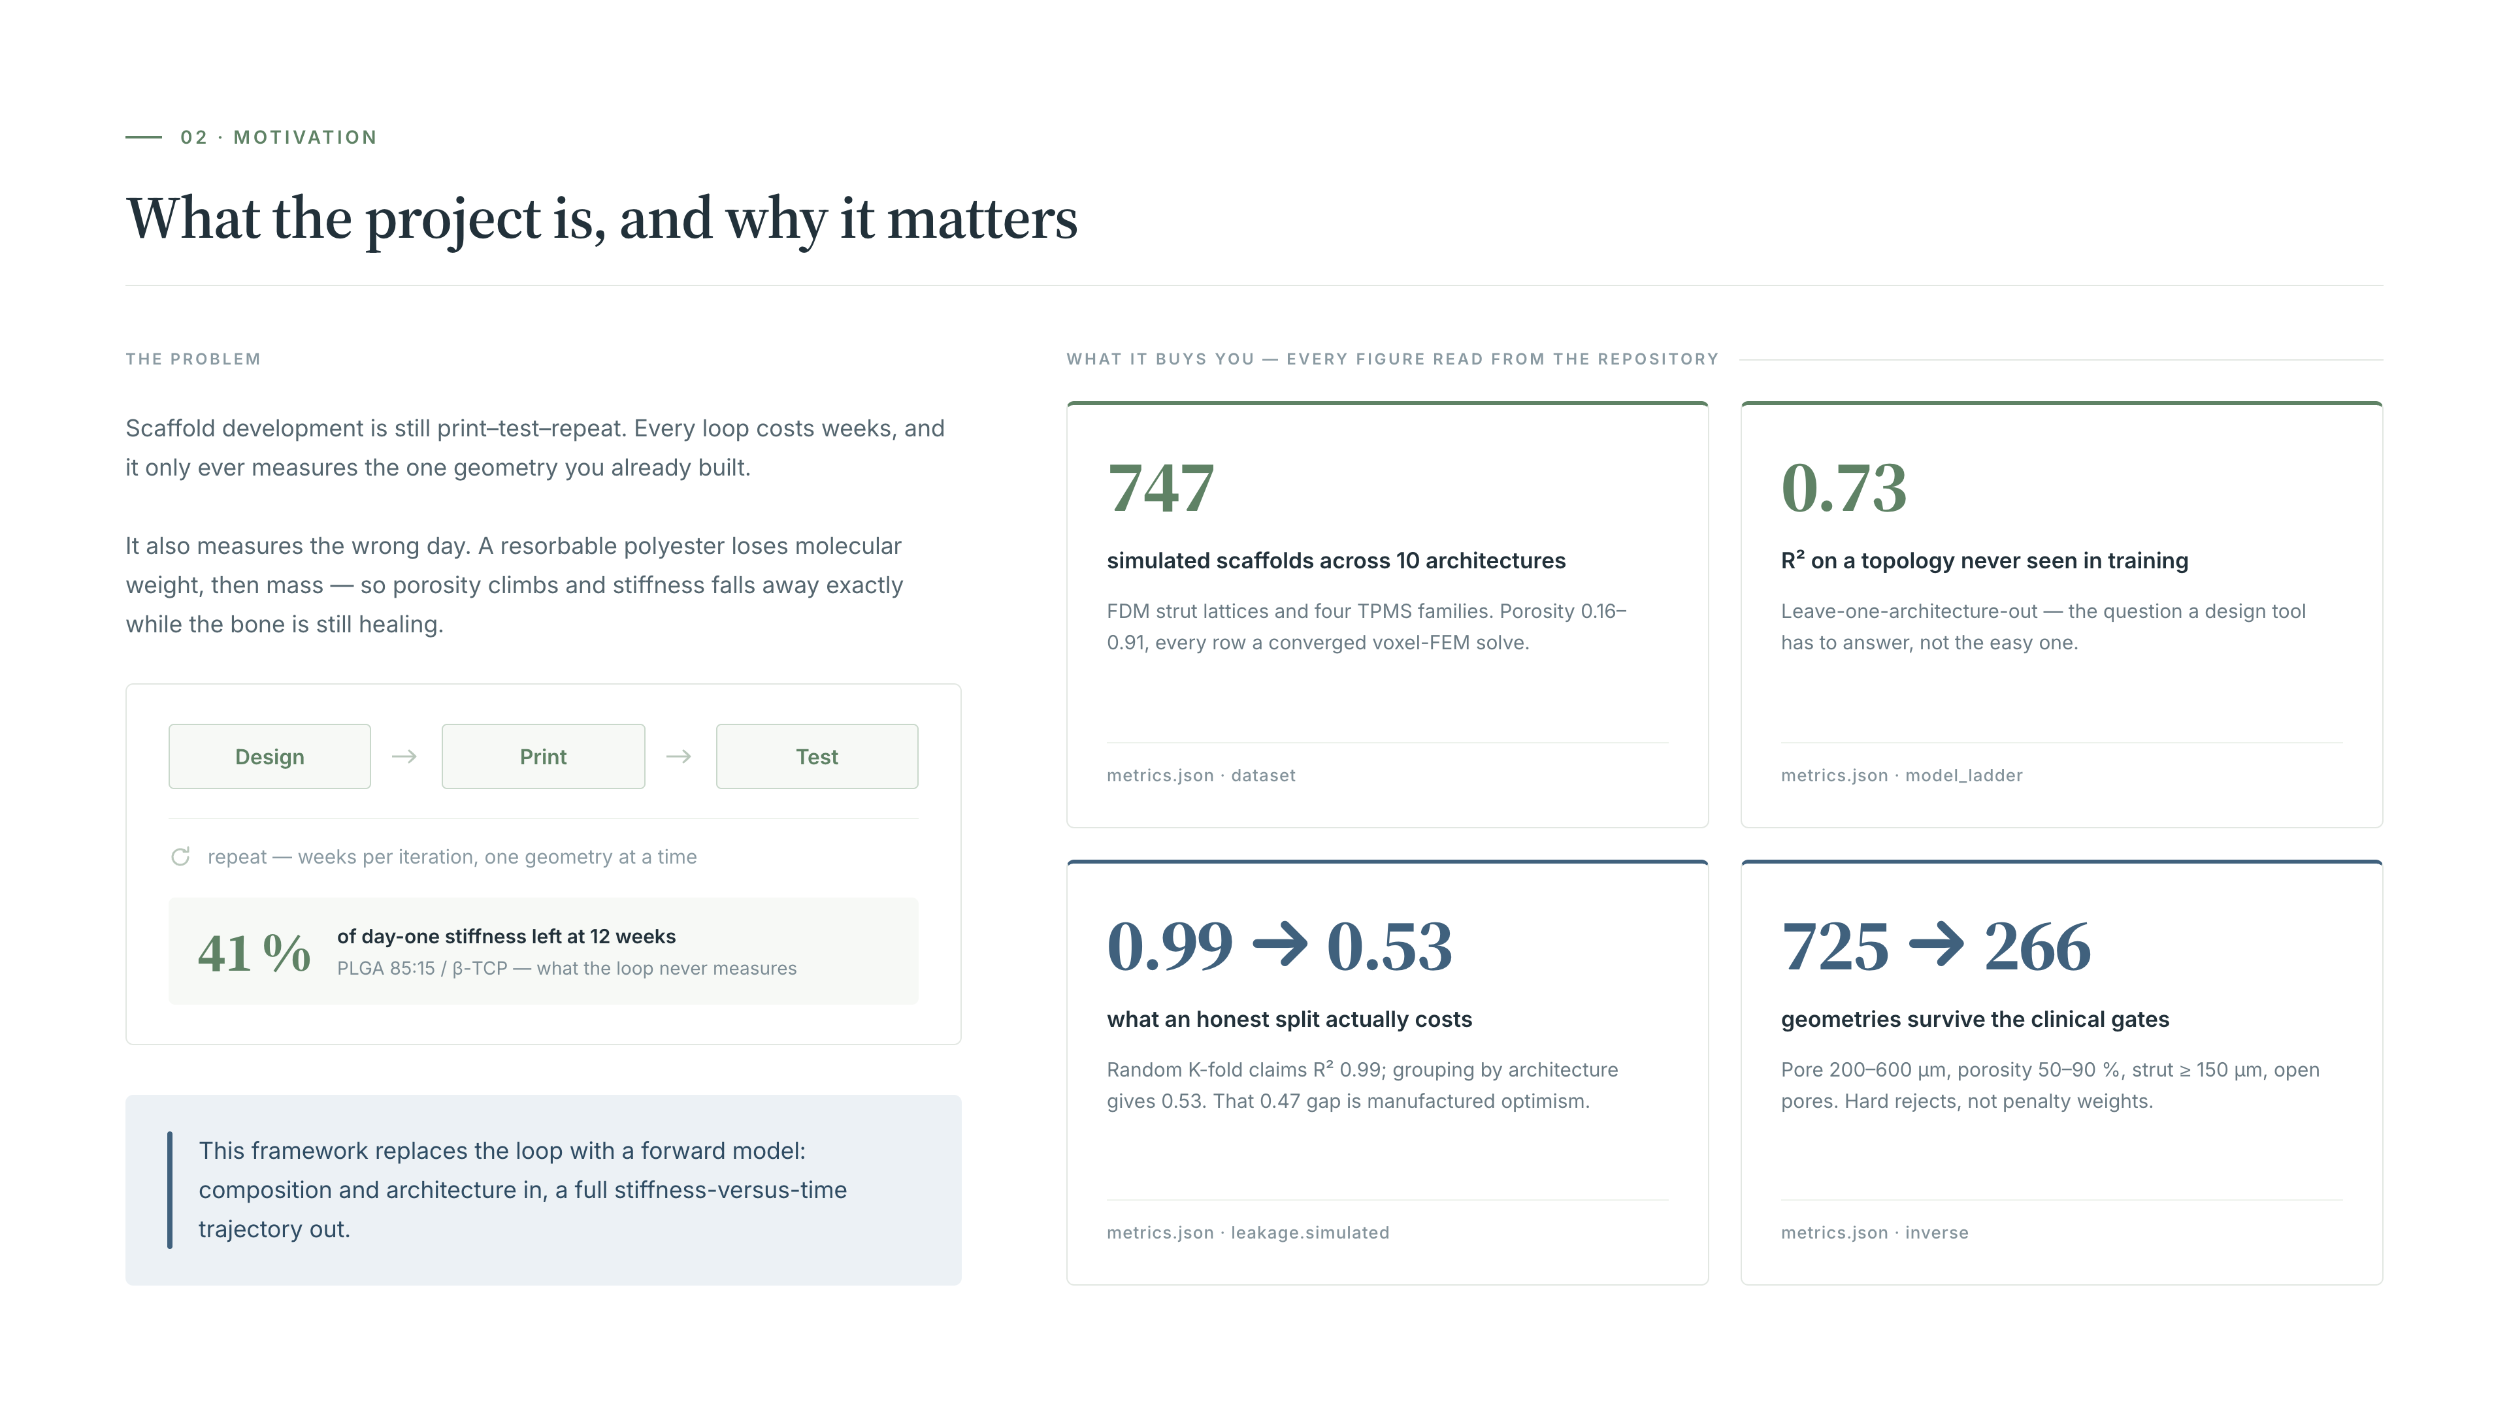
Notes:
So why does this matter? Take the problem first, on the left.
Scaffold development today is a print-test-repeat loop. You design a geometry, print it,
crush it in a testing machine, and learn one number about one scaffold. That takes weeks, and
at the end you know about the thing you already built — it tells you nothing about the
geometry you didn't try.
There's a second, subtler problem, and it's the one that actually motivated this project. The
number you measure on day one is not the number that matters clinically. These are resorbable
polymers. They hydrolyse, they lose molecular weight, then they start losing mass, so the
scaffold gets more porous and less stiff over exactly the weeks when the bone is trying to
heal. The figure in the box is from my own pipeline: a PLGA 85:15 scaffold with beta-TCP is
down to about forty-one percent of its day-one stiffness by week twelve. A scaffold that is
perfect in the testing machine can be far too soft by the time it matters. So what you really
want to predict is a trajectory, not a single value.
Now the four claims on the right. I've attached a real number to each one, because I don't
want to stand here and say this saves time and cost without evidence. Each card also carries
where in the repository the number comes from.
First, scale. The simulated tier is 747 scaffolds spanning ten distinct architectures — FDM
strut lattices and four TPMS families, gyroid, diamond, Schwarz-P and IWP, in sheet and
network modes. Porosity runs from about 0.16 to 0.91. Every row is a converged voxel finite
element solve, not an interpolation.
Second, generalisation. The headline accuracy is R-squared 0.73, and the important word is
which R-squared. That is leave-one-architecture-out: I hold out an entire topology, train on
the rest, and predict the one the model has never seen. That's the question a design tool
actually has to answer.
Third — and this is the methodological point I'm proudest of — honest validation. Score the
same model with a random K-fold split and you get R-squared 0.99. Group the folds by
architecture and the same model gets 0.53. That gap of 0.47 is not accuracy, it's optimism
manufactured by the split. I ran the same audit on a published printability dataset grouped
by DOI: random accuracy 0.83, grouped 0.58, against a majority-class baseline of 0.56. So the
honest score beats guessing by about three points, not by twenty-seven.
Fourth, the clinical constraints are hard gates, not weights in an objective. Of 725 simulated
geometries, only 266 are printable and capable of bone ingrowth. The rejections break down as
249 outside the fifty-to-ninety percent porosity window, 154 outside the 200-to-600 micron
pore window, 35 with struts too thin for a real nozzle, and 21 with closed porosity. A
closed-pore scaffold isn't a slightly worse scaffold — bone physically cannot grow into it —
so no stiffness score should be allowed to buy that off.

Slide 3
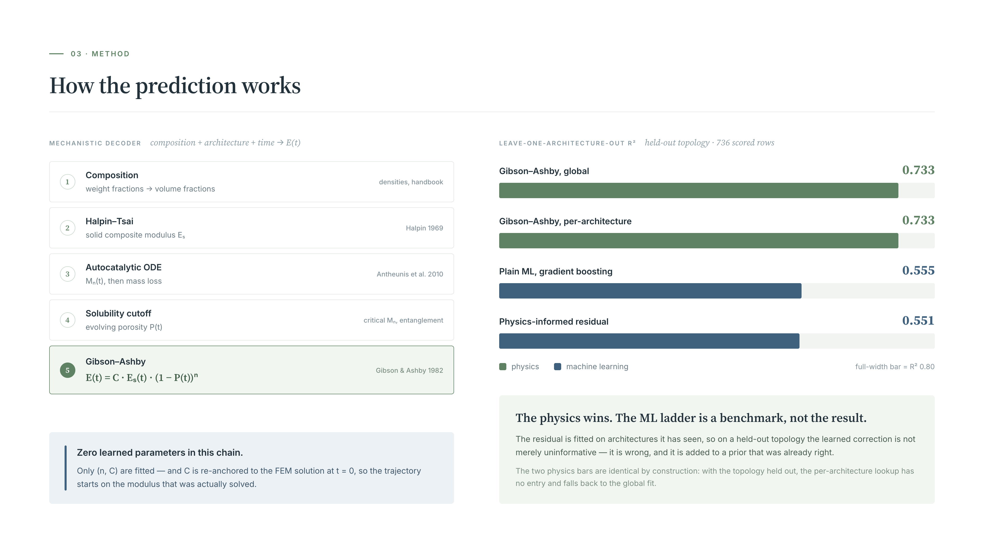
Notes:
This is the machinery. Left side is how a prediction is made; right side is how well it works.
Start on the left. This is what I call the mechanistic decoder, and the important claim about
it is in the blue box: it contains zero learned parameters. Every line is textbook, and I can
defend it step by step.
You give it a composition — say PLGA 85:15 with thirty weight percent beta-tricalcium
phosphate. Step one, I convert weight fractions to volume fractions, because papers report
weight percent but every mechanical model needs volume percent. Step two, Halpin–Tsai gives
me the modulus of the solid composite, E-sub-s: the stiffness of the material the scaffold is
made from, if it were fully dense. Step three, an autocatalytic hydrolysis ODE. Chains break,
each break creates a carboxylic acid end group, and that acid catalyses further breakage — so
degradation accelerates itself. My rate law also captures two real effects: a more porous
scaffold washes acid out faster and so degrades more slowly, and a dissolving ceramic buffers
the acid, which is the known mechanism by which TCP and bioglass slow polyester degradation.
Step four, once chains fall below a critical molecular weight they become soluble and wash
out — that's the mass loss, and mass loss is what drives porosity upward. Step five,
Gibson–Ashby converts that solid modulus and that porosity into the modulus of the porous
scaffold: E of t equals C times E-s of t times one minus P of t, all raised to the power n.
Only n and C are fitted, and there's one refinement worth pointing out. At time zero I already
know the exact FEM answer for that specific geometry, so rather than reading a smoothed value
off the power-law fit, I re-anchor C to reproduce the solved modulus exactly. That leaves the
exponent to do the only job it's needed for — evolving the modulus as degradation raises
porosity. Without that, candidates whose scores differ by under a percent get reordered by
fitting noise.
Now the right-hand side, and I want to be straightforward, because this is not the result I
expected.
I built a four-rung ladder to ask one question honestly: how much does machine learning
actually add over the closed-form theory a supervisor could write on a whiteboard? Rung one is
global Gibson–Ashby, one n and one C for everything. Rung two is Gibson–Ashby fitted per
architecture. Rung three is plain gradient boosting with no physics. Rung four is my proposal
— Gibson–Ashby as a prior, with ML learning only the residual.
Under leave-one-architecture-out the two physics rungs score 0.733, and the two ML rungs score
0.555 and 0.551. The physics wins by about 0.18, and the physics-informed hybrid is very
slightly the worst of the four. I'm not going to present that as an ML success, because it
isn't one.
Two things are worth explaining. The two physics bars are identical, and that's not a plotting
error — it's the point of that control. With the topology held out, the per-architecture
lookup has no entry for it, falls back to the global fit, and returns exactly the same
predictions. Which is precisely why a per-architecture lookup table is not a design tool.
And why does the learned residual actually make things worse? Because the residual it learns
is architecture-specific. On a topology held out entirely, that correction isn't merely
uninformative — it's wrong, and it's being added to a prior that was already right. So it
subtracts accuracy. There are two honest readings and I can't yet settle between them: either
the simulated relative modulus really is a clean power law in relative density, leaving no
transferable residual structure, or the residual stage needs to shrink toward zero when the
held-out geometry falls outside the training manifold. Distinguishing those needs the curated
experimental tier, which is the next stage of the work.
One last thing if you ask about the multi-fidelity layer. I implemented recursive co-kriging in
the Le Gratiet form, fusing a coarse mesh with a fine one. Rho comes out between 0.83 and
0.94, which says the cheap simulation has essentially the right shape and mainly needs
rescaling, and the fused model holds Spearman correlation between 0.92 and 0.94 at every
budget. But I should be honest there too: on R-squared, the fused model only overtakes the
cheap source once you give it about 24 trusted points. Below that, simply trusting the coarse
mesh is as good or better.
REFERENCES
Gibson, L. J. & Ashby, M. F. (1982). The mechanics of three-dimensional cellular materials.
Proc. R. Soc. Lond. A 382(1782), 43–59. doi:10.1098/rspa.1982.0088
[book: Cellular Solids: Structure and Properties, 2nd ed., CUP 1997. doi:10.1017/CBO9781139878326]
Halpin, J. C. (1969). Stiffness and expansion estimates for oriented short fiber composites.
J. Composite Materials 3(4), 732–734. doi:10.1177/002199836900300419
Antheunis, H., van der Meer, J.-C., de Geus, M., Heise, A. & Koning, C. E. (2010). Autocatalytic
equation describing the change in molecular weight during hydrolytic degradation of aliphatic
polyesters. Biomacromolecules 11(4), 1118–1124. doi:10.1021/bm100125b
Le Gratiet, L. & Garnier, J. (2014). Recursive co-kriging model for design of computer
experiments with multiple levels of fidelity. Int. J. Uncertainty Quantification 4(5),
365–386. doi:10.1615/Int.J.UncertaintyQuantification.2014006914
[origin: Kennedy, M. C. & O'Hagan, A. (2000). Biometrika 87(1), 1–13. doi:10.1093/biomet/87.1.1]
POSITIONING — recent ML for bone scaffolds
Liu, W., Zhang, Y., Lyu, Y., Bosiakov, S. & Liu, Y. (2023). Inverse design of anisotropic bone
scaffold based on machine learning and regenerative genetic algorithm. Front. Bioeng.
Biotechnol. 11, 1241151. doi:10.3389/fbioe.2023.1241151
Foroughi, A. H., Valeri, C. & Razavi, M. J. (2024). A review of computational optimization of
bone scaffold architecture. Prog. Biomed. Eng. 7(1), 012003. doi:10.1088/2516-1091/ad879a
Zahedi, S. M. et al. (2025). Comparative evaluation of neural networks and transfer learning for
predicting mechanical properties of 3D-printed bone scaffolds. Macromol. Mater. Eng. 310(10),
e00073. doi:10.1002/mame.202500073

