Slide 1

Basic Details of the Team and Problem Statement
Ministry: Ministry of AYUSH
PS Code: SIH1343
Problem Statement Title:
Identification of Different Medicinal Plants/Raw materials through Image Processing Using Machine Learning Algorithms
Team Name: Data Pioneers
Team Leader Name: Durga S
Institute Code (AISHE): C-16537
Institute Name: St. Joseph’s College of Engineering
Theme Name: MedTech / BioTech / HealthTech

Slide 2
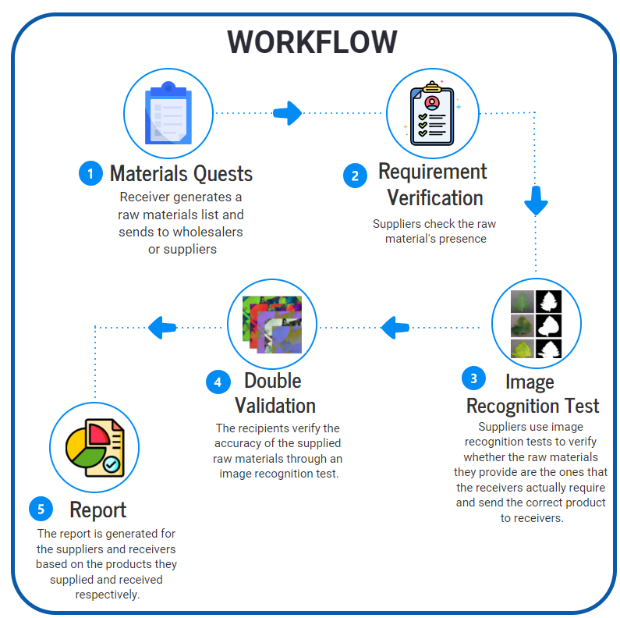
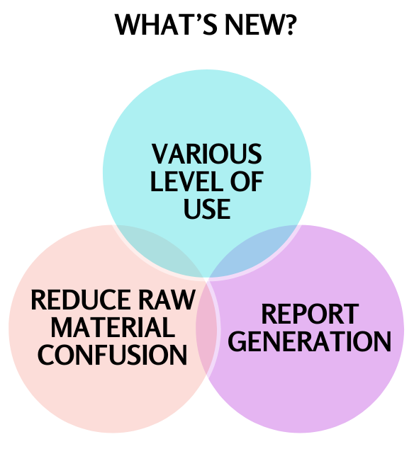
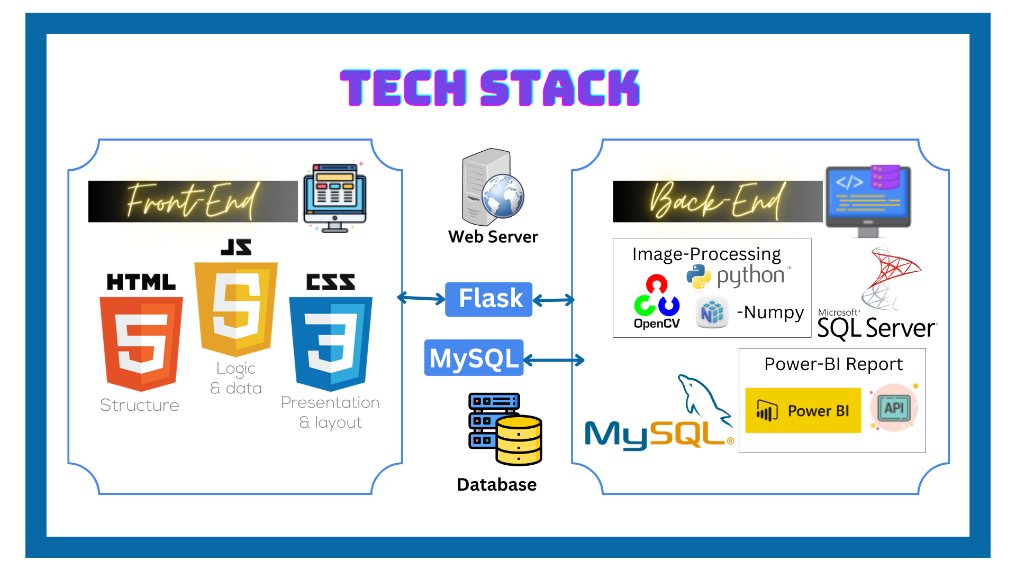
IDEA/APPROACH
India has a diverse range of medicinal plants, but their accurate identification is a major challenge in Ayurvedic Pharmaceutics.
As a result, the market often sells different counterfeit drugs under the same name, causing confusion and misidentification.
To mitigate the issue, we propose a system that uses Image Processing and Machine Learning algorithms to identify different medicinal plants/raw materials accurately.
Our system divides into two main components:
1. Image Recognition: Utilizes advanced image processing techniques to detect the medicinal plants/raw materials.
2. Database Integration: Integrates a comprehensive database of medicinal plant information that includes botanical names, medicinal properties, and traditional uses.

Slide 3
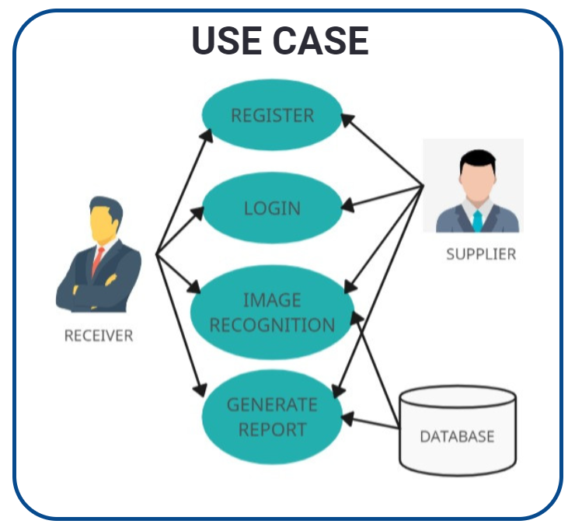
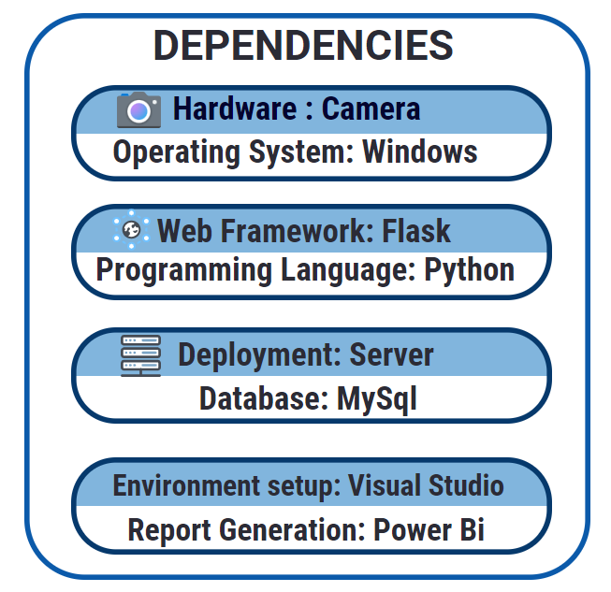
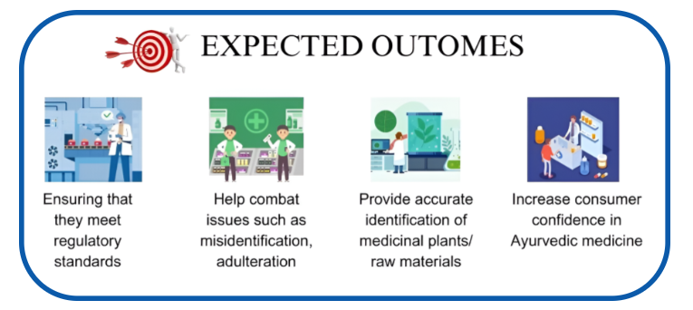
IDEA/APPROACH
Future Enhancement:
!! Integration with Raspberry PI and Humanoid AI-Robot. !!

Slide 4
Team Member Details
Team Leader Name: DURGA S
Branch : BE Stream : CSE Year : III
Team Member 1 Name: JAYA SURYA L
Branch : BE Stream : CSE Year : III
Team Member 2 Name: DHARSHA S R
Branch : BE Stream : CSE Year : III
Team Member 3 Name: ARUN KUMAR T
Branch : BE Stream : CSE Year : III
Team Member 4 Name: JAI UDHAYA S
Branch : BE Stream : CSE Year : III
Team Member 5 Name: HARIHARAAN S
Branch : BE Stream : CSE Year : III
Team Mentor 1 Name: Ms. K.R. RAGHI
Category : Academic Expertise : AI/ML Domain Experience : 5 years
Team Mentor 2 Name: Dr. C. PANDEESWARAN
Category : Academic Expertise : AI/ML Domain Experience : 5 years

