Slide 1
Python and R Programming Unit I
Introduction to Python – Features of Python – Variables, Expressions and Statements – Order of operations – String operations - Functions – Flow of execution – Parameters and arguments

Slide 2
What is a program?
A program is a
- sequence of instructions
- that specifies how to perform a computation
The computation might be
- mathematical, i.e. solving a system of equations or finding the roots of a polynomial
- symbolic, Eg. searching and replacing text in a document
- graphical, Eg. processing an image or playing a video

Slide 3
What is a program?
A few basic instructions appear in just about every language:
Input: Get data from the keyboard, a file, the network, or some other device
Output: Display data on the screen, save it in a file, send it over the network, etc
Math: Perform basic mathematical operations like addition and multiplication
Conditional execution: Check for certain conditions and run the appropriate code
Repetition: Perform some action repeatedly, usually with some variation

Slide 4
What is Python?
Python is a high-level programming language created by Guido Van Rossum
Python was first released in 1991
Today Python interpreters are available for many Operating Systems including Windows and Linux
Python programmers are often called Pythonists or Pythonistas

Slide 5
What is Python?
Python is a high-level, interpreted, interactive, and object-oriented scripting language
Python is designed to be highly readable
Python is Interpreted − Python is processed at runtime by the interpreter. Do not need to compile the program before executing it
Python is Interactive - The python prompt allows us to interact with the interpreter directly to write our programs
Python is Object-Oriented − Python supports the Object-Oriented style or technique of programming that encapsulates code within objects
Python is a Beginner's Language − Python is a great language for beginner-level programmers and supports the development of a wide range of applications from simple text processing to WWW browsers to games

Slide 6
History of Python
Python was developed by Guido van Rossum in the late eighties and early nineties at the National Research Institute for Mathematics and Computer Science in the Netherlands
Python is derived from many other languages, including ABC, Modula-3, C, C++, Algol-68, SmallTalk, Unix shell, and other scripting languages
Python is copyrighted. Python source code is now available under the GNU General Public License (GPL)
Python is now maintained by a core development team at the institute, although Guido van Rossum still holds a vital role in directing its progress

Slide 7
Python Features
Easy-to-learn − Python has few keywords, a simple structure, and a clearly defined syntax. This allows the student to pick up the language quickly
Easy-to-read − Python code is more clearly defined and visible to the eyes
Easy-to-maintain − Python's source code is fairly easy-to-maintain
A broad standard library − Python's bulk of the library is very portable and cross-platform compatible on UNIX, Windows, and Macintosh
Interactive Mode − Python has support for an interactive mode that allows interactive testing and debugging of snippets of code
Portable − Python can run on a wide variety of hardware platforms and has the same interface on all platforms

Slide 8
Python Features
Extendable − Can add low-level modules to the Python interpreter. These modules enable programmers to add to or customize their tools to be more efficient
Databases − Python provides interfaces to all major commercial databases
GUI Programming − Python supports GUI applications that can be created and ported to many system calls, libraries, and windows systems, such as Windows MFC, Macintosh, and the X Window system of Unix
Scalable − Python provides a better structure and support for large programs than shell scripting

Slide 9
Characteristics of Python
It supports functional and structured programming methods as well as OOP
It can be used as a scripting language or can be compiled to byte-code for building large applications
It provides very high-level dynamic data types and supports dynamic type checking
It supports automatic garbage collection
It can be easily integrated with C, C++, COM, ActiveX, CORBA, and Java

Slide 10
Reasons for Popularity
Free:
Python is free to use and distribute and is supported by the community
Python interpreter is available for every major platform
Software Quality:
Better than traditional and scripting languages
Readable code, hence reusable and maintainable
Support for advanced reuse mechanisms

Slide 11
Reasons for Popularity
Developer productivity:
Much better than statically typed languages
Much smaller code
Less to type, debug and maintain
No lengthy compile and link steps
Program portability:
Python programs run unchanged on most platforms
Python runs on every major platform currently in use
Porting a program to a new platform usually need only cut and paste. This is true even for GUI, DB access, Web programming, OS interfacing, Directory access, etc.

Slide 12
Reasons for Popularity
Support libraries:
Strong library support from Text pattern matching to networking
A vast collection of third-party libraries
Libraries for Web site construction, Numeric programming, Game development, Machine Learning, etc.
Enjoyment:
Ease of use
Built-in toolset
Programming becomes more pleasure than work

Slide 13
Reasons for Popularity
Component Integration
Can invoke C, C++ libraries, and Java components
Can communicate with frameworks such as COM, .NET
Can interact over networks with interfaces like SOAP, XML-RPC, and CORBA
With appropriate glue code, Python can subclass C++, Java, and C#.classes, thereby extending the reach of the program
Popularly used for product customization and extension

Slide 14
Where is Python used?
Python is used for multiple purposes. These include:
System programming
Building GUI applications
Internet scripting
Component integration
Database programming
Rapid prototyping
Numeric and Scientific programming
Game programming
Robotics programming

Slide 15
Where is Python used?
Data Science
Data Mining
Desktop Applications
Console-based Applications
Mobile Applications
Software Development
Artificial Intelligence
Web Applications
Enterprise Applications
3D CAD Applications
Machine Learning
Computer Vision or Image Processing
Applications.
Speech Recognitions

Slide 16
Who uses Python today?
Many organizations use Python for varied purposes. These include:
Google - In web search system
YouTube - Video Sharing service
Bit-torrent - Peer to Peer file sharing system
Intel, HP, Seagate, IBM, Qualcomm - Hardware testing
Pixar, Industrial Light and Magic -Movie animation
JP Morgan, Chase, UBS - Financial market forecasting
NASA, FermiLab -Scientific programming
iRobot - Commercial robot vacuum cleaners
NSA - Cryptographic and Intelligence analysis
IronPort - Email Servers

Slide 17
What sets Python apart?
Powerful:-
Dynamic typing
No variable declaration
Automatic allocation and Garbage Collection
Supports classes, modules, and exceptions
Permits componentization and reuse
Powerful containers - Lists, Dictionaries, Tuples, etc.

Slide 18
What sets Python apart?
Ready-made stuff:
Support for operations like joining, slicing, sorting, mapping, etc.
Powerful library
Large collection of third-party utilities
Ease of use:
Type and run
No compile and link steps
Interactive programming experience
Rapid turnaround
Programs are simpler, smaller, and more flexible

Slide 19
Programming Paradigms
The paradigm means organization principle. It is also known as a model
A programming paradigm/model is a style of building the structure and elements of computer programs
There exist many programming models like Functional, Procedural, Object-oriented, Event-driven, etc.
Many languages facilitate programming in one or more paradigms. For example, Python supports Functional, Procedural, Object-oriented, and Event-driven programming models

Slide 20
Functional Programming Model
Functional programming decomposes a problem into a set of functions
These functions provide the main source of logic in the program
Functions take input parameters and produce outputs
Python provides functional programming techniques like lambda, map, reduce and filter
In this model, computation is treated as an evaluation of mathematical functions
The functional programming model is often called a 'Declarative’ programming paradigm as programming is done with expressions or declarations instead of statements

Slide 21
Functional Programming Model
For example, to get the factorial value of a number, or nth Fibonacci number. we can use the following functions:
The output value of a function depends only on its arguments, so calling a function with the same value for an argument always produces the same result
As a result, it is a good fit for parallel execution

Slide 22
Procedural Programming Model
Procedural programming solves the problem by implementing one statement (a procedure) at a time. Thus it contains explicit steps that are executed in a specific order
It also uses functions, but these are not mathematical functions like the ones used in functional programming
Functional programming focuses on expressions, whereas Procedural programming focuses on statements
The procedural programming model is often called 'Imperative’ programming as it changes state with an explicit sequence of statements

Slide 23
Object-oriented Programming Model
Each object has a state (values) and behavior (interface/methods). Objects get state and behavior based on the class from which it created
Objects interact with one another by sending messages to each other, i.e. by calling each other’s interface methods

Slide 24
Event Driven Programming Model
This model is popularly used for programming GUI applications containing elements like windows, check boxes, buttons, combo-boxes, scroll bars, menus, etc.
When users interact with these elements (like clicking a button, moving the scrollbar, or selecting a menu item) events occur and these elements emit messages. There are listener methods that are registered with these GUI elements which react to these events

Slide 25
Python Specification
Python is a specification for a language that can be implemented in different ways. Different popular Python implementations are:
CPython - is the reference implementation, written in C
PyPy - Written in a subset of Python language called RPython
Jython - Written in Java
IronPython -Written in C#
All the implementations are compilers as well as interpreters. The compiler converts the Python program into an intermediate bytecode. This bytecode is then interpreted by the interpreter

Slide 26
Python Installation under Windows
Latest version for Windows and Linux environments was Python 3.10.5
Download the Python installer from www.python.org/downloads/. (http://www.python.org/downloads/. )
To install it on a 32-bit machine or a 64-bit machine
64-bit machine: Download Windows x86-64 executable installer
32-bit machine: Download Windows x86 executable installer
Once you have chosen and downloaded an installer, execute it by double-clicking on the downloaded file

Slide 27
Python Resources
Python source code, binaries, and documentation are available at:
Python official website: www.python.org (http://www.python.org)
Documentation website: www.python.org/doc
Program development in Python can be done in 3 ways:-
Using built-in IDLE
Using third-party IDEs
Using online Python shells

Slide 28
Python Resources
Third-party development tools and the links from where they can be downloaded are given below:
NetBeans IDE for Python: https://download.netbeans.org/netbeans/6.5/python/ea/
PyCharm IDE for Python: https://www.jetbrains.com/pycharm
Visual Studio Code IDE: https://code.visualstudio.com/download (https://download.(https://www.jetbrains.com/pycharm) (https://code.visualstudio.com/downlo
If you do not wish to install any Python development tool on your machine, then you can use any of the following online Python shells:-https://www.python.org/shell/ -https://ideone.com/ -https://repl.it/languages/python3 (https://www.python.org/shell/ ) (https://ideone.com/ ) (https://repl.it/languages/python3 )

Slide 29
Third-party Packages
NumPy: Advanced mathematical operations library with support for large multi-dimensional arrays and matrices
SciPy: Scientific computing library for optimization, integration, interpolation, signal processing, image processing, etc.
Pandas: Library for manipulating numerical tables and time series
MatPlotLib: 2D and 3D Data visualization library
OpenCV: Open source Computer vision library
pip is a commonly used tool for installing packages from PyPI. This tool gets installed when you install Python.

Slide 30
More Sophisticated Tools
Jupyter Notebook -It is a very flexible browser-based tool that lets us interactively work with Python. It lets us put Python code, the output of the code, and any kind of visualization or plot, etc. in the same document called Notebook
Google Colab - This tool provides a free Jupyter notebook environment to execute code on Google's cloud servers
Spyder - This tool provides a Scientific PYthon Development EnviRonment with sophisticated testing and debugging features
Both Jupyter and Spyder are part of a very popular software distribution called Anaconda. So once we download and install Anaconda, we get Jupyter and Spyder ready-made

Slide 31
Working with Python
Once Python is installed, program development can be done using the built-in Python Integrated Development and Learning Environment (IDLE)
IDLE is a good development tool. It offers handy features like syntax highlighting, context-sensitive help, and debugging
Syntax highlighting feature display keywords, functions, methods, and strings in different colors making it easy to identify them
Context-sensitive help can be obtained by pressing Ctrl-Space wherever you need help as you type the program
The debugger lets us locate any logical errors in the program and allows us to trace the flow of execution of the program

Slide 32
Python Programming Modes
Python can be used in two modes:
Interactive mode - used for exploring Python syntax, seeking help, and debugging short programs
Script mode - used for writing full-fledged Python programs
Both modes are supported by IDLE (Python Integrated Development and Learning Environment)
To use IDLE in Interactive mode:-
Locate it in Windows by typing IDLE in the Windows search bar and hit enter, or double click the IDLE icon
It will open the Python shell window showing >>> Python shell prompt

Slide 33
Python Programming Modes
Execute the following Python code at this prompt.
>>> print('Keep calm and bubble on')
It will display the message Keep calm and bubble on followed by the >>> prompt
To use IDLE in Script mode:
Launch IDLE. In the IDLE shell window from the menu select File | New File
A new window will open. Type the following script in it:
print('Those who can’t laugh at themselves…')
print('leave the job to others.')
Using File | Save and save the script under the name 'Test.py'
Execute the script from the Run menu or using F5
The two messages will get printed

Slide 34
Python Programming Modes
Instead of IDLE, to use NetBeans or Visual Studio Code for program development then follow the steps given below:-
Create a new Python project ‘Test’
Type the script in Test.py
Execute the script using F6 in NetBeans or Ctrl F5 in Visual Studio Code
On execution, it will print the two lines

Slide 35
Determining Python Version
Python has evolved over the years. To determine the version installed on the machine through a simple Python script:
import sys
print(sys.version)
Running Python
http://tinyurl.com/thinkpython2e

Slide 36
Values and types
A value is one of the basic things a program works with, like a letter or a number
For example, consider the values 2, 42.0, and 'Hello, World!'
These values belong to different types: 2 is an integer, 42.0 is a floating-point number, and 'Hello, World!' is a string
>>> type(2)
<class 'int'>
>>> type(42.0)
<class 'float'>
>>> type('Hello, World!')
<class 'str'>
>>> type('2')
<class 'str'>
>>> type('42.0')
<class 'str'>
They’re strings

Slide 37
Formal and natural languages
People speak natural languages, such as English, Spanish, and French. They were not designed by people. They evolved naturally
Formal languages are languages that are designed by people for specific applications
For example, the notation that mathematicians use is a formal language that is particularly good at denoting relationships among numbers and symbols
Chemists use formal language to represent the chemical structure of molecules
Programming languages are formal languages that have been designed to express computations

Slide 38
Formal and natural languages
Formal languages tend to have strict syntax rules that govern the structure of statements
For example, in mathematics the statement 3 + 3 = 6 has correct syntax, but 3+ = 3$6 does not
In chemistry, H₂O is a syntactically correct formula, but ₂Zz is not
Syntax rules come in two flavors, pertaining to tokens and structure
Tokens are the basic elements of the language, such as words, numbers, and chemical elements
One of the problems with 3+ = 3$6 is that $ is not a legal token in mathematics. Similarly, ₂Zz is not legal because there is no element with the abbreviation Zz

Slide 39
Formal and natural languages
The second type of syntax rule pertains to the way tokens are combined. The equation 3 + /3 is illegal because even though + and / are legal tokens, you can’t have one right after the other. Similarly, in a chemical formula, the subscript comes after the element name, not before
For a sentence in English or a statement in a formal language, we have to figure out the structure. This process is called parsing
Although formal and natural languages have many features in common—tokens, structure, and syntax—there are some differences:

Slide 40
Formal and natural languages
ambiguity: Natural languages are full of ambiguity, which people deal with by using contextual clues and other information. Formal languages are designed to be nearly or completely unambiguous, which means that any statement has exactly one meaning, regardless of context
redundancy: In order to make up for ambiguity and reduce misunderstandings, natural languages employ lots of redundancy. As a result, they are often verbose. Formal languages are less redundant and more concise
literalness: Natural languages are full of idioms and metaphors. If I say, “The penny dropped”, there is probably no penny and nothing dropping (this idiom means that someone understood something after a period of confusion). Formal languages mean exactly what they say

Slide 41
Formal and natural languages
Because we all grow up speaking natural languages, it is sometimes hard to adjust to formal languages. The difference between formal and natural language is like the difference between poetry and prose, but more so:
Poetry: Words are used for their sounds as well as for their meaning, and the whole poem together creates an effect or emotional response Ambiguity is not only common but often deliberate
Prose: The literal meaning of words is more important, and the structure contributes more meaning. The prose is more amenable to analysis than poetry but still often ambiguous
Programs: The meaning of a computer program is unambiguous and literal, and can be understood entirely by analysis of the tokens and structure

Slide 42
Python Basics – Identifiers and Keywords
Python is a case-sensitive language
Python identifier is a name used to identify a variable, function, class, module, or another object
Rules for creating identifiers:
- Starts with the alphabet or an underscore
- Followed by zero or more letters, _, and digits
- keyword cannot be used as an identifier
All keywords are in lowercase

Slide 43
Python Basics – Identifiers and Keywords
Naming conventions for Python identifiers
Class names start with an uppercase letter. All other identifiers start with a lowercase letter.
Starting an identifier with a single leading underscore indicates that the identifier is private.
Starting an identifier with two leading underscores indicates a strongly private identifier.
If the identifier also ends with two trailing underscores, the identifier is a language-defined special name.

Slide 44
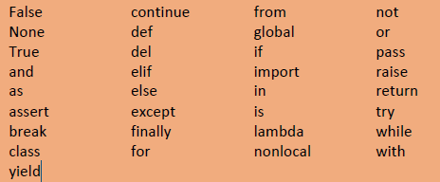
Python Basics – Identifiers and Keywords
Python has 33 keywords shown in Figure

Slide 45
Python Basics – Identifiers and Keywords
We can print a list of Python keywords through the statements:
import keyword #makes the module ‘keyword’ available
print(keyword.kwlist) #syntax modulename.object/function
Output:
['False', 'None', 'True', 'and', 'as', 'assert', 'async', 'await', 'break', 'class', 'continue', 'def', 'del', 'elif', 'else', 'except', 'finally', 'for', 'from', 'global', 'if', 'import', 'in', 'is', 'lambda', 'nonlocal', 'not', 'or', 'pass', 'raise', 'return', 'try', 'while', 'with', 'yield']

Slide 46
Python Types
Python supports 3 categories of data types:
Basic types
int, float, complex, bool, string, bytes
Container types
list, tuple, set, dict
User-defined types
class

Slide 47
Basic Types
Examples of different basic types are given below:
int can be expressed in binary, decimal, octal, hexadecimal
- binary starts with 0b/0B,
- octal with 0o/0O
- hex with 0x/0X b10111, 156, 0o432, 0x4A3
float can be expressed in fractional or exponential form
- 314.1528, 3.141528e2, 3.141528E2
complex contains real and imaginary part
- 3 + 2j, 1 + 4J

Slide 48
Basic Types
bool can take any of the two Boolean values both starting in caps True, False
A string is an immutable collection of Unicode characters enclosed
- within ' ', " " or """ """.
- 'Razzmatazz', "Razzmatazz", """Razzmatazz"""
bytes represent binary data

Slide 49
Basic Types
The type of particular data can be checked using a function called type()
- print(type(35)) # prints <class 'int’>
- print(type(3.14)) # prints <class 'float'>
Integer and Float Ranges
int can be of any arbitrary size
a = 123
b = 1234567890
c = 123456789012345678901234567890

Slide 50
Basic Types
Floats are represented internally in binary as 64-bit double-precision values, as per the IEEE 754 standard.
As per this standard, the maximum value a float can have is approximately 1.8 x 10³⁰⁸.
A number greater than this is represented as inf (short for infinity).

Slide 51
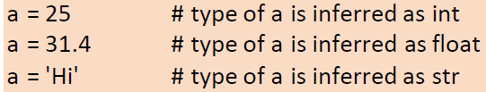

Variable Type and Assignment
There is no need to define the type of a variable.
During execution, the type of the variable is inferred from the context in which it is being used.
Hence Python is called a dynamically-typed language
The type of a variable can be checked using the built-in function type( )

Slide 52
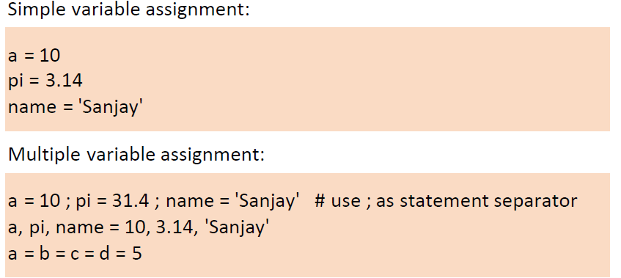

Slide 53
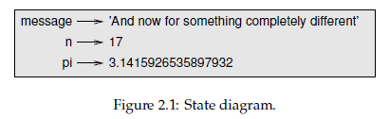
Variables, expressions and statements
Assignment statements
An assignment statement creates a new variable and gives it a value:
>>> message = ‘And now for something completely different’
>>> n = 17
>>> pi = 3.1415926535897932
A variable is a name that refers to a value. A common way to represent variables on paper is to write the name with an arrow pointing to its value. This kind of figure is called a state diagram because it shows what state each of the variables is in

Slide 54
Variables
Variable names can be as long as we like
They can contain both letters and numbers, but they can’t begin with a number
The underscore character, _, can appear in a name
It is often used in names with multiple words, such as your_name or airspeed_of_unladen_swallow

Slide 55
Variables
If you give a variable an illegal name, you get a syntax error:
>>> 76trombones = 'big parade'
SyntaxError: invalid syntax
>>> more@ = 1000000
SyntaxError: invalid syntax
>>> class = 'Advanced Theoretical Zymurgy'
SyntaxError: invalid syntax
76trombones is illegal because it begins with a number
more@ is illegal because it contains an illegal character, @
But what’s wrong with the class? class is one of Python’s keywords

Slide 56
Expressions
An expression is a combination of values, variables, and operators
A value all by itself is considered an expression, and so is a variable, so the following are all legal expressions:
>>> 42
42
>>> n=17
>>> n + 25
42

Slide 57
Expressions
A statement is a unit of code that has an effect, like creating a variable or displaying a value.
>>> n = 17
>>> print(n)
17

Slide 58
Expressions
A statement is a unit of code that has an effect, like creating a variable or displaying a value.
>>> n = 17
>>> print(n)
The first line is an assignment statement that gives a value to n. The second line is a print statement that displays the value of n.
When we type a statement, the interpreter executes it, which means that it does whatever the statement says.

Slide 59
Basic Operators
Operators are the constructs which can manipulate the value of operands.
Consider the expression 4 + 5 = 9. Here, 4 and 5 are called operands and + is called operator.
Types of Operator
Arithmetic Operators
Comparison (Relational) Operators
Assignment Operators
Logical Operators
Bitwise Operators
Membership Operators
Identity Operators

Slide 60
Python Arithmetic Operators
Assume variable a holds 10 and variable b holds 20, then −
Operator | Description | Example
+ Addition | Adds values on either side of the operator | a + b = 30
- Subtraction | Subtracts right hand operand from left hand operand | a – b = -10
* Multiplication | Multiplies values on either side of the operator | a * b = 200
/ Division | Divides left hand operand by right hand operand | b / a = 2

Slide 61
Python Arithmetic Operators
Assume variable a holds 10 and variable b holds 20, then −
Operator | Description | Example
% Modulus | Divides left hand operand by right hand operand and returns remainder | b % a = 0
** Exponent | Performs exponential (power) calculation on operators | a**b = 10 to the power 20
// | Floor Division – The division of operands where the result is the quotient in which the digits after the decimal point are removed. But if one of the operands is negative, the result is floored. i.e. rounded away from zero (towards negative infinity) | 9//2=4 and 9.0/2.0=4.0, -11/3=-4, -11.0/3=-4.0

Slide 62
Python Comparison Operators
These operators compare the values on either side of them and decide the relation between them. They are also called Relational operators. Assume a=10 and b =20
Operator | Description | Example
== | If the values of two operands are equal, then the condition becomes true | (a==b) is not true
!= | If the values of two operands are not equal, then condition becomes true | (a !=b) is true
<> | If values of two operands are not equal, then condition becomes true | (a<>b) is true. This is similar to != operator

Slide 63
Python Comparison Operators
Assume a=10 and b =20
Operator | Description | Example
> | If the value of left operand is greater than the value of the right operand, then condition becomes true | (a>b) is not true
< | If the value of the left operand is less than the value of the right operand, then condition becomes true | (a>b) is true
>= | If the value of the left operand is greater than or equal to the value of the right operand, then the condition becomes true | (a>=b) is not true
<= | If the value of the left operand is less than or equal to the value of the right operand, then condition becomes true | (a<=b) is true

Slide 64
Python Assignment Operators
Assume variable a holds 10 and variable b holds 20
Operator | Description | Example
= | Assigns values from right side operands to left side operand | c=a+b assigns value of a+b into c
+= Add AND | It adds right operand to the left operand and assign the result to left operand | c +=a is equivalent to c=c+a
-= Subtract AND | It subtracts right operand from the left operand and assign the result to left operand | c -=a is equivalent to c=c-a
*= Multiply AND | It multiplies right operand with the left operand and assign the result to left operand | c *= a is equivalent to c=c*a

Slide 65
Python Assignment Operators Assume variable a holds 10 and variable b holds 20, then −
Operator | Description | Example
/= Divide AND | It divides left operand with the right operand and assign the result to left operand | c /= a is equivalent to c=c/a
%= Modulus AND | It takes modulus using two operations and assign the result to left operand | c %= a is equivalent to c=c%a
**= Exponent AND | Performs exponential (power) calculation on operators and assign value to the left operand | c **= a is equivalent to c=c**a
//= Floor Division | It performs floor division in operators and assign value to the left operand | c //= a is equivalent to c=c//a

Slide 66
Python Bitwise Operators
The Bitwise operator works on bits and performs the bit-by-bit operation.
Assume if a = 60; and b = 13; Now in the binary format their values are
a = 0011 1100
b = 0000 1101
a&b = 0000 1100
a|b = 0011 1101
a^b = 0011 0001
~a = 1100 0011

Slide 67
Python Bitwise Operators
Operator | Description | Example
& Binary AND | Operator copies a bit to the result if it exists in both operands | (a & b) means (0000 1100)
| Binary OR | It copies a bit if it exists in either operand | (a | b) = 61 (means 0011 1101)
^ Binary XOR | It copies the bit if it is set in one operand but not both | (a ^ b) = 49 means (0011 0001)

Slide 68
Python Bitwise Operators
Operator | Description | Example
~ Binary Ones Complement | It is unary and has the effect of ‘flipping’ bits | (~a) = - 61 (means 1100 0011 in 2’s complement form due to a signed binary number)
<< Binary Left Shift | The left operands value is moved left by the number of bits specified by the right operand | a << 2 = 240 (means 1111 0000)
>> Binary Right Shift | The left operands value is moved right by the number of bits specified by the right operand | a >> 2 = 15 (means 0000 1111)

Slide 69
Python Logical Operators
The following logical operators are supported by the Python language. Assume variable a holds 10 and variable b holds 20 then
Operator | Description | Example
and Logical AND | If both the operands are true then condition becomes true | (a and b) is true
or Logical OR | If any of the two operands are non-zero then condition becomes true | (a or b) is true
not Logical NOT | Used to reverse the logical state of its operand | Not(a and b) is false

Slide 70
Python Membership Operators
These operators test for membership in a sequence, such as strings, lists, or tuples.
Operator | Description | Example
in | Evaluates to true if it finds a variable in the specified sequence and false otherwise | x in y, here in results in a 1 if x is a member of sequence y
not in | Evaluates to true if it does not finds a variable in the specified sequence and false otherwise | x not in y, here not in results in a 1 if x is not a member of sequence y

Slide 71
Python Identity Operators
These operators compare the memory locations of two objects. There are two identity operators
Operator | Description | Example
is | Evaluates to true if the variables in either side of the operator point to the same object and false otherwise | x is y, here is results in 1 if id(x) equals id(y)
is not | Evaluates to false id the variables on either side of the operator point to the same object and true otherwise | x is not y, here is not results in 1 if id(x) is not equal to id(y)

Slide 72
Order of Operations
When an expression contains more than one operator, the order of evaluation depends on the order of operations. For mathematical operators, Python follows mathematical convention.
The acronym PEMDAS is a useful way to remember the rules:
Parentheses have the highest precedence and can be used to force an expression to evaluate in the order you want. Since expressions in parentheses are evaluated first,
2 * (3-1) is 4, and (1+1)**(5-2) is 8.

Slide 73
Order of operations
Exponentiation has the next highest precedence,
1 + 2**3 is 9, not 27
2 *3**2 is 18, not 36.
Multiplication and Division have higher precedence than Addition and Subtraction
2*3-1 is 5, not 4,
6+4/2 is 8, not 5.
Operators with the same precedence are evaluated from left to right (except exponentiation).
degrees / 2 * pi,
The division happens first and the result is multiplied by pi.
To divide by use parentheses or write degrees / 2 * pi.

Slide 74
Conversions
Mixed mode operations:
Operation between int and float will yield float.
Operation between int and complex will yield complex
Operation between float and complex will yield complex
We can convert one numeric type to another using built-in functions int(), float(), complex() and bool()

Slide 75
Conversions
Type conversions:
int(float/numeric string) # from float/numeric string to int
int(numeric string, base) # from numeric string to int in base
float(int/numeric string) # from int/numeric string to float
float(int) # from int to float
complex(int/float) # convert to complex with imaginary part 0
complex(int/float, int/float) # convert to complex
bool(int/float) # from int/float to True/False (1/0)
str(int/float/bool) # converts to string
chr(int) # yields character corresponding to int
int( ) removes the decimal portion from the quotient, so always rounds towards zero.
int(3.33) # yields 3
int(-3.33) # yields -3

Slide 76
String Operations
In general, can’t perform mathematical operations on strings, even if the strings look like numbers, so the following are illegal:
'chinese‘ - 'food'
'eggs‘ / 'easy'
'third‘ * 'a charm'
But there are two exceptions, + and *.
The + operator performs string concatenation, which means it joins the strings by linking them end-to-end. For example:
>>> first = ‘Data'
>>> second = ‘Science'
>>> first + second
Output: DataScience

Slide 77
String operations
The * operator also works on strings; it performs repetition.
>>>'Spam'*3
'SpamSpamSpam'.
If one of the values is a string, the other has to be an integer.

Slide 78
Comments
To add notes to our programs to explain in natural language what the program is doing. These notes are called comments, and they start with the # symbol:
# compute the percentage of the hour that has elapsed
percentage = (minute * 100) / 60
In this case, the comment appears on a line by itself. We can also put comments at the end of a line:
percentage = (minute * 100) / 60 # percentage of an hour
Everything from the # to the end of the line is ignored—it has no effect on the execution of the program.

Slide 79
Comments
Multi-line comments should be written in a pair of ‘’’ or “””.
‘’’Additional program: Calculate bonus to be paidURL: https://www.ykanetkar.com (https://www.ykanetkar.com) Author: Yashavant, Date: 18 May2020 ‘’’
Indentation matters! Don’t use it casually. The following code will report an error 'Unexpected indent'.
a = 20
b = 45

Slide 80
Debugging
Three kinds of errors can occur in a program: syntax errors, runtime errors, and semantic errors
Syntax error: “Syntax” refers to the structure of a program and the rules about that structure. For example, parentheses have to come in matching pairs, so (1 + 2) is legal, but 8) is a syntax error
If there is a syntax error anywhere in the program, Python displays an error message and quits, and will not be able to run the program
Runtime error: The second type of error is a runtime error, so called because the error does not appear until after the program has started running
These errors are also called exceptions because they usually indicate that something exceptional (and bad) has happened

Slide 81
Debugging
Semantic error: The third type of error is “semantic”, which means related to meaning
If there is a semantic error in your program, it will run without generating error messages, but it will not do the right thing
It will do something else. Specifically, it will do what you told it to do
Identifying semantic errors can be tricky because it requires you to work backward by looking at the output of the program and trying to figure out what it is doing

Slide 82
Functions
The function is a named sequence of statements that performs a computation
To define a function, we specify the name and the sequence of statements. Later, we can “call” the function by name
Python function is a block of code that performs a specific and well-defined task
Two main advantages of function are:
(a) They help us to divide our program into multiple tasks. For each task, we can define a function. This makes the code modular
(b) Functions provide a reuse mechanism. The same function can be called any number of times

Slide 83
Functions
There are two types of Python functions:
(a) -Ex. len( ), sorted( ), min( ), max( ), etc.
(b) User-defined functions
Built-in functions
Python has many built-in functions that are always available in any part of the program. The print( ) function that we have been using to send output to the screen is a built-in function
Help about any built-in function is available using help(function)

Slide 84
Built-in Functions
abs(x) # returns absolute value of x
pow(x, y) # returns the value of x raised to y
min(x1, x2,...) # returns smallest argument
max(x1, x2,...) # returns largest argument
divmod(x, y) # returns a pair(x// y, x% y)
round(x [,n]) # returns x rounded to n digits after
bin(x) # returns binary equivalent of x
oct(x) # returns octal equivalent of x
hex(x) # returns hexadecimal equivalent of x

Slide 85
Following Python program shows how to use some of these built-in functions:
a = abs(-3) # assigns 3 to a
print(min(10, 20, 30, 40)) # prints 10
print(hex(26)) # prints 1a

Slide 86
Built-in Modules
Apart from built-in functions, Python provides many built-in modules. Each module contains many functions
For performing sophisticated mathematical operations we can use the functions present in built-in modules math, cmath, random, decimal
math - many useful mathematics functions
cmath - functions for performing operations on complex numbers
random -functions related to random number generation
decimal -functions for performing precise arithmetic operations

Slide 87
Mathematical functions in math module:
pi, e # values of constants pi and e
sqrt(x) # square root of x
factorial(x) # factorial of x
fabs(x) # absolute value of float x
log(x) # natural log of x (log to the base e)
log10(x) # base-10 logarithm of x
exp(x) # e raised to x
trunc(x) # truncate to integer
ceil(x) # smallest integer >= x
floor(x) # largest integer <= x
modf(x) # fractional and integer arts of x

Slide 88
round() built-in function can round to a specific number of decimal places, whereas math module's library functions trunc(), ceil() and floor() always round to zero decimal places.
Trigonometric functions in math module:
degrees(x) # radians to degrees
radians(x) # degrees to radians
sin(x) # sine of x radians
cos(x) # cosine of x radians
tan(x) # tan of x radians

Slide 89
sinh(x) # hyperbolic sine of x
cosh(x) # hyperbolic cosine of x
tanh(x) # hyperbolic tan of x
acos(x) # cos inverse of x, in radians
asin(x) # sine inverse of x, in radians
atan(x) # tan inverse of x, in radians
hypot(x, y) # sqrt(x * x + y * y)

Slide 90
Random number generation functions from the random module:
random( ) # random number between 0 and 1
randint(start, stop) # random number in the range
seed( ) # sets current time as seed for random number generation
seed(x) # sets x as seed for random number generation logic
To use functions present in a module, we need to import the module using the Import statement

Slide 91
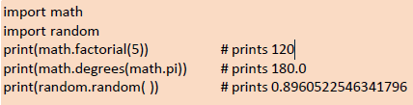
Use of functions in the math module and random module:
There are many built-in functions and many functions in each built-in module. It is easy to forget the names of the functions. We can get a quick list of them using the following program:

Slide 92
Container Types
Container types typically refer to multiple values stored together. Examples of different basic types are given below:
# list is a indexed collection of similar/dissimilar entities
[10,20,30,40,30,40,50,10], ['She', 'sold', 10, 'shells'’]
# tuple is an immutable collection
('Sanjay', 34, 4500.55), ('Let Us Python', 350, 195.00)
# set is a collection of unique values
{10, 20, 30, 40}, {'Sanjay', 34, 45000}
# dict is a collection of key-value pairs, with unique key enclosed in ' '
{'ME101' : 'Strength of materials', 'EE101' : 'Electronics'}

Slide 93
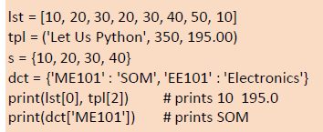
Container Types
Values in a list and tuple can be accessed using their position in the list or tuple. Values in a set can be accessed using a for loop
Values in a dictionary can be accessed using a key. This is shown in the following program:

Slide 94
Python Type Jargon
Often following terms are used while describing Python types:
Collection - a generic term for container types
Iterable - means a collection that can be iterated over using a loop
Ordered collection - elements are stored in the same order in which they are inserted. Hence its elements can be accessed using an index, i.e. its position in the collection.
Unordered collection - elements are not stored in the same order in which they are inserted. So we cannot predict at which position a particular element is present. So we cannot access its elements using a position-based index.

Slide 95
Python Type Jargon
Sequence - is the generic term for an ordered collection
Immutable - means an unchangeable collection
Mutable - means the changeable collection
Let us now see which of these terms apply to the types that we have seen so far.
String -ordered collection, immutable, iterable.
List-ordered collection, mutable, iterable.
Tuple-ordered collection, immutable, iterable.
Set -unordered collection, mutable, iterable.
Dictionary -unordered collection, mutable, iterable.

Slide 96
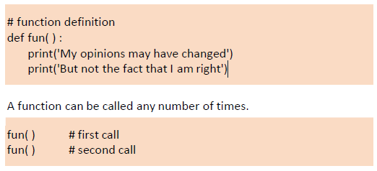
User-defined function

Slide 97
When a function is called, control is transferred to the function, its statements are executed and control is returned to the place from where the call originated
Python convention for function names:
- Always use lowercase characters
- Connect multiple words using _
- Example: cal_si( ), split_data( ), etc.
A function can be redefined. While calling the function its latest definition will be called

Slide 98
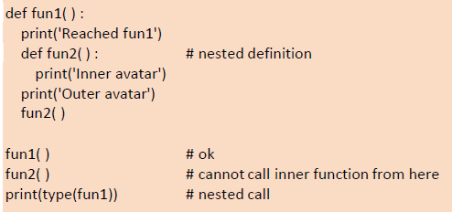
Function definitions can be nested. When we do so, the inner function is able to access the variables of the outer function. The outer function has to be called for the inner function to execute

Slide 99
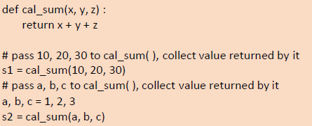
Communication with Functions
Communication with functions is done using parameters/arguments passed to it and the value(s) returned from it.
The way to pass values to a function and return values from it is shown below:

Slide 100
The return statement returns control and value from a function. return without an expression returns None.
To return multiple values from a function we can put them into a list/tuple/set/dictionary and then return it.
Suppose we pass arguments a, b, c to a function and collect them in x, y, z. Changing x, y, z in the function body, does not change a, b, c. Thus a function is always called by value.
A function can return different types through different return statements.
A function that reaches end of execution without a return statement will always return None.

Slide 101
Types of Arguments
Arguments in a Python function can be of 4 types:
(a) Positional arguments
(b) Keyword arguments
(c) Variable-length positional arguments
(d) Variable-length keyword arguments
Positional and keyword arguments are often called 'required' arguments, whereas, variable-length arguments are called 'optional' arguments.

Slide 102
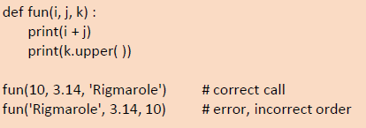
Positional arguments must be passed in correct positional order. For example, if a function expects an int, float, and string to be passed to it, then while calling this function the arguments must be passed in the same order.
While passing positional arguments, the number of arguments passed must match with the number of arguments received

Slide 103
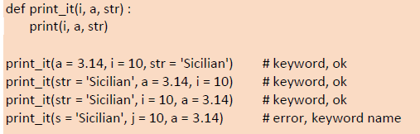
Keyword arguments can be passed out of order. Python interpreter uses keywords (variable names) to match the values passed with the arguments used in the function definition.
An error is reported in the last call since the variable names in the call and the definition do not match.

Slide 104
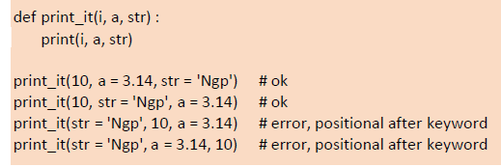
In a call we can use positional as well as keyword arguments. If we do so, the positional arguments must precede keyword arguments

Slide 105
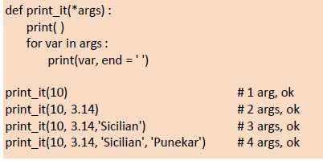
Sometimes a number of positional arguments to be passed to a function is not certain. In such cases, variable-length positional arguments can be received using *args
Args used in definition of print_it( ) is a tuple. * indicates that it will hold all the arguments passed to print_it( ). The tuple can be iterated through using a for loop.

Slide 106
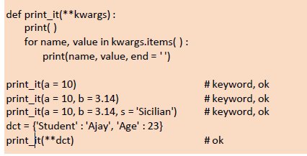
Sometimes number of keyword arguments to be passed to a function is not certain. In such cases, variable-length keyword arguments can be received using **kwargs.
Kwargs used in definition of print_it( )is a dictionary containing variable names as keys and their values as values. **indicates that it will hold all the arguments passed to print_it( ).

Slide 107
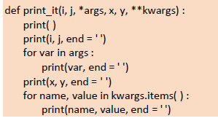
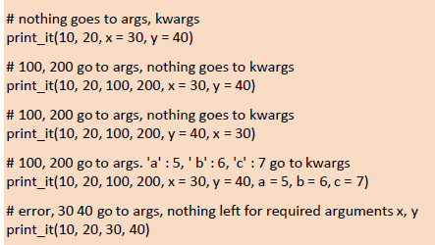
We can use any other names in place of argsand kwargs. We cannot use more than one argsand more than one kwargshile defining a function.
If a function is to receive required as well as optional arguments then they must occur in following order:
-positional arguments-variable-length positional arguments-keyword arguments-variable-length keyword arguments

Slide 108
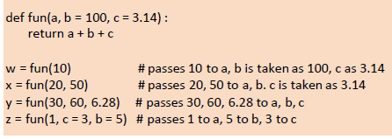
While defining a function default value can be given to arguments. Default value will be used if we do not pass the value for that argument during the call.

