Slide 1

DEPARTMENT OF CSE (ARTIFICIAL INTELLIGENCE AND MACHINE LEARNING) ACADEMIC YEAR 2025 - 2026 SEMESTER III ARTIFICIAL INTELLIGENCE LABORATORY MINI PROJECT REVIEW <TITLE OF THE PROJECT>
REGISTER NUMBER
NAME | Hariharan.N
YEAR | II
SECTION | A
FACULTY IN-CHARGE | Mrs. M. Divya

Slide 2
PROBLEM STATEMENT
Artificial Intelligence (AI) enables machines to perform tasks that require human-like reasoning, learning, and decision-making. In gaming, AI is widely used for pathfinding and intelligent navigation.
This project implements a Text-Based Adventure Game using the Breadth-First Search (BFS) algorithm. The aim is to simulate an AI agent that explores rooms (as graph nodes) and finds the shortest path to the Treasure Room.
Expected Result:
BFS identifies the shortest and most efficient path.
The player can explore manually or use AI auto-navigation.
Future Possibilities:
Add obstacles, locked rooms, and puzzles.
Extend with A* Search or a graphical interface (Tkinter/Pygame).

Slide 3
THEORETICAL BACKGROUND
Problem Statement
Design a text-based adventure game.
Player navigates rooms to reach a Treasure Room.
Supports:
Manual navigation (directions: north, south, etc.)
Automatic navigation using a search algorithm.
Map represented as a graph:
Nodes → Rooms
Edges → Connections between rooms

Slide 4
THEORETICAL BACKGROUND
BFS Algorithm (Overview)
Start at source node (starting room).
Add node to queue and mark as visited.
While queue not empty:
Dequeue a node.
If goal → stop & construct path.
Else → enqueue all unvisited neighbors.

Slide 5
THEORETICAL BACKGROUND
BFS Example
Entrance -- Hall -- Kitchen
| |
Library Garden
|
Tower -- Treasure Room
Execution Steps:
Queue: [Entrance] → Explore Hall & Library
Queue: [Hall, Library] → Explore Kitchen & Garden
Queue: [Garden, Tower] → Explore Treasure Room
Shortest Path:
Entrance → Hall → Garden → Tower → Treasure Room
Justification & Conclusion
BFS guarantees minimum moves to reach treasure.
Simple implementation for unweighted graphs.
Supports manual & auto navigation.
Efficient for small to medium-sized game maps.

Slide 6
IMPLEMENTATION AND CODE
Link to code in Git-hub Repository
List | Git-hub Repository Links
Implementation of Code Link
Word Document Report Link
PPT Link

Slide 7
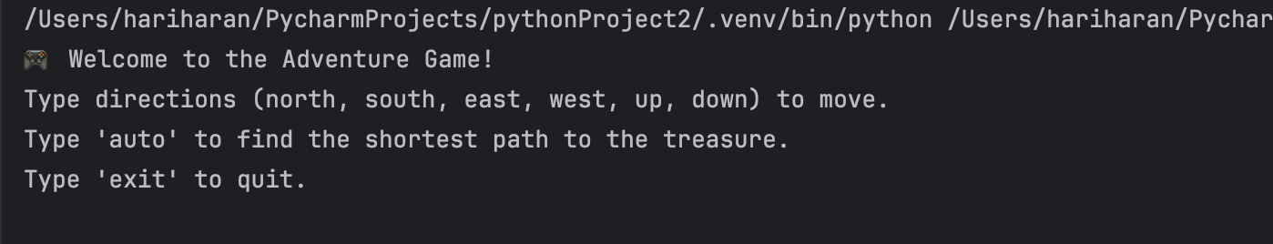
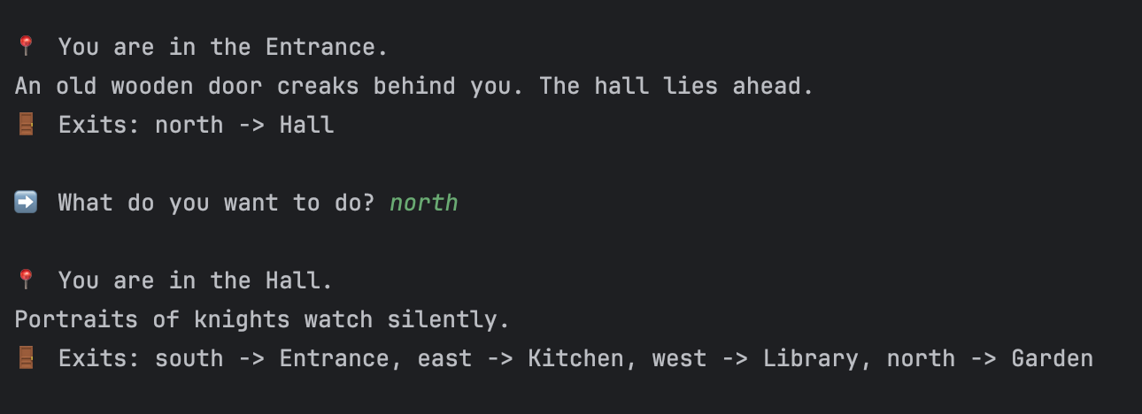
OUTPUT AND RESULTS
Game Start Screen:
Shows the welcome message, instructions for manual and auto mode.
Example:
Manual Navigation Example:
Player chooses a direction.
Current room description and available exits are displayed.

Slide 8
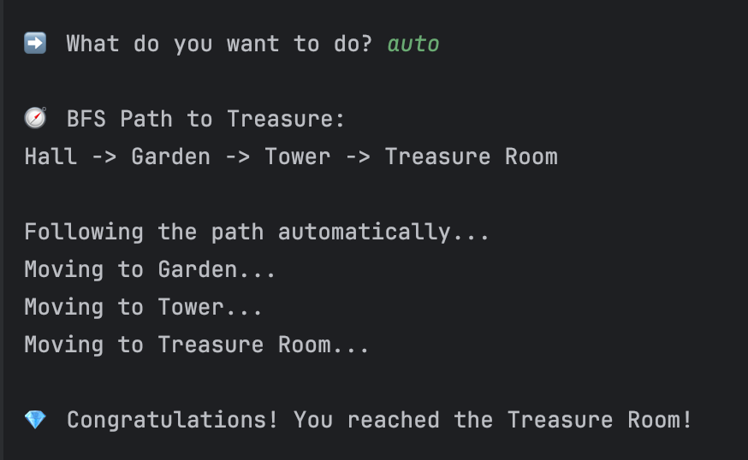
OUTPUT AND RESULTS
Auto Navigation Example (BFS):
Player types auto to find shortest path.
BFS finds and follows
path step-by-step:
Explanation:
BFS algorithm explores all rooms level by level.
Ensures the shortest path from Entrance to Treasure Room.
Manual mode allows player exploration, auto mode demonstrates algorithm efficiency.

Slide 9
OUTPUT AND RESULTS
Results
BFS successfully finds the shortest path in all tested room graphs.
Automatic navigation simulates real-time movement using step delays.
Manual mode allows user-driven exploration.
Algorithm handles multiple branches and avoids revisiting rooms.
Example Result:
Shortest Path: Entrance → Hall → Garden → Tower → Treasure Room
Time to reach treasure: minimal steps guaranteed by BFS.

Slide 10
OUTPUT AND RESULTS
Future Enhancements
Obstacles and Collectibles:
Introduce keys, locked doors, traps, or monsters to make gameplay challenging.
BFS can be modified to avoid obstacles or collect items before reaching the goal.
Weighted Paths:
Assign weights to rooms or paths (danger level, cost, time).
Use Dijkstra or A* to find optimal paths in weighted scenarios.
Randomized Map Generation:
Generate new maps each time for replayability.
BFS can still adapt to find paths in dynamically generated graphs.
Graphical Interface:
Upgrade from text-based to a GUI using Python’s Tkinter or Pygame.
Animate player movement along the BFS path visually.
Multiple Goals or Quests:
Include multiple treasure rooms or side quests.
BFS can compute paths for multiple goals efficiently.

Slide 11
REFERENCES
GeeksforGeeks. Breadth First Search (BFS) Algorithm in Python. https://www.geeksforgeeks.org/breadth-first-search-or-bfs-for-a-graph/
Python Software Foundation. Python 3 Official Documentation. https://docs.python.org/3/
Real Python. Build a Text Adventure Game with Python. https://realpython.com/python-adventure-game/
TutorialsPoint. Python Classes and Objects. https://www.tutorialspoint.com/python/python_classes_objects.htm
Medium (Towards Data Science). Understanding Breadth-First Search (BFS) in Graph Theory. https://towardsdatascience.com/

