Slide 1

DEPARTMENT OF CSE (ARTIFICIAL INTELLIGENCE AND MACHINE LEARNING) ACADEMIC YEAR 2025 - 2026 SEMESTER III ARTIFICIAL INTELLIGENCE LABORATORY MINI PROJECT REVIEW <TITLE OF THE PROJECT>
REGISTER NUMBER
NAME | Hariharan.N
YEAR | II
SECTION | A
FACULTY IN-CHARGE | Mrs. M. Divya

Slide 2
PROBLEM STATEMENT
Artificial Intelligence (AI) enables machines to perform tasks that require human-like reasoning, learning, and decision-making. In gaming, AI is widely used for pathfinding and intelligent navigation.
This project implements a Text-Based Adventure Game using the Breadth-First Search (BFS) algorithm. The aim is to simulate an AI agent that explores rooms (as graph nodes) and finds the shortest path to the Treasure Room.
Expected Result:
BFS identifies the shortest and most efficient path.
The player can explore manually or use AI auto-navigation.
Future Possibilities:
Add obstacles, locked rooms, and puzzles.
Extend with A* Search or a graphical interface (Tkinter/Pygame).

Slide 3
THEORETICAL BACKGROUND
Problem Statement
Design a text-based adventure game.
Player navigates rooms to reach a Treasure Room.
Supports:
Manual navigation (directions: north, south, etc.)
Automatic navigation using a search algorithm.
Map represented as a graph:
Nodes → Rooms
Edges → Connections between rooms

Slide 4
THEORETICAL BACKGROUND
BFS Algorithm (Overview)
Breadth-First Search (BFS) is a graph traversal algorithm that explores nodes level by level:
Start at the source node (starting room).
Add the source node to a queue and mark it as visited.
While the queue is not empty: a. Remove the first node from the queue. b. If it is the goal node, stop and construct the path. c. Otherwise, add all unvisited neighbors to the queue and mark them visited.
Repeat until the goal is found or all nodes are explored.

Slide 5
THEORETICAL BACKGROUND
BFS Example
Entrance -- Hall -- Kitchen
| |
Library Garden
|
Tower -- Treasure Room
Execution Steps:
Queue: [Entrance] → Explore Hall & Library
Queue: [Hall, Library] → Explore Kitchen & Garden
Queue: [Garden, Tower] → Explore Treasure Room
Shortest Path:
Entrance → Hall → Garden → Tower → Treasure Room
Justification & Conclusion
BFS guarantees minimum moves to reach treasure.
Simple implementation for unweighted graphs.
Supports manual & auto navigation.
Efficient for small to medium-sized game maps.

Slide 6
IMPLEMENTATION AND CODE
Link to code in Git-hub Repository
List | Git-hub Repository Links
Implementation of Code Link
Word Document Report Link
PPT Link

Slide 7
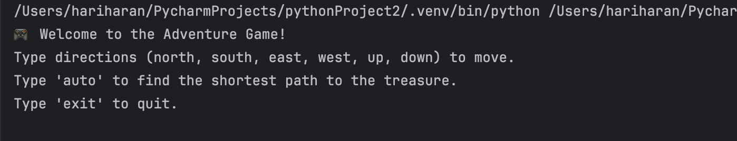
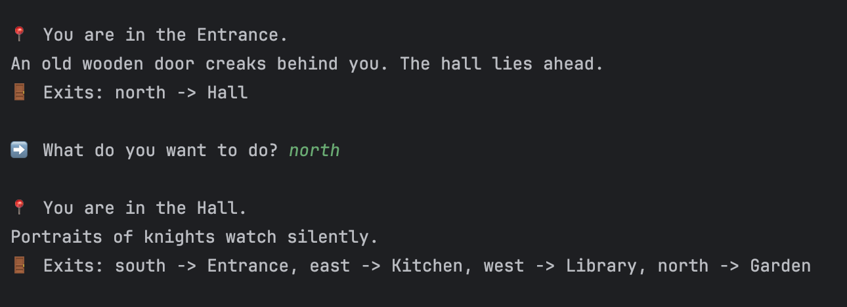
OUTPUT AND RESULTS
Game Start Screen:
Shows the welcome message, instructions for manual and auto mode.
Example:
Manual Navigation Example:
Player chooses a direction.
Current room description and available exits are displayed.

Slide 8
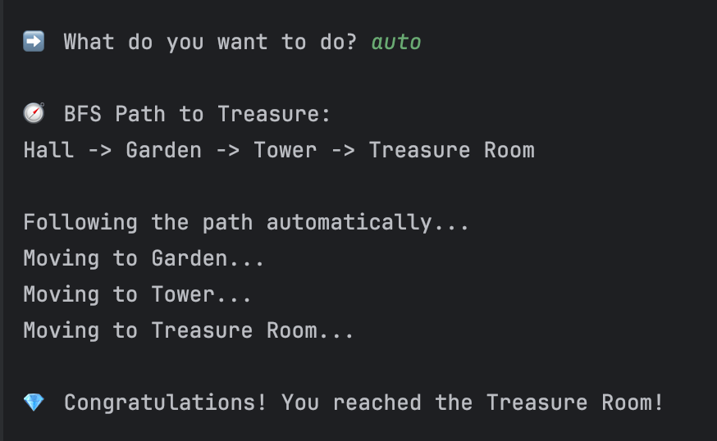
OUTPUT AND RESULTS
Auto Navigation Example (BFS):
Player types auto to find shortest path.
BFS finds and follows
path step-by-step:
Explanation:
BFS algorithm explores all rooms level by level.
Ensures the shortest path from Entrance to Treasure Room.
Manual mode allows player exploration, auto mode demonstrates algorithm efficiency.

Slide 9
OUTPUT AND RESULTS
Results
BFS successfully finds the shortest path in all tested room graphs.
Automatic navigation simulates real-time movement using step delays.
Manual mode allows user-driven exploration.
Algorithm handles multiple branches and avoids revisiting rooms.
Example Result:
Shortest Path: Entrance → Hall → Garden → Tower → Treasure Room
Time to reach treasure: minimal steps guaranteed by BFS.

Slide 10
OUTPUT AND RESULTS
Future Enhancements
Obstacles and Collectibles:
Introduce keys, locked doors, traps, or monsters to make gameplay challenging.
BFS can be modified to avoid obstacles or collect items before reaching the goal.
Weighted Paths:
Assign weights to rooms or paths (danger level, cost, time).
Use Dijkstra or A* to find optimal paths in weighted scenarios.
Randomized Map Generation:
Generate new maps each time for replayability.
BFS can still adapt to find paths in dynamically generated graphs.
Graphical Interface:
Upgrade from text-based to a GUI using Python’s Tkinter or Pygame.
Animate player movement along the BFS path visually.
Multiple Goals or Quests:
Include multiple treasure rooms or side quests.
BFS can compute paths for multiple goals efficiently.

Slide 11
REFERENCES
GeeksforGeeks. Breadth First Search (BFS) Algorithm in Python. https://www.geeksforgeeks.org/breadth-first-search-or-bfs-for-a-graph/
Python Software Foundation. Python 3 Official Documentation. https://docs.python.org/3/
Real Python. Build a Text Adventure Game with Python. https://realpython.com/python-adventure-game/
TutorialsPoint. Python Classes and Objects. https://www.tutorialspoint.com/python/python_classes_objects.htm
Medium (Towards Data Science). Understanding Breadth-First Search (BFS) in Graph Theory. https://towardsdatascience.com/

