Slide 1

DA 204o: Data Science in Practice Course Project Presentation on: Sentiment Analysis and Summarizing of Book Reader Reviews
Aviroop Karmakar, M-Tech (AI), aviroopk@iisc.ac.in
Hariharan N, M-Tech (DSBA), nhariharan@iisc.ac.in
Nagaraja SB, M-Tech (DSBA), nagarajasb@iisc.ac.in

Slide 2
Problem Definition
Background of the problem: Online reviews are crucial for helping customers decide on books, with platforms like Amazon hosting millions of reviews. However, the overwhelming number of reviews makes it difficult for customers to assess the general sentiment and whether a book is worth purchasing.
Why is it important? Automating the sentiment analysis and providing concise summary of reviews can help customer, while predicting sales based on reviews can support authors and publishers in understanding a book's market performance.
Objectives of the project To build a model that can predict the sentiment (positive, negative, neutral) and Automatic summarization of book reviews. How can Data Science solve the problem? We can can leverage NLP models like BERT, BART which can be trained/finetuned on the given data and help in prediction of the sentiment and auto summarization of the book reviews.

Slide 3
Data Collection
Data source: Dataset obtained from [Kaggle - Amazon Book Reviews] link: https://www.kaggle.com/datasets/mohamedbakhet/amazon-books-reviews
Description of the data (features, size, format) The dataset contains two CSV files: 1. books_rating.csv having the following features: i. id Ii. review_score Iii. review_helpfulness Iv. review_summary v. price vi. Title 2. book_details.csv having the following features: i. id Ii. title iii. description iv. author

Slide 4
Exploratory Data Analysis
Exploratory Data Analysis (EDA):
In-Depth Analysis of Dataset: Conducted a detailed exploration of all relevant columns to understand their properties and underlying distributions. Insights were visualized using distribution plots, highlighting key trends and patterns within the dataset.
Normalization of Labels: The review/score and review/helpfulness column, serving as the target label, contained inconsistent and improper values. A custom user-defined function (UDF) was employed to normalize these values to a standard scale of 0–5, ensuring data consistency and reliability for downstream tasks.
Tools Used: Utilized Spark DataFrame for efficient handling and processing of the dataset, which was approximately 3 GB in size. Spark’s distributed computing capabilities enabled seamless analysis of this large dataset.

Slide 5
Data Sampling for training
Data Sampling:
Sampling Strategy: Implemented stratified sampling to create a balanced dataset of 5,000 data points. This approach ensures proportional representation of all sentiment categories (positive, negative, neutral), mitigating potential biases in the training process.
Rationale for Stratified Sampling: Maintains class distribution, particularly crucial for imbalanced datasets. Enhances the model's ability to generalize across all sentiment classes.
Tools Used: Pandas: For examining data distributions post-sampling.

Slide 6
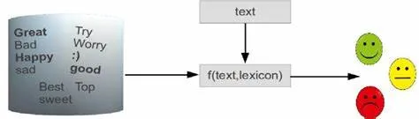
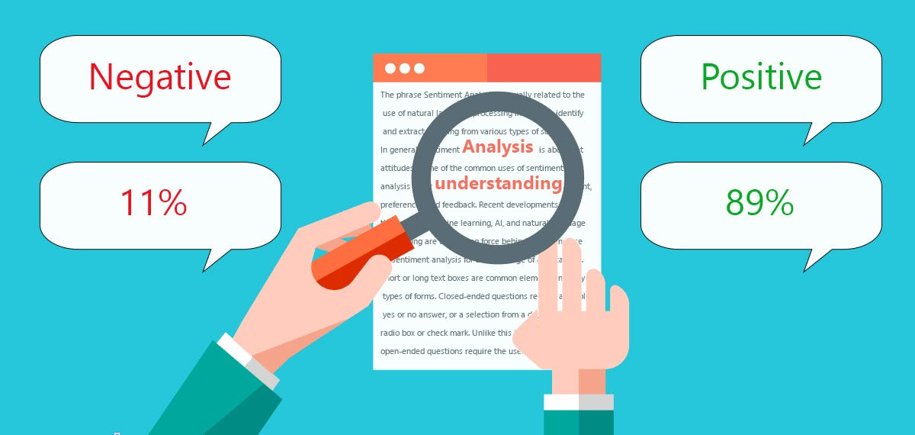
Model Selection and Training
Model Selection:
Lexical Model: Use a fixed dictionary or pre-defined rules to analyze text based on individual words
Ex., TF-IDF with Random Forest Regression
Contextual Model: Leverage deep learning to understand the meaning of words in context within a sentence or document
Ex., LSTM, BERT
Source: Medium
Source: Medium

Slide 7
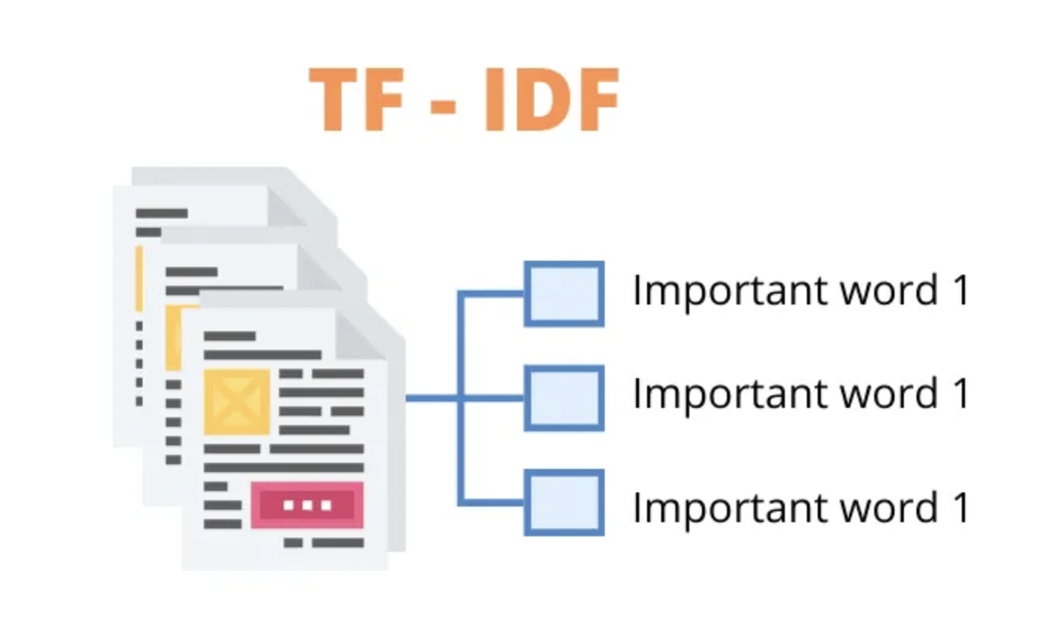
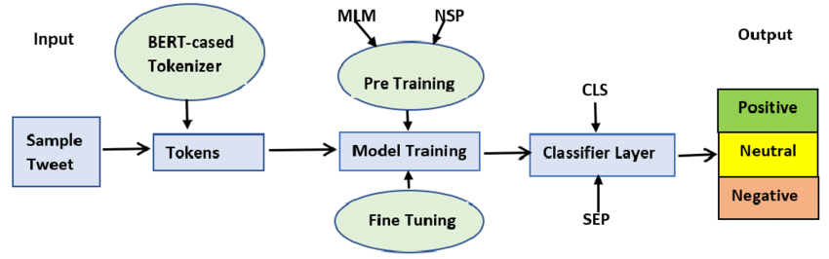
Model Selection and Training
Model Selection:
Models Trained in Project
1. TF-IDF Vectorizer:
Used as a baseline to understand how individual words contribute to sentiment without considering context.
2. LSTM
Capable of understanding the context in customer reviews (e.g., "This book is not as good as expected")
3. BERT Models:
BERT is effective for our use case since it captures bidirectional context and is pre-trained on large corpora, enhancing accuracy in sentiment classification
Source: Analytics Vidhya
Source: Research Gate

Slide 8
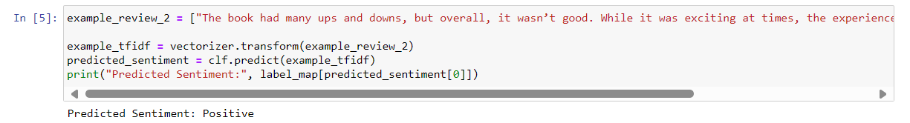
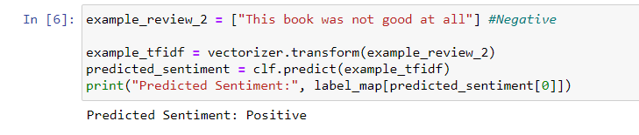
Model Selection and Training
Model Training Results:
Metric | TF-IDF Vectorizer | LSTM | BERT
Accuracy | 0.72 | 0.70 | 0.76
F1 Score | 0.74 | 0.69 | 0.80
Limitations of TF-IDF and LSTM Models
Poor negation handling due to poor contextual understanding
Sentences with words like “not good” not predicted as “Negative” with TF-IDF & LSTM Models

Slide 9
Model Selection and Training
Model Selection (Auto Summarization):
Extraction-based summarization: Content is extracted from the original data without major modification, including key-phrases, sentences, and sequences.
Ex., LexRank , TextRank
Abstractive-based summarization: Generate new text that might not exist in the original text, keeping sentiment and essence of the main sentence
Ex., BART, T5
Models Trained in Project
1. BART:
BART is autoencoder model that is trained to reconstruct the original input from a corrupted version of the input, particularly effective for text generation and text reconstruction tasks
Source: https://en.wikipedia.org/wiki/Automatic_summarization

Slide 10
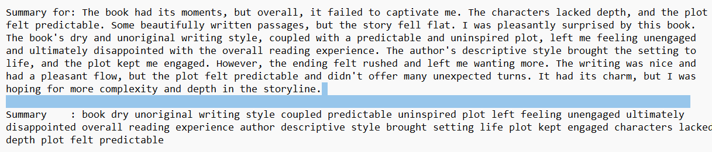
Model Selection and Training
Model Training Results (Auto Summarization) :
 | TF-IDF Vectorizer
Training loss | 1.282
Validation loss | 1.847
Sample output:

Slide 11
Model Selection and Training
Model Training (Auto Summarization) :
Model Finalized: BART (Bidirectional and Auto-Regressive Transformers)- Pre trained with "facebook/bart-large-cnn“ specialized for summarization tasks
Tools Used: Transformers Library (Hugging Face): For seamless integration of the pretrained BART model.
spacy Library : For sentence extraction Pandas: For dataset manipulation and preparation for the model pipeline.
Resources used: Tesla v-100 GPU with 2 cores

Slide 12
Training configurations and evaluation metrics
Training Configurations:
Learning Rate: Optimized at 5e-5 for stable convergence.
Batch Sizes: Set to 16 for both training and evaluation to balance memory usage and computational efficiency.
Epochs: Trained for 3 epochs to ensure the model learns effectively without overfitting.
Warmup Steps: Applied 100 steps to smooth the learning rate adjustment initially.
Evaluation Strategy:
Evaluated the model's performance after every epoch using a weighted average of metrics to account for class imbalance.
Metrics computation is done for the multi-class sentiment classification task (positive, neutral, negative).
Metrics Used for Evaluation:
Accuracy, F1-score, Training and Validation loss

Slide 13
Challenges and Risks
Challenges faced:
Data Imbalance: The dataset had more positive reviews than neutral and negative ones, which affected the model’s performance
Overfitting: Model overfitted to training data, especially when predicting sentiments due to imbalanced data, leading to poor generalization
Negation Handling: Sentences with negations, such as "not bad" or "could have been better," are difficult to interpret which led to incorrect sentiment classification
Ambiguity in Reviews: Some reviews are ambiguous or contradictory in sentiment, making it difficult for the model to classify them accurately (e.g., "The storyline was captivating, but the writing style was dull.")
Unavailability of summaries: Dataset does not contain predefined summaries, this needs to be generated
Mitigating challenges:
Data Imbalance: Used techniques under-sampling and class-weight adjustments to balance the dataset. Oversampling was not considered due to huge dataset
Overfitting: Applied regularization techniques, cross-validation, and ensured proper train-test splits to avoid overfitting
Negation Handling: Leveraged Bi-directional contextual models like BERT, which can understand and process such subtleties more effectively
Ambiguity in Reviews: Usage of data augmentation techniques to enhance model robustness to such cases (E.g., Extracting samples from diverse category)
Unavailability of summaries: Generated synthetic summaries from review text by using NLP, sentiment analysis, and cosine similarity to extract diverse and representative sentences from the input review.

Slide 14
Future Enhancements
Aspect summarization: is a text summarization task that focuses on extracting and summarizing specific aspects or features like Plot, Phase, Character, Writing style etc...

Slide 15
Role and Responsibilities
Student 1 (Aviroop Karmakar): Contribute to feature extraction, model development and evaluation
Student 2 (Hariharan N): Contribute to feature extraction, model development and evaluation
Student 3 (Nagaraja S B):
Contribute to model development and final report generation

Slide 16
Data Science Canvas |  |  | Project: | Sentiment Analysis of books from reader’s reviews
 |  |  | Team: | Aviroop Karmakar, Hariharan N, Nagaraja S B
Problem Statement |  |  |  | Execution & Evaluation |  | Data Collection & Preparation
Business Case & Value Added Which business case should be analyzed and what added value does it generate? Business Case: Analyze the sentiment of Amazon book reviews to provide insights into customer opinions and preferences Value Added: This project will help authors, publishers, and customers understand general sentiment trends, improve marketing strategies, and predict potential book sales based on sentiment analysis | Model Selection Which analysis methods can be considered on the basis of the specific data landscape and the business case? Use transformer-based models like BERT for sentiment classification Consider traditional machine learning methods like logistic regression for baseline comparison | Model Requirements Which model requirements must be complied with in order to obtain a valid model? Accurate prediction of sentiment (positive, negative, neutral) Ability to handle imbalanced datasets Robust preprocessing and feature extraction from review text | Skills What skills are needed to provide the data and model development? Pandas for data manipulation scikit-learn for traditional machine learning models (e.g., regression) Transformers (Hugging Face) for utilizing BERT and other transformer-based models for sentiment analysis PyTorch for training and fine-tuning BERT (or using pre-trained versions) NLTK for basic text preprocessing (if needed) Matplotlib for data visualization | Model Evaluation Which indicators require quality control and validation and how should they be interpreted? Is real-time monitoring necessary? Use accuracy, precision, recall, and F1-score to assess the sentiment classification model Cross-validation will ensure robust model performance Real-time monitoring is not required, but model retraining could be considered periodically based on new reviews | Data Storytelling What requirements does the target group have for the presentation of the results and how do I effectively communicate this data? Create visualizations to show sentiment distribution across different books Use dashboards or summary reports to make data insights easy to understand for authors, publishers, and other stakeholders Focus on clear presentation of sentiment trends, predictions, and model performance | Data Selection & Cleansing Which of the available data is relevant? Do the data have to be cleaned up? Relevant data includes review text, review score, and book metadata Cleaning involves removing duplicates, handling missing values, tokenizing text, and standardizing numerical features like price | Data Collection How and with which methods should additionally required data be collected? What properties has this data to fulfil? Methods like web scraping might be used if additional data is required for future analysis Collected data should ensure consistency in structure and format for easy integration with existing datasets
Data Landscape Which data is required for this and which is already available? Which additional data has to be collected? Data Required: Amazon book reviews dataset, which includes review text, review score, and book details Available Data: Kaggle dataset containing books_rating.csv and book_details.csv |  | Software & Libraries Which software should be used? Is there already a standard solution? Which libraries are used? Software: Python with Jupyter Notebooks for model development Libraries: Hugging Face Transformers for BERT, PyTorch for deep learning, Pandas for data manipulation, scikit-learn for evaluation metrics, and NLTK for text preprocessing |  |  |  | Data Integration In which system should the data from different sources be migrated? Store processed data and model outputs in cloud storage like AWS S3 for easy access Use databases like SQLite or Google BigQuery if scaling up data storage is necessary | Explorative Data Analysis Are there outliers or structures to be considered? Creation of descriptive key figures for the first assessment of the data. Generate descriptive statistics (mean, median, etc.) to understand the distribution of review sentiments Visualize data with plots (histograms, word clouds) to better understand review content
Adopted from: https://github.com/tomalytics/datasciencecanvas

