Slide 1







Capstone Project Stack overflow developer survey 2019
Hariharan G
28-01-2024

Slide 2



OUTLINE
Executive Summary
Introduction
Methodology
Results
Visualization – Charts
Dashboard
Discussion
Findings & Implications
Conclusion
Appendix

Slide 3

EXECUTIVE SUMMARY
Current Technology Usage
Top 10 Languages worked with
Top 10 Databases worked with
Platforms worked with
Top 10 Web-frames worked with
Future Technology Trends
Top 10 Languages desired next year
Top 10 Databases desired next year
Platforms desired next year
Top 10 Web-frames desired next year
Demographics
Respondents classified by gender
Respondents count for countries
Respondents count by age
Respondents count by gender by forml education

Slide 4

INTRODUCTION
Top 10 Programming Languages in demand
Top 10 Database skills in demand
Top 10 Platformed utilizations
Top 10 Web-frame platforms in demand

Slide 5

METHODOLOGY
Collecting data-Stack overflow 2019
Using API
Using Web-scaping
Exploring Data
Finding duplicates and removing duplicated
Finding and imputing missing values
Normalizing data
Handling outliers
Correlation
Visualizing Data
Visualization, Distribution, Relation, Composition and Comparison of data
Building a dashboard

Slide 6
RESULTS

Slide 7
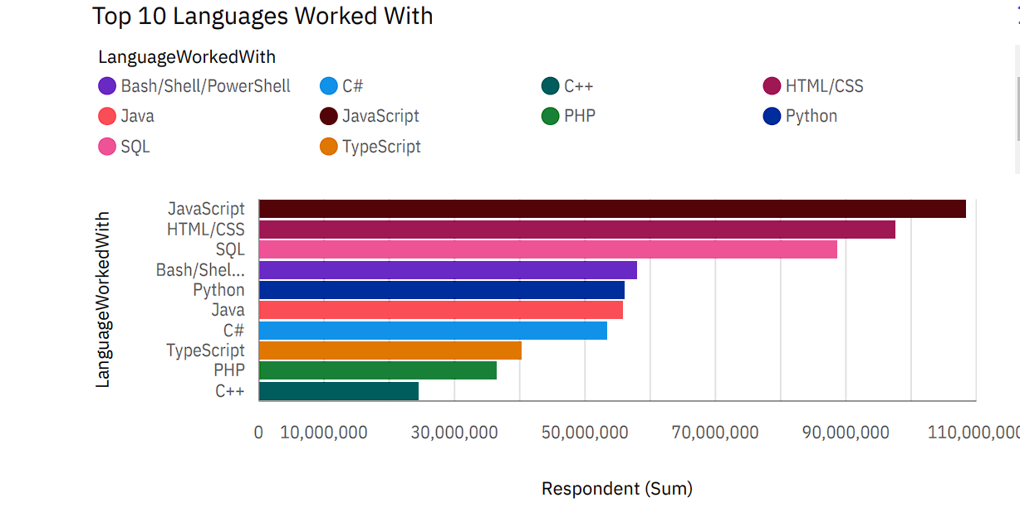
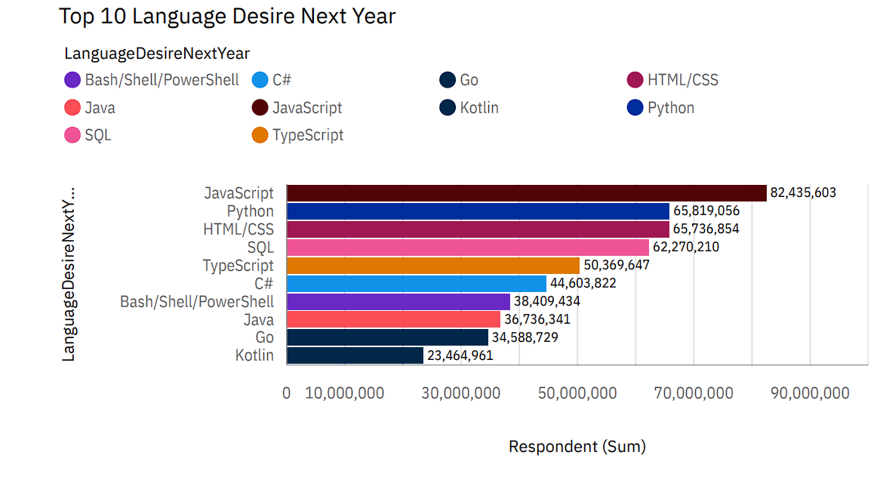
PROGRAMMING LANGUAGE TRENDS
Current Year
Next Year

Slide 8
PROGRAMMING LANGUAGE TRENDS - FINDINGS & IMPLICATIONS
Findings
Javascript appears to be popular in current as well as future years.
Web assembly comes as least popluar and VBA comes least popular in next year.
Python and SQL appear to be evergreen mid polular choice for current and next year.
Implications
Javascript is the upcoming trending language amoung the users.
Web assembly and VBA are relaced by other programming languages at most places
Python and SQL are evergreen languages.0

Slide 9
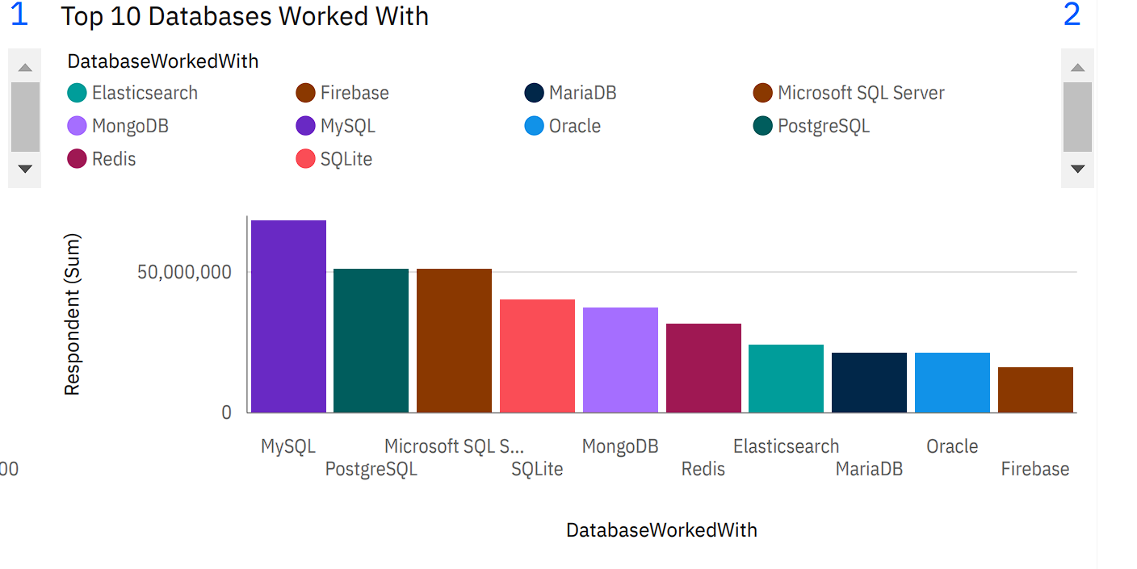
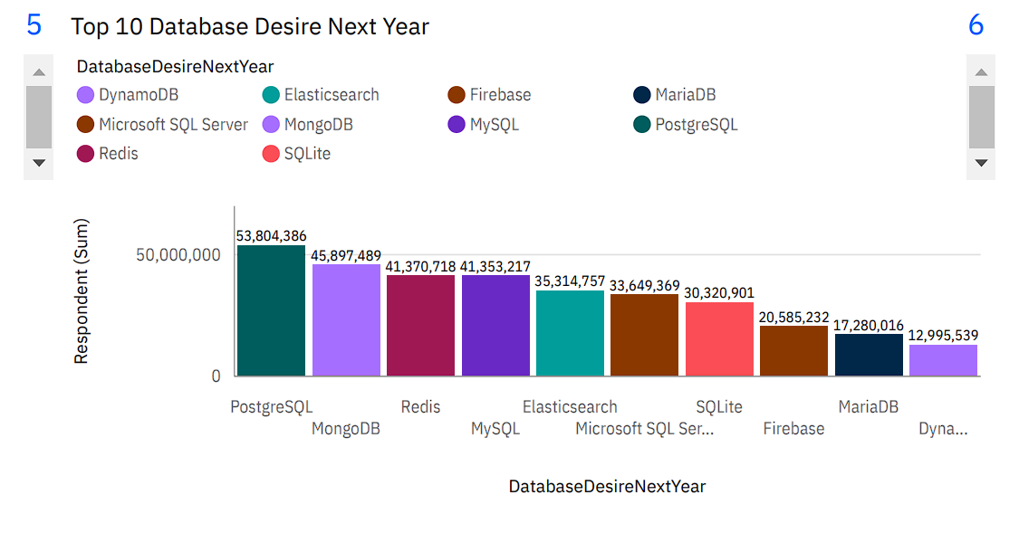
DATABASE TRENDS
Current Year
Next Year

Slide 10
DATABASE TRENDS - FINDINGS & IMPLICATIONS
Findings
MySQL comes out as the most popular choice this year while PostgreSQL out shines every other group next year
Coutchbase comes out as least favourite this year and also next year.
Elasticsearch,MongoDB and Redis shows increasing trend while MySQL is showning decreasing trend in next year.
Implications
PostgreSQL is becoming the next poluar Database skill.
Coutchbase is being replaced by other languages at most places.
Elasticsearch,MongoDB and Redis is becoming more poluar than MySQL

Slide 11

DASHBOARD
The permanent link of the read only view version of the dashboard Is as follows
<https://github.com/Hariharan-G-Nair/dashbord/blob/main/dashboard_capstone_project.pdf.>

Slide 12
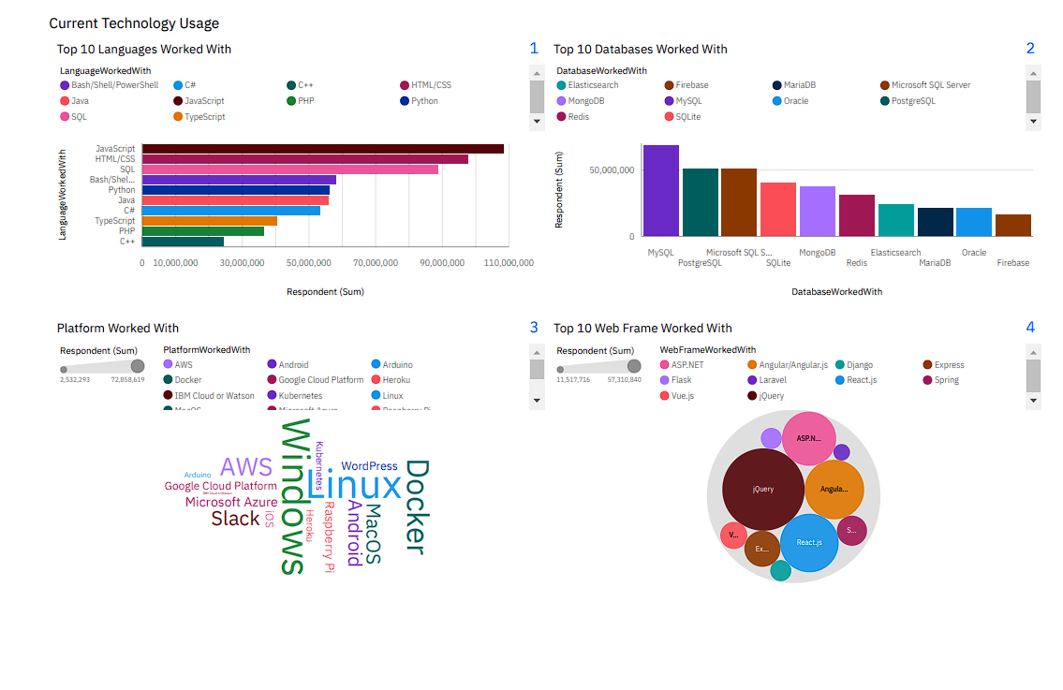
DASHBOARD TAB 1

Slide 13
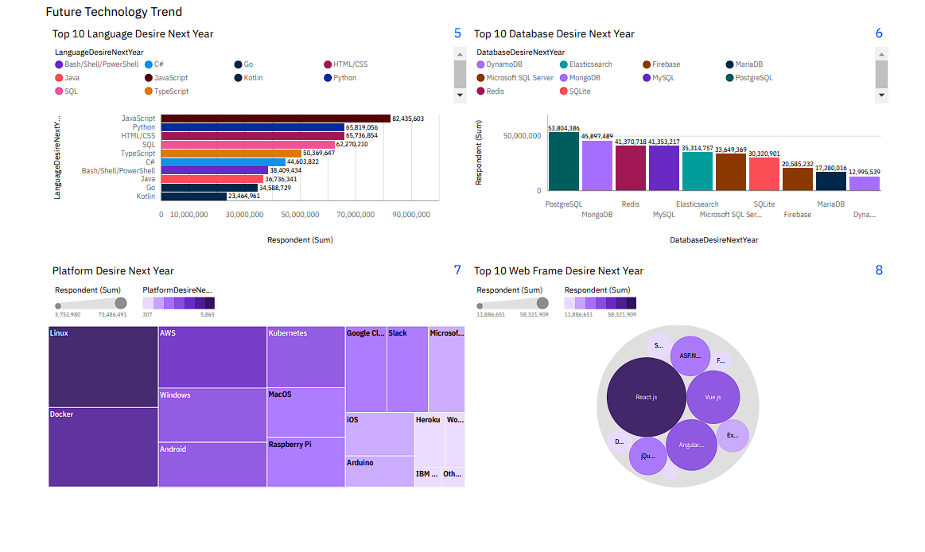
DASHBOARD TAB 2

Slide 14
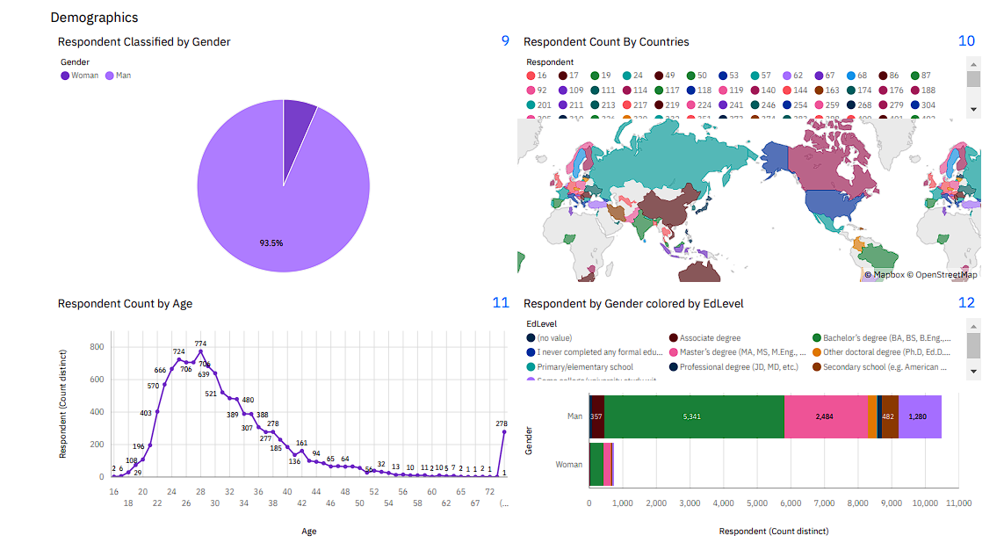
DASHBOARD TAB 3

Slide 15
DISCUSSION
All age groups used for survey.
All Gender groups used for suvey.
People from different countries were asked for survey.

Slide 16
OVERALL FINDINGS & IMPLICATIONS
Findings
Technology trends changes every year.
USA is the most technological country.
There are extreme age and gender discrimination.
Implications
Programmers should always follow latest technology methods.
More countries should have equal chance to be exposed to changing technology trends.
Gender and age should be the concerns or benefits of emloyment

Slide 17

CONCLUSION
Technology Trends.
Programming Languages,Database,Platform and Web frame trends.
Demographic trends.
Gender and education
Programming languages trends and salary trends.

Slide 18

APPENDIX
Include any relevant additional charts, or tables that you may have created during the analysis phase.

Slide 19
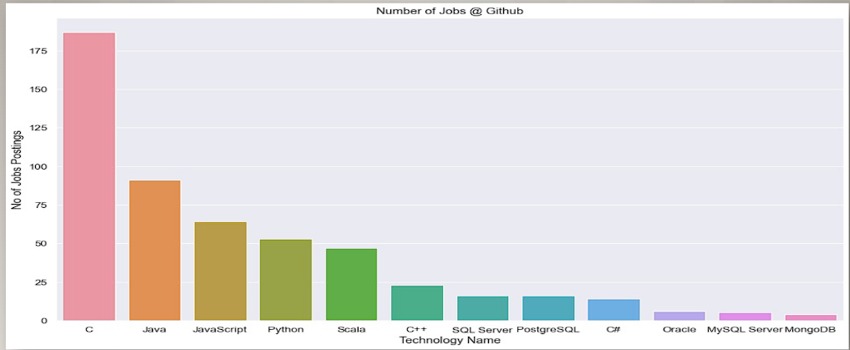
JOB POSTINGS

Slide 20
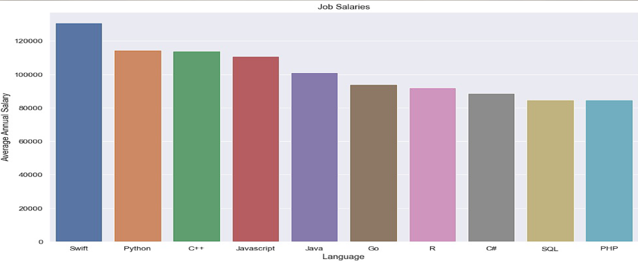
POPULAR LANGUAGES

