Slide 1


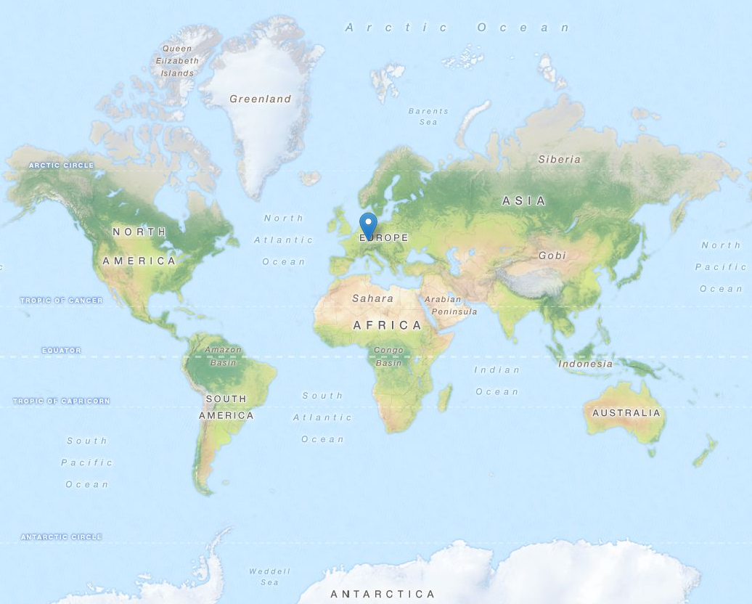
Spatial Partitioning and Querying for Apache Spark
Hariharan Gandhi (hariharan.gandhi@de.ibm.com)

Slide 2
In this presentation
Why is Geospatial processing so important ?
What do we need to address ?
How do we Solve ?

Slide 3
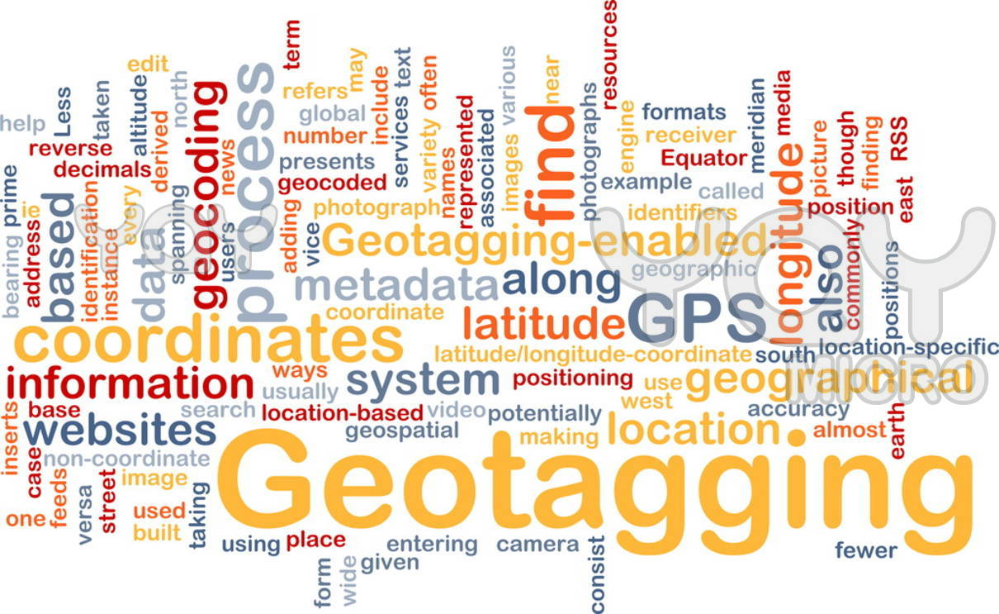








Slide 4
Trending Scenario
Very large volume of Geo-spatial data
Businesses need location aware services
  Like tweets in an particular area
  Weather information of a holiday spot which you plan to visit over the vacation
  Attractions nearby
  Take me through the shortest route
  many more.....

Slide 5

Seek support from Parallel computing platforms
To handle such large volumes
But unfortunately, no native support (yet)
Needs modifying internal implementations

Slide 6

Why partition ?
Spatial Indexing for retrieval
Range Queries, grouping – Network cost due to shuffling between clusters/nodes

Slide 7
When to partition ?
GeoSpatial operations intense application,. Eg: Location aware services
Major interests of queries are Geospatial:
    Ex: Maps, Uber, Jodel, AirBnB, Emergency Services
Multiple reads

Slide 8
The plan
Introduce a partitioning scheme in Apache Spark that partitions data-sets considering Geo-spatial info:
Communication in distributed environment:
  minimize network traffic by allowing spark program to control RDD partitioning
Retained Spatial Locality:
  nearby points are probably in the same partition / cluster
Minimize data points shuffling during Geo-spatial queries
Optimized for Search & Range queries on Geo-points

Slide 9

Implementing on Spark
GeoHash Partitioner
GeoHash Query Layer

Slide 10
GeoHash Partitioner

Slide 11
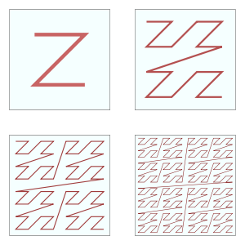
Space Filling Curves
Z-order Curve
Hilbert Curve

Slide 12
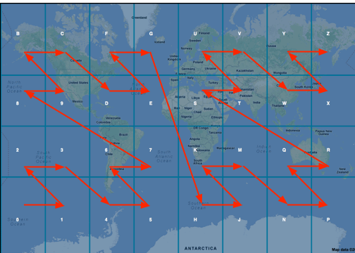
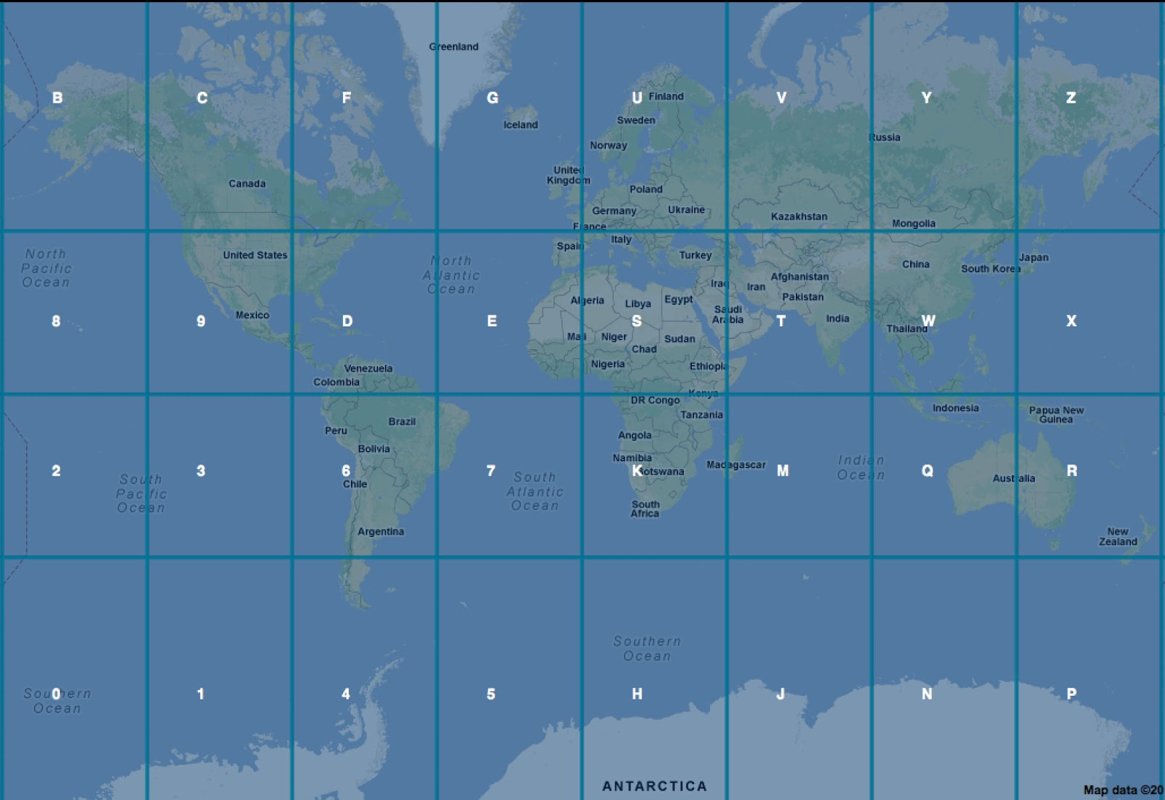
GeoHash

Slide 13
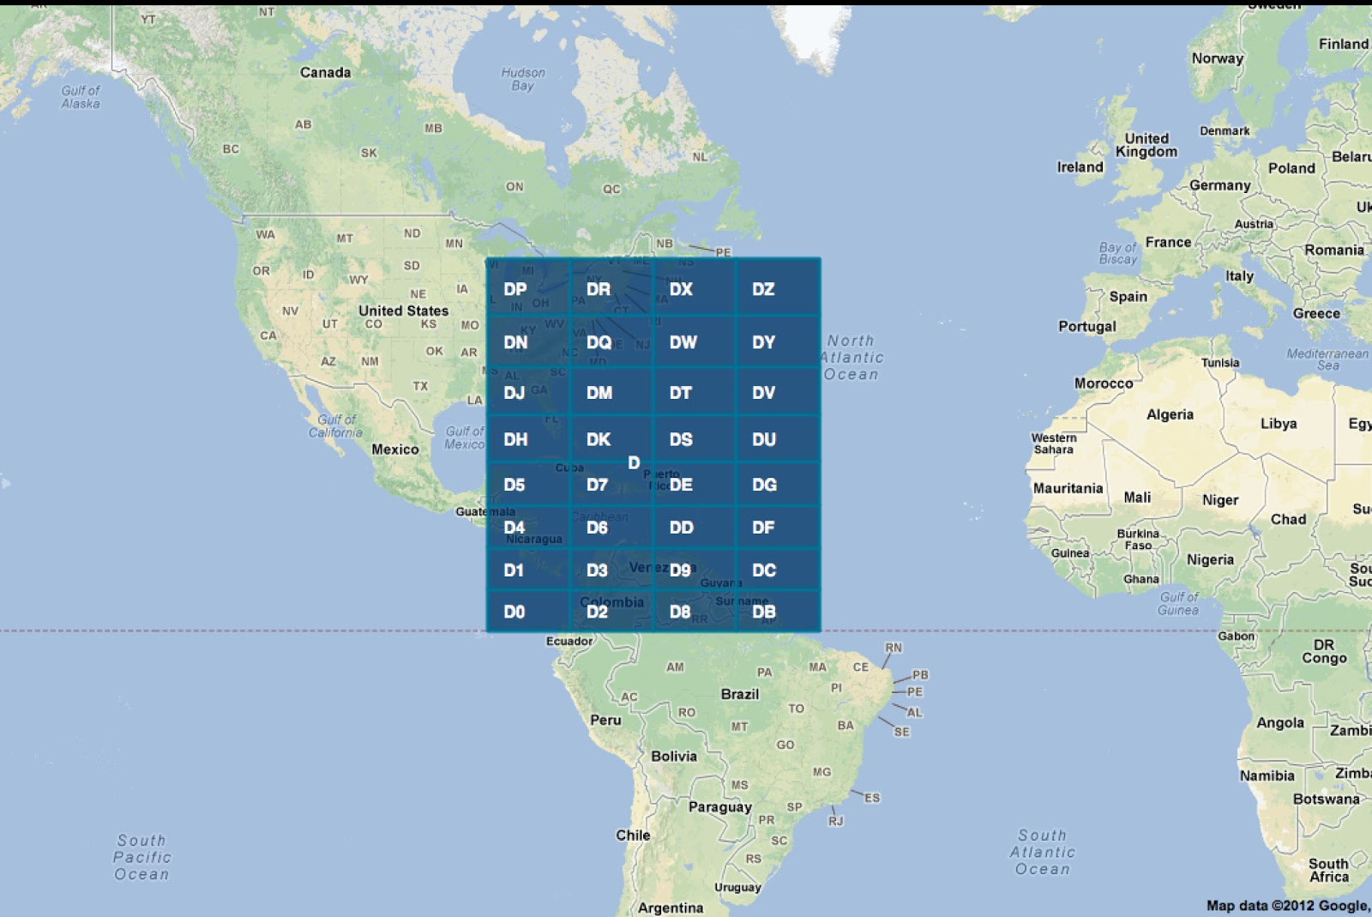
GeoHash

Slide 14
GeoHash Partitioner

Slide 17
Variable length
So now we need to map to nodes
This variable length grids are mapped on to a data structure
dr
Prefix
5
7
r
2
Partition
number
Partition
number
Partition
number

Slide 18
Custom Partitioning
Step1: Load Aware
Step2: Variable length to generate Hash
Step3: Map these hash to RDD partitions

Slide 19
Arch1
Geo-Hash Partitioner
Re-calculate Hash for new load
Incoming Key value
(Geo-Hash)
Hash to Partition data structure
Geo-Hash to
Partition
mapper
Load Aware
Hash
Mapper
Geo-hash distribution
and load information
Geo-hash Key assigned
to its partition
Default Partitioning
Geo-Based Partitioning
m1
m2
World
Region with less data points
Region with a lot of data points ( > threshold)
Neighboring Region with less data
Smaller region with a lot of data points
Region with no data points

Slide 20
Implementing on Spark
GeoHash Partitioner
GeoHash Query Layer

Slide 21
Query act on all nodes
Normally executes code/query on all nodes
Large Scan

Slide 22
GeoHash Query Layer
Leverage the knowledge of previous partitioning and efficiently query on subset of data:
Identify the type of Query
Determine the areas of interest from the overall world
Figure out partitions that contain our interested region
Slice out the partitions from the RDD
Push the query on the final RDD based on the Query predicates

Slide 23


Slide 24
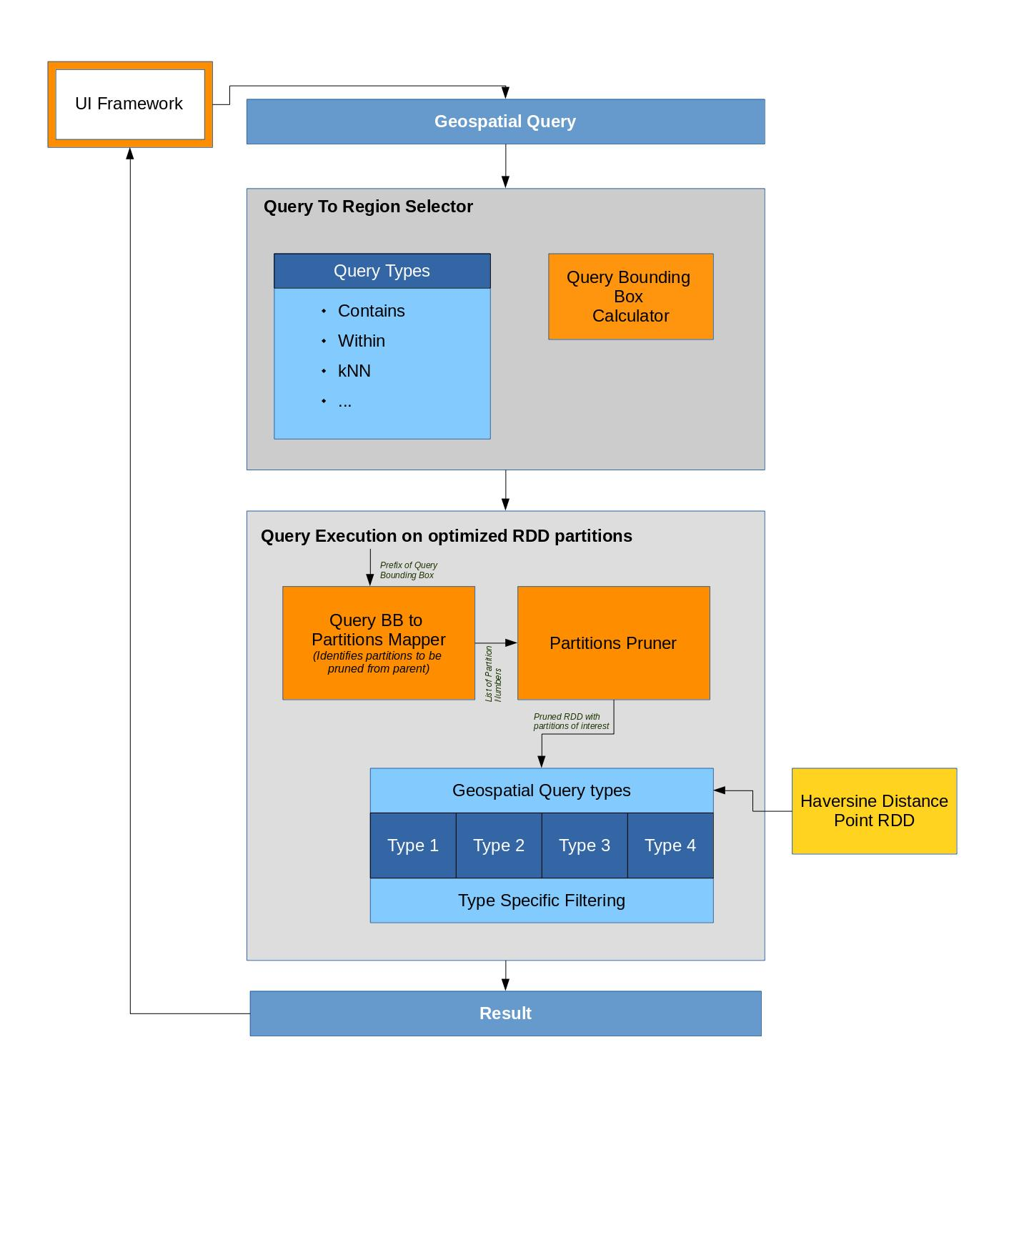
Arch2

Slide 25
DEMO

Slide 26

Thank you
Supervision: Gregor Moehler (moehler@de.ibm.com)
References for image: http://hariharan-gandhi.github.io/thesis/GeoHash_Partitioner_reference.pdf

