Slide 1
C Programming

Slide 2
History
Dennis Ritchie designed the C language at Bell Laboratories in the early 1970s
Ancestorial languages:
ALGOL 60 (1960)
Cambridge's CPL (1963)
Martin Richards's BCPL (1967)
Ken Thompson's B language (1970) at Bell Labs
C is a general-purpose programming language
UNIX operating system was originally written in C

Slide 3
Overview
C program is composed of
One or more source files, or
Translation units
Common declarations are often collected into header files and are included into the source files with a special #include command
One external function must be named main(); this function is where the program starts
Each of which contains some part of the entire C program - typically, some number of external functions

Slide 4
C Compiler
Independently processes each source file and translates the C program text into instructions understood by the computer
“Understands” the C program and analyzes it for correctness
If the programmer has made an error the compiler can detect, then the compiler issues an error message
The output of the compiler is usually called object code or an object module

Slide 5
Linker
When all source files are compiled, the object modules are given to a program called the linker
It resolves references between the modules, adds functions from the standard run-time library, and detects some programming errors such as the failure to define a needed function
This is typically not specific to C; each computer system has a standard linker that is used for programs written in many different languages
It produces a single executable program, which can then be invoked or run

Slide 6
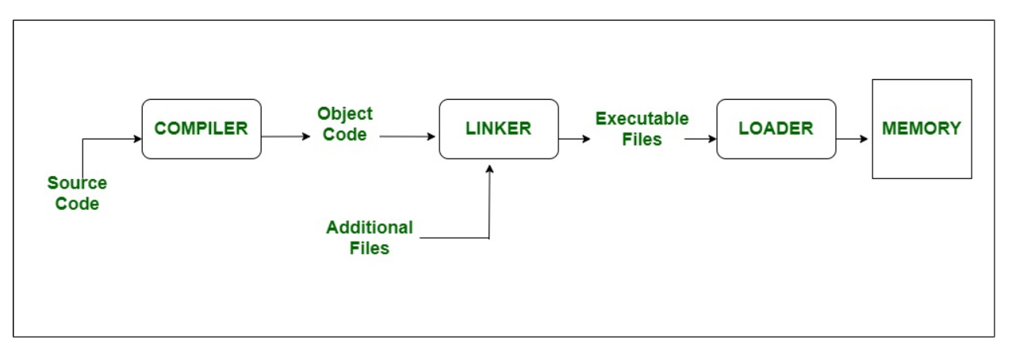

Slide 7
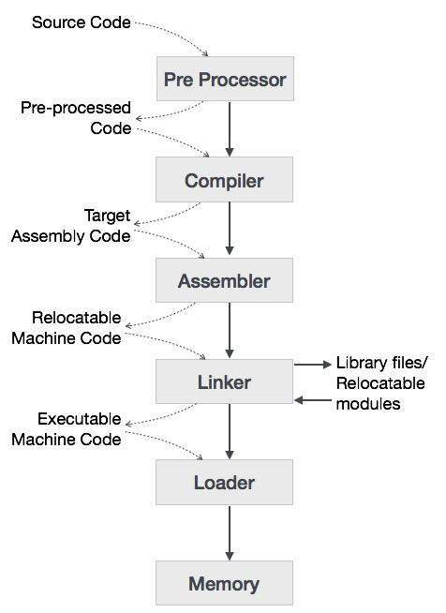

Slide 8
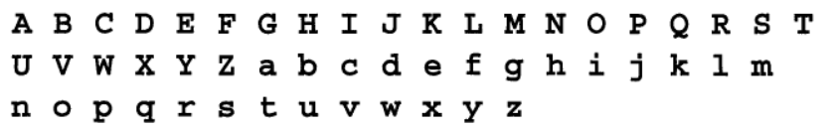


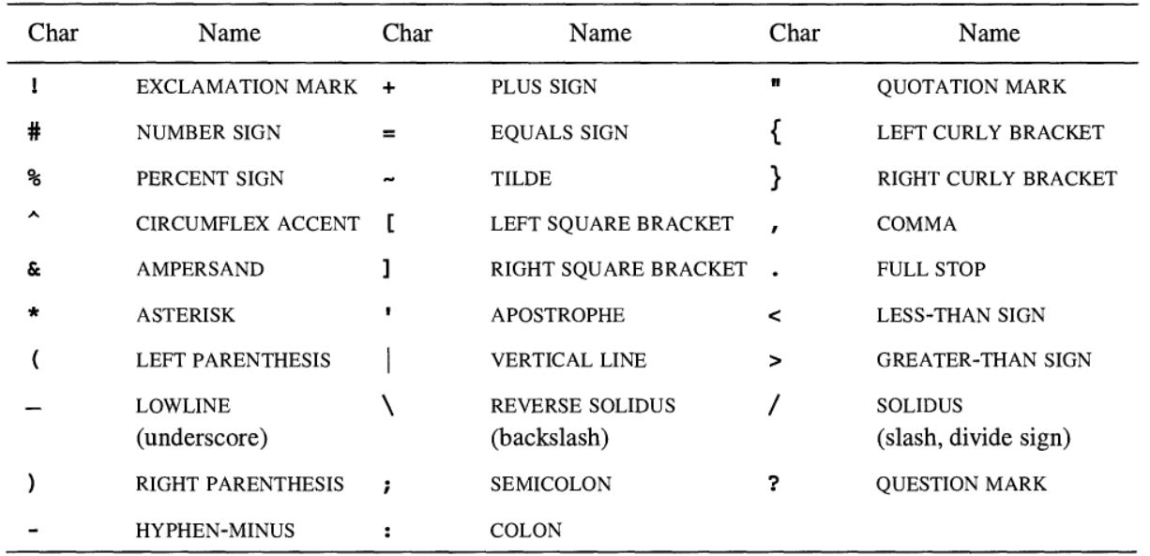
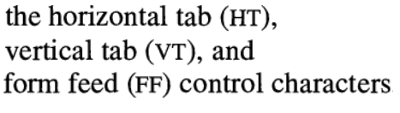
Lexical Elements – Character Set

Slide 9
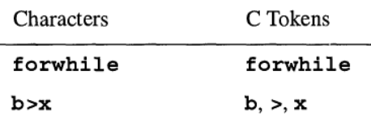
Tokens
The characters making up a C program are collected into lexical tokens
Classes of tokens: operators, separators, identifiers, keywords, and constants
The compiler always forms the longest tokens possible as it collects characters in left-to-right order, even if the result does not make a valid C program
Adjacent tokens may be separated by whitespace characters or comments

Slide 10
Keywords
Keywords are predefined, reserved words used in programming that have special meanings to the compiler
Keywords are part of the syntax, and they cannot be used as an identifier

Slide 11
Keywords
#include <stdio.h>
int main()
{
int result;
if ( result != 0 )
printf_s( "Bad file handle\n" );
}

Slide 12
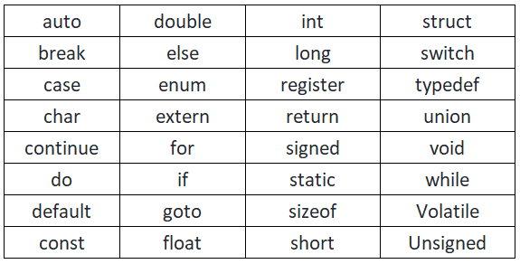
Keywords

Slide 13
Identifiers
"Identifiers" or "symbols" are the names supplied for variables, types, functions, and labels in a program by the user
Identifier names must differ in spelling and case from any keywords
Identifier can be created by specifying it in the declaration of a variable, type, or function
Once declared, you can use the identifier in later program statements to refer to the associated value

Slide 14
Identifiers
#include <stdio.h>
int main()
{
int result;
if ( result != 0 )
printf_s( "Bad file handle\n" );
}

Slide 15
Constants
C Constants are like a variable, except their value never changes during execution once defined
Types
Integer
Decimal
Hexadecimal – 0x, 0X
Octal – 0
Float
Character
String

Slide 16


Pre-processor
The C preprocessor is a simple macro processor that conceptually processes the source text of a C program before the compiler proper reads the source program

Slide 17

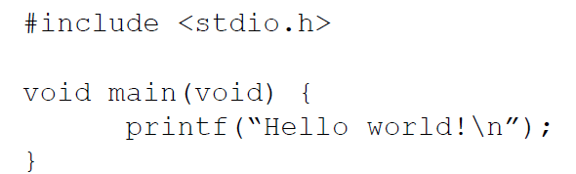



C Program - Introduction

Slide 18

main()
Function Prototyping
Return type
Function Name
Input Arguments
Getting Inputs from console

Slide 19
Header File
stdio → Standard Input Output
Contains functions that will be used in the source code
#include → Pre-processor directive
Instructs compiler to find the function definition of certain functions mentioned in the header file
The preprocessor is a program that runs before the C compiler itself
It serves to perform text substitutions on the source code prior to the actual compilation

Slide 20
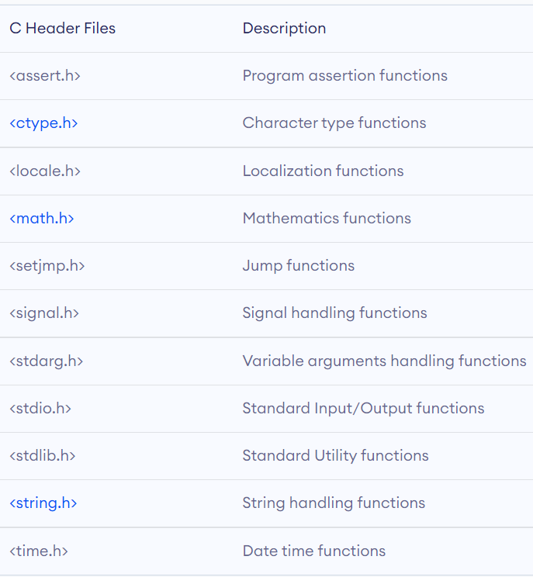
Standard C Library files

Slide 21
Short form

Slide 22
Declaration
A declaration is a statement describing an identifier, such as the name of a variable or a function
Variables are containers for storing data values
Defined using a data type
int a
float w = 10.89
A function is a block of code which only runs when it is called
Defined using function name, return type and arguments

Slide 23
Variables
A variable is a name of the memory location
It is used to store data
Its value can be changed, and it can be reused many times
Declaration of variables require data type to be specified

Slide 24
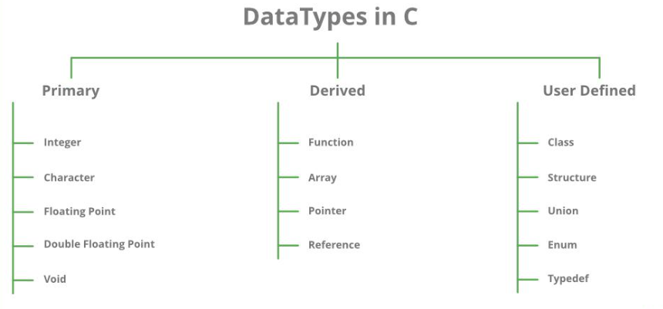
Variable Data Types
Each variable in C has an associated data type
Each data type requires different amounts of memory and has some specific operations which can be performed over it

Slide 25
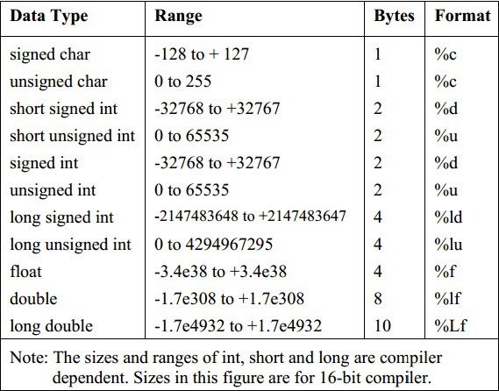
Variable Data Types – Range & Size

Slide 26
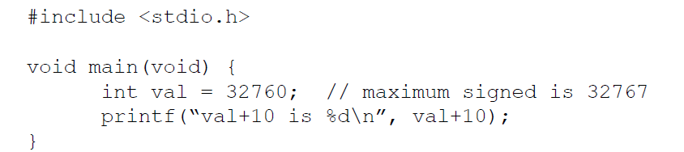
Variable Data Type - Example
Variable Definition
Variable Declaration
Format Specifier

Slide 27
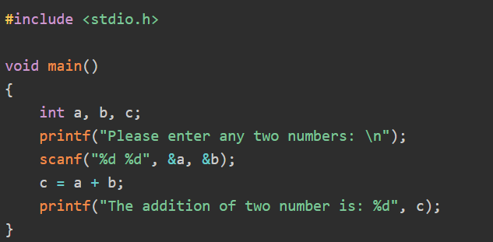
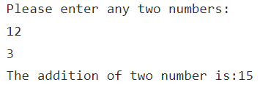
Data Input/Output - integer
Output

Slide 28
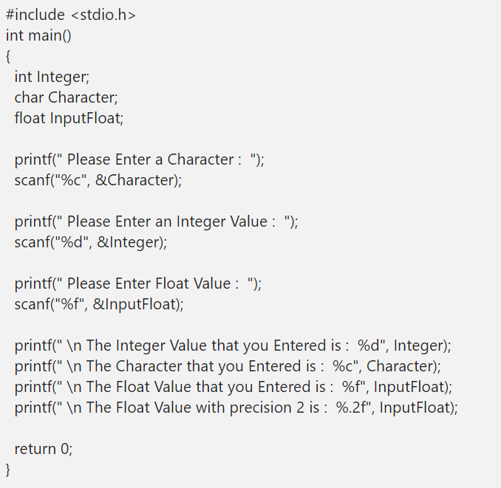
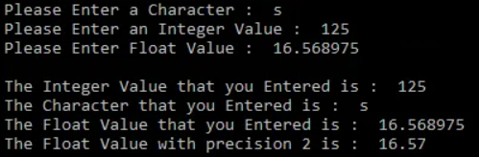
Data Input/Output – int, float, char
Output

Slide 29
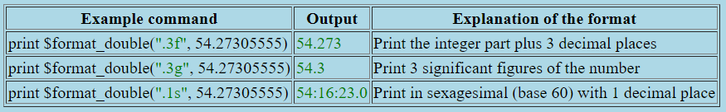
Data Input/Output – floating point

Slide 30
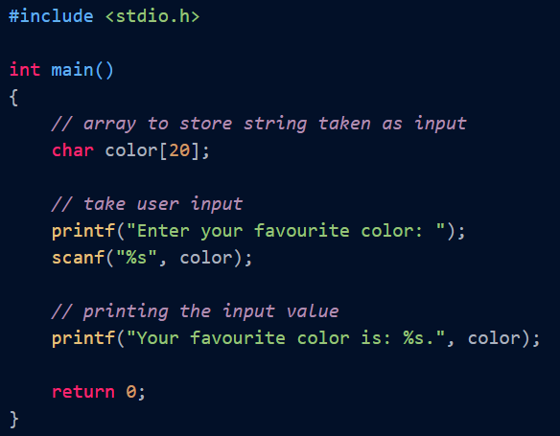

Data Input/Output – string
Output
%s in scanf() can be used to accept string inputs
Name of the string is mentioned in the function as it points to the initial address of character array

Slide 31
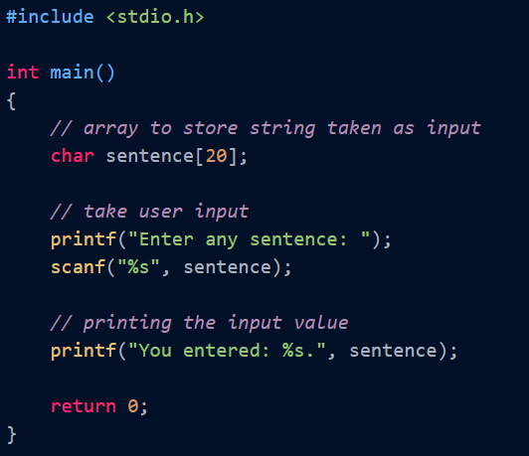

Data Input/Output – string
Output
If the size of the array is not sufficient, it may lead to overflow

Slide 32
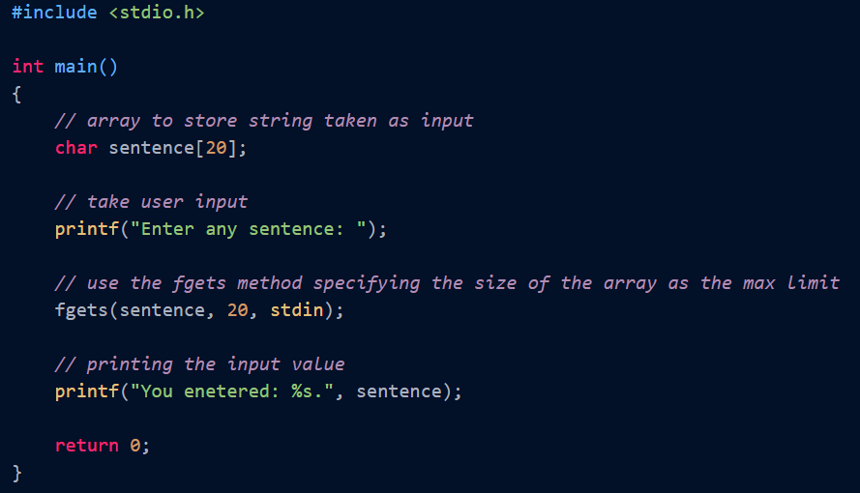

Data Input/Output – string
Output
User can mention the upper limit of the string input that can be stored in the variable
If the entered string size is less than the mentioned size, entered content is stored as such
If the entered content is having size greater than the mentioned size, the function restricts the input and buffer overflow is prevented
Output

Slide 33
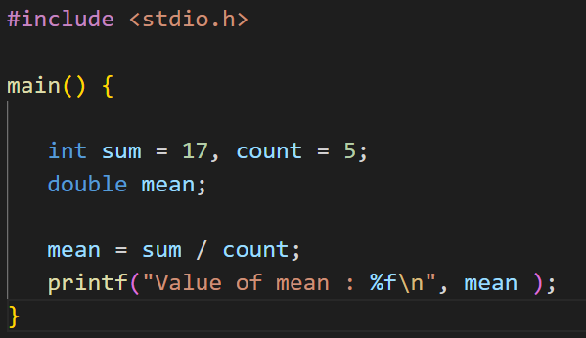
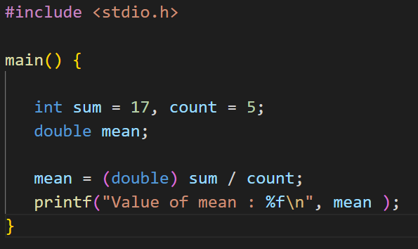
Typecast
Converting one datatype into another is known as type casting or, type-conversion
Output
Output

Slide 34
Scope
In C programming, every variable is defined in scope
Scope can be regarded as the section or region of a program where a variable has its existence
The variable cannot be used or accessed beyond that region
In C programming, a variable declared within a function differs from a variable declared outside of a function

Slide 35
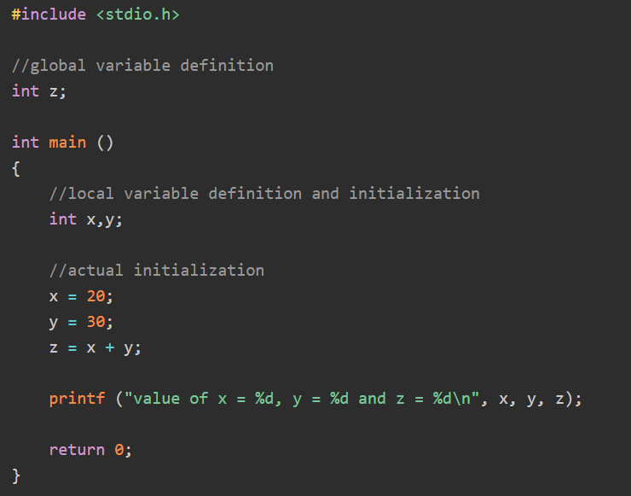
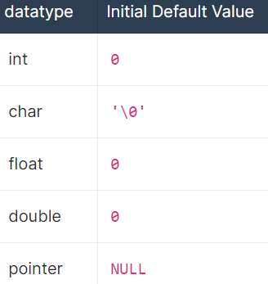
Scope
x, y → Local Variable
Defined within a function
Can be accessed only within the function where it is defined
In this case it is main()
Values should be initialised by the user
z → Global Variable
Defined outside main
Can be accessed by main and all user defined function within the program
Can be accessed outside the program by using extern keyword
Value will get initialised to 0

Slide 36
Storage Class
A storage class defines the scope (visibility) and life-time of variables and/or functions within a C Program
Storage classes in a C program
auto
register
static
extern

Slide 37
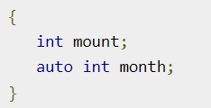

Storage Class
auto
The auto storage class is the default storage class for all local variables.
register
The register storage class is used to define local variables that should be stored in a register instead of RAM.
This means that the variable has a maximum size equal to the register size (usually one word) and can't have the unary '&' operator applied to it (as it does not have a memory location)

Slide 38
Storage Class
static
The static storage class instructs the compiler to keep a local variable in existence during the life-time of the program instead of creating and destroying it each time it comes into and goes out of scope. Therefore, making local variables static allows them to maintain their values between function calls.
The static modifier may also be applied to global variables. When this is done, it causes that variable's scope to be restricted to the file in which it is declared.
In C programming, when static is used on a global variable, it causes only one copy of that member to be shared by all the objects of its class.

Slide 39
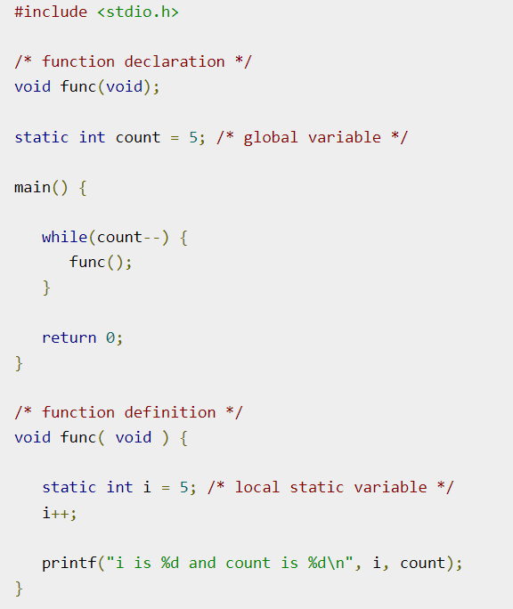
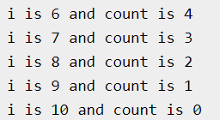
Storage Class
static
Output

Slide 40
Storage Class
extern
The extern storage class is used to give a reference of a global variable that is visible to ALL the program files. When 'extern’ is used, the variable cannot be initialized however, it points the variable name at a storage location that has been previously defined.
In a multiple files scenario, if there is a global variable or function to be used in other files, then extern will be used in another file to provide the reference of defined variable or function.

Slide 41
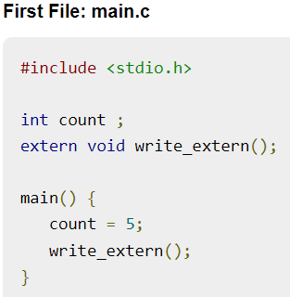
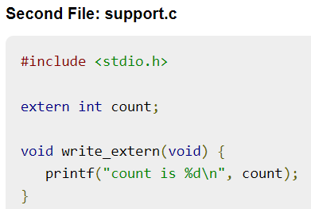


Storage Class
extern
terminal
Output

Slide 42
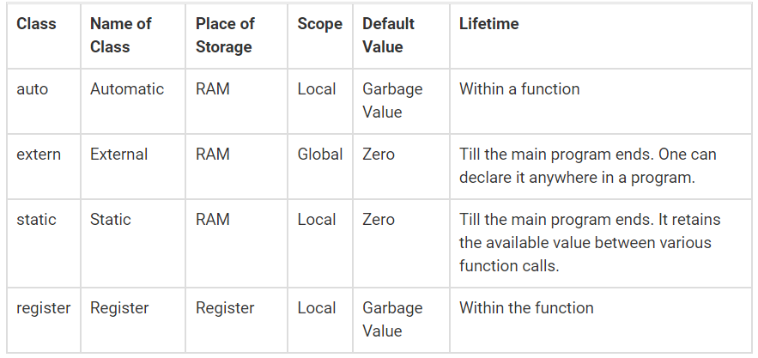

Slide 43
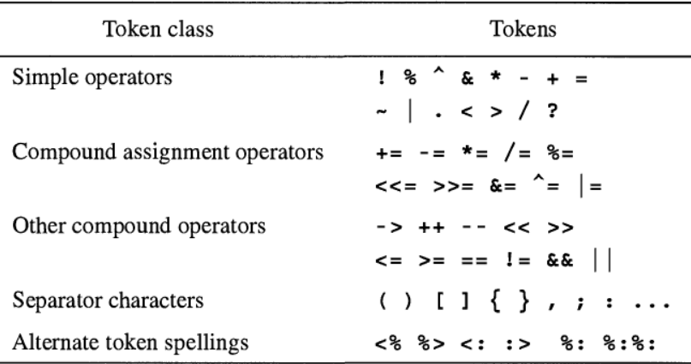
Operators & Separators
Assists programmers using I/O devices without certain U.S.—English characters
Operators | Equivalent Punctuators
<% | {
%> | }
<: | [
:> | ]
%: | #
%:%: | ##
Header file is0646.h defines macros
that expand to certain operators

Slide 44
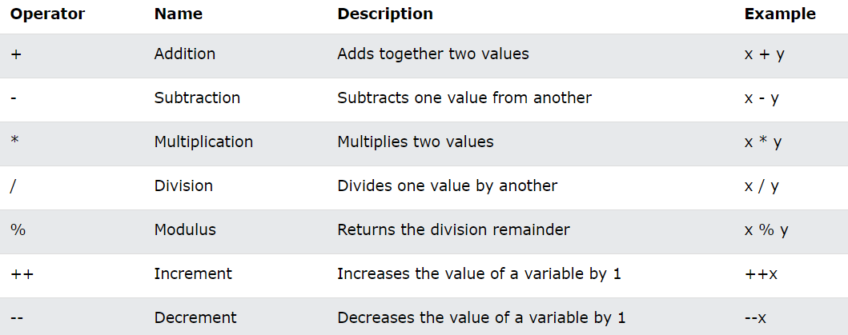
Operators - Arithmetic

Slide 45
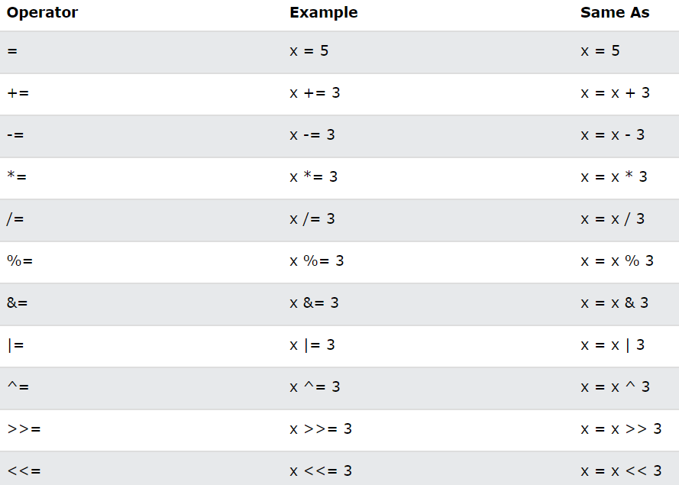
Operators - Assignment

Slide 46
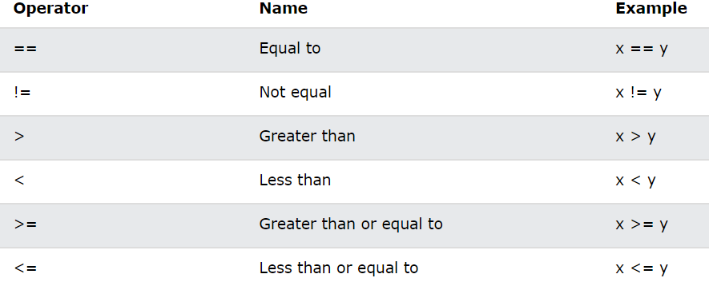
Operators – Comparison

Slide 47
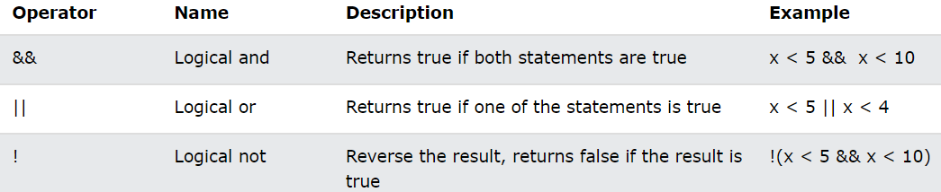
Operator - Logical

Slide 48
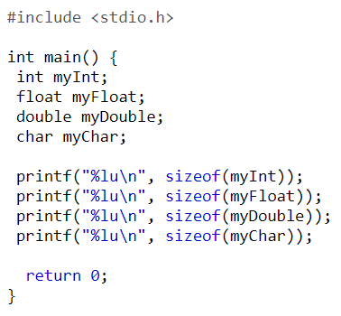
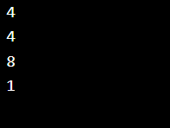
Operator - sizeof
The memory size (in bytes) of a data type or a variable can be found with the sizeof operator
Program
Output

Slide 49
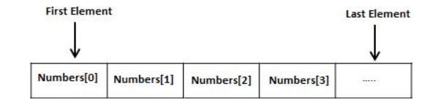



Array
Arrays a kind of data structure that can store a fixed-size sequential collection of elements of the same type
An array is used to store a collection of data, but it is often more useful to think of an array as a collection of variables of the same type
Syntax
Declaration
Initialisation
Defining a single element

Slide 50
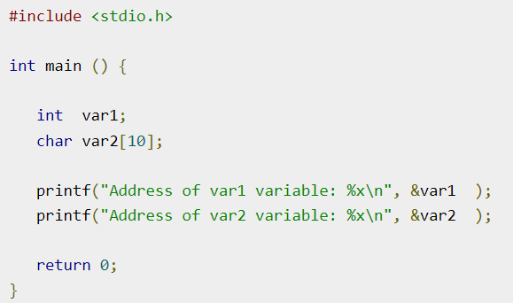

Pointers
Every variable is a memory location
Every memory location has its address defined which can be accessed using ampersand (&) operator, which denotes an address in memory
A pointer is a variable which stores memory address of another variable of same data type
A pointer can be declared without data type using ‘void’
Output

Slide 51
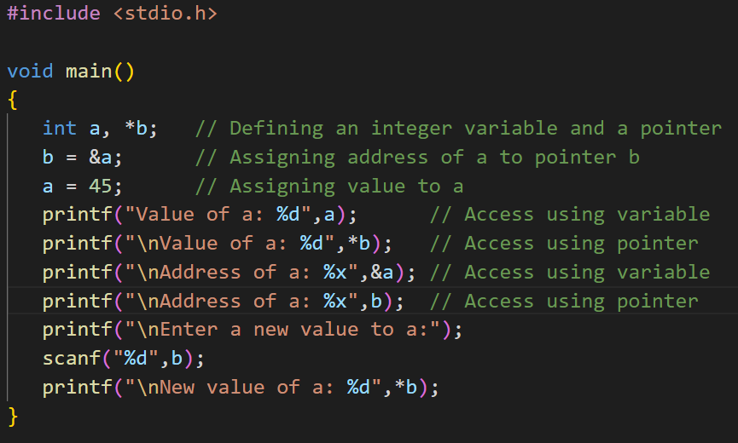
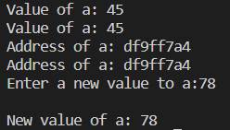
Pointer to a variable
Output:

Slide 52
Void pointer?
NULL pointer?
Dangling pointer?

Slide 53
Conditional Statements
Conditional statements require the usage of relational operators such as >, <, >=, <=, ==
Conditional statements offered in C
if to specify a block of code to be executed, if a specified condition is true
else to specify a block of code to be executed, if the same condition is false
else if to specify a new condition to test, if the first condition is false
switch to specify many alternative blocks of code to be executed

Slide 54


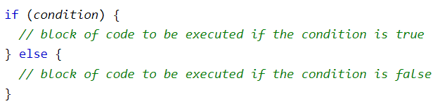
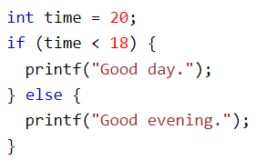
if Statement
else Statement

Slide 55
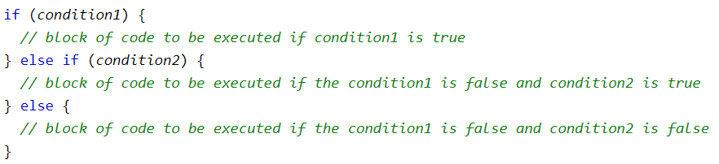
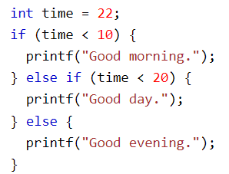
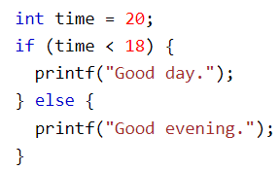

else if Statement
Shorthand If...Else (Ternary Operator)

Slide 56
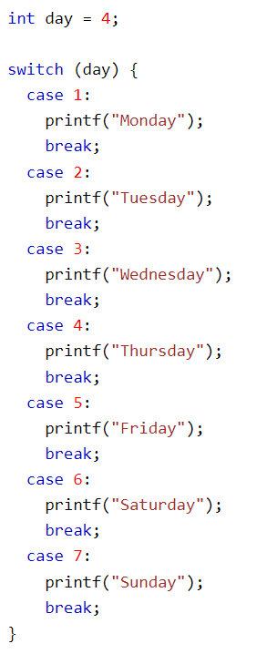
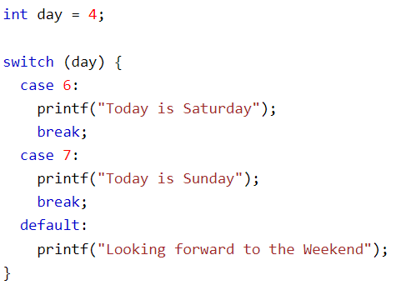
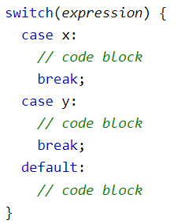
Switch Statement

Slide 57

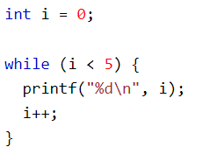
Looping Statements
Loops can execute a block of code as long as a specified condition is reached
Loops are handy because they save time, reduce errors, and they make code more readable
While Loop

Slide 58





do/While Loop
Output
for Loop
Output

Slide 59




break and Continue
Break was used to "jump out" of a switch statement/loop
Continue statement breaks one iteration (in the loop), if a specified condition occurs, and continues with the next iteration in the loop
Output
Output

Slide 60




Array Operations
Printing Elements of an 1D Integer array
Output
Printing Elements of an 1D Integer array
Output

Slide 61


Array Operations using Pointer
Printing Elements of an 1D Integer array
Output
Printing Elements of an 1D Integer array
Output

Slide 62


User Defined Functions
Function Declaration
returnType functionName(type1 parameterName1, type2 parameterName2, ...);
returnType functionName(type1 , type2, ...);
Function Definition
returnType functionName(functionParameters...)
{
// function body
}

Slide 63


Pass by Value
Output

Slide 64


Pass by Value
Output

Slide 65


Pass by Reference
Output

Slide 66


Function with No Return Value and without Argument
Output

Slide 67


Function with No Return Value and with Arguments
Output

Slide 68


Function with a Return Value and without Any Argument
Output

Slide 69


Function with a Return Value and with an Argument
Output

Slide 70
Argument | Parameter
Also known as actual parameters | Also known as formal parameters
Arguments are used while calling the function | Parameters are used during the declaration of the function
Argument is the actual value of this variable that gets passed to function. | Parameter is variable in the declaration of the function.

Slide 71
Recursion
Recursion: repetition of a process in a similar way until the specific condition reaches
In C Programming, if a function calls itself from inside, the same function is called recursion
The function which calls itself is called a recursive function, and the function call is termed a recursive call
The recursion contains two cases in its program body.
Base case: When you write a recursive method or function, it keeps calling itself, so the base case is a specific condition in the function. When it is met, it terminates the recursion. It is used to make sure that the program will terminate. Otherwise, it goes into an infinite loop.
Recursive case: The part of code inside the recursive function executed repeatedly while calling the recursive function is known as the recursive case.

Slide 72


Recursion - Syntax

Slide 73



Direct Recursion
Output

Slide 74



Indirect Recursion
Output

