Slide 1

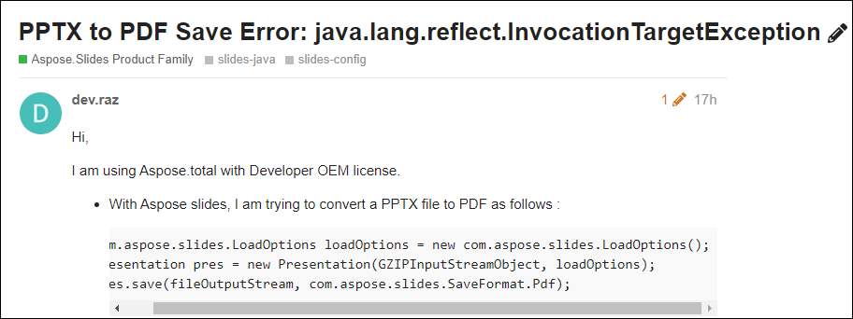
Sample PowerPoint File
https://forum.aspose.com/t/pptx-to-pdf-save-error-java-lang-reflect-invocationtargetexception/240115

Slide 2
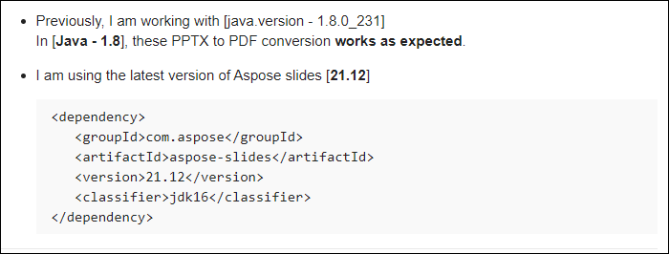

Slide 3
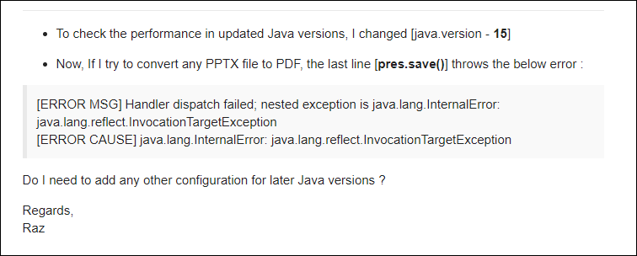

Slide 4

This is a Sample Slide
Here is an outline of bulleted points
You can print out PPT files as handouts using the
PRINT >
PRINT WHAT > HANDOUTS option

Slide 5
This is a Sample Slide
Here is an outline of bulleted points
You can print out PPT files as handouts using the
PRINT >
PRINT WHAT > HANDOUTS option

Slide 6
This is a Sample Slide
Here is an outline of bulleted points
You can print out PPT files as handouts using the
PRINT >
PRINT WHAT > HANDOUTS option

Slide 7
This is a Sample Slide
Here is an outline of bulleted points
You can print out PPT files as handouts using the
PRINT >
PRINT WHAT > HANDOUTS option

Slide 8
This is a Sample Slide
Here is an outline of bulleted points
You can print out PPT files as handouts using the
PRINT >
PRINT WHAT > HANDOUTS option

Slide 9
This is a Sample Slide
Here is an outline of bulleted points
You can print out PPT files as handouts using the
PRINT >
PRINT WHAT > HANDOUTS option

Slide 10
This is a Sample Slide
Here is an outline of bulleted points
You can print out PPT files as handouts using the
PRINT >
PRINT WHAT > HANDOUTS option

Slide 11
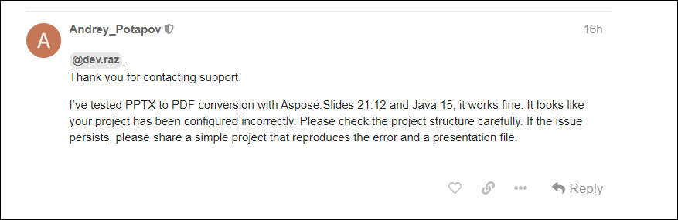
This is a Sample Slide

