Slide 1

Reactjs project.!
E-commerce web
Application

Slide 2
HOODERS TEAM MEMBERS; ->Anil Vikash p (727821TUIT009) ->Barath v (727821TUIT016) ->Hariharan m (727821TUIT029) ->manoj kumar n (727821TUIT057) ->mohamED noufal Ansari T(727821TUIT060) ->mohan kumar m (727821TUIT061)

Slide 3




Slide 4


Slide 5


Slide 6


Slide 7


Slide 8


Slide 9
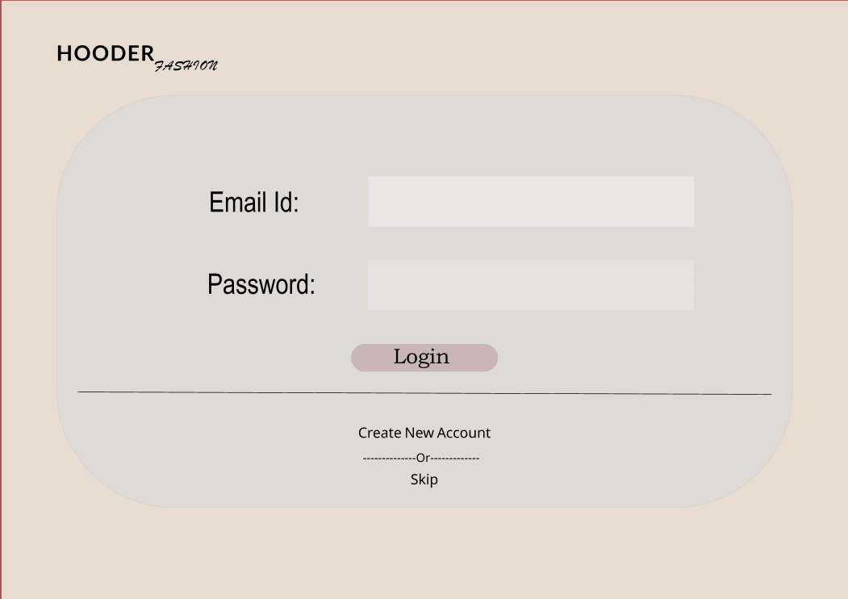

Slide 10
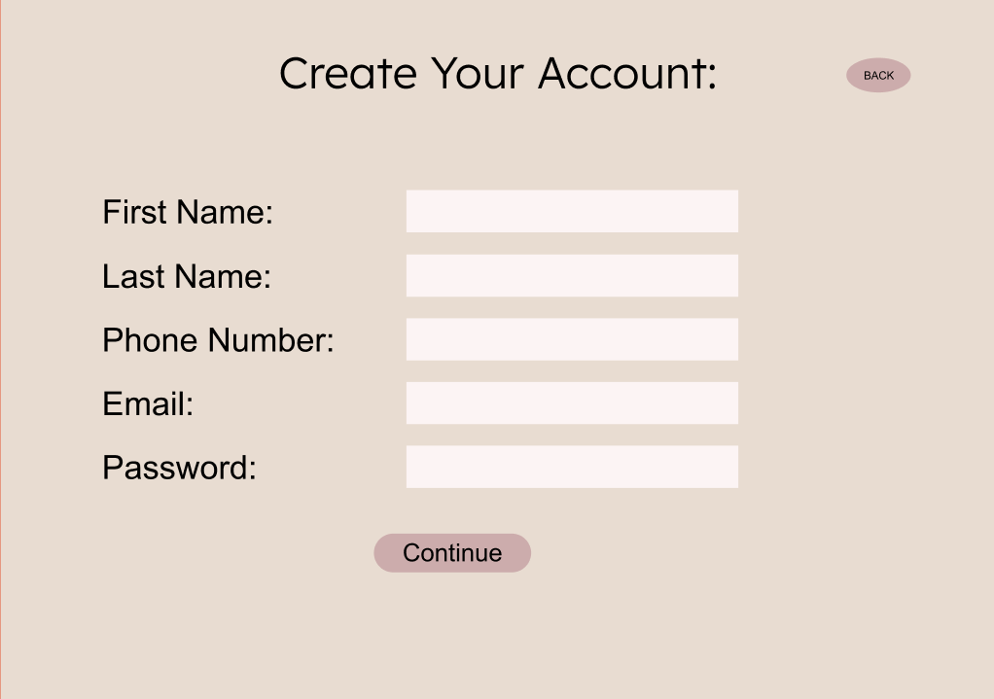

Slide 11
REFFERENCES:-
figMA LINK:-
https://www.figma.com/file/e0EQR7G7HgzsSXd8UP2ivp/Untitled?node-id=0%3A1&t=cQzAZ6cLnHkQqa1s-1
Github link:-

Slide 12
THANK YOU…!

