Slide 1
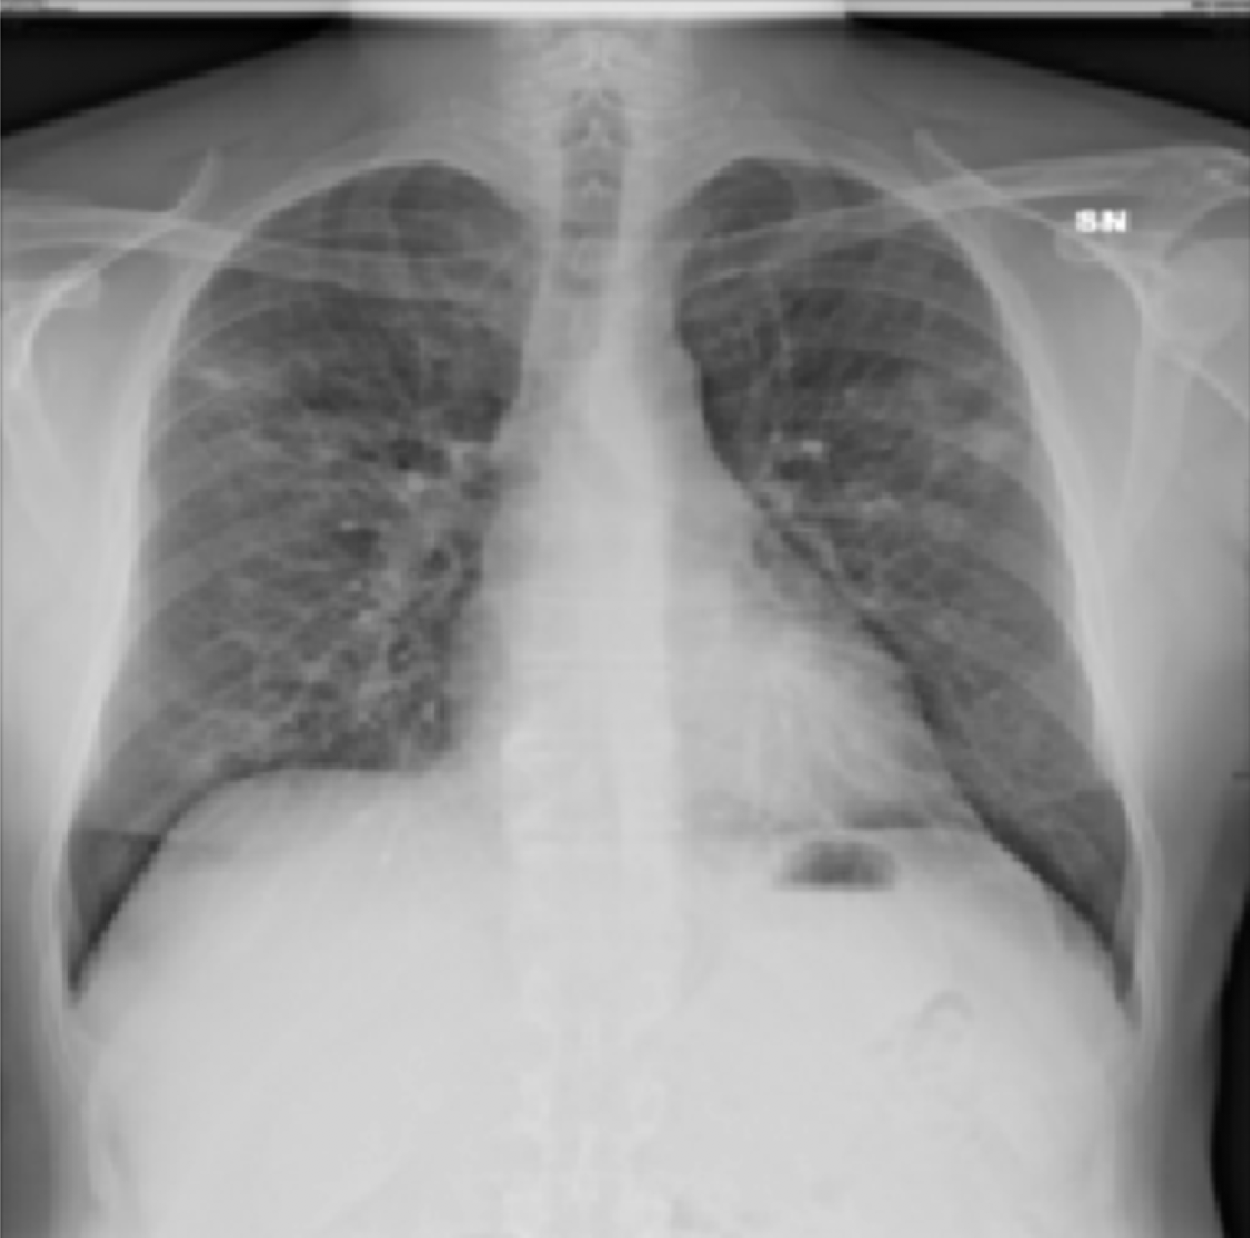
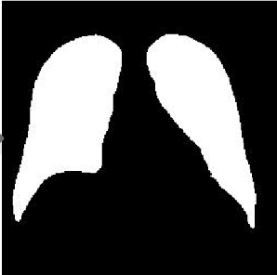
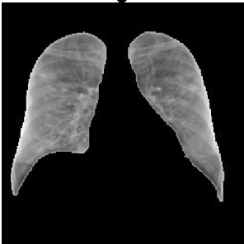
Point-wise multiplication
Point-wise addition
2D Convolution (kernel size f1 x f2, output channels, optional stride, optional groups) +BatchNorm + ReLU
Lung Region Segmentation
CONV
CSDB
mainline
RCSDB
mainline
Spatial
CONV
3 x 3
1024
/2
Spatial
CONV
4 x 4
4
COVID-19
Spatial
CONV
7 x 7, 32
/2
Spatial
CONV
5 x 5, 64
Reversed CSDB Block
Spatial CONV
3 x 3, 512
Normal
Channel-Shuffled
Dual-Branched
(CSDB) Block
Softmax
B. Pneumonia
CSDB side
output features
RCSDB side output features
V. Pneumonia
Class Prediction
y_{cls}
Grouped CONV
3 x 3, 256, g = 4
/2
Channel-Shuffled
Dual-Branched (CSDB) Block
Dropout
10%
Depthwise Separable CONV
3 x 3, 512
Avg POOL
4 x 4
/2
Reversed CSDB Block
Dropout
5%
Avg POOL
4 x 4
/2
csdb_aux1
auxiliary features
rcsdb_aux1
auxiliary features
csdb_conv2
rcsdb_conv2
Spatial
CONV
3 x 3
512
Spatial
CONV
3 x 3 128
/2
Spatial
CONV
3 x 3 256
/2
Spatial
CONV
3 x 3 256
Shuffled CONV
3 x 3
256
Spatial
CONV
3 x 3 512
/2
Spatial
CONV
3 x 3
512
Shuffled CONV
3 x 3
512
CSDB
input
CSDB
mainline
RCSDB
input
RCSDB
mainline
csdb_conv1
csdb_aux2
rcsdb_conv1
rcsdb_aux2
Depthwise Separable CONV
3 x 3, 512
/2
Avg POOL
4 x 4
/2
CSDB side output features
RCSDB attention features
Grouped CONV
3 x 3, 512, g = 4
Avg POOL
4 x 4
/2
RCSDB side output
features
Dropout
10%
Dropout
5%

Slide 2







Point-wise multiplication
Point-wise addition
2D Convolution (kernel size f1 x f2, output channels, optional stride, optional groups) +BatchNorm + ReLU
Jacobian product function
Partial derivative function
Loss function
Lung Region Segmentation
CONV
$$J$$
$$∂$$
$$L$$
CSDB
mainline
RCSDB
mainline
Spatial
CONV
3 x 3
1024
/2
Spatial
CONV
4 x 4
4
Spatial
CONV
7 x 7
32
/2
Spatial
CONV
5 x 5, 64
Reversed CSDB Block
Spatial CONV
3 x 3, 512
Softmax
$$LC$$
CSDB Block
Cross-entropy loss
CSDB side
output features
RCSDB side output features
Class Prediction
y_{cls}
Conv filters
Gradient of feature map wrt filters
Feature map
$$∂$$
Filter loss between class and within class
$$LF$$
..
Global Average Pooling
$$J$$
Weighted Gradient of y_{cls} wrt filters
Gradient of y_{cls} wrt feature map
Softmax
$$∂$$
Conv filters response to y_{cls}

