Slide 1
IFT598: Data Visualization and Reporting IMDB Most Popular Films and series Sravan Srivatsa Sai Yendeti Naga manikanta gudapati Satya Abhishek Reddy Nallamilli Hariharan Balakrishnan To Dr. Asmaa Elbadrawy

Slide 2
Introduction to dataset
The data is about most popular 300 Films and series on IMDB.
There are 14 columns in the dataset. Name, Genre, Type, certificate, nudity, violence, profanity, Alcohol, frightening is of data type char and Date, rates, votes, Duration, and episodes are Integer values.
The Data types of the Column are specified below:
Categorical: Name, Genre, Type
Ordinal: Certificates, Nudity, Violence, Profanity, Alcohol, Frightening
Interval: Date
Date: Release date of the Movie/Series
Rate: IMDB’s Rating for that movie/ series based on the users rating.
Votes: Number of people rated for a movie/series

Slide 3
Data Pre-Processing
Removing null from columns which are important for visualizations with the help of pandas.
Making the episodes column for movies to ‘1’.
Removing all the duplicate rows which have the same movie name/series name.
Sorted all the values by Date.
Converting some columns which are string type like rates, duration, episodes to integer values.
For genre columns replacing the duplicates for the same movie/series.
In tableau we split the genre so that we know the main genre of the film/series
We have done our data preprocessing in JupyterNotebook

Slide 4
Who are the users?
Audience who wants to watch good movies which they can judge by high IMDB ratings.
Telecasting channels who are looking for good movie to telecast on small screen.
Family audience who are looking for some content which has no adult content and no violence.
If movie reviewers want to know any information regarding the movie/series like genre, release date and many more other details.
For audience who are willing to watch the film/series of duration, genre selection is made easy.
All the major OTT platforms will display the information preview which is taken from the IMDB site as it is the most trustworthy site.

Slide 5
Questions
What is the duration of one/multiple selected movies?
How many of them are adult based and children movies?
What are the series with the highest number of episodes?
To know the number of votes, Rating and no of episodes of a movie?
Which genres are having the highest rating?
How many movies are there with all the types of violence?
Which movies/series are having the highest rating?
What the movies having a rating between the specified range?
What are the movies released in that particular year?
What are the movies based upon the genre?

Slide 6
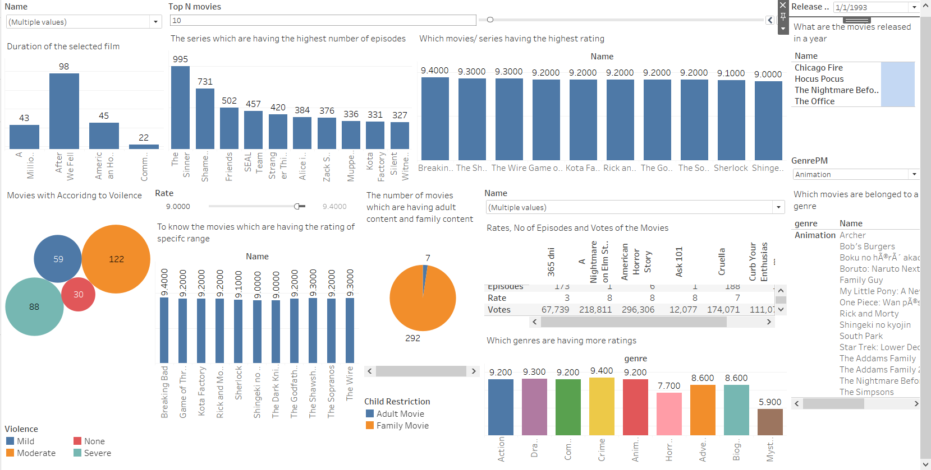
Dashboard

Slide 7
Dashboard Interactivity
In this dashboard there are many plots which we added interactivity.
We have created parameters which are listed below and used calculated fields to produce a new columns from the existing columns data.
Name: Gives drop down to select the movie name.
Rate: This enables user to select the rating using slider.
Top N Movies: To get the top movies which have the highest rating, and which are having the highest number of episodes.
Release Year: Gives a dropdown to select the year so that we can get to know what are the movies/series released that year.
Genre: Gives the dropdown of the genres, so the user can get the movies/series related to selected genre.

