Slide 1



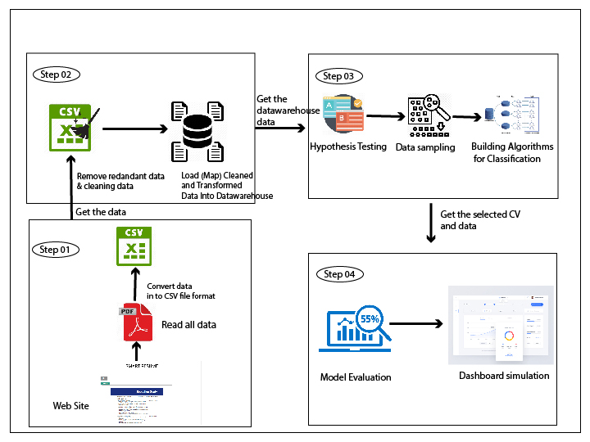
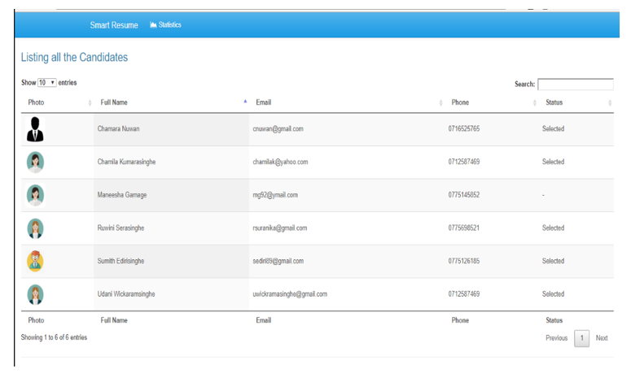
SMART RESUME
BUSINESS INTELLIGENCE TOOL FOR CV SELECTION
S.P. Senarath, Yureshani H.B.D, K.A. Madhushika, Y.I. Kodittuwakku
Sri Lanka Institute of Information Technology , Malabe , Sri Lanka
Research Problem and Objectives
Methodology
Smart Resume is a hybrid tool which is consisting with both web and desktop application parts.
BOT
Main goal of this part is to develop an intelligent boot. A bot (short for "robot") is an automated program that runs over the Internet will be implemented to do the following tasks.
Download CVs automatically
Read the downloaded CV’s.
Classify the data in CV.
Save the classified data in CSV format.
ETL
Extract Transform and Load tool to cleansing and store relevant data in the data base where the tool itself can access those data easily, to further analyze. Below are the main points to be covered here.
Extract the data in CSV file.
Clean them to reduce redundancies.
Load them in to the database in correct formats.
Predictive Model Building
This is the center or the key process of the whole idea. Here the predictive model is built using machine learning algorithms to satisfy the following tasks.
Get user requirements.
Generate the best candidate list according to the user requirement.
Model Evaluation and Dashboard Simulation
Main focus of this part is to deliver an accurate and a user friendly product which meets below key points.
Dashboard simulation of the generated results.
Evaluate the accuracy of the result.
Background and Literature
“Web Page Downloading and Classification” downloads Web pages using Microsofr ‘s Windows Internet API tool named Winlnet. It uses(AI) techniques; Breadth-First search algorithm, Constraint Satisfaction method. The Breadth-First. Those are then used to traverse the Web page’s links and identify the pages as abstract, full text, PDF or image files.[1]
In this article, it is expected that the reviews of some metrics to recognize the optimum solution will sensitize data mining. This article also suggests several important aspects in constructing a better metric for recognizing the optimal solution for the generative type of classification algorithms.[2]
System Diagram
Below is the pictorial representation of the system.
Step 1 : Internet BOT
Step 2 : ETL (Extract Transform Load) Tool
Step 3: Predictive Model
Step 4 : Evaluation and dashboard simulation
Results and Discussion
Develop the solution
As the result of “Smart Resume” it provides a better approach for automate the CV shortlisting process to a job vacancy in IT industry.
Ultimate goal of this tool is,
To come up with a solution to ease the shortlisting of the CVs from large number of
collection.
To minimize the time and the effort of the company.
To interview the best list of and recruit the most suitable ones for the
position.
To overcome the limitations which had in traditional manual process.
Step 1 : Use an internet BOT to download the CVs in PDF format and get the relevant data to CSV file.
Step 2 : ETL tool to extract data from the CSV, clean them and load into the database
Step 3: Make predictions by using the data taken from the database in predictive algorithms. (Shortlisting process)
Step 4 : Evaluate the accuracy of the predictive models and represent the prediction result in a dashboard in order to make it user friendly.
Conclusions
With the purpose of eliminating the human mistakes, time wastage and the huge effort of the company, we have implemented an automated system – Smart Resume, to shortlist the CVs which are applied for a job vacancy. This tool read all the CVs and write attributes into a csv file, relevant attributes are saved into a data warehouse after cleansing and the classification model generates the best candidate list using those data and user requirements. Finally, accuracy of that model calculates and the generated result is displayed on a web-based dashboard.
References
[1] L. Q. Tran, C. W. Moon, D. X. Le, and G. R. Thoma, “Web Page Downloading and Classification,” Proc. IEEE Symp. Comput. Med. Syst., pp. 321–326, 2001.
[2] H. M. and S. M.N., &amp;quot;A REVIEW ON EVALUATION METRICS FOR DATA CLASSIFICATION EVALUATIONS&amp;quot;, Pdfs.semanticscholar.org, 2015. [Online].

