Slide 1


Department of ECE
College of Engineering Guindy, Anna University, Chennai
EC23702 – MINI PROJECT
Review I
07/08/2026
Intelligent Battery Health Monitoring
and Predictive Management
Project Members:
Madhavshankar K (Reg. No.: 2023105023)
Ragul S (Reg. No.: 2023105041)
Akash Rajan R (Reg. No.: 2023105508)
Under the Guidance of:
Dr K Praveen
Assistant Professor (SI. Gr.)
Department of ECE
CEG Campus, Anna University

Slide 2

Layout
Introduction
Literature Review
Problem Statement
Objectives
Proposed Methodology
Results
Timeline
References

Slide 3
Introduction
Modern EVs rely on Li-ion battery packs that need continuous monitoring of voltage, current, and temperature to stay safe and efficient.
Commercial low cost BMS units only perform voltage/current monitoring, basic balancing, and overcharge/over-discharge protection.
These systems are reactive, they respond only after a fault (overheating, weak cell, leakage) has already occurred.
This project aims to make the BMS intelligent and predictive estimating SOC/SOH, predicting thermal rise and weak cells, and optimizing charging/cooling before problems occur.
Scope: sensing → filtering → state estimation → predictive fault diagnosis → adaptive control (cooling, balancing, charging) → cloud/mobile reporting.

Slide 4
Literature Review
Paper Title | Methodology | Inference
“Passive and Active Battery Balancing Comparison Based on MATLAB Simulation” - Daowd, Omar, Van Den Bossche, Van Mierlo (Vrije Universiteit Brussel) | Simulink comparison of passive (resistor-bleed) vs. active (charge-transfer) cell balancing circuits under simulated charge/discharge cycles. | Active balancing gives faster convergence and higher energy efficiency than passive balancing; passive is simpler but wastes energy as heat — guided our choice of adaptive active balancing.
“Improved BMS: A Smart Electric Vehicle Design Based on an Intelligent Battery Management System” - Bhuvaneswari et al., ICICT 2024 (IEEE) | Smart BMS architecture combining real-time sensing with intelligent control logic for improved monitoring and protection in EVs. | Confirms the shift from threshold-based protection to intelligent, sensor-fused decision-making as the key novelty gap in low-cost EV BMS.
“Hierarchical Energy Optimization Strategy and Its Integrated Reliable Battery Fault Management for Hybrid Hydraulic Electric Vehicle” - Kamal & Adouane | Hierarchical control strategy layering energy optimization with fault management for reliability in hybrid electric-hydraulic vehicles. | Supports a layered architecture (estimation → fault prediction → control) and reinforces the need for integrated fault management, not just isolated protection triggers.

Slide 5
Problem Statement
Existing low-cost EV BMS units only do voltage/current monitoring, basic balancing, and overcharge/over-discharge protection, they cannot predict failure before it happens.
P1 - Cell leakage is detected only after severe degradation; the owner is warned too
late.
P2 - Noisy sensor signals cause false SOC, temperature, and balancing readings.
P3 - Cooling systems run on fixed thresholds, wasting energy.
P4 - Battery aging is ignored during charging, every cell is charged identically.
P5 - No predictive maintenance, the owner has no idea which cell is weakening or
when replacement is needed.
P6 - Most student BMS projects skip thermal-runaway prevention, adaptive cooling,
and health/fault prediction entirely.

Slide 6
Objectives
01
Increase overall battery life
02
Prevent thermal runaway / explosion
03
Reduce energy loss in balancing
04
Detect weak cells early
05
Detect internal leakage
06
Optimize charging strategy
07
Enable adaptive cooling control
08
Improve overall system efficiency
09
Predict battery replacement need

Slide 7
Proposed Methodology
Battery Pack (Voltage / Current / Temp Sensors)
Predictive Thermal Model
(Temp-rise forecast)
Adaptive EKF Filtering
Adaptive Cooling & Charging Control
SOC / SOH Estimation
ML Fault Prediction
Leakage & Weak-Cell Detection
Cloud DB + Mobile App Notification

Slide 8
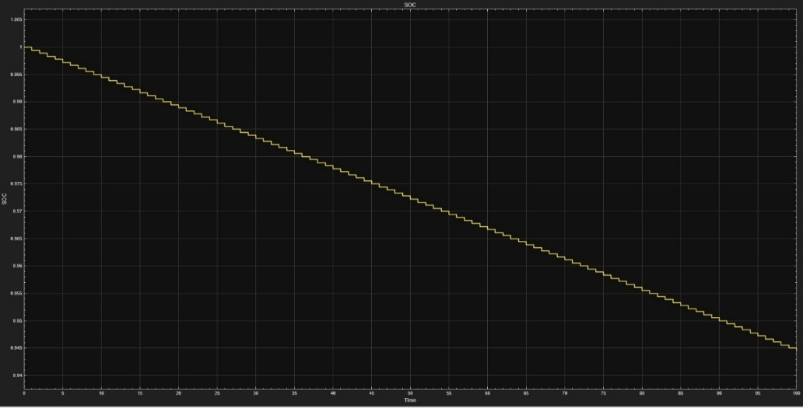
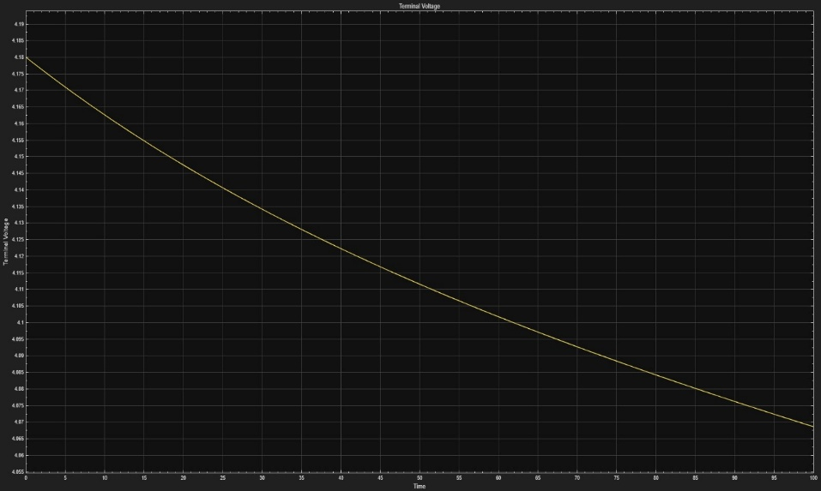
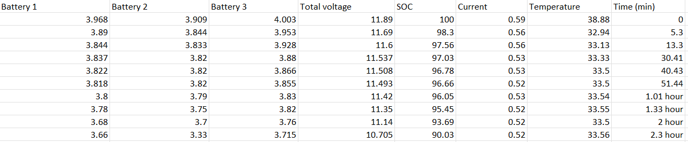
Current Status & Results
Simulink model of the Li-ion cell built and validated and electrical behavior replicated ideally in simulation.
Real-time hardware tests conducted: charge/discharge cycling of 2500 mAh Li-ion cells with a 12 V DC motor of 200 RPM as load.
SOC VS TIME PLOT
Lookup (LU) table generated from the test data, now being fed into Simulink to drive a real-time-matched simulation.
TERMINAL VOLTAGE VS TIME PLOT

Slide 9
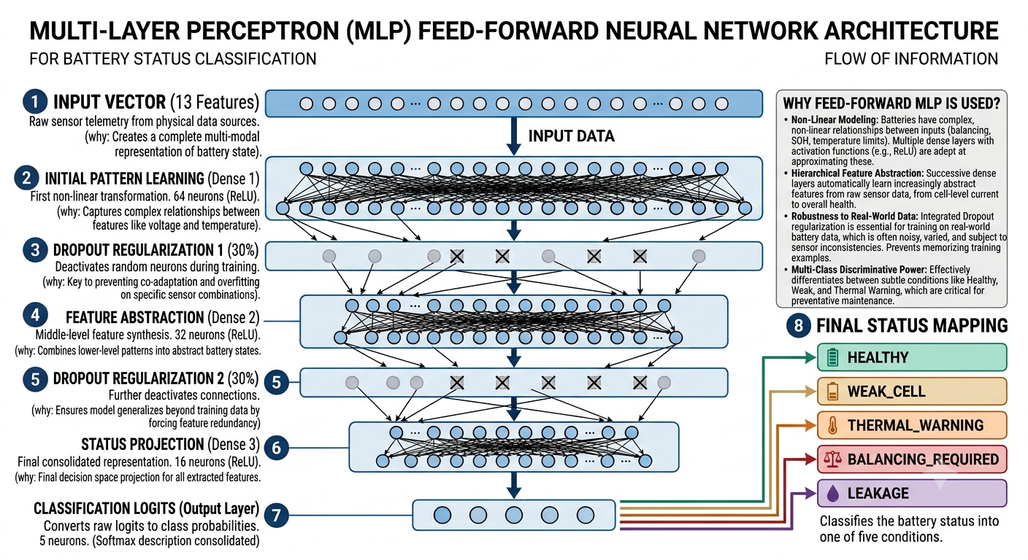
Current Status & Results

Slide 10
Timeline
Ph 1-2
Ph 3
Ph 4
Ph 5
Ph 6
Ph 7
Ph 8
Battery fundamental + literature survey
Simulink battery model (ideal)
Conduction of charge/
discharge tests + LU table
ML fault prediction models (temp/circuit/balancing)
Integrate ML model into Simulink
Coolant + balancing circuit design
Full-system testing
Done
Done
Done
Done
In Progress
Future
Future
Currently at Phase 6 -- real-time Simulink integration of the ML fault-prediction model.

Slide 11
References
[1] M. Daowd, N. Omar, P. Van Den Bossche, and J. Van Mierlo, "Passive and Active Battery Balancing Comparison Based on MATLAB Simulation," Vrije Universiteit Brussel & Erasmus University College Brussels, Belgium.
[2] S. Bhuvaneswari, "Improved BMS: A Smart Electric Vehicle Design based on an Intelligent Battery Management System," 2024 International Conference on Inventive Computation Technologies (ICICT), IEEE, DOI: 10.1109/ICICT60155.2024.10544810.
[3] E. Kamal and L. Adouane, "Hierarchical Energy Optimization Strategy and Its Integrated Reliable Battery Fault Management for Hybrid Hydraulic-Electric Vehicle."

