Slide 1

OpenCost
Understanding Kubernetes Cost Beyond Cloud Bills

Slide 2




Opencost and its Architecture
Opensource cost monitoring for kubernetes
Vendor-Neutral
Unified Cost Model
Multi-Cloud Support
Extensible Architecture
Flexible Deployment
Platform
Prometheus
Opencost API
Prometheus Querier
Aggregation + Filtering
Assets
Cloud Provider API
Allocations
SaaS Billing API
Querier
API/UI User
Cloud Costs
Metrics Emitter
Custom Costs
Cloud Cost Pipeline
OpenCost Plugins

Slide 3
Why This Matters: The day-2 cost problem
Day 2 Ops - Cost Management
Total Cost Visibility
Unit Economics for Engineers
Kubernetes Cost Model
CLUSTER
Resource Allocation Cost
CPU, GPU, Memory, Disk, LB
Resource Usage Cost
Egress, Cross Region/ Zone
Overhead Costs
Control plane costs
Licensing/Subscription costs
CONTAINER
CPU
Egress traffic
GPU
Cross Region traffic
MEMORY
Cross Zone traffic
DISK

Slide 4
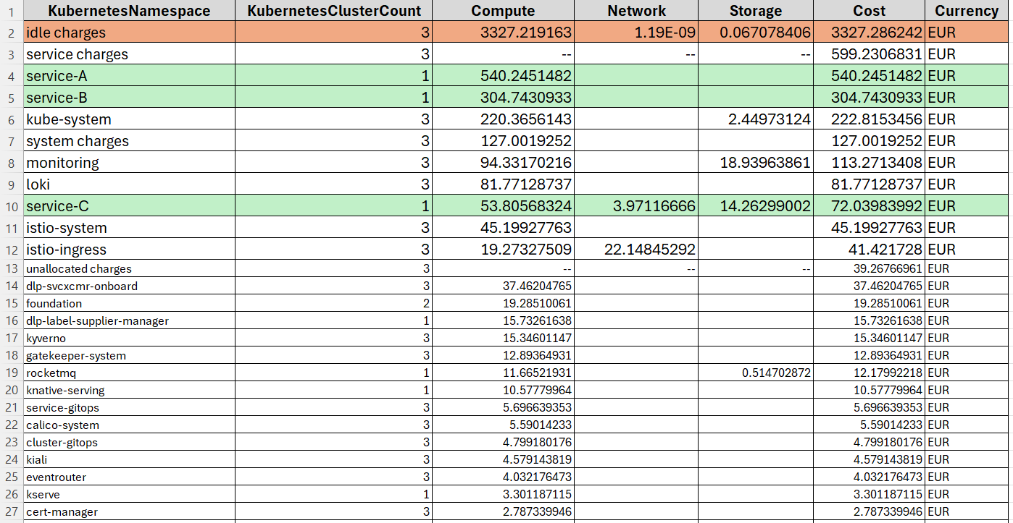

Why Adopt an OpenCost-Like Solution?

Slide 5


Opencost vs downstream vendors
Collaboration, not competition: A shared standard enabling diverse experiences
(Upstream)
(Downstream Vendors)
Open Standard
Core data model, spec-first API design, and community driven roadmap
Standard UX and Workflows
Tailored interface, SSO/RBAC, and enterprise specific team management
Reference Implementation
Neutral reference UI and collection pipeline for Allocations and Assets
Broader Observability
Advanced automation, anomaly detection, rightsizing
Unbiased Integration
Vendor-neutral base for cloud costs (AWS, Azure, GCP) and custom pricing
Commercial Support
SLAs, dedicated support channels, and guaranteed stability for enterprise

Slide 6
DEMO/Dashboard Walkthrough

Slide 7
Get involved with Opencost
https://opencost.io
Slack
https://slack.cncf.io/#opencost
GitHub
https://github.com/opencost/opencost
https://github.com/opencost/opencost-helm-chart
https://github.com/opencost/opencost-website
Docs
https://opencost.io/docs
LinkedIn
https://linkedin.com/showcase/opencost/

