Slide 1
வணக்கம் MAKKALAE!!
CHATBOT DEVELOPMENT USING RAG & VECTOR DATABASE
— with a kutty story —
Anand Sundaramoorthy SA · July 25, 2026 · Track 1
Notes:
Welcome everyone warmly in Tamil. Energy high. One line on what the talk is: a story about building a chatbot properly, with the math that makes it work.

Slide 2
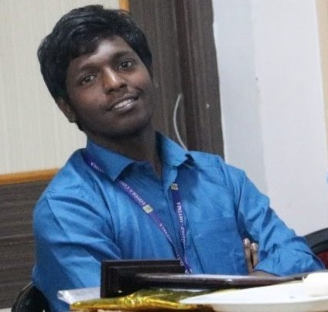
ABOUT ME!
• Developer & Builder from Chennai
• Tech & finance enthusiast
• Love building things — and releasing them as open source
• Ex- AI Intern, Full-Stack Dev & Project Manager @ DiffuseAI
• Ex-Business Development Manager @ Sparks AI
• Ex-Product & Automation Engineering Intern @ D2RAI Labs
• Ex-Freelancer
• And finally… MSc Data Science @ Loyola College
Notes:
40 seconds max. Land the open-source builder identity + experience arc, end on 'MSc Data Science at Loyola' — it sets up the story.

Slide 3
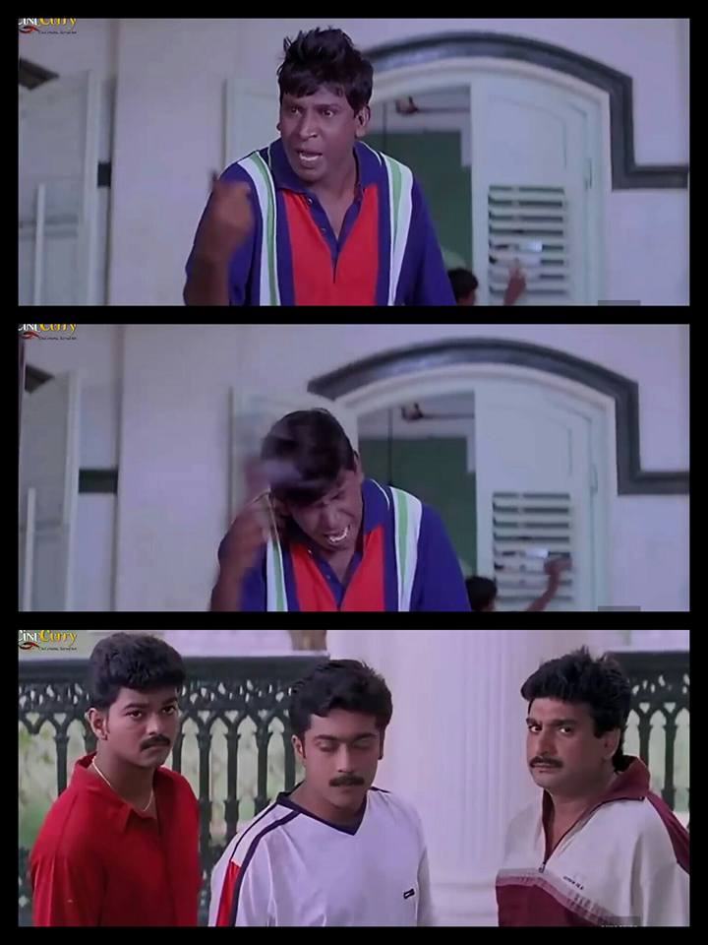
THE NEXT 40 MINUTES
1 story · konjam math · நிறைய memes
Notes:
Set expectations with a laugh. Promise: by the end they can build this themselves.

Slide 4
ADMISSION SEASON.
One helpdesk number. It rings every 30 seconds.
Notes:
Story mode ON. Slow down. Paint the admission-season chaos.

Slide 5
SAME 20 QUESTIONS × THOUSANDS OF PARENTS
• "What is the fee?"
• "Last date to apply?"
• "My daughter got 92%, which course?"
• "Hostel available aa?"
• "Application submit aagala, enna panrathu?"
Notes:
Everyone asks the SAME things. Humans answering them 500 times a day.

Slide 6

HELPDESK STAFF, CALL #500 OF THE DAY
Notes:
Beat of sympathy for helpdesk staff — that's the real problem worth solving.

Slide 7
“LLM இருக்கே!”
Just connect an API and go live… right?
Notes:
The naive idea every dev has first. Let the audience nod along.

Slide 8
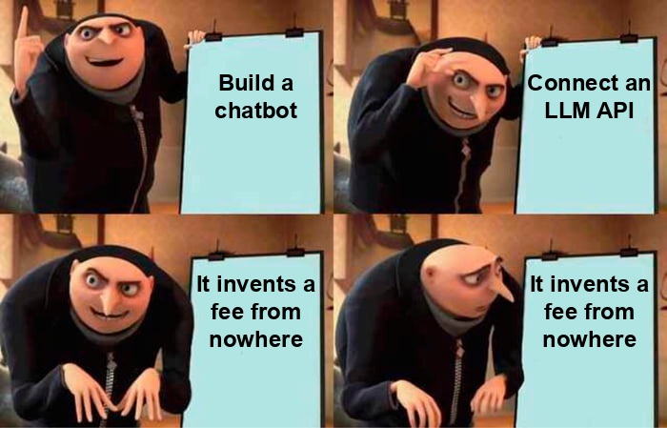
THE PLAN
Notes:
Punchline: hallucination. The bot answered with total confidence and total nonsense.

Slide 9
LLMs DON'T KNOW YOUR DATA
• Training data has a cutoff date
• It has never seen your documents
• It predicts the next likely token — not the truth
• Confidence ≠ correctness
Notes:
Why it hallucinated: the model never saw our documents. It predicts tokens, not truth.

Slide 10
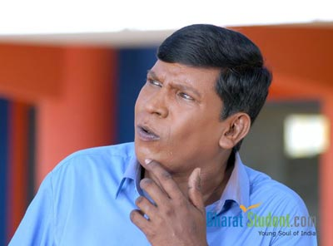
HOW DO I MAKE IT ANSWER FROM MY DOCUMENTS?
Notes:
The question that leads to RAG. Pause here.

Slide 11
RAG = OPEN-BOOK EXAM
Don't retrain the student. Hand them the right page at answer time.
Notes:
The one-line mental model. If they remember nothing else, remember this.

Slide 12
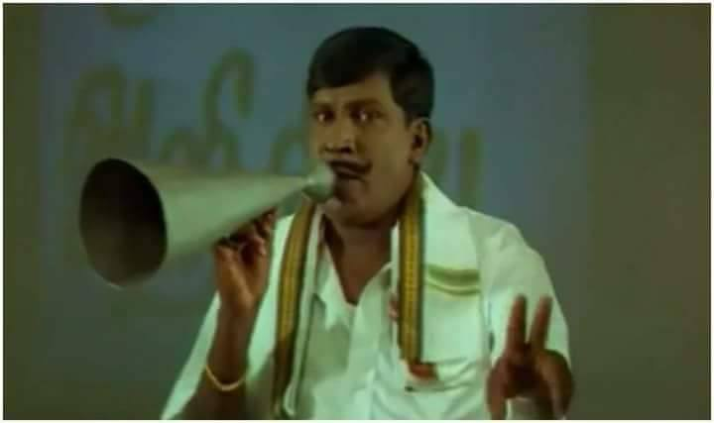
INTRODUCING… RAG!
Retrieval-Augmented Generation
Notes:
Megaphone moment. Name the technique AFTER the intuition.

Slide 13
EVERY RAG CHATBOT HAS 3 PHASES
INGEST
documents → chunks → vectors
RETRIEVE
find the right chunks for a question
GENERATE
LLM answers using ONLY those chunks
Offline, once per document update: INGEST · Online, every question: RETRIEVE + GENERATE
Notes:
The whole talk in one diagram. We'll zoom into each box. This diagram returns on slide 33 fully detailed.

Slide 14
PHASE 1: INGESTION
• Take your knowledge source — documents, website, FAQs, database
• Extract clean text (strip menus, headers, junk)
• Split into chunks — typically 500–1500 characters
• Keep 10–20% overlap so answers don't get cut at boundaries
Notes:
Generalize: ANY source works — docs, website, FAQ sheet, database export. Chunking numbers are typical ranges, not gospel.

Slide 15
WHAT IS AN EMBEDDING?
TEXT → [0.12, −0.98, 0.45, … ]
A vector of hundreds of numbers. Meaning becomes direction in space.
Each number = one learned feature. Individually they mean nothing to humans — the pattern of the whole vector carries the meaning.
Common sizes: 384 · 768 · 1536 dimensions, depending on the embedding model
Notes:
Embedding = text becomes a point in space. Similar meaning = nearby points. Stress: no single number is readable — a human can't decode 0.12; only the whole pattern (direction) carries meaning. Dims vary by model: 384, 768, 1536.

Slide 16
THE MEASUREMENT STEP: COSINE SIMILARITY
cos θ = (A · B) / (‖A‖ ‖B‖)
Same direction → similar meaning. “fee” ≈ “கட்டணம்” point the same way.
The encoder does the understanding — cosine only measures how close two directions are.
1.0 = same direction · 0 = unrelated · −1 = opposite · alternatives: dot product (normalized vectors), Euclidean distance
Notes:
Careful framing: semantic search = encoder (does the understanding) + measurement (compares directions). Cosine is only the measurement step. Alternatives exist: dot product (if normalized), Euclidean distance. 2D intuition: 'fee' and 'கட்டணம்' point the same way, zero shared letters.

Slide 17
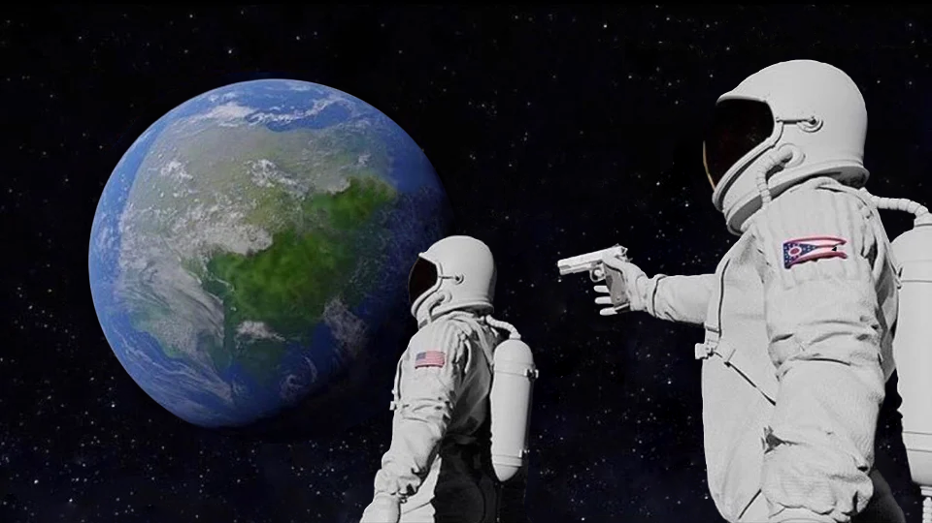
“WAIT, THE MEASUREMENT IS JUST ONE FORMULA?”
“Always has been.” (semantic search ≠ cosine — the encoder does the real magic)
Notes:
Demystify the measurement — but repeat the caveat: the encoder model is where the semantics live; cosine is just the ruler.

Slide 18
INGESTION = ONE LOOP
for chunk in chunks:
vector = embed(chunk) # hundreds of numbers
vectordb.upsert(id, vector, {"text": chunk})
any language · any provider · any vector DB
Notes:
The entire ingestion phase is one loop. Any language, any embedding provider, any vector DB — same three lines.

Slide 19
1 MILLION CHUNKS. NOW WHAT?
• Brute force: compare the query with every single vector
• Cost per query: O(N × d) — N vectors × d dimensions
• 1M chunks × 768 dims = ~768M multiplications per question
• And you pay it on EVERY question
Notes:
Brute force compares the query with EVERY stored vector. Fine at 1k chunks, brutal at 1M. Every query pays the full cost.

Slide 20
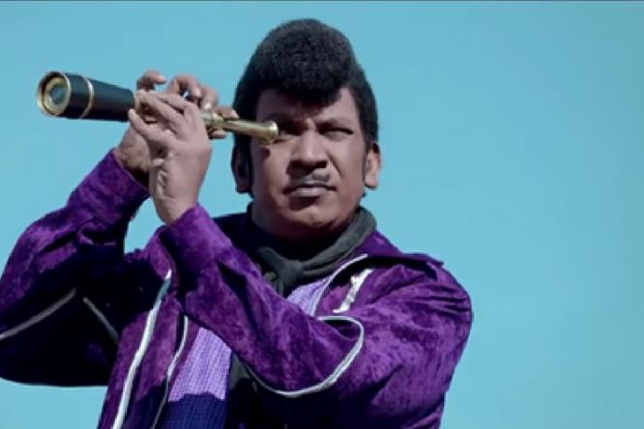
SEARCHING EVERY CHUNK, ONE BY ONE
Notes:
This is your for-loop at scale. There has to be a better way — ANN.

Slide 21
ANN: DON'T CHECK EVERYONE
Approximate Nearest Neighbour — ask the right neighborhood. Trade a little recall for a LOT of speed.
Notes:
Approximate Nearest Neighbour: give up perfect recall (~95-99% is typical), get orders of magnitude speed.

Slide 22
HNSW — LAYERED HIGHWAYS
Layer 2 — few nodes, LONG hops
Layer 1 — more nodes, medium hops
Layer 0 — ALL nodes, short precise hops
skip-list × graph → greedy descent → ~O(log N) · your vector DB implements this FOR you
Notes:
HNSW = skip list × graph. Top layers: few nodes, long jumps. Bottom layer: everyone. Greedy descent ≈ O(log N). Vector DBs run this for you — know what you're paying for.

Slide 23
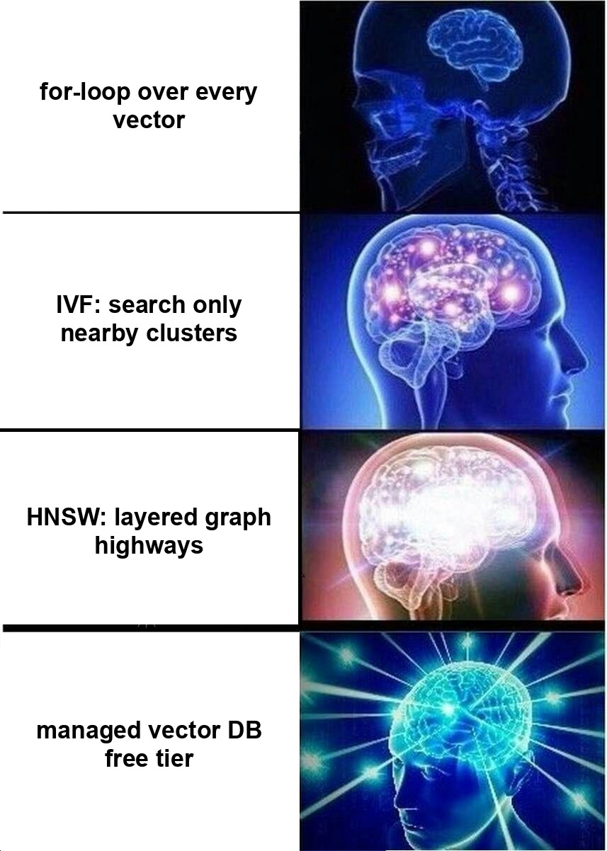
HOW DEVS SEARCH VECTORS
Notes:
Comic relief after the heaviest math. All four are valid at the right scale.

Slide 24
“CSIR NET EXEMPTION?”
Pure vector search returns… semantic mush.
Embeddings blur exact tokens — codes, IDs, acronyms, program names.
Notes:
Twist: embeddings BLUR exact tokens. Codes, IDs, acronyms melt into semantic mush. Real failure mode every RAG builder hits.

Slide 25
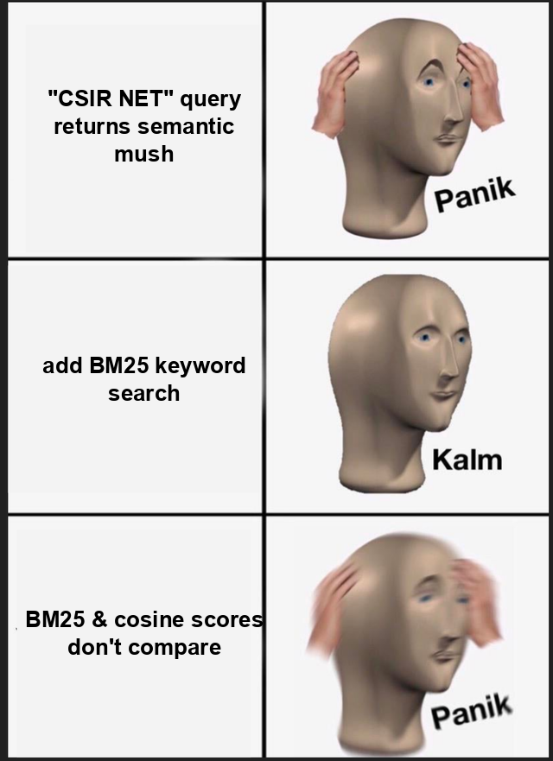
VECTORS: GREAT UNTIL THEY AREN'T
Notes:
Panels: exact codes fail (panik) → add BM25 (kalm) → scores don't compare (panik). That last panik sets up RRF two slides ahead.

Slide 26
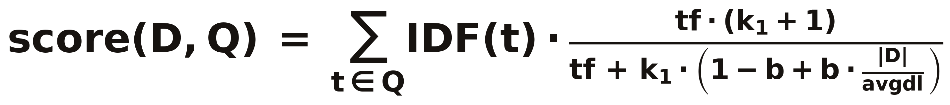
OLD IS GOLD: BM25
Rare words matter more (IDF) · repeating a word saturates (k₁) · long docs get normalized (b)
Standard defaults: k₁ ≈ 1.2–2.0, b ≈ 0.75 — they just work
Notes:
BM25: the classic keyword ranker from the 90s, still king for exact terms. Walk the fraction: IDF = rare words matter; numerator/denominator = term-frequency saturation via k1; b normalizes document length.

Slide 27
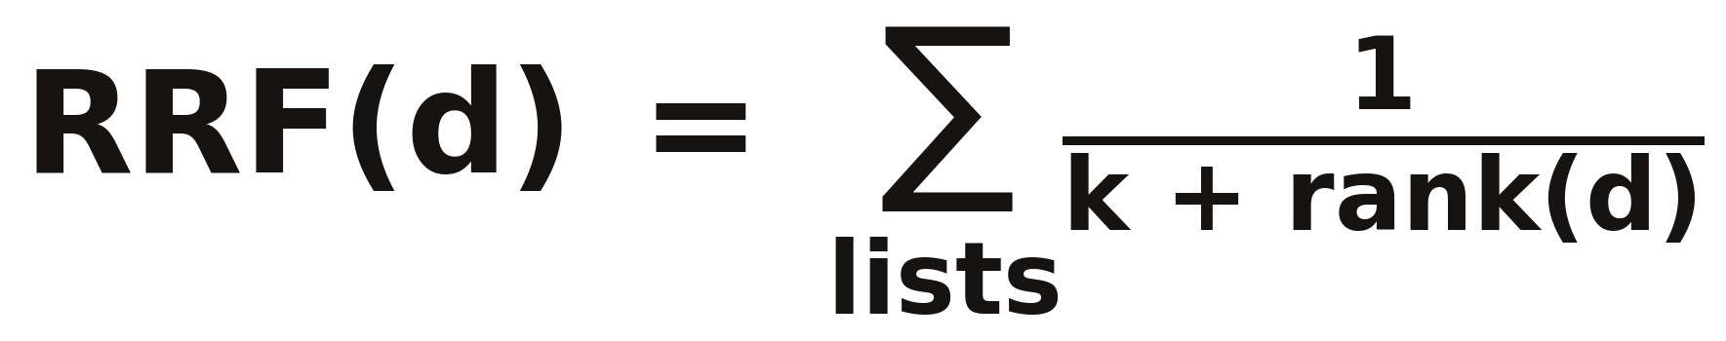
MERGE THE TWO LISTS: RRF
Each list votes 1/(k + rank) for its results — add the votes.
Only ranks are used, so BM25 and cosine scores never need comparing.
Reciprocal Rank Fusion · k = 60 by convention
Notes:
Two ranked lists, incompatible scores. RRF merges by RANK, not score — each list votes 1/(k+rank) for its results; add the votes. k=60 by convention.

Slide 28
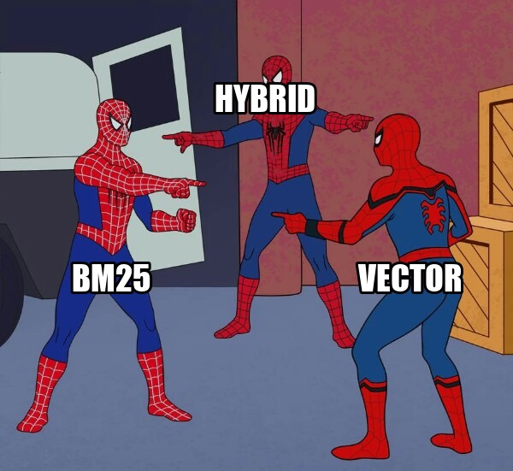
BM25 vs VECTOR vs HYBRID
Why not both, properly merged?
Notes:
Hybrid retrieval = the practical answer in production.

Slide 29
USERS ASK FOLLOW-UPS
• User: “Tell me about B.Com” → works fine
• User: “and the fee?” → retrieval gets garbage
• Fix: rewrite the query using conversation history
• “and the fee?” → “What is the fee for B.Com?”
Notes:
Users never ask self-contained questions. 'and the fee?' means nothing to retrieval. Fix: small LLM call rewrites it using chat history.

Slide 30

CACHE EVERYTHING
• Cache key: (language, rewritten query)
• Repeat questions answer in milliseconds, not seconds
• Zero LLM cost on cache hits
• Users ask the same 20 things — that IS the workload
Notes:
Same 20 questions = cache heaven. Cache key: language + rewritten query. Repeated answers return in milliseconds.

Slide 31

PROVIDERS WILL FAIL
• Primary LLM → fallback LLM → static FAQ → graceful error
• Different providers = independent quotas
• Timeout guards on stream start AND between chunks
• Degrade gracefully — never hang, never lie
Notes:
Every provider fails: quota, 5xx, stalls. Chain fallbacks; last resort is deterministic FAQ answers. Never show a spinner forever.

Slide 32
CAGE THE LLM
• Prompt-injection guard — before the LLM ever sees the message
• Rate limiting per user / IP — bots can't burn your quota
• Grounding rule: answer ONLY from the provided context — else say “I don't know”
• Scope rule: off-topic questions get politely redirected
Notes:
Guardrails: injection guard before the LLM, rate limits per user/IP, and hard grounding rules in the system prompt.

Slide 33
THE FULL PICTURE
USER
question
GUARD
injection + rate limit
CACHE
hit → done
REWRITE
history-aware query
HYBRID
BM25 + vector + RRF
LLM
grounded + failover
DOCUMENTS
your knowledge source
CHUNK + EMBED
offline, on every update
VECTOR DB
HNSW inside
Top lane: every question (online) · Bottom lane: every document update (offline)
Notes:
Everything assembled. Walk the request path left to right. This is the slide to photograph.

Slide 34
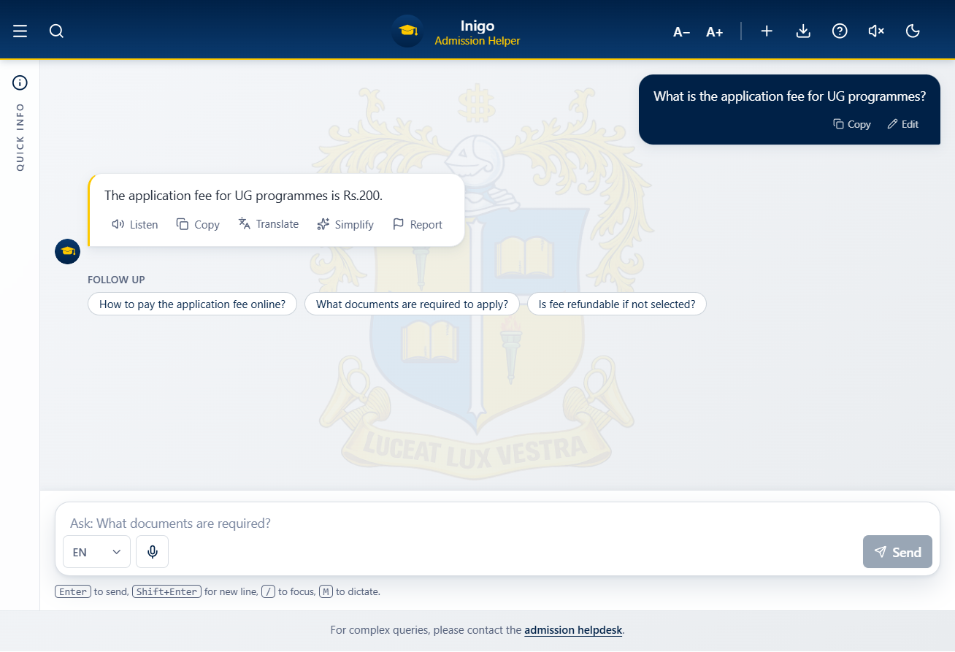
THE BOT FROM THE STORY: BOTINIGO.COM
தமிழ் or English or Hindi — same pipeline, language detected per message
Notes:
The bot from the story, live in production. Exact fee answer, grounded in the prospectus. Point out the follow-up chips and Translate/Simplify actions.

Slide 35
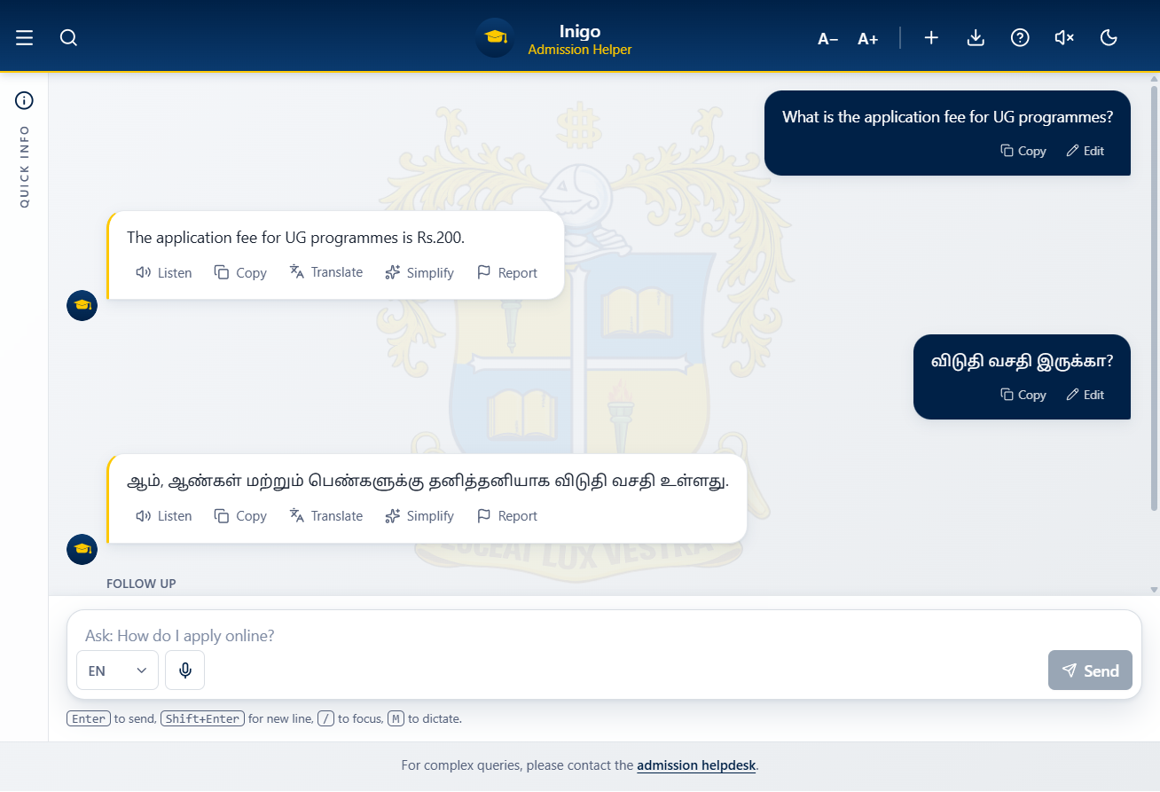
THE BOT FROM THE STORY: BOTINIGO.COM
தமிழ் or English or Hindi — same pipeline, language detected per message
Notes:
Same bot answering IN TAMIL — per-message language detection. No separate Tamil pipeline, same retrieval underneath.

Slide 36
BUILD YOUR OWN — THE RECIPE
1. Pick a knowledge source you actually care about
2. Extract text → chunk (500–1500 chars, 10–20% overlap)
3. Embed → any vector DB (free tiers everywhere)
4. Add keyword search (BM25) → merge with RRF
5. Cage the LLM: grounding rules + injection guard + rate limit
6. Cache answers · chain fallback providers
7. Ship → watch real questions → fix the gaps
Notes:
The empowerment slide: everything is OSS or free-tier. Anyone in this hall can ship one this weekend.

Slide 37
LESSONS FROM PRODUCTION
• Hybrid beats pure vector — exact terms need keyword search
• Ground everything — no context, no answer, no guessing
• Cache aggressively — real users repeat themselves
• Fail open, degrade gracefully — fallbacks over spinners
Notes:
Four honest lessons from running one in production. Slow down, these are earned.

Slide 38

PRESENTATION FINISHED!
Got any questions?
Notes:
Q&A opener. Keep energy up.

Slide 39


நன்றி! THANK YOU!!
linkedin.com/in/anandsundaramoorthysa
Anand Sundaramoorthy SA
Notes:
Namaste close. QR → LinkedIn. Invite people to connect and to try building their own bot this weekend.

