Slide 1

DISASTER RECOVERY
WITH
IBM VIRTUAL SERVERS.
(PART-2)

Slide 2

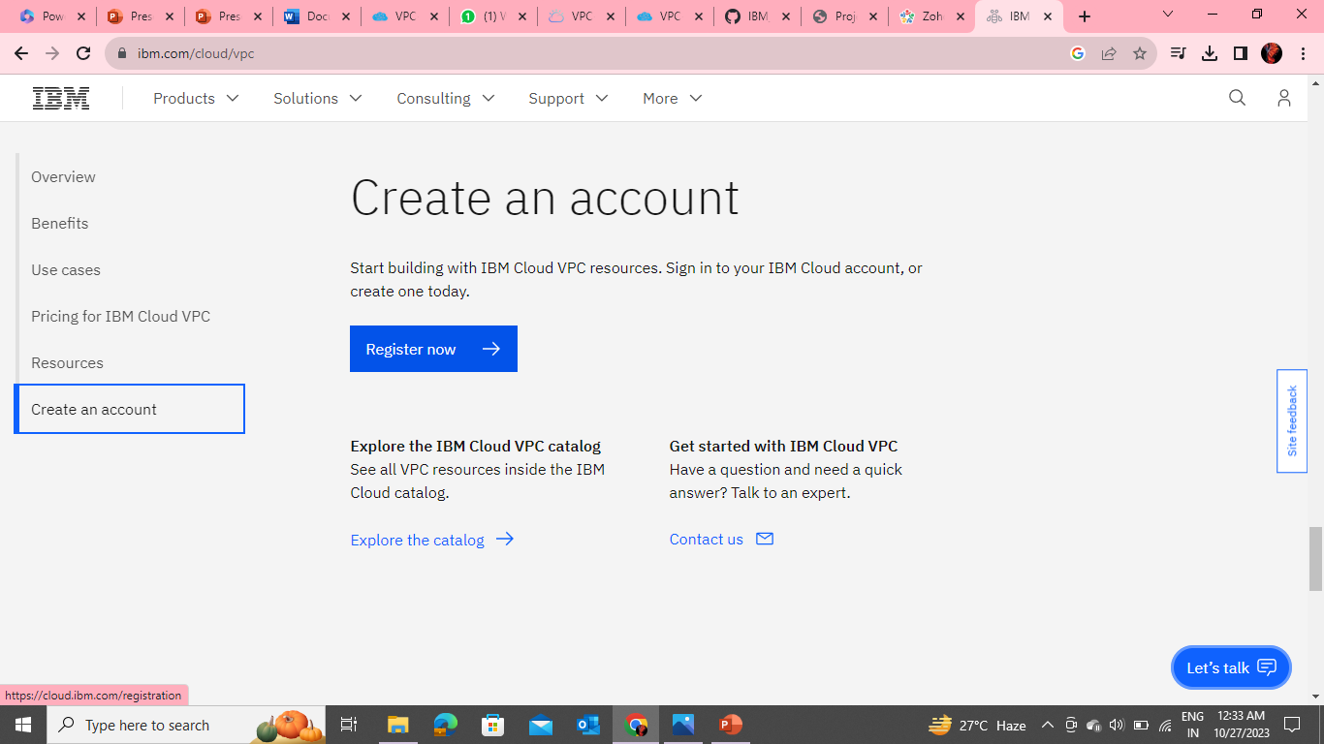
Creating Your Account In VPC:
To create your account on VPC+, follow these instructions
Visit https://vpc.wanclouds.net and Register an account.

Slide 3
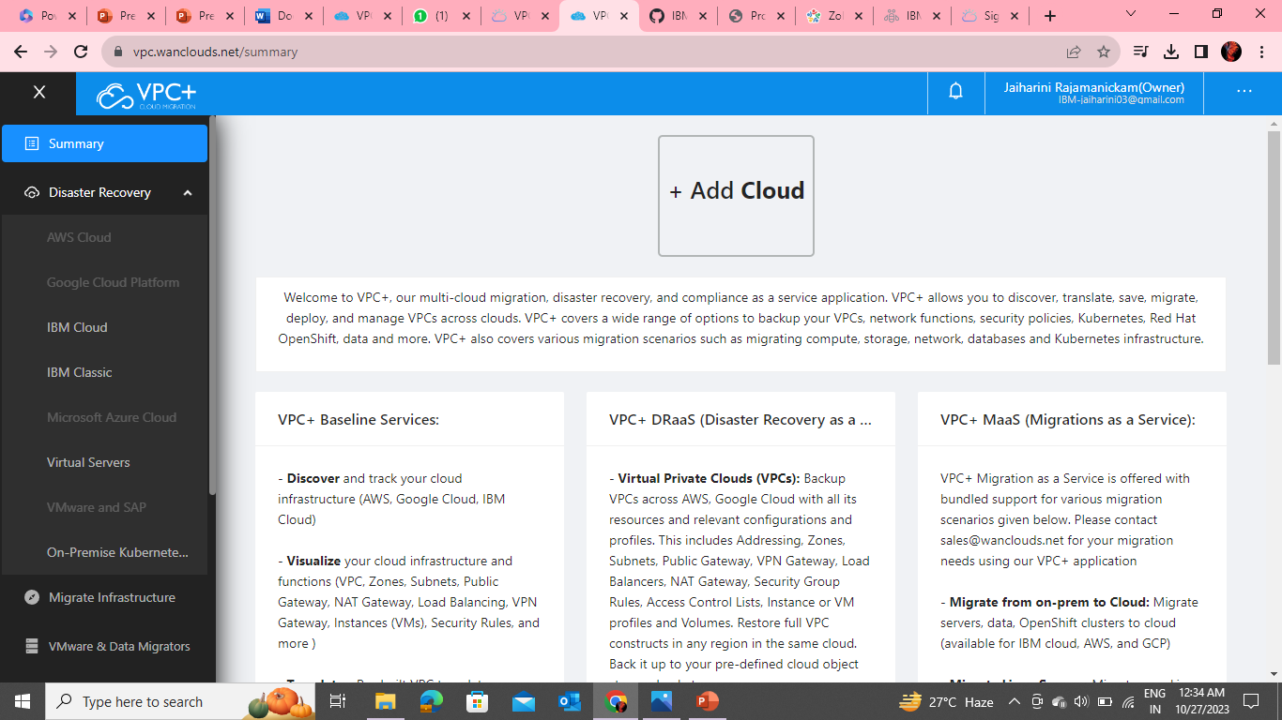
Confirm your email address and login to your newly created account on https://vpc.wanclouds.net
Once logged in, you will be able to add your cloud accounts and start using VPC+.

Slide 4
ADDING YOUR CLOUD ACCOUNTS
You must add a cloud account for VPC+ to be able to discover your existing environment.
Adding a cloud account on VPC+ will let you:
Discover your existing environment
Migrate it to your desired cloud
Manage it with the ability to add, delete or edit sections of your VPC

Slide 5
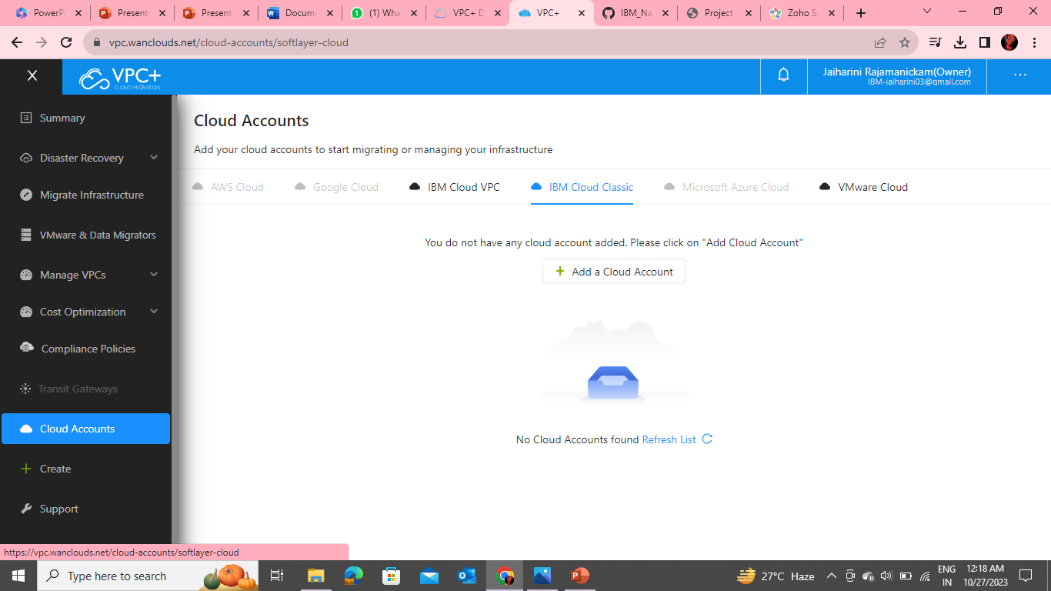
To add a cloud account, follow the instructions for each Cloud provider below:
IBM Cloud:
Navigate to the sidebar and click on Cloud Accounts.
Under the IBM Cloud Classic tab, click on Add Account to add your Cloud account.

Slide 6
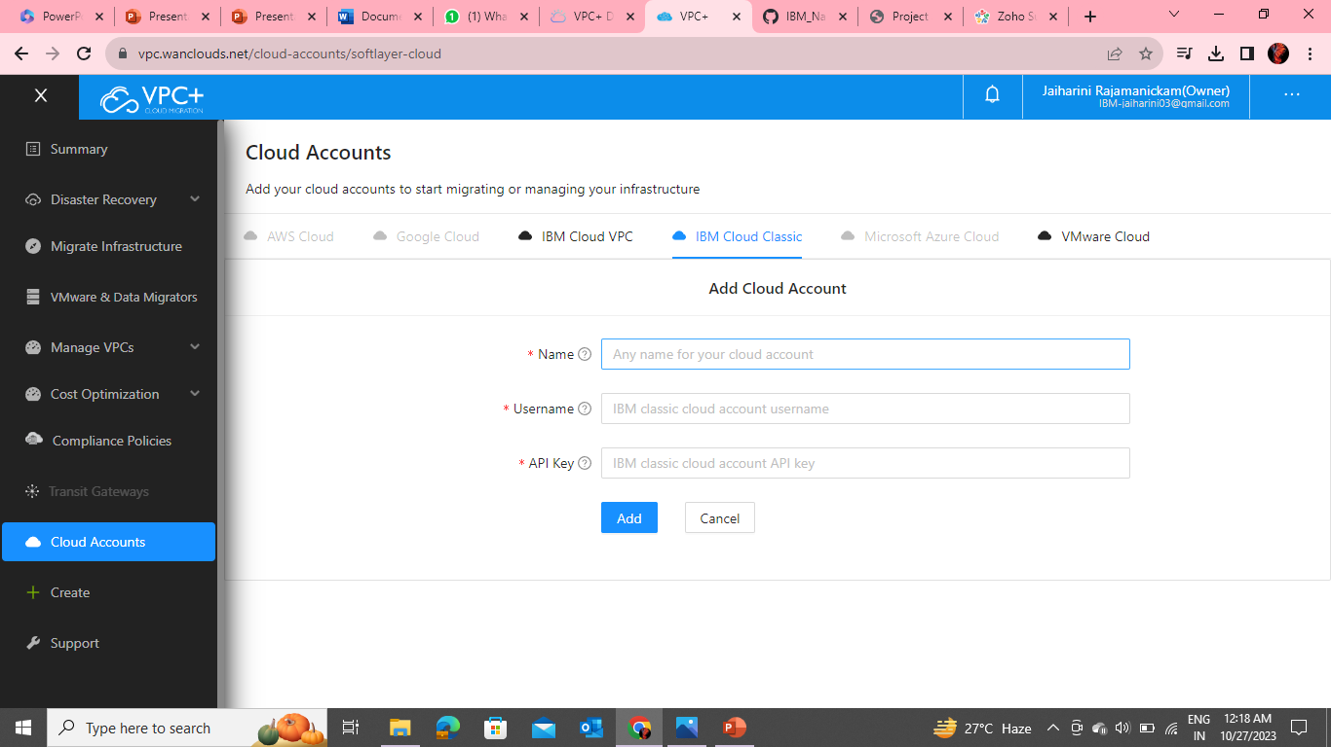
Give the account Name and enter the Username and API Key of your IBM Cloud classic infrastructure. This will be used to discover your current environment.

Slide 7
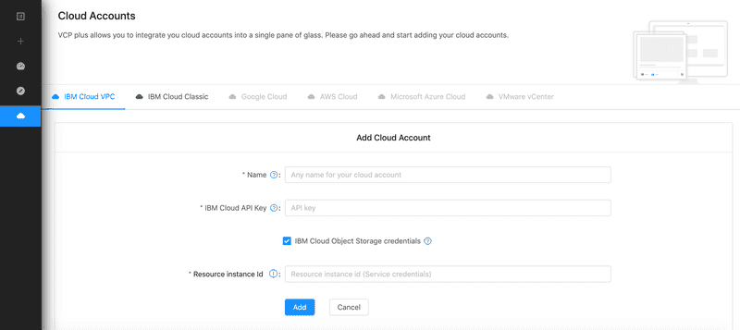
Under the tab, IBM Cloud VPC, add your VPC infrastructure API Key and your IBM Cloud Object Storage (COS) Resource Instance ID.

Slide 8
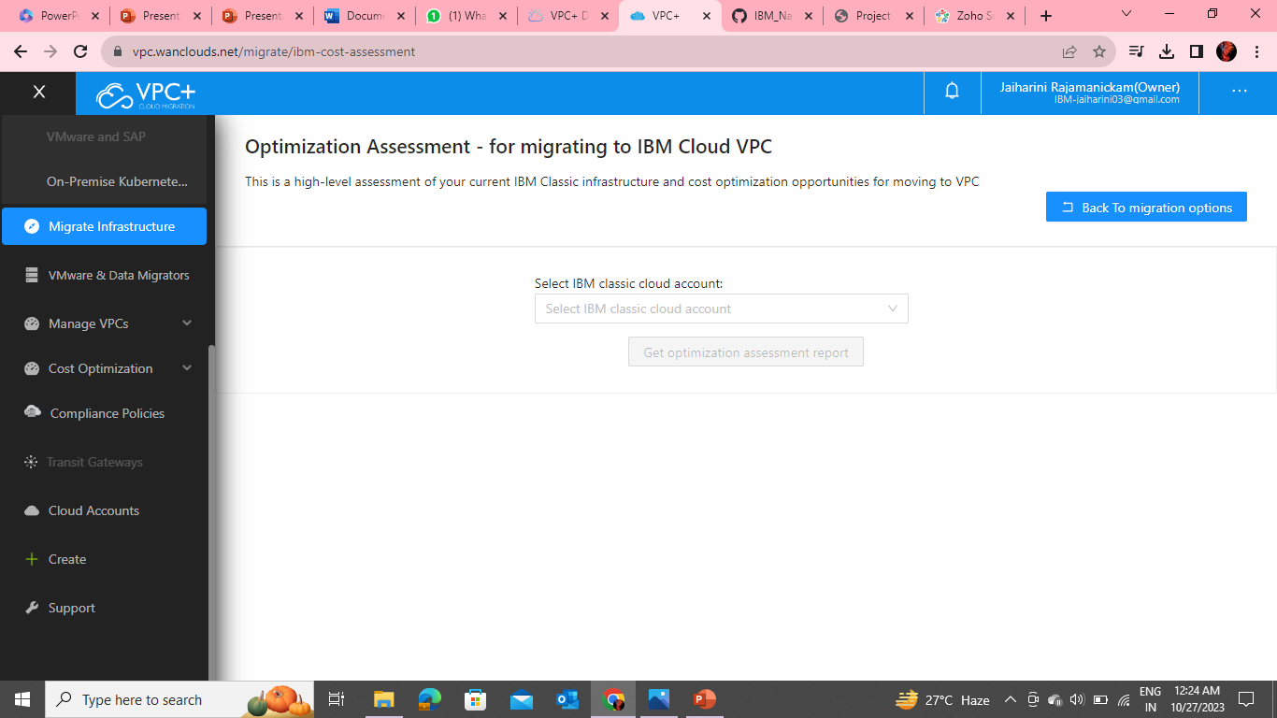
Your API key will be used to migrate from Classic Infrastructure to VPC Infrastructure and your IBM Cloud Object Storage (COS) Resource Instance ID will be used to migrate primary or secondary volumes of your Virtual Server Instances (VSIs).

Slide 9
Other cloud providers:
Navigate to the sidebar and click on Cloud Accounts.
Choose your cloud provider from the tabs.
Click on Add Account and enter the username and API key (you can get this information by logging into your respective Cloud account) to let VPC+ sync with your Cloud account.

Slide 10
What Resources can be
Backed up
and
Restored?

Slide 11
IBM Cloud Virtual Private Cloud(VPC):
With Wanclouds Inc DRaaS we can backup and restore our entire IBM Cloud Virtual Private Cloud construct, configurations and resources such as:
VPN Configuration
SSH Keys
NAT
CDN
Virtual Machines (VMs)
Public Gateway
Data Volumes
IKS/ROKS Clusters
VLANs and Subnets
Virtual Server Instances (VSIs)
Storage Volumes (primary and secondary)
Security Groups
IBM Cloud Load Balancers
Firewall (ACL) Configuration
Security Groups

Slide 12
IKS & OpenShift Clusters
With DRaaS you can also backup and restore your entire cluster such as IBM Cloud Managed Kubernetes clusters (IKS) and OpenShift Kubernetes Clusters including resources like:
Worker nodes
Worker pools
Services
Pods
Namespaces
Secrets
StatefulSets
DaemonSet
Deployments
ConfigMaps
Custom Resource Definitions
Persistent volumes

