Slide 1
Hariharasudhan V
Final Project
3/21/2024 Annual Review

Slide 2
PROJECT TITLE
Chat with PDF: Enhancing Document Understanding through Conversational AI
3/21/2024 Annual Review

Slide 3


AGENDA
Problem Statement
Project Overview
Who are the End Users?
Solution and Value Propositions
WOW factor in the solution
Modelling
Results
3/21/2024 Annual Review

Slide 4

PROBLEM STATEMENT
Many users face challenges in comprehensively understanding large PDF documents.
Extracting relevant information efficiently from such documents can be time-consuming and boring.
3/21/2024 Annual Review

Slide 5

PROJECT OVERVIEW
This project aims to streamline the process of understanding PDF documents by enabling users to engage in conversational queries about the content.
By integrating AI-powered tools, it seek to provide quick and accurate responses to user questions.
3/21/2024 Annual Review

Slide 6

WHO ARE THE END USERS?
Students and researchers requiring quick access to information from academic papers.
Professionals needing to extract data from lengthy reports or manuals.
Individuals seeking to understand complex documents without investing extensive time in reading.
3/21/2024 Annual Review

Slide 7

YOUR SOLUTION AND ITS VALUE PROPOSITION
Solution:
It leverages AI technologies to offer a user-friendly interface where individuals can upload PDF files and ask questions about their content. This approach significantly reduces the time and effort required to extract pertinent information from documents.
Value Proposition:
Time-saving: Quickly obtain answers from lengthy documents.
Accuracy: AI-driven responses ensure reliable information retrieval.
User-friendly: Intuitive interface suitable for non-technical users.
3/21/2024 Annual Review

Slide 8

THE WOW IN YOUR SOLUTION
Seamless Integration: The solution offers a user-friendly interface that facilitates easy upload of PDF documents and intuitive querying, ensuring a smooth and hassle-free user experience.
Conversational AI: Leveraging advanced natural language processing (NLP) techniques, the solution enables users to interact with the system in a conversational manner, allowing them to pose questions in natural language.
Real-time Responses: Instantaneous generation of answers from the document content. The system generates instantaneous responses to user queries by extracting relevant information directly from the document content, providing users with timely access to accurate information without delay.
3/21/2024 Annual Review

Slide 9
MODELLING
Text Extraction: The PyPDF2 library is utilized to extract textual content from PDF documents, enabling the conversion of PDF data into machine-readable text format.
Embeddings: Google Generative AI embeddings are employed to represent text data in a high-dimensional vector space, capturing semantic information and relationships between words and phrases.
Vector Storage: FAISS utilized for efficient storage and retrieval of text embeddings.
Conversational AI: Utilization of a ChatGoogleGenerativeAI model for question-answering tasks and it employs advanced natural language processing techniques to understand user queries and generate contextually relevant responses based on the provided document chunks.
3/21/2024 Annual Review

Slide 10
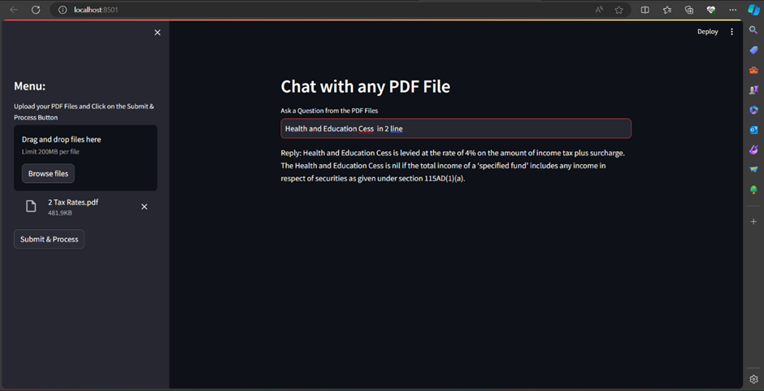
RESULTS
Demo Link
3/21/2024 Annual Review

