Slide 1

GCD Program EDA Project
Breast_cancer_survival Dataset Study and Analysis
By
Hariharen LMG
Mar’19 batch

Slide 2
Dataset Information
Survey was conducted between 1958 and 1969 at the University of Chicago's Billings Hospital on the survival of patients who had undergone surgery for breast cancer with following four attributes
1. Age of patient at time of operation (numerical) 2. Patient's year of operation (year - 1900, numerical) 3. Number of positive axillary nodes detected (numerical) 4. Survival status (class attribute) -- 1 = the patient survived 5 years or longer -- 2 = the patient died within 5 year
Rows = 306 & Columns = 4 attributes
All values are filled and no null values found

Slide 3
Problem statement
To understand and Identify the pattern of Breast Cancer patients for survival more than 5 years from the available dataset

Slide 4
Profiling Observation
History of Patient Age is ranging from 30 to 83
17 duplicated rows (different patients in the same year may observed with similar behaviour)
Zero missing data
44% (136 out of 306 ) of the patients were not detected for any positive axillary nodes
73.5% (225 out of 306 ) of the patients have survived for 5 years and longer

Slide 5
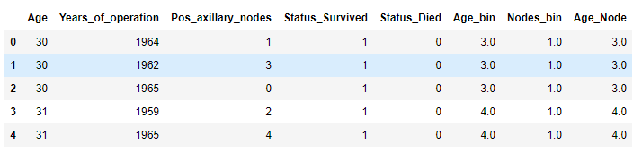
Temporary DataFrame
Following changes done in the Temporary dataframe
Years_of_operation – modified as per actual year
Status_Survived and Status_Died labels created for ease calculation and analysis
Age_bin & Nodes_bin columns created for group analysis
Age_Node column derived by multiplying the Age bin & Node bin to understand the effect of both put together

Slide 6
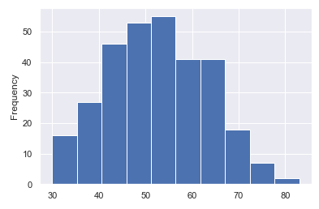
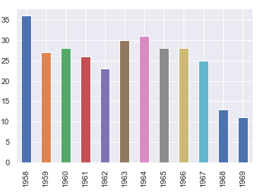
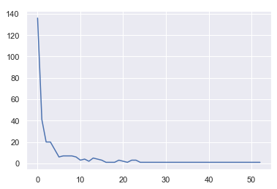
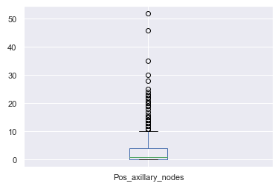
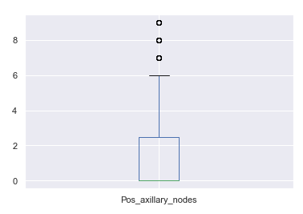
Variable distribution
Age Histogram : Density high between 40 & 70 (82%)
Patients count Year wise bar chart : Reduced to 30% in tail compared to 1958
Nodes line/box chart : 44% of the cases were detected zero +ve axillary nodes
& 87% of the patients are notices <=10 +ve axillary nodes

Slide 7
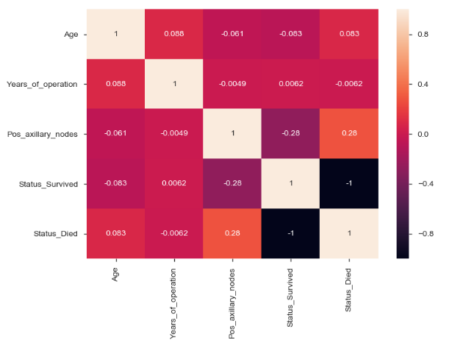
Correlation analysis
Heatmap: The small -ve correlation observed between positive axillary nodes and Survival >5 years

Slide 8
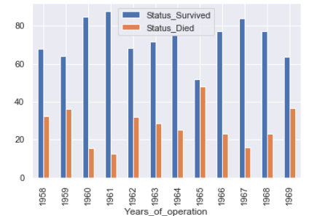
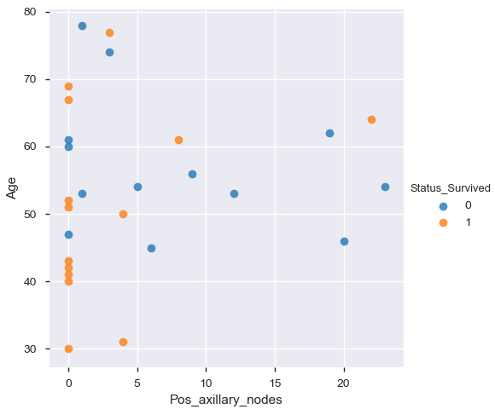
Analysis w.r.t. Years
Year wise Percentage of Survival >5 yrs
Years_of_operation = 1965
%
In all years the survival >5 years is 64% except in 1965.
Further checking 1965 data, we can see the patients with <5 +ve axillary nodes and Age <=52 have high probability to survive more than 5 years

Slide 9
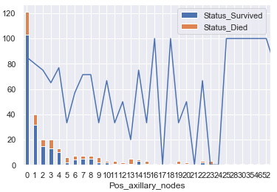
Analysis w.r.t. Nodes
As Positive axillary nodes increases, the probability for survival more than 5 years reduces.
Positive axillary nodes wise Count & Percentage of Survival >5 yrs

Slide 10
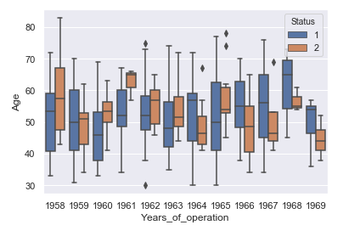
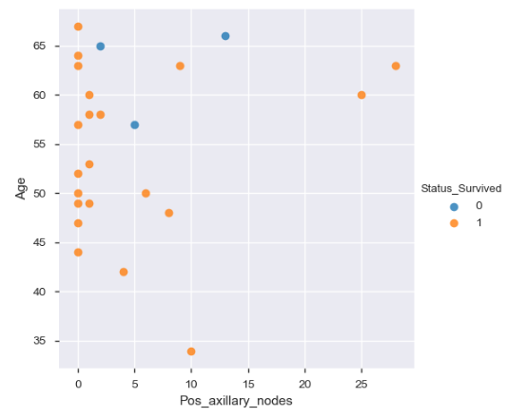
Age Vs Years pattern
Years_of_operation = 1961
1961 year box plot has no overlapping . On further analysis, Patients noticed with following combination have high probability to survive >5 years
<5 +ve nodes and Age <64 years
>5 & <=10 +ve nodes and Age <52 yrs

Slide 11
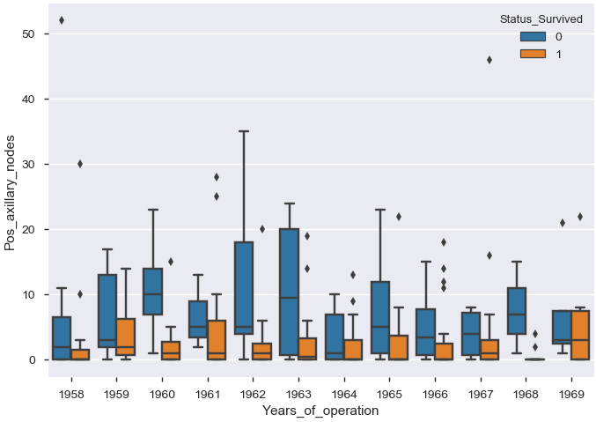
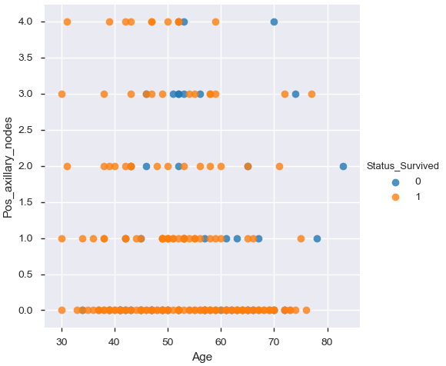
Nodes Vs Years pattern
Pos_axillary_nodes <5
From the box plot it is very clear that the patients detected with lesser no. of +ve nodes (say <5 nodes) have high probability for survival >5 years.
81% of the patients who detected with <5 +ve axillary nodes have survived more than 5 years

Slide 12
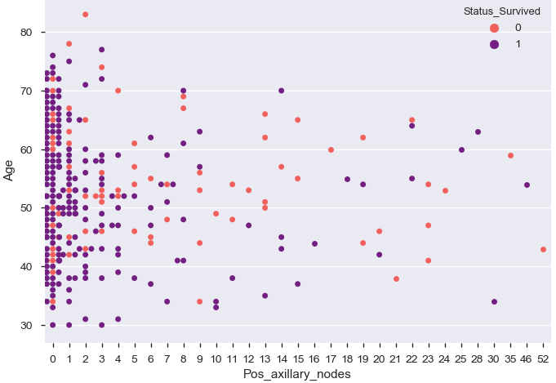
Nodes Vs Age pattern
From the swarm plot, it seems that as the +ve axillary nodes increase, the Patient Age decreases for the survival >5 years and vice versa..

Slide 13
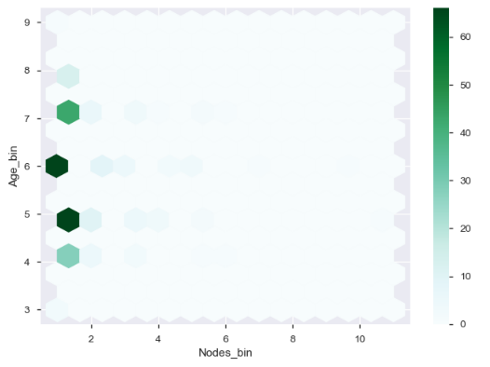
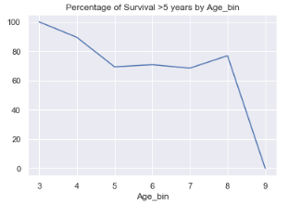
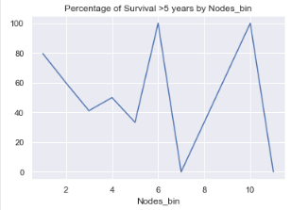
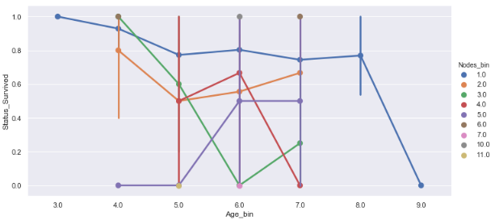
Segmenting Age & Nodes
%
%
Most of the population lies in Nodes_bin 1,2 and in Age_bin 4, 5, 6, 7, 8 which is 85% (246) out of 289 patients (of which survival >5 yrs is 77%)
As Age or +ve axillary node increases, the probability decreases
In general, Nodes_bin 1 & 2 have higher probability of survival >5 yrs (77%)

Slide 14
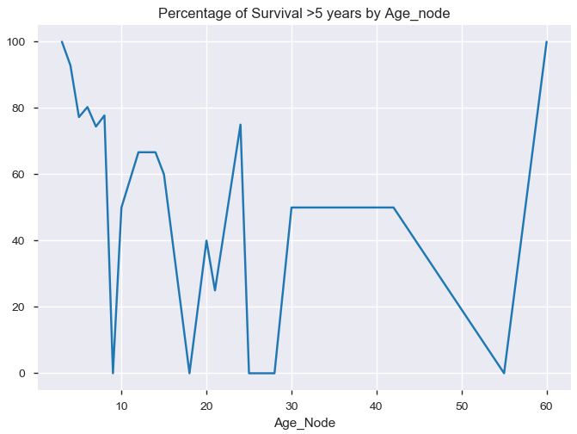
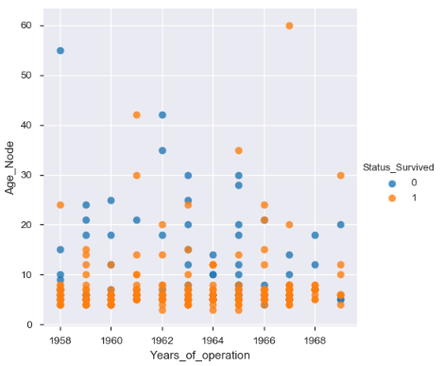
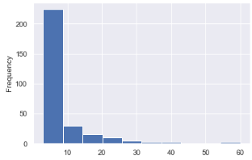
Analysis Age_Node
Age_Node Histogram :
Density high for <10 (78%)
Age_Node Vs Survival>5 yrs
Age_Node Vs Years
%
Similar scenario observed that as Age_Node increases, the probability decreases for the survival >5 years. And the above calculation says clearly that Age_Node <10 have high probability for survival >5 years which is about 80%
This again confirms either Aged patients or patients with high no. of positive axillary nodes will have very less chance to survive >5 years.

Slide 15
Conclusion
No. of cases reported with Breast Cancer have reduced as awareness increases
Cases identified at earlier stage with less positive axillary nodes have more chances for survival >5 years.
81% of patients survived more than 5 years who are detected with less than 5 no. of +ve axillary nodes.
When +ve axillary nodes detected is >=5 (Age plays a role), lesser the Age have better probability for the patients to survive more than 5 years.
The criticality increases and probability decreases as the Age and the no. of +ve axillary nodes detected are increasing

Slide 16
Thankyou

