Slide 1
Global AI Summit 2024, Hyderabad
MATHack 2.0
Automated Vehicle and Property Insurance
Team Name: Digital Eye
Members: Harsini A B - harsiniab22it@psnacet.edu.in
Harinee P - harineep22it@psnacet.edu.in
Dharun M - dharunm22it@psnacet.edu.in
DeepaLakshmi G - tharshnedeepa2004@gmail.com
Hariharan E - hariharane22it@psnacet.edu.in
Date: 10.08.2024

Slide 2

The Problem
Stakeholders
Manual claims processing is slow, error-prone, and costly
Time-consuming inspections
Human error in damage assessment
Susceptibility to fraudulent claims
Insurance companies
Policyholders
Repair shops
Fraud investigators

Slide 3

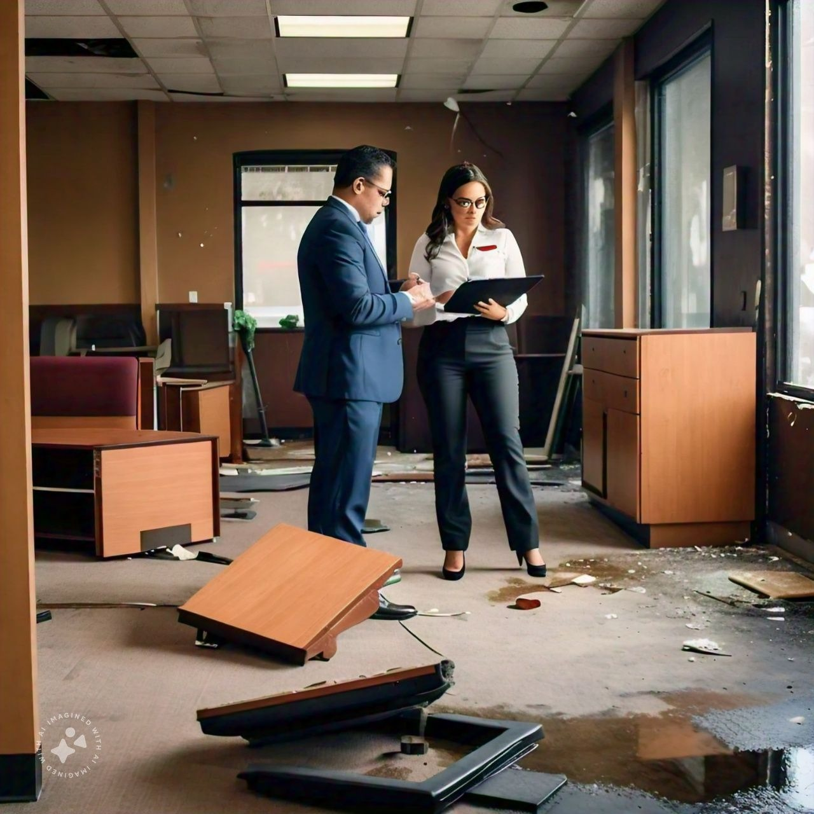
How it works today
Manual inspections:
Adjusters visit the damage site
Document damage through photos and reports
Time-consuming and subjective
Telematics:
Vehicle data for accident reconstruction
Limited to vehicle claims
No visual assessment of damage
Third-party inspection services:
Outsourced inspections
Can be costly and time-consuming

Slide 4
Market size
Unique Selling Proposition (USP):
Context: The global property and vehicle insurance market is substantial.
Statistics: In 2020, the global property and vehicle insurance market was valued at approximately $1.6 trillion. The market is expected to grow due to increasing urbanization, natural disasters, road accidents and property ownership.
Efficiency: Faster claim resolution due to automation.
Accuracy: AI-driven assessments are consistent and data-driven.
Enhanced Customer Experience: Prompt responses and accurate damage assessments.

Slide 5
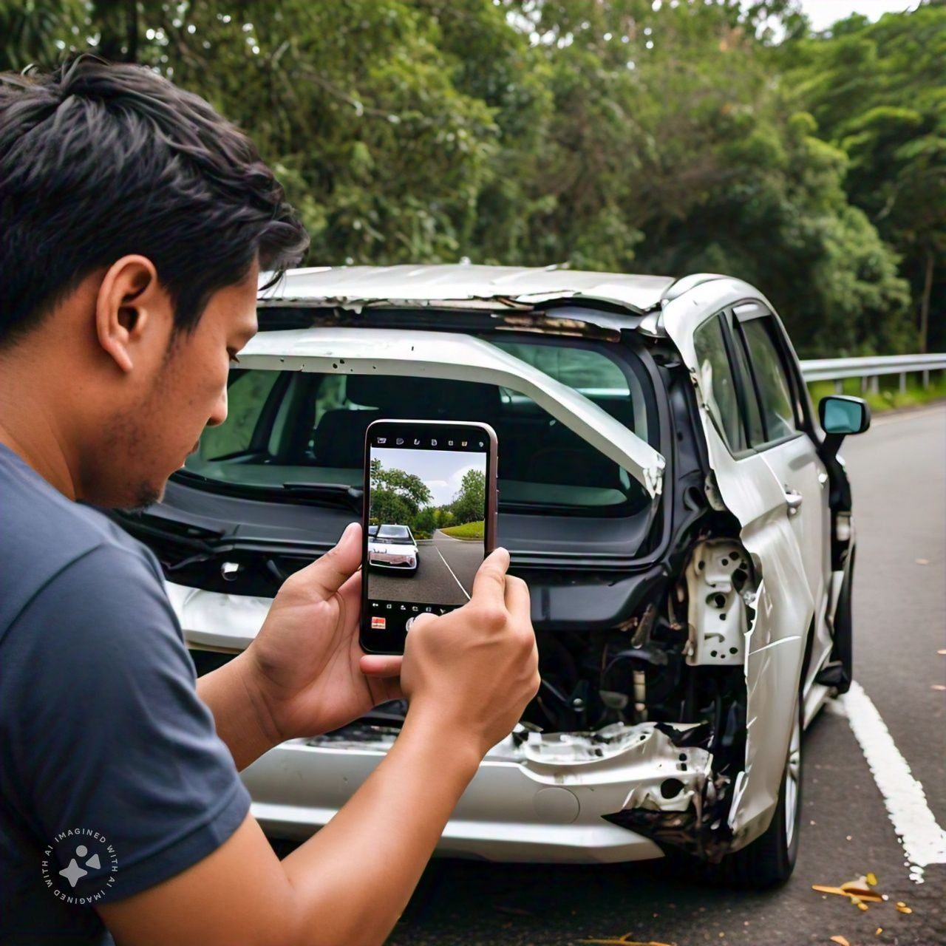
Our Solution
AI-powered damage assessment platform:
Analyze images and videos of damaged property and vehicles
Accurately identify and quantify damage
Estimate repair costs
Detect potential fraud
Benefits:
Speed and accuracy
Cost reduction
Improved customer experience
Fraud prevention

Slide 6
User selects image or video of damaged property/vehicle and uploads media to the application.
Application processes uploaded media. Damage detection, severity assessment, and classification occurs
Machine learning model predicts repair costs based on damage extent. Historical data informs cost estimation.
Application integrates with insurance company's claims management system. Automated claim processing occurs
Insurance company reviews claim and report. Claim approved or rejected
User receives notification of claim status and views claim details and next steps
How it works
Image/video capture:
Policyholders capture images and videos using smartphones or drones
Cloud-based platform:
Image/video processing and analysis
AI models for damage assessment and cost estimation
Data storage and management
Integration:
Seamless integration with insurance systems

Slide 7
Advantages
Tech Architecture
Speed and accuracy: Faster and more precise damage assessment than manual methods
Cost reduction: Streamlined process reduces operational costs
Improved customer experience: Faster claim settlements and reduced paperwork
Fraud prevention: Proactive identification of suspicious claims.
Components:
Computer vision models (CNNs)
Machine learning algorithms
Blockchain for tamper-proof timestamps
Workflow automation
Integration:
User-friendly interface for image capture
External databases for cost refinement

Slide 8
Call to action
Implementation: Collaborate with insurers to pilot the solution
Feedback Loop: Continuously improve the model based on real-world data
Competitive Edge: Position insurance companies as tech-forward and customer-centric.

