Slide 1

Trading Simulation Game
Arminas, Callum, Harik, Pal

Slide 2
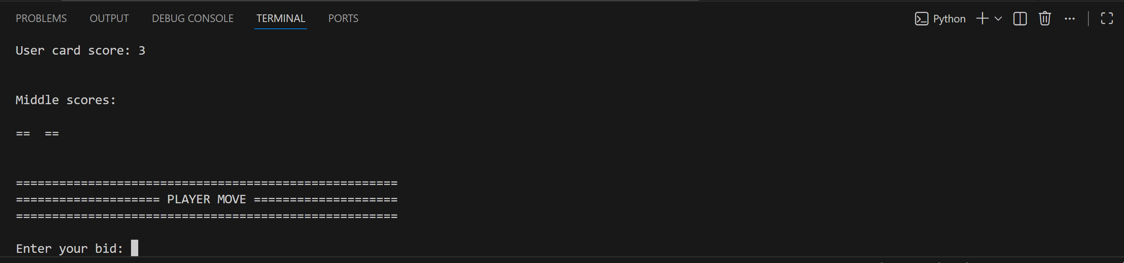
Introduction
We simulate the game we played in week 1
We act as the market maker for other players who are 'optimal', 'suboptimal' and 'insider' traders.
Notes:
This project is a game that involves market making against a certain number of players who are all playing the game from the first session of this bootcamp.
The players are made up of optimal players, who calculate the expected value and trade based on this; sub optimal players whose EV calculation is subject to some random noise; and insider traders who know information in advance.
The goal is to maximise profit at the end of it.
As many of you know from when we played this game, the score in the middle is very dependent on individual cards, and thus hedging your position is very important to not be exposed to this risk.

Slide 3
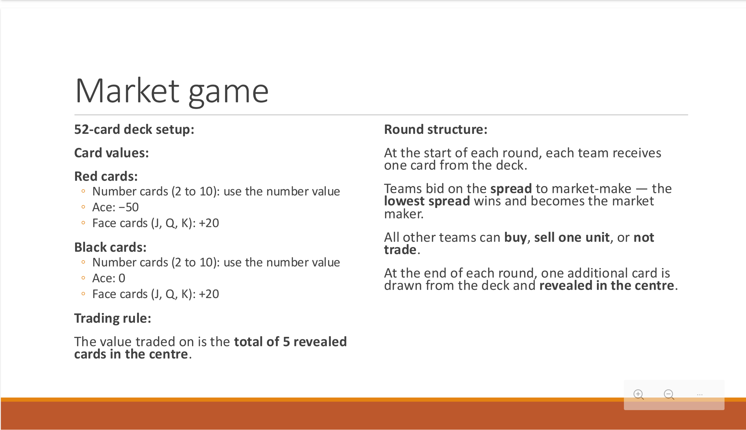
Comparison to original game
Notes:
Here are the rules of the game. In this version however, the number of rounds (number of cards in the middle) is a variable. Also, it is possible to have more than 1 deck, and this is also a variable that can be changed by the user.
Also, no trader is forced to trade, which prevents the strategy of having a very large spread and profiting that way.

Slide 4
Simulation observations
Most profitable with sub-optimal players
Essentially 50-50 when playing against suboptimal players
Virtually impossible to win long term against insider players
Knowing the ratio optimal : sub-optimal : insider effects how we play the game
Knowing number of insiders gives us an edge over optimal players
Notes:
There are many different strategies, and each has their advantages and disadvantages. The issue with a large spread is that nobody trades, which then prevents you from making any material profit. Having a small spread firstly means your profit per 2 opposing trades is quite low. It also means that you could have a non zero delta, because the traders may have a different idea of what the expected value is.
Furthermore, you may aim to make the spread asymmetric on purpose in order to move towards a hedged position.

Slide 5
DEMO

Slide 6
Extension Ideas
Use skewed distributions for sub-optimal players to model market sentiments
Simulations in which the ratio of player types is unknown to the user
Noise in the sub optimal player decisions being a variable, not just a constant

