Slide 1
LEARNING MANAGEMENT SYSTEM
D.PRANATHI -20RH1A1245
D.PRAVALIKA- 20RH1A1246
G.HARIKA-20RH1A1250

Slide 2
ABSTRACT
Online learning allows students to have greater control over their learning process in terms of time and place. However, students often experience unwanted negative emotions due to the lack of emotional support while interacting with online learning content.
Learning Management System needs to be an intelligent and modern solution. This is because, for a platform to see high user adoption, people have to like using it. Audiences take most naturally to an LMS when it adopts modern solutions that people are used to working with.

Slide 3
OBJECTIVE
The main objective of Learning Management Systems is to enhance the learning process. A Learning Management System not only delivers content, but also handles registering courses, course administration, skill gap analysis, tracking, and reporting.
Most LMSs are web based and are used in various educational institutes and companies to improve classroom teaching, learning methodology, and company records. They are used in various industries and scenarios like in financial services, compliance training, computer based training, online assessment, collaborative learning, application sharing, and so on.

Slide 4
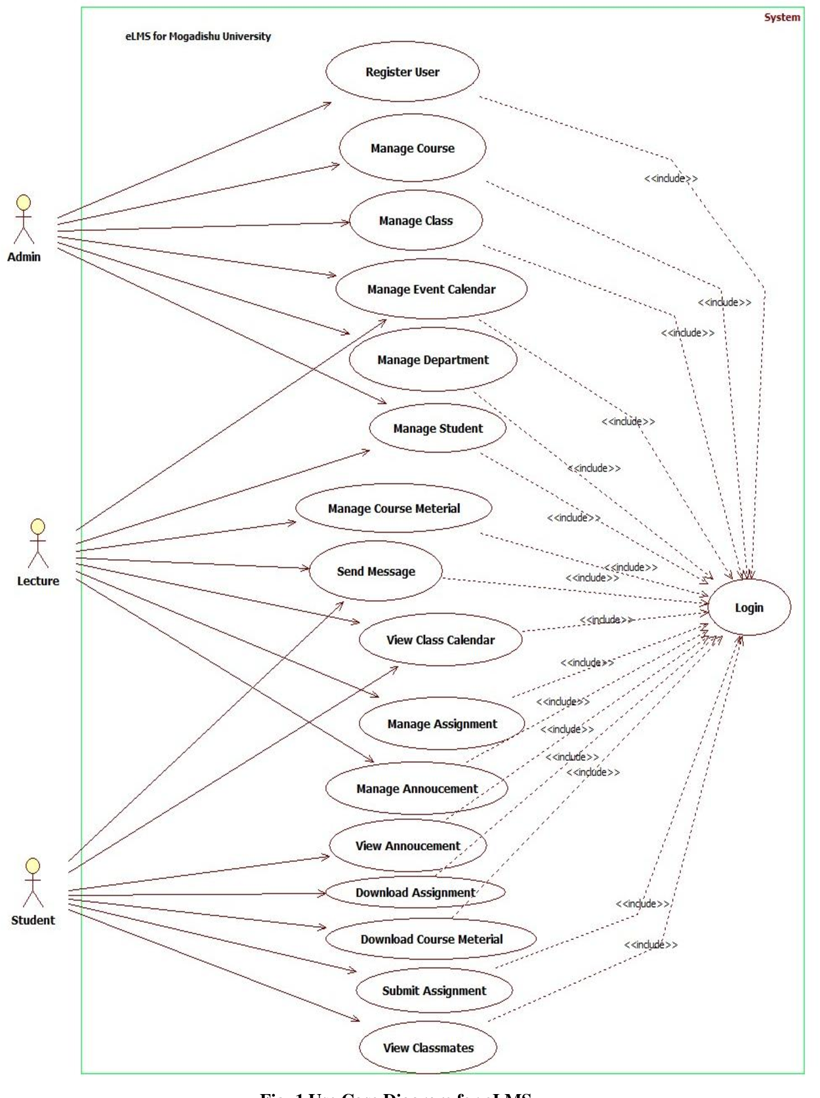
USECASE DIAGRAM
X.

Slide 5
CONCLUSION
LMS is a real time project which is useful for the public who are facing problems with the current manual work of bus pass registration and renewal. It also increases the validity period, frequently warns to the people before completion of his validity period by sending . The system has been developed with much care and free of errors and at the same time it is efficient and less time consuming.

Slide 6
THANK YOU

