Slide 1

Final Project
N.Harika

Slide 2

Introduction to Key and Logger Security
Key loggers are a type of malware that record every keystroke a user makes, including sensitive information like passwords and financial data. This presentation will cover the basics of key loggers, the risks they pose, and strategies for protecting against them.

Slide 3
Understanding Key Loggers
1
What are Key Loggers?
2
How Do They Work?
3
Who Uses Key Loggers?
Key loggers are software or hardware devices that secretly monitor and record a user's keyboard input, including passwords, credit card numbers, and other sensitive data.
Key loggers can be installed on a target computer to capture all keystrokes, which are then transmitted to the attacker for malicious use.
Key loggers are commonly used by cybercriminals, stalkers, and even employers to spy on user activity without their knowledge or consent.

Slide 4
Types of Key Loggers
Software-based
Hardware-based
Hybrid
These key loggers are installed as malicious programs on a target computer, often hidden within other applications.
Hardware key loggers are physical devices that are attached between the keyboard and the computer, recording all keystrokes.
Some key loggers use a combination of software and hardware components to capture and transmit user input.

Slide 5
Risks of Key Logger Attacks
Data Theft
Spying and Stalking
Key loggers can steal sensitive information like passwords, credit card numbers, and personal data, leading to identity theft and financial fraud.
Attackers can use key loggers to monitor a victim's online activities, communication, and even physical location without their knowledge.
System Compromise
Reputational Damage
Key loggers can be used to gain remote access to a target computer, allowing the attacker to install additional malware and take control of the system.
The discovery of a key logger can seriously undermine trust and damage the reputation of the affected individual or organization.

Slide 6
Protecting Against Key Loggers
1
Antivirus and Anti-Malware
2
Firewall and Network Security
Installing and regularly updating reliable antivirus and anti-malware software can help detect and remove key loggers.
Implementing a strong firewall and securing your network can prevent key loggers from transmitting stolen data to the attacker.
3
Physical Security
4
User Awareness
Regularly inspecting your computer and peripherals for any physical signs of tampering can help detect hardware-based key loggers.
Educating users on the risks of key loggers and safe computing practices can significantly reduce the likelihood of successful attacks.

Slide 7




Keyboard and Mouse Security Best Practices
Use Encrypted Input
Employ virtual keyboards or other secure input methods to prevent key loggers from capturing sensitive data.
Regularly Inspect Devices
Visually check your keyboard and mouse for any signs of tampering or additional hardware components.
Avoid Public Computers
Refrain from using public computers or shared devices to enter sensitive information, as they may be compromised.

Slide 8



Hardware-based Security Solutions
USB Security Dongles
Hardware Encryption
Wireless Keyboards
These devices encrypt keyboard input, preventing key loggers from capturing sensitive data.
Dedicated hardware-based encryption devices can protect against key loggers and other security threats.
Wireless keyboard and mouse sets can eliminate the risk of hardware-based key loggers.

Slide 9
Conclusion and Key Takeaways
Key Loggers Pose Serious Risks
Key loggers can lead to data theft, identity fraud, and system compromise if left undetected.
Multilayered Approach is Essential
Protecting against key loggers requires a combination of software, hardware, and user awareness measures.
Regularly Inspect Devices
Physically checking keyboards, mice, and other input devices for tampering is crucial.
Stay Vigilant and Informed
Continuous education and monitoring are necessary to keep up with evolving key logger threats.

Slide 10
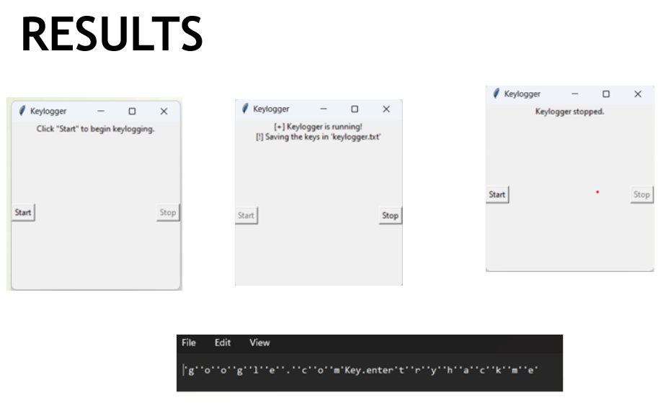

Slide 11
PROJECT LINK
https://github.com/Harika-Nimmaganti/APSSDC_PROJECT.git

