Slide 1
TEAM OFFGRID / DEFENSE & DISASTER ROBOTICS
AUTONOMOUS SWARM
AUG 2026 • REV 1.0
“When GPS fails and RF links jam, SUTRA geonavigates and locates survivors in real-time.”
PROJECT
SUTRA.
Swarm Unified Tactical Reconnaissance Architecture — decentralized multi-UAV flight, Deep JSCC neural zero-cliff video, and 3.59cm terrain-corrected DEM survivor geolocation.
01
02
03
DECENTRALIZED GNC
SEMANTIC WIRELESS
AI VISION & GEO
50Hz
Offboard Rate
-5dB
Jam Resilience
3.59cm
Slope Precision
PX4 MicroXRCE + VIO EKF2
Deep JSCC Zero-Cliff Video
Thermal AI + 3D Terrain Raycast
CORE ARCHITECTURE TEAM (OFFGRID)
RESEARCH-BACKED & EMPIRICALLY VALIDATED
Harika
Vedanth Sai Ram
Nikhil
Siva Kesava
Rohith Kumar
Operations Lead
AI & Vision Lead
Tech Lead · Swarm Architect
Lead · Subsystem D
Lead · Subsystem F
PRESENTER · OPS
PRESENTER · VISION
PRESENTER · GNC/COMMS
3D GIS GCS
FIELD CONOPS

Slide 2
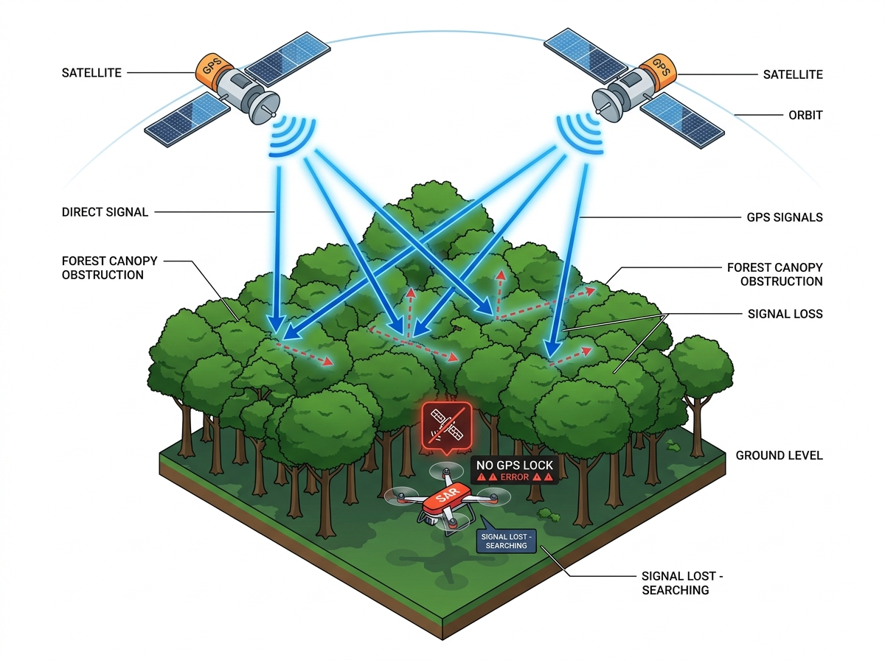
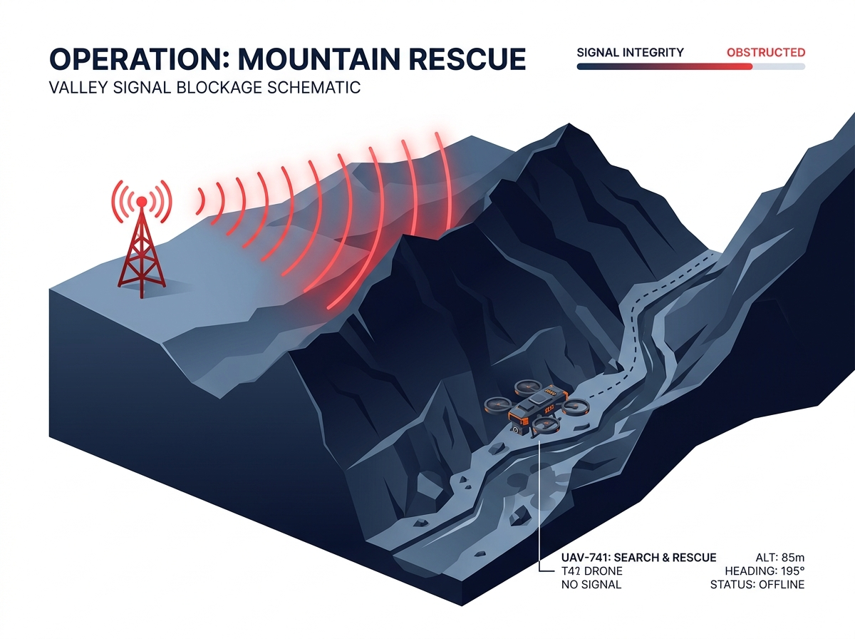
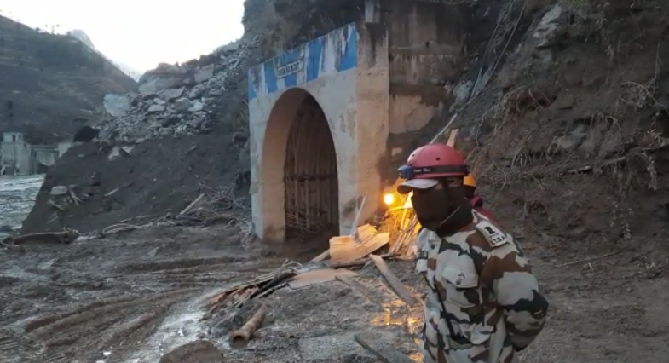
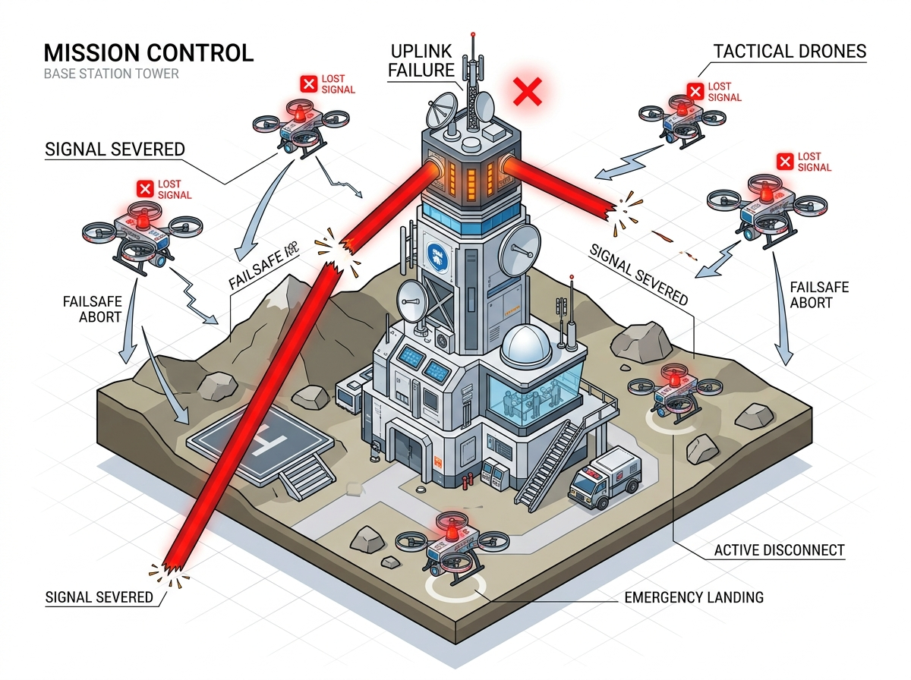
THE PROBLEM — 4 SUBSYSTEM FAILURE VOIDS
FIELD DISASTER AUDIT
Traditional Search & Rescue Collapses Across 4 Critical Voids
70% CANOPY CRASHES
15-30m GEO ERROR
2-3 HOURS DELAY
₹40L+ AIRFRAMES
Wayanad Canopy Crash
Chamoli Gorge RF Cut
Sikkim Slope Geo Error
Central Link Abort
SUBSYSTEM A // GNC
GPS MULTI-PATH
SUBSYSTEM B // COMMS
DIGITAL CLIFF
SUBSYSTEM C // VISION
35% FALSE ALARM
SUBSYSTEM D // C2 GCS
15-25 CREW LOAD
Canopy GPS Drift & Crashes
Mountain Ravine RF Blackout
Smoke Blindspots & Slope Drift
Central Pilot Bottleneck
CORE FAILURE MECHANISM:
CORE FAILURE MECHANISM:
CORE FAILURE MECHANISM:
CORE FAILURE MECHANISM:
Dense foliage blocks satellite GNSS signals
Ridgelines sever direct line-of-sight RF
2D cameras miss survivors in smoke and assume flat terrain
1-pilot-per-drone manual radio control
OPERATIONAL IMPACT:
OPERATIONAL IMPACT:
OPERATIONAL IMPACT:
OPERATIONAL IMPACT:
Commercial drones lose position lock, drifting into tree canopies and causing rotor loss.
Conventional H.264 digital video completely cuts out below 5dB SNR, causing total blindness.
Smoke & mud blind optical cameras; 45° slopes cause 15–30m GPS coordinate errors.
Requires 15–25 personnel and 45–90 min setup; sortie aborts if the single pilot link drops.
70% Loss
0 Hold
<5dB SNR
0 Relay
15–30m
35%
2–3 Hrs
₹12.5L
Canopy Sorties
Non-GPS Stability
Video Blackout
Single-Drone Link
Slope Geo Error
False Alarm Rate
Search Time / mi²
Cost / Deployment
TARGET: PX4 & 3D ORCA
LEAD: NIKHIL
TARGET: DEEP JSCC MESH
LEAD: NIKHIL
TARGET: THERMAL + 3D DEM
LEAD: VEDANTH
TARGET: WEBGPU ATAK GCS
LEAD: SIVA
FIELD EVIDENCE
Wayanad Landslide Audit
AUDIT FINDING
70% RF/GPS Disconnect
COST PENALTY
₹40L Military Airframes
SURVIVOR RISK
412% Disaster Surge
PAGE 02
TEAM OFFGRID — PROJECT SUTRA

Slide 3
THE SOLUTION — 4 CORE SUBSYSTEM MOATS
SWARM ARCHITECTURE
AI Swarm Drones Find Survivors 3-4x Faster Than Traditional SAR
10-18 MIN/MI²
78-85% DETECTION
12% FALSE ALARMS
₹95,000 SORTIE
SUBSYSTEM A // GNC
50Hz OFFBOARD
SUBSYSTEM B // COMMS
-5dB RESILIENT
SUBSYSTEM C // VISION
3.59cm RESIDUAL
SUBSYSTEM D // C2 GCS
1-2 OPERATORS
SUTRA-FSD GNC & 3D ORCA
Deep JSCC Neural Video
Thermal & 3D AI Geolocation
Pegasus 3D WebGPU GCS
SOLVES PROBLEM VOID:
SOLVES PROBLEM VOID:
SOLVES PROBLEM VOID:
SOLVES PROBLEM VOID:
Canopy GPS Multi-Path Drift & Crashes
Mountain Ravine RF Ridge Blackout
Smoke Blindspots & 15-30m Slope Drift
15-25 Ground Crew Cognitive Overload
SOLUTIONAL MOAT:
SOLUTIONAL MOAT:
SOLUTIONAL MOAT:
SOLUTIONAL MOAT:
Decentralized 3D velocity obstacle collision avoidance + PX4 MicroXRCE 50Hz offboard setpoint streaming.
Differentiable joint source-channel coding yielding zero digital cliff and graceful video degradation down to -5dB.
Fuses thermal body heat + optical AI with 3D elevation raycasting on Jetson Orin (<15ms), giving rescue teams exact coordinates on steep slopes.
Offline tactical 3D digital twin + ATAK plugin, empowering 1-2 operators to orchestrate full drone swarms.
0.05s
0 Tower
-5dB
0 Cliff
<15ms
3.59cm
1-2 Ops
100%
Latency
Reliance
SNR Thresh
Degradation
Inference
Raycast Error
Crew Size
Offline ATAK
DECENTRALIZED VIO
50Hz RATE
SEMANTIC COMMS
EDGE TPU
SLOPE CORRECTED
JETSON ORIN
ATAK INTEGRATION
WEBGPU 3D
TAM PROJECTION
₹74,500 Cr Market
DEMAND DELTA
+412% Surge
REGULATORY
37 Nations Mandate
NDMA / SDRF GRANTS
₹1,500 Cr Allocation
PAGE 03
TEAM OFFGRID — PROJECT SUTRA

