Slide 1
INTRO TO CSS
IAT100 Spring 2008

Slide 2
INTRO TO CSS
Covered in this lesson:
  Overview
    What is CSS?
    Why to use CSS?
    CSS for Skinning your Website
  Structure
    CSS Syntax Introduction
    Three places CSS can be defined
    CSS Syntax Specifics
    Cascading Inheritance
  Applied
    CSS Hands-on
Thangam S

Slide 3
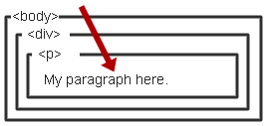
WHAT IS CSS?
Cascading Style Sheet
    Stylesheet Language
      Standards-based set of properties and attributes to define styles
    To describe the presentation a document written in a
    ‘markup language’ like HTML or XML
      Markup encoding: <p>My paragraph here.</p>
      Defines the style of how things in <p> tags appear.
      Font, color, size, margins, etc.
    Cascading
      Rules to determine how to
      apply markup that contains
      other markup
Thangam S

Slide 4
WHY CSS?
Separate Content from Form
  Content is the text and images, marked up to define regions of specific types
  Form defines the “style” for the content
<font size=“14px”>
My First Header
</font>
<font size=“12px” color=“red” face=“Verdana”>
My information 1 goes here.
</font>
<font size=“14px”>
My Second Header
</font>
<font size=“12px” color=“red” face=“Verdana”>
Different information goes here.
</font>
Thangam S
The old way:

Slide 5
WHY CSS? CONTINUED.
Separate Content from Form
  Content
  Form or Style
<p class=“header”>My First Header</p>
<p class=“info”>My Information 1 goes here</p>
<p class=“header”>My Second Header</p>
<p class=“info”>Different Information goes here</p>
(Specific markup properties like Class will be discussed later).
Thangam S
.header { font-size:14px;}
.info { font-family: verdana;
font-color: blue;
font-size: 12px; }

Slide 6
WHAT DOES THIS SEPARATION GET US?
Separate Content from Form
  Specify the style once for every instance of that class.
    Example: Specify the font once for all text on the HTML page that you’ve identified as a “header”.
  The stylesheet can be a separate file which all HTML pages on your entire site can link to.
    Only have to specify the style once for your ENITRE SITE
  Can change the style for your entire site by editing only ONE FILE.
Thangam S

Slide 7
CSS SKINNING
“Skinning” - changing the look of a page or your site
  Selecting an appearance by choosing which stylesheet to use.
<link rel="stylesheet" type="text/css" href=“skin1.css" />
<p class=“info”>My Information 1 goes here</p>
+
Thangam S
skin1.css
.info { background-color: White;
font-family: Verdana;
font-color: Blue; }
=
Some information goes here.

Slide 8
CSS SKINNING 2
“Skinning” - changing the look of a page or your site
  Selecting an appearance by choosing which stylesheet to use.
<link rel="stylesheet" type="text/css" href=“skin2.css" />
<p class=“info”>My Information 1 goes here</p>
+
Thangam S
skin1.css
.info { background-color: Blue;
font-family: Serif;
font-color: White; }
=
Some information goes here.

Slide 9
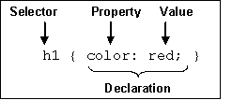
CSS SYNTAX
3 Elements to a CSS Statement
  Selector
    What HTML sections does it affect?
  Property
    What attribute of that HTML section will be affected?
  Value
    What change will be made to that attribute?
Thangam S

Slide 10
THREE CSS DEFINITION LOCATIONS
Inline: the “style” attribute
  Note, the selector for inline CSS is the tag which contains the style attribute.
Internal: the <style> markup tag
External: the .css stylesheet file
<p style=“font-color:red;font-size:10px;”>Content</p>
<html><head><style>
p { background-color: Red;
font-family: serif;
font-color: White; }
</style></head><body>
<p>Content</p>
</body></html>
Thangam S
<link rel="stylesheet" type="text/css" href=“mystylesheet.css" />

Slide 11
CSS SYNTAX: SELECTORS
There are many kinds of selectors and many ways to reference them:
  Type, Class, ID, Pseudo, etc.
HTML Type Tag – selected with the tag type
The Class Attribute – precede the class with a period
p { font-size: 10px;
font-color: White; }
<p>Content</p>
Thangam S
.myinfo { font-size: 10px;
font-color: White; }
<p class=“myinfo”>Content</p>
<div class=“myinfo”>Other content</div>

Slide 12
CASCADING INHERITANCE
Nested elements inherit
the properties from the
its parent
If you specify a style for the
<body> tag it will affect all
content in your HTML page.
If you want to override
inherited settings, you
need to specify a style in
a more local element
body { font-family: Verdana;
font-size: 14px; }
Thangam S
body { font-family: Verdana;
font-size: 1.1em; }
.littletext { font-size: 8px; }
<body>
This text is larger.
<p class=“littletext”>This text is smaller.</p>

Slide 13
HOW CSS WORKS
CSS is a language that defines style constructs such as fonts, colors, and positioning, which are used to describe how information on a web page is formatted and displayed.
CSS styles can be stored directly in an HTML web page or in a separate style sheet file.
Either way, style sheets contain style rules that apply styles to elements of a given type.
When used externally, style sheet rules are placed in an external style sheet document with the file extension .css.
Thangam S

Slide 14
HOW CSS WORKS
A style rule is a formatting instruction that can be applied to an element on a web page, such as a paragraph of text or a link.
Style rules consist of one or more style properties and their associated values.
An internal style sheet is placed directly within a web page, whereas an external style sheet exists in a separate document and is simply linked to a web page via a special tag— more on this tag in a moment.
The cascading part of the name CSS refers to the manner in which style sheet rules are applied to elements in an HTML document.
More specifically, styles in a CSS style sheet form a hierarchy in which more specific styles override more general styles
Thangam S

Slide 15

A BASIC STYLE SHEET
Thangam S
This page uses a style sheet to fine-tune the appearance and spacing of the text and images.

Slide 16

HOW CSS WORKS
Thangam S
This page uses the same style sheet as the one shown in Figure 1, thus maintaining a consistent look and feel.

Slide 17
HOW CSS WORKS
These pages share several visual properties that could be put into a common style sheet:
They use a large, bold Verdana font for the headings and a normal size and weight Verdana font for the body text.
They use an image named logo.gif floating within the content and on the right side of the page.
All text is black except for subheadings, which are purple.
They have margins on the left side and at the top.
There is vertical space between lines of text.
The footnotes are centered and in small print.
Thangam S

Slide 18
A SINGLE EXTERNAL STYLE SHEET
body {
font-size: 10pt;
font-family: Verdana, Geneva, Arial, Helvetica, sans-serif;
color: black;
line-height: 14pt;
padding-left: 5pt;
padding-right: 5pt;
padding-top: 5pt;
}
h1 {
font: 14pt Verdana, Geneva, Arial, Helvetica, sans-serif;
font-weight: bold;
line-height: 20pt;
}
p.subheader {
font-weight: bold;
color: #593d87;
}
Thangam S

Slide 19
A SINGLE EXTERNAL STYLE SHEET
img {
padding: 3pt;
float: right;
}
a {
text-decoration: none;
}
a:link, a:visited {
color: #8094d6;
}
a:hover, a:active {
color: #FF9933;
}
Thangam S

Slide 20
A SINGLE EXTERNAL STYLE SHEET
div.footer {
font-size: 9pt;
font-style: italic;
line-height: 12pt;
text-align: center;
padding-top: 30pt;
}
Thangam S

Slide 21
HTML CODE FOR THE PAGE SHOWN IN FIGURE 1
<html xmlns=”http://www.w3.org/1999/xhtml” xml:lang=”en”>
<head>
<title>About BAWSI</title>
<link rel=”stylesheet” type=”text/css” href=”styles.css” />
</head>
<body>
<h1>About BAWSI</h1>
<p><img src=”logo.gif” alt=”BAWSI logo”/>The Bay Area Women’s
Sports Initiative (BAWSI) is a public benefit, nonprofit
corporation with a mission to create programs and partnerships
through which women athletes bring health, hope and wholeness to
our community. Founded in 2005 by Olympic and World Cup soccer
stars Brandi Chastain and Julie Foudy and Marlene Bjornsrud,
former general manager of the San Jose CyberRays women’s
professional soccer team, BAWSI provides a meaningful path for
women athletes to become a more visible and valued part of the
Bay Area sports culture.</p>
Thangam S

Slide 22
HTML CODE FOR THE PAGE SHOWN IN FIGURE 1
<p class=”subheader”>BAWSI’s History</p>
<p>The concept of BAWSI was inspired by one of the most
spectacular achievements in women’s sports history and born out
of one its biggest disappointments... </p>
<p><a href=”secondpage.html”>[continue reading]</a></p>
<div class=”footer”>Copyright &copy; 2005-2009 BAWSI
(www.bawsi.org). All rights reserved. Used with permission.</div>
</body>
</html>
Thangam S

Slide 23
A CSS STYLE PRIMER
CSS includes various style properties that are used to control fonts, colors, alignment, and margins, to name just a few. The style properties in CSS can be generally grouped into two major categories:
Layout properties—Consist of properties that affect the positioning of elements on a web page, such as margins, padding, alignment, and so on
Formatting properties—Consist of properties that affect the visual display of elements within a website, such as the font type, size, color, and so on
Thangam S

Slide 24
LAYOUT PROPERTIES
CSS layout properties are used to determine how content is placed on a web page.
One of the most important layout properties is the display property, which describes how an element is displayed with respect to other elements. There are four possible values for the display property:
block—The element is displayed on a new line, as in a new paragraph.
list-item—The element is displayed on a new line with a list-item mark (bullet) next to it.
inline—The element is displayed inline with the current paragraph.
none—The element is not displayed; it is hidden.
Thangam S

Slide 25
LAYOUT PROPERTIES
The display property is one of the few style properties that can be applied in most style rules. Following is an example of how to set the display property:
display:block;
You control the size of the rectangular area for an element with the width and height properties.
Like many size-related CSS properties, width and height property values can be specified in several different units of measurement:
  in—Inches
  cm—Centimeters
  mm—Millimeters
  px—Pixels
  pt—Points
Thangam S

Slide 26
FORMATTING PROPERTIES
CSS formatting properties are used to control the appearance of content on a web page, as opposed to controlling the physical positioning of the content.
One of the most popular formatting properties is the border property, which is used to establish a visible boundary around an element with a box or partial box. The following border properties provide a means of describing the borders of an element:
border-width—The width of the border edge
border-color—The color of the border edge
border-style—The style of the border edge
border-left—The left side of the border
border-right—The right side of the border
border-top—The top of the border
border-bottom—The bottom of the border
border—All the border sides
Thangam S

Slide 27
FORMATTING PROPERTIES
The border-width property is used to establish the width of the border edge.
It is often expressed in pixels, as the following code demonstrates:
border-width:5px;
Not surprisingly, the border-color and border-style properties are used to set the border color and style.
Following is an example of how these two properties are set:
border-color:blue;
border-style:dotted;
Thangam S

Slide 28
FORMATTING PROPERTIES
The border-style property can be set to any of the following values:
solid—A single-line border
double—A double-line border
dashed—A dashed border
dotted—A dotted border
groove—A border with a groove appearance
ridge—A border with a ridge appearance
inset—A border with an inset appearance
outset—A border with an outset appearance
none—No border
Thangam S

Slide 29
FORMATTING PROPERTIES
Following is an example of setting both color properties to predefined colors:
color:black;
background-color:orange;
You can also assign custom colors to these properties by specifying the colors in hexadecimal or as RGB (Red, Green, Blue) decimal values, just as you do in HTML:
background-color:#999999;
color:rgb(0,0,255);
You can also control the alignment and indentation of web page content without too much trouble. This is accomplished with the text-align and
text-indent properties, as the following code demonstrates:
text-align:center;
text-indent:12px;
Thangam S

Slide 30
FORMATTING PROPERTIES
The following font properties are used to set the various parameters associated with fonts:
font-family—The family of the font
font-size—The size of the font
font-style—The style of the font (normal or italic)
font-weight—The weight of the font (light, medium, bold, and so on)
Following is an example of setting these font properties:
font-family: Arial, sans-serif;
font-size: 36pt;
font-style: italic;
font-weight: medium;
Thangam S

Slide 31
FORMATTING PROPERTIES
font—Lets you set many font properties at once. You can also include the words bold and/or italic and a font size. Each of these font properties can be specified separately with font-family, font-size, font-weight, and font-style if you prefer.
line-height—Also known in the publishing world as leading.
color—Sets the text color using the standard color names or hexadecimal color codes.
text-decoration—Useful for turning link underlining off—simply set it to none. The values of underline, italic, and line-through are also supported.
text-align—Aligns text to the left, right, or center, along with justifying the text with a value of justify.
padding—Adds padding to the left, right, top, and bottom of an element; this padding can be in measurement units or a percentage of the page width.
Thangam S

Slide 32
USING STYLE CLASSES
A style class is a custom set of formatting specifications that can be applied to any element in a web page.
a CSS style property is a specific style that can be assigned a value, such as color or font-size.
You associate a style property and its respective value with elements on a web page by using a selector.
A selector is used to identify tags on a page to which you apply styles. Following is an example of a selector, a property, and a value all included in a basic style rule:
h1 { font: 36pt Courier; }
In this code, h1 is the selector, font is the style property, and 36pt Courier is the value.
The selector is important because it means that the font setting will be applied to all h1 elements in the web page.
Thangam S

Slide 33
USING STYLE CLASSES CONT..
Suppose you want two different kinds of <h1> headings for use in your documents.
You would create a style class for each one by putting the following CSS code in a style sheet:
h1.silly { font: 36pt Comic Sans; }
h1.serious { font: 36pt Arial; }
Notice that these selectors include a period (.) after h1, followed by a
descriptive class name.
To choose between the two style classes, use the class attribute, like this:
<h1 class=”silly”>Marvin’s Munchies Inc. </h1>
<p>Text about Marvin’s Munchies goes here. </p>
Or you could use this:
<h1 class=”serious”>MMI Investor Information</h1>
<p>Text for business investors goes here.</p>
Thangam S

Slide 34
USING STYLE CLASSES CONT..
You can essentially create your own custom HTML tag by using the div selector followed by a period (.) followed by any style class name you make up and any style specifications you choose.
That tag can control any number of font, spacing, and margin settings all at once.
Wherever you want to apply your custom tag in a page, use a <div> tag with the class attribute followed by the class name you created
div.footer {
font-size: 9pt;
font-style: italic;
line-height: 12pt;
text-align: center;
padding-top: 30pt; }.
This style class is applied in Listing 3.2 with the following tag:
<div class=”footer”>
Thangam S

Slide 35
USING STYLE IDS
A style ID is a custom set of formatting specifications that can be applied only to one element in a web page. You can use IDs across a set of pages but only once per time within each page.
For example, suppose you have a title within the body of all your pages.
Each page has only one title, but all the pages themselves include one instance of that title.
Following is an example of a selector with an ID indicated, plus a property and a value:
p#title {font: 24pt Verdana, Geneva, Arial, sans-serif}
Notice that this selector includes a hash mark, or pound sign (#), after p, followed by a descriptive ID name.
When referencing a style ID in HTML code, simply specify the ID name in the id attribute of an element, like so:
<p id=”title”>Some Title Goes Here</p>
Thangam S

Slide 36
INTERNAL STYLE SHEETS AND INLINE STYLES
In some situations, you might want to specify styles that will be used in only one web page, in which case you can enclose a style sheet between <style> and </style> tags and include it directly in an HTML document.
Style sheets used in this manner must appear in the <head> of an HTML document.
No <link /> tag is needed, and you cannot refer to that style sheet from any other page
Thangam S

Slide 37
INTERNAL STYLE SHEETS AND INLINE STYLES
<?xml version=”1.0” encoding=”UTF-8”?>
<!DOCTYPE html PUBLIC “-//W3C//DTD XHTML 1.1//EN”
“http://www.w3.org/TR/xhtml11/DTD/xhtml11.dtd”>
<html xmlns=”http://www.w3.org/1999/xhtml” xml:lang=”en”>
<head>
<title>Some Page</title>
<style type=”text/css”>
div.footer {
font-size: 9pt;
line-height: 12pt;
text-align: center;
}
</style>
</head>
<body>
...
<div class=”footer”>
Copyright 2009 Acme Products, Inc.
</div>
</body>
</html>
Thangam S

Slide 38
WORKING WITH FONTS, TEXT BLOCKS,
AND LISTS
Boldface, Italics, and Special Text Formatting
The font-weight style rule enables you to set the weight, or boldness, of a font using a style rule.
Standard settings for font-weight include normal, bold, bolder, and lighter (with normal being the default).
Italic text is controlled via the font-style rule, which can be set to normal, italic, or oblique.
Style rules can be specified together if you want to apply more than one, as the following example demonstrates:
<p style=”font-weight:bold; font-style:italic”>This paragraph is bold and italic!</p>
Thangam S

Slide 39
BOLDFACE, ITALICS, AND SPECIAL TEXT FORMATTING
The following code shows how to italicize text in a bulleted list:
<ul>
<li style=”font-style:italic”>Important Stuff</li>
<li style=”font-style:italic”>Critical Information</li>
<li style=”font-style:italic”>Highly Sensitive Material</li>
<li>Nothing All That Useful</li>
</ul>
S0me tags:
<small></small>—Small text
<big></big>—Big text; not present in HTML5 because text size is better controlled by CSS
<sup></sup>—Superscript text
<sub></sub>—Subscript text
<em></em> or <i></i>—Emphasized (italic) text
<strong></strong> or <b></b>—Strong (boldface) text
Thangam S

Slide 40
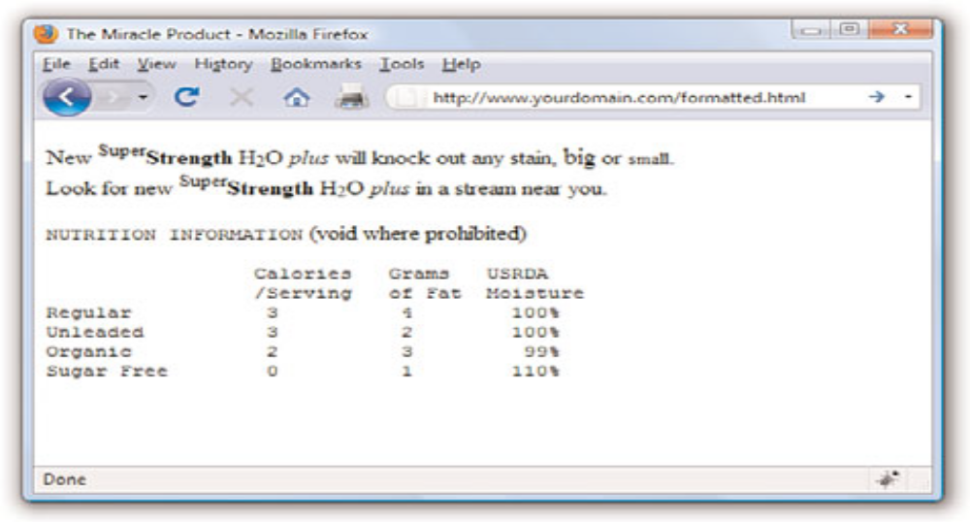
BOLDFACE, ITALICS, AND SPECIAL TEXT FORMATTING
<tt></tt>—Monospaced text (typewriter font) not present in HTML5 because font appearance is better controlled by CSS
<pre></pre>—Monospaced text, preserving spaces and line breaks
Thangam S

Slide 41
TWEAKING THE FONT
The <big>, <small>, and <tt> tags give you some rudimentary control over the size and appearance of the text on your pages.
However, there might be times when you’d just like a bit more control over the size and appearance of your text.
<font size=”5” color=”purple”>this text will be big and purple.</font>
Following are a few of the main style rules used to control fonts:
  font-family—Sets the family (typeface) of the font
  font-size—Sets the size of the font
  color—Sets the color of the font
Following is an example of the font-family style used to set the typeface for a paragraph of text:
<p style=”font-family:arial, sans-serif, ‘times roman’”>
<p style=”font-family:arial, sans-serif, ‘times roman’; font-size:14pt; color:green”>
Thangam S

Slide 42
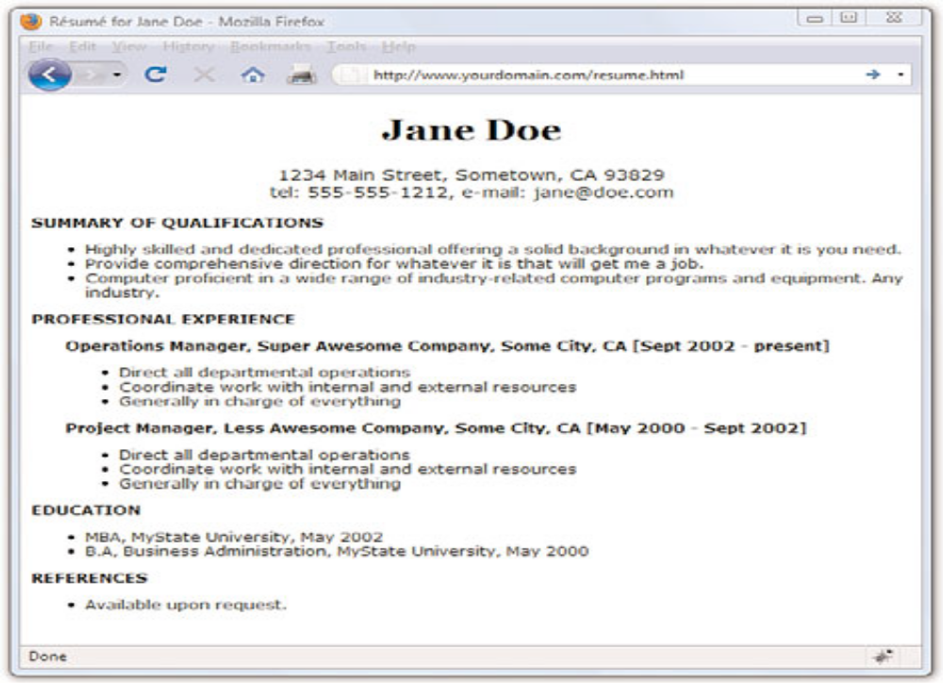
USING FONT STYLE RULES TO CREATE A BASIC RESUME
Thangam S

Slide 43
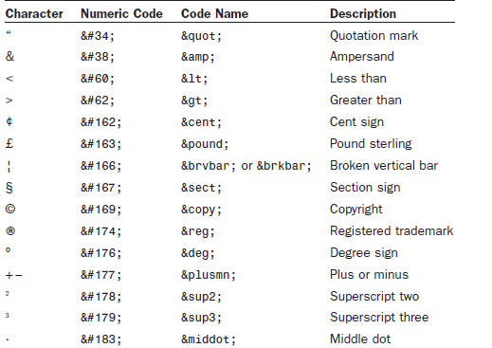
WORKING WITH SPECIAL CHARACTERS
Commonly Used English Language Special Characters
Thangam S

Slide 44
ALIGNING TEXT ON A PAGE
HTML gives you the option to align a single HTML block-level element, such as text contained within a <p></p> or <div></div> tag pair.
Using Attributes
Attributes are used to provide additional information related to an HTML tag.
Attributes are special code words used inside an HTML tag to control exactly what the tag does.
They are very important in even the simplest bit of web content, so it’s important that you are comfortable using them.
In the following example, each paragraph could be left-aligned:
<p style=”text-align: left;”>Text goes here.</p>
<p class=”leftAlignStyle”>Text goes here.</p>
<p id=”firstLeftAlign”>Text goes here.</p>
Thangam S

Slide 45
ALIGNING TEXT ON A PAGE
For example, the following code will be rendered by most popular web browsers:
<P STYLE=TEXT-ALIGN:CENTER>
If you want to stay compatible with the latest standards and software, you should always use the following instead:
<p style=”text-align:center”>
Aligning Block-Level Elements
Thangam S

Slide 46
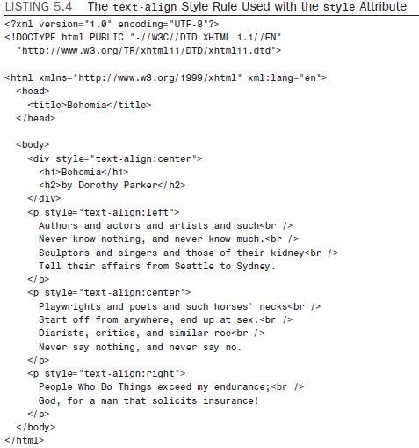
ALIGNING TEXT ON A PAGE
Thangam S

Slide 47
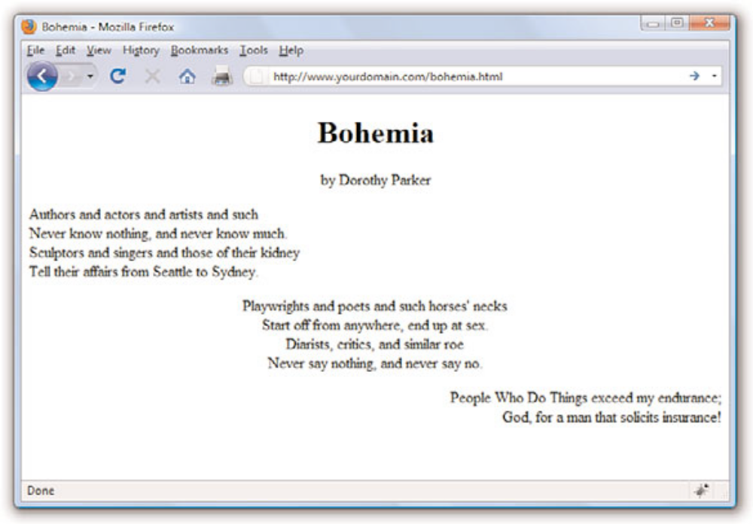
ALIGNING TEXT ON A PAGE
Thangam S

Slide 48
THE THREE TYPES OF HTML LISTS
Ordered list—An indented list that has numbers or letters before each list item.
The ordered list begins with the <ol> tag and ends with a closing </ol> tag.
List items are enclosed in the <li></li> tag pair, and line breaks appear automatically at each opening <li> tag. The entire list is indented.
Unordered list—An indented list that has a bullet or other symbol before each list item.
The unordered list begins with the <ul> tag and closes with </ul>. Like the ordered list, its list items are enclosed in the <li></li> tag pair.
A line break and symbol appear at each opening <li> tag, and the entire list is indented.
Definition list—A list of terms and their meanings. This type of list, which has no special number, letter, or symbol before each item, begins with <dl> and ends with </dl>.
The <dt></dt> tag pair encloses each term and the <dd></dd> tag pair encloses each definition. Line breaks and indentations appear automatically.
Thangam S

Slide 49
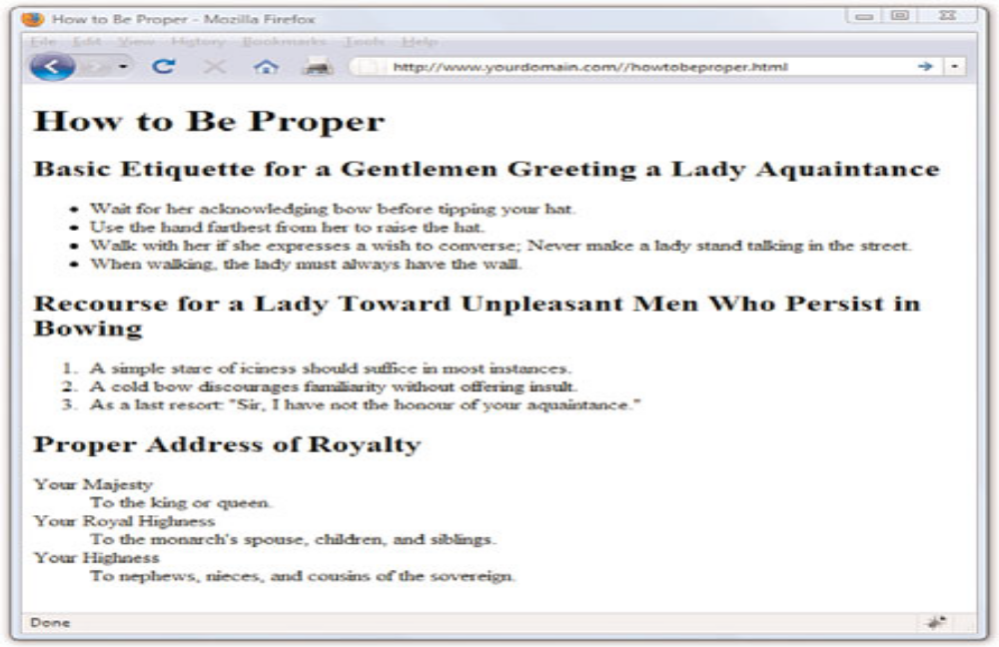
THE THREE TYPES OF HTML LISTS
Thangam S

Slide 50
ADVANCED TYPOGRAPHY WITH CSS3
Font Variant in CSS3
The collection of font-variant- prefixed properties in CSS3 aims to give designers and developers access to special characters (glyphs) in fonts that can make the typography on a page more sophisticated.
font-variant-ligatures
A ligature is a glyph that combines two or more characters into one symbol.
One common example is the combination of a lowercase f and i, where the dot on the i becomes part of the f (fi).
font-variant-caps
Allows the selection of small-cap glyphs (small-caps) from the font’s character set rather than simulating them in the browser.
The all-smallcaps
value uses small caps for upper- and lowercase letters.
Thangam S

Slide 51
ADVANCED TYPOGRAPHY WITH CSS3
font-variant-position
Selects superscript (super) or subscript (sub) glyphs from the font’s character set when they are available.
font-variant-numeric
Allows the selection of various number character styles if they are available.
font-variant-alternates
Fonts sometimes offer more than one glyph for a particular character—for example, a few swash designs for the letter S, or an old-fashioned s that looks more like an f.
font-variant-east-asian
Allows selection of particular Asian glyphs.
Thangam S

Slide 52
OTHER CSS3 PROPERTIES
font-size-adjust
font-kerning
font-feature-settings
Thangam S

Slide 53
WORKING WITH MARGINS, PADDING,
ALIGNMENT, AND FLOATING
The margin and padding properties—For adding space around elements
The align and float properties—Used to place your elements in relation to others
Thangam S

Slide 54
USING MARGINS
Style sheet margins enable you to add empty space around the outside of the rectangular area for an element on a web page.
It is important to remember that the margin property works with space outside of the element.
Following are the style properties for setting margins:
margin-top—Sets the top margin
margin-right—Sets the right margin
margin-bottom—Sets the bottom margin
margin-left—Sets the left margin
margin—Sets the top, right, bottom, and left margins as a single property
Thangam S

Slide 55
USING MARGINS CONT..
We want the margin around each <div> to be 15 pixels on all sides, so we can use the following:
margin-top:15px;
margin-right:15px;
margin-bottom:15px;
margin-left:15px;
You could also write that in shorthand, using the margin property:
margin:15px 15px 15px 15px;
When you use the margin property (or padding, or border) and you want all four values to be the same, you can simplify this even further and use:
margin:15px;
Thangam S

Slide 56
USING MARGINS CONT..
When using shorthand for setting margins, padding or borders, there are actually three approaches, which vary based on how many values you use when setting the property:
One value—The size of all the margins
Two values—The size of the top/bottom margins and the left/right margins (in that order)
Four values—The size of the top, right, bottom, and left margins (in that order)
Thangam S

Slide 57
SIMPLE CODE TO PRODUCE FOUR COLORED <DIV>S WITH BORDERS
AND MARGINS
<?xml version=”1.0” encoding=”UTF-8”?>
<!DOCTYPE html PUBLIC “-//W3C//DTD XHTML 1.1//EN”
“http://www.w3.org/TR/xhtml11/DTD/xhtml11.dtd”>
<html xmlns=”http://www.w3.org/1999/xhtml” xml:lang=”en”>
<head>
<title>Color Blocks</title>
<style type=”text/css”>
div {
width:250px;
height:100px;
border:5px solid #000000;
color:black;
font-weight:bold;
text-align:center;
}
div#d1 {
background-color:red;
margin:15px;
}
div#d2 {
background-color:green;
margin:15px;
}
div#d3 {
background-color:blue;
}
div#d4 {
background-color:yellow;
margin:15px;
}
</style>
</head>
<body>
<div id=”d1”>DIV #1</div>
<div id=”d2”>DIV #2</div>
<div id=”d3”>DIV #3</div>
<div id=”d4”>DIV #4</div>
</body>
</html>
Thangam S

Slide 58
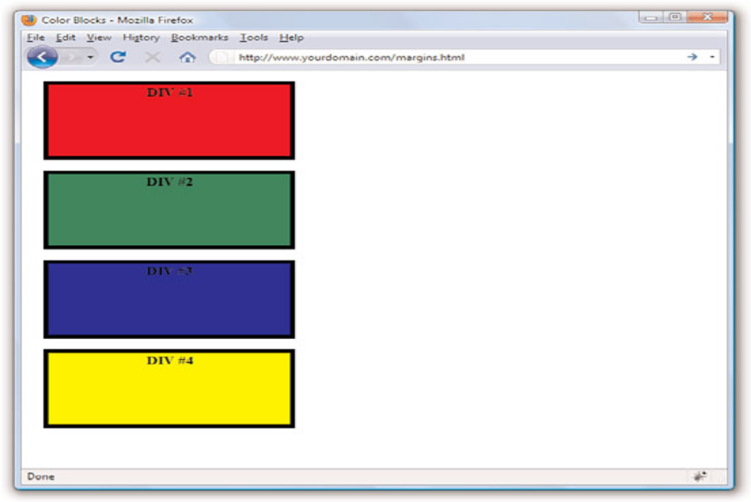
USING MARGINS CONT..
Thangam S

Slide 59
PADDING ELEMENTS
Padding is similar to margins in that it adds extra space to elements, but the big difference is where that space is located.
If you recall, margins are added to the outside of elements. On the other hand, padding adds space inside the rectangular area of an element.
The following padding properties are available for use in setting the padding of style rules:
padding-top—Sets the top padding
padding-right—Sets the right padding
padding-bottom—Sets the bottom padding
padding-left—Sets the left padding
padding—Sets the top, right, bottom, and left padding as a single property
Thangam S

Slide 60
PADDING ELEMENTS CONT..
Following is an example of how you might set the left and right padding for a style rule so that there are 10 pixels of padding on each side of an element’s
content:
padding-left:10px;
padding-right:10px;
Following is more explicit code that performs the same task by specifying
all the padding values:
padding:12px 8px 12px 8px;
Thangam S

Slide 61
SIMPLE CODE TO PRODUCE FOUR COLORED <DIV>S WITH BORDERS,
MARGINS, AND PADDING
<?xml version=”1.0” encoding=”UTF-8”?>
<!DOCTYPE html PUBLIC “-//W3C//DTD XHTML 1.1//EN”
“http://www.w3.org/TR/xhtml11/DTD/xhtml11.dtd”>
<html xmlns=”http://www.w3.org/1999/xhtml” xml:lang=”en”>
<head>
<title>Color Blocks</title>
<style type=”text/css”>
body {
margin:0px;
}
div {
width:250px;
height:100px;
border:5px solid #000000;
color:black;
font-weight:bold;
margin:25px;
}
div#d1 {
background-color:red;
text-align:center;
padding:15px;
}
div#d2 {
background-color:green;
text-align:right;
padding:25px 50px 6px 6px;
}
div#d3 {
background-color:blue;
text-align:left;
padding:6px 6px 6px 50px;
}
div#d4 {
background-color:yellow;
text-align:center;
padding:50px;
}
</style>
</head>
<body>
<div id=”d1”>DIV #1</div>
<div id=”d2”>DIV #2</div>
<div id=”d3”>DIV #3</div>
<div id=”d4”>DIV #4</div>
</body>
</html>
Thangam S

Slide 62
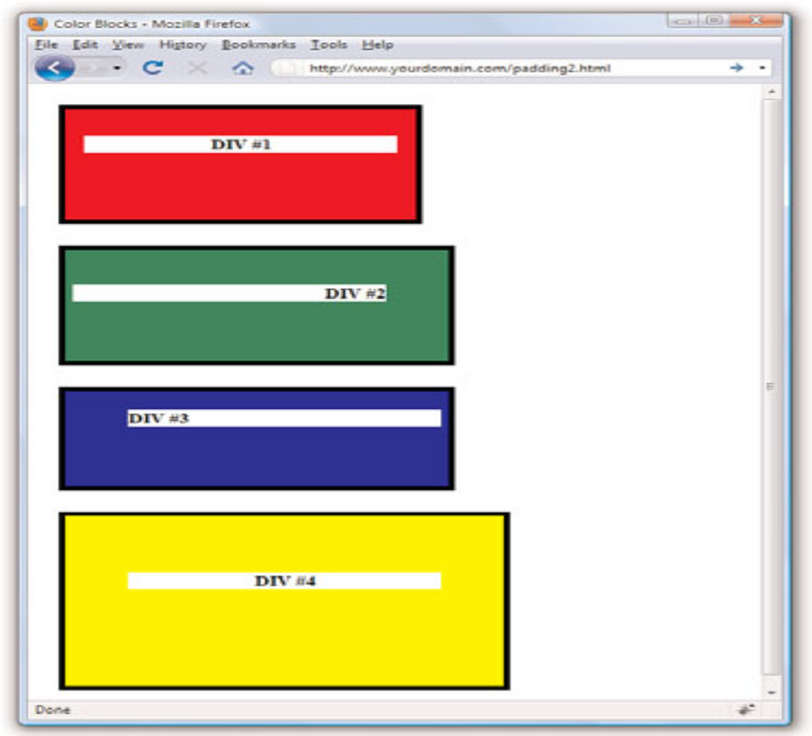
Thangam S

Slide 63
KEEPING EVERYTHING ALIGNED
There are two style properties that enable you to control the alignment of elements:
text-align and vertical-align.
Following are common values for use with the vertical-align property:
top—Aligns the top of an element with the current line
middle—Aligns the middle of an element with the middle of its parent
bottom—Aligns the bottom of an element with the current line
text-top—Aligns the top of an element with the top of its parent
baseline—Aligns the baseline of an element with the baseline of its parent
text-bottom—Aligns the bottom of an element with the bottom of its parent
Thangam S

Slide 64
UNDERSTANDING THE FLOAT PROPERTY
Understanding the float property is fundamental to understanding CSS based layout and design; it is one of the last pieces in the puzzle of how all these elements fit together.
Briefly stated, the float property allows elements to be moved around in the design such that other elements can wrap around them.
Elements float horizontally, not vertically, so all you have to concern yourself with are two possible values: right and left.
Thangam S

Slide 65
USING FLOAT TO PLACE <DIV>S
<?xml version=”1.0” encoding=”UTF-8”?>
<!DOCTYPE html PUBLIC “-//W3C//DTD XHTML 1.1//EN”
“http://www.w3.org/TR/xhtml11/DTD/xhtml11.dtd”>
<html xmlns=”http://www.w3.org/1999/xhtml” xml:lang=”en”>
<head>
<title>Color Blocks</title>
<style type=”text/css”>
body {
margin:0px;
}
div {
width:250px;
height:100px;
border:5px solid #000000;
color:black;
font-weight:bold;
margin:25px;
}
div#d1 {
background-color:red;
float:left;
}
div#d2 {
background-color:green;
float:left;
}
div#d3 {
background-color:blue;
float:left;
}
</style>
</head>
<body>
<div id=”d1”>DIV #1</div>
<div id=”d2”>DIV #2</div>
<div id=”d3”>DIV #3</div>
</body>
</html>
Thangam S

Slide 66
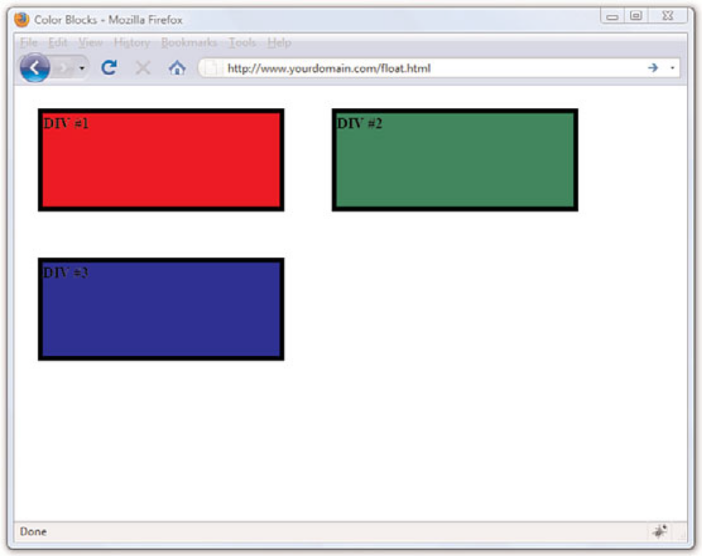
USING FLOAT TO PLACE THE COLOR BLOCKS.
Thangam S

