Slide 1
Creating Fixed or Liquid Layouts

Slide 2
Understanding Fixed Layouts
A fixed layout, or fixed-width layout, is just that: a layout in which the body of the page is set to a specific width.
That width is typically controlled by a master “wrapper” <div> in which all content is contained.
The width property of that <div> would be set in the style attribute or in a style sheet entry if the <div> was given an ID value such as “main” or “wrapper” (although the name is up to you).
When creating a fixed-width layout, the most important decision is determining the minimum screen resolution you want to accommodate.
For many years, 800×600 has been the “lowest common denominator” for web designers, resulting in a typical fixed width of approximately 760 pixels.
However, since 2007, the number of people using an 800⋅600 screen resolution has been less than 8% (and is currently approximately 4%).
Given that, many web designers consider 1024⋅768 the current minimum screen resolution, leading to fixed-width designs anywhere between 800 and 1000 pixels wide.

Slide 3
Understanding Fixed Layouts Cont..
A main reason for creating a fixed-width layout is so that you can have precise control over the appearance of the content area.
However, if users visit your fixed-width site with smaller or much larger screen resolutions than the resolution you had in mind while you designed it, they might encounter scrollbars (if their resolution is smaller) or a large amount of empty space (if their resolution is greater).
However, Figure shows how this site looks when the browser window is more than 1400 pixels wide: There is a lot of empty space (or “real estate”) on both sides of the main body content.
There is another consideration when creating a fixed-width layout: whether to place the content flush-left or whether to center it.
Placing the content flush-left produces extra space on the right side only; centering the content area creates extra space on both sides.

Slide 4
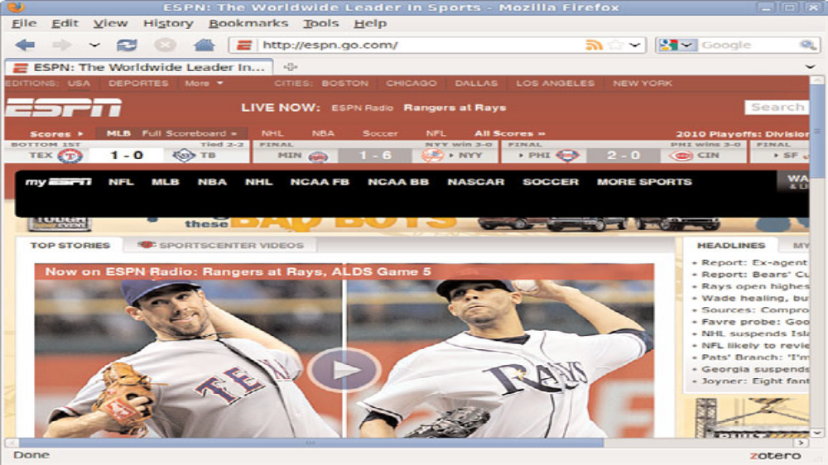
Understanding Fixed Layouts Cont..
A fixed-width example with a smaller screen size.

Slide 5
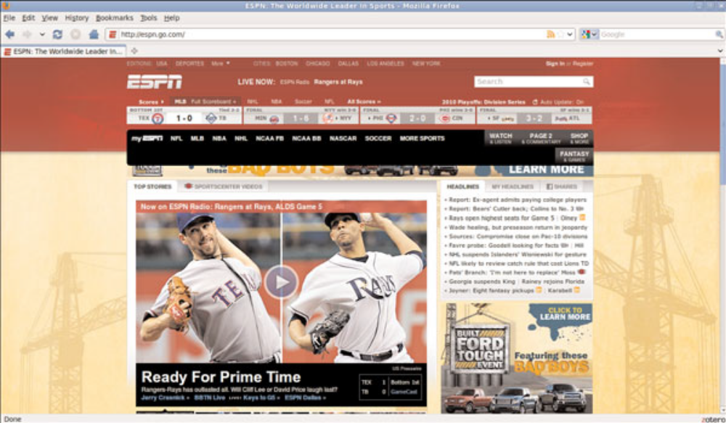
Understanding Fixed Layouts Cont..
A fixed-width example with a larger screen size.

Slide 6
Understanding Liquid Layouts
Aliquid layout—also called a fluid layout—is one in which the body of the page does not use a specified width in pixels, although it might be enclosed in a master “wrapper” <div> that uses a percentage width.
The idea behind the liquid layout is that it can be perfectly usable and still retain the overall design aesthetic even if the user has a very small or very wide screen.

Slide 7
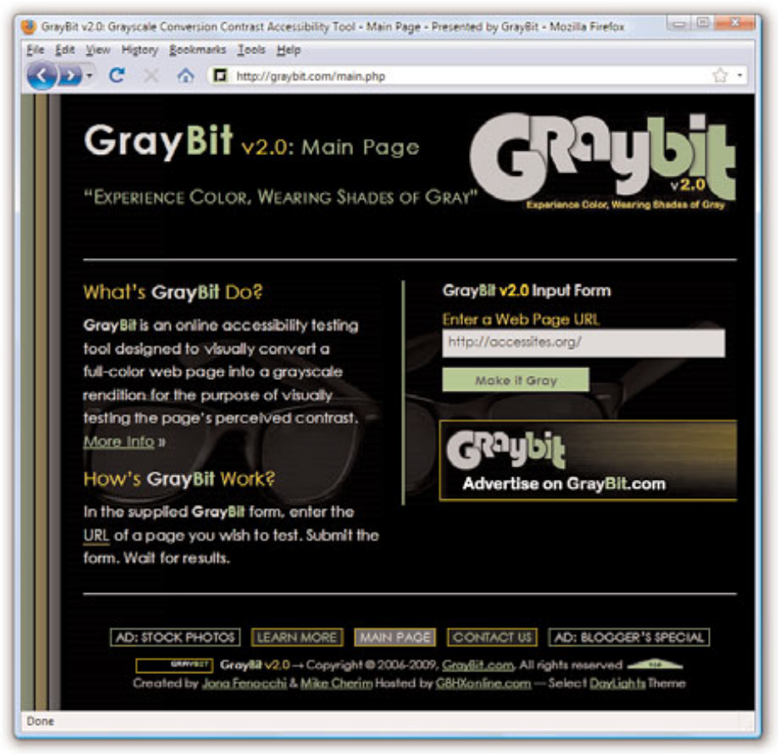
Understanding Liquid Layouts Cont..
A liquid layout as viewed in a relatively small screen.

Slide 8
Understanding Liquid Layouts Cont..
In the browser window is approximately 770 pixels wide.
This example shows a reasonable minimum screen width before a horizontal scrollbar appears.
In fact, the scrollbar does not appear until the browser is 735 pixels wide.

Slide 9

Understanding Liquid Layouts Cont..
A liquid layout as viewed in a very small screen.

Slide 10
Understanding Liquid Layouts Cont..
On the other hand, Figure shows a very small browser window (545 pixels wide).
In Figure, you can see a horizontal scrollbar; in the header area of the page content, the logo graphic is beginning to take over the text and appear on top of it.
But the bulk of the page is still quite usable.
The informational content on the left side of the page is still legible, and it is sharing the available space with the input form on the right side.

Slide 11
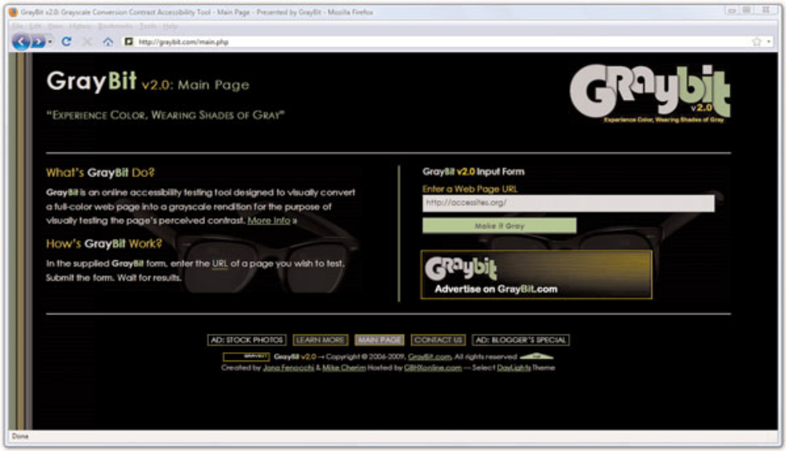
Understanding Liquid Layouts Cont..
A liquid layout as viewed in a wide screen.

Slide 12
Understanding Liquid Layouts Cont..
Figure shows how this same page looks in a very wide screen.
In Figure, the browser window is approximately 1330 pixels wide.
There is plenty of room for all of the content on the page to spread out.
This liquid layout is achieved because all the design elements have a percentage width specified (instead of a fixed width).
In doing so, the layout makes use of all the available browser real estate.

Slide 13
Creating a Fixed/Liquid Hybrid Layout
A fixed/liquid hybrid layout is one that contains elements of both types of layouts.
For example, you could have a fluid layout that includes fixedwidth content areas either within the body area or as anchor elements (such as a left-side column or as a top navigation strip).
You can even create a fixed content area that acts like a frame, “Using Windows and Frames,” in which the fixed content area remains fixed even as users scroll through the content.

Slide 14
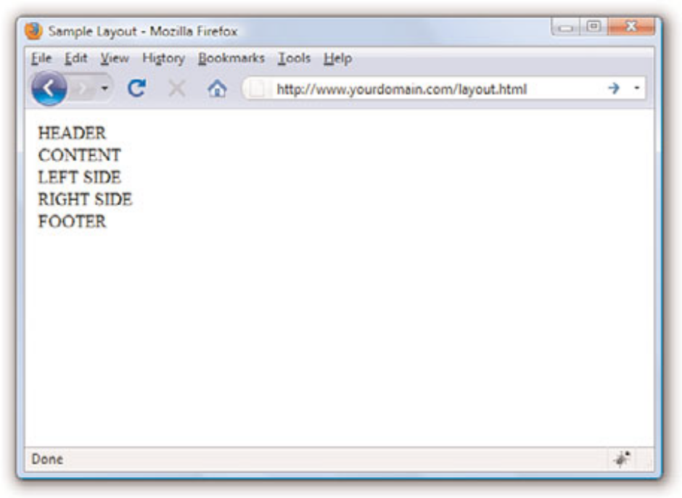
Starting with a Basic Layout Structure
<?xml version=”1.0” encoding=”UTF-8”?>
<!DOCTYPE html PUBLIC “-//W3C//DTD XHTML 1.1//EN”
“http://www.w3.org/TR/xhtml11/DTD/xhtml11.dtd”>
<html xmlns=”http://www.w3.org/1999/xhtml” xml:lang=”en”>
<head>
<title>Sample Layout</title>
<link href=”layout.css” rel=”stylesheet” type=”text/css” />
</head>
<body>
<div id=”header”>HEADER</div>
<div id=”wrapper”>
<div id=”content_area”>CONTENT</div>
<div id=”left_side”>LEFT SIDE</div>
<div id=”right_side”>RIGHT SIDE</div>
</div>
<div id=”footer”>FOOTER</div>
</body>
</html>
At this stage, the layout.css file includes only this entry:
body {
margin:0;
padding:0;
}

Slide 15
Defining Two Columns in a Fixed/Liquid Hybrid Layout
We can start with the easy things first. Because this layout is supposed to be liquid, we know that whatever we put in the header and footer areas will extend the width of the browser window regardless of how narrow or wide the window might be.
Adding the following code to the style sheet gives the header and footer area each a width of 100% and the same background color:
#header {
float: left;
width: 100%;
background-color: #7152F4;
}
#footer {
float: left;
width: 100%;
background-color: #7152F4;
}
Now things get a little trickier. We have to define the two fixed columns on either side of the page, plus the column in the middle.
In the HTML, note that there is a <div> that surrounds all three, and it is called wrapper.
This element is defined as follows:
#wrapper
{
float: left;
padding-left: 200px;
padding-right: 125px;
}

Slide 16
Defining Two Columns in a Fixed/Liquid Hybrid Layout Cont..
#left_side {
position: relative;
float: left;
width: 200px;
background-color: #52f471;
right: 200px;
margin-left: -100%;
}
#right_side {
position: relative;
float: left;
width: 125px;
background-color: #f452d5;
margin-right: -125px;
}
#content_area {
position: relative;
float: left;
background-color: #ffffff;
width: 100%;
}

Slide 17
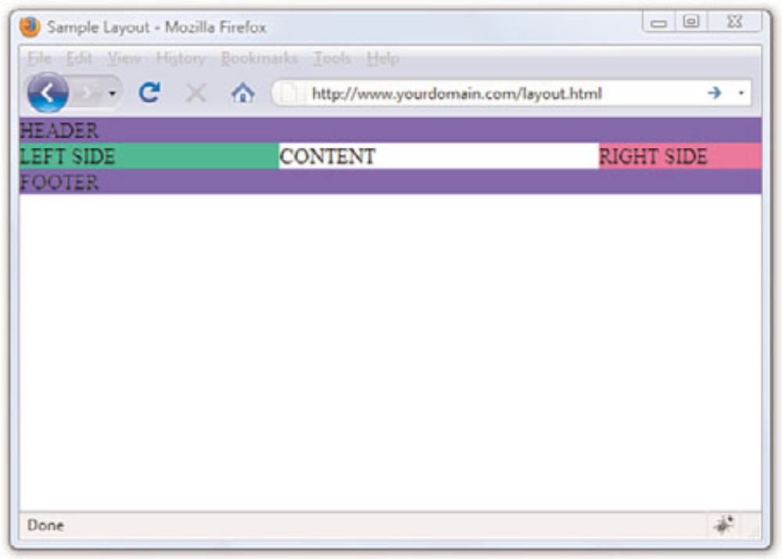
Defining Two Columns in a Fixed/Liquid Hybrid Layout Cont..
A basic HTML template after some styles have been put in place.

Slide 18
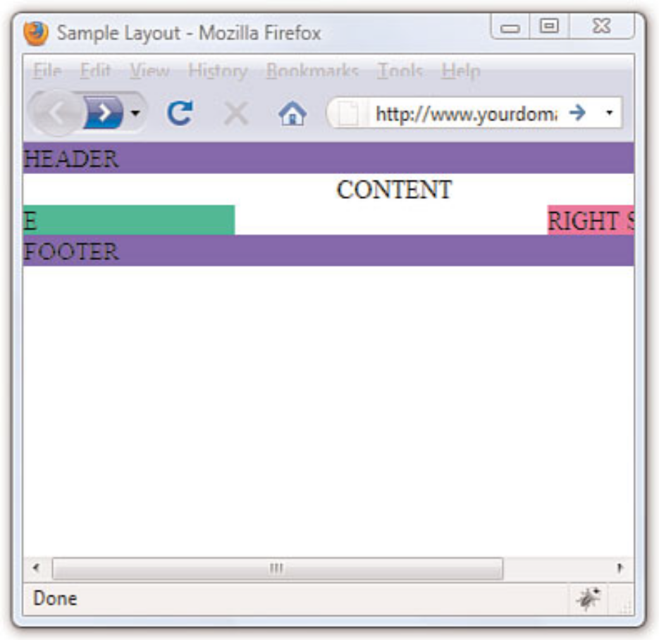
Defining Two Columns in a Fixed/Liquid Hybrid Layout Cont..
A basic HTML template resized under 400 pixels: bad!

Slide 19
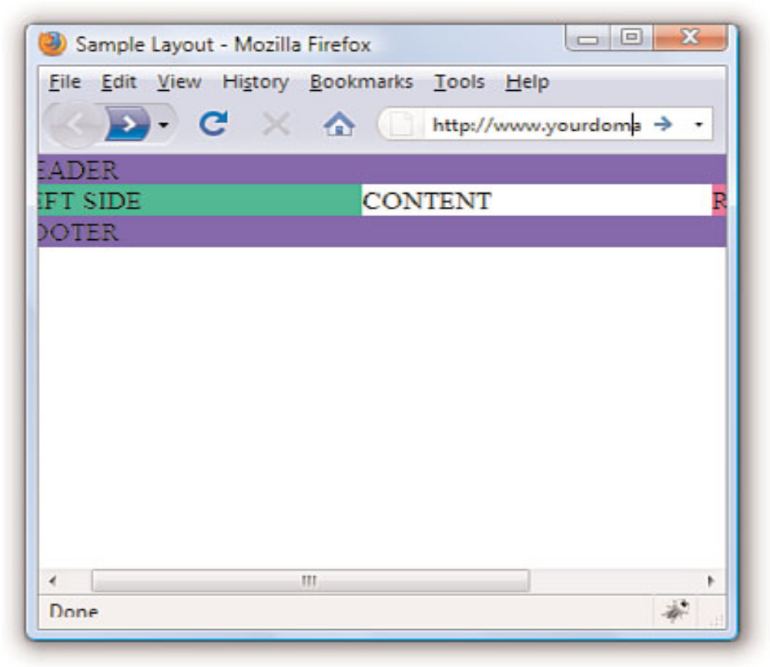
Setting the Minimum Width of a Layout
body {
margin: 0;
padding: 0;
min-width: 525px;
}
A basic HTML template resized under 400 pixels: better!

Slide 20
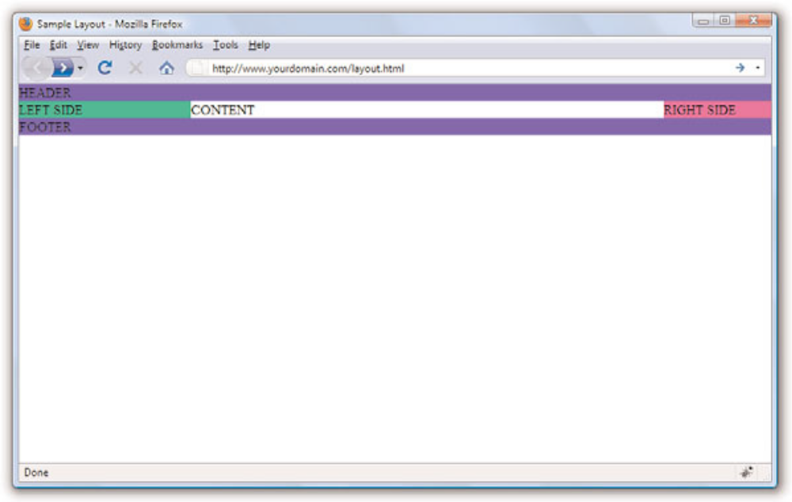
Setting the Minimum Width of a Layout Cont..
A basic HTML template when viewed in a browser window wider than 800 pixels.

Slide 21
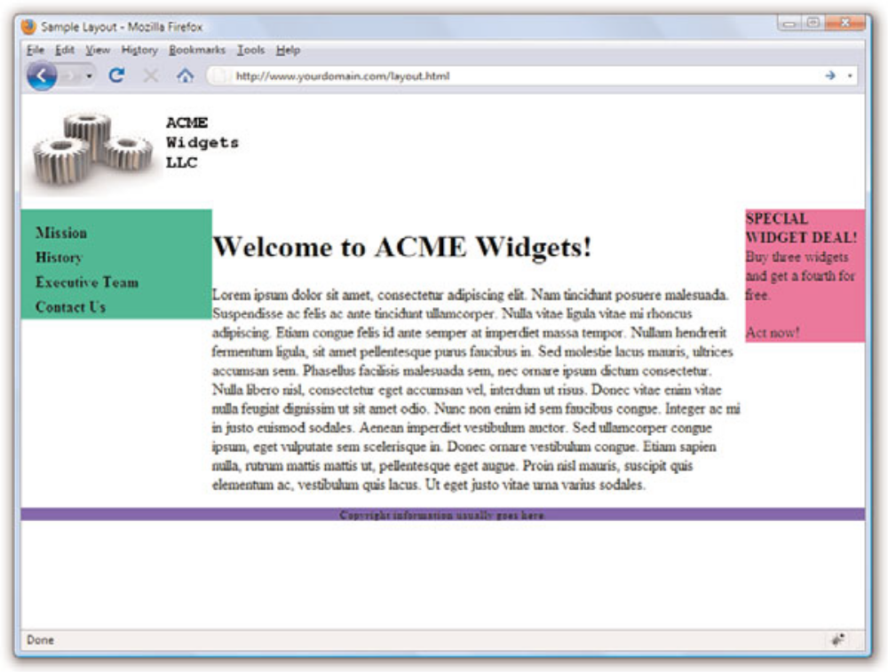
Handling Column Height in a Fixed/Liquid Hybrid Layout
Columns are only as tall as theircontents

Slide 22
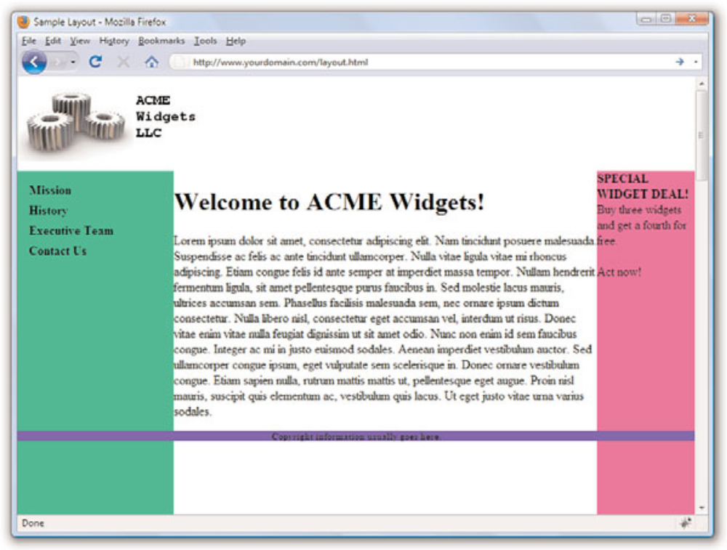
Handling Column Height in a Fixed/Liquid Hybrid Layout Cont..
Color fields are now visible despitethe amount of content in the columns.

Slide 23
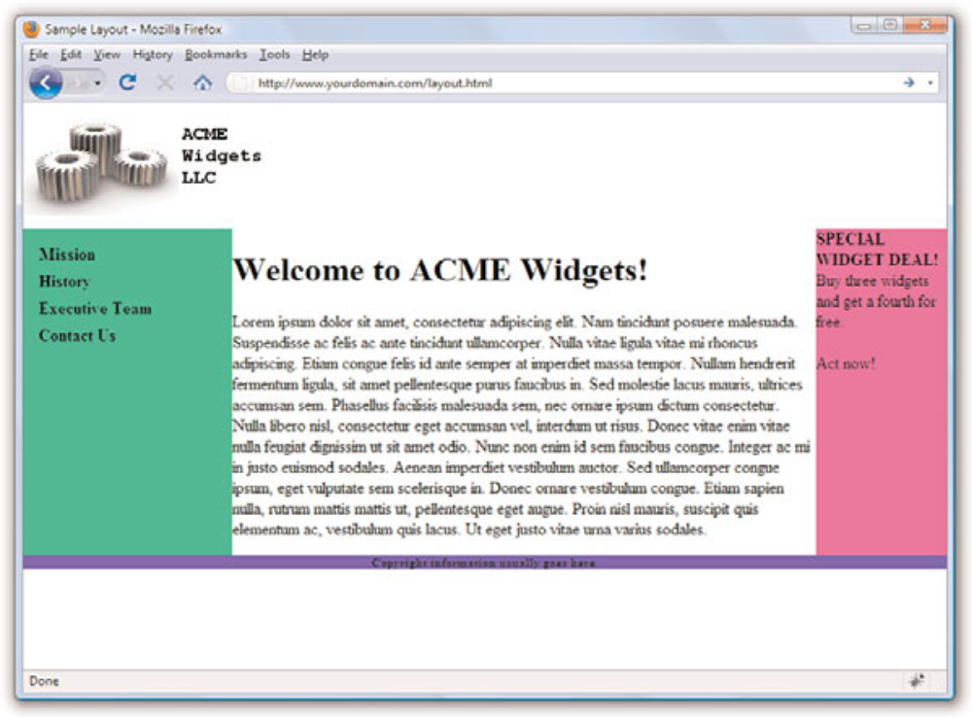
Handling Column Height in a Fixed/Liquid Hybrid Layout Cont..
Congratulations! It’s a fixed width/liquid hybrid layout.

